Slide 1
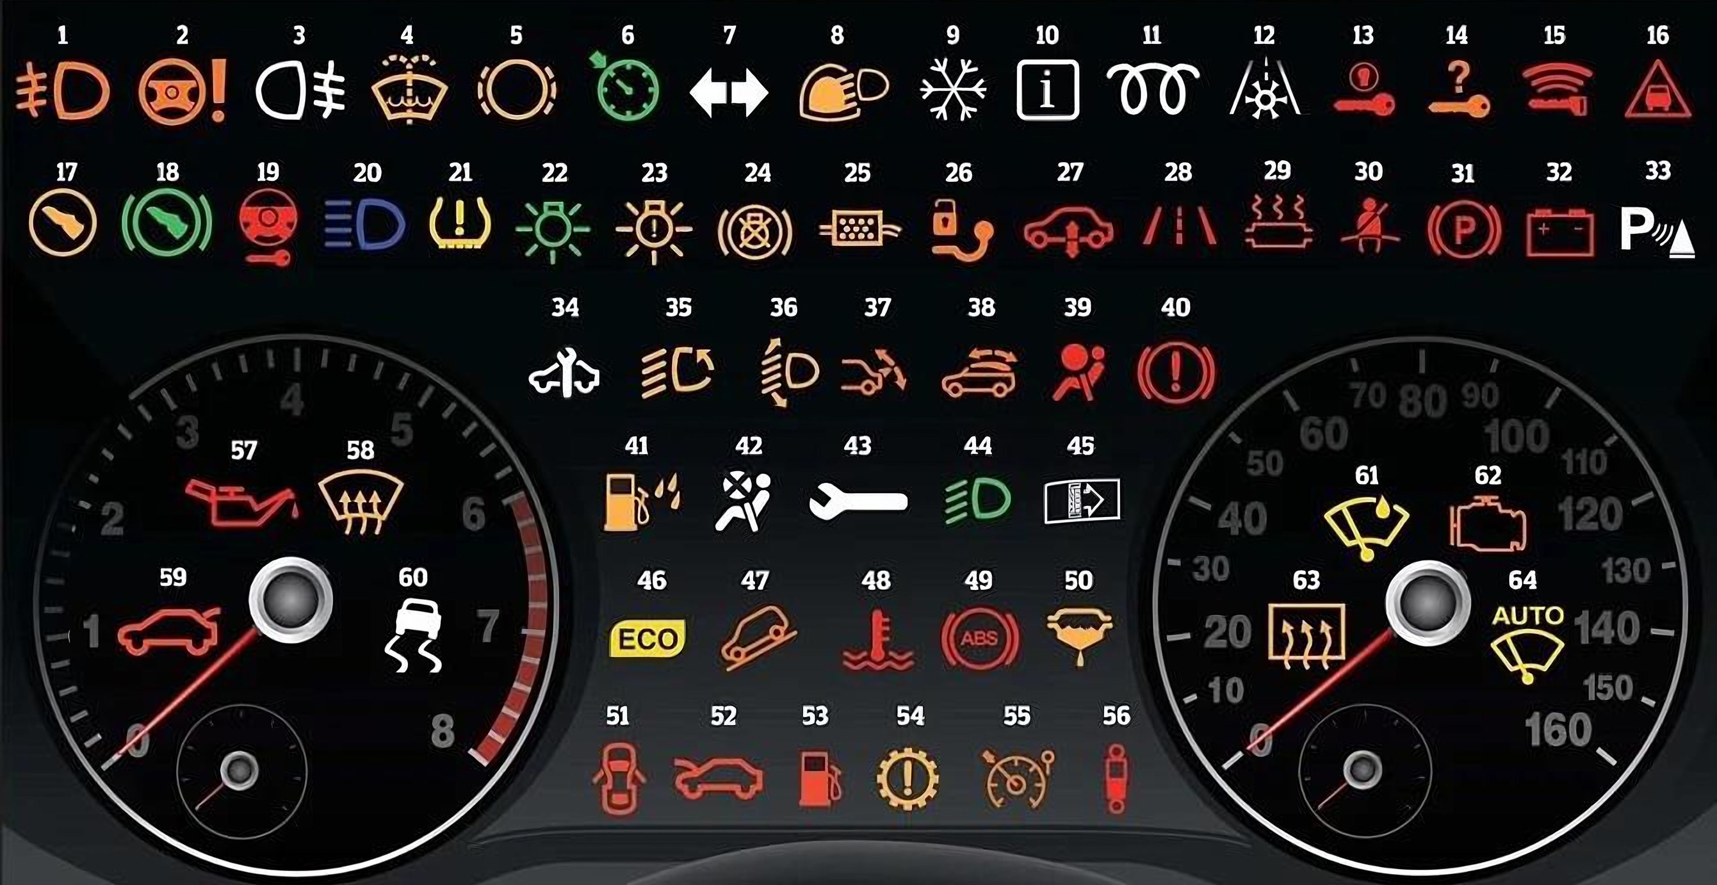
DASHBOARD GUIDE
Complete Car Dashboard Warning Lights Guide
What each light means, and what the driver should do
Notes:
Welcome. This guide covers the most common passenger-car warning lights.
Ask: Has anyone had a warning light come on while driving? What did you do?
Key message: a warning light is the car talking to you. Never ignore it.

Slide 2
Your Dashboard Is Talking to You
At start-up
Most lights flash on as a bulb check, then go out.
Stays on?
The car is reporting a problem or a system state.
Colour = urgency
Red, amber and green/blue tell you how fast to act.
Colours, symbols and meanings vary by make and model. Always check the vehicle handbook.
Notes:
This board shows 64 common symbols. You do not need to memorise them all. The colour tells you how urgent it is.
Ask: How many of these symbols do you recognise?
Note: at ignition-on, most lights come on briefly as a bulb check, then go out once the engine starts. A light that stays on needs attention.

Slide 3
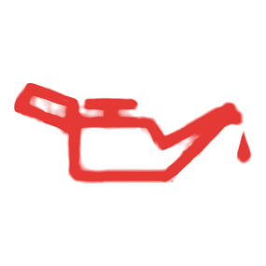

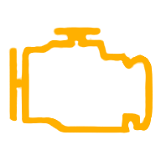



How to Read Warning-Light Colours
RED
AMBER / YELLOW
GREEN / BLUE
Serious warning
Stop safely when indicated. Check the handbook. Do not drive on.
Needs attention
A fault or condition. Drive carefully and get it checked soon.
System active
Information only: a function is on or working.
Colours, symbols and meanings vary by make and model. Always check the vehicle handbook. Not every red light needs the same response.
Notes:
Reveal one colour at a time.
Red: usually a serious warning. Stop safely as soon as you can when the handbook says so (e.g. oil pressure, overheating, brakes).
Amber/yellow: a fault or condition that needs attention soon.
Green/blue: a system is on or working (e.g. indicators, high beam).
Important: not every red light needs the same response. A seatbelt reminder means buckle up, while low oil pressure means stop the engine. Always follow the vehicle handbook.
Ask: Which colour would make you stop the car?

Slide 4


Critical Red Warnings: Stop Safely
Oil Pressure Warning
Engine Temperature
STOP SAFELY NOW
STOP SAFELY NOW
Means: Engine oil pressure is too low.
Do: Stop when safe, switch off the engine. Do not drive on.
Means: The engine is overheating.
Do: Stop when safe, switch off, let it cool. Never open a hot cap.
Brake System Warning
Battery / Charging
STOP SAFELY NOW
STOP & GET HELP
Means: Parking brake on, low fluid or brake fault.
Do: Release the parking brake. Still on? Stop; don't drive.
Means: Charging system failed; the car may stop.
Do: Switch off extra electrics. Stop safely; get it checked.
Notes:
These are the most serious warnings. Reveal one card per click; the final click pulses all four symbols.
Oil pressure loss and overheating can destroy an engine in minutes. Stop as soon as it is safe, switch off and follow the handbook. Ask: Where is the safest place to stop on your usual route?
Oil Pressure Warning: Engine oil pressure is too low. Stop when safe, switch off the engine. Do not drive on.
Engine Temperature: The engine is overheating. Stop when safe, switch off, let it cool. Never open a hot cap.
Brake System Warning: Parking brake on, low fluid or brake fault. Release the parking brake. Still on? Stop; don't drive.
Battery / Charging: Charging system failed; the car may stop. Switch off extra electrics. Stop safely; get it checked.
Remind the group: colours and symbols vary between manufacturers, so check the handbook for your vehicle.

Slide 5



Engine and Vehicle Faults
Check Engine (MIL)
Transmission Warning
INSPECT PROMPTLY
INSPECT PROMPTLY
Means: Engine or emissions fault detected.
Do: Book an inspection. If flashing, slow down and stop safely.
Means: Gearbox fault or overheating (where fitted).
Do: Drive gently to a safe place; get it checked.
Power Steering (EPS)
Diesel Particulate Filter
INSPECT PROMPTLY
INSPECT PROMPTLY
Means: Steering assist fault: steering may feel heavy.
Do: Slow down, drive carefully to a safe place, get it checked.
Means: Exhaust filter is getting blocked (diesels).
Do: Follow the handbook (often a steady drive); else see a garage.
Notes:
These lights usually mean 'get it checked soon'. A flashing check-engine light is more urgent: reduce speed and stop safely.
Ask: Who would you report an engine warning to at work?
Check Engine (MIL): Engine or emissions fault detected. Book an inspection. If flashing, slow down and stop safely.
Transmission Warning: Gearbox fault or overheating (where fitted). Drive gently to a safe place; get it checked.
Power Steering (EPS): Steering assist fault: steering may feel heavy. Slow down, drive carefully to a safe place, get it checked.
Diesel Particulate Filter: Exhaust filter is getting blocked (diesels). Follow the handbook (often a steady drive); else see a garage.
Remind the group: colours and symbols vary between manufacturers, so check the handbook for your vehicle.

Slide 6





Safety Systems
Airbag (SRS) Warning
Seatbelt Reminder
ABS Warning
INSPECT PROMPTLY
BUCKLE UP FIRST
INSPECT PROMPTLY
Means: Airbag fault: airbags may not deploy.
Do: Report it and get it repaired before the car is used.
Means: A seatbelt is not fastened.
Do: Everyone buckles up before the car moves.
Means: Anti-lock brakes off; normal brakes still work.
Do: Drive carefully, leave more stopping distance, get it checked.
Stability / Traction (ESC)
Brake Assist *
Good to know
Traction control (TCS) usually shares the ESC symbol, or shows 'TCS'. An 'OFF' version means the system was switched off. Brake Assist often has no symbol of its own.
CAUTION
INSPECT PROMPTLY
Means: Flashing: system working on a slippery road. Steady: fault or off.
Do: Flashing: ease off. Steady: drive carefully, get it checked.
Means: Emergency brake-assist fault (where indicated).
Do: Normal brakes work. Drive carefully; book a check.
* Symbol design varies by manufacturer. A generic example is shown.
Notes:
These systems protect you in an emergency. If one is faulty, it may not work when you need it.
Ask: What is the difference between a flashing and a steady ESC light?
Airbag (SRS) Warning: Airbag fault: airbags may not deploy. Report it and get it repaired before the car is used.
Seatbelt Reminder: A seatbelt is not fastened. Everyone buckles up before the car moves.
ABS Warning: Anti-lock brakes off; normal brakes still work. Drive carefully, leave more stopping distance, get it checked.
Stability / Traction (ESC): Flashing: system working on a slippery road. Steady: fault or off. Flashing: ease off. Steady: drive carefully, get it checked.
Brake Assist: Emergency brake-assist fault (where indicated). Normal brakes work. Drive carefully; book a check.
Remind the group: colours and symbols vary between manufacturers, so check the handbook for your vehicle.

Slide 7





Tyres and Driver Assistance
Tyre Pressure (TPMS)
Lane Departure Warning
Forward Collision Warning *
CHECK TYRES SOON
STAY ALERT
BRAKE NOW
Means: One or more tyres are under-inflated.
Do: Slow down, check pressures at the next safe stop.
Means: Car is drifting out of lane (or system fault).
Do: Steer back; take a break if you are tired.
Means: Risk of hitting the vehicle or object ahead.
Do: Brake and increase your following distance.
Adaptive Cruise Control *
Blind-Spot Monitor *
Parking Sensor Warning
SYSTEM ACTIVE
CHECK MIRRORS
INSPECT PROMPTLY
Means: Cruise is keeping a set gap to the car ahead.
Do: You are still in control: be ready to brake.
Means: A vehicle is in your blind spot.
Do: Don't change lanes; check mirrors and shoulder.
Means: Parking sensors faulty, dirty or switched off.
Do: Clean the sensors; look all round before moving.
* Symbol design varies by manufacturer. A generic example is shown.
Notes:
Driver-assistance systems help, but they never replace an alert driver. Symbols for forward collision, adaptive cruise and blind-spot systems vary a lot between makers. The symbols here are generic examples.
Ask: Who has had a forward collision warning? What happened?
Tyre Pressure (TPMS): One or more tyres are under-inflated. Slow down, check pressures at the next safe stop.
Lane Departure Warning: Car is drifting out of lane (or system fault). Steer back; take a break if you are tired.
Forward Collision Warning: Risk of hitting the vehicle or object ahead. Brake and increase your following distance.
Adaptive Cruise Control: Cruise is keeping a set gap to the car ahead. You are still in control: be ready to brake.
Blind-Spot Monitor: A vehicle is in your blind spot. Don't change lanes; check mirrors and shoulder.
Parking Sensor Warning: Parking sensors faulty, dirty or switched off. Clean the sensors; look all round before moving.
Remind the group: colours and symbols vary between manufacturers, so check the handbook for your vehicle.

Slide 8





Fuel, Doors and Operating Status
Low Fuel
Low Washer Fluid
Door Open
REFUEL SOON
TOP UP SOON
CLOSE IT FIRST
Means: Fuel is running low.
Do: Refuel soon; never risk running dry on a busy road.
Means: Washer reservoir is nearly empty (where fitted).
Do: Top up before your journey.
Means: A door is not fully closed.
Do: Stop and close it securely before moving.
Parking Brake On
Glow Plug (Diesel)
Good to know
Some cars show a separate symbol for bonnet or boot open. Treat them like door open: close and latch before moving.
RELEASE FIRST
WAIT, THEN START
Means: The parking brake is applied.
Do: Release before driving. Still lit? See brake warning.
Means: Engine is pre-heating. Flashing = fault.
Do: Start when it goes out. Flashing: get it checked.
Notes:
These are everyday status lights, but some (door open, parking brake) must be dealt with before moving.
Ask: Why is a low washer-fluid light a safety issue?
Low Fuel: Fuel is running low. Refuel soon; never risk running dry on a busy road.
Low Washer Fluid: Washer reservoir is nearly empty (where fitted). Top up before your journey.
Door Open: A door is not fully closed. Stop and close it securely before moving.
Parking Brake On: The parking brake is applied. Release before driving. Still lit? See brake warning.
Glow Plug (Diesel): Engine is pre-heating. Flashing = fault. Start when it goes out. Flashing: get it checked.
Remind the group: colours and symbols vary between manufacturers, so check the handbook for your vehicle.

Slide 9


Lights and Visibility Indicators
High Beam On
Turn Indicators
INFORMATION
INFORMATION
Means: Main-beam headlights are on.
Do: Dip for oncoming traffic and cars ahead.
Means: Indicator is on. Fast flashing = bulb out.
Do: Cancel after turning; replace failed bulbs.
Front Fog Lamps
Rear Fog Lamp
INFORMATION
FOG ONLY
Means: Front fog lamps are on.
Do: Use only when visibility is poor.
Means: Rear fog lamp is on.
Do: Switch off when visibility improves; it dazzles others.
Notes:
Green and blue lights tell you a function is on. The rear fog lamp is amber because it can dazzle other drivers if left on.
Ask: When should you switch the rear fog lamp off?
High Beam On: Main-beam headlights are on. Dip for oncoming traffic and cars ahead.
Turn Indicators: Indicator is on. Fast flashing = bulb out. Cancel after turning; replace failed bulbs.
Front Fog Lamps: Front fog lamps are on. Use only when visibility is poor.
Rear Fog Lamp: Rear fog lamp is on. Switch off when visibility improves; it dazzles others.
Remind the group: colours and symbols vary between manufacturers, so check the handbook for your vehicle.

Slide 10
Annotated Dashboard Reference
Tyre pressure
Battery
1
5
Oil pressure
Brake system
2
6
Engine temp.
Airbag (SRS)
3
7
ABS
Check engine
4
8
Notes:
Click to reveal each label. These are the eight lights the group must know.
Ask the group to name each symbol before you click.

Slide 11
Complete Dashboard Reference (1–32)
1
Fog light (front)
9
Winter mode
17
Press clutch pedal
25
Diesel particulate filter
2
Power steering warning
10
Information indicator
18
Press brake pedal
26
Trailer tow hitch warning
3
Fog light (rear)
11
Glow plug / diesel pre-heat
19
Steering lock warning
27
Air suspension warning
4
Washer fluid low
12
Frost warning
20
Main beam (high beam)
28
Lane departure warning
5
Brake pad warning
13
Ignition switch warning
21
Tyre pressure low
29
Catalytic converter warning
6
Cruise control on
14
Key not in vehicle
22
Sidelight information
30
Seat belt not on
7
Direction indicators
15
Key fob battery low
23
Exterior light fault
31
Parking brake light
8
Rain and light sensor
16
Distance warning
24
Brake lights warning
32
Battery / alternator
Notes:
Use this as a reference sheet. The numbers match the dashboard board on slides 2 and 10.
Corrections to the original board: #40 is also the general brake-system warning; #60 is the stability/traction control (ESC) symbol, and the 'OFF' version shows the word OFF.
Suggest printing these two slides for vehicles or the site office.

Slide 12
Complete Dashboard Reference (33–64)
33
Parking assist
41
Water in fuel filter
49
ABS warning
57
Oil pressure low
34
Service required
42
Airbag deactivated
50
Fuel filter warning
58
Windscreen defrost
35
Adaptive lighting
43
Fault (general)
51
Door open
59
Boot open
36
Headlight range control
44
Dipped beam headlights
52
Bonnet open
60
Stability control (ESC)
37
Rear spoiler warning
45
Dirty air filter
53
Low fuel
61
Rain sensor
38
Convertible roof warning
46
Eco driving indicator
54
Automatic gearbox warning
62
Engine / emissions warning
39
Airbag warning
47
Hill descent control
55
Speed limiter
63
Rear window defrost
40
Brake system / handbrake
48
Temperature warning
56
Suspension dampers
64
Auto windscreen wiping
Notes:
Use this as a reference sheet. The numbers match the dashboard board on slides 2 and 10.
Corrections to the original board: #40 is also the general brake-system warning; #60 is the stability/traction control (ESC) symbol, and the 'OFF' version shows the word OFF.
Suggest printing these two slides for vehicles or the site office.

Slide 13
Warning Light On: What Should I Do?
RED
Find a safe place
Stop & switch off
Check the handbook
Call for help & report
AMBER
Drive carefully
Check the handbook
Book an inspection
Report it
GREEN / BLUE
System is active
No action needed
Unexpected? Check
Switch off if not needed
If in doubt, don't drive. Stop safely and get advice.
Notes:
Reveal one row at a time.
Red: find a safe place, stop, switch off and check the handbook. For oil pressure or overheating, stop as soon as it is safe; driving on can destroy the engine. Call for assistance and report it.
Amber: reduce demands on the car, check the handbook and arrange an inspection soon. Report it.
Green/blue: no action needed unless you did not expect it.
Ask: Where is the vehicle handbook kept in your work vehicle?

Slide 14
Quick Knowledge Check
Q1
Q2
Q3
Q4
What does it mean?
What does it mean?
What does it mean?
What does it mean?
Oil pressure low: stop safely, switch off.
Tyre pressure low: slow down, check tyres.
Stability control: flashing = slippery, steady = fault.
High beam on: dip for other road users.
Notes:
Point to each symbol and ask: What does it mean, and what would you do? Click to reveal each answer after the group has replied.
1 Oil pressure: stop safely and switch off.
2 Tyre pressure: slow down and check the tyres.
3 Stability control: flashing means slippery; steady means fault or switched off.
4 High beam: dip for other road users.

Slide 15
Final Safety Takeaways
Check at start-up
Lights should go out after the engine starts.
Red = stop safely
Follow the handbook. Never drive on with oil pressure, overheating or brake warnings.
1
2
Amber = act soon
Book an inspection and report it.
If in doubt, don't drive
Report every warning light to your supervisor.
3
4
Notes:
Recap the four takeaways. Close by asking each person to name one light they will now look out for.

