Slide 1
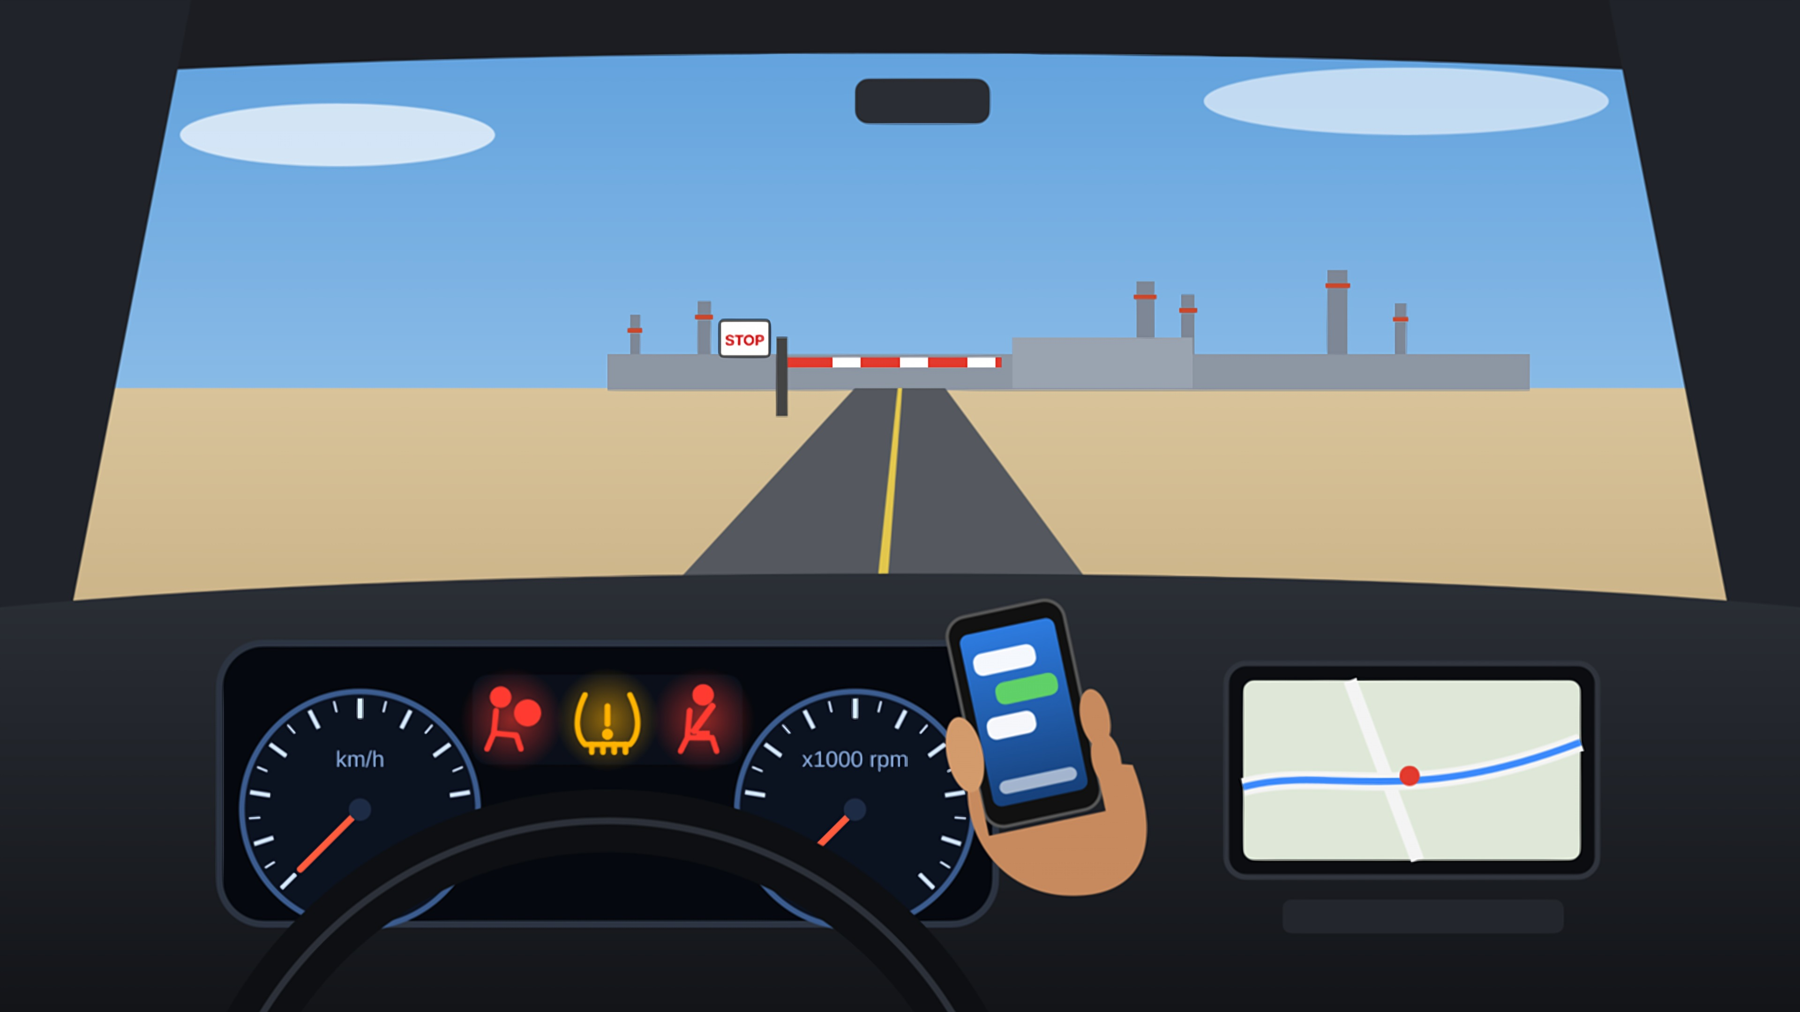
CHALLENGE A
Can You Spot All 5 Hazards?
Hazard Identification Challenge A · Arriving at the site gate
Notes:
Welcome everyone. Today's toolbox talk is a quick hazard-spotting challenge.
Ask: Who has ever driven up to a site gate while checking a message or with a warning light on?
Explain: You will see one picture. There are 5 hazards in it. Work in pairs and write them down.

Slide 2
Can You Spot All 5 Hazards?
Look inside AND outside · 60 sec
Notes:
Ask: Can you spot all 5 hazards? Give the group 60 seconds. Do not point anything out yet.
Expected answers (keep hidden): 1 texting while driving, 2 closed barrier and STOP sign ahead, 3 airbag warning light on, 4 tyre-pressure warning light on, 5 seatbelt warning light on.
Tip: if the group is stuck, say 'look at the dashboard' or 'look at the driver's hands'.

Slide 3
Take a Closer Look
Outside
What is ahead of the car?
1
Dashboard
What are the warning lights saying?
2
Driver
Where are the hands and eyes?
3
Write down your 5 answers before we reveal them.
Notes:
Use the three prompts one at a time (click to reveal each).
Ask: What is ahead of the car? What are the dashboard lights telling the driver? Where are the driver's hands and eyes?
Let people call out answers. Write them on a flip chart before you reveal.

Slide 4
The 5 Hazards
2
Closed barrier & STOP sign ahead
1
Texting while driving
3
Airbag (SRS) warning ON
4
Low tyre pressure (TPMS)
5
Seatbelt not fastened
Notes:
Click once per hazard. Ask the group before each click: 'What is the next one?'
1 Texting while driving: eyes off the road and one hand off the wheel.
2 Closed barrier and STOP sign: the driver is distracted while approaching a mandatory stop.
3 Airbag (SRS) warning: the airbag may not work in a crash.
4 Tyre-pressure warning: a tyre is under-inflated, so grip and braking are reduced.
5 Seatbelt warning: the driver is not wearing a seatbelt.
Real-world example: at 50 km/h, a car covers about 14 metres every second. A 3-second glance at a phone is over 40 metres driven blind.

Slide 5

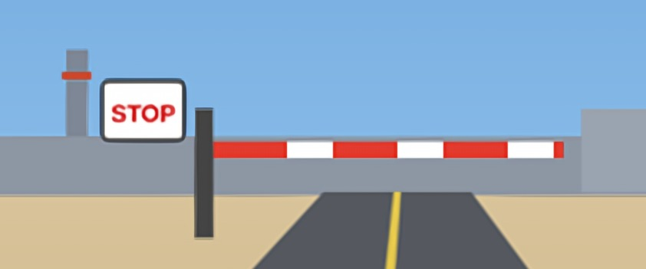
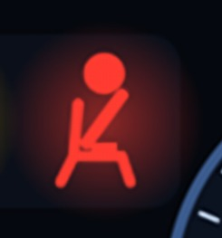
Why It Matters: Driver Behaviour
1
2
5
Texting while driving
Closed barrier ahead
Seatbelt not fastened
Why it's dangerous
Eyes off the road for seconds; one hand off the wheel.
What to do
Phone away or on Do Not Disturb. Pull over safely to use it.
Why it's dangerous
Late braking can hit the barrier, gate staff or the car ahead.
What to do
Slow down early, stop at the line, follow site rules.
Why it's dangerous
Serious injury even in a low-speed crash.
What to do
Buckle up before the vehicle moves.
Notes:
Reveal one card per click. For each one ask: What could happen? What should the driver do instead?
Phone: switch it off or use Do Not Disturb. Pull over safely to use it.
Barrier: slow early, stop at the line and follow the site entry rules.
Seatbelt: everyone buckles up before the vehicle moves, even for short trips on site.

Slide 6
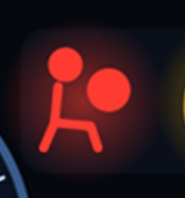

Why It Matters: Vehicle Warnings
3
4
Golden rule
Never ignore a warning light.
Check it, report it, and only drive when it is safe.
Airbag (SRS) warning
Low tyre pressure
Why it's dangerous
Airbags may not work in a crash.
What to do
Report it; get it repaired before use.
Why it's dangerous
Less grip, longer stopping, risk of blow-out.
What to do
Slow down, stop safely and check tyres.
Notes:
Reveal one card per click.
Airbag (SRS): the airbag system has a fault and may not deploy. Report it and get it repaired before the vehicle is used.
Tyre pressure: stop when safe, check the pressures and inflate, or change the tyre.
Ask: Who checks tyre pressures as part of their pre-start check?

Slide 7
Key Learning Points
Phone away before you start the engine
✓
Discuss
Which of the 5 hazards do you see most often?
What makes people check their phone while driving?
Who do you report a warning light to?
Seatbelt on before the vehicle moves
✓
Slow down early for gates, barriers and STOP signs
✓
Warning light on? Check, report, then decide
✓
Notes:
Reveal each learning point, then use the discussion questions.
Ask the questions and let the group talk. There are no wrong answers. Finish by asking each person to commit to one thing they will do differently.

