Slide 1
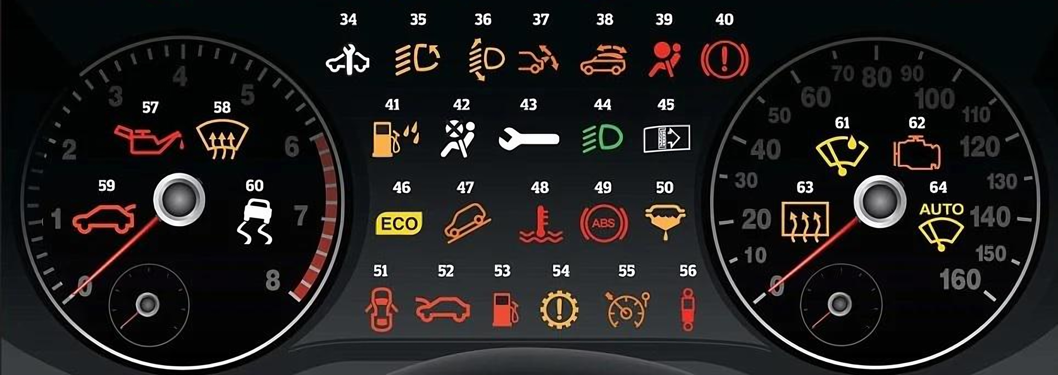
CHALLENGE B
What Is Unsafe in This Picture?
Hazard Identification Challenge B · Pre-start vehicle check
Notes:
Welcome. This challenge is about the pre-start check: deciding whether a vehicle is safe to drive BEFORE you set off.
Ask: Who checks the dashboard every time they start a vehicle? What do you do if a light stays on?

Slide 2
What Is Unsafe in This Picture?
You start a pool car. These lights stay ON after the engine starts.
Find the 5 lights that mean: DO NOT DRIVE
Notes:
Set the scene: you start a pool car and these lights stay ON after the engine starts.
Ask: Which 5 lights mean you must NOT drive until the vehicle is checked? Call out the numbers.
Expected answers (keep hidden): 57 oil pressure, 48 engine temperature, 40 brake system, 39 airbag, 52 bonnet open. Give the group 60–90 seconds.

Slide 3
Need a Clue?
1
2
3
Clue 1: Colour
Red usually means a serious warning.
Clue 2: Driving
What could fail while you are moving?
Clue 3: Protection
What protects you, or could block your view?
Other lights are also on. Some are safe information lights, others need attention soon.
Notes:
Only use these clues if the group is stuck. Reveal them one at a time.
Clue 1: red usually means a serious warning.
Clue 2: what could fail while you are driving (engine, brakes)?
Clue 3: what protects you in a crash, and what could block your view?
After the clues, collect the group's answers before revealing.

Slide 4
Answers: The 5 Do-Not-Drive Warnings
1
Oil pressure low
2
Bonnet open
3
Engine overheating
4
Airbag (SRS) fault
5
Brake system fault
Notes:
Click once per answer.
1 #57 Oil pressure low: the engine can seize.
2 #52 Bonnet open: it can fly up and block the view.
3 #48 Engine temperature: the engine is overheating.
4 #39 Airbag (SRS): airbags may not deploy.
5 #40 Brake system: parking brake on, low fluid or a brake fault.
Also mention: #51 door open and #59 boot open must be closed before moving. #49 ABS and #62 engine light need prompt inspection.

Slide 5



Why It Matters: Engine and Brakes
1
3
5
Oil pressure low (#57)
Engine overheating (#48)
Brake system (#40)
Why it's dangerous
The engine can seize and stop suddenly in traffic.
What to do
Do not drive. Check the oil level and report it.
Why it's dangerous
Engine damage, breakdown, and burns from hot coolant.
What to do
Do not drive. Let it cool; never open a hot cap.
Why it's dangerous
Brakes may fail, or the parking brake may be dragging.
What to do
Release the parking brake. If the light stays on, do not drive.
Notes:
Reveal one card per click. For each one ask: What could happen if you drove anyway?
Oil pressure and overheating: stop the engine to prevent serious damage. Brakes: never drive with a brake system warning that stays on.

Slide 6
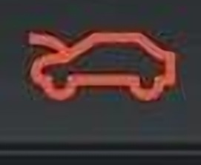

Why It Matters: Protection and Visibility
2
4
Pre-start rule
A red warning that stays on after start-up = do not drive.
Tag the vehicle and report it.
Bonnet open (#52)
Airbag fault (#39)
Why it's dangerous
The bonnet can fly up at speed and block your view.
What to do
Close it fully and check it is latched.
Why it's dangerous
Airbags may not deploy in a crash.
What to do
Report it; get it repaired before use.
Notes:
Reveal one card per click.
Airbag: the vehicle should not be used until it is repaired (follow company policy).
Bonnet: a bonnet that flies open at speed blocks the whole windscreen.
Remind the group: if in doubt, don't drive; report it to your supervisor.

Slide 7
Which Hazard Is the Most Serious?
A
B
C
D
E
Oil pressure low
Bonnet open
Engine overheating
Airbag fault
Brake system
Trainer's view: E, the brake system. Losing braking can cause a collision instantly. A (oil pressure) and C (overheating) can also stop the engine without warning. All five mean: do not drive.
Notes:
Ask everyone to vote with their hands: A, B, C, D or E. Ask two people to explain their choice.
Then click to show the trainer's answer. There is no single 'right' answer. The brake system (E) can cause a collision immediately. Oil pressure and overheating can stop the engine without warning. All five mean: do not drive.

Slide 8
Key Learning Points
1
2
3
Look
Check every light after start-up: most should go out in a few seconds.
Decide
Red light still on? Do not drive. Amber? Get it checked soon.
Report
Tag the vehicle and tell your supervisor. Never hand over a faulty car.
Notes:
Recap the three steps of a pre-start check. Ask: what will you do the next time a red light stays on after start-up?

