Slide 1
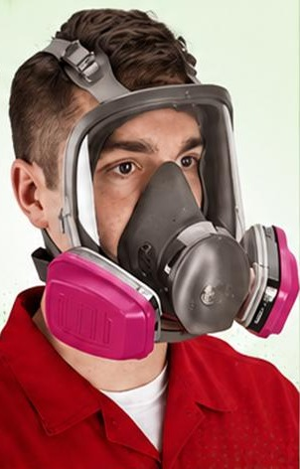
October 2026
REFRESHER SESSION
FULL FACE & HALF FACE MASK RESPIRATORS
Respiratory Protection Refresher Training
Gas Desulfurization Plant
Notes:
Welcome. This is a refresher on full face and half-mask respirators, plus the Avon NH15 escape hood used at the Gas Desulfurization Plant. All technical numbers in this deck come from the source refresher material; anything marked 'general guidance' is general good practice, not a source requirement.

Slide 2





WHY RESPIRATORY PROTECTION MATTERS
What is a respiratory hazard?
Harmful gases, vapours, dust, fumes or particles in the air you breathe — for example H₂S (Hydrogen Sulfide).
Why do we need respirators?
A respirator reduces how much of the contaminant reaches your lungs.
Why do selection and fit matter?
The wrong mask or wrong cartridge gives the wrong protection. A poor seal lets contaminated air leak in.
It only works when worn and checked
Inspect it, wear it correctly and do the seal checks — every time.
H₂S hazard — gas-processing environment
Notes:
General introduction (plain-language background, not source-specific values). Key idea: a respirator only protects you if it is the right type, has the right cartridge, fits and seals properly, and has been checked before use.

Slide 3
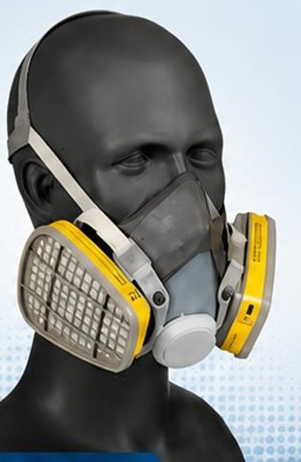
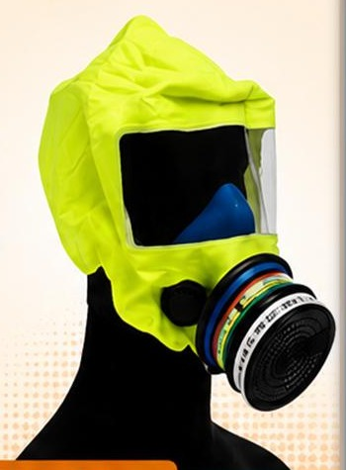
TYPES OF RESPIRATORY EQUIPMENT
FULL FACE RESPIRATORS
HALF-MASK RESPIRATORS
ESCAPE RESPIRATORS
Maximum protection. Complete coverage.
Balanced protection. Everyday use.
Short term use. Emergency only.
COVERS
Entire face — eyes, nose and mouth (eye protection)
USED FOR
Environments with harmful gases or particulate matter
COVERS
Nose and mouth
USED FOR
Lightweight — commonly used for less hazardous environments
COVERS
Hood-type escape device (example shown)
USED FOR
Emergency use — short-duration protection during evacuation
BEST USED IN:
BEST USED IN:
BEST USED IN:
Chemical handling
Toxic environments
General maintenance
Dusty work areas
Emergency evacuation
Fire & smoke situations
Dust & fume exposure
Spray operations
Chemical handling
Painting & coating
Hazardous spills / leaks
Notes:
Source: 'Types of Respiratory Equipment'. Full face: maximum protection, complete coverage, covers the entire face providing eye protection, used in environments with harmful gases or particulate matter. Half-mask: balanced protection, everyday use, covers nose and mouth, lightweight, commonly used for less hazardous environments. Escape: short-term use, emergency only, designed for emergency use providing protection for a short duration during evacuation. Photos are taken from the source graphic.

Slide 4



FULL FACE vs HALF MASK
FULL FACE
HALF MASK
Covers eyes, nose and mouth
Covers nose and mouth
Greater facial coverage — includes eye protection
Eyes remain exposed
VS
APF 50
APF 10
Source example: 3M FF-400
Source example: 3M 6000 or 7000 series
Notes:
Full face covers eyes, nose and mouth. Half mask covers nose and mouth only — eyes remain exposed. APF examples are from the source: APF 50 full face (3M FF-400) and APF 10 half mask (3M 6000 or 7000 series).

Slide 5
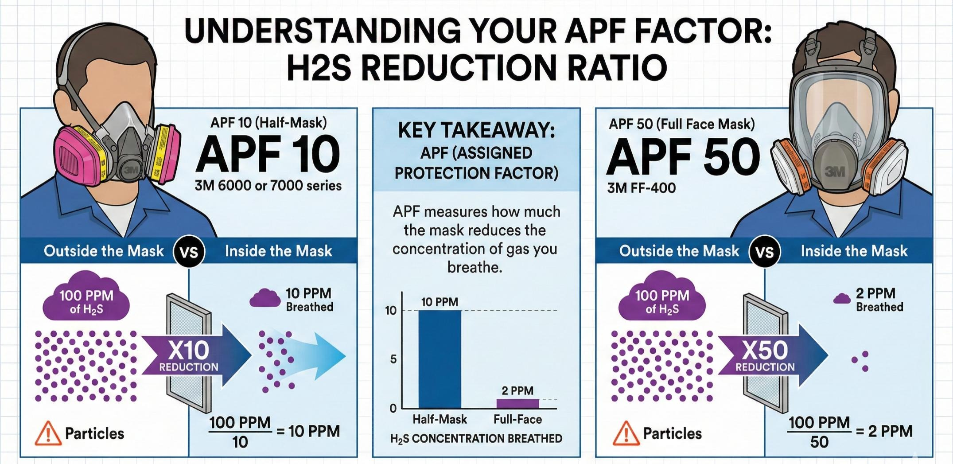
APF – WHAT DOES IT MEAN?
APF
= Assigned Protection Factor
APF tells us how much the respirator reduces the concentration of a contaminant reaching the wearer.
APF 10
Half Mask
APF 50
Full Face Mask
Source visual: “Understanding your APF factor: H₂S reduction ratio”
Higher APF number → greater reduction of the contaminant reaching the wearer.
Notes:
APF = Assigned Protection Factor. Source wording: 'APF measures how much the mask reduces the concentration of gas you breathe.' Source examples: APF 10 for half mask (3M 6000 or 7000 series) and APF 50 for full face mask (3M FF-400).

Slide 6
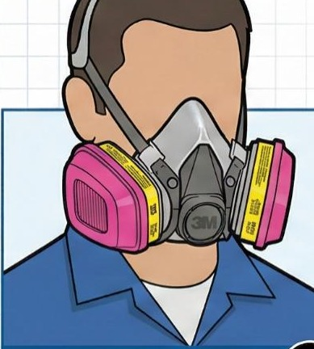
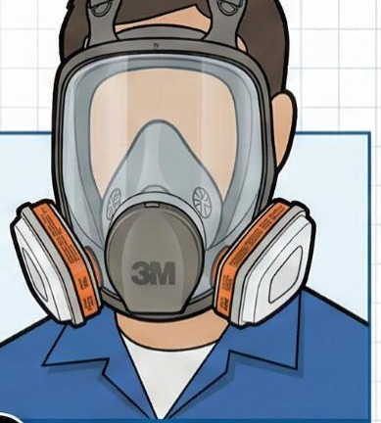
APF: SIMPLE H₂S EXAMPLE
OUTSIDE THE MASK
100 ppm
H₂S
INSIDE (BREATHED)
10 ppm
100 ÷ 10 = 10
÷ 10
APF 10 – Half Mask
OUTSIDE THE MASK
100 ppm
H₂S
INSIDE (BREATHED)
2 ppm
100 ÷ 50 = 2
÷ 50
APF 50 – Full Face
REMEMBER: Higher APF = greater reduction, but the respirator must still be suitable for the hazard and concentration.
Notes:
Source example: 100 ppm H₂S outside the mask. Half mask APF 10: 100 ÷ 10 = 10 ppm breathed. Full face APF 50: 100 ÷ 50 = 2 ppm breathed. Click to reveal: concentration → reduction → result, for each mask, then the chart and the reminder. Note: this is a teaching example of the reduction ratio; it does not by itself make a respirator suitable — see MUC and IDLH next.

Slide 7
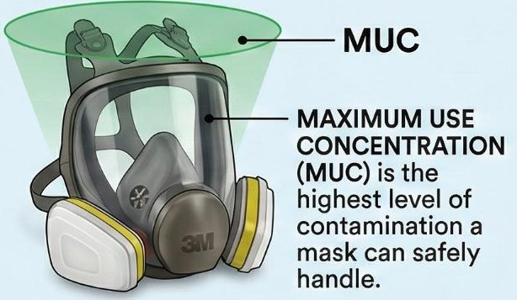
MUC – YOUR SAFETY CEILING
MUC = APF × PEL
APF
Assigned Protection Factor
depends on the mask type
PEL
Permissible Exposure Limit
the legal limit
MUC = Maximum Use Concentration
The highest level of contamination a mask can safely handle (source definition).
SOURCE EXAMPLE – H₂S (PEL = 10 ppm)
Half Mask: APF 10 × PEL 10 ppm = 100 ppm MUC
Full Face: APF 50 × PEL 10 ppm = 500 ppm MUC
Notes:
Source: 'Understanding MUC: your safety ceiling'. MUC = Maximum Use Concentration — the highest level of contamination a mask can safely handle. Formula: MUC = APF × PEL. APF = Assigned Protection Factor (mask type). PEL = Permissible Exposure Limit (legal limit). H₂S case study: PEL 10 ppm; half mask 10 × 10 = 100 ppm MUC; full face 50 × 10 = 500 ppm MUC. Continue to the next slide for the IDLH limit.

Slide 8



H₂S MUC CASE STUDY
PEL = 10 ppm
IDLH = 100 ppm
CRITICAL SAFETY RULE
Permissible Exposure Limit
Immediately Dangerous to Life or Health
If the air concentration is higher than your MUC, you are in immediate danger.
HALF MASK (APF 10)
FULL FACE (APF 50)
APF 10 × PEL 10 ppm
APF 50 × PEL 10 ppm
=
=
MUC 100 ppm
MUC 500 ppm
Always check the actual gas concentration.
Calculated MUC
(same value as the IDLH in this example)
Calculated “potential” MUC
Source note: must not exceed IDLH limits (100 ppm)
Use the correct cartridge.
A calculated MUC does NOT make a respirator safe for every situation. The source shows the IDLH (100 ppm) as a limit that must not be exceeded.
Do not exceed applicable safety limits.
Notes:
Recreation of the source case study (H₂S, PEL = 10 ppm, IDLH = 100 ppm). Half mask: APF 10 × PEL 10 = MUC 100 ppm. Full face: APF 50 × PEL 10 = 500 ppm MUC, labelled 'potential' in the source, with the source note 'Must not exceed IDLH limits'. Critical safety rule from the source: if the air concentration is higher than your MUC, you are in immediate danger. Source key takeaways: always check the gas concentration; use the correct cartridge. Stress that a calculation alone never makes a respirator safe for every situation — follow site procedures for IDLH atmospheres.

Slide 9
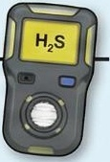

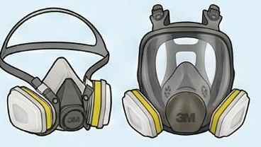
KNOW THE ATMOSPHERE BEFORE YOU TRUST THE MASK
Check the gas concentration.
Select the correct respiratory protection.
H₂S
Select the correct cartridge.
Gas detector
Respirators
H₂S warning
H₂S CONCENTRATION SCALE – source example values
Know the limitations of the respirator.
0–10 ppm
10–100 ppm
100 ppm +
At or below PEL (10 ppm)
Above PEL
IDLH (100 ppm)
Never assume that wearing a mask automatically makes the atmosphere safe.
Scale not to proportion.
Notes:
Key safety message. Values on the scale are only the source H₂S example values: PEL 10 ppm and IDLH 100 ppm. A respirator reduces exposure — it does not make an unsafe atmosphere safe. Always measure the gas first (gas detector), then select the correct respirator and cartridge, and know its limits.

Slide 10




PRE-USE CHECK – BEFORE YOU WEAR IT
CARTRIDGE EXAMPLE (SOURCE)
3M 6006 Multi-Gas/Vapor Cartridge
Facepiece
Straps
Valves
Filters / Cartridges
Fits 3M 6000, 6500, 7000 and 7500 series half masks
NIOSH approval lists hydrogen sulfide for ESCAPE ONLY
Rated up to 10 × PEL with a half-face mask
Does not filter dust or mists unless paired with an approved particulate pre-filter (e.g. P100)
No cracks, tears or distortion
Present, elastic, not worn out
In place, clean, not damaged
Correct type, fitted properly
Seals
Damage
Cleanliness
Correct Assembly
Face seal and gaskets in place
No holes or missing parts
Clean and ready to use
All parts fitted correctly
THEN: Positive Pressure Check + Negative Pressure Check (next slides)
Inspection points are general guidance — always follow the manufacturer’s instructions and site procedure.
Check the cartridge is approved for YOUR hazard.
Notes:
Source title: 'Pre-use checks – full face respirators / half mask respirators'. The eight inspection points are general guidance (the source does not list detailed inspection criteria) — always follow the manufacturer's instructions and site procedure. The cartridge example (3M 6006) comes from the supplied Word document: fits 3M 6000/6500/7000/7500 half masks; NIOSH approval lists hydrogen sulfide for escape only; rated up to 10 × PEL with a half-face mask; gas/vapour cartridge does not filter dust or mists unless paired with an approved particulate pre-filter such as P100.

Slide 11
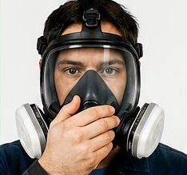
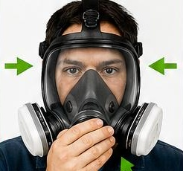
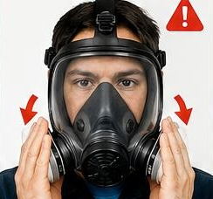
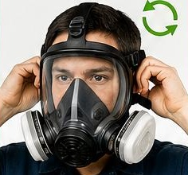
POSITIVE PRESSURE CHECK – EXHALE TEST
1
BLOCK THE EXIT
2
PERFORM THE “BULGE” TEST
3
CHECK FOR LEAKAGE
4
ADJUST AND REPEAT IF REQUIRED
Cover the exhalation valve with your palm.
Exhale gently. The facepiece should slightly puff out (“bulge”) away from your face.
If you feel air escaping against your skin, the seal is broken.
Adjust the straps and repeat until no air escapes.
GOAL: the facepiece bulges slightly and NO air escapes.
Notes:
Source graphic: Positive Pressure Check (Exhale Test). 1 Block the exit – cover the exhalation valve with your palm. 2 The 'bulge' test – exhale gently; the facepiece should slightly puff out or bulge away from your face. 3 Leak detection – if you feel air escaping against your skin, the seal is broken. 4 Action – adjust the straps and repeat until no air escapes. Photos are the source panels.

Slide 12
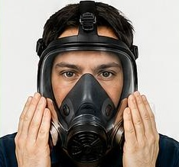
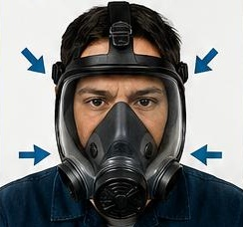
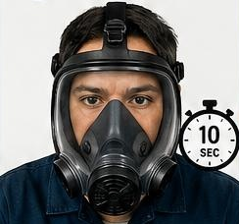
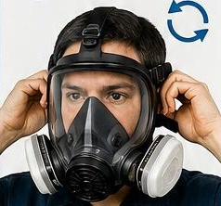
NEGATIVE PRESSURE CHECK – INHALE TEST
1
BLOCK THE INTAKE
2
PERFORM THE “COLLAPSE” TEST
3
HOLD & VERIFY
4
RETIGHTEN / RECHECK IF REQUIRED
Cover the cartridge openings or filters with your hands.
Inhale gently. The facepiece should “collapse” or pull inward toward your face.
Hold your breath for 10 seconds. The mask should stay collapsed. If it doesn’t, air is leaking in from the sides.
Re-tighten the straps and recheck.
The facepiece should remain collapsed while the check is performed (hold 10 seconds).
Notes:
Source graphic: Negative Pressure Check (Inhale Test). 1 Block the intake – cover the cartridge openings or filters with your hands. 2 The 'collapse' test – inhale gently; the facepiece should collapse or pull inward toward your face. 3 Hold and verify – hold your breath for 10 seconds; the mask should stay collapsed; if it doesn't, air is leaking in from the sides. 4 Action – re-tighten straps and recheck.

Slide 13
POSITIVE vs NEGATIVE PRESSURE CHECK
POSITIVE PRESSURE CHECK
NEGATIVE PRESSURE CHECK
EXHALE TEST
INHALE TEST
Checks for OUTWARD leakage
Checks for INWARD leakage
BLOCK
The exit — exhalation valve (palm)
BLOCK
The intake — cartridge openings / filters (hands)
BREATHE
Exhale gently
BREATHE
Inhale gently, hold 10 seconds
LOOK FOR
Facepiece bulges out — no outward leakage
LOOK FOR
Facepiece collapses inward and stays collapsed
Notes:
Positive pressure = exhale test: block the exit (exhalation valve) and check that the facepiece bulges with no outward leakage. Negative pressure = inhale test: block the intake (cartridge openings/filters) and check the facepiece collapses inward and stays collapsed for 10 seconds. Both checks come from the source pre-use check graphics.

Slide 14
COMMON FIT / LEAKAGE PROBLEMS
Loose straps
Poor face seal
Incorrect positioning
Damaged mask
Wrong cartridge / filter fitting
Mask can move and let air past the seal
Gaps between the mask and your skin
Mask not sitting correctly on the face
Cracks, tears or missing parts
Wrong type, or not fitted correctly
WARNING SIGN – EXHALE TEST
You feel air escaping against your skin → the seal is broken.
WARNING SIGN – INHALE TEST
The mask does not stay collapsed → air is leaking in from the sides.
IF THE SEAL IS NOT CORRECT, THE RESPIRATOR CANNOT PROVIDE THE EXPECTED PROTECTION.
Notes:
The five problem examples are general guidance. The two warning signs come directly from the source pressure-check graphics. If you cannot get a good seal, do not use the respirator — report it and get help.

Slide 15
ESCAPE RESPIRATORS
WORK RESPIRATOR
ESCAPE RESPIRATOR
Full face & half-mask respirators
Short term use. Emergency only.
Half mask: everyday use
Full face: used where harmful gases or particulate matter are present
Selected for the hazard and concentration (APF / MUC)
Designed for emergency use
Short-duration protection during evacuation
Emergency evacuation, fire & smoke, hazardous spills / leaks
ESCAPE = GET OUT
ESCAPE ≠ CONTINUE WORK
Notes:
Source: escape respirators are 'Short term use. Emergency only.' and are 'designed for emergency use, providing protection for a short duration during evacuation'. Best used in emergency evacuation, fire and smoke situations, hazardous spills/leaks. Never use an escape device to carry on working.

Slide 16
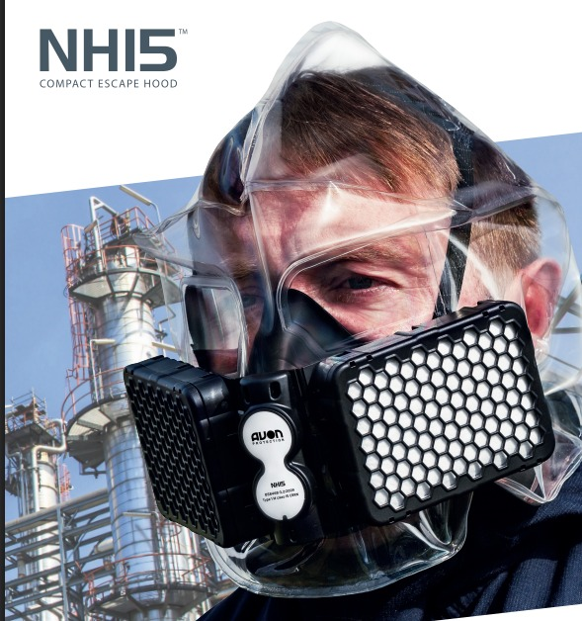
DONNING OF ESCAPE HOOD – NH15
AVON NH15 COMPACT ESCAPE HOOD
Emergency escape hood – details from the Avon NH15 brochure (source)
< 30 s
Don in less than 30 seconds
15 min
Minimum protection to evacuate
5 yr
Shelf life
Packaged size | 3.4" × 4.0" × 6.0"
Weight | 625 g (23 oz)
NIOSH certified | TC-14G-0302
Approved for CE marking | PPE Regulation 2016/425/EU – Module B: Certificate CE 684846
Clear hood – all-round vision | Full
Self-adjusting harness / anti-fog visor | Yes / Yes
Filter protrusion from face | 2"
Batteries | No
Word source also states: 100 min chemical breakthrough vs 5,000 ppm H₂S — a filter test figure, not extra working time.
Notes:
All figures are taken from the supplied Avon NH15 brochure pages: don in less than 30 seconds; minimum 15 minutes of respiratory, vision and facial protection to allow sufficient time to evacuate; 5-year maintenance-free shelf life; packaged size 3.4 x 4.0 x 6.0 in; 625 g (23 oz); NIOSH TC-14G-0302; CE: PPE Regulation 2016/425/EU Module B, certificate CE 684846; full all-round vision; self-adjusting harness; anti-fog visor; low user noise; 2 in filter protrusion; balanced on the head; no batteries. Reflective label helps rescue teams see the wearer. The Word document states 100 minutes of chemical breakthrough protection against 5,000 ppm H₂S — present this as a filter test figure only; the escape device is for getting out.

Slide 17
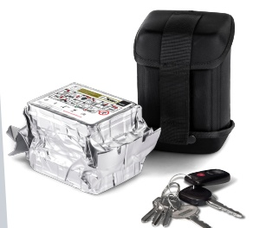


NH15 DONNING – STEP-BY-STEP
STEP 1
STEP 2
STEP 3
STEP 4
OPEN
DON
FIT
EVACUATE
Open the protective packaging.
Put on the reflective hood — in less than 30 seconds.
The self-adjusting harness helps give a correctly fitted hood.
Get out of the contaminated area. Minimum 15 minutes of protection to evacuate.
FOLLOW THE MANUFACTURER’S APPROVED DONNING PROCEDURE.
Detailed hand-by-hand donning steps are not shown in the source material — steps above use only what the source states.
Notes:
The source only states: achieve protection within 30 seconds of opening the protective packaging and donning the reflective hood; the self-adjusting harness provides comfort and the security of a correctly fitted hood; minimum 15 minutes of protection to allow sufficient time to evacuate. Detailed donning steps are NOT in the source — demonstrate using the manufacturer's approved instructions (on the pack) or a training unit.

Slide 18




DO / DO NOT
DO
DO NOT
Inspect before use
Use damaged equipment
Check the seal
Ignore leakage
Perform the required pre-use test
Use the wrong cartridge
Use the correct cartridge / filter
Assume the mask makes an unsafe atmosphere safe
Check the atmosphere
Follow the approved procedure
Continue using equipment that fails the required check
Notes:
Summary of safe behaviours. If equipment fails any check — remove it from use, report it and get a replacement.

Slide 19
QUICK KNOWLEDGE CHECK
1
What does APF stand for?
Answer: B
A) Air Pressure Factor B) Assigned Protection Factor C) Approved Purification Filter
2
Which gives greater facial coverage?
Answer: A
A) Full face respirator B) Half-mask respirator
3
What is MUC?
Answer: B
A) Minimum Use Cartridge B) Maximum Use Concentration C) Mask Use Check
4
What is the purpose of the positive pressure (exhale) test?
Answer: B
A) Check the cartridge date B) Check the face seal for leaks C) Measure the gas
5
Is an escape respirator meant for normal, continuous work?
Answer: B
A) Yes B) No — it is for emergency escape only
Notes:
Ask each question, let the group answer, then click to reveal. 1 B – Assigned Protection Factor. 2 A – Full face (covers eyes, nose and mouth). 3 B – Maximum Use Concentration (MUC = APF × PEL). 4 B – checks the face seal: block the exhalation valve, exhale gently, the facepiece should bulge with no air escaping. 5 B – No: escape respirators are short-term, emergency-only, for evacuation.

Slide 20
KEY TAKEAWAYS
1
Know the hazard.
6
Perform the required fit / seal checks.
2
Know the concentration.
7
Understand APF and MUC.
3
Select the correct respirator.
8
Know the limitations.
4
Select the correct cartridge / filter.
9
Escape equipment is for escape.
5
Check the respirator before use.
10
When in doubt – STOP and seek guidance.
Notes:
Recap the ten key points. Finish on number 10: when in doubt, stop the job and ask your supervisor or HSE.

Slide 21
THANK YOU FOR YOUR PARTICIPATION AND CONTRIBUTIONS!
Gas Desulfurization Plant
Respiratory Protection Refresher Training
Notes:
Thank participants. Invite questions. Remind them where respirators, cartridges and NH15 escape hoods are stored and who to contact for fit or equipment issues.

