Slide 1
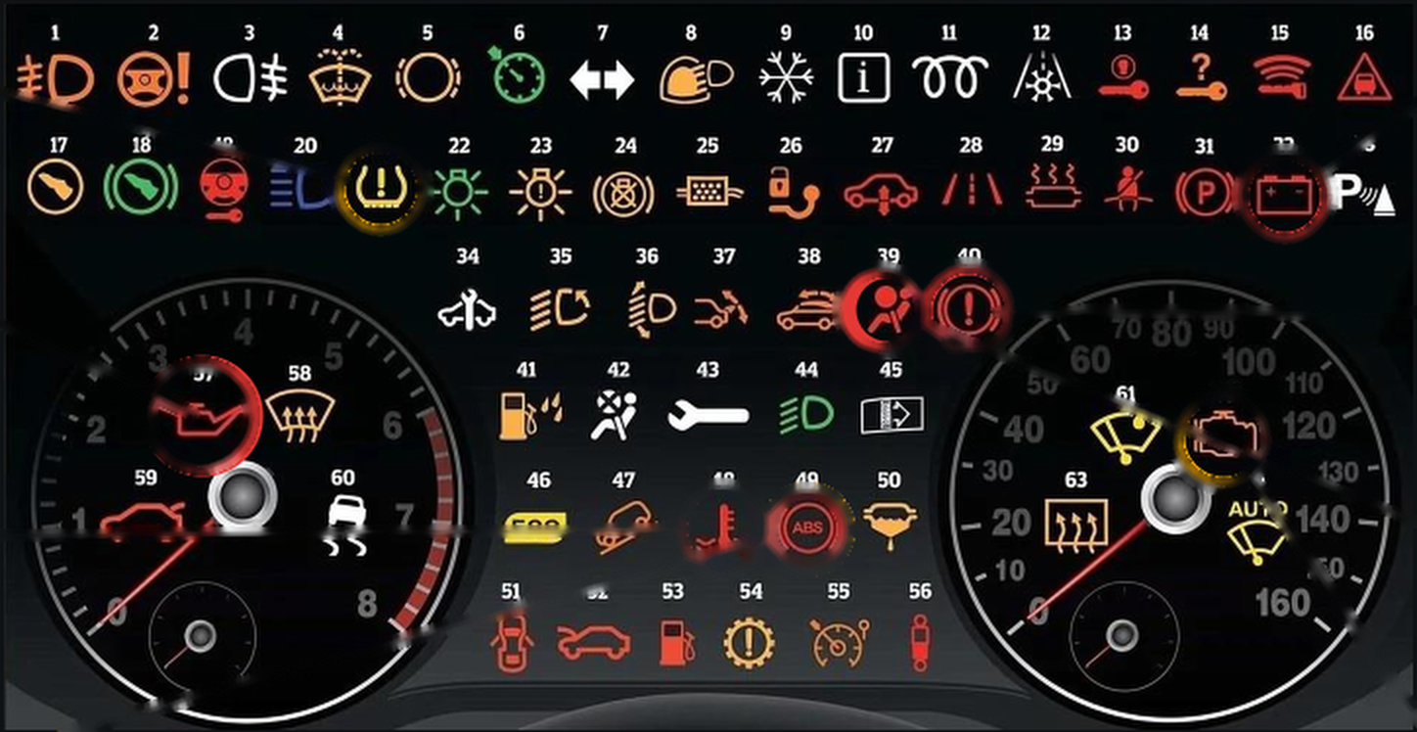
Dashboard Warning Lights: Complete Reference
RED Stop safely as soon as possible
AMBER Get it checked soon
GREEN / BLUE Information only
1
Fog light (front)
23
Exterior light fault
45
Dirty air filter
2
Power steering warning
24
Brake lights warning
46
Eco driving indicator
21
32
3
Fog light (rear)
25
DPF (diesel filter)
47
Hill descent control
4
Washer fluid low
26
Tow hitch warning
48
Temperature warning
39
40
5
Brake pad warning
27
Air suspension warning
49
ABS warning
6
Cruise control on
28
Lane departure warning
50
Fuel filter warning
57
7
Direction indicators
29
Catalytic converter
51
Door open
62
8
Rain and light sensor
30
Seat belt not on
52
Bonnet open
48
49
9
Winter mode
31
Parking brake light
53
Low fuel
10
Information indicator
32
Battery / alternator
54
Auto gearbox warning
11
Glow plug (diesel)
33
Parking assist
55
Speed limiter
12
Frost warning
34
Service required
56
Suspension dampers
13
Ignition switch warning
35
Adaptive lighting
57
Oil pressure low
14
Key not in vehicle
36
Headlight range control
58
Windscreen defrost
15
Key fob battery low
37
Rear spoiler warning
59
Boot open
57
Oil pressure
48
Engine temp.
40
Brake system
39
Airbag (SRS)
16
Distance warning
38
Convertible roof
60
Stability control (ESC)
17
Press clutch pedal
39
Airbag warning
61
Rain sensor
Stop – switch engine off
Stop – overheating
Stop – brake fault
Don't drive – report it
18
Press brake pedal
40
Brake / handbrake
62
Engine / emissions
19
Steering lock warning
41
Water in fuel filter
63
Rear window defrost
32
Battery
21
Tyre pressure
49
ABS
62
Check engine
20
Main beam (high beam)
42
Airbag deactivated
64
Auto windscreen wiping
Stop – charging fault
Check tyre pressures
No ABS – get checked
Get checked; flashing = stop
21
Tyre pressure low
43
Fault (general)
22
Sidelight information
44
Dipped beam
Notes:
- Colour rule: RED = stop safely as soon as possible; AMBER = get it checked soon; GREEN/BLUE = information only (a system is switched on).
- Click 1 rings the five RED lights in the picture (oil pressure, engine temperature, brake system, airbag, battery). Click 2 rings the three AMBER lights (tyre pressure, ABS, check engine).
- A FLASHING check-engine light usually means a serious misfire – reduce speed and stop safely. With the ABS light on, normal braking still works but without anti-lock.
- Symbols and colours vary by manufacturer – always confirm in the vehicle handbook. Numbers 1–64 match the picture labels.

