Slide 1

Testing Consumer Reactions to Direct Mail Ads: Option A vs Option B

Slide 2
Background & Objective
MVP tested two direct-mail Medicare Advantage ad concepts (Option A and B) and each ad was shown to a unique sample of 500 respondents.
Respondents rated:
Likelihood to Open the Mailer (Column E)
Likelihood to Take the Next Step / Contact MVP (Column S)
Ratings captured on a 1–5 scale (1 = Not Likely, 5 = Extremely Likely)
We ran independent-sample t-tests to compare mean ratings for both ads and determine if the differences were statistically significant. We also analyzed results by gender and household income to identify which demographic segments showed stronger preferences or response patterns

Slide 3
Option A Drives Higher Open Rates Than Option B
Likelihood to Open (Column E):
Metric
Option A
Option B
T/Z-Statistic
p-value
Conclusion (α=0.05)
Mean Score
3.03
2.75
t=3.0913
0.0020
Significant (A > B)
High Response Proportion (4 or 5)
42.00%
33.40%
z=2.8058
0.0050
Significant (A > B)
Likelihood to Take Next Step (Column S):
Metric
Option A
Option B
T/Z-Statistic
p-value
Conclusion (α=0.05)
Mean Score
3.06
3.06
t=0.0000
1.0000
Not Significant
High Response Proportion (4 or 5)
44.4%
44.4%
z=0.0000
1.0000
Not Significant

Slide 4
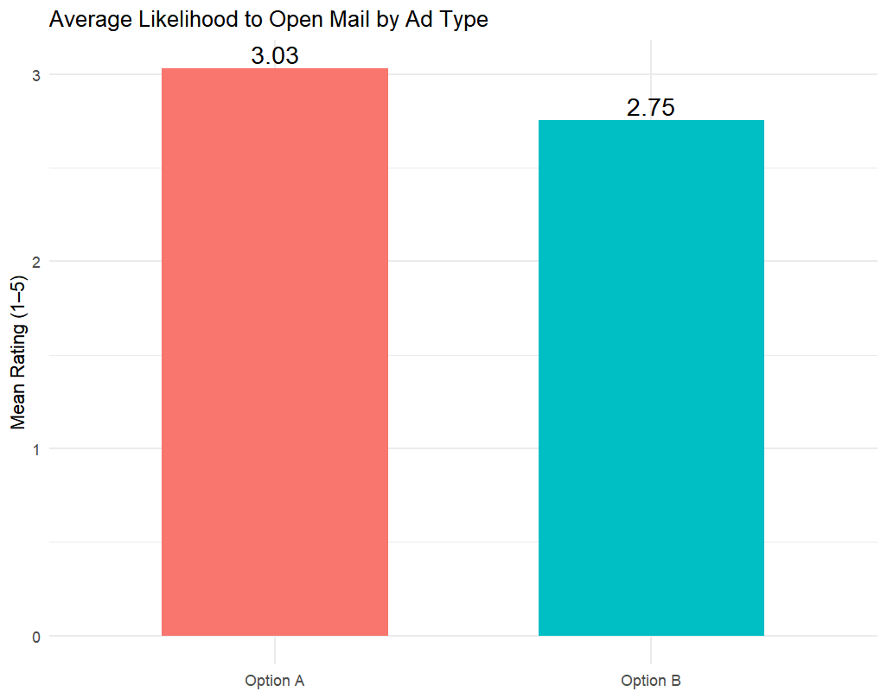
Overall Findings（By Column E）
Option A shows a clear advantage in attracting attention and encouraging recipients to open the mailer.
Respondents perceived it as more appealing and relevant at first glance. In contrast, both concepts perform similarly when it comes to motivating the next step, such as calling or visiting the website.
The main difference lies in first impressions rather than content persuasion.

Slide 5
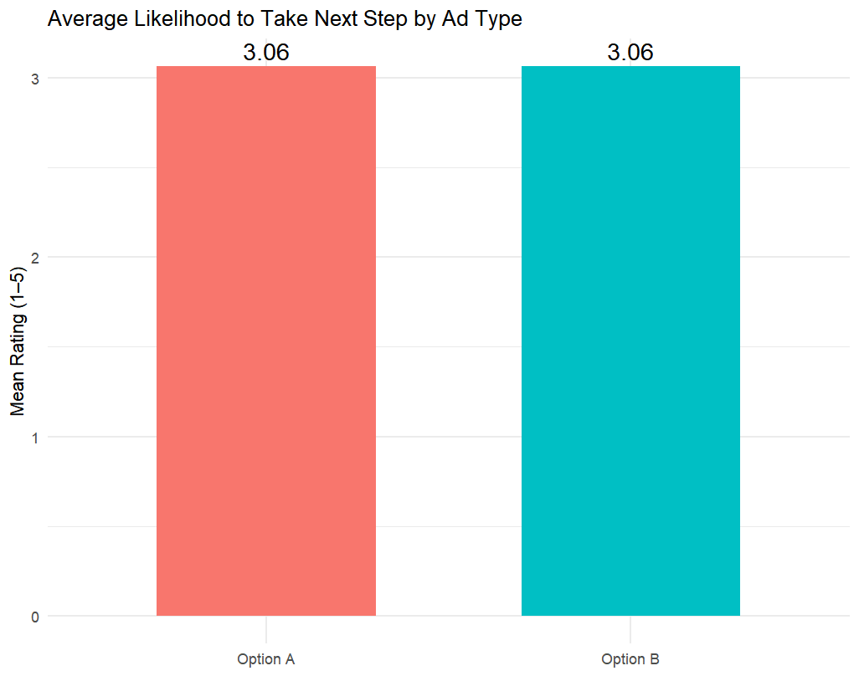
Behavioral Funnel（By Column S）
The results reveal a clear gap between attention and action. Option A effectively encourages recipients to open the mail, but both ads perform similarly once the content is read.
This suggests that improving the message clarity, benefits communication, and call-to-action could increase overall conversion after initial engagement.

Slide 6
Subgroup Analysis: Household Income Differences
The advantage of Option A for "Likelihood to Open" is strongest and most statistically significant for respondents in the mid-to-high income bracket of $75,000-$99,999.
Likelihood to Open (Mean Score & Proportion) by Income Group:
Income Group
Option A
Option B
p-value (Mean)
Prop A
Prop B
p-value (Prop)
Conclusion (α=0.05)
$75,000-$99,999
3.12
2.74
0.0400
46.73%
31.78%
0.0251
Significant (A > B)
$100,000+
3.13
2.76
0.0870
43.02%
30.23%
0.0817
Not Significant
$50,000-$74,999
3.06
2.68
0.0587
42.86%
31.63%
0.1041
Not Significant
$25,000-$49,999
2.92
2.76
0.4330
39.81%
36.11%
0.5749
Not Significant
<$25,000
2.94
2.82
0.5709
37.62%
36.63%
0.8842
Not Significant

Slide 7
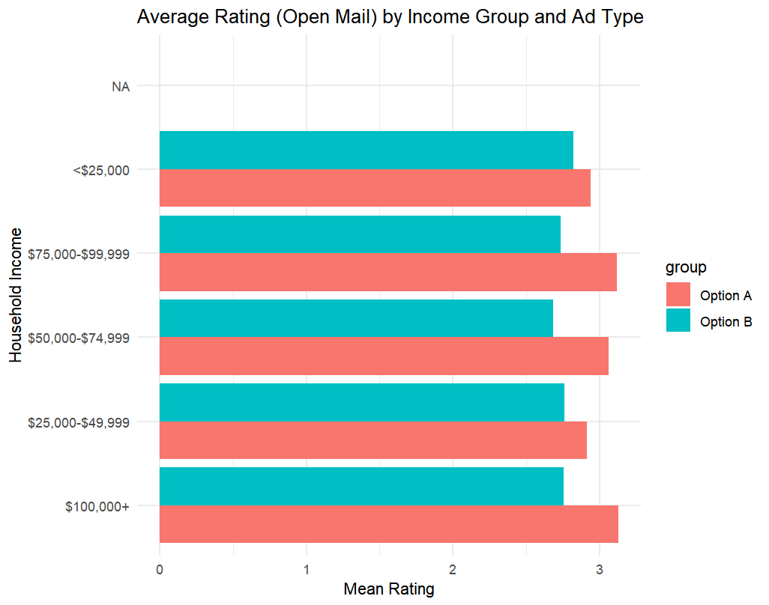
Income Differences
The advantage of Option A is most pronounced among middle-to-high income respondents. These individuals respond more favorably to professional and trustworthy visual cues, while lower- and higher-income groups show more neutral reactions.
Segmenting creative strategies by income level could further optimize campaign impact.

Slide 8
Subgroup Analysis: Gender Differences
The overall advantage of Option A for "Likelihood to Open" is statistically significant only among Male respondents.
Male Respondents:
Metric
Option A
Option B
T/Z-Statistic
p-value
Conclusion (α=0.05)
Mean Score
3.06
2.73
t=2.6595
0.0081
Significant (A > B)
High Response Proportion (4 or 5)
40.08%
30.56%
z=2.2367
0.0253
Significant (A > B)
Likelihood to Take Next Step
2.98
2.98
p=1.0000
1.0000
Not Significant
Female Respondents:
Metric
Option A
Option B
T/Z-Statistic
p-value
Conclusion (α=0.05)
Mean Score
3.00
2.77
t=1.7387
0.0827
Not Significant
High Response Proportion (4 or 5)
43.95%
36.29%
z=1.7406
0.0818
Not Significant
Likelihood to Take Next Step
3.15
3.15
p=1.0000
1.0000
Not Significant

Slide 9
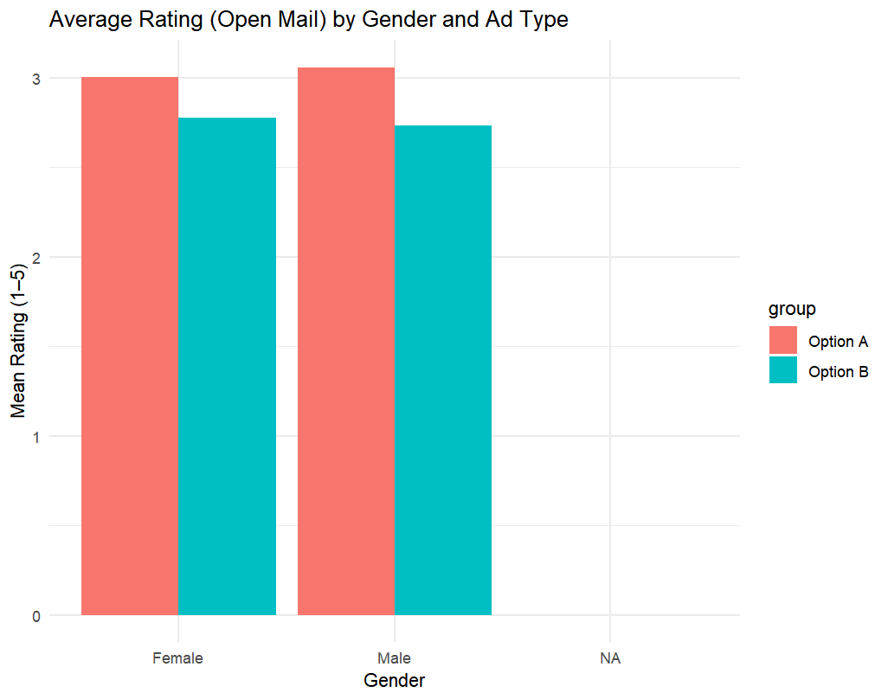
Subgroup Analysis: Gender Differences
The stronger performance of Option A is primarily driven by male respondents, who found its design clearer and more trustworthy.
Female respondents showed similar reactions to both versions, indicating that while Option A appeals broadly, its strongest pull is among men.
This highlights the importance of considering visual tone and style in gender-specific messaging.

Slide 10
Key Insights
Option A outperformed Option B on Likelihood to Open
Statistically significant difference (p < 0.05)
No significant difference on Likelihood to Take Next Step
Gender Analysis:
Advantage for Option A driven primarily by male respondents
Female responses showed no meaningful gap
Income Analysis:
Strongest effect among mid-to-high income group ($75 k – $99 k)
Lower-income and higher-income groups showed minimal difference
Overall Conclusion:
First-impression design (headline + envelope clarity) most influences engagement
Tailoring creative by gender and income segment may further lift results

Slide 11
Strategic Implications
This research highlights how subtle creative choices can meaningfully affect audience engagement.
To maximize future impact, marketing teams should:
1.Prioritize First-Impression Design
Optimize envelope layout, typography, and headline hierarchy to ensure instant visual recognition.
The mailer must communicate relevance and urgency before it is even opened.
2.Segment and Tailor Creative by Demographic
Adapt tone, color palette, and message framing for key groups—particularly males and middle-income households, who showed the strongest engagement lift.
3.Strengthen Content-Driven Conversion
Refine the internal copy with clearer calls-to-action, simplified benefit statements, and trust cues such as endorsements or plan guarantees.
4.Integrate Future Testing and Personalization
Implement follow-up experiments combining direct-mail with digital touchpoints, exploring personalized messaging to translate attention into measurable response.
Overall, turning a strong first impression into real action will depend on combining visual clarity, audience insight, and message authenticity

