Slide 1
What We Are Setting Up
The complete local development toolchain
1
Node.js
2
Android Studio
3
Expo Project
4
Local Build
Provides Node, npm and npx for
the JavaScript/TypeScript toolchain.
Provides the Android SDK,
emulator, platform tools and
build tools.
Creates and manages
the React Native application.
Gradle builds the Android app
and ADB installs it on the emulator.
Code → Expo/React Native → Gradle → APK → ADB → Android Emulator
2

Slide 2
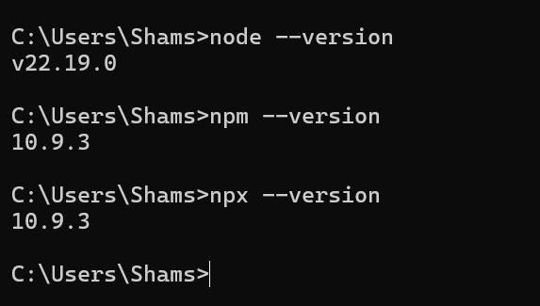

Step 1 — Install Node.js
Use the current Node.js LTS release
Install Node.js LTS.
npm is installed with Node.js.
Use npx to run Expo CLI commands — no global Expo CLI installation is required.
Verify the installation from a terminal.
node --version
npm --version
3

Slide 3
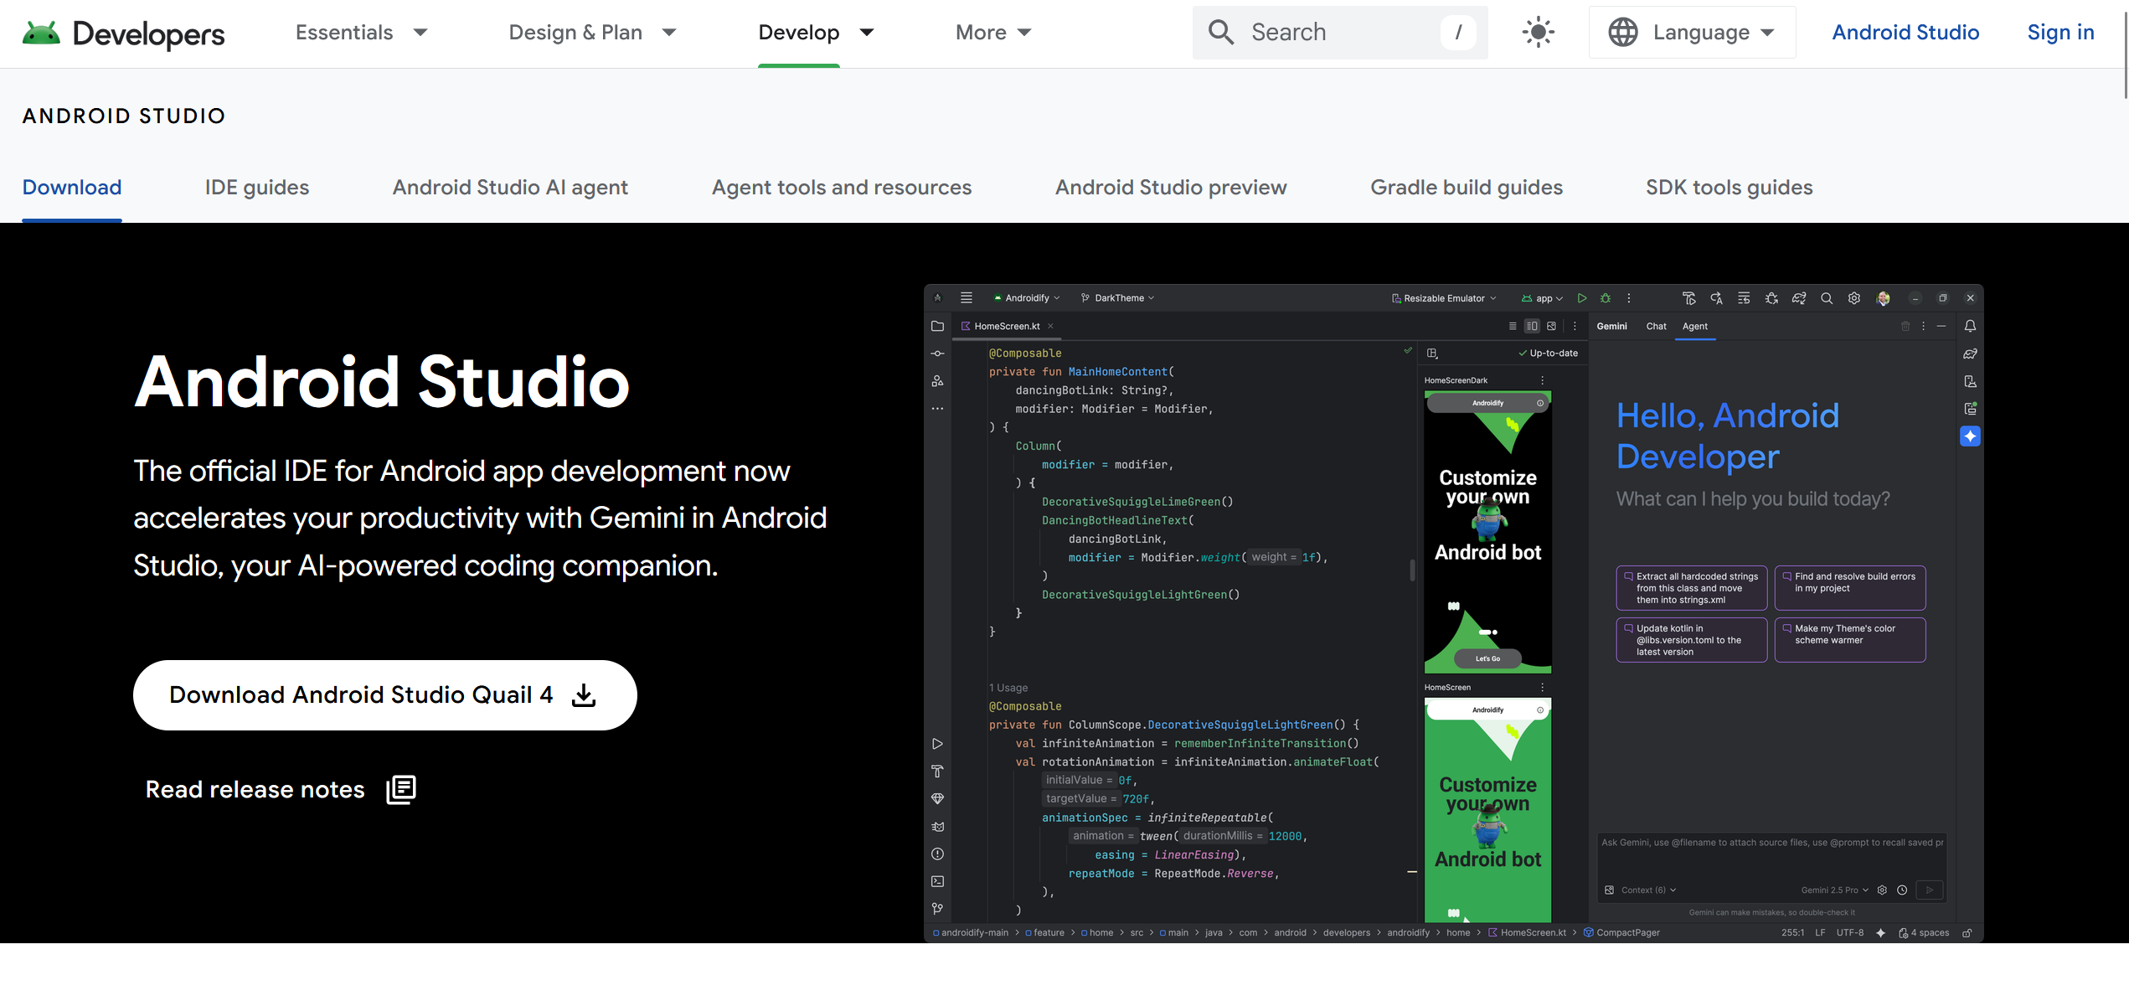
Step 2 — Install Android Studio
Install the Android development components needed by React Native
Android Studio-
https://developer.android.com/studio
4

Slide 4
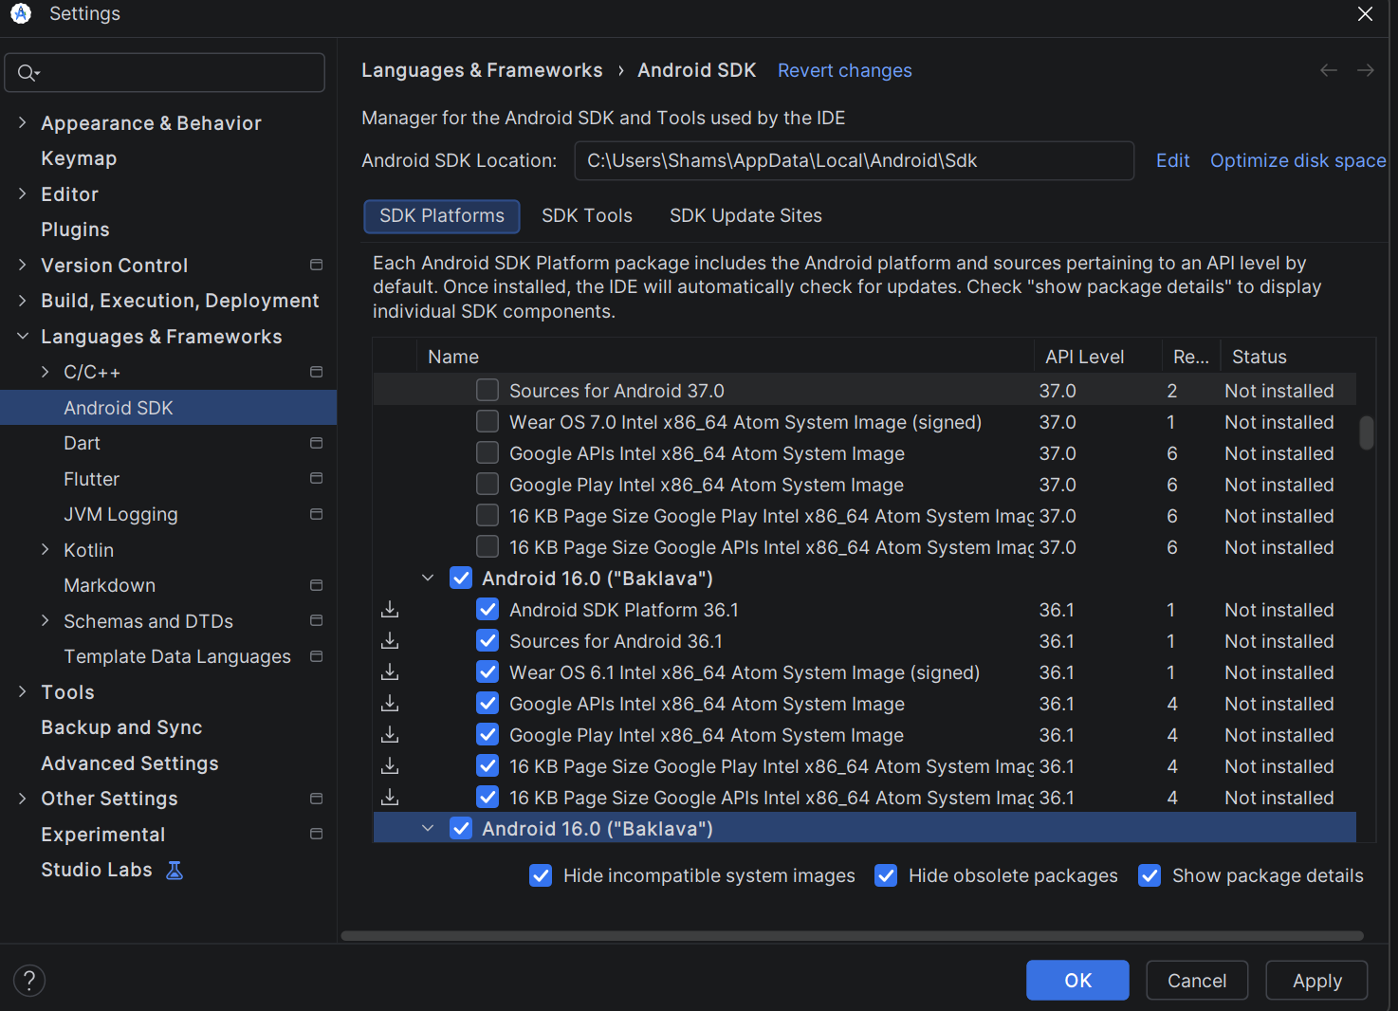
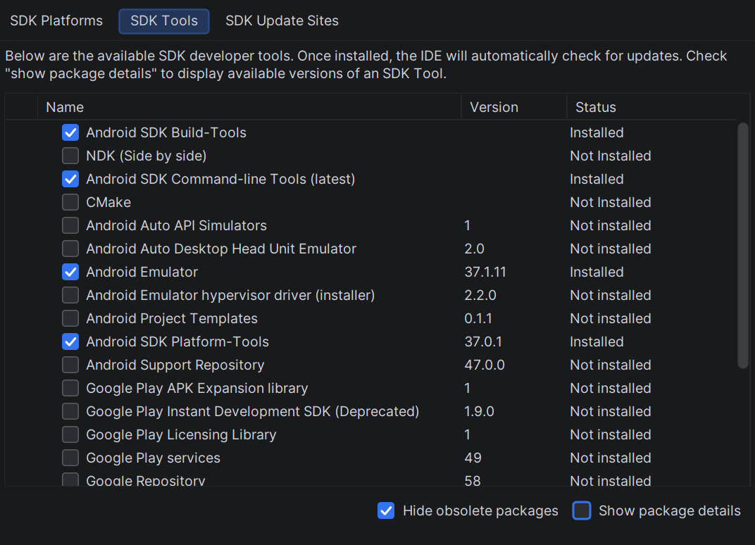
Step 3 — Install API version
From Languages and frameworks
select Android SDK and then SDK Platforms.
Scroll to find Android 16 and install it.
Select the SDK Tools tab.
Check Show Package Details to see individual versions.
Make sure these are checked:
  Android SDK Build-Tools
  Android SDK Command-line Tools (latest)
  Android Emulator
  Android SDK Platform-Tools
4

Slide 5
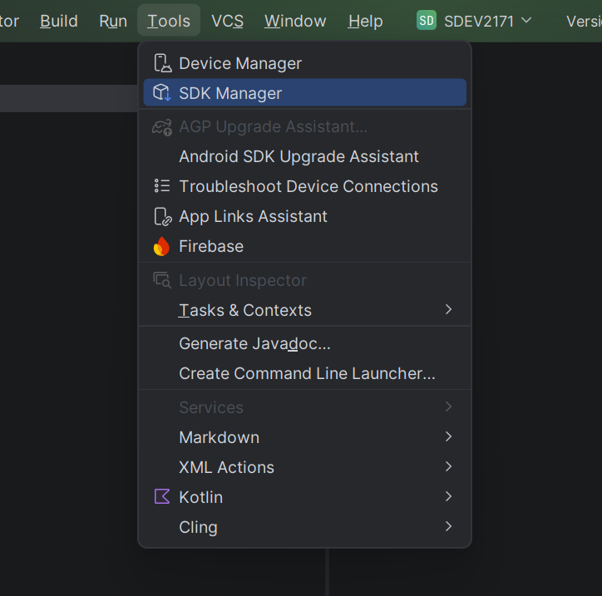
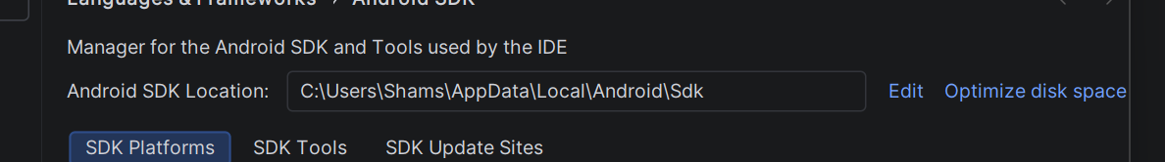

Step 3 — Configure the Android SDK Path (Part 1)
Open Android Studio. Go to Tools → SDK Manager.
At the top, find Android SDK Location. Copy that full path. It will usually look like:
C:\Users\YourName\AppData\Local\Android\Sdk
Press Windows + R and write sysdm.cpl:
From Advanced tab open click Environment Variables...
Under User variables for <your username>, click New...
Enter Variable name: ANDROID_HOME (keep all caps)
For Variable value, paste the SDK path you copied: C:\Users\YourName\AppData\Local\Android\Sdk and Click OK.
Now add Android tools to your Path. Under User variables, select: Path and Click Edit.
Click New and add: %ANDROID_HOME%\platform-tools
Click New again and add: %ANDROID_HOME%\emulator
Click OK on every open Environment Variables window.
Close any Command Prompt, PowerShell, or VS Code terminals that were already open. Open a new terminal.
Check that ANDROID_HOME is available. In Command Prompt type- echo %ANDROID_HOME%
Then, Check that adb works and type- adb --version
Lastly, Check that the emulator command works and type- emulator -version
If both adb and emulator return version information, your Android SDK path is configured correctly.

Slide 6
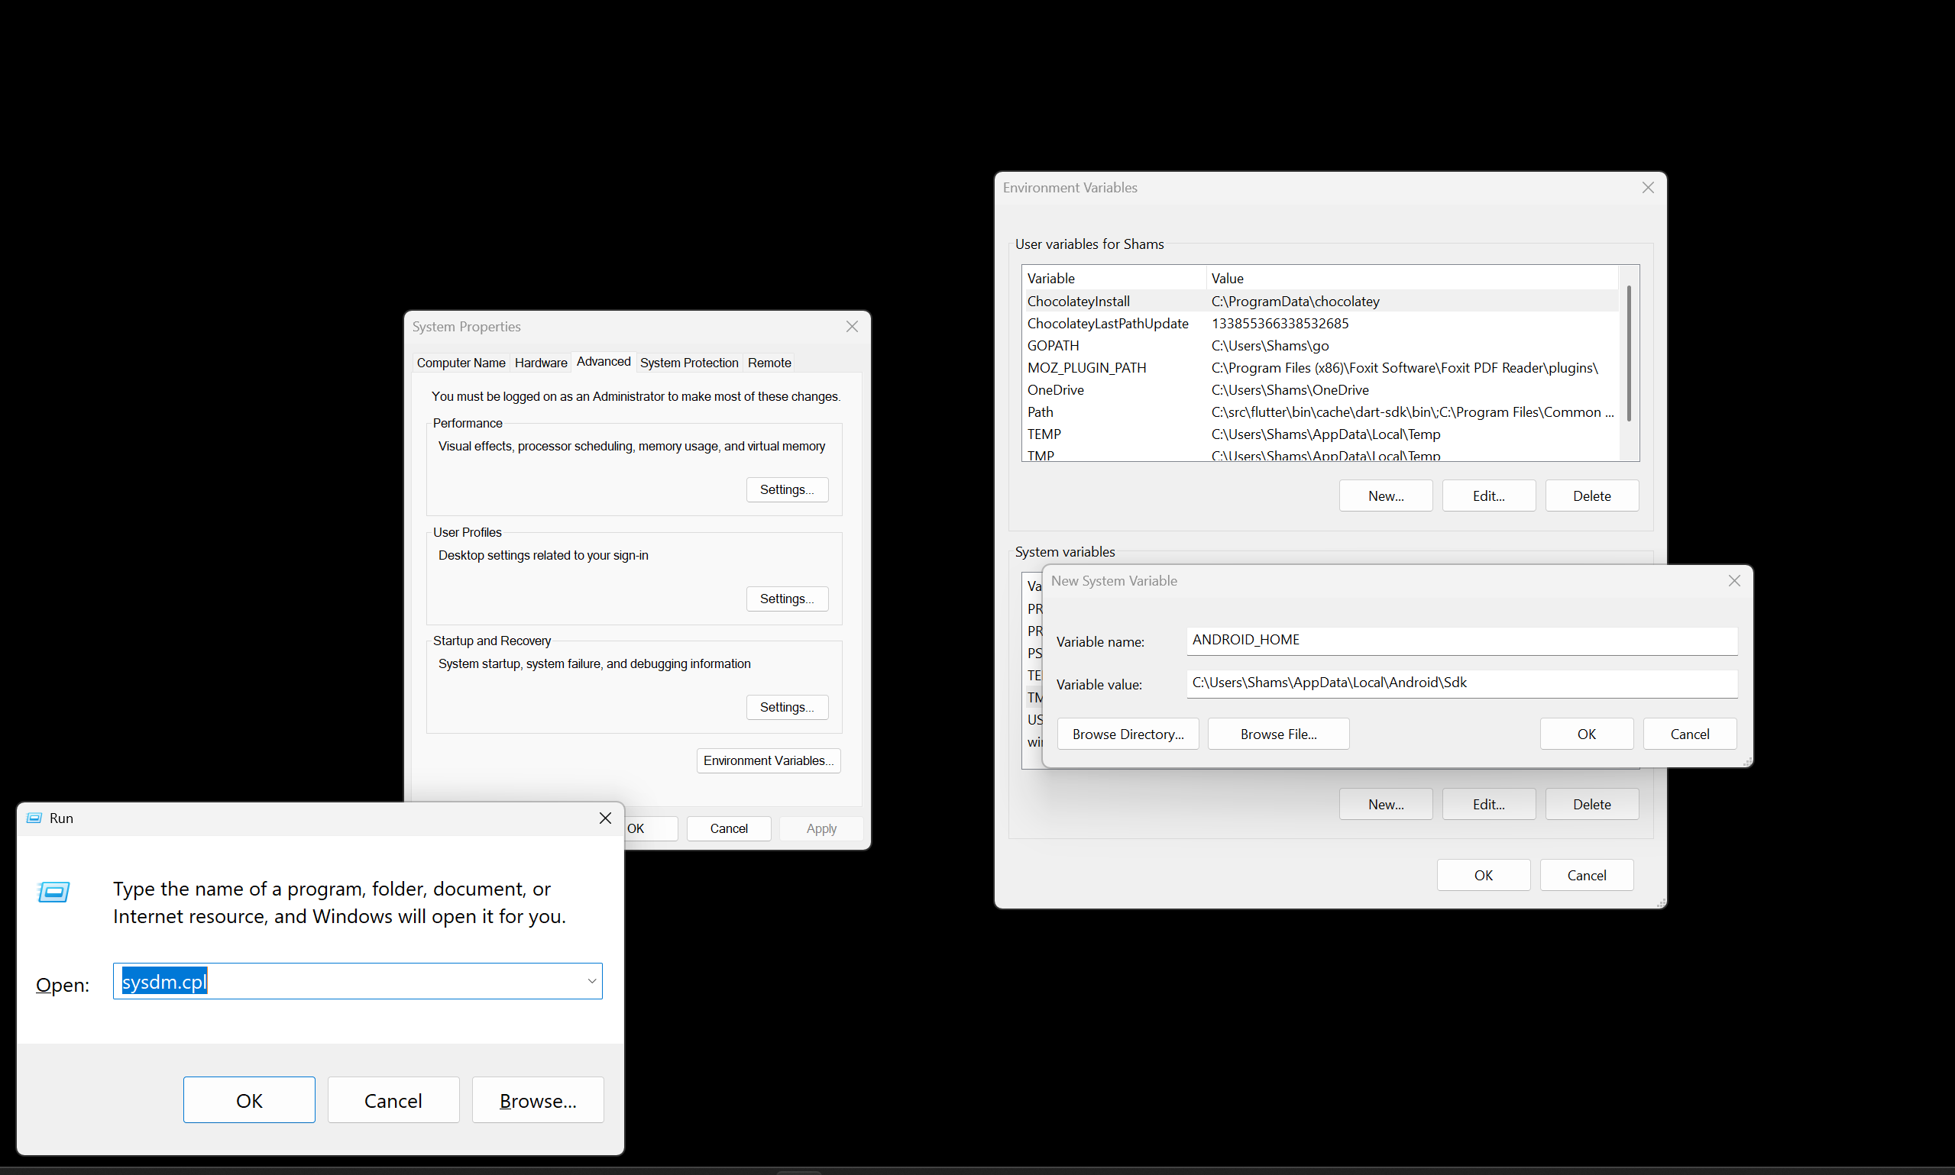
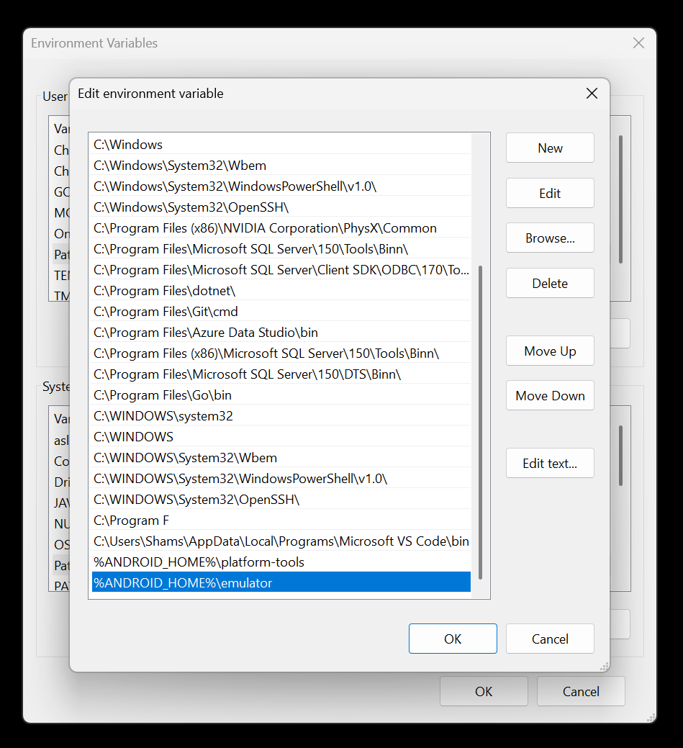


Step 3 — Configure the Android SDK Path (part 2)
User Variable
System Variable

Slide 7

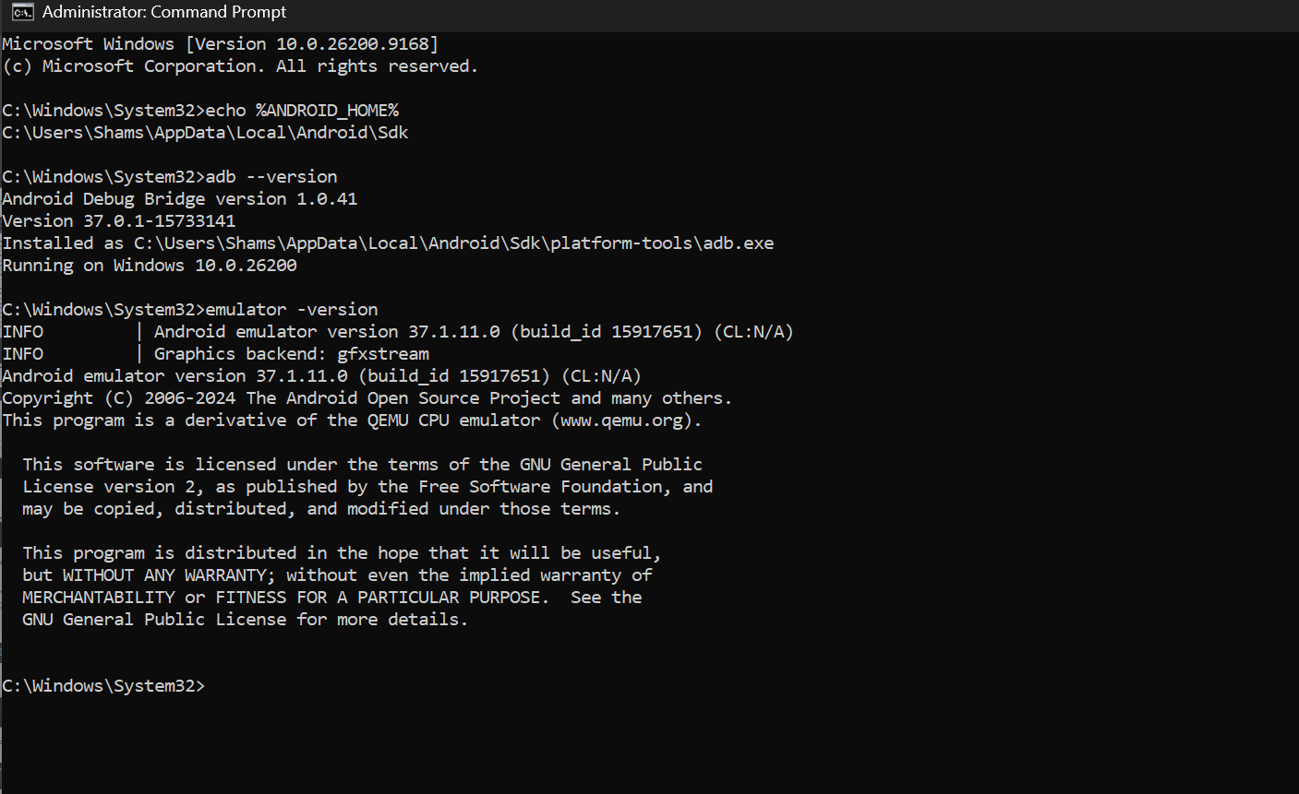
Step 3 — Configure the Android SDK Path (part 3)

Slide 8
Step 4 — Download and set Java SDK
See the separate word document for this step and go through the steps there.

Slide 9
Step 5 — Create the Expo / React Native Project
Create the project from a normal terminal or from VSCode
npx create-expo-app@latest MyFirstApp
cd MyFirstApp
MyFirstApp
app /
create-expo-app creates the React Native project.
npx downloads/runs the required CLI package without a global install.
The project can use JavaScript or TypeScript.
Expo Go is not part of this workflow.
assets /
package.json
node_modules /
7

Slide 10
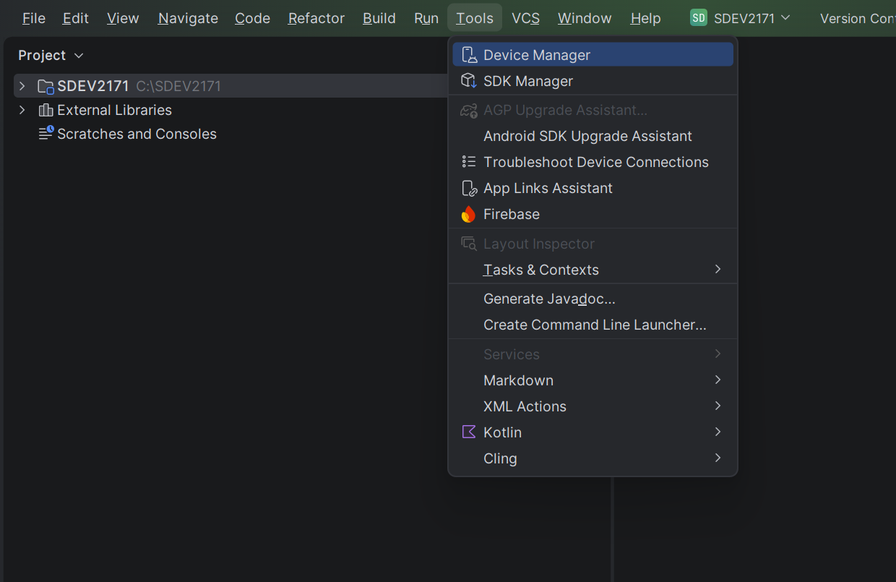
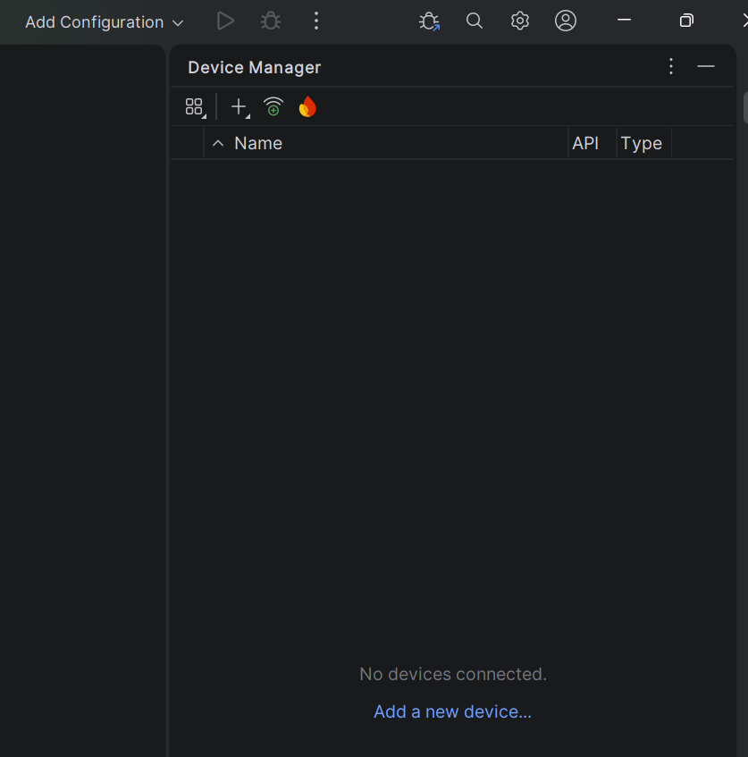
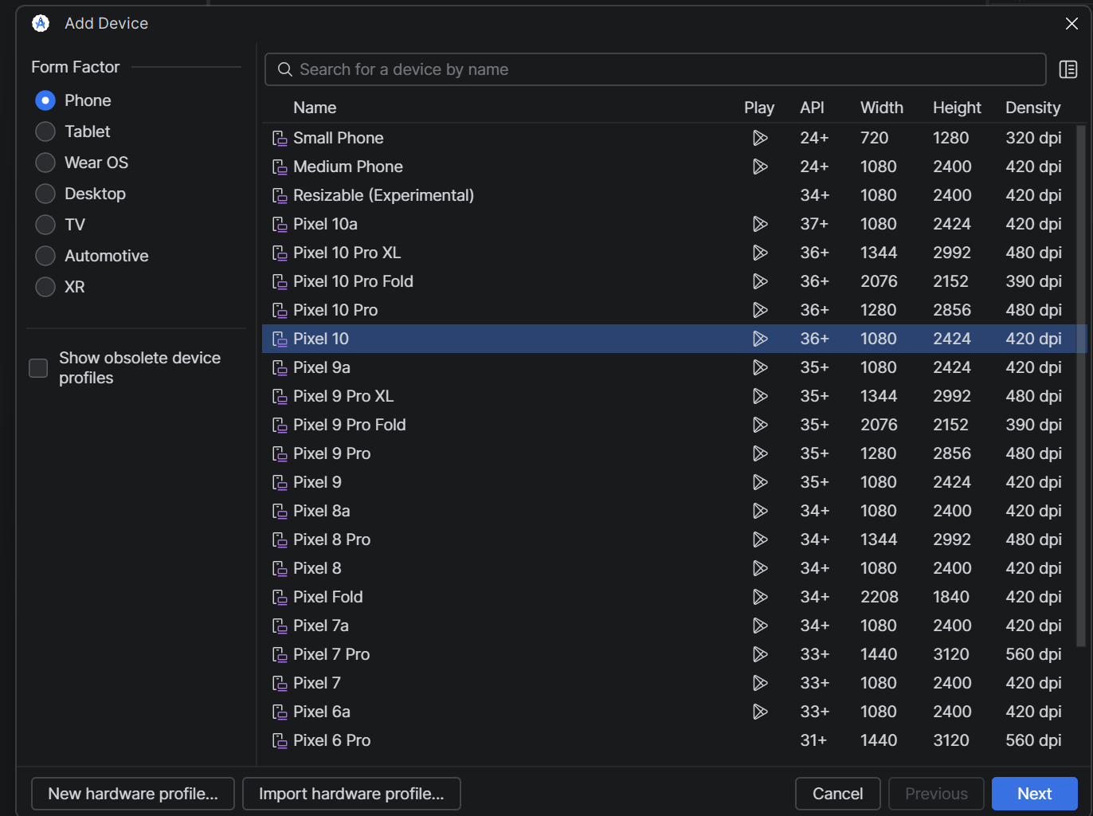
Step 6 — Create a Virtual Device and Run It

Slide 11
Step 7 — Build and Install the Android App
npx expo run:android
IMPORTANT: Make sure the emulator is running before this step!
Expo generates/configures the native Android project when needed.
Gradle compiles the Android application.
ADB installs the debug app on the emulator.
The app launches on the emulator.
The first build is slower because Gradle downloads dependencies.
8

