Slide 1
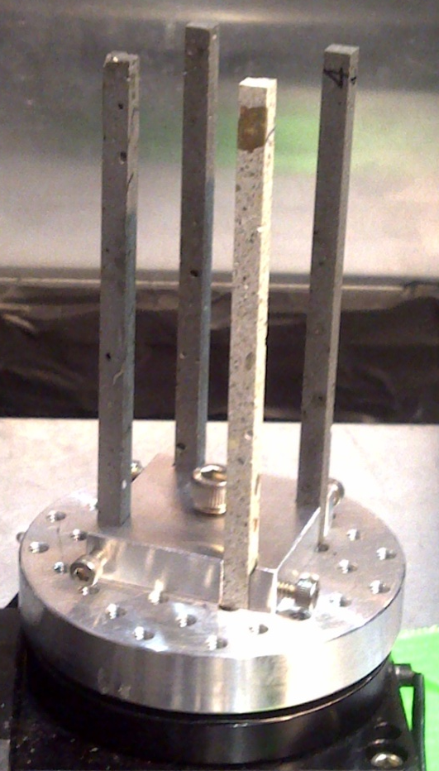


Neutron Computed Tomography
of Ultra-High Performance Concretes
Team:
Fei Ren (PI), ORNL
Hassina Bilheux, ORNL
Sophie Voisin, ORISE
Lakeisha Walker, ORNL
Sample Dimensions Height: 100 mm
Area: 25 mm²
Contact: Hassina Bilheux (bilheuxhn@ornl.gov) Fei Ren (renf@ornl.gov)

Slide 2
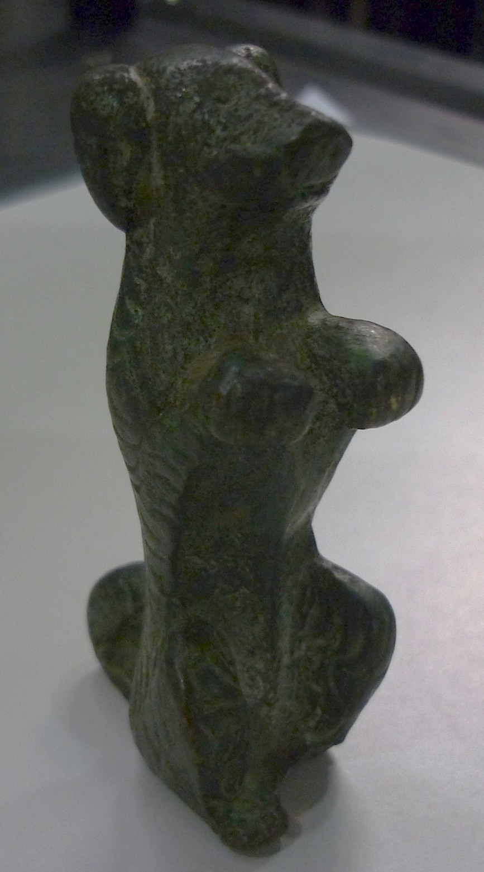


Neutron Computed Tomography
Of Ancient Bronze Dog
from
the Ancient City of Petra, Jordan
Team:
Krysta Ryzewski (PI), Wayne University
Hassina Bilheux, ORNL
Susan Herringer, Brown University
Brian Sheldon, Brown University
Sophie Voisin, ORISE
Lakeisha Walker, ORNL
WAYNE STATE UNIVERSITY
Sample Dimensions Height: 7.5 cm
Width: 3.5 cm
Depth: 2 cm
BROWN
UNIVERSITY
Contact: Hassina Bilheux (bilheuxhn@ornl.gov) Krysta Ryzewski (krysta.ryzewski@wayne.edu)

Slide 3



Neutron Computed Tomography
Of
Red Cedar
Team:
Jeff Warren (PI), ORNL
Hassina Bilheux, ORNL
Sophie Voisin, ORISE
Misun Kang, University of Tennessee
Ed Perfect, University of Tennessee
Chu-Lin Cheng, University of Tennessee
Juske Horita, Texas Tech. University
Sample Dimensions Height: 7.0 cm
Diameter: 2.6 cm
University of Tennessee
ORNL
Texas Tech. University
Energy and Environment Sciences
Contact: Hassina Bilheux (bilheuxhn@ornl.gov) Jeff Warren (warrenjm@ornl.gov)

