Slide 1
Tcp/Socket programming in java

Slide 2
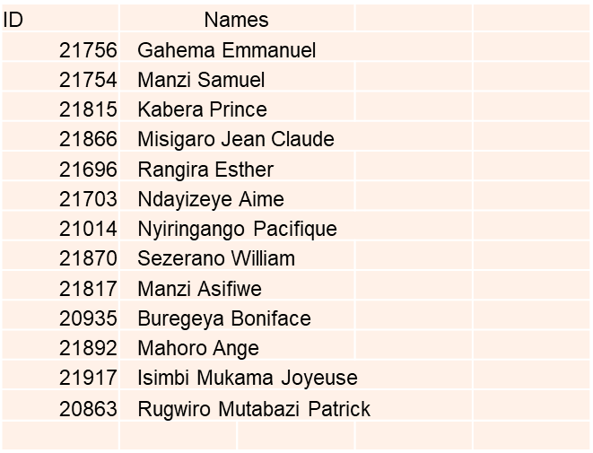
Group three members:

Slide 3
What to know first?
It is the communication that occurs between the client and the server must be reliable. Means no data can be dropped and must arrive on the client side in the same order in which the server sent it.
TCP provides a reliable, point-to-point communication channel that client-server applications.

Slide 4
What is a socket?
Socket: is one end-point of a two-way communication link between two programs running on the network.
Socket classes are used to represent the connection between a client program and a server program.
The java.net package provides two classes :
Socket that implement the client side of the connection
Server Socket implement server side of the connection, respectively.
And also a socket is bound to a port number so that the TCP layer can identify the application that data is destined to be sent to.
The server just waits, listening to the socket for a client to make a connection request.

Slide 5
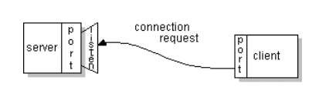
On the client-side: The client knows the hostname of the machine on which the server is running and the port number on which the server is listening.
To make a connection request, the client tries to connect with the server on the server's machine and port.
The client also needs to identify itself to the server so it binds to a local port number that it will use during this connection. For example If everything goes well, the server accepts the connection.

Slide 6

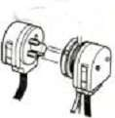
Types of socket
There are two essential types of socket:
1.STREAM
–
a.k.a. TCP
Limit on Number of
Processes that can
“Listen” for
–
reliable delivery
successfully request
service
in
service at a time
–
-
order guaranteed
connection
Service
–
-
oriented
–
bidirectional
Request
2
1
Service
Request
Request
Process
Service
Serviced
Request
3
Connect

Slide 7


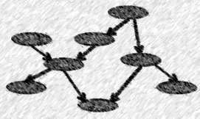
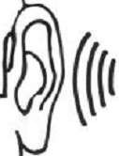
2. DATAGRAM
–
a.k.a. UDP
–
unreliable delivery; data can be
lost, although this is unusual
–
no order guarantees
–
app
Process
no notion of “connection”
–
indicates
dest
. for each packet
–
can send or receive
Send to recipient
Indeterminate
path
Process
Receive from Sender

Slide 8
Tcp vs udp socket programming
Sockets are a protocol independent method of creating a connection between processes. Sockets can be either
Connection based or Connectionless: Is a connection established before communication or does each packet describe the destination?
Packet based or Streams based: Are there message boundaries or is it one stream?
Reliable or Unreliable: Can messages be lost, duplicated, reordered, or corrupted?

Slide 9
What is tcp?
TCP is a connection-oriented protocol. This means that before the client and server can start to send data to each other, they first need to handshake and establish a TCP connection.
When creating the TCP connection, we associate with it the client socket address (IP address and port number) and the server socket address (IP address and port number).
With the TCP connection established, when one side wants to send data to the other side, it just drops the data into the TCP connection via its socket. This is different from UDP, for which the server must attach a destination address to the packet before dropping it into the socket.

Slide 10
Socket programming with tcp
keyboard
monitor
Client server app
client reads line from standard input (inFromUser stream) , sends to server via socket (outToServer stream)
server reads line from socket
server converts line to uppercase, sends back to client
client reads, prints modified line from socket (inFromServer stream)
r
e
input
s
U
stream
m
Client
o
r
F
n
Process
i
Input stream:
process
sequence of bytes
output stream:
into process
sequence of bytes
out of process
r
r
e
e
v
v
output
r
r
input
e
e
stream
S
S
stream
o
m
T
o
t
r
u
F
o
n
i
client TCP
clientSocket
socke
t
TCP
socket
to network
from network

Slide 11
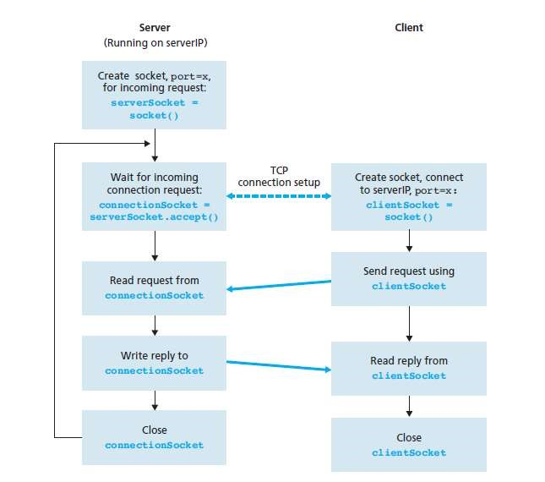
Client/server socket interaction: tcp connection

Slide 12
The java.net.socket class
The java.net.socket class:
Its Connection is accomplished via construction.
And Each Socket object is associated with exactly one remote host.
Sending and receiving data is accomplished with output and input streams.
There are methods to get an input stream for a socket and an output stream for the socket.

Slide 13
The java.net.serversocket class
The java.net.ServerSocket class represents a server socket.
It is constructed on a particular port.
Then it calls accept() to listen for incoming connections.
accept() blocks until a connection is detected.
Then accept() returns a java.net.Socket object that is used to perform the actual communication with the client.
the “plug”
backlog is the maximum size of the queue of connection requests

Slide 14
How to set up input and output stream?
Once a socket has connected you send data to the server via an output stream. You receive data from the server via an input stream.
The are two methods to use: Methods getInputStream and getOutputStream of class Socket:
BufferedReader in = new BufferedReader( new InputStreamReader(link.getInputStream()));
PrintWriter out = new PrintWriter(link.getOutputStream(),true);

Slide 15
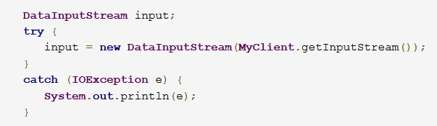
How can you create input stream?
On the client side, you can use the DataInputStream class to create an input stream to receive response from the server:
•

Slide 16

Some Tcp sockets
SocketClient.java
CLIENT:
Establish a connection to the server
Socket link = new Socket(<server>,<port>);
Set up input and output streams
Send and receive data
Close the connection
•

Slide 17
Some Tcp sockets
SocketServer.java
SERVER:
Create a ServerSocket object
ServerSocket servSocket = new ServerSocket(1234);
Put the server into a waiting state Socket link = servSocket.accept();
Set up input and output streams
•use thread to serve this client via link
Send and receive data out.println(awaiting data…); String input = in.readLine();
Close the connection link.close()

Slide 18
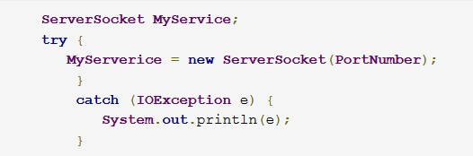
Socket server:
way of opening a socket:
•

Slide 19
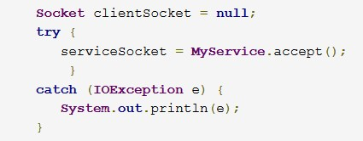
And also when you are implementing a server you also need to create a socket object from the ServerSocket in order to listen for and accept connections from clients.

Slide 20
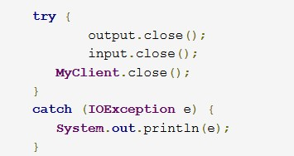
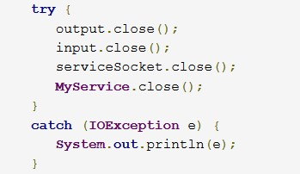
How to close a sockets?
You should always close the output and input stream before you close the socket.
On the client side: On the server side:
•

Slide 21
Thank you!!
Thank you!!

