Slide 1

Design of an embedding alignment program by dynamic programming
Jean Delhomme, Tatiana Galochkina, Jean-Christophe Gelly
16/09/2022

Slide 2






Introduction ⁽¹⁾
Sequence alignment is used for :
Evolutionary links identification
Structure prediction
function prediction
Traditional methods are looking for sequence homology, residue per residue
CPTLIVMVGLPARGKTYISKKLTRYLNFIGVPTREFNVGQYRRDMVKTYKSFEFFLPDNEEGLKIR
TNTTRERRAMIFNFGEQNGYKTFFVESICVDPEVIAANIVQVKLGSPDYVNRDSDEATEDESYKLN

Slide 3
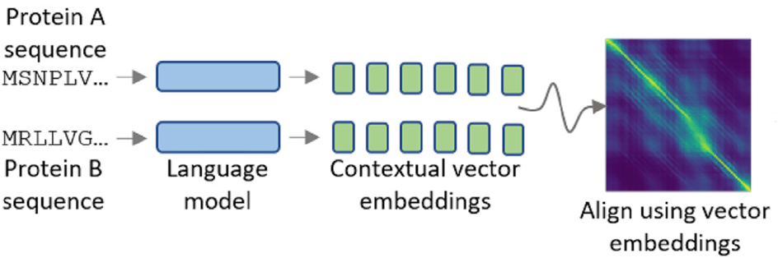
Introduction
New approach : deep learning and vector embeddings
Figure 1 : the use of embeddings for sequence alignment. ⁽²⁾

Slide 4
Table of contents
The algorithm
Results
Discussion

Slide 5
Table of contents
The algorithm
Results
Discussion

Slide 6
1. The algorithm
Environment : python 3.10.4 numpy 1.23.1
Functionalities :
Vector embeddings
Dynamic programming
3 alignment methods : Global ⁽³⁾, local ⁽⁴⁾ and semi-global ⁽⁵⁾
Linear and affine gaps
Input : 1 fasta file and 1 embedding file (T5 ProtTrans) for each protein.
Output : aligned sequence in a separate txt file.

Slide 7
Table of contents
The algorithm
Results
Discussion

Slide 8
2. Results
Objectives :
The algorithm must work
The results must be coherent
3 tests :
Best case : one protein on itself
Worst case : two very different proteins
In between : two not so different proteins

Slide 9
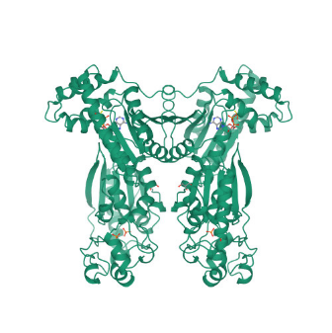
2. Results : best case
TM score : 1,00
6PF2K
6PF2K
Figure 2 : alignment of 6PF2K against itself. ⁽⁶⁾

Slide 10
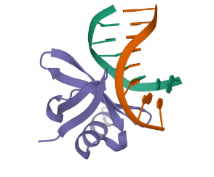
2. Results : worst case
TM score : 0,16
6PF2K
7kD_DNA_binding
Figure 3 : alignment of 6PF2K against 7kD_DNA_binding. ⁽⁶⁾⁽⁷⁾

Slide 11
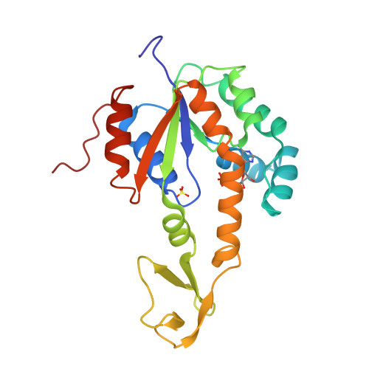
2. Results : in between
TM score : 0,62
6PF2K
adk
Figure 4 : alignment of 6PF2K against adk. ⁽⁶⁾⁽⁸⁾

Slide 12
Table of contents
The algorithm
Results
Discussion

Slide 13
3. Discussion
Protein 1
Protein 2
Alignment score
TM score
6595
1,00
229
0,16
2326
0,62
Table 1 : result summary. ⁽⁶⁾⁽⁷⁾⁽⁸⁾

Slide 14

Conclusion
Functioning program
Embedding is a plus
Affine gap
argparse
OOP
Python
Github
sys.argv
numpy
markdown
programming practices

Slide 15
References
S. Altschul et al. (2017) Handbook of Discrete and Combinatorial Mathematics. 2nd edition, Chapter 20.1 Sequence
T. Bepler et al. (2021) Learning the protein language: Evolution, structure, and function.
Needleman, Saul B. & Wunsch, Christian D. (1970) A general method applicable to the search for similarities in the amino acid sequence of two proteins.
Smith, Temple F. & Waterman, Michael S. (1981) Identification of Common Molecular Subsequences.
A Elnaggar et al. (2020) ProtTrans: Towards Cracking the Language of Life's Code Through Self-Supervised Deep Learning and High Performance Computing
Page pdb de la 6-phosphofructo-2-kinase/fructose-2,6-bisphosphatase bifunctional enzyme complexed with atp-g-s and phosphate : https://www.rcsb.org/structure/1bif
Page pdb de la hyperthermophile chromosomal protein sac7d bound with kinked dna duplex : https://www.rcsb.org/structure/1azp
Page pdb de 2AK3 : https://www.rcsb.org/structure/2ak3

Slide 16
Thank you for your listening
QUESTIONS

Slide 17
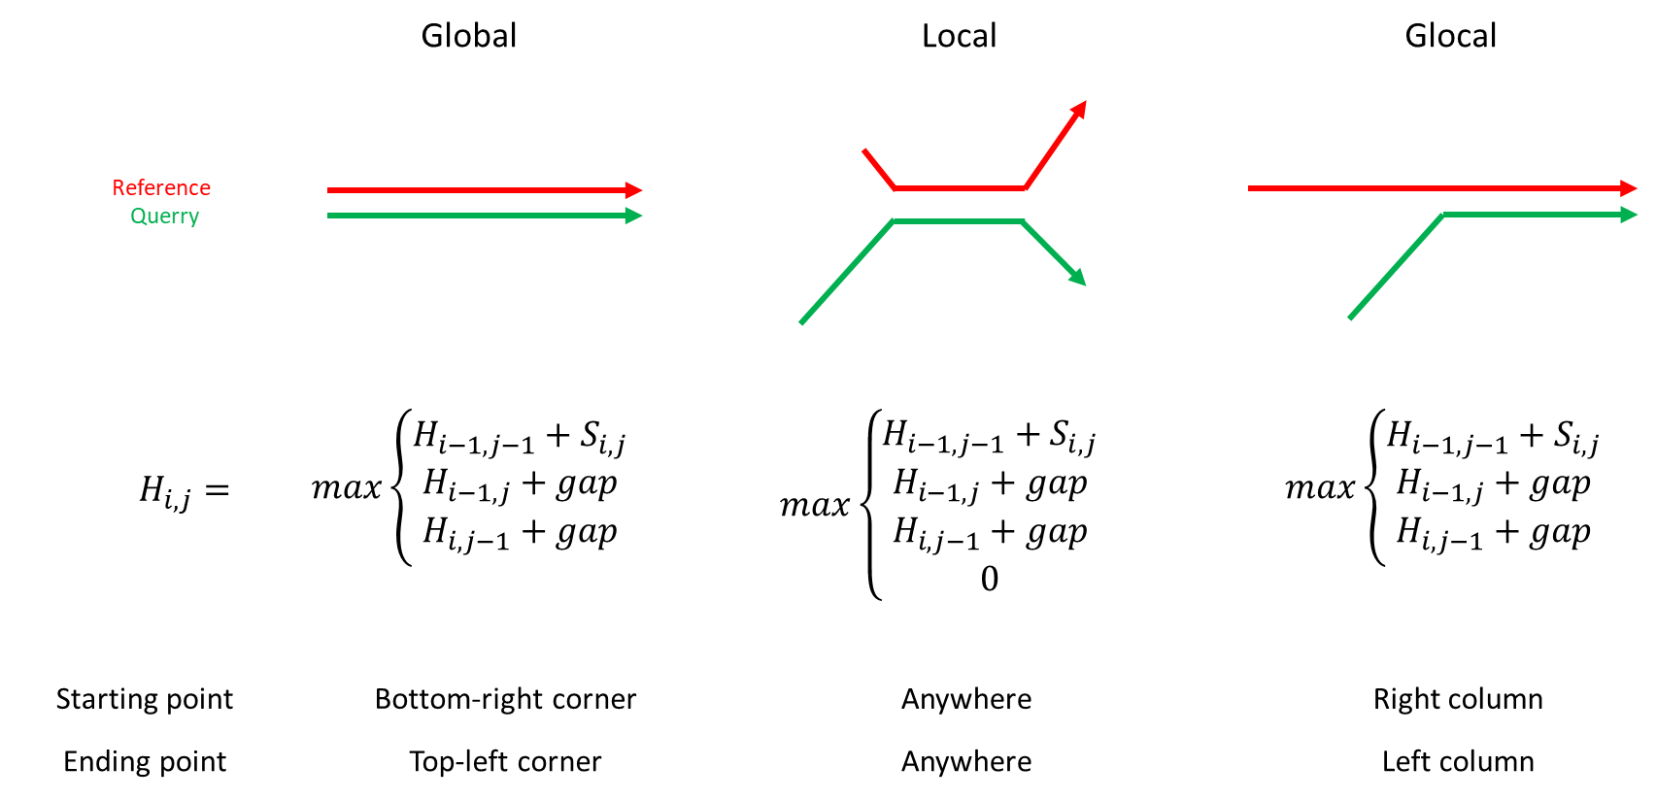
Alignment methods

Slide 18
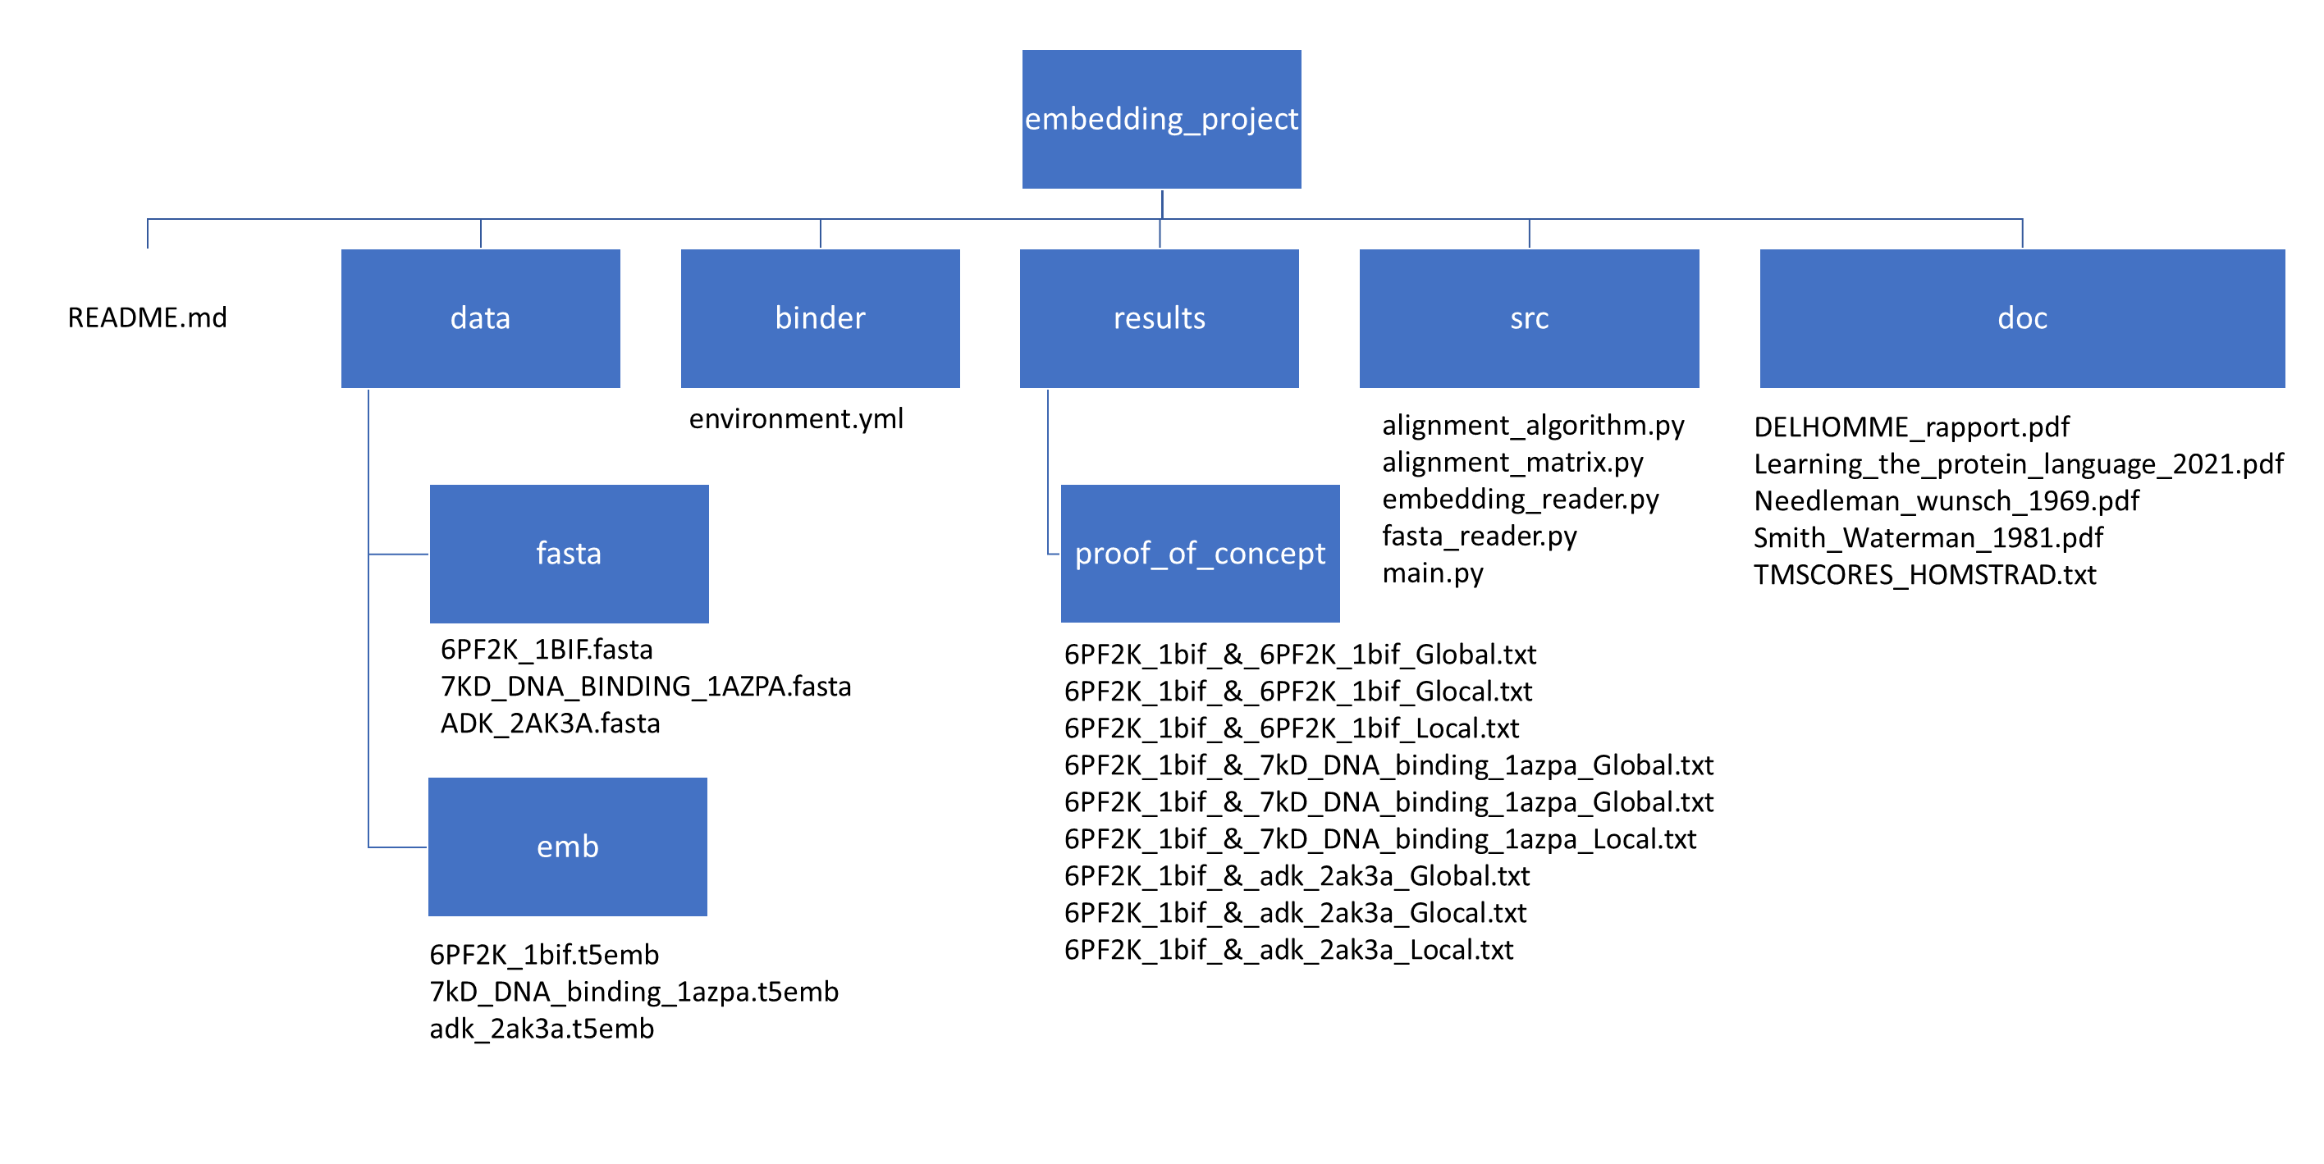
Program structure

