Slide 1
Title slide
Group name and members

Slide 2
Executive summary
Michael
Final result (i.e. accuracy achieved)
Model used
Quick recap of alternatives considered
Other important methodology or considerations

Slide 3
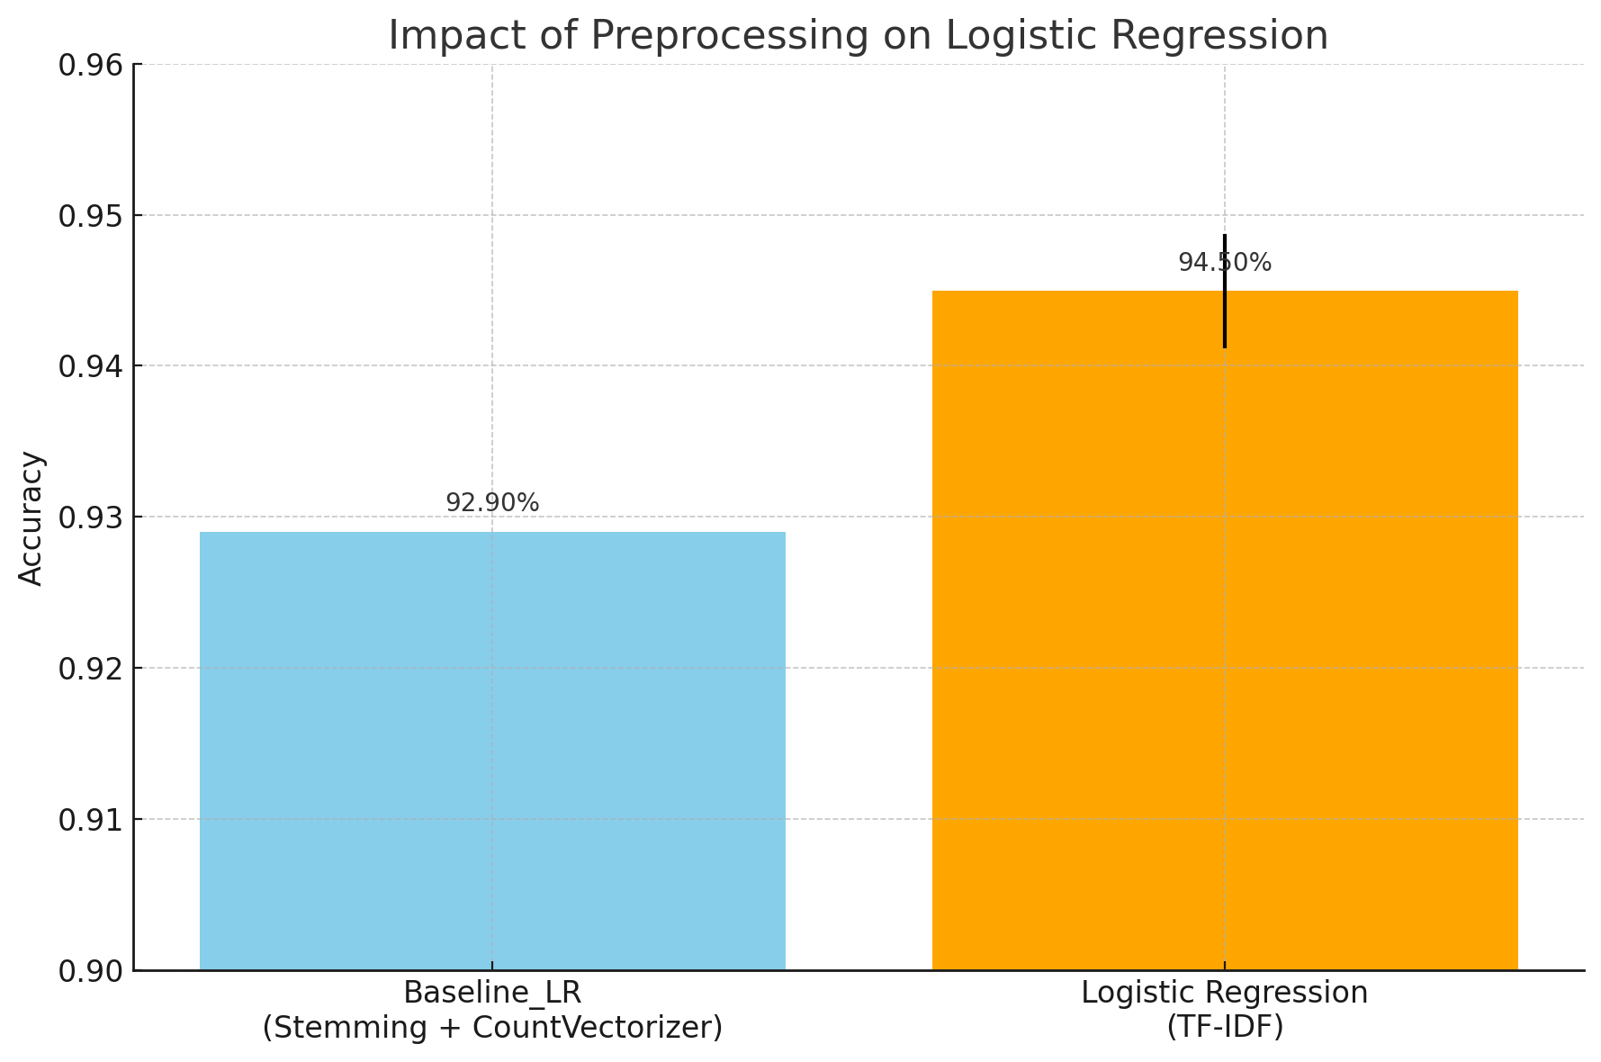
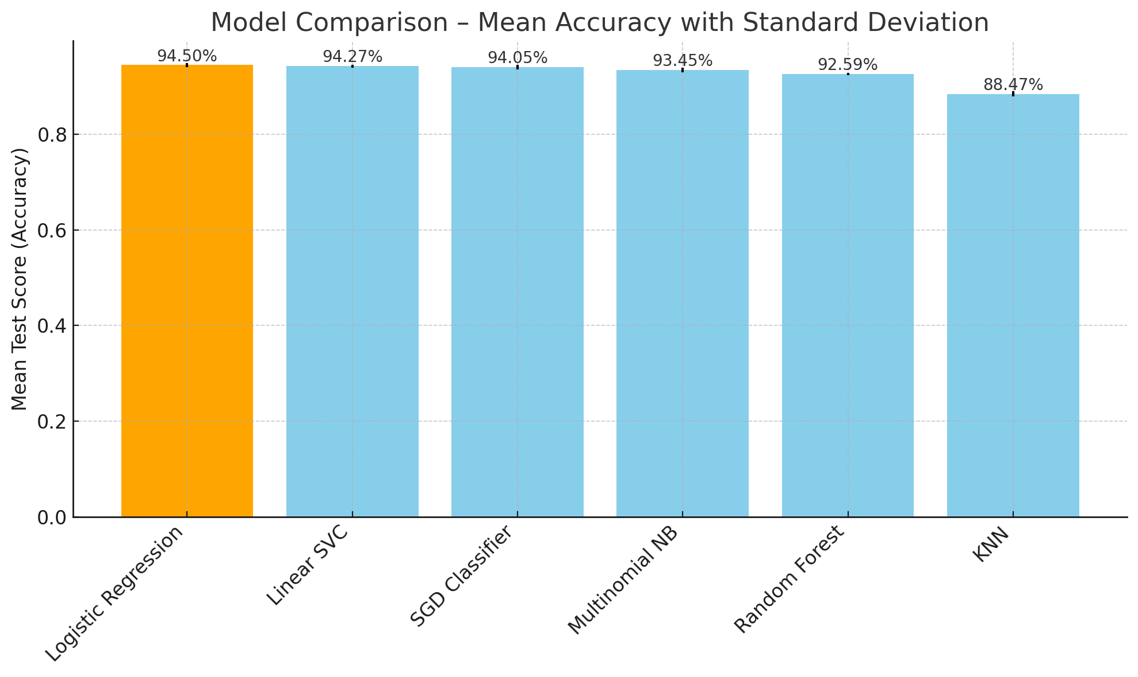
Classical Models Exploration
JD
Baseline: Logistic Regression with Stemming + CountVectorizer
Model Selection & Evaluation : GridSearchCV + TF- IDF
Notes:
2 or 3 points
One slide on the classical
One for the embedded

Slide 4
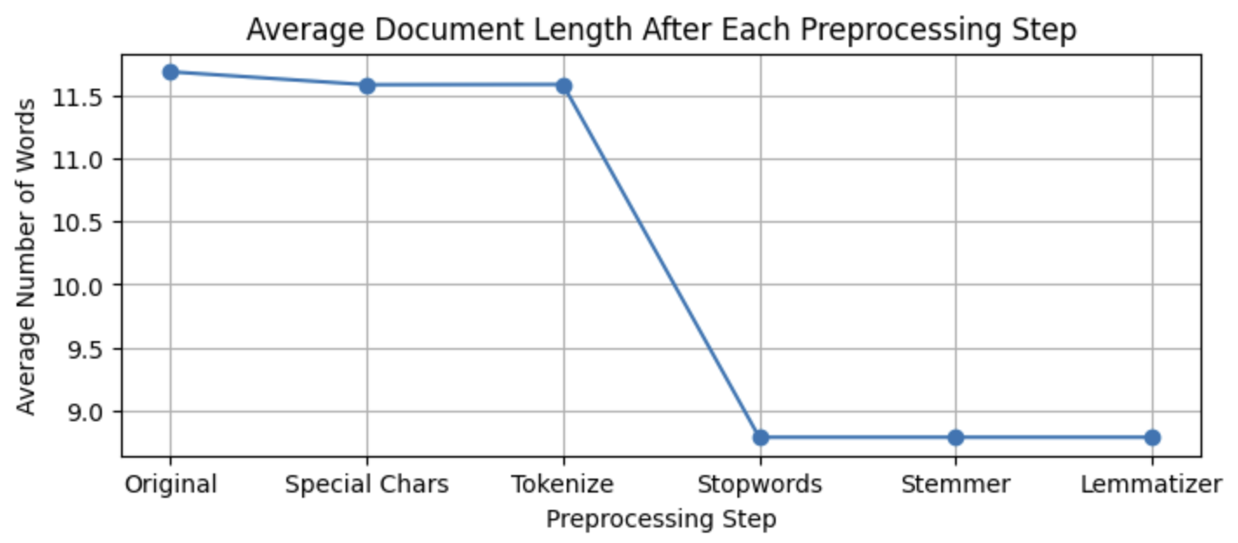
Preprocessing and Tuning
Mercy
Text Prepocessing | Feature Preprocessing
Text Structure Analyzation (Shape, Columns, Duplicates…) Text Normalization (Tokenize, Stopwords, Stemmetize, Lemmatize…) Data Augmentation (Text Synonyms) Hyperparameters (N-Gram range…) | Bag-of-Words (BoW) TF-IDF GloVe - word Embedding

Slide 5
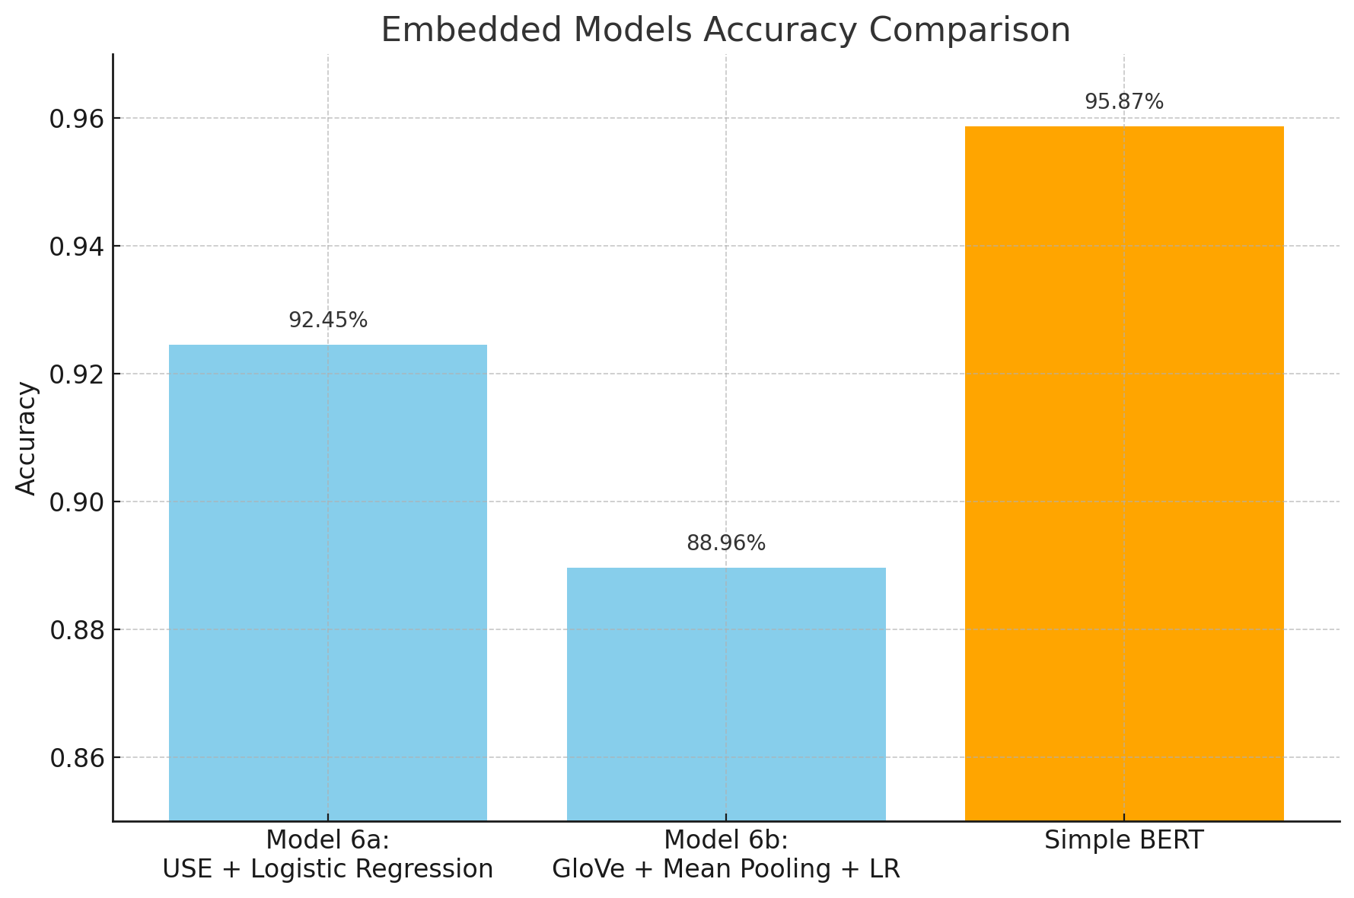
Embedded Models Exploration
JD
Model 6a : Universal Sentence Encoder for sentence-level semantics.
Model 6b : GloVe embeddings with mean pooling.
Simple BERT : Contextual embeddings with minimal preprocessing.

Slide 6
Methods (models) – 1 or 2 slides
JD
Explain the models you tried and why
Chart comparing them.
Try to capture subtleties but don’t make it too complicated.
For example, if a model didn’t improve with preprocessing then don’t include it. But if a model was very affected by preprocessing/hyperparameters then it’s interesting to see how
Notes:
2 or 3 points
One slide on the classical
One for the embedded

Slide 7
Testing vs Validation accuracy
Michael
Compare both numbers
If they are very different, explain why

Slide 8
Takeaways
Simple models can still perform well with proper tuning
Embeddings (BERT) bring performance at the cost of training time
Data cleaning was crucial: garbage in, garbage out
Learned to balance model performance, interpretability, and compute cost
Improve collaboration skills, version code with git and github, and structure an ML workflow (reusable functions)

Slide 9
Instructions
All team members must participate (either split the slides, or discuss the part that you did for each slide)
7 minutes for presentation (HARD limit) + 3 minutes for questions
Tip: Rehearse the presentation at least once
Submit: code + ppt + predictions csv on a github repo
Deadline: Friday 5pm. Presentations will start around that time so we have a 30-min buffer to account for technical issues
Each student must submit their own repo to the Ironhack portal
Group members may submit the same files – but each on their own repo

