Slide 1

Title slide
Group name and members

Slide 2
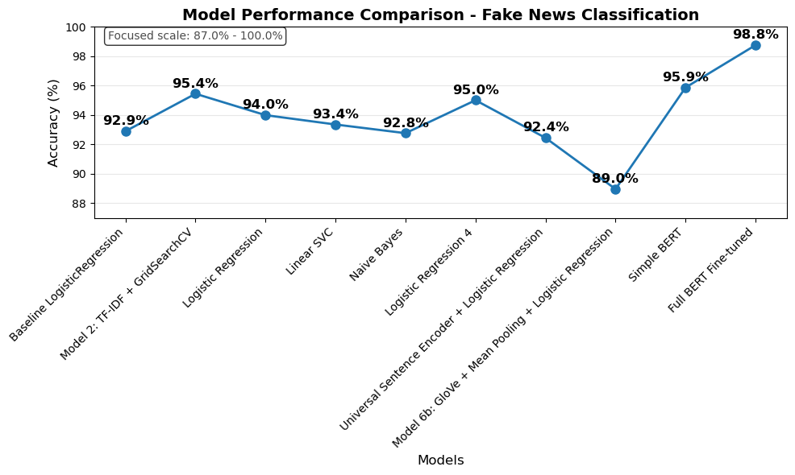
Executive summary
Final Result: 98.76% accuracy
Production-ready fake news detection
Model Performance:
Traditional ML: 95.4% (TF-IDF + GridSearchCV)
Simple BERT: 95.9% (frozen features)
Full BERT Fine-tuned: 98.8% (end-to-end training)
Key Breakthrough: Fine-tuning vs. feature extraction
Unfrozing all 109M BERT parameters for task-specific learning
+2.9% accuracy gain through end-to-end optimization
Bottom Line: BERT fine-tuning delivers state-of-the-art performance - the extra training investment pays off for production deployment

Slide 3
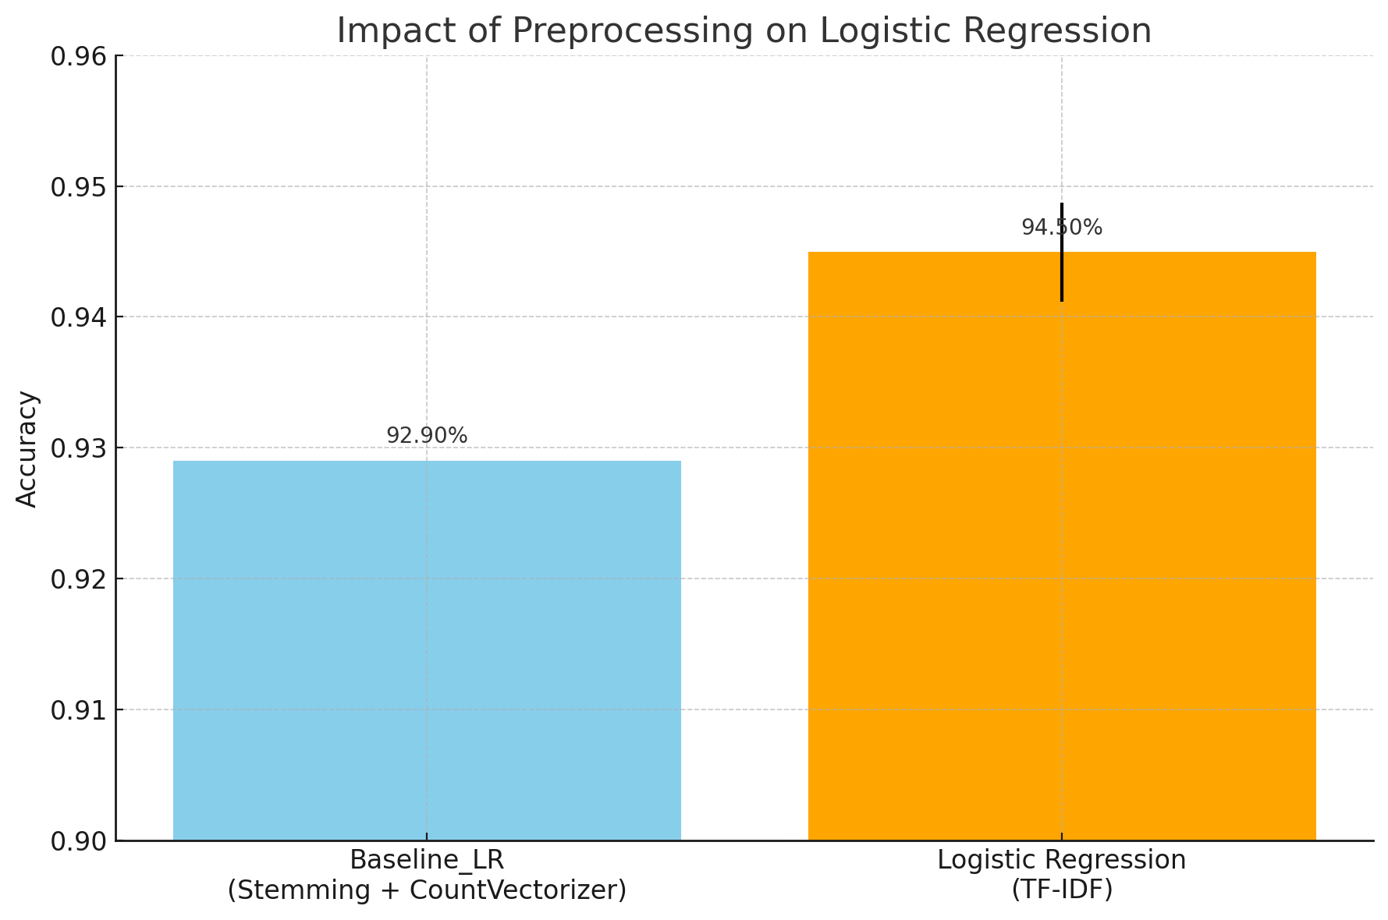
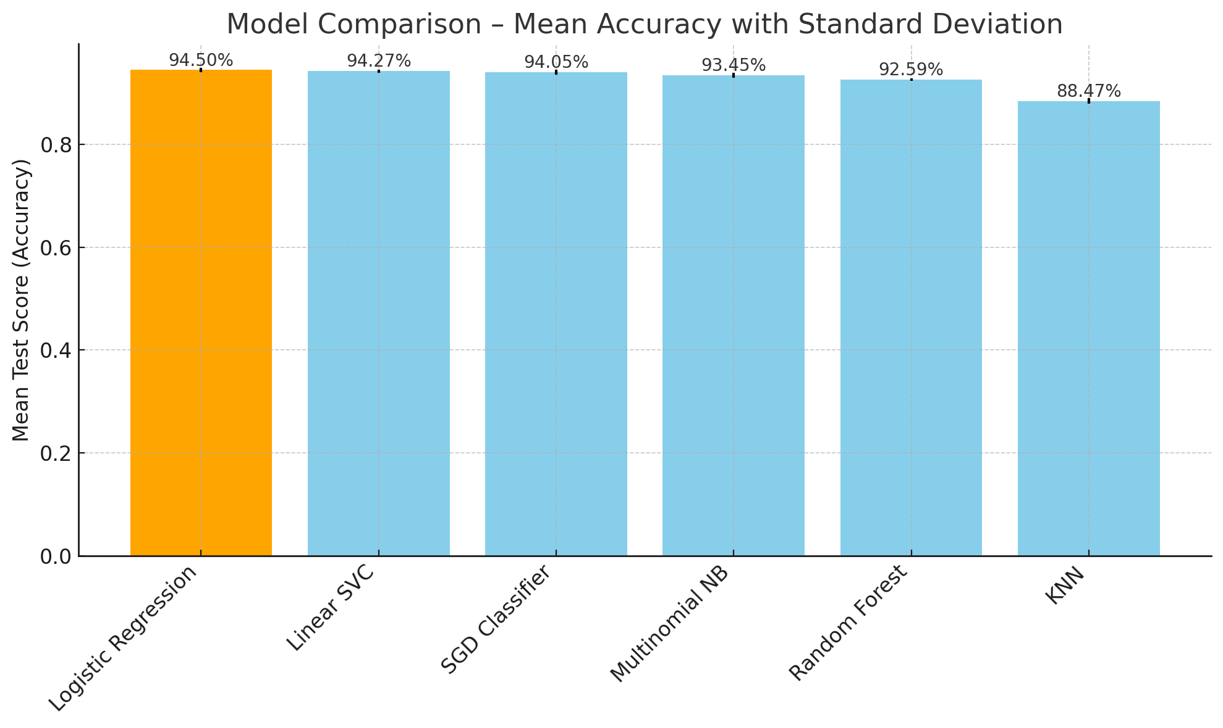
Classical Models Exploration
Baseline: Logistic Regression with Stemming + CountVectorizer
Model Selection & Evaluation : GridSearchCV + TF- IDF
Notes:
2 or 3 points
One slide on the classical
One for the embedded

Slide 4
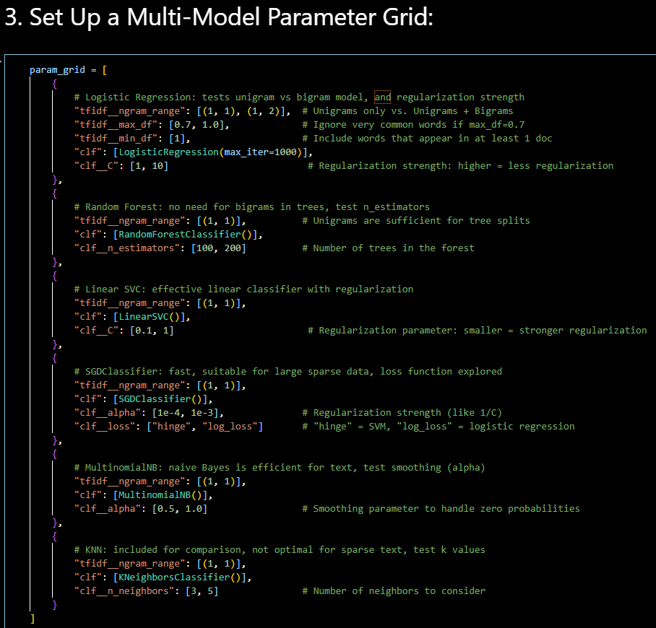
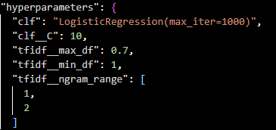
GridSearchCV parameters
Best Logistic Regression parameters:

Slide 5
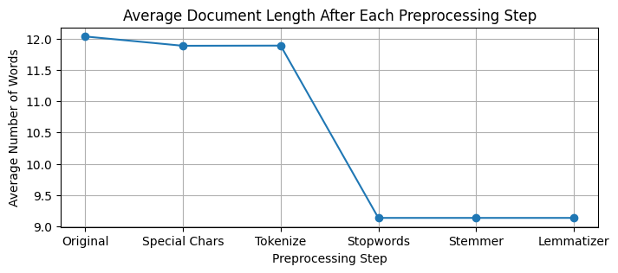
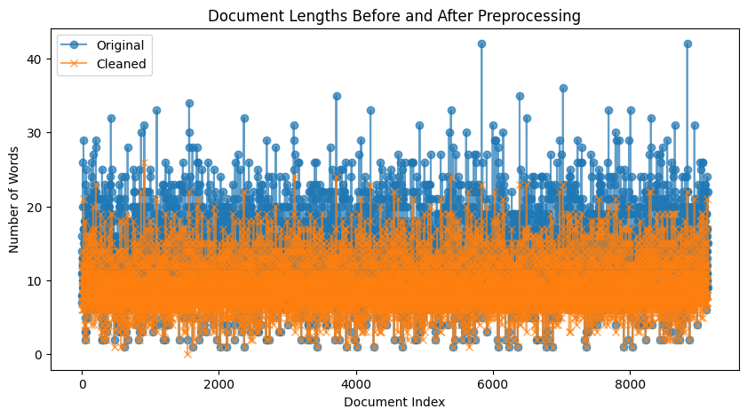
Preprocessing and Tuning
Text Prepocessing | Feature Preprocessing
Text Structure Analyzation (Shape, Columns, Duplicates…) Text Normalization (Tokenize, Stopwords, Stemmetize, Lemmatize…) Data Augmentation (Text Synonyms) Hyperparameters (N-Gram range…) | Bag-of-Words (BoW) TF-IDF GloVe - word Embedding

Slide 6
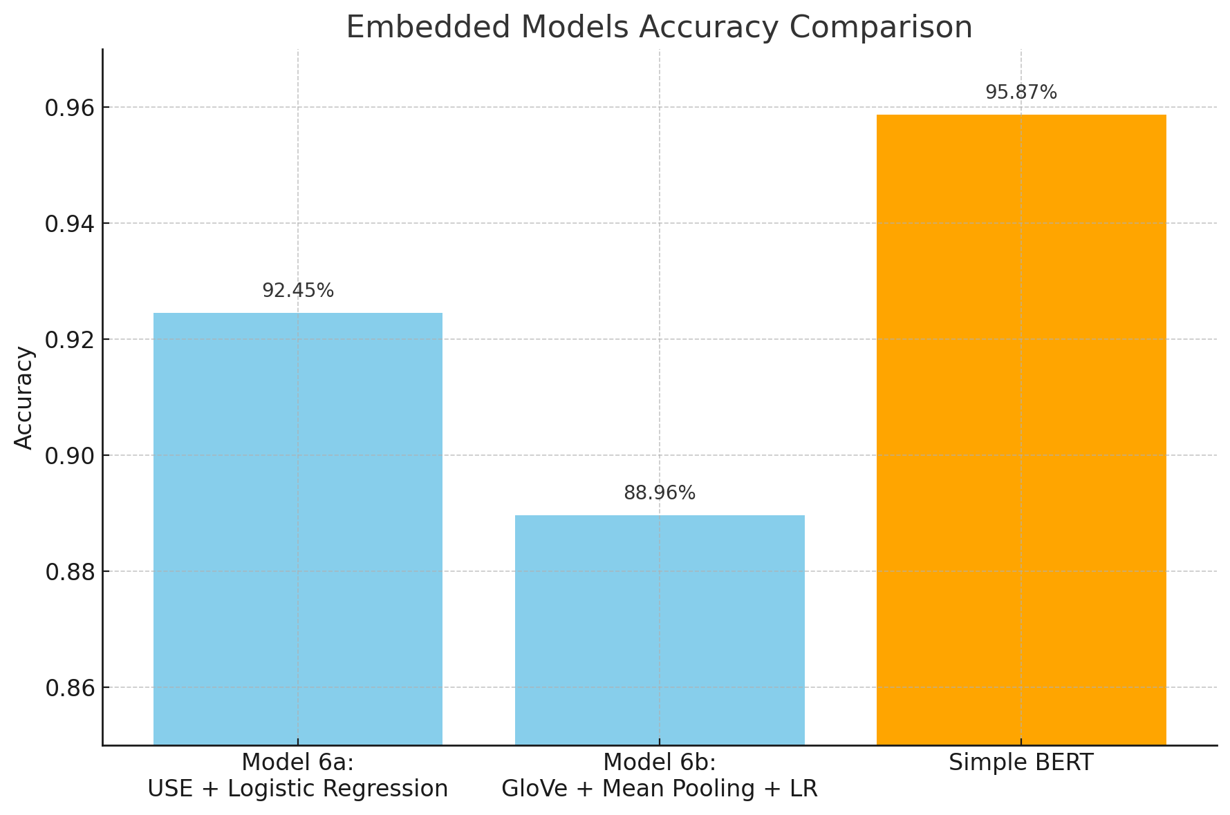
Embedded Models Exploration
Model 6a : Universal Sentence Encoder for sentence-level semantics.
Model 6b : GloVe embeddings with mean pooling.
Simple BERT : Contextual embeddings with minimal preprocessing.

Slide 7
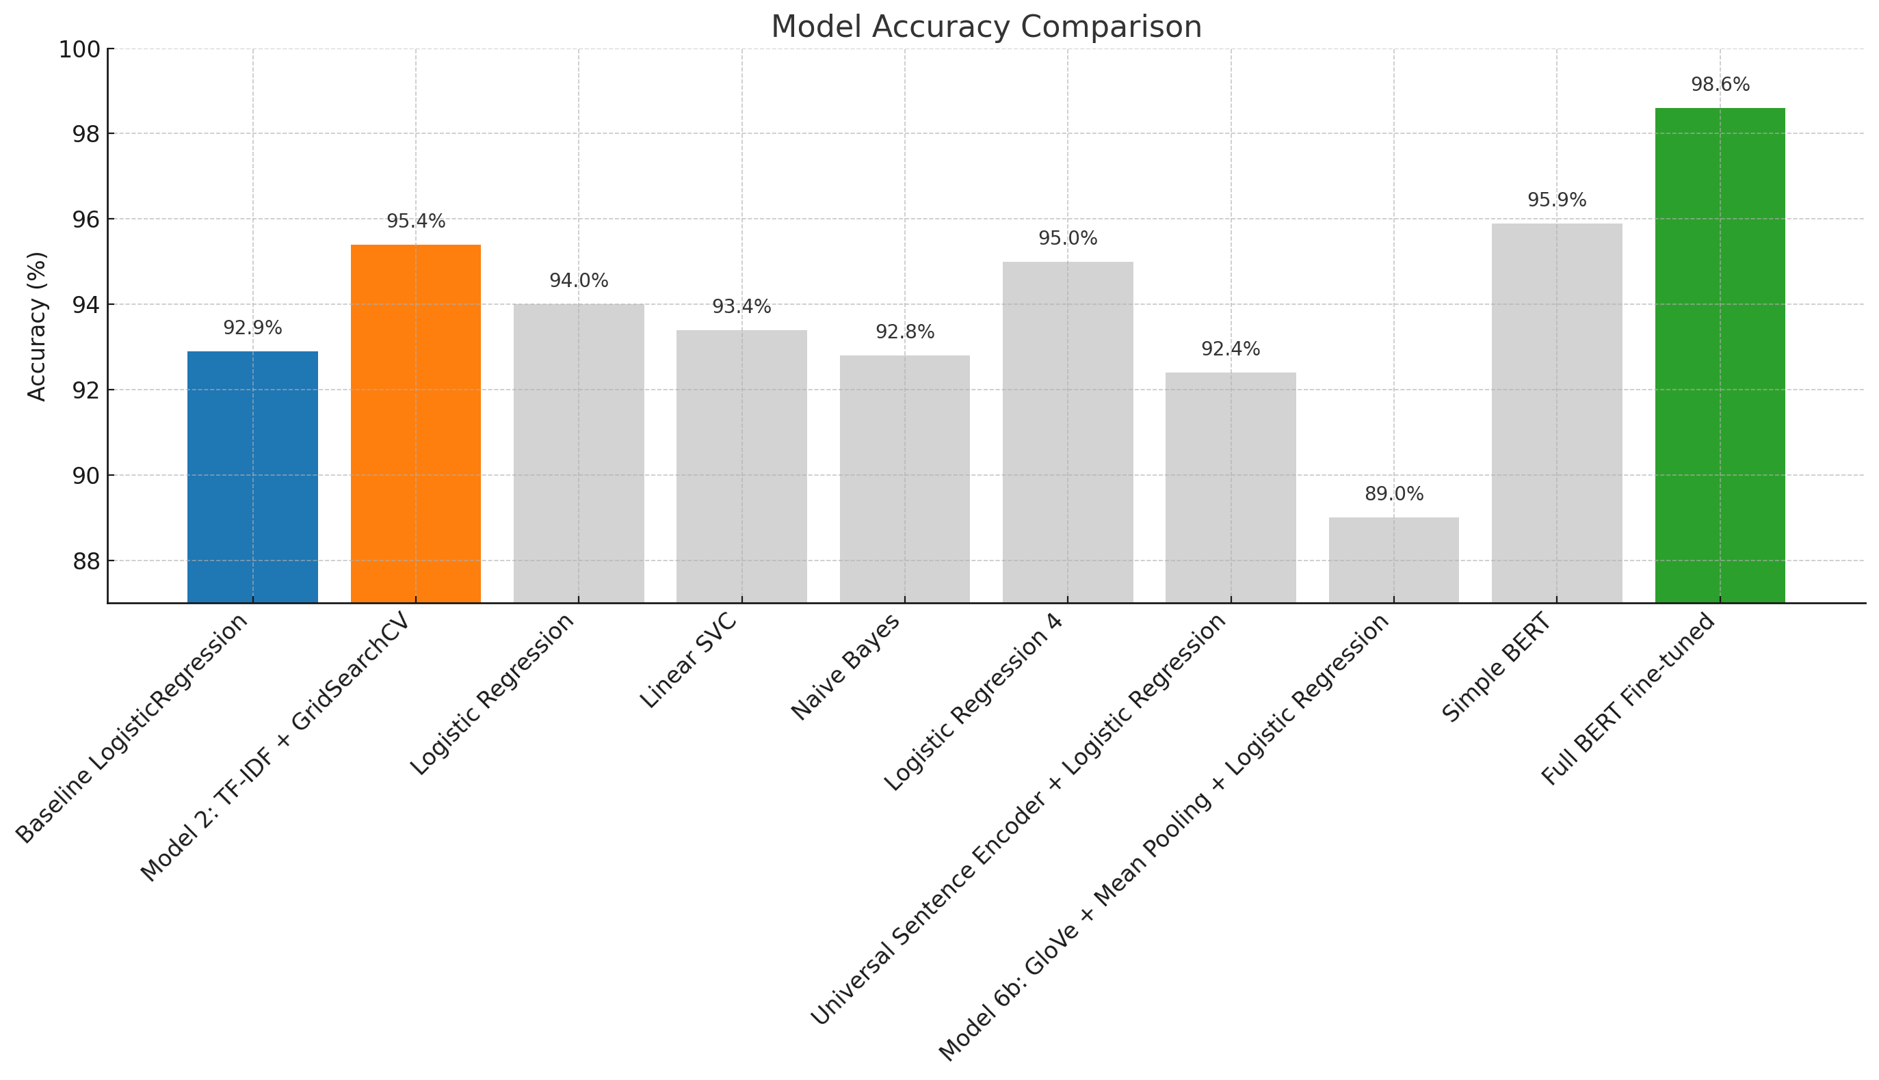
Deep Learning Breakthrough - Full BERT Model
Key Results & Why It Was Effective:
98.76% accuracy
Fine-tuning breakthrough
End-to-end learning
Contextual understanding
Whate Made the Big Jump from Simple BERT:
Unfroze BERT parameters
Task-specific adaptation
Gradient flow optimization
Training time investment

Slide 8
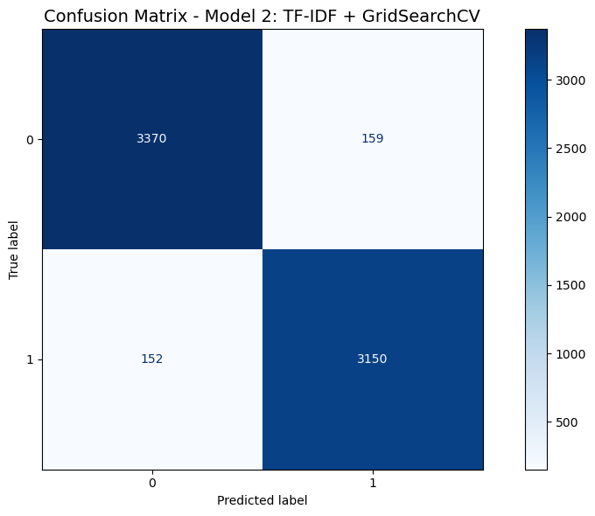
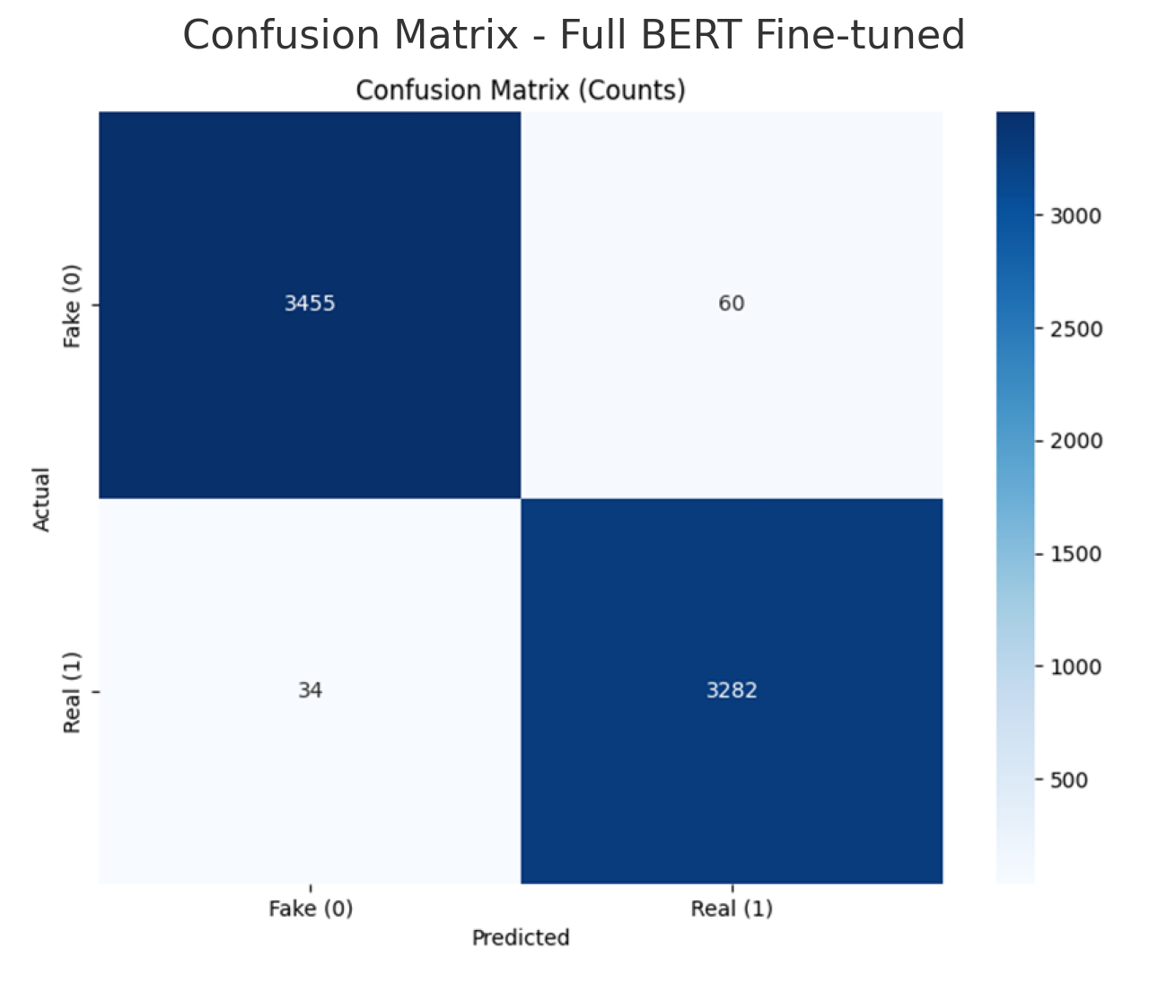
BERT Model Architecture & Learning
Bidirectional context
Attention mechanism
109M parameters
Fine-tuning approach

Slide 9
Takeaways
Simple models can still perform well with proper tuning
Embeddings (BERT) bring performance at the cost of training time
Data cleaning was crucial: garbage in, garbage out
Learned to balance model performance, interpretability, and compute cost
Improve collaboration skills, version code with git and github, and structure an ML workflow (reusable functions)
Thank you for listening

