Slide 1
Title slide
Group name and members

Slide 2
Executive summary
Michael
Final result (i.e. accuracy achieved)
Model used
Quick recap of alternatives considered
Other important methodology or considerations

Slide 3
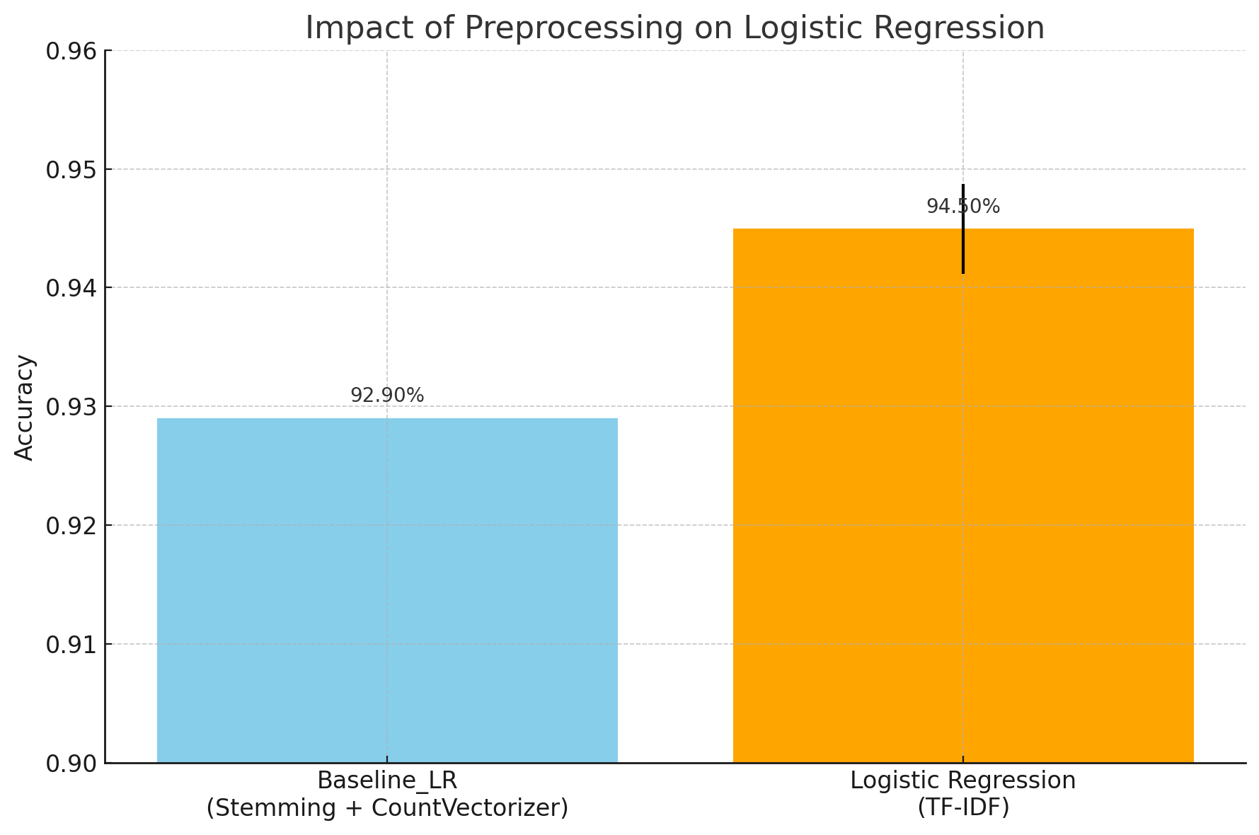
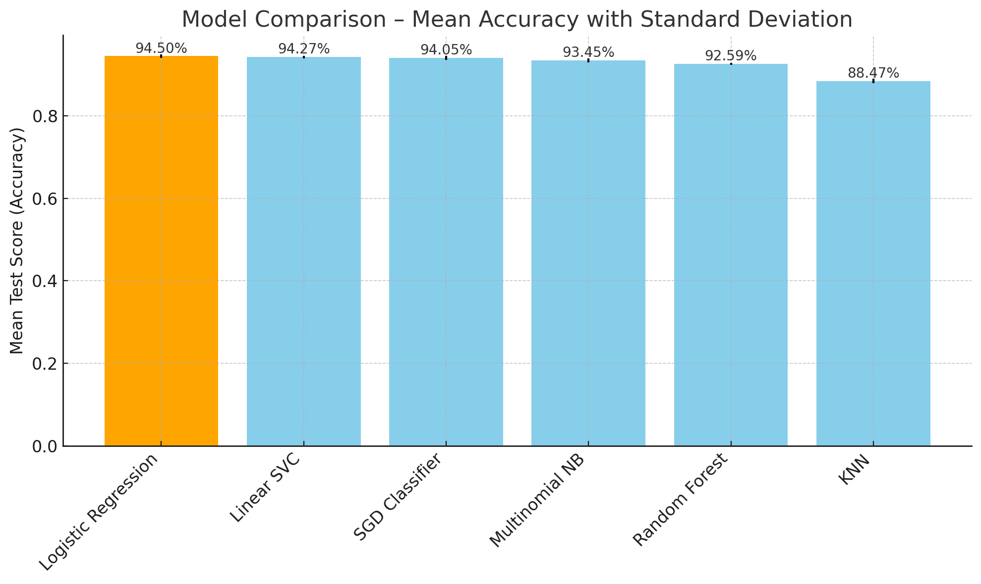
Classical Models Exploration
JD
Baseline: Logistic Regression with Stemming + CountVectorizer
Model Selection & Evaluation : GridSearchCV + TF- IDF
Notes:
2 or 3 points
One slide on the classical
One for the embedded

Slide 4
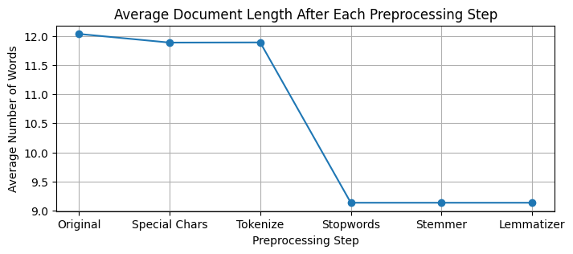
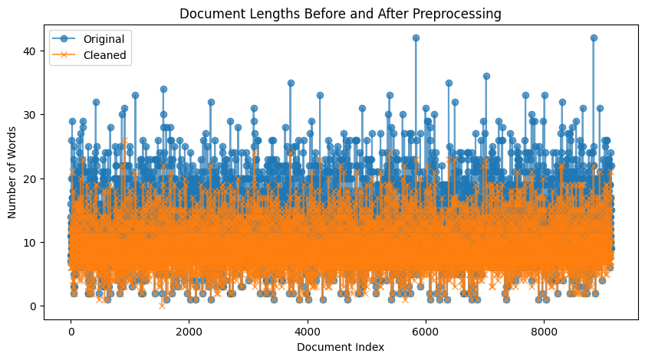
Preprocessing and Tuning
Mercy
Text Prepocessing | Feature Preprocessing
Text Structure Analyzation (Shape, Columns, Duplicates…) Text Normalization (Tokenize, Stopwords, Stemmetize, Lemmatize…) Data Augmentation (Text Synonyms) Hyperparameters (N-Gram range…) | Bag-of-Words (BoW) TF-IDF GloVe - word Embedding

Slide 5
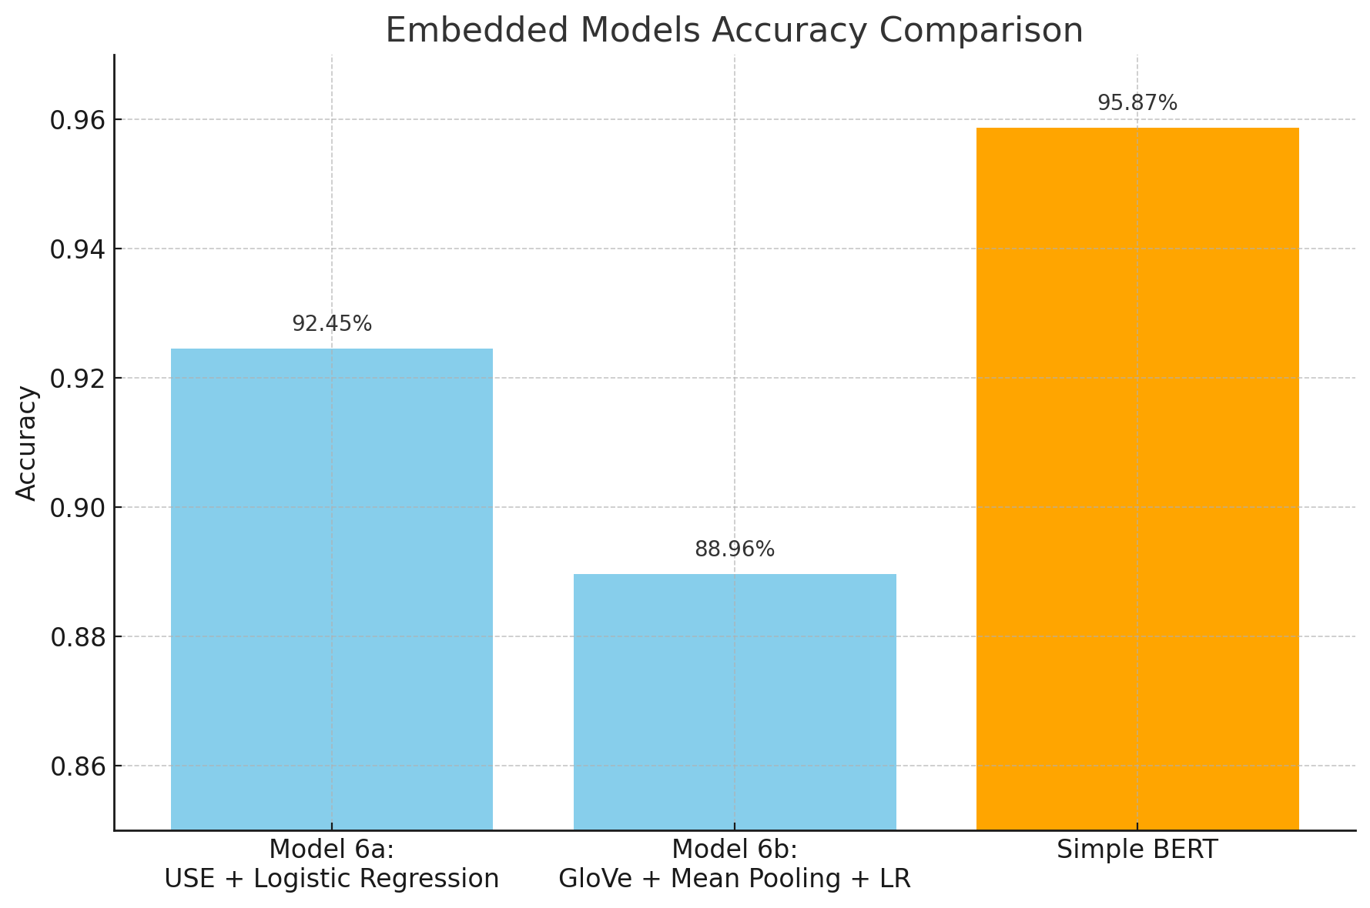
Embedded Models Exploration
JD
Model 6a : Universal Sentence Encoder for sentence-level semantics.
Model 6b : GloVe embeddings with mean pooling.
Simple BERT : Contextual embeddings with minimal preprocessing.

Slide 6
Methods (models) – 1 or 2 slides
JD
Explain the models you tried and why
Chart comparing them.
Try to capture subtleties but don’t make it too complicated.
For example, if a model didn’t improve with preprocessing then don’t include it. But if a model was very affected by preprocessing/hyperparameters then it’s interesting to see how
Notes:
2 or 3 points
One slide on the classical
One for the embedded

Slide 7
Testing vs Validation accuracy
Michael
Compare both numbers
If they are very different, explain why

Slide 8
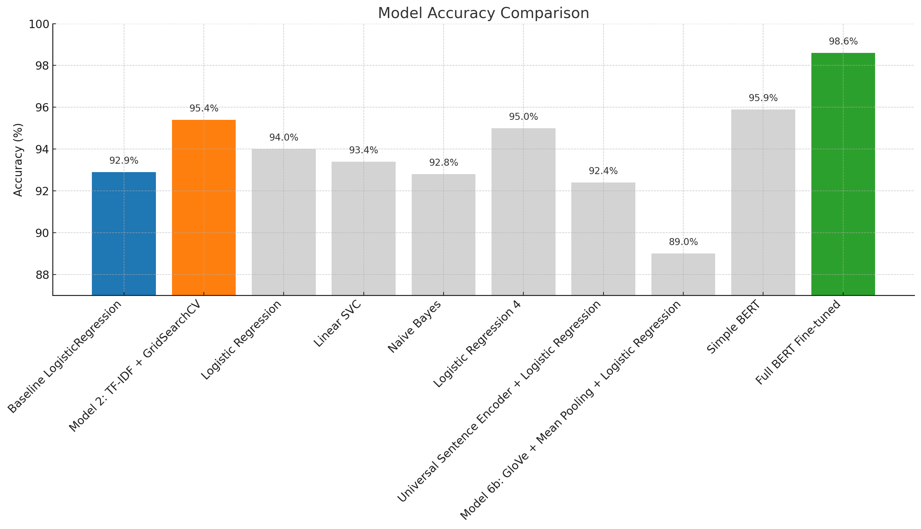

Slide 9
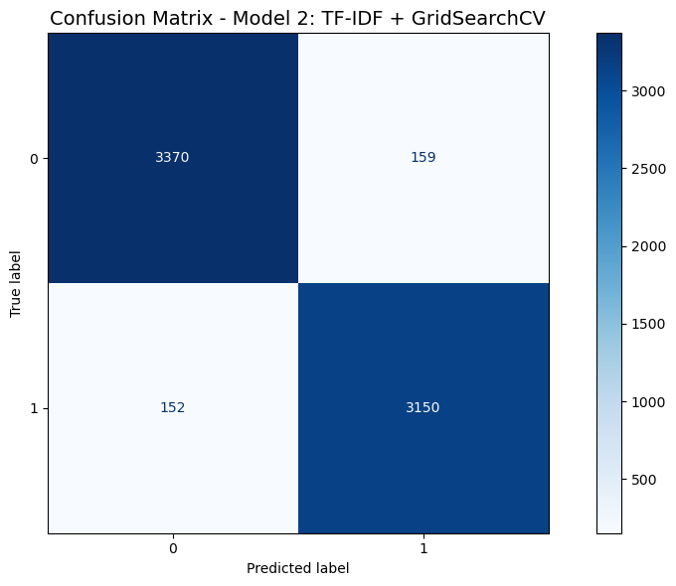
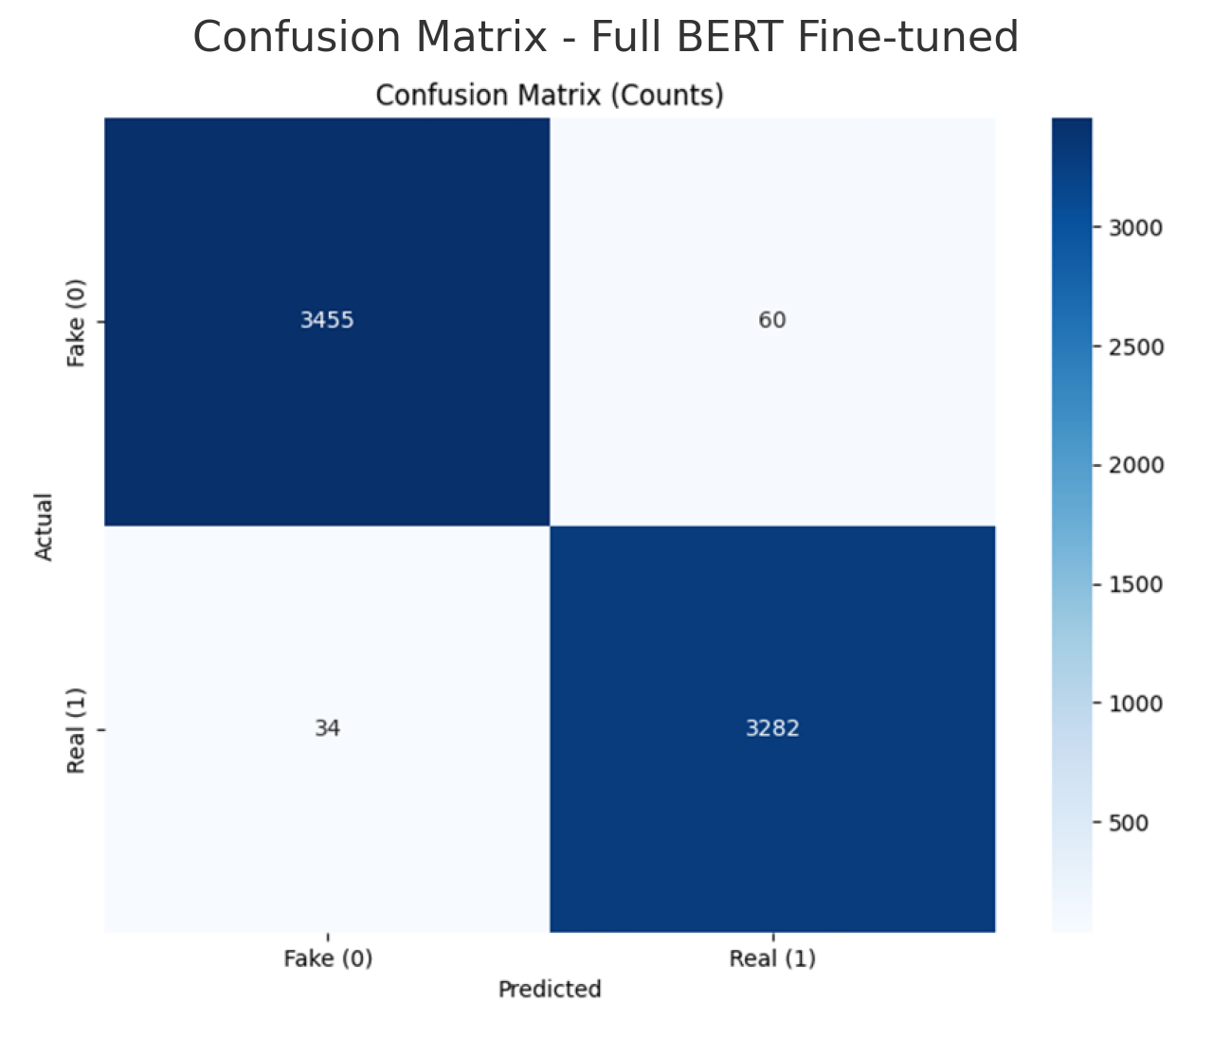
Confusion matrix comparison between GridSearchCV LR and Full BERT

Slide 10
Takeaways
Simple models can still perform well with proper tuning
Embeddings (BERT) bring performance at the cost of training time
Data cleaning was crucial: garbage in, garbage out
Learned to balance model performance, interpretability, and compute cost
Improve collaboration skills, version code with git and github, and structure an ML workflow (reusable functions)

Slide 11
Instructions
All team members must participate (either split the slides, or discuss the part that you did for each slide)
7 minutes for presentation (HARD limit) + 3 minutes for questions
Tip: Rehearse the presentation at least once
Submit: code + ppt + predictions csv on a github repo
Deadline: Friday 5pm. Presentations will start around that time so we have a 30-min buffer to account for technical issues
Each student must submit their own repo to the Ironhack portal
Group members may submit the same files – but each on their own repo

