Slide 1
Evaluation and Generalization of Capsule Networks in Neurorobotics
Master’s Thesis in Robotics, Cognition, Intelligence
Jean Elsner
Submission Date 29 November 2018

Slide 2
Table of Contents
Motivation of Capsule Network Architecture
Formalizing Generalization
Dataset Generation
Results

Slide 3
Limitations of Deep Learning
Convolutional neural networks (CNNs) are the current state-of-the-art deep learning approach in computer vision. They do however suffer several drawbacks that limit their use especially in real-time applications (robotics).
Invariant only to variations in position, not affine transformations in general
Training artificial neural networks is computationally very expensive and can take several days or even weeks
High latency during inference, high energy requirements limit mobile/real-time applications
Creation of large labelled datasets necessary, covering all variations in lighting, color, viewpoints etc.

Slide 4
Limitations of Deep Learning
Convolutional neural networks (CNNs) are the current state-of-the-art deep learning approach in computer vision. They do however suffer several drawbacks that limit their use especially in real-time applications (robotics).
Invariant only to variations in position, not affine transformations in general
Training artificial neural networks is computationally very expensive and can take several days or even weeks
High latency during inference, high energy requirements limit mobile/real-time applications
Creation of large labelled datasets necessary, covering all variations in lighting, color, viewpoints etc.
Capsule networks are proposed to tackle two of these issues by learning a specific representation!

Slide 5
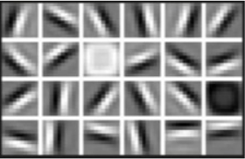
Capsule
A capsule is conceived as a group of neurons – a state vector (or matrix) and an activation. Every capsule represents a feature whose instantiation parameters and probability of being present are encoded in the state vector and activation respectively.
Instantiation Parameters
The coordinates of a specific instance of an object on the appearance manifold. For a simple object like an edge, this could be orientation, strength, etc. For more complex objects these can be pose, lighting, occlusion and many more.
State Matrix
=
Capsule
Activation Logit
First layer kernels as learned by a CNN

Slide 6
Routing between Capsules
Assuming a layer of capsules already extracted their activation and state from pixel intensities, a routing algorithm can be designed to propagate the signal in a capsule network based on agreement.
Capsules in the lower layer cast votes about what they expect the state of the capsules in the higher level to be, based on their own state
The more capsules agree about a higher capsule’s state the higher its activation
States of higher capsules are computed based on the average votes they received

Slide 7
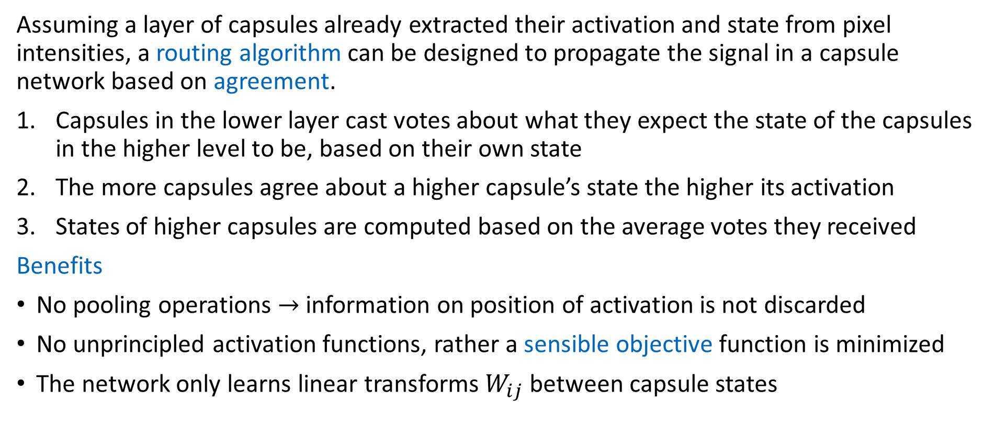
Routing between Capsules
Assuming a layer of capsules already extracted their activation and state from pixel intensities, a routing algorithm can be designed to propagate the signal in a capsule network based on agreement.
Capsules in the lower layer cast votes about what they expect the state of the capsules in the higher level to be, based on their own state
The more capsules agree about a higher capsule’s state the higher its activation
States of higher capsules are computed based on the average votes they received
Benefits
No pooling operations $→$ information on position of activation is not discarded
No unprincipled activation functions, rather a sensible objective function is minimized
The network only learns linear transforms $W_{ij}$ between capsule states

Slide 8
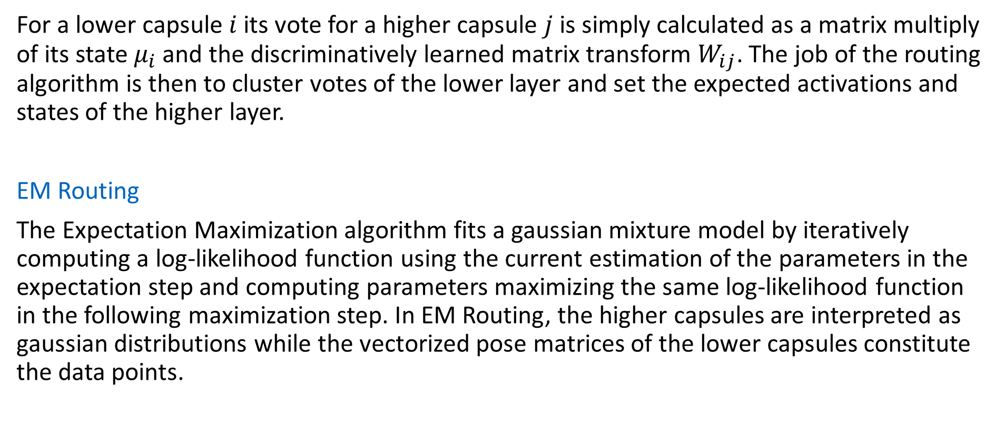
Routing between Capsules
For a lower capsule $i$ its vote for a higher capsule $j$ is simply calculated as a matrix multiply of its state $μ_{i}$ and the discriminatively learned matrix transform $W_{ij}$. The job of the routing algorithm is then to cluster votes of the lower layer and set the expected activations and states of the higher layer.
EM Routing
The Expectation Maximization algorithm fits a gaussian mixture model by iteratively computing a log-likelihood function using the current estimation of the parameters in the expectation step and computing parameters maximizing the same log-likelihood function in the following maximization step. In EM Routing, the higher capsules are interpreted as gaussian distributions while the vectorized pose matrices of the lower capsules constitute the data points.

Slide 9
Pipeline Architecture
Odometry Pipeline
2D Features
Feature Extractor
Feature Tracker
3D Point Cloud
Triangulation
Pose Estimation
Optimization
Bundle Adjustment
Outlier Detection

Slide 10
Pipeline Architecture
The Odometry Pipeline takes a series of calibrated images from the KITTI database and reconstructs the camera poses. To this end, a pair of images is used to triangulate a set of 3D points (initialization) and the main odometry loop is run.
Feature Tracking
Pose Estimation
Removal of bad points
Triangulation of new points
Bundle Adjustment
The main loop consists of these steps:
2D Features are tracked to the next frame
2D-3D correspondences are used to solve the Perspective-n-Point (PnP) problem
New 3D points are triangulated when necessary, while outliers are removed
Bundle Adjustment may be performed to further optimize camera poses and 3D points

Slide 11
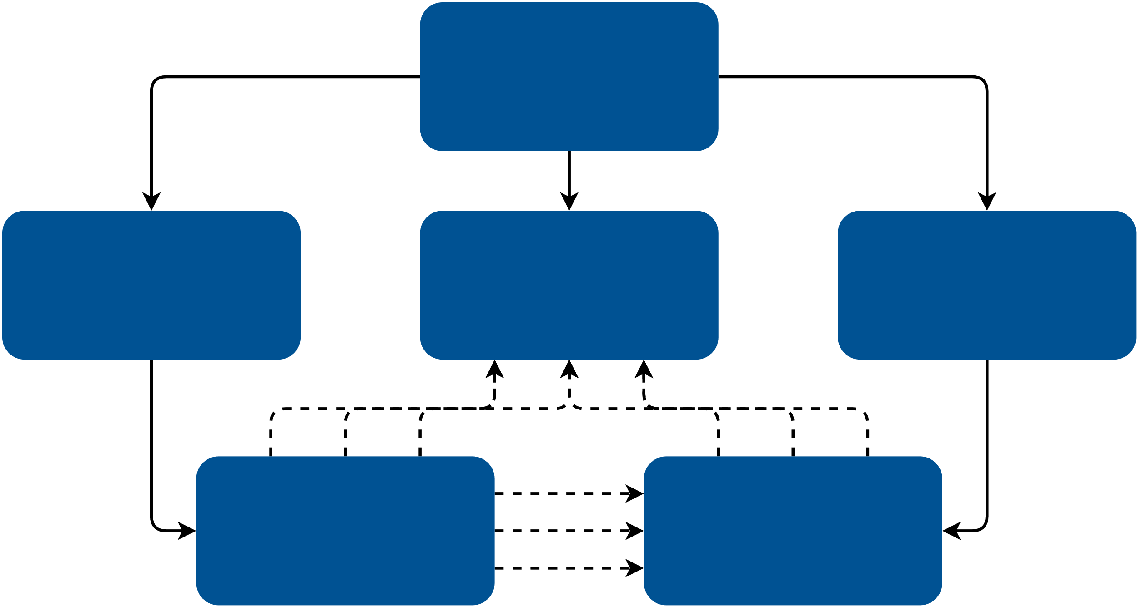




Pipeline Architecture
Shared Pointer
Weak Pointer
Odometry Pipeline
$${\text{Frame}}_{i}$$
3D Points
$${\text{Frame}}_{i+1}$$
$$\text{2}\text{D} \text{Features} \\ \text{in} {\text{Frame}}_{i}$$
$$\text{2}\text{D} \text{Features} \\ \text{in} {\text{Frame}}_{i+1}$$

Slide 12
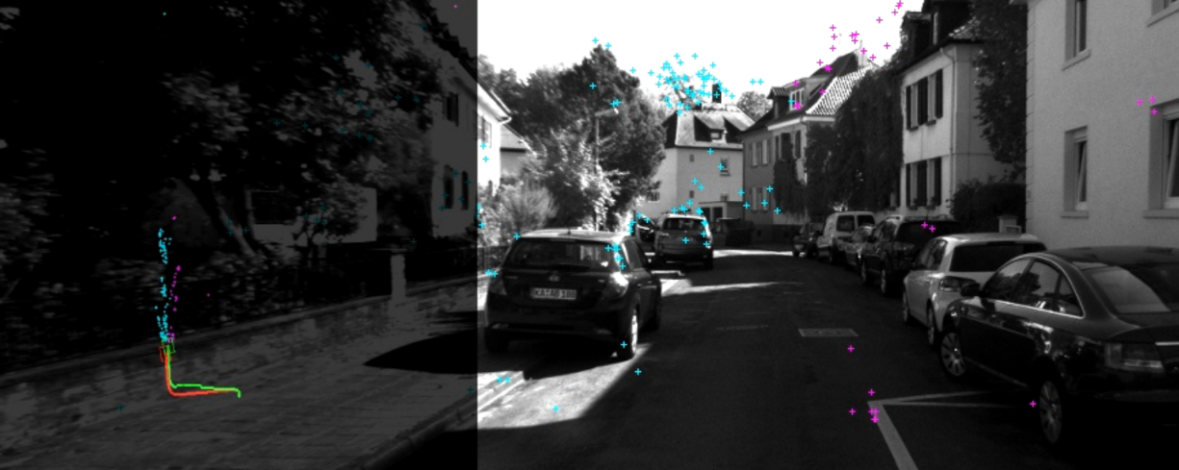
Pipeline Architecture
The reconstructed trajectory is rendered next to the ground truth and written to a video file. Additionally the 3D point cloud can be viewed within the application.
Notable aspects of the architecture include:
Configurability: many of the pipeline’s settings can be fine tuned in an external configuration file
Modularity: several main components may be switched out, alternative implementations are available
Multithreading: Feature extraction and matching is separated from pose estimation and optimization
Screenshot of video produced by Odometry Pipeline

Slide 13


Pipeline Architecture
The Odometry Pipeline is implemented in C++ and uses several open source libraries. OpenCV is used for general image processing, 2D feature extraction and tracking, pose estimation and video production. Optimization through bundle adjustment is achieved with Ceres Solver. Finally, Dlib is utilized for its 3D point cloud viewer as well as multithreading tools.
Ceres Solver

Slide 14
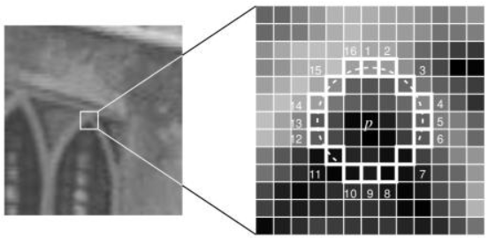
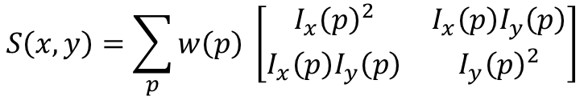

Feature Extraction and Tracking
The robust extraction of invariant points of interest is the corner stone of the Odometry pipeline. Within the architecture, different modules for 2D feature extraction are available.
ShiTomasiFeatureExtractor
Corner detector that selects local maxima in variation in all directions. Candidates are calculated using the Eigenvalues of the pixel‘s structural tensor [1].
OpenCVGoodFeatureExtractor
OpenCV based corner detector similar to the implementation above. Uses heuristic corner response measure instead of calculating Eigenvalues [2].
OpenCVFASTFeatureExtractor
Machine learning based. Checks pixels on a circle around the point of interest [3].
Structural tensor
$$S\left(x,y\right)=\sum_{p}{w\left(p\right)} \left[\begin{matrix}I_{x}{\left(p\right)}^{2} & I_{x}\left(p\right)I_{y}\left(p\right) \\ I_{x}\left(p\right)I_{y}\left(p\right) & I_{y}{\left(p\right)}^{2}\end{matrix}\right]$$
Corner response measure
$$R=\det{M}−k{\left(\text{trace} M\right)}^{2}$$
FAST (Features from Accelerated Segment Test) algorithm, from Rosten 2006

Slide 15
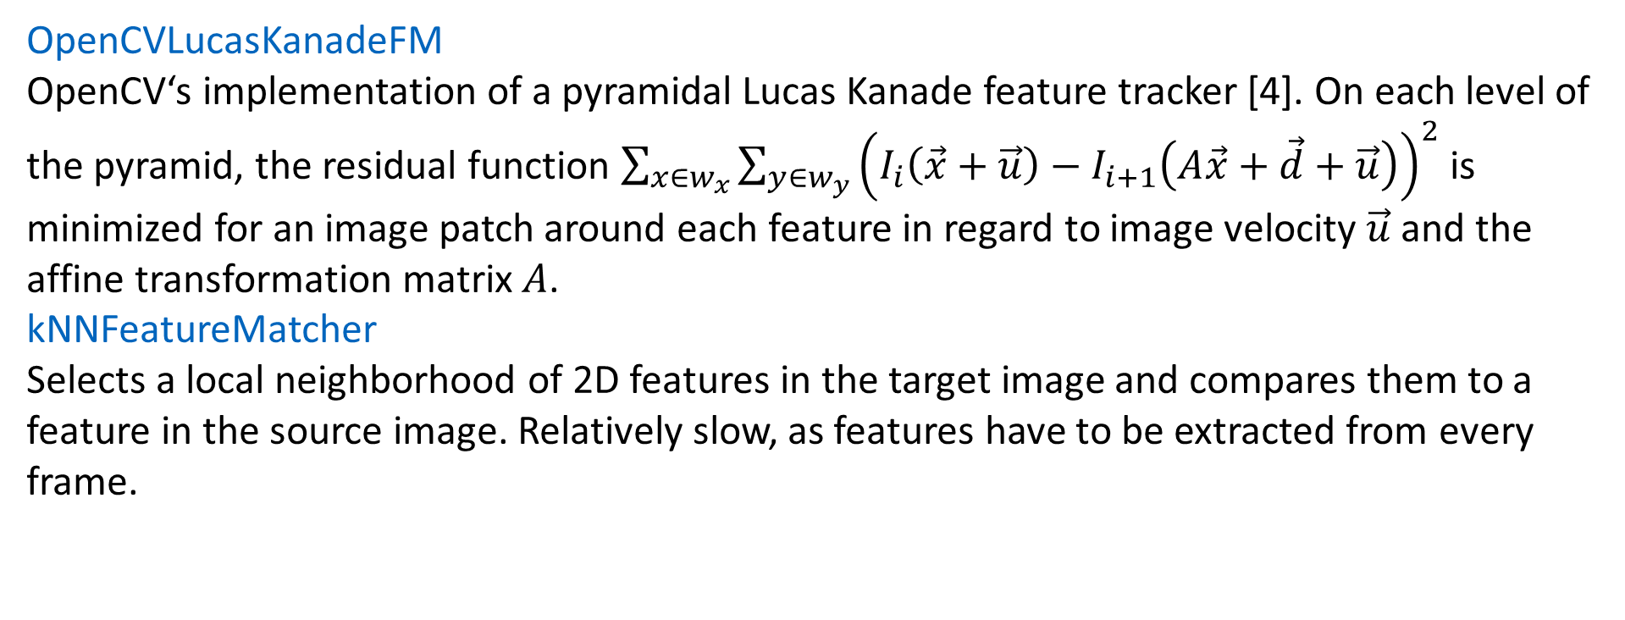
Feature Extraction and Tracking
Features need to be tracked between frames in order to perform pose estimation or triangulation of new 3D points.
OpenCVLucasKanadeFM
OpenCV‘s implementation of a pyramidal Lucas Kanade feature tracker [4]. On each level of the pyramid, the residual function $\sum_{x∈w_{x}}{{\sum_{y∈w_{y}}{\left(I_{i}\left(\vec{x}+\vec{u}\right)−I_{i+1}\left(A\vec{x}+\vec{d}+\vec{u}\right)\right)}}^{2}}$ is minimized for an image patch around each feature in regard to image velocity $\vec{u}$ and the affine transformation matrix $A$.
kNNFeatureMatcher
Selects a local neighborhood of 2D features in the target image and compares them to a feature in the source image. Relatively slow, as features have to be extracted from every frame.

Slide 16
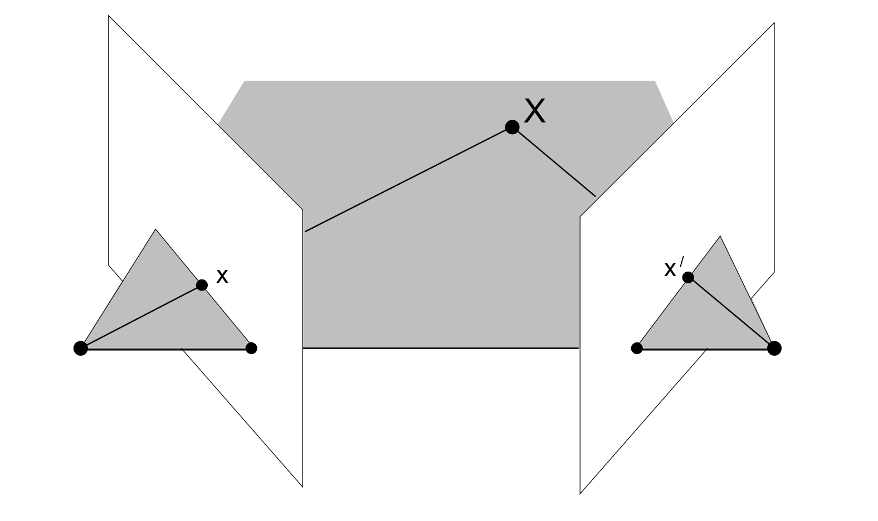
Triangulation and Pose Estimation
Both during initialization and whenever the number of seen 3D points drops below a threshold, new 3D points need to be triangulated given 2D-2D correspondences between frames.
OpenCVFivePointTri
This module uses OpenCV‘s implementation of a five-point algorithm [6] to determine the essential matrix for 2D-2D correspondences between two frames. Given the relative poses of the cameras, 3D points can be triangulated as an intersection of two lines, as seen to the right.
Triangulation of image point correspondences [5]

Slide 17
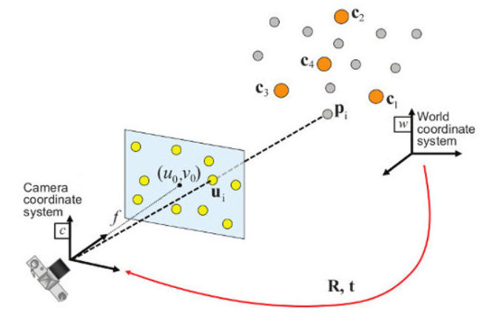
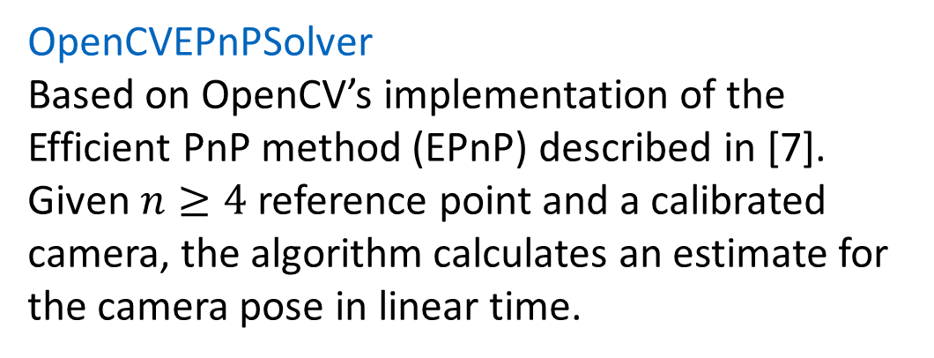
Triangulation and Pose Estimation
After initialization, feature tracking will provide 2D-3D correspondences for each frame, that can be used to estimate the pose of the camera (Perspective-n-Point problem).
OpenCVEPnPSolver
Based on OpenCV’s implementation of the Efficient PnP method (EPnP) described in [7]. Given $n≥4$ reference point and a calibrated camera, the algorithm calculates an estimate for the camera pose in linear time.
Perspective-n-Point problem, as illustrated in the OpenCV documentation [8]

Slide 18
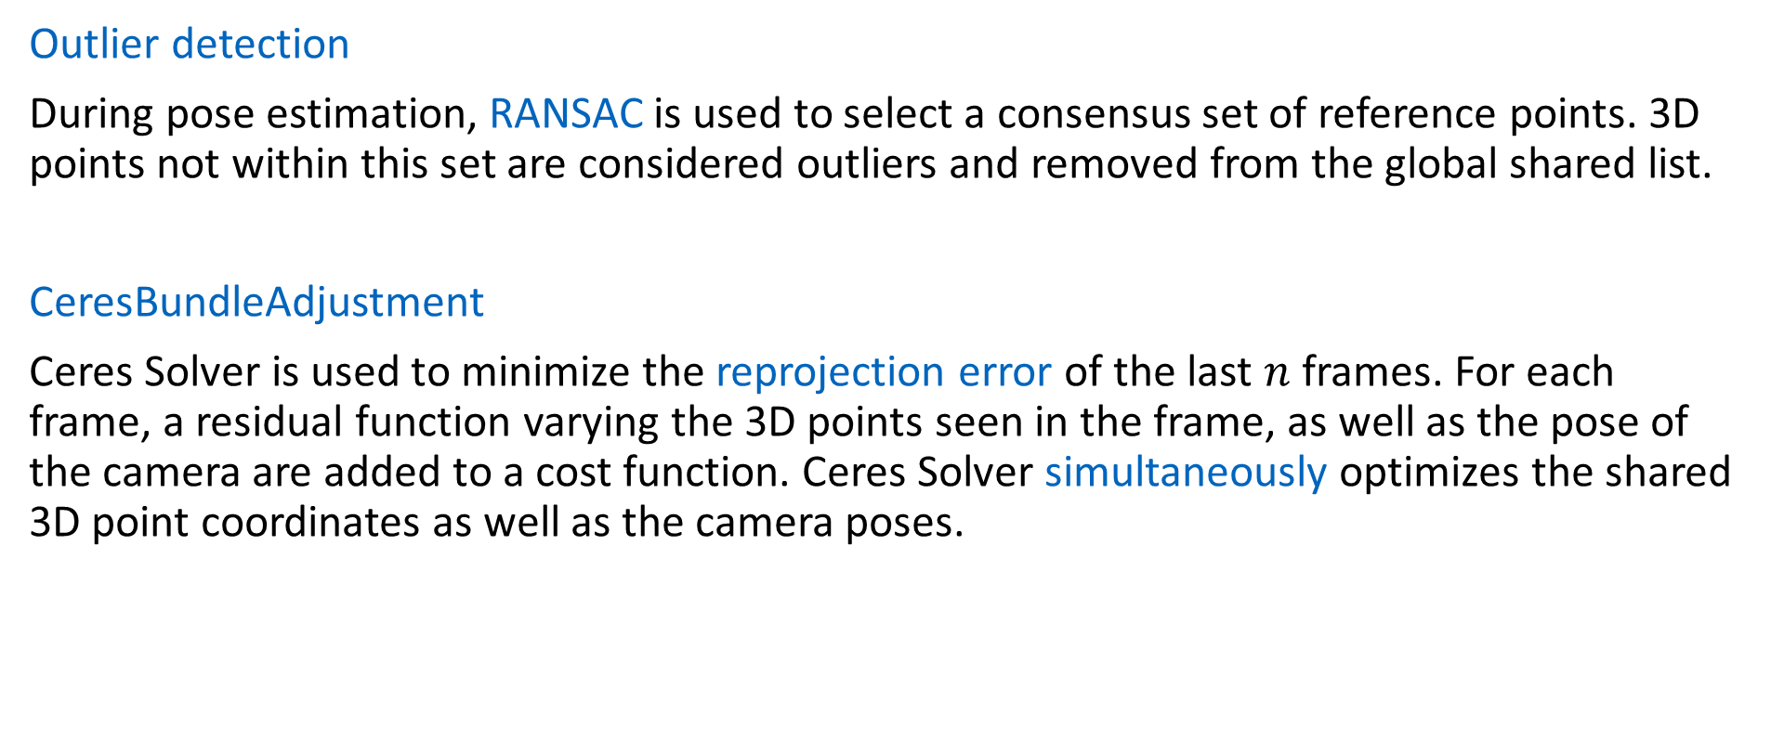
Bundle Adjustment and Optimizations
Outlier detection
During pose estimation, RANSAC is used to select a consensus set of reference points. 3D points not within this set are considered outliers and removed from the global shared list.
CeresBundleAdjustment
Ceres Solver is used to minimize the reprojection error of the last $n$ frames. For each frame, a residual function varying the 3D points seen in the frame, as well as the pose of the camera are added to a cost function. Ceres Solver simultaneously optimizes the shared 3D point coordinates as well as the camera poses.

Slide 19
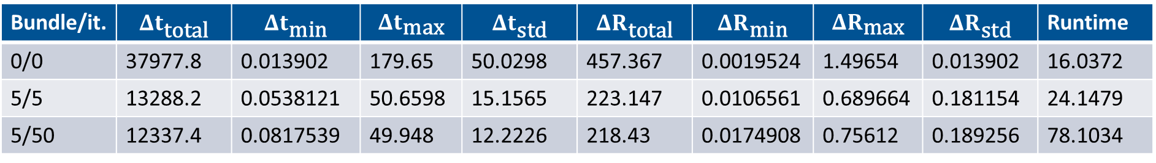
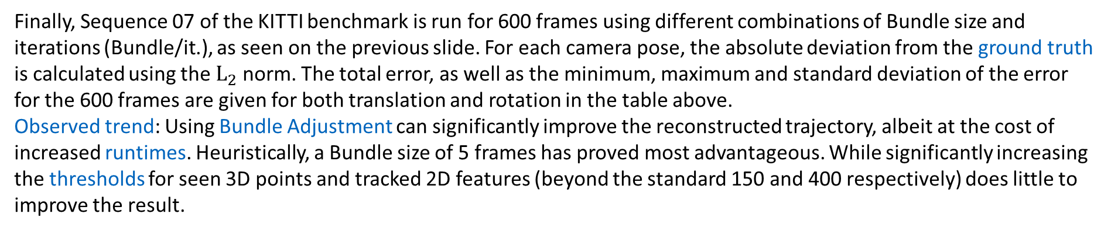
Conclusion
Bundle/it. | $$Δt_{\text{total}}$$ | $$Δt_{\text{min}}$$ | $$Δt_{\text{max}}$$ | $$Δt_{\text{std}}$$ | $$ΔR_{\text{total}}$$ | $$ΔR_{\text{min}}$$ | $$ΔR_{\text{max}}$$ | $$ΔR_{\text{std}}$$ | Runtime
0/0 | 37977.8 | 0.013902 | 179.65 | 50.0298 | 457.367 | 0.0019524 | 1.49654 | 0.013902 | 16.0372
5/5 | 13288.2 | 0.0538121 | 50.6598 | 15.1565 | 223.147 | 0.0106561 | 0.689664 | 0.181154 | 24.1479
5/50 | 12337.4 | 0.0817539 | 49.948 | 12.2226 | 218.43 | 0.0174908 | 0.75612 | 0.189256 | 78.1034
Finally, Sequence 07 of the KITTI benchmark is run for 600 frames using different combinations of Bundle size and iterations (Bundle/it.), as seen on the previous slide. For each camera pose, the absolute deviation from the ground truth is calculated using the ${\text{L}}_{2}$ norm. The total error, as well as the minimum, maximum and standard deviation of the error for the 600 frames are given for both translation and rotation in the table above.
Observed trend: Using Bundle Adjustment can significantly improve the reconstructed trajectory, albeit at the cost of increased runtimes. Heuristically, a Bundle size of 5 frames has proved most advantageous. While significantly increasing the thresholds for seen 3D points and tracked 2D features (beyond the standard 150 and 400 respectively) does little to improve the result.

Slide 20
Conclusion
YouTube Channel
Including videos running with different settings and during different stages of development
https://www.youtube.com/channel/UC1qMUwRQFM96uWErU2Avc1g
GitHub Repository
Full source code and instruction for compilation available on GitHub
https://github.com/JeanElsner/practical-multi-view

Slide 21
Conclusion
References
[1] J. Shi and C. Tomasi. Good Features to Track. 9th IEEE Conference on Computer Vision and Pattern Recognition, 1994.
[2] C. Harris and M. Stephens. A Combined Corner and Edge Detector. Proceedings of the 4th Alvey Vision Conference, 147–151, 1988.
[3] E. Rosten and T. Drummond. Machine Learning for High-Speed Corner Detection. Computer Vision–ECCV 2006, 430–443, 2006.
[4] Jean-Yves Bouguet. Pyramidal Implementation of the Affine Lucas Kanade Feature Tracker. Intel Corporation, 5, 2001.
[5] R.Hartley and A. Zisserman. Multiple View Geometry in Computer Vision. Cambridge University Press, 2004.
[6] David Nistér. An Efficient Solution to the Five-Point Relative Pose Problem. Pattern Analysis and Machine Intelligence, IEEE Transactions on, 26(6):756–770, 2004.
[7] V. Lepetit and F. Moreno-Noguer and P. Fua. EPnP: An Accurate O(n) Solution to the PnP Problem. International journal of computer vision, 81(2):155–166, 2009.
[8] OpenCV: Camera Calibration and 3D Reconstruction. Retrieved from https://docs.opencv.org/3.4.1/d9/d0c/group__calib3d.html#ga549c2075fac14829ff4a58bc931c033d.

