Slide 1
Evaluation and Generalization of Capsule Networks in Neurorobotics
Master’s Thesis in Robotics, Cognition, Intelligence
Jean Elsner
Submission Date 29 November 2018

Slide 2
Table of Contents
Motivation of Capsule Network Architecture
Formalizing Generalization
Dataset Generation
Results

Slide 3
Limitations of Deep Learning
Convolutional neural networks (CNNs) are the current state-of-the-art deep learning approach in computer vision. They do however suffer several drawbacks that limit their use especially in real-time applications (robotics).
Invariant only to variations in position, not affine transformations in general
Training artificial neural networks is computationally very expensive and can take several days or even weeks
High latency during inference, high energy requirements limit mobile/real-time applications
Creation of large labelled datasets necessary, covering all variations in lighting, color, viewpoints etc.

Slide 4
Limitations of Deep Learning
Convolutional neural networks (CNNs) are the current state-of-the-art deep learning approach in computer vision. They do however suffer several drawbacks that limit their use especially in real-time applications (robotics).
Invariant only to variations in position, not affine transformations in general
Training artificial neural networks is computationally very expensive and can take several days or even weeks
High latency during inference, high energy requirements limit mobile/real-time applications
Creation of large labelled datasets necessary, covering all variations in lighting, color, viewpoints etc.
Capsule networks are proposed to tackle two of these issues by learning a specific representation!

Slide 5
Capsule
A capsule is conceived as a group of neurons – a state vector (or matrix) and an activation. Every capsule represents a feature whose instantiation parameters and probability of being present are encoded in the state vector and activation respectively.
State Matrix
=
Capsule
Activation Logit

Slide 6
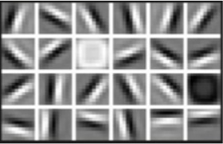
Capsule
A capsule is conceived as a group of neurons – a state vector (or matrix) and an activation. Every capsule represents a feature whose instantiation parameters and probability of being present are encoded in the state vector and activation respectively.
Instantiation Parameters
The coordinates of a specific instance of an object on the appearance manifold. For a simple object like an edge, this could be orientation, strength, etc. For more complex objects these can be pose, lighting, occlusion and many more.
State Matrix
=
Capsule
Activation Logit
First layer kernels as learned by a CNN

Slide 7
Routing between Capsules
Assuming a layer of capsules already extracted their activation and state from pixel intensities, a routing algorithm can be designed to propagate the signal in a capsule network based on agreement.
Capsules in the lower layer cast votes about what they expect the state of the capsules in the higher level to be, based on their own state
The more capsules agree about a higher capsule’s state the higher its activation
States of higher capsules are computed based on the average votes they received

Slide 8
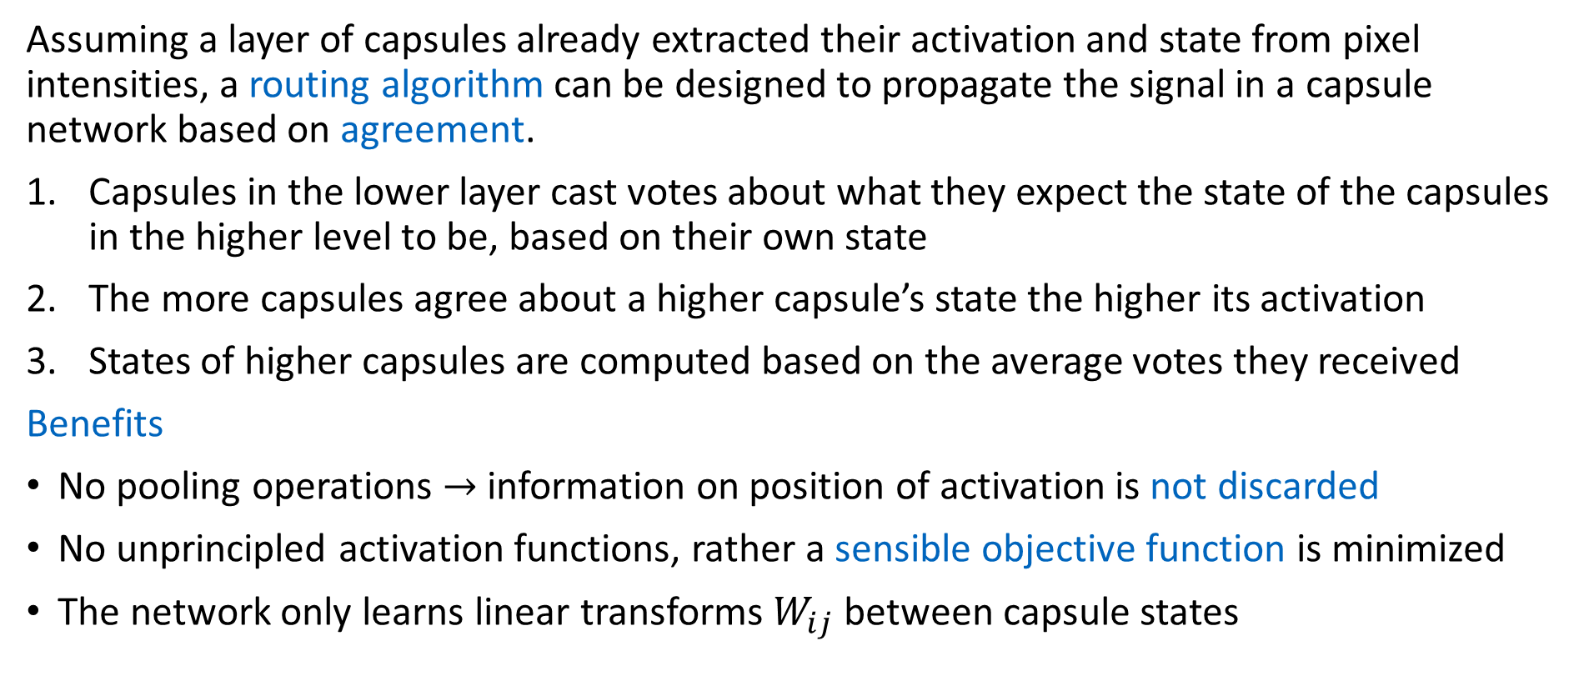
Routing between Capsules
Assuming a layer of capsules already extracted their activation and state from pixel intensities, a routing algorithm can be designed to propagate the signal in a capsule network based on agreement.
Capsules in the lower layer cast votes about what they expect the state of the capsules in the higher level to be, based on their own state
The more capsules agree about a higher capsule’s state the higher its activation
States of higher capsules are computed based on the average votes they received
Benefits
No pooling operations $→$ information on position of activation is not discarded
No unprincipled activation functions, rather a sensible objective function is minimized
The network only learns linear transforms $W_{ij}$ between capsule states

Slide 9
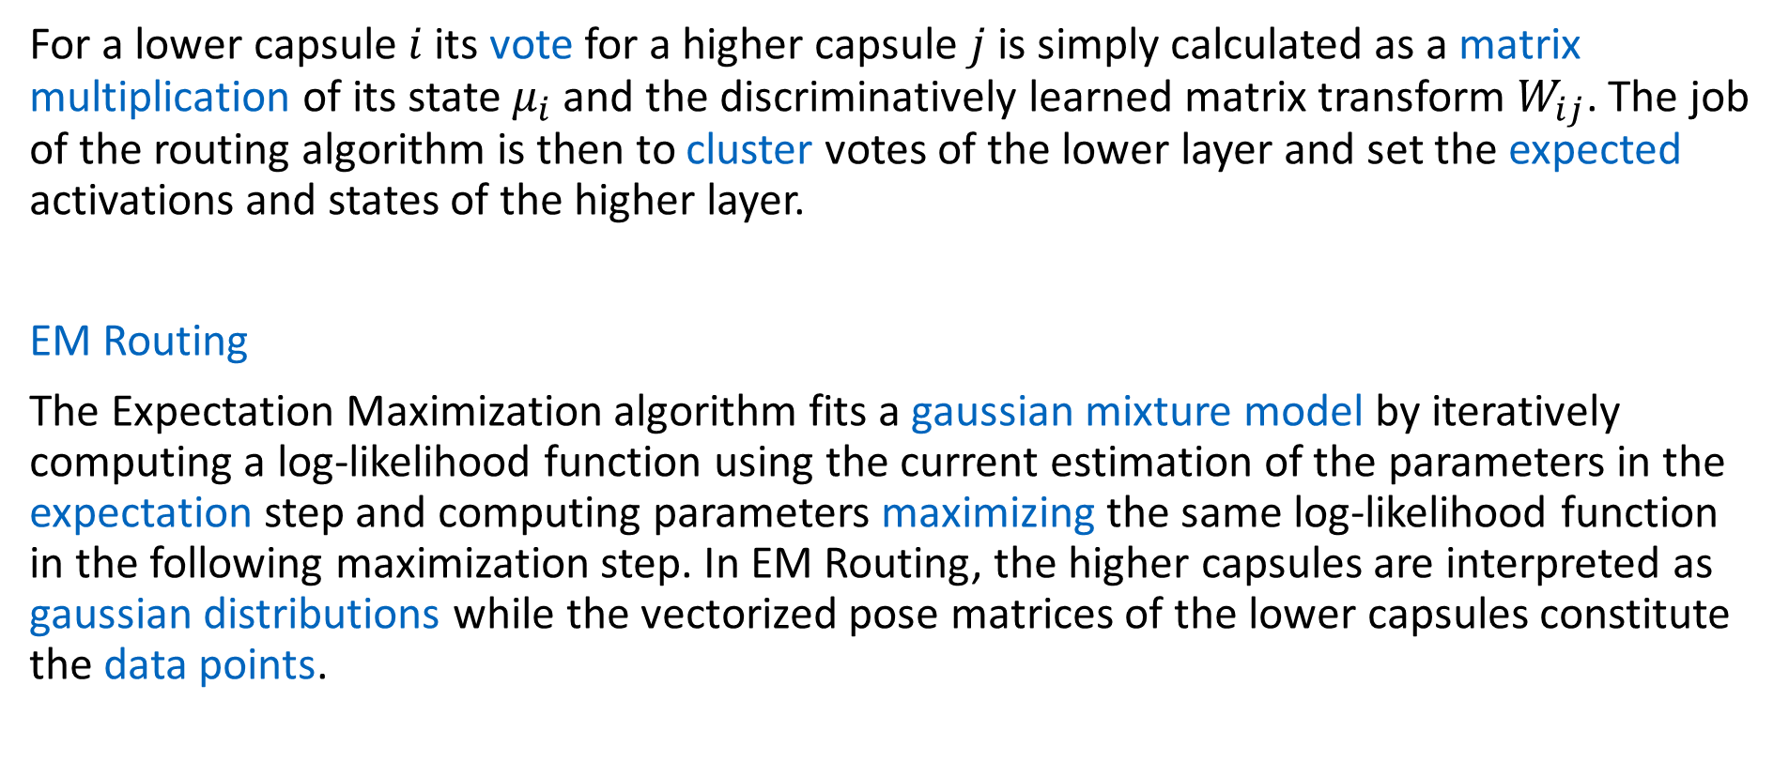
Routing between Capsules
For a lower capsule $i$ its vote for a higher capsule $j$ is simply calculated as a matrix multiplication of its state $μ_{i}$ and the discriminatively learned matrix transform $W_{ij}$. The job of the routing algorithm is then to cluster votes of the lower layer and set the expected activations and states of the higher layer.
EM Routing
The Expectation Maximization algorithm fits a gaussian mixture model by iteratively computing a log-likelihood function using the current estimation of the parameters in the expectation step and computing parameters maximizing the same log-likelihood function in the following maximization step. In EM Routing, the higher capsules are interpreted as gaussian distributions while the vectorized pose matrices of the lower capsules constitute the data points.

Slide 10
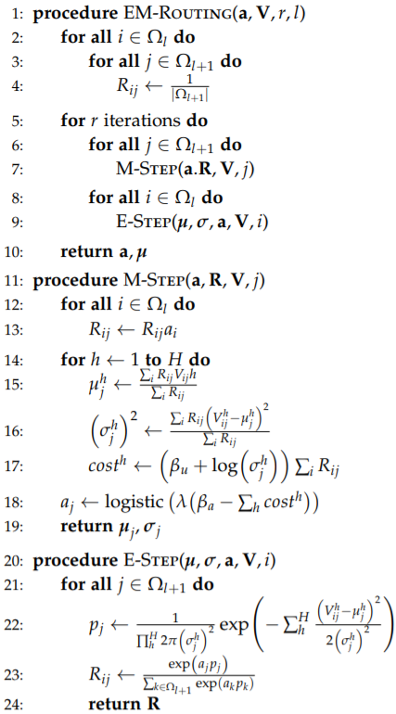
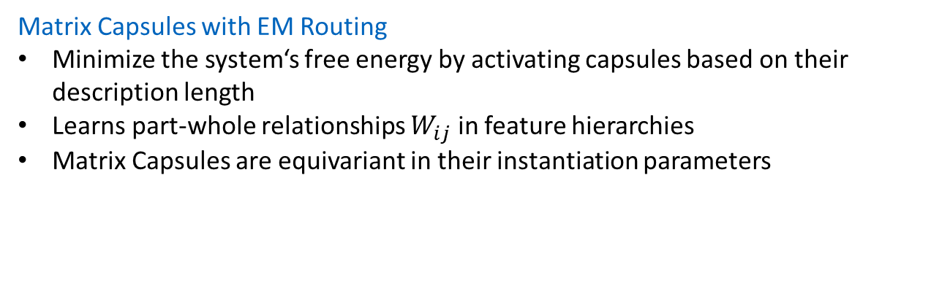
Routing between Capsules
Matrix Capsules with EM Routing
Minimize the system‘s free energy by activating capsules based on their description length
Learns part-whole relationships $W_{ij}$ in feature hierarchies
Matrix Capsules are equivariant in their instantiation parameters

Slide 11
Routing between Capsules
Matrix Capsules with EM Routing
Minimize the system‘s free energy by activating capsules based on their description length
Learns part-whole relationships $W_{ij}$ in feature hierarchies
Matrix Capsules are equivariant in their instantiation parameters
Cost for description length

Slide 12

Routing between Capsules
Matrix Capsules with EM Routing
Minimize the system‘s free energy by activating capsules based on their description length
Learns part-whole relationships $W_{ij}$ in feature hierarchies
Matrix Capsules are equivariant in their instantiation parameters
Cost for description length
Probability of seeing the Vote $V_{ij}$ under capsule $j$

Slide 13
Open Questions
How to initialize the first capsule layer from pixel intensities?
Does training matrix capsules with EM routing discriminatively result in the capsules learning useful instantiation parameters?
How do capsule networks perform compared to established methods?

Slide 14
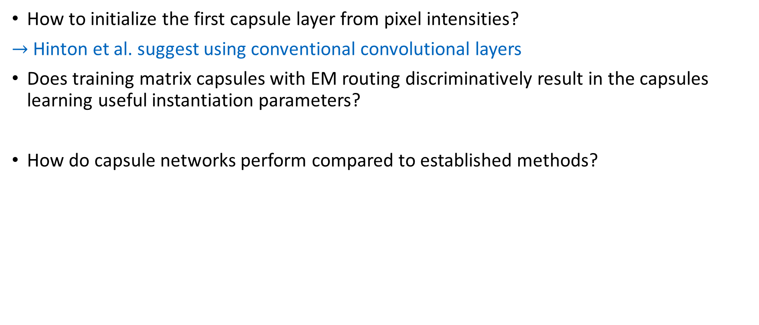
Open Questions
How to initialize the first capsule layer from pixel intensities?
$→$ Hinton et al. suggest using conventional convolutional layers
Does training matrix capsules with EM routing discriminatively result in the capsules learning useful instantiation parameters?
How do capsule networks perform compared to established methods?

Slide 15
Formalizing Generalization
Capsules are equivariant in their instantiation parameters, i.e. a nonlinear transform in pixel intensities results in only a linear transformation in the instantiation parameter‘s activation. The capsule‘s activation probability remains the same.
A capsule‘s ability to generalize is encoded in their instantiation parameters
Capsule networks can also use convolutional capsule layers, as such they inherently generalize to variations in position like CNNs

Slide 16
Formalizing Generalization
Capsules are equivariant in their instantiation parameters, i.e. a nonlinear transform in pixel intensities results in only a linear transformation in the instantiation parameter‘s activation. The capsule‘s activation probability remains the same.
A capsule‘s ability to generalize is encoded in their instantiation parameters
Capsule networks can also use convolutional capsule layers, as such they inherently generalize to variations in position like CNNs
Idea
Every instantiation parameter corresponds to a perturbation of the data. Parameterize the data to produce perturbed versions across the entire perturbation space and evaluate the capsule networks trained on the unperturbed versions.

Slide 17
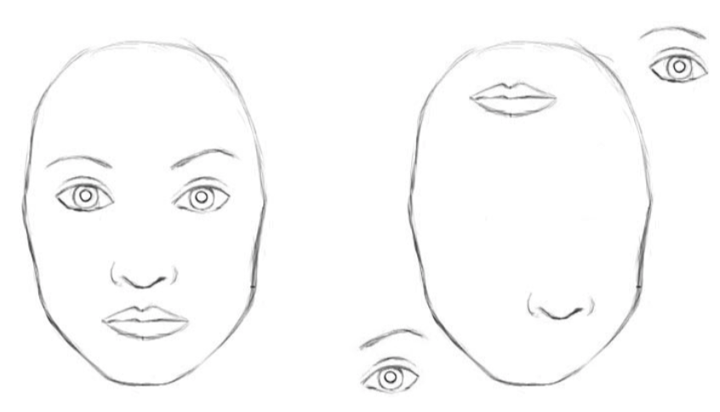
Example for Perturbation
Capsule networks learn part-whole relationships between features. This means that capsules only activate if the capsules beneath them are in agreement about the state of the instantiation parameters of the higher capsule based on their own instantiation.
Example
In a capsule network trained to recognize faces, capsules in one layer could learn such features as eyes, noses and lips. If the capsules’ instantiation represent poses, the part-whole transforms would describe relative poses. The part-whole relationships can be deconstructed by placing the features in such a way that the capsules representing them are no longer in agreement. A capsule network, that successfully learned to represent poses, should not respond to the deconstructed version.
Deconstruction of part-whole relationships

Slide 18
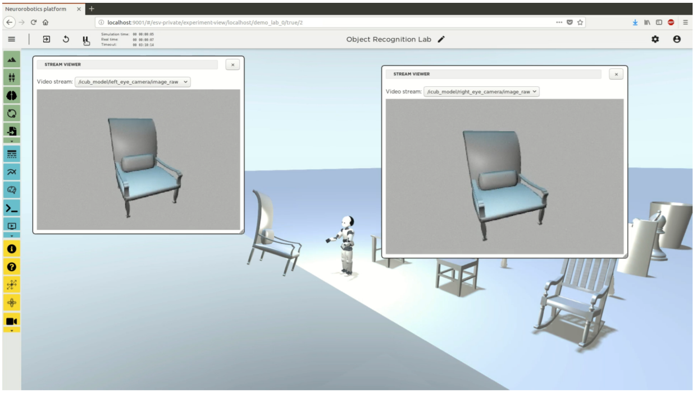
Dataset Generation
The Neurorobotics Platform is used to generate object recognition data.

Slide 19
Dataset Generation
The Neurorobotics Platform is used to generate object recognition data.
Advantages
Large labelled datasets can be create with little “manual labor”
Supports different modalities by using simulated noisy sensors
Control perturbations to customize data to test for generalization specifically

Slide 20
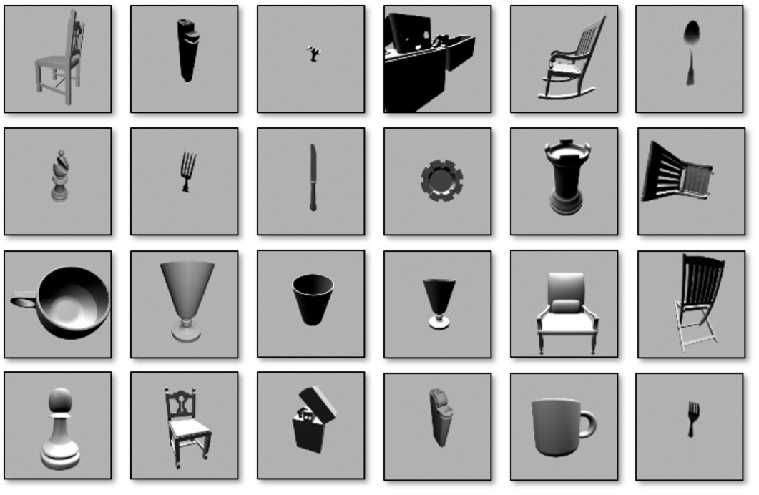
Object recognition dataset
Used in thesis: stereoscopic images of 5 everyday object classes

Slide 21
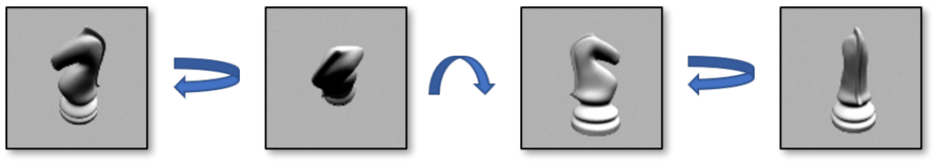
Parameterized Perturbations
Samples of different viewpoints from the object recognition dataset. The same object from the class of chess figures is viewed from different azimuths and elevations under the same lighting. Note that while the shape of the figure is symmetrical across one axis, the two sides are lit-up differently under different viewpoints

Slide 22
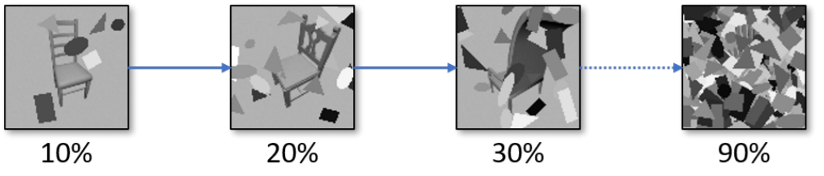
Parameterized Perturbations
Augmentation of the object recognition dataset to test for robustness against occlusion. Ellipses, rectangles and triangles of varying shape and color are randomly placed on the images to occlude the object. An entire dataset is created for each increment in the percentage of coverage.

Slide 23
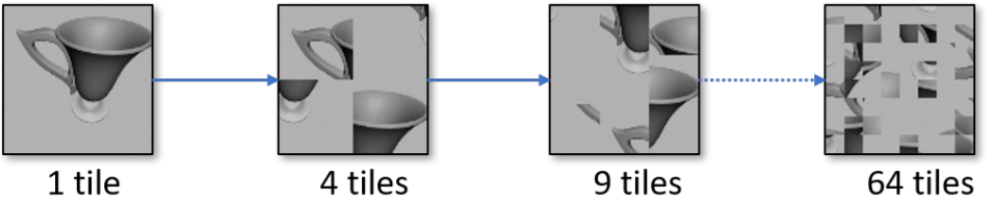
Parameterized Perturbations
Augmentation of the object recognition dataset to test the robustness of part-whole relationships. The images are divided into an increasing number of squares that are randomly permuted. For each number of tiles, an entire dataset is created.

Slide 24
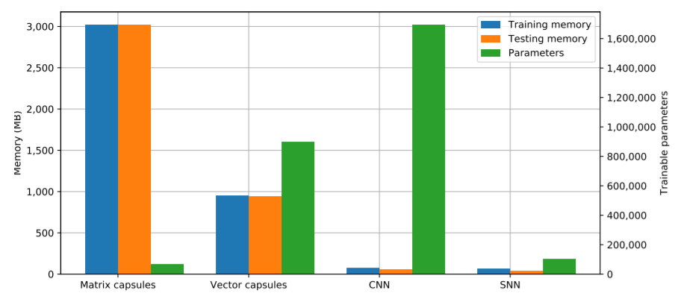
Runtime Results
Matrix Capsules are a good prior for how objects are encoded in images, they only need few variables to achieve very good results – but this comes at a computational cost.

Slide 25
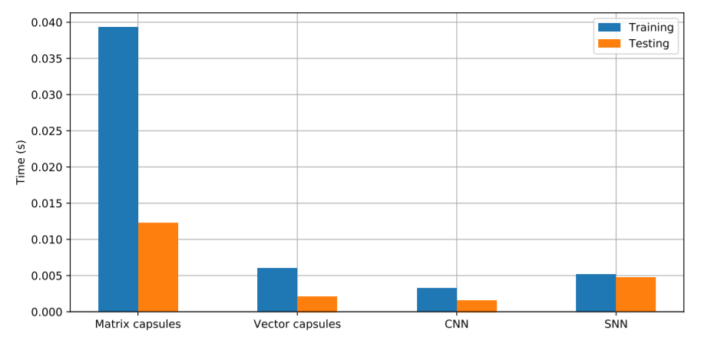
Runtime Results
Matrix Capsules are a good prior for how objects are encoded in images, they only need few variables to achieve very good results – but this comes at a computational cost.

Slide 26
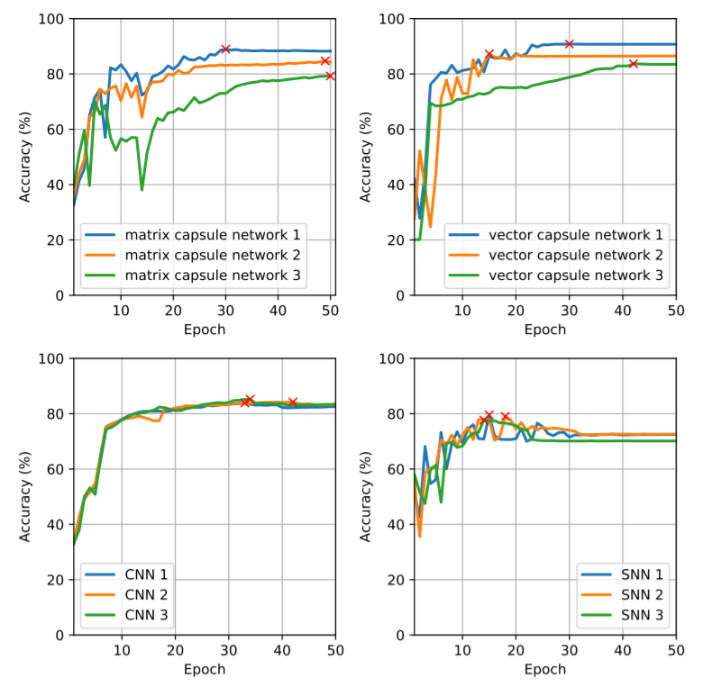
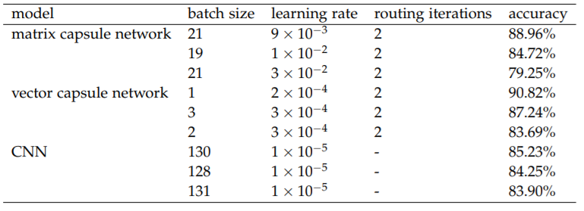
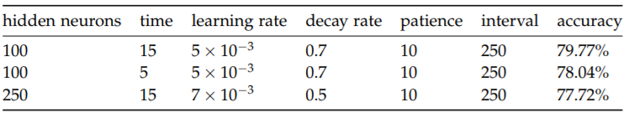
Object Recognition Results
Matrix Capsules are a good prior for how objects are encoded in images, they only need few variables to achieve very good results – but this comes at a computational cost.

Slide 27
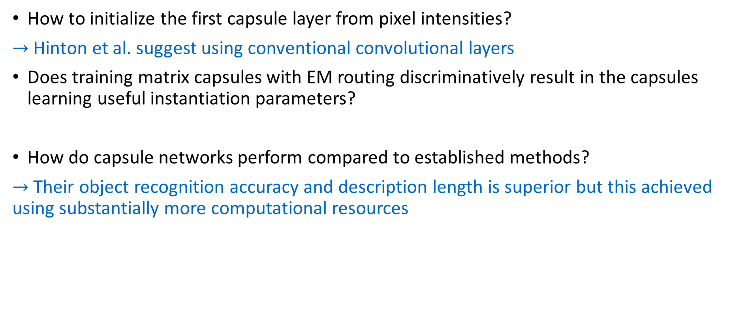
Open Questions
How to initialize the first capsule layer from pixel intensities?
$→$ Hinton et al. suggest using conventional convolutional layers
Does training matrix capsules with EM routing discriminatively result in the capsules learning useful instantiation parameters?
How do capsule networks perform compared to established methods?
$→$ Their object recognition accuracy and description length is superior but this achieved using substantially more computational resources

Slide 28
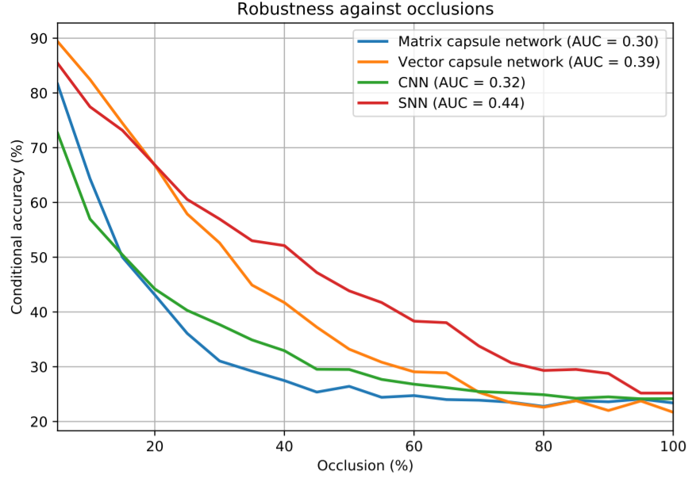
Generalization Results
The capsule networks did not perform particularly well at generalization, suggesting that they did not learn useful instantiation parameters but rather abstract pixel statistics.

Slide 29
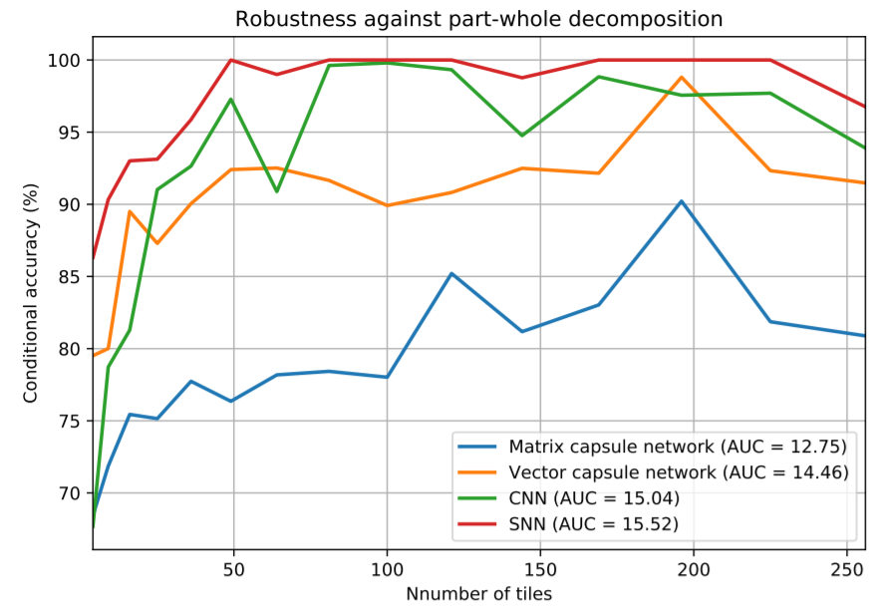
Generalization Results
The capsule networks did not perform particularly well at generalization, suggesting that they did not learn useful instantiation parameters but rather abstract pixel statistics.

Slide 30
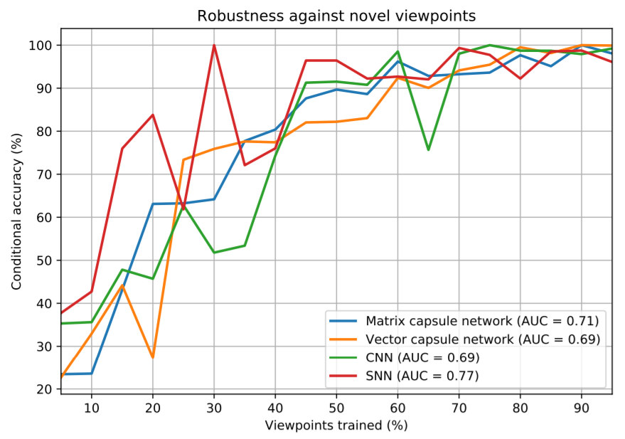
Generalization Results
The capsule networks did not perform particularly well at generalization, suggesting that they did not learn useful instantiation parameters but rather abstract pixel statistics.

Slide 31
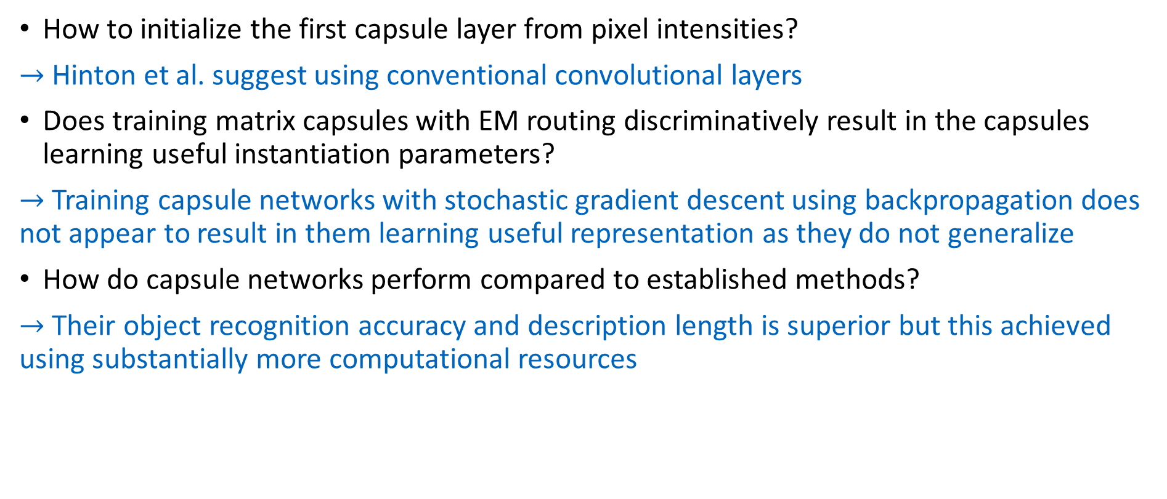
Conclusion
How to initialize the first capsule layer from pixel intensities?
$→$ Hinton et al. suggest using conventional convolutional layers
Does training matrix capsules with EM routing discriminatively result in the capsules learning useful instantiation parameters?
$→$ Training capsule networks with stochastic gradient descent using backpropagation does not appear to result in them learning useful representation as they do not generalize
How do capsule networks perform compared to established methods?
$→$ Their object recognition accuracy and description length is superior but this achieved using substantially more computational resources

Slide 32
Conclusion
The thesis as well as the experiment for the Neurorobotics Platform used to generate the dataset as well as all the artificial neural network implementations are available at GitHub
https://github.com/JeanElsner/thesis-capsules-neurorobotics
Thank you for your attention!

