Slide 1
AZ-300T04 Module 01: Creating Web Applications using PaaS
Subtitle or speaker name

Slide 2
Module 01: Creating Web Applications using PaaS Lesson 01: Introduction to Web Apps

Slide 3
Web Apps Overview
A PaaS offering for hosting web applications:
Flexibility:
Support for variety of frameworks, including .NET, .NET Core, Java, PHP, Node.js, Python, and Ruby.
The ability to use different deployment methods, including Visual Studio, FTP, and Web Deploy.
Integration with a wide range of code repositories.
Scalability:
Vertical scaling (manual)
Horizontal scaling (manual and automatic)
Built-in load balancing
Hosting model:
Available on both Windows and Linux OS
Support for containerized workloads on Linux OS
Integration with CI/CD pipelines.

Slide 4
Key Features of App Service Web Apps
Multiple languages and frameworks
DevOps optimization
Global scale with high availability
Connections to SaaS platforms and on-premises data
Security and compliance
Application templates
Visual Studio integration
API and mobile features
Serverless code

Slide 5
Azure App Service plans
In App Service, an app runs in an App Service plan.
An App Service plan defines a set of compute resources for a web app to run.
Compute resources are analogous to the server farm in conventional web hosting.
One or more apps can be configured to run on the same computing resources (or in the same App Service plan).
When an App Service plan is created in a certain region a set of compute resources is created for that plan in that region. Whatever apps are put into the App Service plan run on those compute resources as defined by your App Service plan. Each App Service plan defines:
Region (West US, East US, etc.)
Number of VM instances
Size of VM instances (Small, Medium, Large)
Pricing tier (Free, Shared, Basic, Standard, Premium, PremiumV2, Isolated, Consumption)

Slide 6
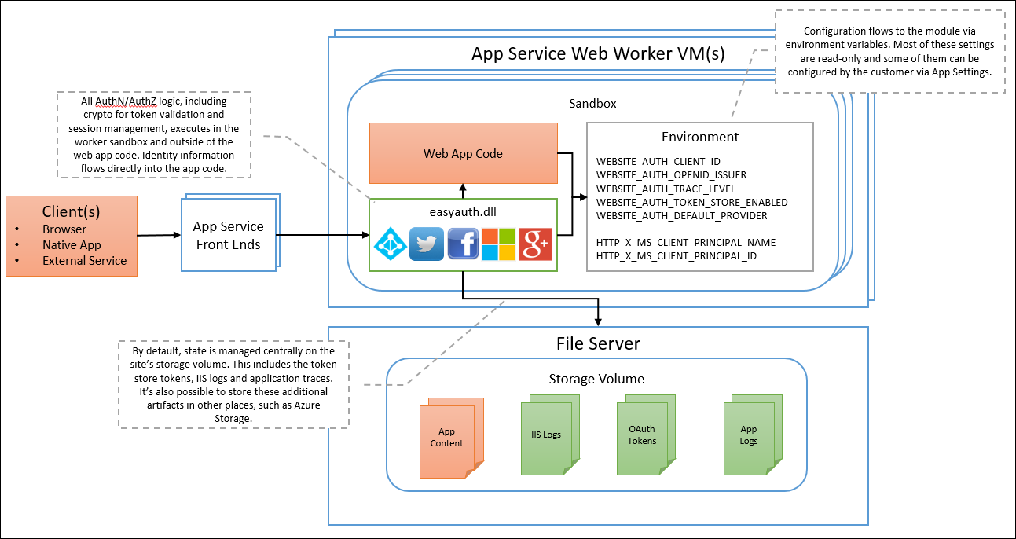
Authentication and authorization in Azure App Service
Azure App Service provides built-in authentication and authorization support.
Users and access data can be signed in by writing minimal or no code in a web app, API, and mobile back end, and Azure Functions.
An authentication and authorization module runs in the same sandbox as the application code.
All incoming HTTP requests pass through before being handled by the application code.
The module handles several things for the app:
Authenticates users with the specified provider
Validates, stores, and refreshes tokens
Manages the authenticated session
Injects identity information into request headers

Slide 7
Controlling App Service traffic by using Azure Traffic Manager
Azure Traffic Manager controls how requests from web clients are distributed to apps in Azure App Service.
When App Service endpoints are added to an Azure Traffic Manager profile, Azure Traffic Manager keeps track of the status of your App Service apps (running, stopped, or deleted)… it decides which of the endpoints should receive traffic.
Azure Traffic Manager uses four different routing methods. These methods are described in the following list:
Priority: use a primary app for all traffic, and provide backups in case the primary or the backup apps are unavailable.
Weighted: distribute traffic across a set of apps, either evenly or according to weights, which you define.
Performance: when you have apps in different geographic locations, use the “closest” app in terms of the lowest network latency.
Geographic: direct users to specific apps based on which geographic location their DNS query originates from.

Slide 8
About App Service Environments
Isolated and dedicated environments for securely running App Service at high scale
Offer hosting for:
Windows web apps
Linux web apps
Docker containers
Mobile apps
Functions
Provide unique (to App Service) functionality, including:
Isolated pricing tier
Virtual network integration
Support for layered security model and upstream security devices
The ability to host up to 100 App Service plan instances
Three worker tier sizes:
One vCPU/3.5 GB RAM
Two vCPU/7 GB RAM
Four vCPU/14 GB RAM

Slide 9
Module 01: Creating Web Applications using PaaS Lesson 02: Using shell commands to create an App Service Web App

Slide 10
Using shell commands
Azure Web Apps can be managed by using shell-based interface:
Azure Cloud Shell:
Integrates directly with the Azure portal
Offers the choice of Bash and PowerShell
Includes popular command line tools
Azure CLI:
Offers multi-platform support
Facilitates automation
Allows Linux/UNIX admins to leverage their scripting experience
Azure PowerShell:
Offers multi-platform support
Facilitates automation
Allows Windows admins to leverage their scripting experience

Slide 11
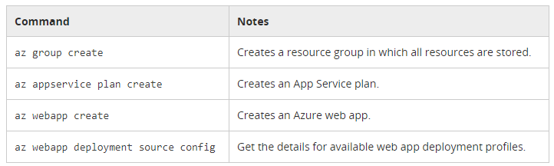
Creating a Web App with Azure CLI
Implementation steps:
1. Create the resource group
2. Create the App Service Plan
3. Create the web app
4. Deploy the app (specifics depend on the deployment source)
Azure CLI commands:

Slide 12
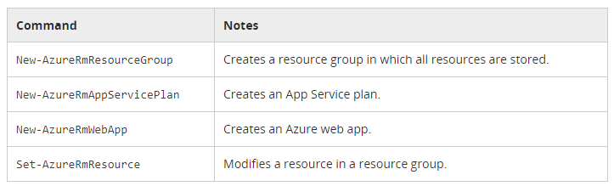
Creating a Web App with Azure PowerShell
Implementation steps:
1. Create the resource group
2. Create the App Service Plan
3. Create the web app
4. Deploy the app (specifics depend on the deployment source)
Azure PowerShell commands:

Slide 13
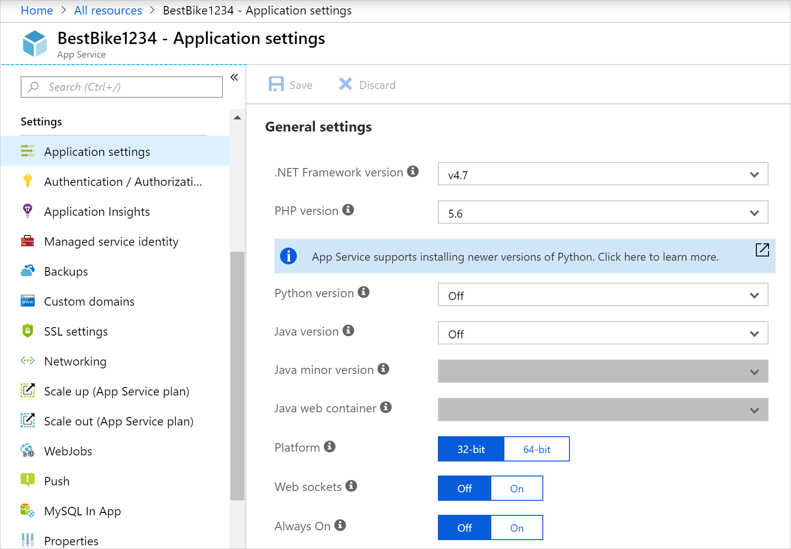
Create a Web App by using the Azure Portal
By creating a Web App in the Azure portal, you are creating a set of hosting resources in App Service, which can used to host any web-based application that is supported by Azure(ASP.NET Core, Node.js, PHP, etc.)
The figure below shows how to configure the framework/language used by the app:
The Azure portal provides a template to create a web app
App name: The name of the web app.
Subscription: A valid and active subscription.
Resource group: A valid resource group.
OS: The operating system. The options are: Windows, Linux, and Docker containers.
App Service plan/location: A valid Azure App Service plan.
Applications Insights: Use the Azure Application Insights option for the monitoring and metric tools that the Azure portal offers.

Slide 14
Module 01: Creating Web Applications using PaaS Lesson 03: Creating Background Tasks

Slide 15
Overview of WebJobs
A feature of Azure App Service for execution of background tasks:
Includes support for executables or scripts (.cmd, .bat, .exe, .ps1, .sh, .php, .py, .js, .jar)
Tasks execute in the same context as the App Service app
Azure WebJobs SDK provides programmability
Can run:
Continuously:
Start immediately when the WebJob is created and run in an endless loop
Run on all instances of the web app (you can restrict it to individual instances)
Support remote debugging
On trigger:
Start on-demand or on-schedule
Run on a single instance selected by the Azure platform
Do not support remote debugging
Times out after 20 minutes of inactivity, unless you enable the Always On feature;
Always On requires Basic, Standard, or Premium pricing tier

Slide 16
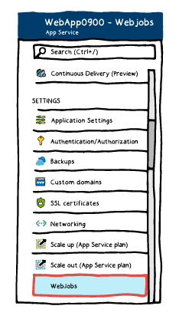
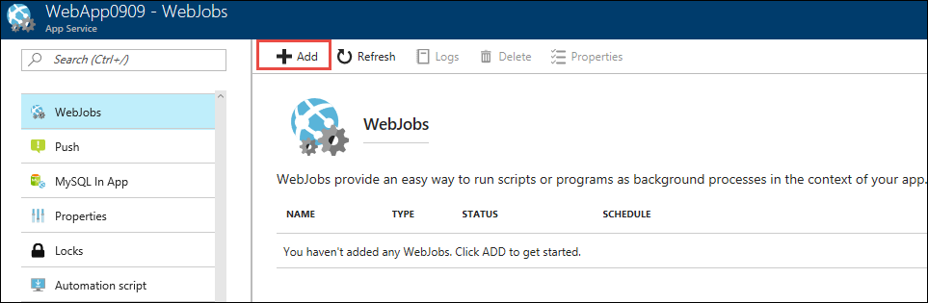
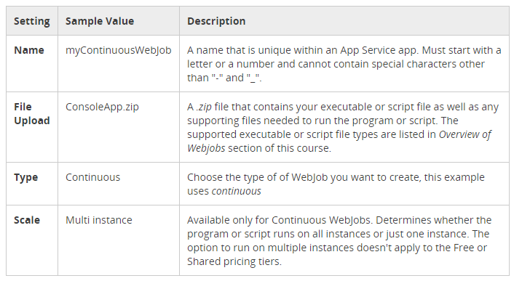
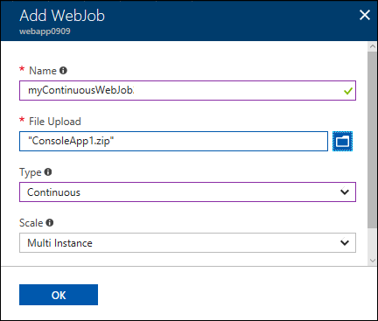
Creating a continuous Webjob
Implementation steps (the Azure portal):
1. Navigate to the App Service page of the web app, API app, or mobile app.
2. On the WebJobs blade, click Add.
3. Configure Add WebJob settings.

Slide 17
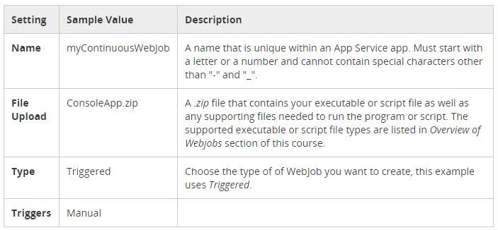
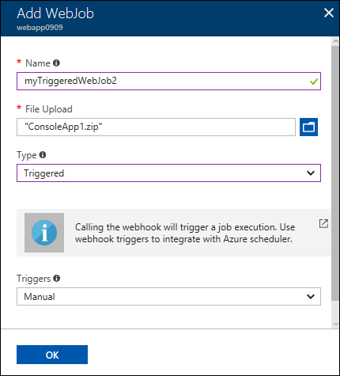
Creating a triggered Webjob
Implementation steps (the Azure portal):
1. Navigate to the App Service page of the web app, API app, or mobile app.
2. On the WebJobs blade, click Add.
3. Configure Add WebJob settings.

Slide 18
Module 01: Creating Web Applications using PaaS Lesson 04: Using Swagger to document an API

Slide 19
Getting started with Swashbuckle
Swashbuckle consists of the following components:
Swashbuckle.AspNetCore.Swagger
Swashbuckle.AspNetCore.SwaggerGen
Swashbuckle.AspNetCore.SwaggerUI
To install Swashbuckle in Visual Studio:
From the Package Manager Console window:
Go to View > Other Windows > Package Manager Console
Navigate to the directory in which the TodoApi.csproj file exists
Run Install-Package Swashbuckle.AspNetCore
From the Manage NuGet Packages dialog:
Right-click the project in Solution Explorer > Manage NuGet Packages
Set the Package source to “nuget.org”
Enter “Swashbuckle.AspNetCore” in the search box
Select the “Swashbuckle.AspNetCore” package from the Browse tab and click Install

Slide 20
Add and configure Swagger middleware
Implementation steps:
Add the Swagger generator to the services collection in the Startup.ConfigureServices method
Import the Swashbuckle.AspNetCore.Swagger namespace to use in the Info class
In the Startup.Configure method, enable the middleware for serving the generated JSON document and the Swagger UI
Launch the app, and navigate to http://localhost:<port>/swagger/v1/swagger.json.
The generated document describing the endpoints will appears as shown in Swagger specification (swagger.json).

Slide 21
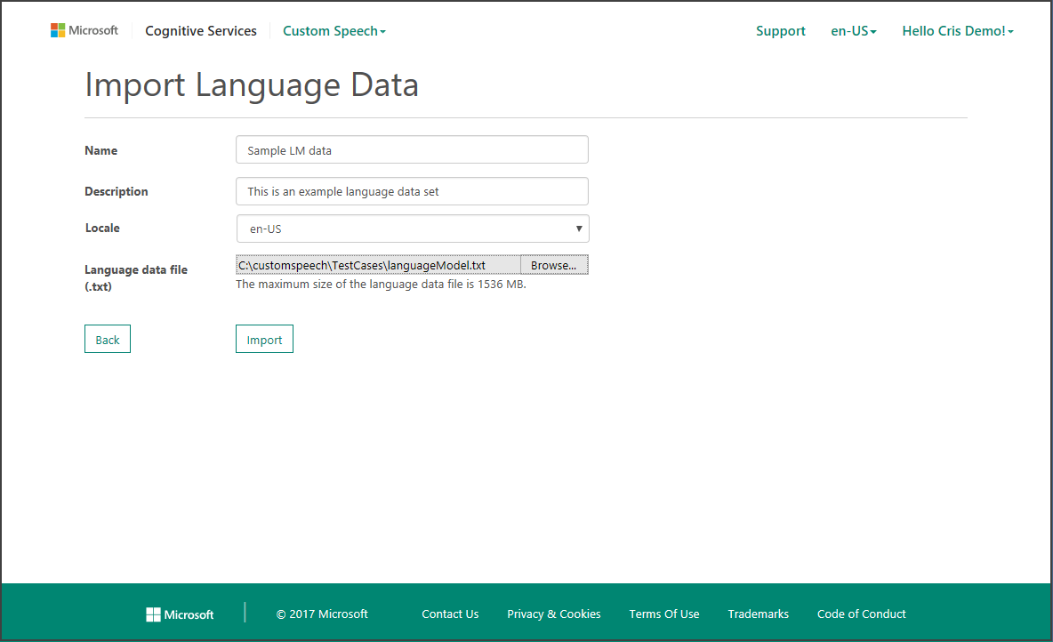
Documenting the object model – API info and description
Configuration passed to AddSwaggerGen adds such information as:
Author
License
Description

Slide 22
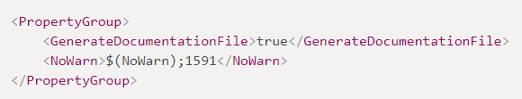
Enabling XML comments
Implementation steps:
Right-click the project in Solution Explorer and select Edit <project_name>.csproj.
Manually add the following to the .csproj project file:
Enabling XML comments provides debug information for undocumented public types and members. Such types and members are indicated by warning messages.
To suppress warnings project-wide, add a semicolon-delimited list of codes in the project file (e.g. 1591)
To suppress warnings for specific members, enclose the code in #pragma warning preprocessor directives.

Slide 23
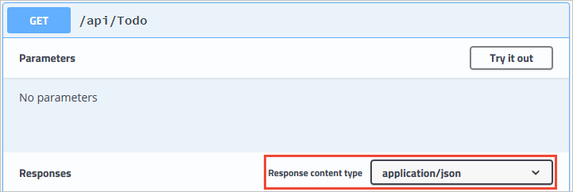
Decorating the model with attributes
Implementation steps:
Decorate the model with attributes, found in the System.ComponentModel.DataAnnotations namespace, to help drive the Swagger UI components.
Add the [Required] attribute to the Name property of the TodoItem class:
The presence of this attribute changes the UI behavior and alters the underlying JSON schema
Add the [Produces("application/json")] attribute to the API controller.
Its purpose is to declare that the controller's actions support a response content type of application/json
The Response Content Type drop-down selects this content type as the default for the controller's GET actions

Slide 24
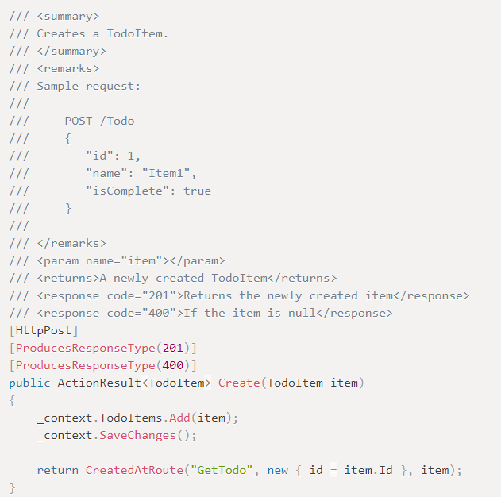
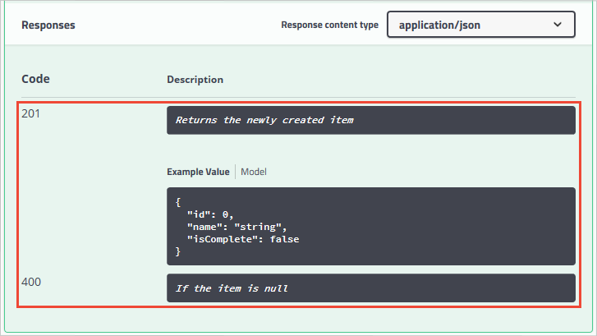
Describing response types
The response types and error codes are denoted in the XML comments and data annotations:
The Create action returns an HTTP 201 status code on success.
An HTTP 400 status code is returned when the posted request body is null.
Without proper documentation in the Swagger UI, the consumer lacks knowledge of expected outcomes. Fix that problem by using the approach illustrated in the following example:
The Swagger UI now documents the expected HTTP response codes:

Slide 25
Module 01: Creating Web Applications using PaaS Lesson 05: Creating an App Service Logic App

Slide 26
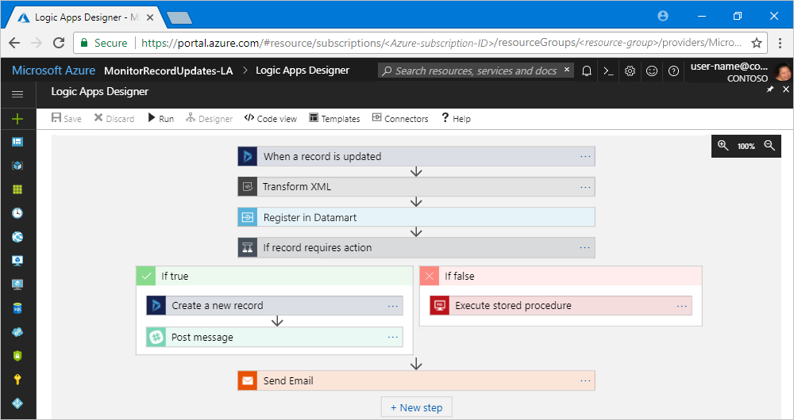
Azure Logic Apps explained
Trigger-based workflows integrating apps, data, systems, and services:
For example:
Processing and routing orders across on-premises systems and cloud services.
Moving uploaded files from an SFTP or FTP server to Azure Storage.
Sending email notifications with Office 365 in response to external events.
Monitor tweets for a specific subject, analyze the sentiment, and create alerts or tasks.
Can be created using minimal or no-code:
Include 200+ predefined connectors
Support integration with custom APIs (API apps)
Consist of:
A worklfow – a sequence of steps in an acyclic graph
A trigger – an event that initiates workflow execution
Actions – workflow steps (a service, application or API)
Connectors – representations of APIs or data sources

Slide 27
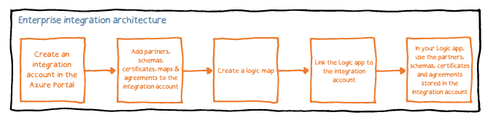
B2B scenarios and the Enterprise Integration Pack
Enterprise Integration Pack enables B2B scenarios:
Provides features equivalent to BizTalk Server and Microsoft Azure BizTalk Services
Uses Integration accounts to simplify the storage and management of B2B artifacts
Offers several important benefits:
Allows you to store all artifacts in an integration account.
Facilitates building B2B workflows and integration with third-party SaaS apps, on-premises apps, and custom apps by using the Azure Logic Apps engine and all its connectors.
Simplifies creating and integrating custom code for your logic apps with Azure functions.
Use the following steps to build B2B apps with Enterprise Integration Pack:

Slide 28
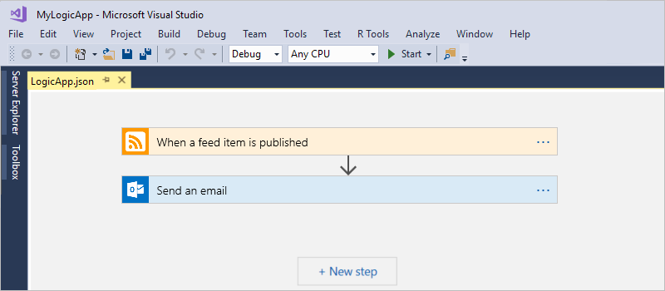
Before you begin
Objective:
create a logic app that monitors RSS feed and sends email for each new posted item
Prerequisites:
If you don't have an Azure subscription, sign up for a free Azure account.
Download and install the following tools:
Visual Studio 2017 or 2015
Microsoft Azure SDK for .NET (2.9.1 or later)
Azure PowerShell.
Azure Logic Apps Tools for VS 2017 or 2015
Set up an email account:
Office 365 Outlook
Outlook.com
Gmail
Ensure access to the Azure portal

Slide 29
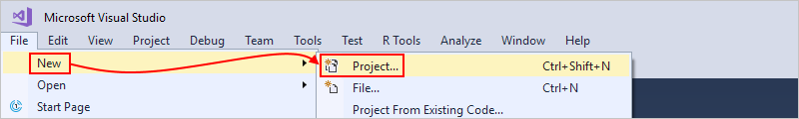
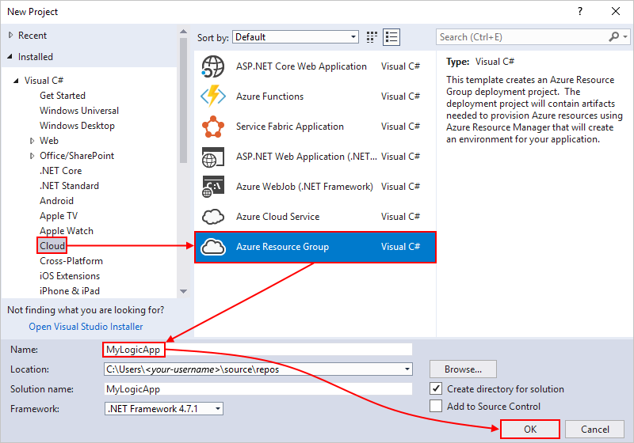
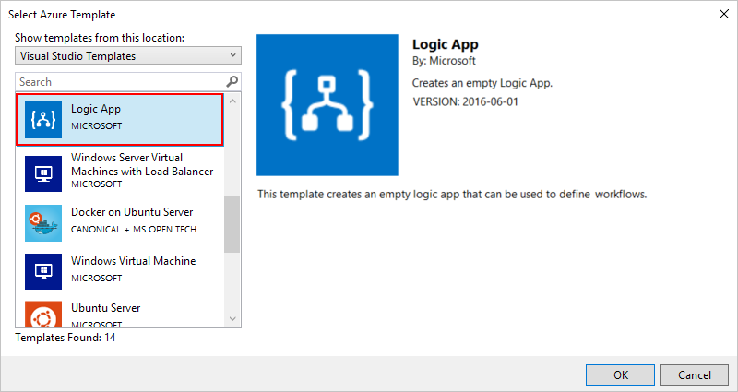
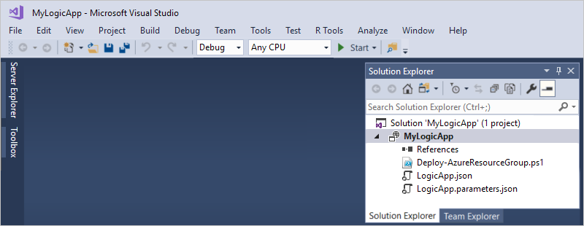
Create an Azure resource group project
Implementation steps:
1. Start Visual Studio
2. Create a new project
3. Select the project template:
Visual C#
Cloud
Azure Resource Group
4. Select the Azure template:
Logic App
5. Visual Studio generates the project.

Slide 30
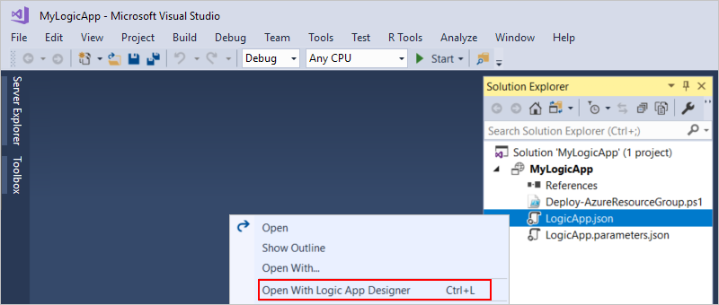
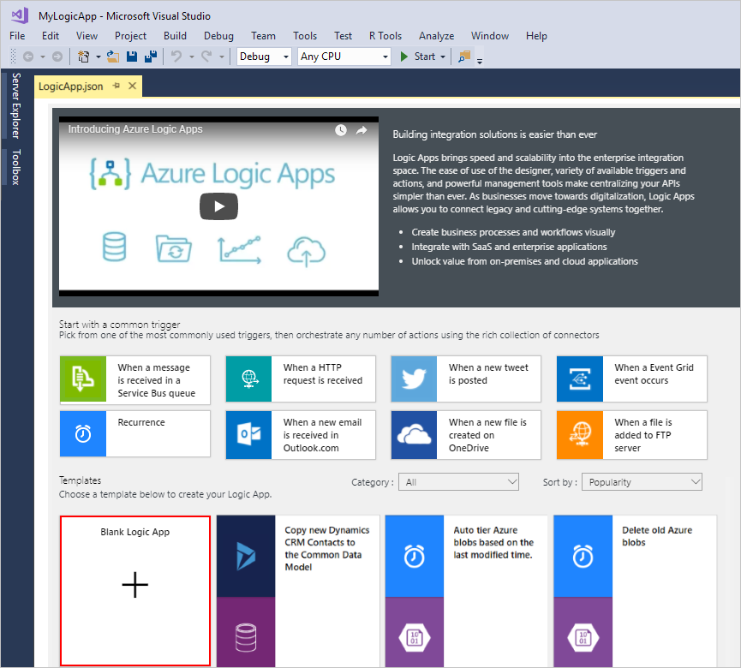
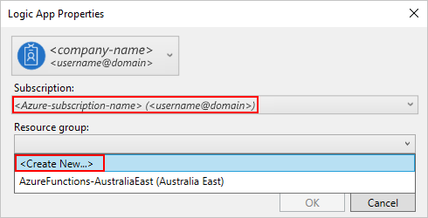
Create a blank Logic App
Implementation steps:
1. Open LogicApp.json with Logic App Designer
2. Create a new Azure resource group
3. In the Logic App Designer, select Blank Logic App

Slide 31
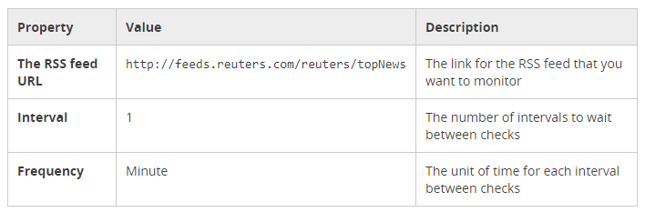
Build the Logic App workflow
Implementation steps:
1. In Logic App Designer, select the When a feed item is published trigger
2. Configure trigger properties:
3. Under the When a feed item is published trigger, add the Send an email action.
4. When prompted, sign in to your email account.
5. In the Send an email action, specify the data that you want the email to include.
6. Save the logic app.

Slide 32
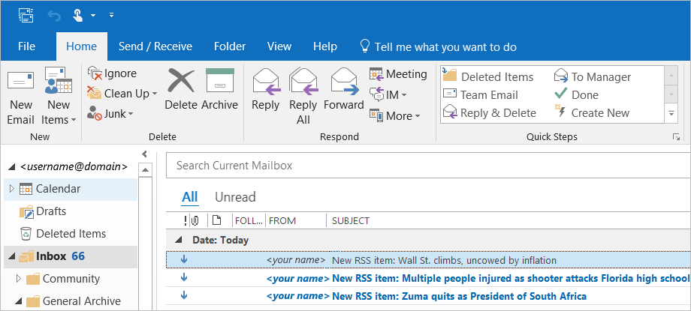
Deploy the Logic App to Azure
Implementation steps:
1. From the Solution Explorer, select the Deploy action to deploy the logic app to Azure.
2. Keep the Azure subscription, resource group, and other default settings.
3. Provide the resource name for the logic app to use at deployment.
4. Monitor the deployment in the Visual Studio Output window.
5. After deployment finishes, the logic app will check the RSS feed on schedule (every minute). If the RSS feed has new items, the app sends an email for each new item.

Slide 33
Clean up resources
Implementation steps:
1. Sign in to the Azure portal with the same account used to create your logic app.
2. On the main Azure menu, select Resource groups. Select the resource group for your logic app, and then select Overview.
3. On the Overview page, choose Delete resource group. Enter the resource group name as confirmation, and choose Delete.

Slide 34
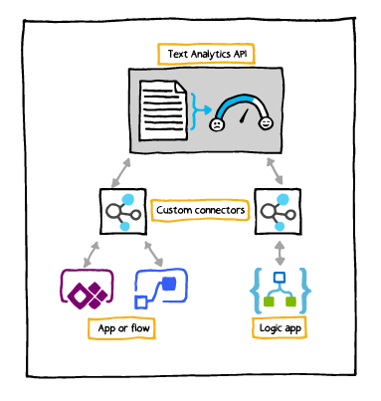
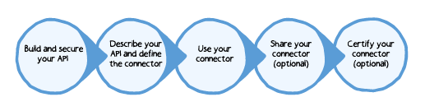
Custom connectors overview
Offer extensibility beyond built-in connectors:
Function-based: generate data by calling a function
To create custom connectors, use the following implementation steps:

Slide 35
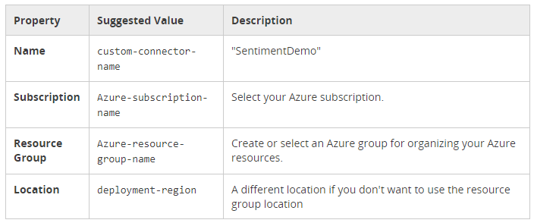
Create a custom connector in Logic Apps
Objective:
create a custom connector and define its behavior by using an OpenAPI definition
Implementation steps:
1. From the Azure portal, create a new Logic App Connector resource
2. Provide the connector resource properties:
3. After Azure deploys your connector, the custom connector blade opens automatically.

Slide 36
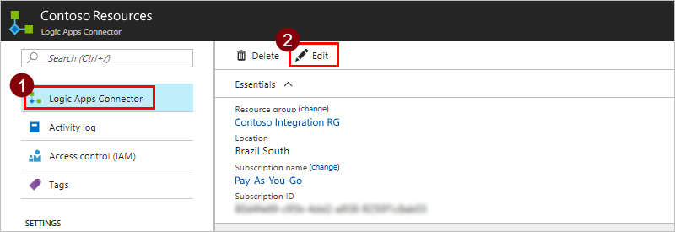
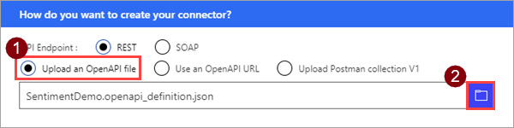
Import the OpenAPI definition
Prerequisites:
An OpenAPI definition that describes the example API.
An API key for the Cognitive Services Text Analytics API
Implementation steps:
1. On the connectors blade, select Logic Apps Connector, then choose Edit.
2. Select Upload an OpenAPI file and navigate to the OpenAPI definition you created.

Slide 37
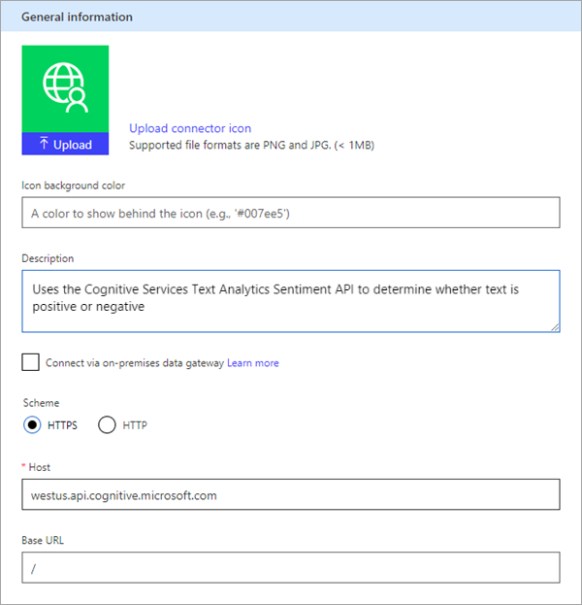
Review general details
On the General page, review the information that was imported from the OpenAPI definition, including the API host and the base URL for the API. The connector uses the API host and the base URL to determine how to call the API.

Slide 38
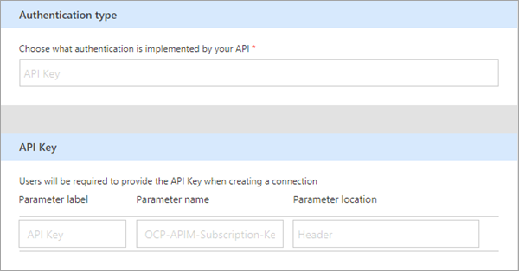
Review authentication type
On the Security page, review the authentication information for the API key
The label is displayed when someone first makes a connection with the custom connector; you can choose Edit and change this value. The parameter name and location must match what the API expects:
In this case “Ocp-Apim-Subscription-Key” and "Header".

Slide 39
Logic App deployment template overview
To create a template for a logic app, you must:
define its resources
parameterize the template (as needed)
A logic app has three basic components:
Logic app resource: Contains information about things like pricing plan, location, and the workflow definition.
Workflow definition: Describes your logic app's workflow steps and how the Logic Apps engine should execute the workflow.
Connections: Refer to separate resources that securely store metadata about any connector connections, such as a connection string and an access token. In the logic app resource, your logic app references these resources in the parameters section.

Slide 40
Create a Logic App deployment template
The simplest methods rely on:
Visual Studio Tools for Logic Apps
Logic App Template Creator PowerShell module:
Analyzes the logic app and its connections
Generates template resources based on the analysis
To generate a logic app template by using PowerShell:
1. Install the logic app template PowerShell module:
Install-Module –Name LogicAppTemplate
2. Generate a logic app template
armclient token $SubscriptionId | Get-LogicAppTemplate -LogicApp MyApp -ResourceGroup MyRG -SubscriptionId $SubscriptionId -Verbose | Out-File C:\template.json

Slide 41
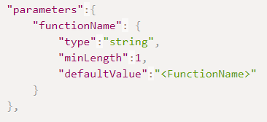
Add parameters to Logic App template
You can use logic app parameters in triggers and actions:
Child workflow
Function app
APIM call
API connection runtime URL
API connection path
You can also use template functions and parameters:
For example, you can replace the Azure Function resource ID:
For Logic App Designer to work, you must provide default values of parameters

Slide 42
Adding your Logic App to an existing Resource Group
Implementation steps (from Visual Studio):
1. Open the JSON template.
2. In the JSON Outline window, right-click the resources node and click Add New Resource.
3. From the Add Resource dialog box, add the Logic App resource and set its properties.
4. Deploy the template.
5. From the Logic Apps Designer, authorize OAuth connections:
After deployment, the logic app works end-to-end with valid parameters. However, you must still authorize OAuth connections to generate a valid access token. To authorize OAuth connections, open the logic app in the Logic Apps Designer, and authorize these connections. For automated deployment, you can use a script to consent to each OAuth connection.

Slide 43
Online Lab - Implementing and Managing Application Services

