Slide 1
AZ-300T04 Module 03: Using Azure Kubernetes Service
Subtitle or speaker name

Slide 2
Module 03: Using Azure Kubernetes Service Lesson 01: Creating an Azure Kubernetes Service Cluster

Slide 3
About Azure Kubernetes Service
Managed Kubernetes cluster hosted in Azure with a range of benefits:
Flexible deployment options
Identity and security management
Integrated logging and monitoring
Cluster node scaling
Cluster node upgrades
HTTP application routing
GPU enabled nodes
Development tooling integration
Virtual network integration
Private container registry

Slide 4
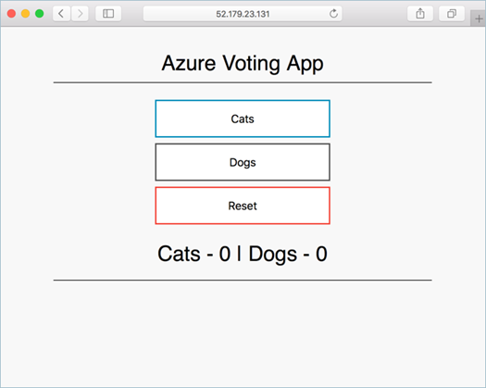
Deploy an AKS cluster using Azure CLI
Implementation steps:
1. Create a resource group:
az group create --name myAKSCluster --location eastus
2. Create an AKS cluster:
az aks create --resource-group myAKSCluster --name myAKSCluster --node-count 1 --enable-addons monitoring --generate-ssh-keys
3. Connect to the AKS cluster:
az aks get-credentials --resource-group myAKSCluster \ --name myAKSCluster
4. Create a Kubernetes manifest file (azure-vote.yaml)
5. Run the containerized application:
kubectl apply -f azure-vote.yaml
6. Monitor the progress of the deployment:
kubectl get service azure-vote-front –watch
7. Monitor health and logs (from the Azure portal)

Slide 5
Deploy an AKS cluster using Azure Portal
Implementation steps:
1. Create a resource > Kubernetes Service:
Basics: Project details, Cluster details, Scale
Authentication: A new or existing service principal and RBAC settings
Networking: Http application routing and Network configuration (Basic or Advanced)
Monitoring: A new or existing Log Analytics workspace.
2. Connect to the cluster:
az aks get-credentials --resource-group myAKSCluster \ --name myAKSCluster
3. Create a Kubernetes manifest file (azure-vote.yaml)
4. Run the containerized application:
kubectl apply -f azure-vote.yaml
5. Monitor health and logs (from the Azure portal)

Slide 6
Module 03: Using Azure Kubernetes Service Lesson 02: Azure Container Registry

Slide 7
Azure Container Registry overview
Key concepts:
Registry
Repository
Image
Container
ACR is a managed container registry based on Docker Registry 2.0:
Integrates with Azure Container Registry Build (for building container images)
Is available in three service tiers: Basic, Standard, and Premium
Offers:
Webhook integration
Azure AD authentication
Delete functionality
Geo-replication (with the Premium tier)

Slide 8
Deploy an image to ACR using Azure CLI
docker push <acrLoginServer>/aci-helloworld:v1
Implementation steps:
1. Create a resource group:
az group create --name myResourceGroup --location eastus
2. Create a container registry:
az acr create --resource-group myResourceGroup --name myContainerRegistry007 --sku Basic
3. Log in to ACR:
az acr login --name <acrName>
4. Push a new image to ACR (or pull and tag an existing image first):
docker pull microsoft/aci-helloworld
docker tag microsoft/aci-helloworld <acrLoginServer>/aci-helloworld:v1
docker push <acrLoginServer>/aci-helloworld:v1
5. Deploy a container by using an image in ACR:
az container create --resource-group myResourceGroup --name acr-quickstart --image <acrLoginServer>/aci-helloworld:v1 --cpu 1 --memory 1 --registry-username <acrName> --registry-password <acrPassword> --dns-name-label aci-demo --ports 80

Slide 9
Module 03: Using Azure Kubernetes Service Lesson 03: Azure Container Instances

Slide 10
Azure Container Instances Overview
A managed container hosting option offering a range of benefits:
Fast startup times
Public IP connectivity and DNS name
Hypervisor-level security
Custom sizes
Persistent storage
Linux and Windows containers
Co-scheduled groups

Slide 11
Create Container for Deployment to ACI
When using the Virtual Kubelet provider for Azure Container Instances (ACI), both Linux and Windows containers can be scheduled on a container instance as if it is a standard Kubernetes node.
This section is an overview of installing the Virtual Kubelet into an AKS cluster.
Installation: Use the az aks install-connector command to install Virtual Kubelet. The following example deploys both the Linux and Windows connector.
Validate Virtual Kubelet: To validate that Virtual Kubelet has been installed, return a list of Kubernetes nodes using the kubectl get nodes command.
Run Linux container: Create a file named virtual-kubelet-linux.yaml.
Run Windows container: Create a file named virtual-kubelet-windows.yaml

Slide 12
Deploy a Container to ACI
In the last section a container image was create and pushed to the Azure Container Registry. This section is an overview of how to deploy the container to Azure Container Instances.
Deploy the container from Azure Container Registry to Azure Container Instances
View the running application in the browser
Display the container's logs

Slide 13
Implement an application using Virtual Kubelet
Virtual Kubelet provider is an experimental open source project:
Allows scheduling AKS-managed containers on Azure Container Instances
Combines functional benefits of AKS with low pricing of ACI
Supports both Windows and Linux containers
To install the Virtual Kubelet provider:
Ensure that the prerequisites are satisfied:
An existing AKS cluster
Azure CLI version 2.0.33 and Helm installed
A service account and role binding for use with Tiller (for RBAC-enabled AKS clusters)
Run the az aks install-connector command:
az aks install-connector --resource-group myAKSCluster --name myAKSCluster --connector-name virtual-kubelet --os-type Both
Once the installation completes, you can deploy Windows and Linux containers to ACI:
In the .yaml file, replace kubernetes.io/hostname with the name of the Linux/Windows Virtual Kubelet node

