Slide 1
AZ-300T04 Module 04 - Understanding Azure Functions
Subtitle or speaker name

Slide 2
Module 04 - Understanding Azure Functions Lesson 01: Azure Functions overview

Slide 3
Azure Functions
Solution for running small pieces of code, or "functions," in the cloud:
Write only code that is relevant to business logic
Removes the necessity to write “plumbing” code to connect or host application components
Build on open-source WebJobs code
Supports a wide variety of programming languages, for instance:
C#
Node.js
Java
PHP
Python
Even supports scripting languages, such as:
Bash
PowerShell

Slide 4
Event-Based Triggers
Azure Functions, features no-code triggers that can invoke a function based on changes in the following services:
Azure
Storage Blobs
Cosmos DB
Storage Tables
Mobile Apps
Office 365 files
Third-Party
Twilio
SendGrid
Many more

Slide 5
Azure Functions scale and hosting concepts
Azure Functions run in two modes:
Consumption plan
Azure App Service plan
The Consumption plan automatically allocates compute power when code is running. An app is scaled out when needed to handle load, and scaled down when code is not running. Users don't have to pay for idle VMs or reserve capacity in advance.
When a function app created you choose the hosting plan for functions in the app.
In either plan, an instance of the Azure Functions host executes the functions.
The type of plan controls:
How host instances are scaled out.
The resources that are available to each host.

Slide 6
Azure Functions triggers and bindings concepts
A trigger defines how a function is invoked. A function must have exactly one trigger. Triggers have associated data, which is usually the payload that triggered the function.
Input and output bindings provide a declarative way to connect to data from within your code. Bindings are optional and a function can have multiple input and output bindings.
Triggers and bindings let you avoid hardcoding the details of the services that you're working with. Your function receives data (for example, the content of a queue message) in function parameters. You send data (for example, to create a queue message) by using the return value of the function. In C# and C# script, alternative ways to send data are out parameters and collector objects.
When you develop functions by using the Azure portal, triggers and bindings are configured in a function.json file. The portal provides a UI for this configuration but you can edit the file directly by changing to the Advanced editor.
When you develop functions by using Visual Studio to create a class library, you configure triggers and bindings by decorating methods and parameters with attributes.

Slide 7
Optimize the performance and reliability of Azure Functions
General best practices
The following are best practices in how you build and architect your serverless solutions using Azure Functions:
Avoid long running functions
Cross function communication
Write functions to be stateless
Write defensive functions
Assume your function could encounter an exception at any time. Design your functions with the ability to continue from a previous fail point during the next execution.
Next: a scenario that requires the following actions:
Query for 10,000 rows in a db.
Create a queue message for each of those rows to process further down the line.

Slide 8
Module 04 - Understanding Azure Functions Lesson 02: Develop Azure Functions using Visual Studio

Slide 9
Getting started
Azure Functions Tools for Visual Studio 2017 is an extension for Visual Studio that lets you develop, test, and deploy C# functions to Azure.
The Azure Functions Tools provides the following benefits:
Edit, build, and run functions on your local development computer.
Publish your Azure Functions project directly to Azure.
Use WebJobs attributes to declare function bindings directly in the C# code instead of maintaining a separate function.json for binding definitions.
Develop and deploy pre-compiled C# functions. Pre-complied functions provide a better cold-start performance than C# script-based functions.
Code your functions in C# while having all of the benefits of Visual Studio development.

Slide 10
Creating an Azure Functions project
The Azure Functions project template in Visual Studio creates a project that can be published to a function app in Azure. A function app lets you group functions as a logical unit for management, deployment, and sharing of resources.
In Visual Studio, select New > Project from the File menu.
In the New Project dialog, select Installed, expand Visual C# > Cloud, select Azure Functions, type a Name for your project, and click OK. The function app name must be valid as a C# namespace, so don't use underscores, hyphens, or any other nonalphanumeric characters.
Use the settings specified in the table below, and click OK.

Slide 11
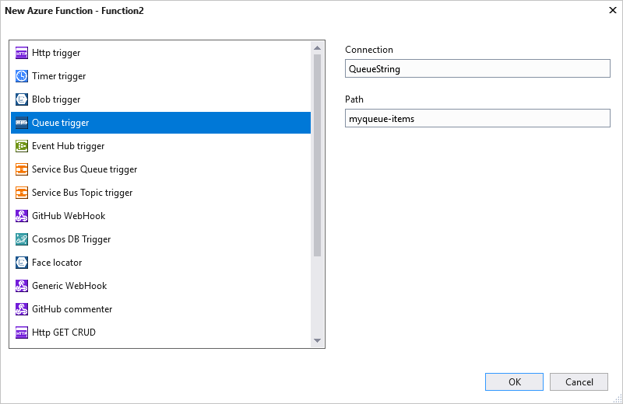
Creating a function
In pre-compiled functions, the bindings used by the function are defined by applying attributes in the code. When you use the Azure Functions Tools to create your functions from the provided templates, these attributes are applied for you.
In Solution Explorer, right-click on your project node and select Add > New Item. Select Azure Function, type a Name for the class, and click Add.
Choose your trigger, set the binding properties, and click Create. The following example shows the settings when creating a Queue storage triggered function.
Examine the newly added class. You see a static Run method, that is attributed with the FunctionName attribute. This attribute indicates that the method is the entry point for the function.

Slide 12
Add bindings to the Azure Function
As with triggers, input and output bindings are added to your function as binding attributes. Add bindings to a function as follows:
Make sure you have configured the project for local development.
Add the appropriate NuGet extension package for the specific binding. The binding-specific NuGet package requirements are found in the reference article for the binding. For example, find package requirements for the Event Hubs trigger in the Event Hubs binding reference article.
If there are app settings that the binding needs, add them to the Values collection in the local setting file. These values are used when the function runs locally. When the function runs in the function app in Azure, the function app settings are used.
Add the appropriate binding attribute to the method signature. In the following example, a queue message triggers the function, and the output binding creates a new queue message with the same text in a different queue.

Slide 13
Testing and publishing Azure Functions
Azure Functions Core Tools lets you run Azure Functions project on your local development computer.
You are prompted to install these tools the first time you start a function from Visual Studio.
To publish to Azure:
In Solution Explorer, right-click the project and select Publish.
Select Azure Function App, choose Create New, and then select Publish.
If you haven't already connected Visual Studio to your Azure account, select Add an account….
In the Create App Service dialog, use the Hosting settings.
Click Create to create a function app and related resources in Azure with these settings and deploy your function project code.
After the deployment is complete, make a note of the Site URL value, which is the address of your function app in Azure.

Slide 14
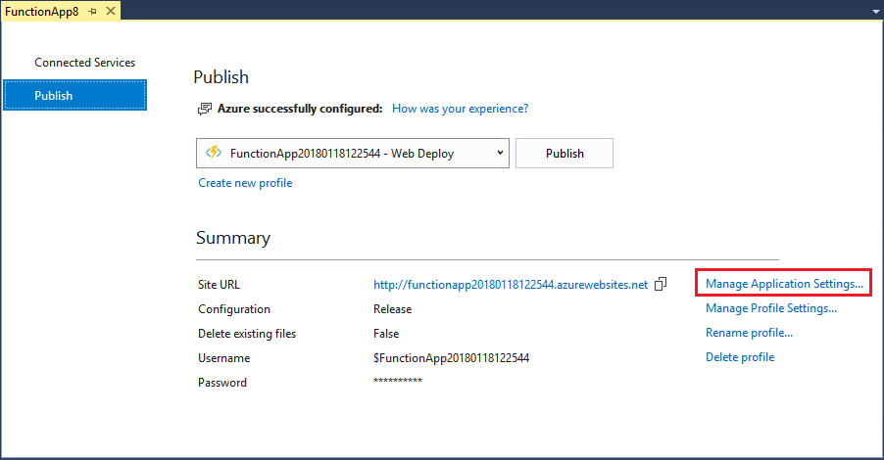
Function app settings
Any settings you added in the local.settings.json must be also added to the function app in Azure. These settings are not uploaded automatically when you publish the project.
The easiest way to upload the required settings to your function app in Azure is to use the Manage Application Settings… link that is displayed after you successfully publish your project.

Slide 15
Module 04 - Understanding Azure Functions Lesson 03: Implement Durable Functions

Slide 16
Durable Functions overview
Durable Functions is an extension of Azure Functions and Azure WebJobs that lets you write stateful functions in a serverless environment. The extension manages state, checkpoints, and restarts for you.
The extension lets you define stateful workflows in a new type of function called an orchestrator function.
Below are examples of the advantages of orchestrator functions:
They define workflows in code. No JSON schemas or designers are needed.
They can call other functions synchronously and asynchronously. Output from called functions can be saved to local variables.
They automatically checkpoint their progress whenever the function awaits. Local state is never lost if the process recycles or the VM reboots.

Slide 17
Create a Durable Function in C#
In this tutorial, you learn how to use the Visual Studio 2017 tools for Azure Functions to locally create and test a “hello world” durable function. This function will orchestrate and chain together calls to other functions.
You then publish the function code to Azure. These tools are available as part of the Azure development workload in Visual Studio 2017.
To complete this tutorial:
Install Visual Studio 2017 and ensure that the Azure development workload is also installed.
Make sure you have the latest Azure Functions tools.
Verify you have the Azure Storage Emulator installed and running.

Slide 18
Fan-out/fan-in Durable Function example
Fan-out/fan-in refers to the pattern of executing multiple functions concurrently and then performing some aggregation on the results. This lesson explains a sample that uses Durable Functions to implement a fan-out/fan-in scenario. The sample is a durable function that backs up all or some of an app's site content into Azure Storage.
In this sample, the functions upload all files under a specified directory recursively into blob storage. They also count the total number of bytes that were uploaded.
A single function execution can only run on a single VM, so the throughput will be limited by the throughput of that single VM. If there's a failure midway through the backup could fail in a partially-completed state. It would then need to be restarted.
A more robust approach would be to write two regular functions: one would enumerate the files and add the file names to a queue, and another would read from the queue and upload the files to blob storage.

