Slide 1
AZ-300T02 Module 01: Evaluating and Performing Server Migration to Azure
Subtitle or speaker name

Slide 2
Module 01: Evaluating and Performing Server Migration to Azure Lesson 01: Migrate to Azure

Slide 3
Optional Video: Migration

Slide 4
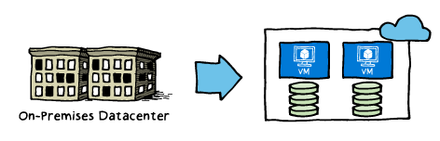
Migration Goals
Technology-focused and business-focused, including:
Addressing the hardware obsolescence cycle
Moving away from the ‘pre-purchase capacity’ model
Lack of IT agility
Desire to re-focus on core competencies
Expense of maintaining a global presence
Enable disaster-recovery scenarios

Slide 5
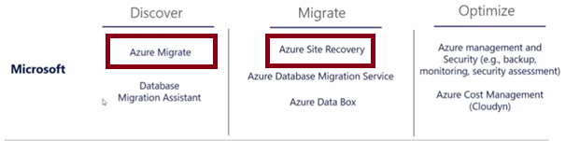
Migration Phases
When planning for migration to Azure, consider the following phases:
Discover: gain better visibility of on-premises workloads and assess the optimal resource level to run them in Microsoft Azure.
Azure Migrate is the primary tool for this, and includes:
Automated server, app, and database discovery.
Intelligent workload right-sizing and costing for maximum ROI.
Workload configuration analyses and recommendations.
Migrate: move selected workloads to Azure.
Azure Site Recovery is the primary tool for this and includes:
Lifting and shifting of servers, apps, databases, and data.
Containerization of existing applications and infrastructure
Modernization options for apps and databases.
Optimize: fine tune your Azure-based workloads and maximize your ROI.
There are many Microsoft partners to help you with backup, monitoring, security assessments, and cost management.

Slide 6
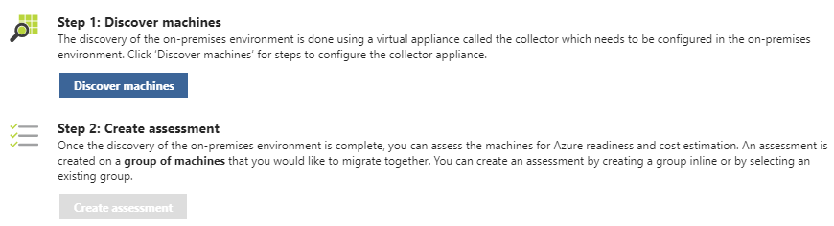
Azure Migration Service
Provides assessment of on-premises workloads for migration to Azure:
migration suitability of on-premises machines
performance-based sizing
cost estimates for running your on-premises machines on Azure VMs
Follows two steps:
Discover machines
Create Assessments

Slide 7
Optional Video: Azure Migrate

Slide 8
Optional Video: Migrating Applications to the Cloud

Slide 9
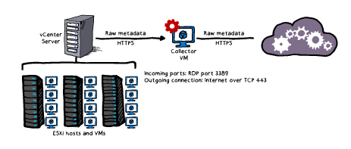
Using Azure Migrate: A Look ahead
Architecture:
Closely integrated with the components of an VMware vCenter environment
Process
Create a project
Discover the machines
Collect the information
Assess the project

Slide 10
Module 01: Evaluating and Performing Server Migration to Azure Lesson 02: Azure Migrate Process

Slide 11
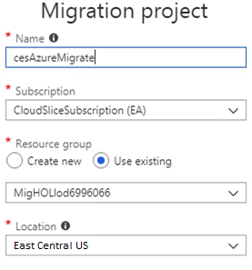
Creating a Project
The initial step of the Azure Migrate
A project contains metadata representing on-premises environment:
Name
Subscription
Resource Group
Location
Discovery records of VMware VMs
Project limits:
Up to 1,500 discovered VMs per project
Up to 1,500 assessed VMs per project
Up to 20 projects per subscription

Slide 12
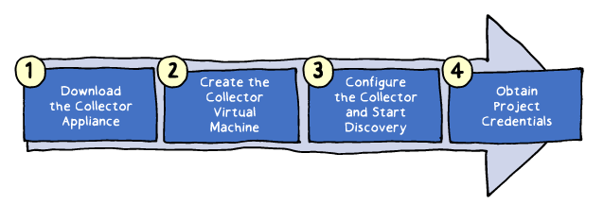
Creating a Collector
A virtual appliance which handles discovery
Implementation consists of four main steps:
Downloading the Collector appliance (an Open Virtualization Appliance (.ova) file downloadable from the Azure Migrate project in the Azure portal)
Creating the Collector virtual machine by importing the .ova file on the vCenter server
Configuring the Collector to initiate discovery
Assigning to the Collector project credentials including Azure Migrate project ID and key

Slide 13
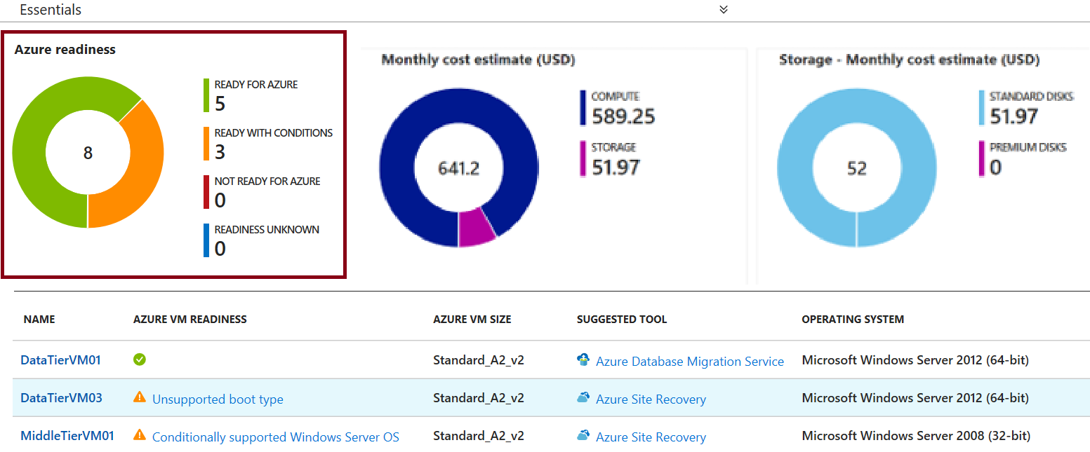
Assessing Readiness
Assessment is based on the readiness status of discovered VMs:
Ready for Azure (green): along with the recommended Azure VM size
Ready with conditions (Orange) and Not ready for Azure (Red): including readiness issues and remediation steps.
Readiness unknown (Blue)

Slide 14
Assessing VM Sizing
Azure Migrate VM assessment offers two types of sizing :
Performance-based sizing (default) which takes into account:
Storage: maps the size and performance of VM disks to Azure VM disks
Network: identifies Azure VM sizes that offer matching number and performance of network adapters
Compute: determines CPU and memory requirements based on performance history of discovered VMs
On-premises sizing:
Matches the size of on-premises VM to an equivalent Azure VM
Does not take into account performance history of discovered VMs

Slide 15
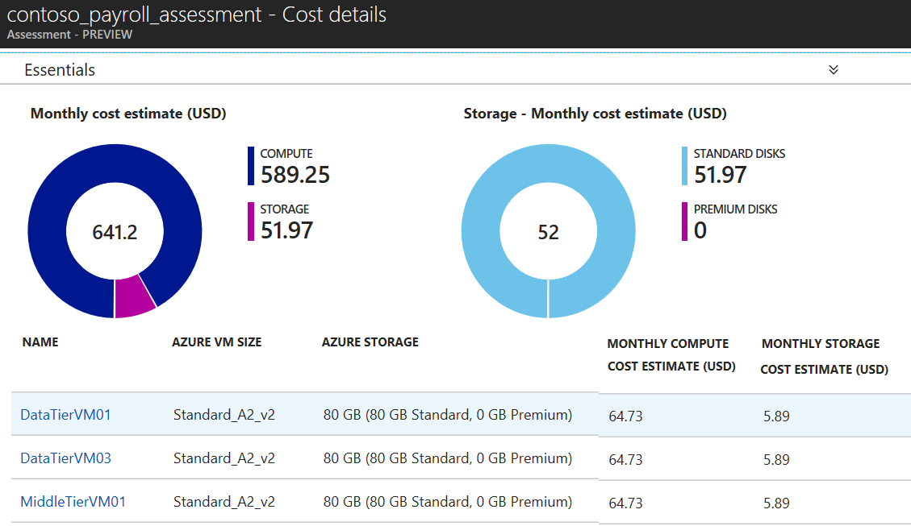
Estimating Cost
Provides the total costs of Azure VMs:
Compute: aggregated monthly cost, which takes into account:
OS type
Software Assurance
Reserved Instances
VM uptime
VM location
currency settings
Storage: aggregated monthly cost.
No offer specific settings

Slide 16
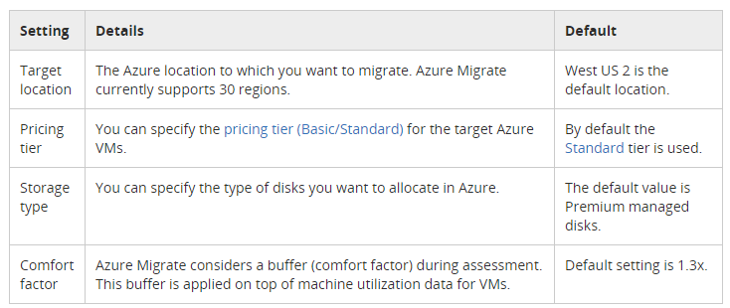
Customizing the Assessment
Customization settings include:
Performance history duration
Target location
Pricing tier
Storage type
Comfort factor
Currency
Discounts
VM uptime

Slide 17
Troubleshooting Azure Migrate
The most common issues include:
Migration project creation failed
No performance data
Collector is not able to connect to the internet
Date and time synchronization error
Error UnableToConnectToServer

Slide 18
Optional Demonstration: Azure Migrate

Slide 19
Practice: Discover and Assess

Slide 20
Practice: Azure Migrate

Slide 21
Module 01: Evaluating and Performing Server Migration to Azure Lesson 03: Overview of Azure Site Recovery (ASR)

Slide 22
Optional Video: ASR Capabilities

Slide 23
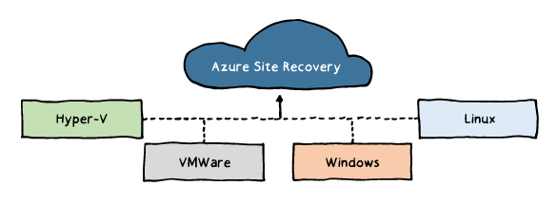
ASR Scenarios
Hyper-V VM replication:
Hyper-V with Virtual Machine Manager (VMM):
Replication to Azure or a secondary datacenter.
Hyper-V without VMM:
Replication to Azure only.
VMware VM replication:
Replication to a secondary site running VMware or to Azure.
Physical Windows and Linux machines:
Replication to a secondary site running VMware or to Azure.

Slide 24
ASR Features
Eliminating the need for disaster recovery sites
Reducing infrastructure costs
Automatically replicating to Azure
Safeguarding against outages of complex workloads
Extending or boosting capacity
Continuous health monitoring

Slide 25
Optional Video: ASR Features

Slide 26
Optional Video: ASR End to End

Slide 27
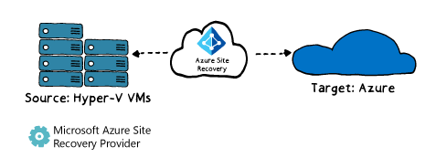
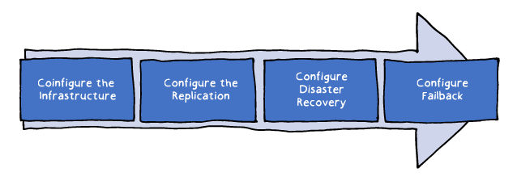
Using ASR: A Look Ahead
Architecture:
The primary and a secondary site
On-premises or in Azure
Process:
Configure the Infrastructure
Configure the Replication
Configure Disaster Recovery
Configure Failback

Slide 28
Module 01: Evaluating and Performing Server Migration to Azure Lesson 04: Preparing the Infrastructure

Slide 29
Configuring Azure
Delegate permissions within the target Azure subscription:
Virtual Machine Contributor built-in role
Site Recovery Contributor built-in role
Create an Azure Storage account:
General Purpose
Read-access geo-redundant
Secure transfer: Disabled
Create an Azure virtual network:
Ensure sufficient bandwidth for intersite replication

Slide 30
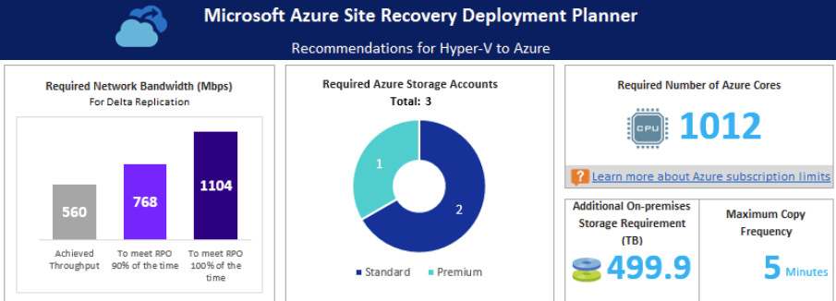
ASR Deployment Planner
A command line tool for profiling Hyper-V VMs to estimate:
Intersite network bandwidth requirements
Azure Storage requirements
Generates a report including:
On-premises summary
Recommendations
VM storage placement
Compatible VMs
Incompatible VMs
Storage requirement
Initial Replication batching
Cost estimate

Slide 31
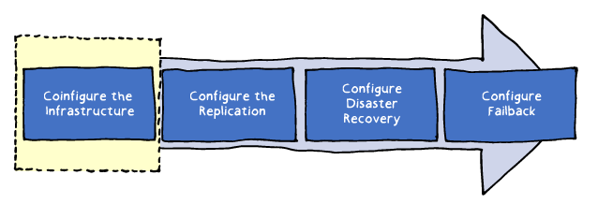
Configure the Infrastructure: Requirements
Verify Hyper-V operating system requirements:
Windows Server 2016 (including server core installation)
Windows Server 2012 R2 with latest updates.
Mixing hosts running Windows Server 2016 and 2012 R2 isn't supported.
Verify Hyper-V host and guest storage requirements:
Hyper-V host storage can include SMB 3.0, SAN (iSCSI), and Multi-path (MPIO).
No support for shared cluster disks and encrypted disks.
Verify internet access:
Hyper-V hosts should have direct access to the internet without using a proxy.
Prepare Windows VMs for access
following a failover (optional)

Slide 32
Configure the Infrastructure: Process
The Azure portal driven sequence:
1. Protection goal (e.g. replicating Hyper-V machines to Azure)
2. Source environment (e.g. Hyper-V site)
3. Target environment (e.g. a resource group in an Azure subscription)
4. Replication settings
5. Deployment planning

Slide 33
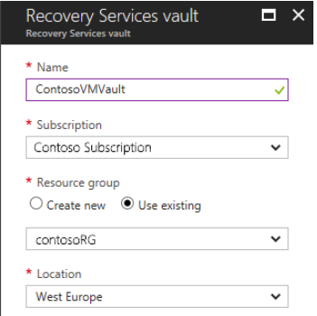
Recovery Services Vault
Hosts ASR metadata and replicated VM disks
Can be created directly from the Azure portal
Serves as the primary configuration interface

Slide 34
Optional Video: Configure the Infrastructure

Slide 35
Practice: Preparing the Azure Environment

Slide 36
Practice: Preparing On-premises Hyper-V Servers

Slide 37
Module 01: Evaluating and Performing Server Migration to Azure Lesson 05: Completing the Migration Process

Slide 38
Optional Video: Configure Failback

Slide 39
Customize the Recovery Plan
Select a replication goal
Set up the source and target environment
Set up a replication policy
Enable replication
Run a test migration to make sure everything's working as expected
Run a one-time failover to Azure

Slide 40
Practice: Using PowerShell to Migrate VMs to Azure

Slide 41
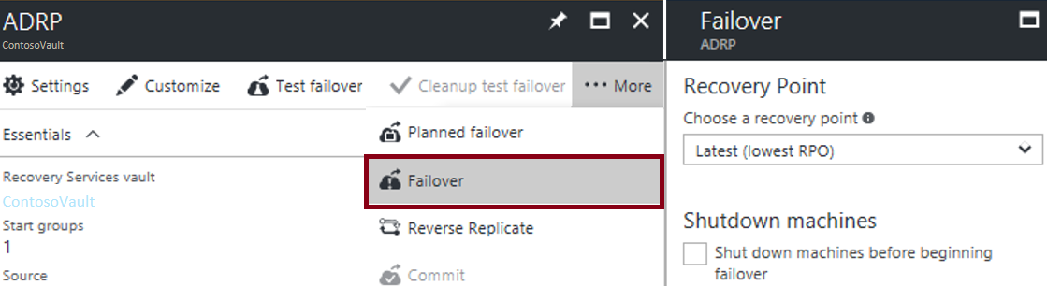
Planned and Unplanned Failovers
ASR facilitates two types of failover:
Planned: guaranteed no data loss
Unplanned: possible data loss
ASR failovers:
are not automatic
can be initiated from the Azure portal

Slide 42
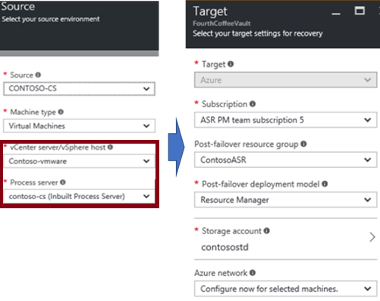
Enable Replication
Start by configuring:
Replication source
Replication target

Slide 43
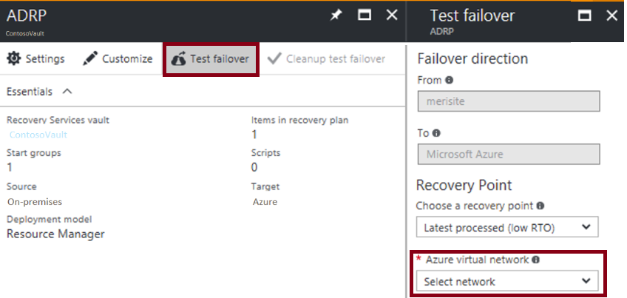
Test Failover
No-impact validation of replication and disaster recovery strategy:
Does not affect ongoing replication and the production environment
Supports single or multiple VMs
Does not require downtime
Does not introduce data loss
Best practices:
Use failover groups
Failover to an isolated network
Integrate with Azure Automation

Slide 44
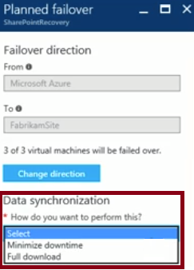
Failback
A planned failover back to the primary site
Offers two data synchronization methods:
Full download:
Faster
Requires VMs to be shut down
Minimize downtime:
Slower
Eliminates the need to shut down VMs

Slide 45
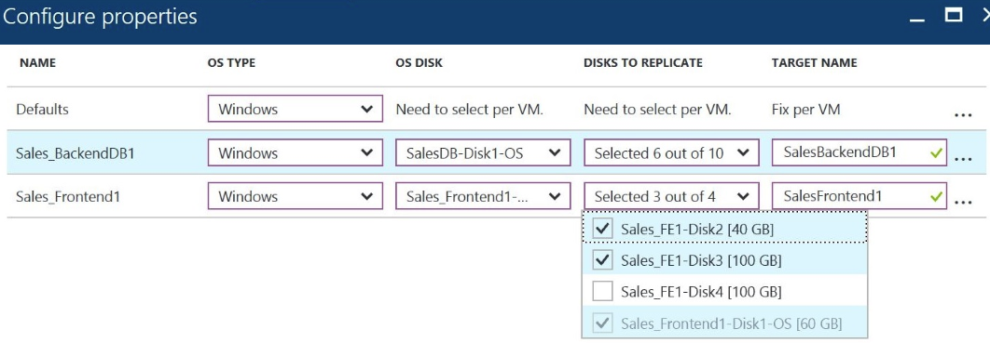
Virtual Machine Replication
To configure:
Select source computers
For each, select the OS type, OS disk, and data disks to replicate
Optionally, exclude disks (e.g. disks hosting a paging file)
For each, specify the name of a target VM

Slide 46
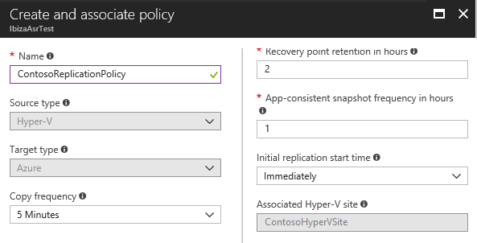
Replication Policy
To configure, specify the following parameters:
Copy frequency:
30 seconds
5 minutes
15 minutes (to be retired)
Recovery point retention
App-consistent snapshot
Initial replication start time

Slide 47
Online Lab: Implementing Azure to Azure Migration

