Slide 1
AZ-300T02 Module 2: Implementing and Managing Application Services
Subtitle or speaker name

Slide 2
Module 02: Evaluating and Performing Server Migration to Azure Lesson 01: Deploying Web Apps

Slide 3
Web App Features
Service included in the App Service offering, which provides:
Multiple languages and frameworks
DevOps optimization
Global scale with high availability
Connections to SaaS platforms and on-premises data
Security and compliance
Application templates
Visual Studio integration
API and mobile features
Serverless code

Slide 4
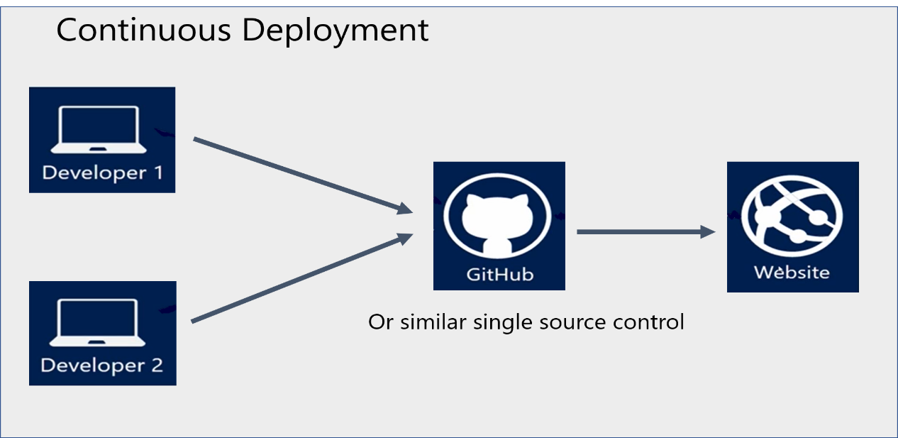
What is Continuous Development?
Automatic publishing of updates to source control code:
Visual Studio Team Services
Bitbucket
GitHub
Git
and many others…

Slide 5
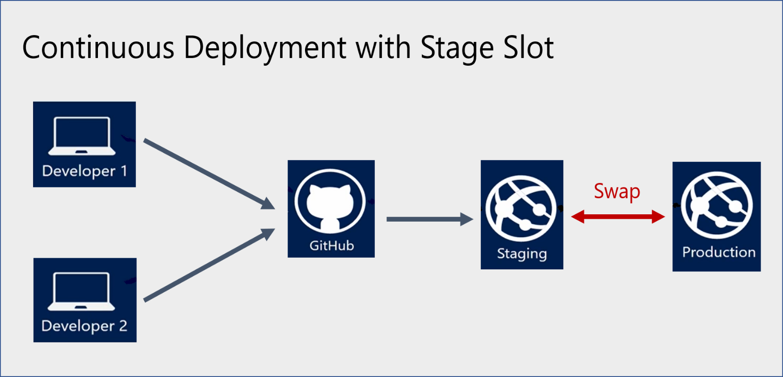
Staging Environments in App Service
A separate deployment slot of App Service services:
Supported by web apps, mobile apps, and API apps
Requires a higher pricing tier:
Standard
Premium
Isolated
Offers a number of benefits:
Additional validation of app changes
Slot warming before swap
Support for auto-swap
Immediate rollback

Slide 6
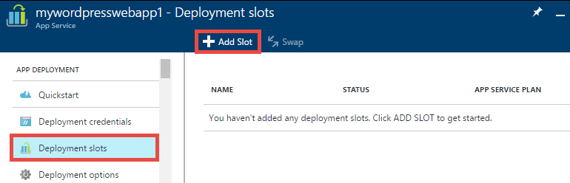
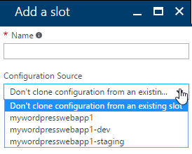
Add a Deployment Slot
The operation can be performed directly from the Azure portal
Slot cloning:
For the first slot:
you can clone the production slot
For subsequent slots:
you can clone any existing slots

Slide 7
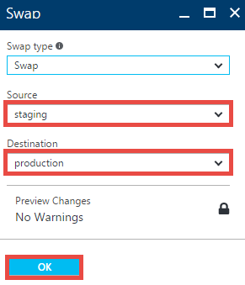
Swap Deployment Slots
There are three types of slot swapping settings:
Settings that are not swapped:
publishing endpoints, custom domain names, SSL certificates and bindings, scale settings, WebJob schedulers.
Settings that are swapped:
general settings, handler mappings, monitoring, diagnostics, and WebJobs.
Settings that are configurable (either swapped or not swapped):
App settings and connection strings.

Slide 8
Demonstration: Deploying to a Stage Slot

Slide 9
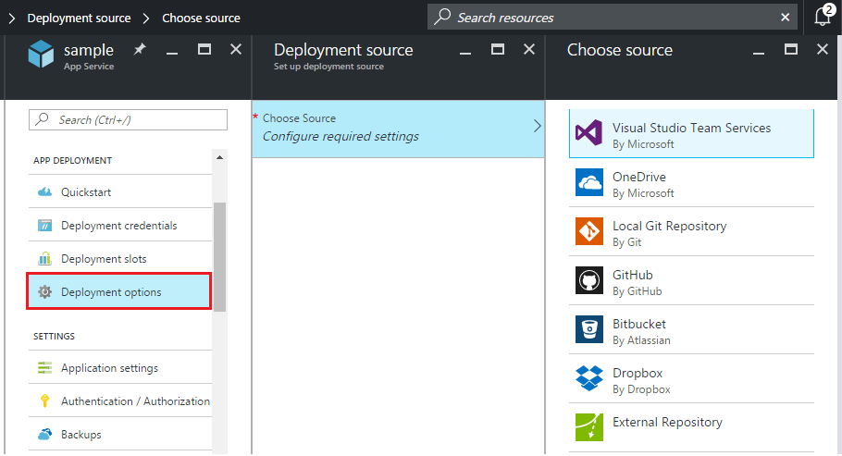
Enabling Continuous Deployment
Configurable from the Azure portal:
VSTS
OneDrive
Local Git
GitHub
Bitbucket
Dropbox
External Repository

Slide 10
Demonstration: Continuous Deployment

Slide 11
Optional Video: Managing App Setting and Connection Strings

Slide 12
Practice: Deployment Slots

Slide 13

Web App Templates
Azure Resource Manager templates for:
Deploying a Windows-based web app:
Configuring a Windows-based web app:
Deploying and configuring a Linux-based web app
Deploying web apps with connected resources (e.g. an Azure SQL Database)
Creating App Service Environment v2

Slide 14
Module 02: Implementing and Managing Application Services Lesson 02: Managing Web Apps

Slide 15
Optional Video: Management Tools and Options

Slide 16
Optional Video: Managing App Settings Overview

Slide 17
Optional Video: Managing General App Settings

Slide 18

Backup Your App
To configure Azure web app backups, provide:
1. Backup storage which designates backup destination:
Azure Storage account and container
2. Backup database (in scenarios where the web app uses a back-end database):
The database must be referenced in the connection strings of the web app
The backup supports Azure SQL Database, Azure Database for MySQL, Azure Database for PostgreSQL, and MySQL in-app
3. Backup schedule (in order to automate backups)

Slide 19
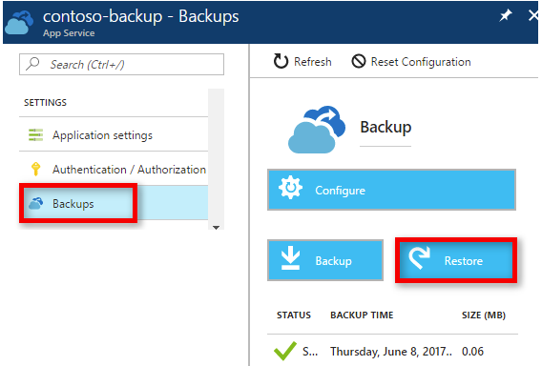

Restore a Backup
Available from the Azure portal
Included in higher pricing tiers:
Standard
Premium
Requires designating:
Restore source:
Any backup of the current web app
Any web app backup in Azure Storage
Restore destination:
An existing web app
A new web app

Slide 20
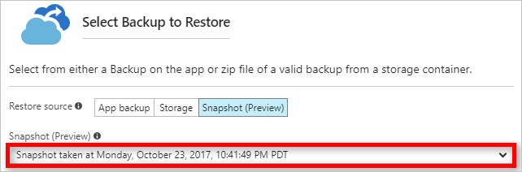
Restore a Snapshot
Automatic, incremental shadow copies of a web app:
Requires the Premium pricing tier
Is a subject to a number of constraints:
You can only restore to the same app or to a slot belonging to that app.
App Service stops the target app or target slot during the restore.
App Service keeps three months’ worth of snapshots for platform data recovery purposes.
You can only restore snapshots from the last 30 days.
Offers several benefits:
No file copy errors due to file locks.
No storage size limitation.
No configuration required

Slide 21
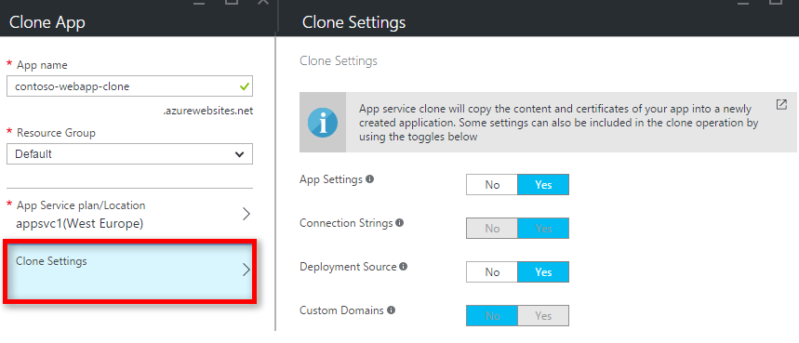
Cloning an App
Creates a replica of a web app in the same or a different region:
Requires the Premium pricing tier
Allows selecting settings to clone, including:
Connection strings
Deployment source
Custom domains
Does not include:
Auto scale settings
Backup schedule
VNET settings
Auth settings
Kudu Extensions
TiP rules
Database content
App Insights

Slide 22
Practice: Azure Backup and Restore

Slide 23
Module 02: Implementing and Managing Application Services Lesson 03: App Service Security

Slide 24
Video: App Security Features Overview

Slide 25

App Service Security Levels
Infrastructure and platform security:
Controlled by the Azure platform
Includes compute, storage, network, web frameworks, integration features, etc.
Involves continuous security and compliance checks:
App Service apps are isolated from both the Internet and from the other customers' Azure resources.
Communication of secrets between App Service apps and other Azure resources does not cross network boundaries and is always encrypted.
Communication between App Service apps and external resources, such as PowerShell, Azure CLI, Azure SDKs, REST APIs, and hybrid connections, is properly encrypted.
24-hour threat management protects App Service resources from malware, distributed denial-of-service (DDoS), man-in-the-middle (MITM), and other threats.
Application security:
Controlled by customers
Includes Azure AD integration, certificate management, secure communication, etc.

Slide 26
Application Security
Customers are responsible for:
Developing, deploying, and managing App Service code and content in a secure way
Protecting apps from cyber threats such as:
SQL Injection
Session hijacking
Cross-site-scripting
Application level Man-In-the-Middle (MITM) attacks

Slide 27
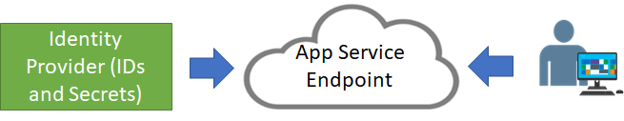
App Service Authentication
Relies on a trust relationship with an identity provider (IdP):
You select an identity provider for your App Service app
The identity provider handles authentication and generates authentication token
The App Service app validates token assertions and authorizes access to its resources
Cookies, JWTs, and bearer tokens validate access for the duration of a session
Directs authentication requests to an authentication endpoint
Includes built-in supports for the most popular identity providers

Slide 28
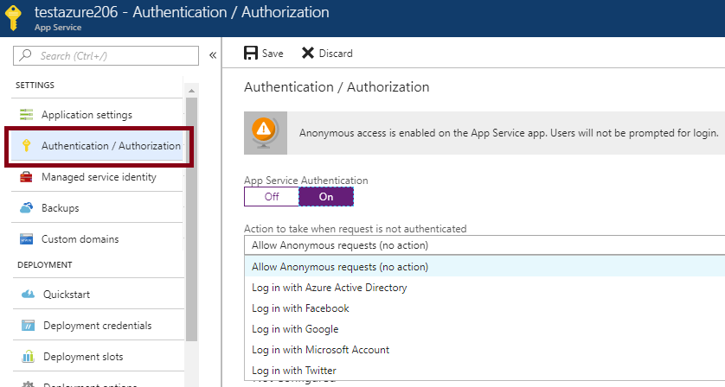
Authentication Providers
Configurable directly from the Azure portal:
Relies on the Authentication/Authorization feature
Uses federated identity
Offers built-in support for:
Azure AD
Facebook
Google
Microsoft Account
Twitter

Slide 29
Optional Video: App Service Authentication Options

Slide 30
Demonstration: Authentication and Authorization Features

Slide 31
Demonstration: App Service Security Features

Slide 32
Optioanl Video: App Service Isolation Overview

Slide 33
Demonstration: App Service Isolation

Slide 34
Module 02: Implementing and Managing Application Services Lesson 04: Serverless Computing Concepts

Slide 35
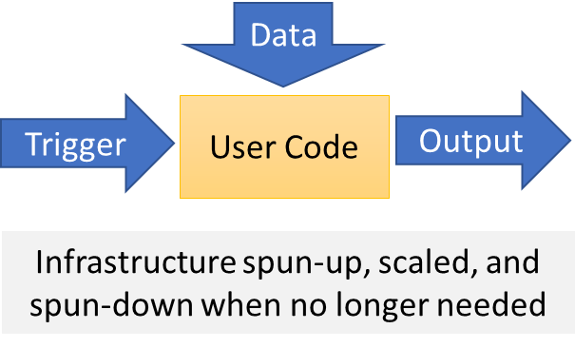
Serverless Computing
Abstracts servers, infrastructure, and operating systems
Reacts to events and triggers in near-real time
Offers a range of benefits:
Eliminates management overhead
Allows developers to focus on business logic
Implements flexible scaling
Reduces costs

Slide 36
Serverless Applications
Compute:
Azure Functions
Cloud Messaging:
Event Grid
Service Bus
Workflow Orchestration:
Logic Apps

Slide 37
Optional Video: Serverless Computing

Slide 38
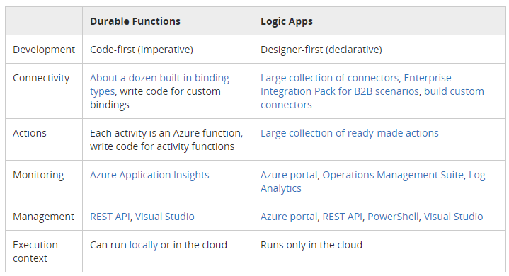
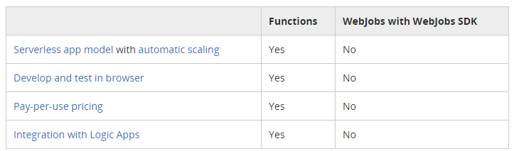
Comparing Serverless Options
Azure Functions vs Logic Apps:
Azure Functions and WebJobs:

Slide 39
Module 02: Implementing and Managing Application Services Lesson 05: Managing Azure Functions

Slide 40
Optional Video: Azure Functions

Slide 41
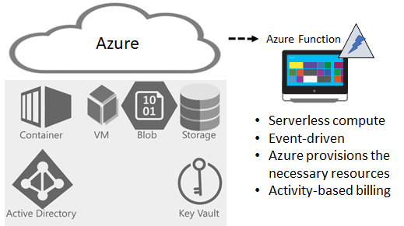
Overview of Azure Functions
Serverless compute service:
Eliminates the need to explicitly provision or manage infrastructure
Enables running code on-demand or in response to a trigger
Incurs charges only when active

Slide 42
Features of Azure Functions
Support for a range of programming languages:
C#, F#, Node.js, Python, PHP, batch, bash, or any executable.
Pay-per-use pricing model
Support for custom dependencies:
NuGet and NPM-based libraries.
Integration with the most popular OAuth providers:
Azure AD, Facebook, Google, Twitter, and Microsoft Account.
Integration with other Azure services and SaaS apps.
Flexible development:
Directly from the Azure portal
Via continuous integration through GitHub, VSTS, and other supported development tools.
Open-source: available on GitHub.
Ease of code reuse:
Developers can reuse their functions in multiple applications.

Slide 43
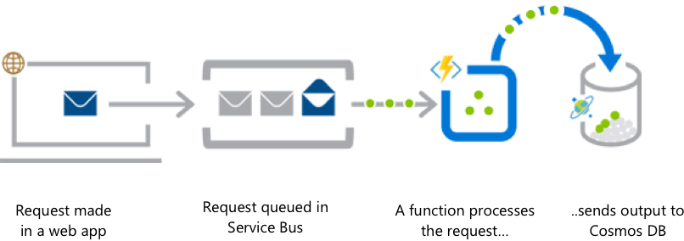
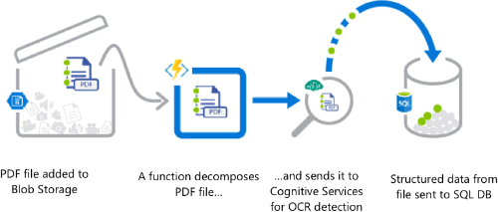
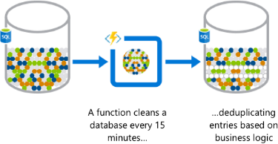
Azure Functions (Examples)
Web app backend
Real-time file processing
Automation of scheduled tasks

Slide 44
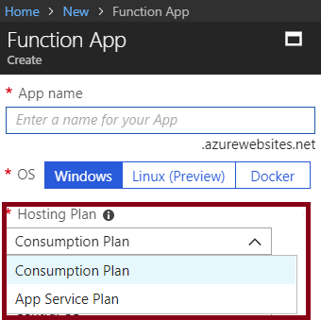
Function Service Plans
Hosting plans:
Consumption Plan:
Azure provides all the necessary compute resources on-demand
Automatic scaling of CPU and memory
Billing is based on:
number of executions
execution time
memory used.
App Service Plan:
The same resource and billing model as for web, mobile, and API apps
Allows for leveraging underutilized App Service deployments
Required for Linux-based function apps

Slide 45
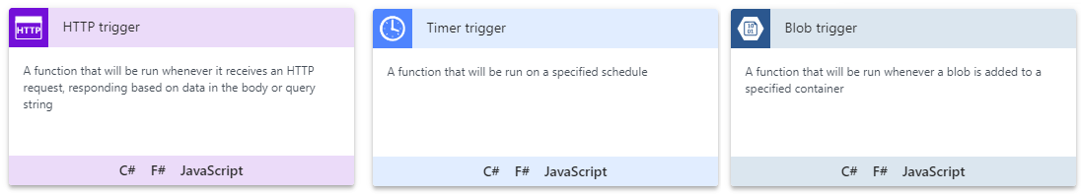
Function Templates
Simplify creating functions for a specific trigger type:
HTTP
Timer
Blob
Event Hub
GitHub
Webhook
Queue

Slide 46
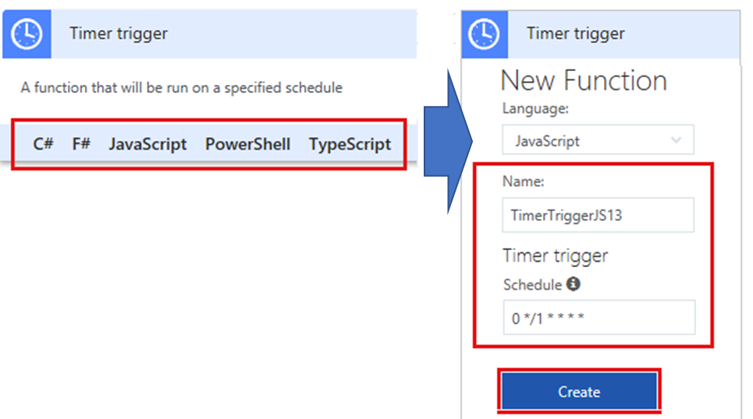
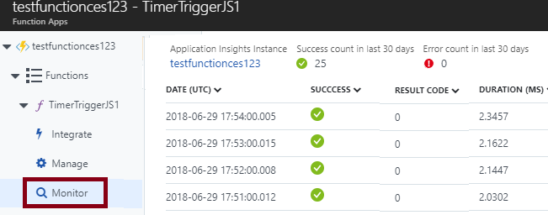
Implementing Functions
In-portal authoring
In-portal monitoring

Slide 47
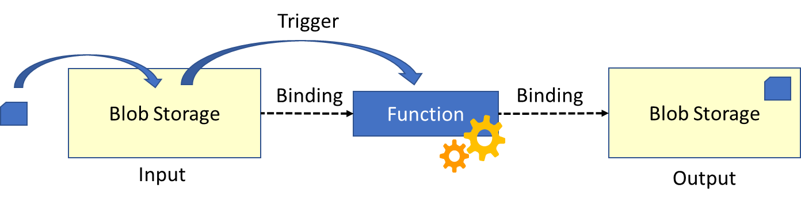
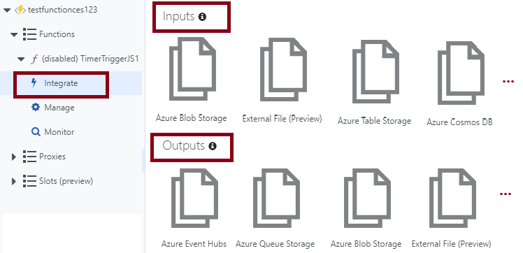
Bindings
Link functions to other services as:
Inputs
Outputs
Configurable in the Azure portal:
Accessible via the Integrate link

Slide 48
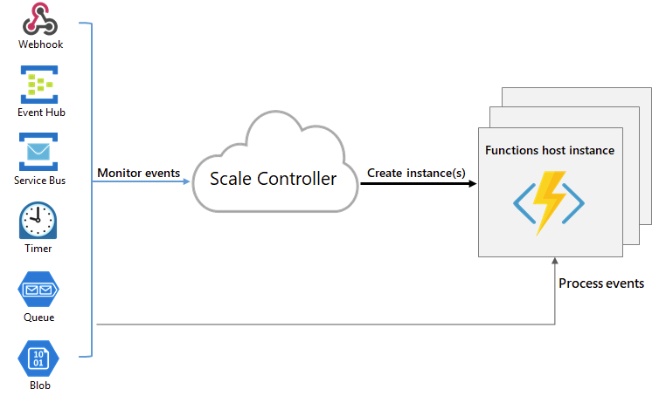
Function Scaling
Relies on the platform-managed Scale Controller
Scale Controller:
Monitors the rate of events
Controls horizontal scaling
Relies on heuristics:
E.g. for Queue Storage trigger:
The queue length
The age of the oldest message

Slide 49
Demonstration: Azure Functions

Slide 50
Practice: Blob Storage Functions

Slide 51
Practice: Timer Functions

Slide 52
Module 02: Implementing and Managing Application Services Lesson 06: Managing Event Grid

Slide 53
Optional Video: Event Grid Overview

Slide 54
Optional Video: Implementing Event Grid

Slide 55
Overview of Event Grid
Managed event routing service with a wide range of benefits:
Simplifies event delivery:
Connects multiple event sources and destinations, including virtually all Azure services and custom sources
Provides fully managed event delivery, intelligent filtering, and the ability to send events to multiple recipients at once
Eliminates polling and the associated cost and latency
Decouples event publishers from subscribers by using a pub/sub model and HTTP-based event delivery,
Simplifies building scalable serverless applications, microservices, and distributed systems.
Facilitates developing reliable cloud applications:
Supports massive auto-scaling with near-real-time notifications for changes
Implements reactive programming leveraging guaranteed event delivery
Promotes focus on product innovation

Slide 56
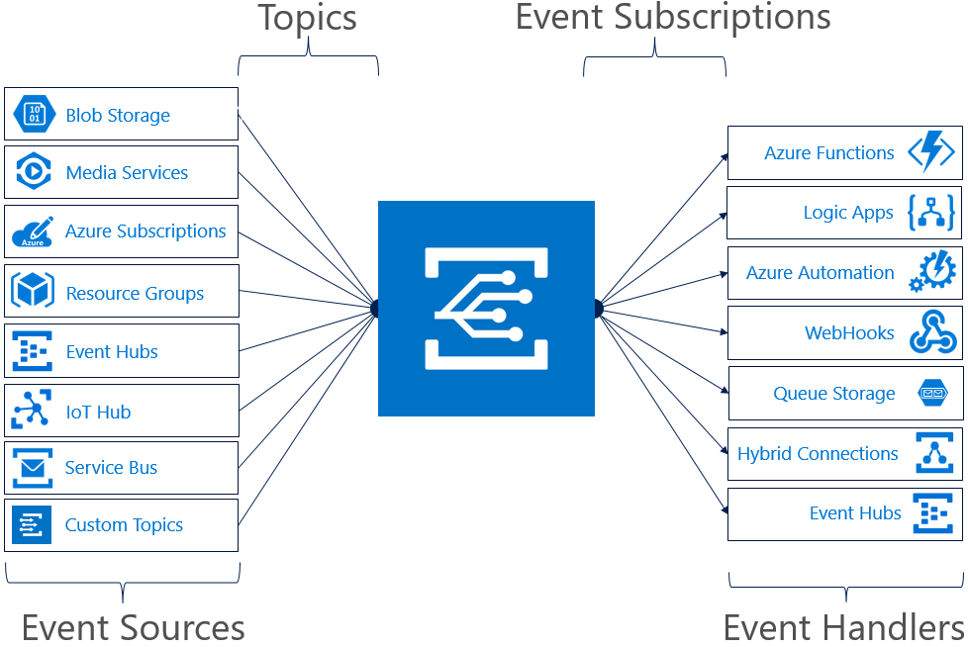
Event Grid Concepts
Event Sources
Topics
Event Subscriptions
Event Handlers

Slide 57
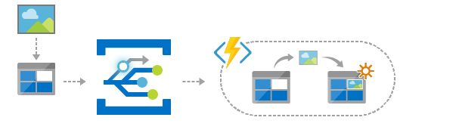
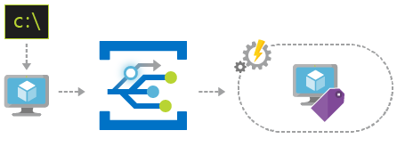
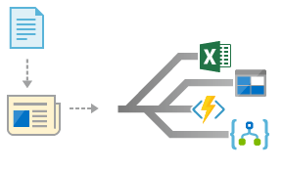
Event Grid Examples
Serverless application architecture
Ops automation
Application integration

Slide 58
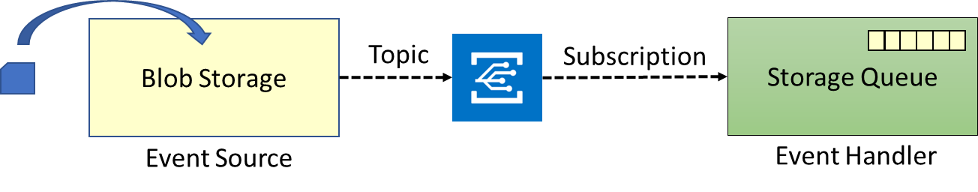
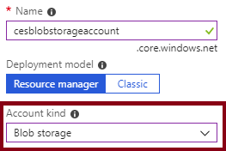
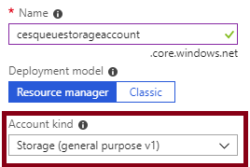
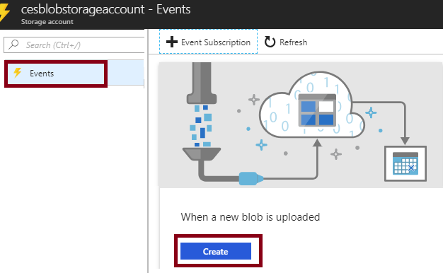
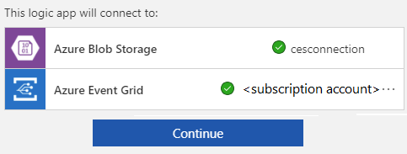
Implementing Event Grid (Part 1)
Implementation components:
Event source: Azure Blob Storage
Event Handler: Azure Queue Storage
Implementation steps (part 1):
1. Create an Azure Storage account (Blob storage)
2. Create an Azure Storage account (general purpose v1))
3. Create an Azure Storage queue
4. Create the event source:
Use the When a new blob is uploaded template
5. Configure the event source:
When prompted, provide the Blob storage account

Slide 59
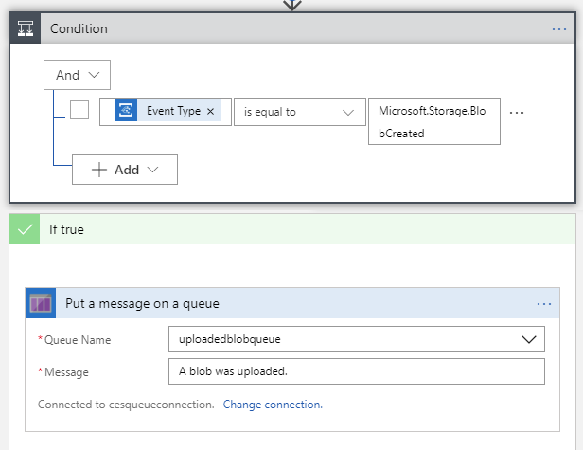
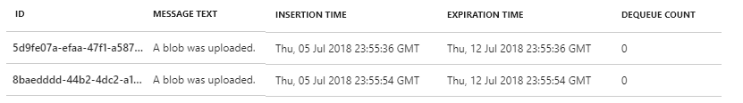
Implementing Event Grid (Part 2)
Implementation steps (part 2):
6. Edit the Logic App:
One condition: True whenever a blob is created
One action: Add a message to the queue.
7. Save changes and start the Logic App
8. Create an storage container and upload a blob
9. View messages in the Storage queue
10. To avoid future charges, delete all resources

Slide 60
Practice: Event Grid

Slide 61
Module 02: Implementing and Managing Application Services Lesson 07: Managing Service Bus

Slide 62
Optional Video: Service Bus

Slide 63
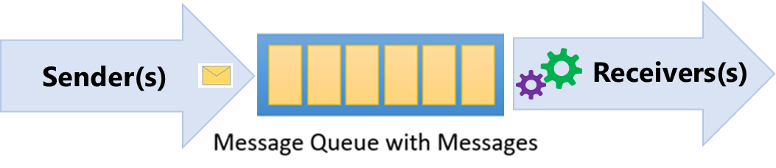
Queues
Azure Service Bus Queues provide:
Asynchronous, brokered messaging
Temporal decoupling of message senders and receivers
Structured message processing
Publish/subscribe capabilities
First In, First Out (FIFO) message delivery

Slide 64
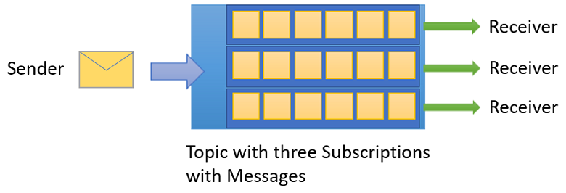
Topics and Subscriptions
One-to-many communication in a publish/subscribe pattern
Useful for scaling large number of recipients
Each published message is available to topic-registered subscriptions
Subscriptions use filters to designate messages to receive

Slide 65
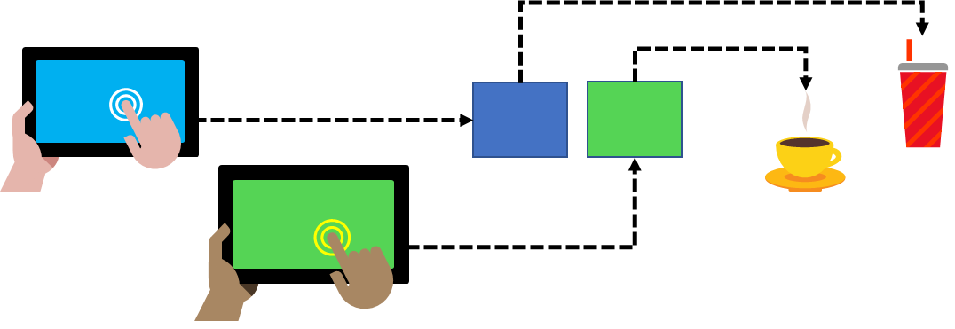
Service Bus Features
Load Leveling
Loose Coupling
Load Balancing

Slide 66
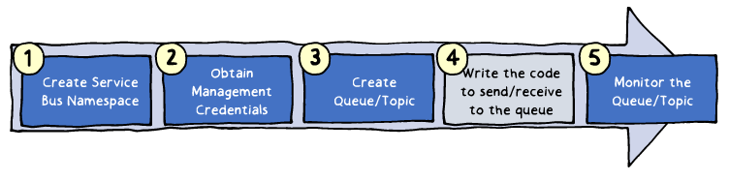
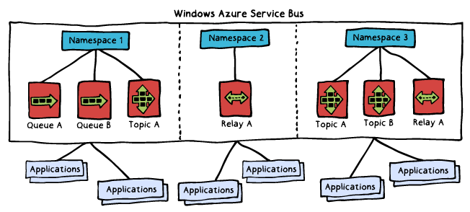
Implementing Service Bus
Implementation steps:
1. Creating a Service Bus namespace
2. Obtaining management credentials
3. Creating queues and topics
4. Writing code to send/receive messages
5. Managing and monitoring queues and topics

Slide 67
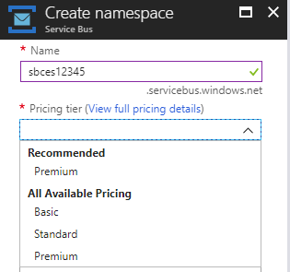
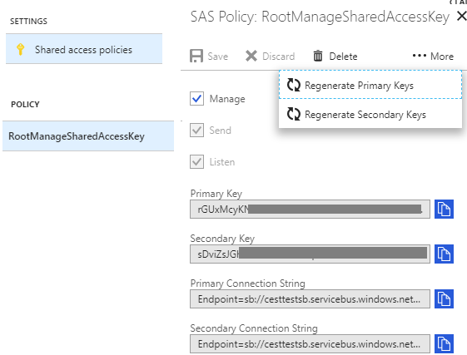
Creating the Namespace
Available directly from the Azure portal:
Name: globally identifies the namespace
Pricing tier: determines capacity and capabilities
Basic
Standard
Premium
Generates a SAS policy:
Includes:
Primary key
Secondary key
Grants full control to the namespace

Slide 68
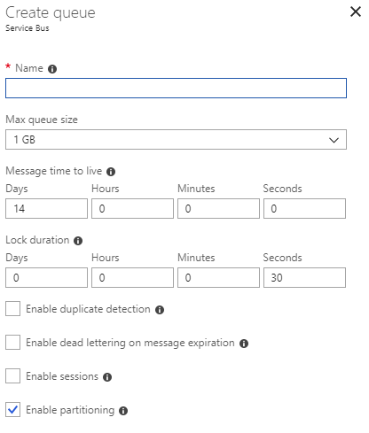
Create a Queue
Available directly from the Azure portal:
Name: identifies the queue within the namespace
Max queue size
Message time to live
Lock duration
Enable duplicate detection
Enable dead lettering
Enable sessions
Enable partitioning

Slide 69
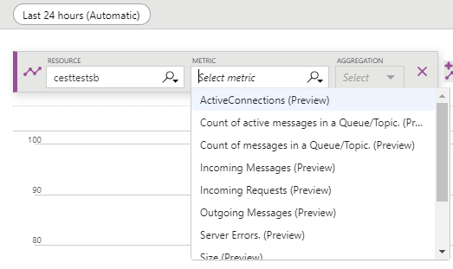
Monitoring Service Bus
Available directly from the Azure portal:
A rich set of metrics:
Namespace level
Queue/topic/message level
Diagnostic logs:
Capture all queue activities

Slide 70
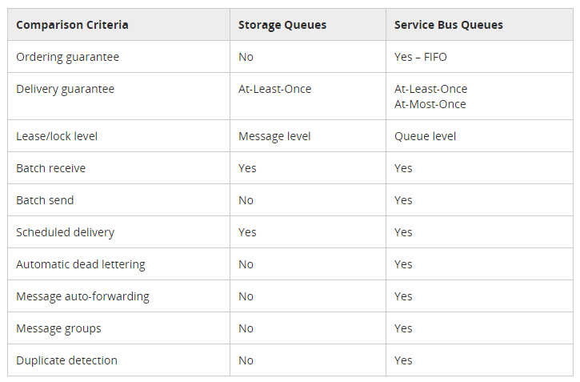
Comparing Service Bus and Storage Queues

Slide 71
Practice: Service Bus Message Queues

Slide 72
Practice: Service Bus Templates

Slide 73
Module 02: Implementing and Managing Application Services Lesson 08: Managing Logic App

Slide 74
Optional Video: Service Bus

Slide 75
Optional Video: Getting Started with Logic Apps

Slide 76
Logic Apps
Implement scalable integrations and workflows
Include a visual designer to model workflows
Offer built-in connectors for cloud and on-premises services and apps
Provide a range of benefits, including:
Getting started quickly from templates.
Saving time by designing complex processes using easy to understand design tools.
Implementing patterns and workflows seamlessly, that would otherwise be difficult to implement in code.
Customizing your logic app with your own custom APIs, code, and actions.
Connecting and synchronizing disparate systems across on-premises and the cloud.

Slide 77
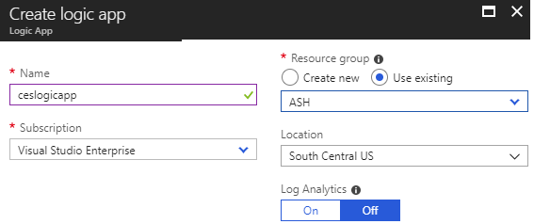
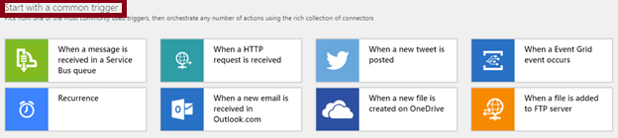
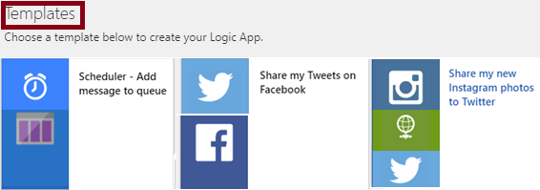
Implementing Logic Apps
From the Azure portal:
To create a logic app, provide:
Name
Subscription
Resource Group
Location
To configure a logic app:
Use the Logic Apps Designer to:
Add triggers
Add connectors
Leverage templates

Slide 78
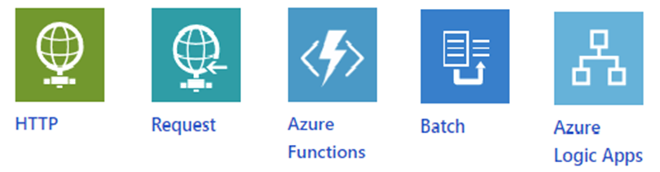

Built-in Triggers and Actions
Triggers:
Recurrence
HTTP
Request
Azure Functions
Batch
Logic Apps
Actions:
Condition
For each
Scope
Switch
Terminate
Until

Slide 79

Managed Connectors
200+ built-in connectors, including:
Managed API connectors:
Azure Blob Storage, Office 365, Dynamics, Power BI, OneDrive, Salesforce, and SharePoint Online.
On-premises connectors:
SQL Server, SharePoint Server, Oracle DB, Twitter, Salesforce, Facebook, and file shares.
Integration account connectors:
Require a paid-for integration account
Transform and validate XML
Encode and decode flat files
Process B2B messages
Enterprise connectors:
Incur extra cost
Provide access to enterprise systems:
Support SAP and IBM MQ.

Slide 80


Logic App Example
The Scheduler logic app consists of:
Recurrence:
Controls scheduling
Put a message on a queue:
Designates the target Storage queue

Slide 81


Logic App Example (cont.)
To customize the workflow:
Add a extra action:
Variable (Initialize Variable)
Modify the action sequence
Add variable to the message

Slide 82
Practice: Logic App Workflow (Advanced)

