Slide 1
AZ-300T06 Module 01: Developing Long-Running Tasks and Distributed Transactions
Subtitle or speaker name

Slide 2
Module 01: Developing Long-Running Tasks and Distributed Transactions Lesson 01: Implement large-scale, parallel, and high-performance apps by using batches

Slide 3
High-performance computing (HPC)
Aggregation of complex processes across different computing nodes:
Maximizes computing power
Facilitates sharing memory and cross-communication between nodes
Leverages cloud benefits to allow access to small and medium-sized enterprises:
Increased elasticity and manageability
Decreased complexity and cost

Slide 4
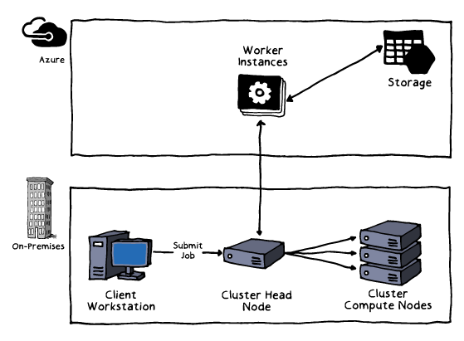
HPC using Microsoft Azure Virtual Machines
Available via Microsoft HPC Pack
Offers cluster and job management capabilities
Consists of a head node (Windows) and compute nodes (Windows or Linux)
Supports “burst to Azure” hybrid scenarios
Benefits from RDMA support of:
H-series VMs (H16r and H16mr):
Intel Haswell-based 16 vCPUs
DDR4 memory
SSD temporary storage
A8 and A9 VM sizes
N-series VMs (designated with “r”)

Slide 5
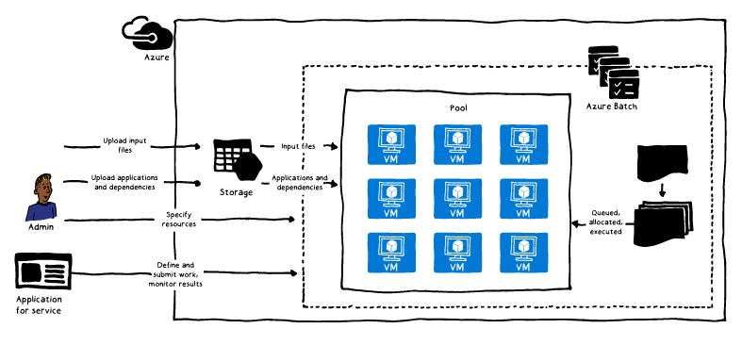
Azure Batch for HPC
PaaS service for large-scale parallel and HPC applications:
Offers autoscaling, automatic node management, and job scheduling
Facilitates scenarios involving end-of-cycle processing, highly scalable apps, and intrinsically parallel workloads e.g.:
Fluid dynamics simulations
Digital content creation
Financial services
Life science research
Image rendering
Supports Batch API

Slide 6
Module 01: Developing Long-Running Tasks and Distributed Transactions Lesson 02: Implement resilient apps by using queues

Slide 7
Asynchronous messaging
Facilitates communication in partitioned workloads scenarios
Enables applications and services to communicate and cooperate
Simplifies building scalable and resilient solutions
Supports asynchronous operations
Allows for decoupling consumers and implementers of services

Slide 8
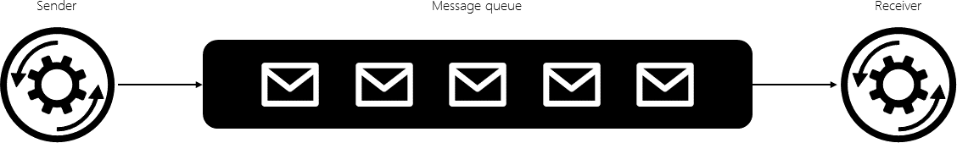
Message queues
Implement asynchronous messaging
Support three fundamental operations:
A sender can post a message to the queue.
A receiver can retrieve a message from the queue (the message is removed from the queue).
A receiver can examine (or peek at) the next available message in the queue (the message is not removed from the queue).

Slide 9
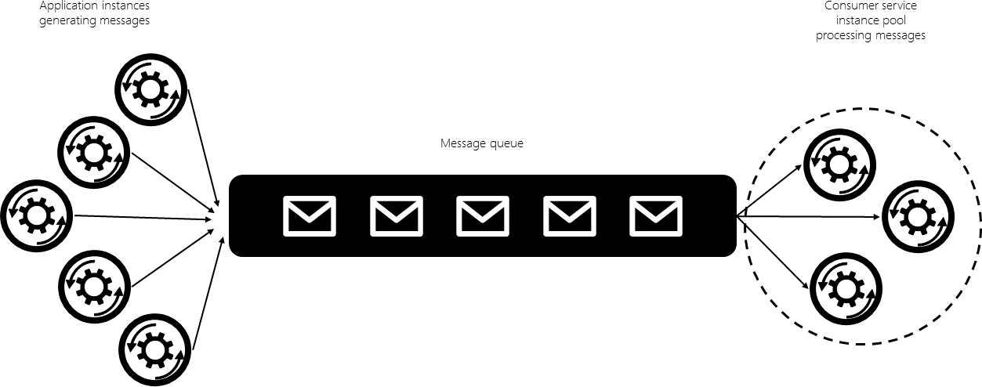
Concurrent queue consumers
Facilitate unpredictable and highly dynamic workloads:
Eliminate the bottleneck associated with a single consumer
Require additional provisions, including:
Coordination among consumers
Load distribution and balancing
Support the use of queues:
Azure Service Bus queues
Azure Storage queues

Slide 10
Using Azure Storage queues in code
Sending a message to a queue:
Create a new CloudQueueMessage
Call the AddMessage method
A CloudQueueMessage can be created from either a string (in UTF-8 format) or a byte array.
Receiving messages from a queue:
Peek at the message in the front of a queue without removing it from the queue by calling the PeekMessage method
Dequeue a message from a queue in two steps (this ensures that if your code fails to process a message due to a hardware or software failure, another instance of your code can get the same message and try again):
Call GetMessage: a message returned from GetMessage becomes invisible to any other code reading messages from this queue. By default, this message stays invisible for 30 seconds.
Call DeleteMessage after the message has been processed to finish removing the message from the queue

Slide 11
Using Azure Service Bus queues in code
Sending messages to a queue:
Create a client that grants access to a specific queue by using the QueueClient class:
pass in a connection string for the Service Bus namespace and the name of a specific queue
Send one or more messages by using the SendAsync or SendBatchAsync method:
Both methods require that you encapsulate the queue message in an object of type Message
Receiving messages from a queue:
Use the same queue client, register a method to new messages asynchronously
Implement the new method:
Include any custom logic but ensure conformance to the Handler(Message, CancellationToken) signature
Call the CompleteAsync method of the queue client at the end of the message handler method to ensures that the message is not received again.
Alternatively, call AbandonAsync if you wish to stop handling the message and receive it again.

Slide 12
Module 01: Developing Long-Running Tasks and Distributed Transactions Lesson 03: Implement code to address application events by using webhooks

Slide 13
Webhooks
Trigger actions in response to external events:
Constitute user-defined HTTP callbacks
Involve configuring an external resource with a URL representing the callback address
Increase efficiency by eliminating the need for polling

Slide 14
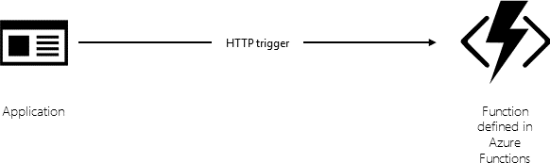
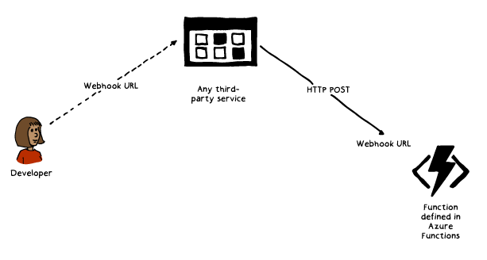
Implementing webhooks using Azure Functions
Defining a trigger:
e.g. an HTTP POST request
POST targets a function-specific URL
Authoring code to be executed:
Business logic relevant to the change
Implementing a trigger binding:
function.json
JavaScript function

