Slide 1
AZ-300T06 Module 03: Develop an App Service Logic App
Subtitle or speaker name

Slide 2
Module 03: Develop an App Service Logic App Lesson 01: Azure Logic Apps overview

Slide 3
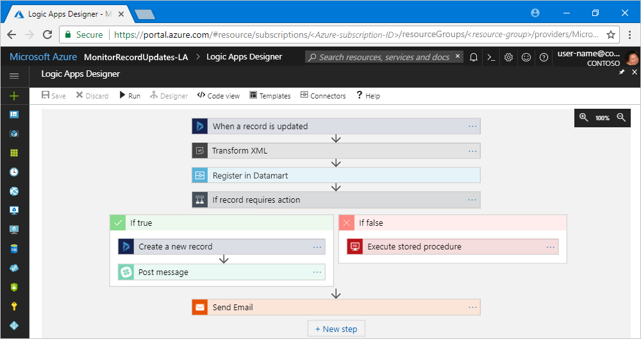
Azure Logic Apps explained
Every logic app workflow starts with a trigger, which fires when a specific event happens, or when new available data meets specific criteria.
Many triggers include basic scheduling capabilities so that you can specify how regularly your workloads run.
Each time that the trigger fires, the Logic Apps engine creates a logic app instance that runs the workflow's actions.
Actions can also include data conversions and flow controls, such as conditional statements, switch statements, loops, and branching.
If the trigger detects an event that matches this criteria, the trigger fires and runs the workflow's actions.
These actions include XML transformation, data updates, decision branching, and email notifications.

Slide 4
Connectors for Azure Logic Apps
Connectors are available as either built-ins or managed connectors.
Built-ins: Actions and triggers help you create logic apps that run on:
Custom schedules
Communicate with other endpoints
Receive and respond to requests
Call Azure functions, Azure API Apps (Web Apps), custom APIs managed and published with Azure API Management
Managed connectors: Provide triggers and actions for accessing other services and systems.
Azure Logic Apps. Managed connectors are organized into these groups:
Managed API connectors | Create logic apps that use services such as Azure Blob Storage, Office 365, Dynamics, Power BI, OneDrive, Salesforce, SharePoint Online, and many more.
On-premises connectors | After you install and set up the on-premises data gateway, these connectors help your logic apps access on-premises systems such as SQL Server, SharePoint Server, Oracle DB, file shares, and others.
Integration account connectors | Available when you create and pay for an integration account, these connectors transform and validate XML, encode and decode flat files, and process business-to-business (B2B) messages with AS2, EDIFACT, and X12 protocols.
Enterprise connectors | Provide access to enterprise systems such as SAP and IBM MQ for an additional cost.

Slide 5
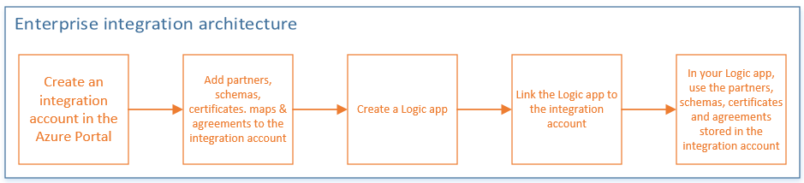
B2B scenarios and the Enterprise Integration Pack
You can build and manage B2B apps with the Enterprise Integration Pack through the Logic App Designer in the Azure portal. You can also manage your logic apps with PowerShell.
Below are the high-level steps you must take before you can create apps in the Azure portal:

Slide 6
Module 03: Develop an App Service Logic App Lesson 02: Create Logic Apps by using Visual Studio

Slide 7
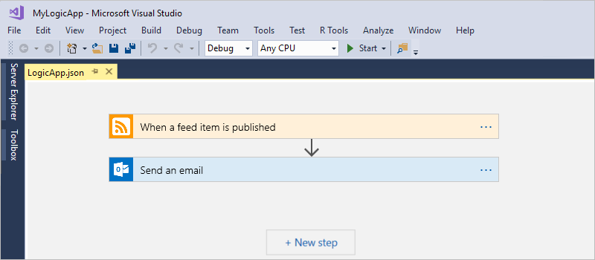
Create Logic Apps by using Visual Studio
With Azure Logic Apps and Visual Studio, you can create workflows for automating tasks and processes that integrate apps, data, systems, and services across enterprises and organizations.
Visual Studio lets you add logic apps to source control, publish different versions, and create Azure Resource Manager templates for different deployment environments.
This lessons shows how to create a logic app that monitors a website's RSS feed and sends email for each new item posted on the site.
Once completed. the logic app looks like the following high-level workflow:

Slide 8
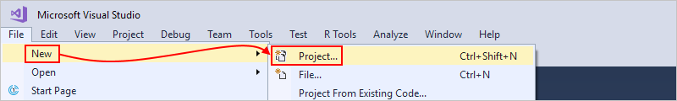
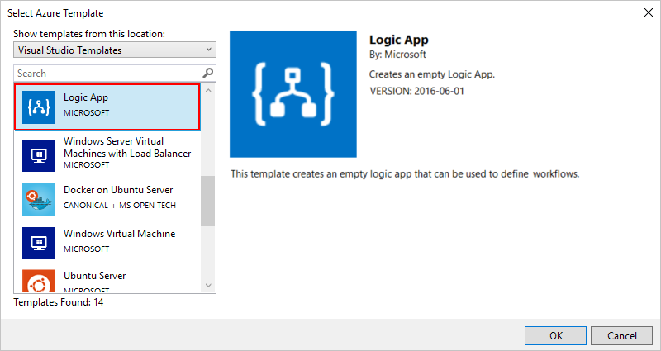
Create an Azure resource group project
To get started, create an Azure Resource Group project.
1. Start Visual Studio and sign in with your Azure account.
2. On the File menu, select New > Project.
3. Under Installed, select Visual C#. Select Cloud > Azure Resource Group, and name the project.
4. Select the Logic App template.

Slide 9
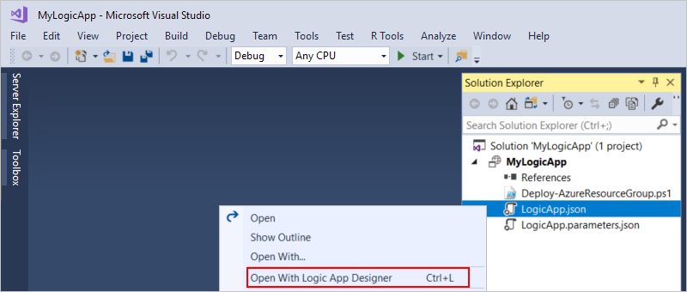
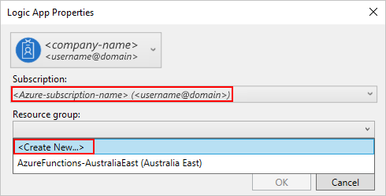
Create a blank Logic App
After you create your Azure Resource Group project, create and build your logic app starting from the Blank Logic App template.
In Solution Explorer, open the shortcut menu for the LogicApp.json file. Select Open With Logic App Designer.
2. For Subscription, select the Azure subscription that you to use. For Resource Group, select Create New…, which creates a new Azure resource group.
3. The Logic Apps Designer opens and shows a page with an introduction video and commonly used triggers. Scroll past the video and triggers. Under Templates, select Blank Logic App.

Slide 10
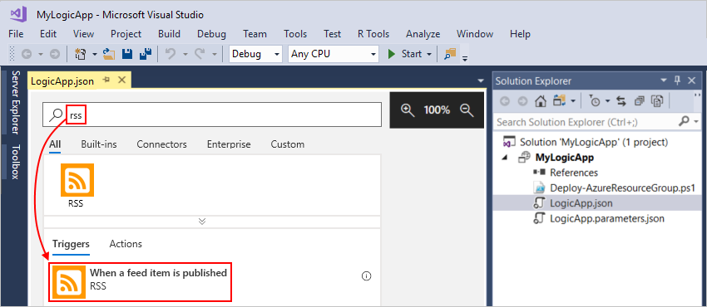
Build the Logic App workflow
Creating a Trigger
A trigger fires when a new RSS feed item appears. Every logic app must start with a trigger, which fires when specific criteria is met. Each time the trigger fires, the Logic Apps engine creates a logic app instance that runs your workflow.
In Logic App Designer, enter “rss” in the search box. Select this trigger: When a feed item is published.
2. Provide the following information for the trigger:
3. Save the project.

Slide 11
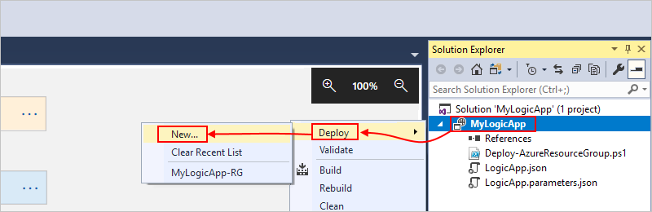
Deploy the Logic App to Azure
To deploy the app from Visual Studio to Azure:
1. In Solution Explorer, on your project's shortcut menu, select Deploy > New. If prompted, sign in with your Azure account.
2. Retain the Azure subscription, resource group, and other default settings, choose Deploy.
3. In Edit Parameters box, provide the resource name for the logic app to use at deployment, then save your settings.

Slide 12
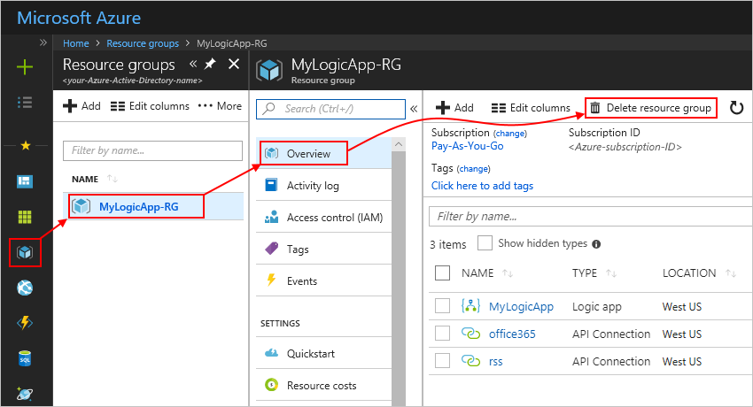
Clean up resources
To delete the resource group that contains your logic app and related resources.
Sign in to the Azure portal with the same account used to create your logic app.
On the main Azure menu, select Resource groups. Select the resource group for your logic app, and then select Overview.
On the Overview page, choose Delete resource group. Enter the resource group name as confirmation, and choose Delete.

