Slide 1
AZ-300T06 Module 04: Developing for Autoscaling
Subtitle or speaker name

Slide 2
Module 04: Developing for Autoscaling Lesson 01: Implement autoscaling rules and patterns

Slide 3
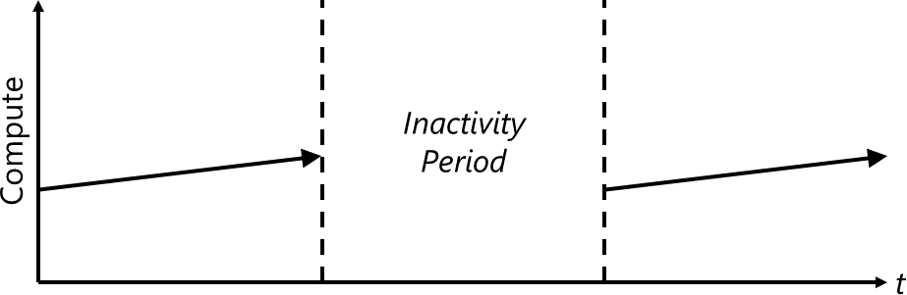
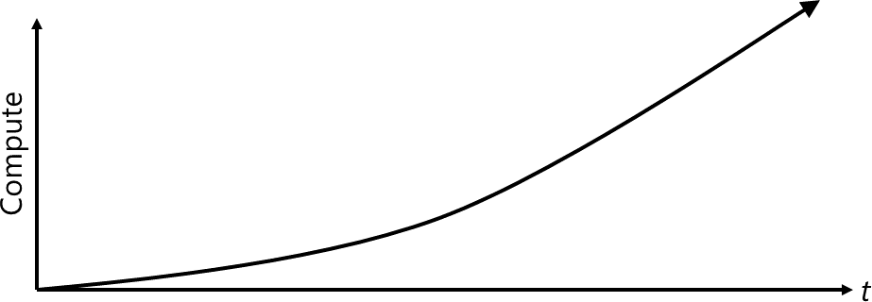
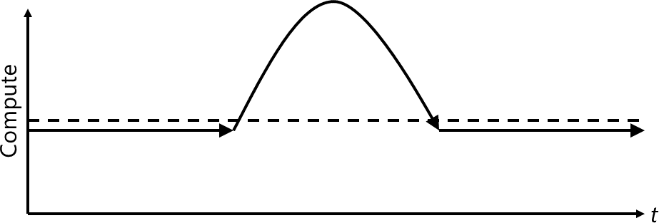
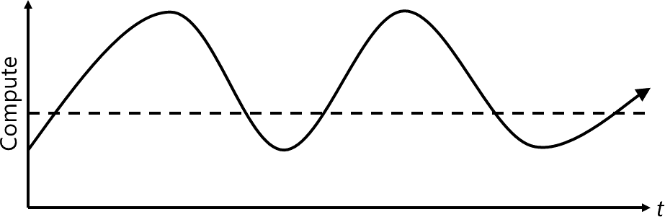
Computing patterns
The most common computing patterns for cloud-based web apps:
On and off:
Common for batch processing
Waste of overprovisioned capacity
Growing fast:
Represents a successful service
Presents growth challenges
Unpredictable bursting:
Unexpected peaks of demand
Waste of overprovisioned capacity
Predictable bursting:
Requires resource provisioning and deprovisioning
Introduced increased management complexity

Slide 4
Scale and auto-scale
Cloud offers elastic scaling by using its practically unlimited resources
Auto-scaling is the ability to monitor workload usage and automatically scale according to changes in usage levels
Many Azure services support manual and automatic scaling:
infrastructure services such as Azure Virtual Machine Scale Sets
application services such as Azure App Service
database services such as Azure Cosmos DB.

Slide 5
Auto-scale metrics
App Service support autoscale:
Requires service plans using Basic, Standard, or Premium pricing tiers
Increases or decreases the instance count within the same service plan
Supports a number of auto-scale metrics:
CPU: CpuPercentage
Memory: MemoryPercentage
Data in: BytesReceived
Data out: BytesSent
HTTP queue: HttpQueueLength
Disk queue: DiskQueueLength
Allow you to trigger alerts when the value of a metric crosses a custom threshold:
Send email notifications to the service administrator and co-administrators
Send email to additional email addresses that you specify
Call a webhook
Start the execution of an Azure runbook

Slide 6
Module 04: Developing for Autoscaling Lesson 02: Implement code that addresses singleton application instances

Slide 7
Querying resources using Azure CLI
Azure CLI is optimized for managing Azure resources:
Supports the --query argument to execute a JMESPath query on command results:
A single result in the format of a JSON document
Multiple results in the format of a JSON array (you can flatten them by using the [] JMESPath operator)
For example, to list Azure VMs in the current subscription, run:
az vm list
To limit results to the image name and offer, run:
az vm list --query '[].{name:name, image:storageProfile.imageReference.offer}'
To list Azure VMs with the Windows Server OS installed, run:
az vm list --query "[?starts_with(storageProfile.imageReference.offer, 'WindowsServer')]“
To list name and vmID or Azure VMs with Ubuntu OS installed, run:
az vm list --query "[?starts_with(storageProfile.imageReference.offer, 'Ubuntu')].{name:name, id:vmId}"

Slide 8
Querying resources using the fluent Azure SDK
Implementation steps:
Create an authenticated client by invoking the Azure.Authenticate static method:
The Authenticate method requires an authorization file necessary to access a target subscription:
Azure azure = Azure.Authenticate("azure.auth").WithDefaultSubscription();
You can generate the file by using the Azure CLI: az ad sp create-for-rbac --sdk-auth > azure.auth
Query resources by using properties of the IAzure interface of the Azure variable:
To list Azure VMs synchronously, use the VirtualMachines property:
azure.VirtualMachines
To list Azure VMs synchronously, use the VirtualMachines property:
var vms = await azure.VirtualMachines.ListAsync(); foreach(var vm in vms) { Console.WriteLine(vm.Name); }
To determine an IP address of an Azure VM, use the IVirtualMachine and related interfaces:
INetworkInterface targetnic = targetvm.GetPrimaryNetworkInterface();
INicIPConfiguration targetipconfig = targetnic.PrimaryIPConfiguration;
IPublicIPAddress targetipaddress = targetipconfig.GetPublicIPAddress();

Slide 9
Module 04: Developing for Autoscaling Lesson 03: Implement code that addresses a transient state

Slide 10
Transient errors
Transient faults are typically self-correcting and include:
momentary loss of network connectivity to components and services
temporary unavailability of a service
timeouts that occur when a service is busy
Applications that use cloud services should be able to handle gracefully transient faults:
If the action that triggered a fault is repeated after a suitable delay, it is likely to succeed

Slide 11

Handling transient errors
Applications can handle a failure by using the following strategies:
Cancel: if the fault indicates that the failure is not transient
Retry: If the specific fault reported is unusual or rare
Retry after delay: If the fault is caused by a common connectivity or busy failure:
The period between retries should be chosen to result in an even distribution of requests from multiple instances of the application:
1.The application invokes an operation on a hosted service. The request fails, and the service host responds with HTTP response code 500 (internal server error).
2.The application waits for a short interval and tries again. The request fails with HTTP response code 500.
3.The application waits for a longer interval and tries again. The request succeeds with
HTTP response code 200 (OK).

Slide 12
Handling transient errors in code
The OperationWithBasicRetryAsync method invokes an external service asynchronously through the TransientOperationAsync method.
The details of the TransientOperationAsync method are service-specific
The method is contained in a try/catch block wrapped in a for loop:
If the TransientOperationAsync method succeeds, the for loop exits.
If the TransientOperationAsync method fails, the catch block examines the reason for the failure. If it's believed to be a transient error, the code waits for a short delay before retrying the operation.
The for loop also tracks the number of times that the operation has been attempted.
If the code fails three times, the exception is assumed to be more long lasting.
If the exception is long lasting, the catch handler throws an exception.

Slide 13
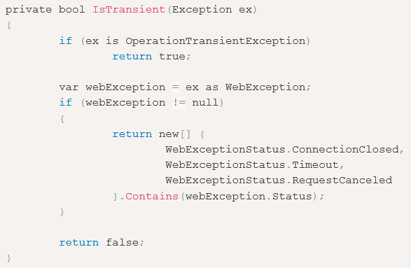
Detecting if an error is transient in code
The IsTransient method checks for a specific set of exceptions that are relevant to the environment the code is run in:
Specifics are context-dependent

