Slide 1
AZ-300T06 Module 05: Manage APIs using API Management
Subtitle or speaker name

Slide 2
Module 05: Manage APIs using API Management Lesson 01: Analyze recommendations on security center

Slide 3
Azure Security Center
Provides unified security management and threat protection
Used to apply security policies across your workloads
Core features includes:
Centralized policy management
Continuous security assessment
Actionable recommendations
Prioritized alerts and incidents
Advanced cloud defenses
Integrated security solutions

Slide 4
Security Center Recommendations
Continuous assessment, help discover potential security issues
Allows viewing of the security hygiene at any time
Creates a list of prioritized security recommendations to guide you though the process of addressing security issues

Slide 5
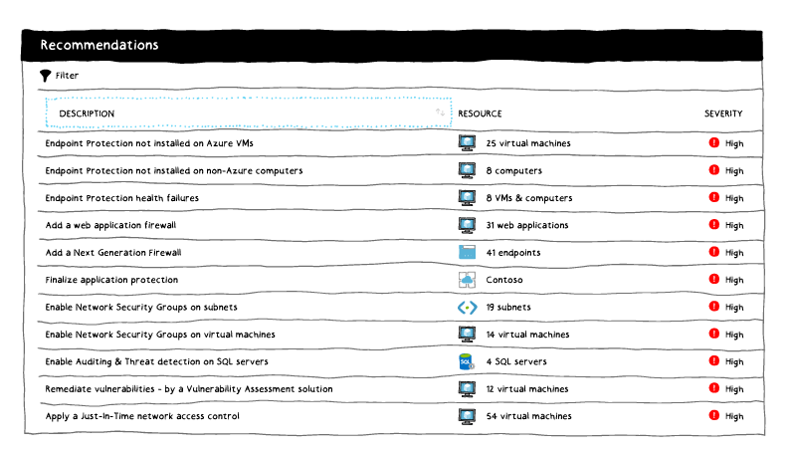
Security Center Monitoring

Slide 6
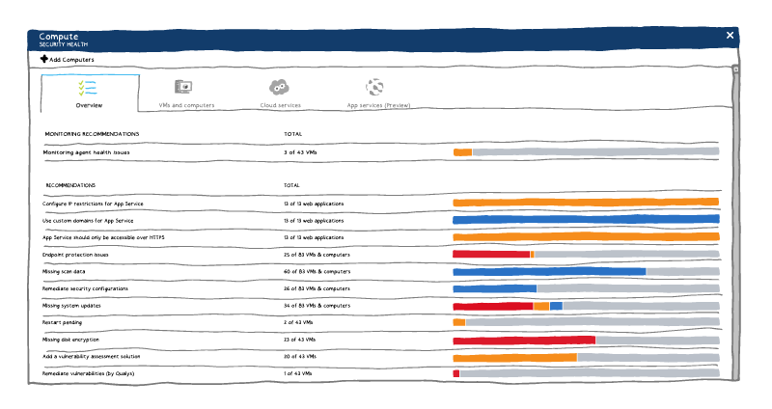
Security Center Recommendations

Slide 7
Module 05: Manage APIs using API Management Lesson 02: Create an API Management instance

Slide 8
Azure API Management (APIM)
Streamlines the process of common tasks necessary for creating an API for external use
Tasks include:
Creating a successful and useful developer portal
Securing API endpoints from anonymous or unwanted access
Managing existing developer access through cache mechanisms, throttling and other policies
Building a monitoring and analytics platform to diagnose issues and monitor adoption
Providing business users and developers with deep insights into how each API is specifically used

Slide 9
Creating an API Management Instance
Create and manage APIs
Each API contain one or more sets operations
Operations are configurable granting control over:
URL mapping
Query and path parameters
Request and response content
Operation response caching

Slide 10
Module 05: Manage APIs using API Management Lesson 03: Configure authentication and policies for APIs

Slide 11
API Management Products
Contains one or more APIs in a package
Products can be open or protected
Open products are free to use without any subscription
Protected products must be subscribed to before use
When a product is ready for developers, it can be published for use

Slide 12
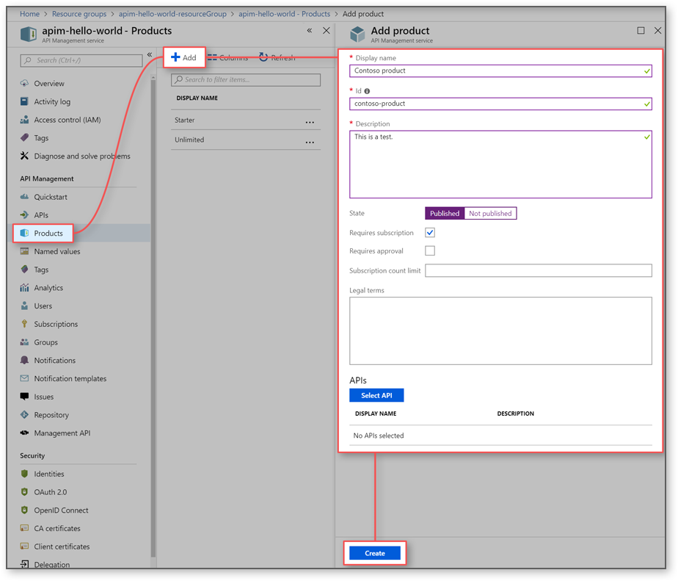
Create and Publish a Product
In Azure API Management, a product contains one or more APIs as well as a usage quota and the terms of use. Once a product is published, developers can subscribe to the product and begin to use the product's APIs.
In this topic, you learn how to:
Create and publish a product
Add an API to the product

Slide 13
Video: API Management Developer Interface
https://youtu.be/8AE9qgHnqHI
Notes:
api_management_dev_interface.mp4

Slide 14
API Management Policies
Collection of statements that are executed sequentially at the request or response of an API
Are a quick way to change the behavior of an API without code changes to the actual back-end API application
A comprehensive list of policy options can be found here: https://docs.microsoft.com/azure/api-management/api-management-policies

Slide 15
Module 05: Manage APIs using API Management Lesson 04: Create an API gateway

Slide 16
Azure Application Gateway
Enables management of traffic to your web applications
Operates as a web traffic load balancer which allows for more specific traffic routing than a traditional load balancer
Can handle additional scenarios such as:
Custom routing
Session affinity
SSL termination
Firewall management
Redirection

Slide 17
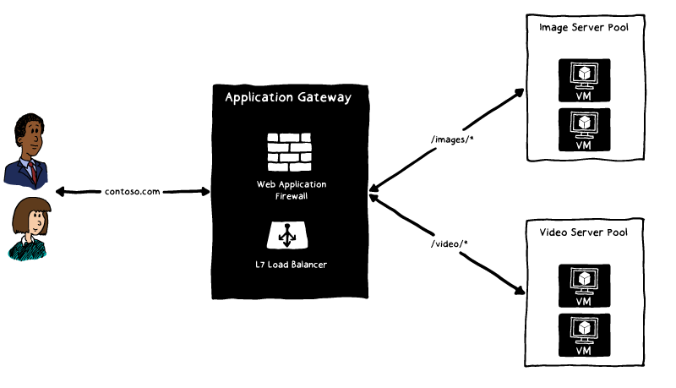
Azure Application Gateway

Slide 18
Autoscaling and SSL Termination
Autoscaling public preview
Application Gateway also offers a public preview of a new SKU [Standard_V2], which offers autoscaling and other critical performance enhancements.
Autoscaling - Application Gateway or WAF deployments under the autoscaling SKU can scale up or down based on changing traffic load patterns.
Zone redundancy - An Application Gateway or WAF deployment can span multiple Availability Zones, removing the need to provision and spin separate Application Gateway instances in each zone with a Traffic Manager.
Static VIP - The application gateway VIP now supports the static VIP type exclusively.
Faster deployment and update time as compared to the generally available SKU.
5X better SSL offload performance as compared to the generally available SKU.
Secure Sockets Layer (SSL) termination
Application gateway supports SSL termination at the gateway, after which traffic typically flows unencrypted to the backend servers.
The application gateway supports end to end SSL encryption.

Slide 19
Web application firewall and multi-site hosting
Web application firewall
Application Gateway that provides centralized protection of your web applications from common exploits and vulnerabilities.
Helps make security management simpler and gives better assurance against threats or intrusions.
Reacts to security threats faster by patching a known vulnerability at a central location.
URL-based routing
URL Path Based Routing allows you to route traffic to back-end server pools based on URL Paths of the request. One of the scenarios is to route requests for different content types to different pool.
Redirection
Application Gateway redirection support offers the following capabilities:
Global redirection from one port to another port on the Gateway. This enables HTTP to HTTPS redirection on a site.
Path-based redirection. This type of redirection enables HTTP to HTTPS redirection only on a specific site area, for example a shopping cart area denoted by /cart/*.
Redirect to an external site.

Slide 20
Sizing
Application Gateway is currently offered in three sizes: Small, Medium, and Large. Small instance sizes are intended for development and testing scenarios.
The following table shows an average performance throughput for each application gateway instance with SSL offload enabled:
Average back-end page response size | Small | Medium | Large
6 KB | 7.5 Mbps | 13 Mbps | 50 Mbps
100 KB | 35 Mbps | 100 Mbps | 200 Mbps

