Slide 1
AZ-300T06 Module 06: Developing Azure Cognitive Services Solutions
Subtitle or speaker name

Slide 2
Module 06: Developing Azure Cognitive Services Solutions Lesson 01: Cognitive Services Overview

Slide 3
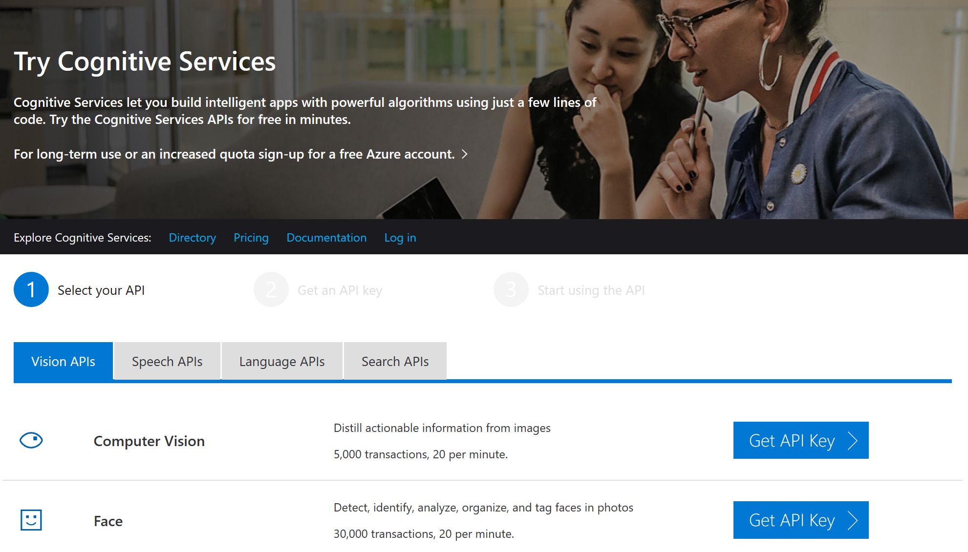
About Cognitive Services
A set of APIs, SDKs and Azure services that:
Simplify development of apps that are intelligent, engaging, and discoverable.
Facilitate features such as:
emotion and video detection
facial, speech and vision recognition
speech and language understanding
Free Trial (https://azure.microsoft.com/en-us/try/cognitive-services

Slide 4
Module 06: Developing Azure Cognitive Services Solutions Lesson 02: Develop Solutions using Computer Vision

Slide 5
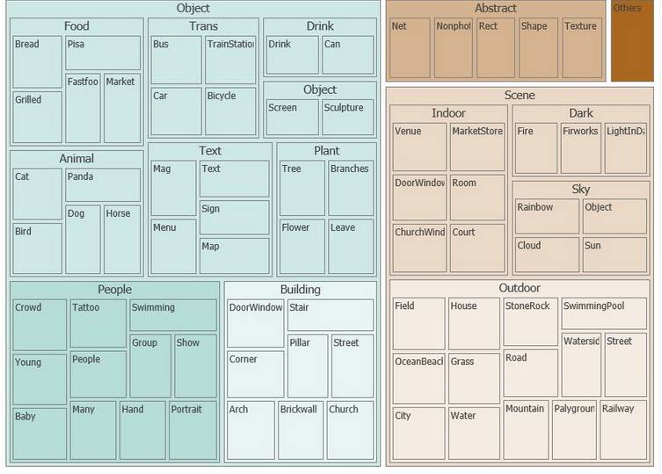
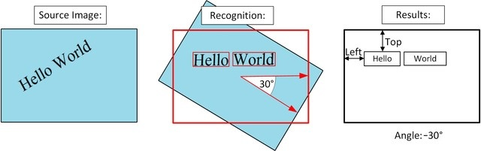
Computer Vision API v2 overview
Provides developers with advanced algorithms for image processing:
Processes an uploaded image or an image references by an URL
Analyzes based on inputs and user choices
Delivers such functionality as:
Tagging images
Categorizing images
Identifying image types
Generating descriptions
Perceiving color schemes
Flagging adult content
Recognizing text
Generating thumbnails
Optical character recognition (OCR)

Slide 6
Analyze an image with C#
Prerequisites:
A subscription key to use Computer Vision
Any edition of Visual Studio 2015 or 2017
Microsoft.Azure.CognitiveServices.Vision.ComputerVision client library NuGet package
Implementation relies on the Analyze Image API-based methods:
The AnalyzeImageAsync method for remote images
The AnalyzeImageInStreamAsync method for local images
The Analyze Image API-based methods allow you to determine:
•A detailed list of tags related to the image content.
•A description of image content in a complete sentence.
•The coordinates, gender, and age of any faces contained in the image.
•The ImageType (clip art or a line drawing).
•The dominant color, the accent color, or whether an image is black & white.

Slide 7
Generate a thumbnail with C#
Prerequisites:
A subscription key to use Computer Vision
Any edition of Visual Studio 2015 or 2017
Microsoft.Azure.CognitiveServices.Vision.ComputerVision client library NuGet package
Implementation relies on the Get Thumbnail API-based methods:
The GenerateThumbnailAsync method for remote images
The GenerateThumbnailInStreamAsync method for local images
The Get Thumbnail API-based methods allow you to generate a thumbnail of an image

Slide 8
Extract handwritten text with C#
Prerequisites:
A subscription key to use Computer Vision
Any edition of Visual Studio 2015 or 2017
Microsoft.Azure.CognitiveServices.Vision.ComputerVision client library NuGet package
Implementation relies on the Analyze Image API-based methods:
The AnalyzeImageAsync method for remote images
The AnalyzeImageInStreamAsync method for local images
The Analyze Image API-based methods allow you to extract handwritten text from an image

Slide 9
Module 06: Developing Azure Cognitive Services Solutions Lesson 03: Develop Solutions using Bing Web Search

Slide 10
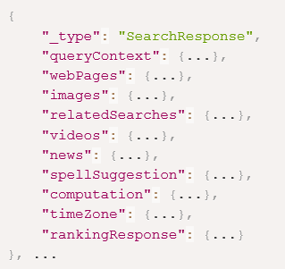
Bing Web Search API overview
Provides an experience similar to Bing.com/search:
Returns search results that Bing determines are relevant to the user's query
Web pages, images, videos, and news, along with related search queries, spelling corrections, time zones, unit conversion, translations, and calculations.
Generates a SearchResponse object containing a collection of answers:
Webpages
Images
Related searches
Videos
News
Computation
TimeZone

Slide 11
Develop a Bing Web Search query in C#
Prerequisites:
A Cognitive Services API account with Bing Search APIs
Any edition of Visual Studio 2017
A sample implementation includes:
a simple console application that performs a Bing Web Search API query and displays the returned raw search results in JSON format.
While the application is written in C#, the API is a RESTful Web service compatible with any programming language that can make HTTP requests and parse JSON.

Slide 12
Filtering the answers in the search response
By default, Bing returns all content that it considers to be relevant
You can customize the response by modifying a query string:
If you're interested in specific types of content such as images, videos, and news, you can request only those answers by using the responseFilter query parameter.
The responseFilter is a comma-delimited list of answers.
Avoid using responseFilter to get results from a single API. If you want content from a single Bing API, call that API directly. For example, to receive only images, send a request to the Image Search API endpoint.
To retrieve search results from a specific domain, include the site: query operator
To limit the number of answers that Bing returns (webpages and images), set the answerCount query parameter to 2.
To include specific types of ranked answers in the response, set the promote query parameter to the answer type you are interested in.

Slide 13
Module 06: Developing Azure Cognitive Services Solutions Lesson 04: Develop Solutions using Custom Speech Service

Slide 14
Custom Speech Service Overview
A cloud-based service that provides the ability to customize speech models for Speech-to-Text transcription:
Contains two statistical models learned from training data:
The acoustic model is a classifier that labels short fragments of audio into one of a number of phonemes, or sound units, in a given language.
The language model is a probability distribution over sequences of words. It helps the system decide among sequences of words that sound similar, based on the likelihood of the word sequences themselves.
Allows creating customized language and acoustic models:
Facilitates application that deal with uncommon vocabulary items, such as product names or jargon

Slide 15
Create a custom acoustic model
Prerequisites:
A Cognitive Services account
Implementation steps:
Prepare the data: provide a collection of speech data, consists of a set of audio files of speech data and a text file of transcriptions of each audio file.
Import the acoustic data set: upload the acoustic data sets
Create the custom acoustic model: choose the base acoustic model, select the acoustic data set, and, optionally, perform offline testing of your new model when the processing is complete. There are two base acoustic models to choose from:
Microsoft Search and Dictation LM is appropriate for speech directed at an application, such as commands, search queries, or dictation.
The Microsoft Conversational LM is appropriate for recognizing speech spoken in a conversational style. This type of speech is typically directed at another person and occurs in call centers or meetings.

Slide 16
Create a custom language model
Prerequisites:
A Cognitive Services account
Implementation steps:
Prepare the data: provide a list of example utterances
Import the language data set: upload a text file of language data
Create the custom language model: set the locale, choose the base language model, select the language data set, and, optionally, perform offline testing of your new model when the processing is complete. There are two base language models to choose from:
Microsoft Search and Dictation LM is appropriate for speech directed at an application, such as commands, search queries, or dictation.
The Microsoft Conversational LM is appropriate for recognizing speech spoken in a conversational style. This type of speech is typically directed at another person and occurs in call centers or meetings.

Slide 17
Module 06: Developing Azure Cognitive Services Solutions Lesson 05: Develop Solutions using QnA Maker

Slide 18
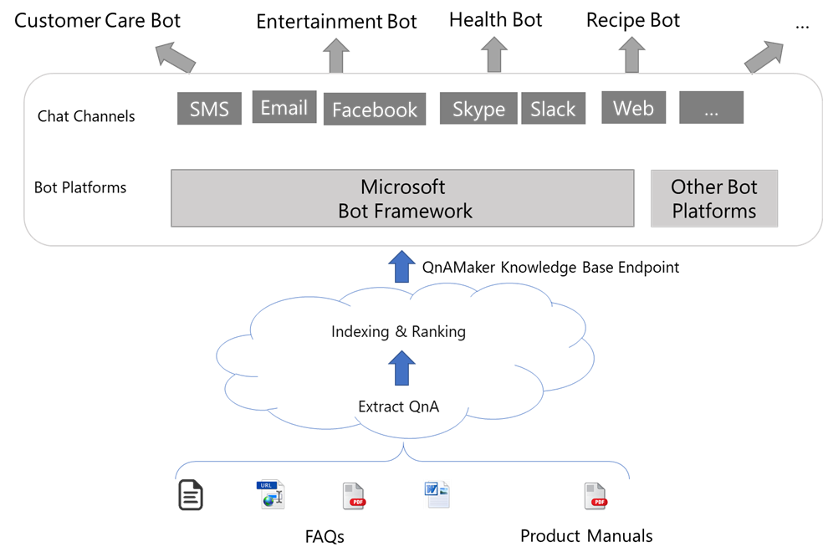
QnA Maker overview
QnA Maker helps building question and answer services from semi-structured content like FAQ documents, URLs, or product manuals:
Offers easy-to-use graphical interface
Does not require development skills

Slide 19
Create a new knowledge base in C#
Prerequisites:
A Cognitive Services API account with QnA Maker chosen as your resource
Any edition of Visual Studio 2017
A sample implementation includes:
A .NET Framework C# console application that implements a QnA Maker knowledge base and displays the returned results in JSON format.
Once the knowledge base is created, you can view it in QnA Maker Portal.

Slide 20
Update a knowledge base in C#
A sample implementation includes:
A .NET Framework C# console application that updates an existing QnA Maker knowledge base and displays the returned results in JSON format.
Once the knowledge base is updated, you can view it in QnA Maker Portal.

Slide 21

Publish a knowledge base in C#
A sample implementation includes:
A .NET Framework C# console application that publishe an existing QnA Maker knowledge base and displays the returned results in JSON format.
A successful response is returned in JSON:

Slide 22
Module 06: Developing Azure Cognitive Services Solutions Lesson 06: Working with the Azure IoT Hub

Slide 23
Azure IoT Hub overview
A managed service that operates as a message hub for bi-directional communication between IoT application and the devices it manages:
Scales to millions of IoT devices
Supports multiple messaging patterns such as:
device-to-cloud telemetry
file upload from devices
request-reply methods
Secures communication channel for devices to send data
Routes device data
Integrates with a number of other Azure services
Facilitates configuring and controlling IoT devices

Slide 24
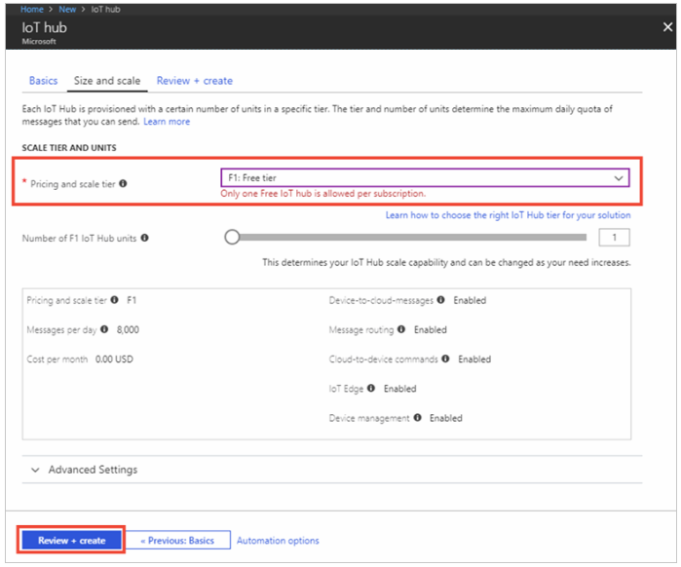
Create an IoT Hub
The IoT hub enables:
Ingesting high volumes of telemetry into the cloud from many devices
Reading and processing that telemetry by back-end services running in the cloud
To create an IoT hub, specify:
Subscription
Resource group
Region
Name
Pricing and scale tier

Slide 25
Register a device
Registration is required for an IoT device to connect to an IoT hub
Implementation steps:
1.Add the IoT Hub CLI extension and create the device identity.
2. Retrieve the device connection string
3. Use the value you retrieved in the previous step to register the device.
4. Retrieve the values of the Event Hubs-compatible endpoint, Event Hubs-compatible path, and iothubowner primary key from your IoT hub.
5. Use the values retrieved in the previous step to enable the back-end application to connect to the IoT hub and retrieve IoT messages

