Slide 1
Deterministic scheduling reconciles cache with preemption for WCET estimation
Michel DESTELLE , Jean-Louis DUFOUR
Sagem, Avionics Division – Eragny center – France
Notes:
http://page.mi.fu-berlin.de/~zoppke/D/history.html
*** sur la justif historique
Under these circumstances John Mauchly, a member of Moore School's Engineering, Science, and Management War Training (ESMWT) program, wrote a first five-page memo called The Use of Vacuum Tube Devices in Calculating. In this paper he suggested a machine that would add 5,000 10-digit numbers per second and would be more than 100 times faster than the fastest computer at that time (the fastest computer in 1942 was a mechanical relay computer operating at Harvard, Bell Laboratories with 15-50 additions per second [1]).
http://ed-thelen.org/comp-hist/CBC.html
http://ed-thelen.org/comp-hist/CBC-Ch-06.pdf

Slide 2
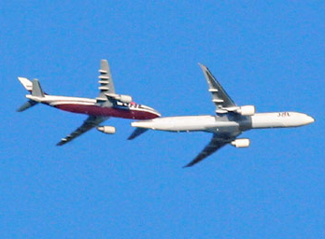

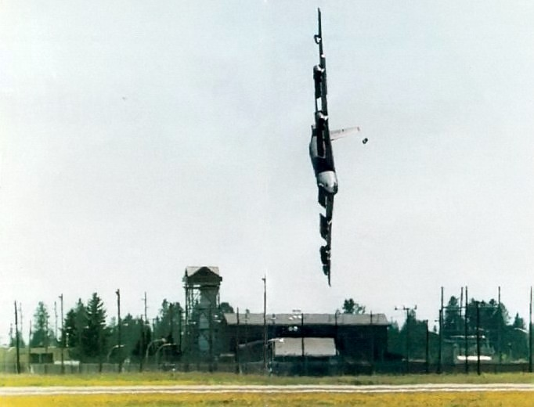
Air Data Inertial Reference Systems
Position (Lat., Lon., Alt.)
Speed vector
IR :
  « Attitude » (Pitch and Roll)
  Speed
  Load factor
ADR :
  Air speed
  Angle Of Attack
3 Units
Same HW/SW
DO 178B level A (“DAL A”)

Slide 3

What is (robust) (software) Partitioning ?
Nov. 1991: ARINC 651 « Design guidance for IMA »
Dec. 1992: DO178B/ED12B:
  §2.3.1: « technique for providing isolation between functionally independent software components to contain and/or isolate faults … implemented by hardware or by a combination of hardware and software »
  Glossary: « process of separating, usually with the express purpose of isolating one or more attributes of the software, to prevent specific interactions and cross-coupling interference »
Oct. 1996: ARINC 653 ed. 1:
  “ability to restrict memory spaces, processing time, … for each individual partition.”
Oct. 2001: DO248B/ED94B, §4.14: « robust partitioning » vs « « pure software means »
« Data coupling »
Question: restrict ➔ prevent ?
Space : Yes
Time : No !
MPU
Deadline
ADR
IR
BITE
OS
HW

Slide 4


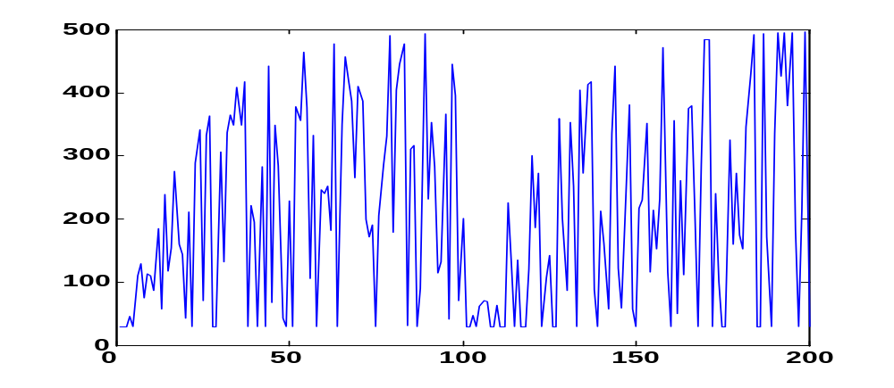
A 500Mhz PowerPC with a 100Mhz SRAM ?!?
PowerPC 8270 500MHz
SRAM 100MHz
16Ko I-cache
16Ko D-cache
64bits in 30ns
Hypothesis : 50/50 instructions/datas
2 instructions in 2*30ns : 33 Mips !?
If in cache : 500 Mips
If not :
  fluctuations (33 ↔ 500 Mips) : improvement of the mean time, not of the worst case …
  … so determination of worst case path even more critical,
    but this not our subject today
Our subject : these fluctuations get worse with multi-tasking …
Message : … but we will manage them, in a crude way today …

Slide 5
1964 : « slave memory » of 32 instructions on Atlas2
Functionally :
‘associative’ memory
  set of couples (@, value)
line | valid | tag | value
0 | 0 | - | -
… | 0 | - | -
34 | 1 | 12 | t := a
35 | 1 | 12 | n := b
36 | 1 | 12 | s := 0
37 | 1 | 12 | i := 0
38 | 1 | 12 | i ?>= n
39 | 1 | 12 | B_YES 1245
40 | 1 | 12 | a := t[i]
41 | 1 | 12 | CALL 6543
42 | 1 | 12 | s := s+a
43 | 1 | 65 | a ?>= 0
44 | 1 | 65 | B_YES 6546
45 | 1 | 65 | a := -a
46 | 1 | 65 | RET
… | 0 | - | -
99 | 0 | - | -
F(a,b) = ∑_{i<b} |a_{i}|
…
# a <- norm of
# vecteur a
# of size b
t := a
n := b
s := 0
i := 0
i ?>= n
B_YES 1245
a := t[i]
CALL 6543
s := s+a
i := i+1
B 1238
a := s
RET
…
# a <- absolute
# value of a
6543 a ?>= 0
6544 B_YES 6546
6545 a := -a
RET
…
(1236, s := 0))
(1237, i := 0))
(1238, i ?>= n)
(1236, s := 0))
(1234, t := a))
(1236, s := 0))
(1236, s := 0))
(1243, i := i+1)
(6543, a ?>= 0)
(1236, s := 0))
ϕ : ‘direct-mapped’
  word at @ ‘………xy’
  goes in line ‘xy’
Approximately
the last 32 instructions
Notes:
1 L A Belady A study of replacement algorithms for a virtual storage computer IBM system journal Vol 5 No 2 1966
2 T Kilburn Data transfer control device U S Patent No 3,218,611 November 16 1965
3 T Kilburn Electronic digital computing machines U S Patent No 3,248,702 April 26 1965
4 F F Lee Look aside memory implementation Project MAC-M-99 MIT Cambridge Mass August 19 1963
5 G G Scarrott The efficient use of multilevel storage Proc IFIPS congress Spartan Books 1965
6 M V Wilkes Slave memories and dynamic storage allocation Project MAC-M-164 MIT Cambridge Mass June 22 1964
D.H.Gibson Considerations in block-oriented systems design AFIPS Joint Computer Conferences archive
Proceedings of the April 18-20, 1967, spring joint computer conference
The feasibility of transmitting blocks of words between memory and CPU is the subject of this study. The question is pertinent to the design of very fast computing systems where the nanoseconds to traverse a few feet become significant. There is intuitive advantage to transmitting blocks of words, rather than a word at a time. The initial access time due to physical distance, effective address mapping, and priority is a few hundred nanoseconds. If this time could be prorated against several words, then the effective access time could be reduced to a few tens of nanoseconds. The question is, of course, can the extra words be useful to the CPU?
This question was explored in a simulation model driven by customer-based IBM 7000 series data. The simulation results indicate that blocks of 4, 8, or 16 words, transmitted to a local storage of 2K to 4K words, will adequately prorate memory access time. With this configuration, block transfer is seen to be an efficient memory access method which can provide high performance, superior to single-word access.

Slide 6
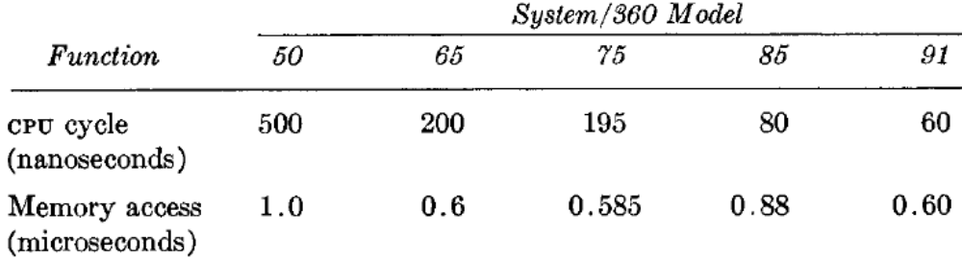
1969: 16Kb cache on IBM System/360 model 85
On 11 test programs :
Model 91 faster than 85 …
… in only 3 cases !
« Write-through » : memory consistent with cache (no « dirty » line)
6
6 
@y …
(@x, 3 )
x := 36
(@x, 3 )
x := 36

.. y ..
@x 3
6
@x 3
6
launched at the same time
« expulsion », at y reading
  Advantage : on a « miss », the target line has not to be saved (« expulsion »)
    It is simply over-written
  Drawback : blocking on successive writes
1975 : « write-back » mode on Amdahl 470
1977 : WT mode with a depth 4 write-buffer on IBM 3033
Notes:
Conti & al :
Cache : 80ns (comme le reste du CPU)
The major design lesson learned from these performance studies was that with a cache of 80 nanosecond cycle and a main storage in the order of one microsecond cycle, one could achieve a performance approximately equivalent to 80 percent of that obtainable with a conventional main storage of 80 nanosecond cycle. It was also observed that a 16K byte cache corresponded to an optimum cost-performance point in the design.
Cache : 16 * (secteur de 1K + 14bits de tag + 1bit_validité/bloc de 64 [donc 16])
Datapath de 16 , organisation en 4 bancs (4*16=64), critical « line » first, en // à l’ALU et au cache
Activity list : LRU

Slide 7
1984 : cache of 128 instructions on the 68020
http://www.mactech.com/articles/mactech/Vol.02/02.11/68020Programming/index.html
Several popular programs … make explicit or implicit assumptions about the speed of execution of various code patterns, either for time delay loops or for SCC accessing ...
The 68020 has an internal cache of 128 words and a pipelined architecture.
Both of these, … , makes the timing of 68020 instructions impossible to predict …
We do not yet have a solution for programs which generate sound such as MacinTalk ...
The voice and tones are very garbled and gravelly.
We have found, however, that they sound better (but not correct) when the 68020 internal cache is disabled.
« Cold-start / warm-start » : execution time context-dependent
  Loops : the first iteration is (much) slower
  Write-back : « ultra-cold-start » when the cache is very « dirty » (max. penalty: 32 μs)
WCET : how to protect oneself from optimistic measurements ?
  State of the Art : tasks start on a « neutral » cache (clean and not « interesting »)
  Compliance to the DO178B Paradigm : prevention of interference
Notes:
garbled / "gA:bld / adjective [account, instructions] confus.
gravelly / "gr&v@lI / adjective [path] caillouteux/-euse; [voice] râpeux/-euse.

Slide 8
Preemptive multi-tasking
T0 + T1 / 2 < 1
T0 + T1 > 1
T0
T0
T0
0
1
2
T1
T1
0
1
2
Method 1: static cutting of T1
T0
T1 part 1
T0
T1 part 2
T0
T1 part 1
T0
T1 part 2
T0
T1 part 1
T0
T1 part 2
0
1
2
3
4
5
t
Method 2: dynamic cutting of T1
Tick interrupt : T1 context is saved
Scheduling syscall : T1 context is restored
T0
T1
T0
T1
T0
T1
T0
T1
T0
T1
T0
T1
0
1
2
3
4
5
t
    Advantage 1 : easy changes
    Advantage 2 : CPU time
    Remark : preemption points are unknown and varying → with cache, it’s a drawback !

Slide 9
« critical » multi-tasking : the « deadline »
« Deadline » = upper bound on the execution time such that …
Periodic tasks: usual implicit deadline = period
  « when a task starts, its preceding launch must have finished »
  Not enough to ensure partitioning :
T0
T1_1
T0
T1_2
T0
T1_3
T0
T1_4
T0
T1_5
T0
T1_1
0
2
4
6
8
10
t
non fatal overload on T0 (1ms over)
Overload on T1
The time stolen by T0 prevents T1 from terminating => partitioning violation
Solution for partitioning: explicit Deadline
  Choice of the Di < Ti to ensure ∑_{i} Di/Ti < 95% (5% = scheduler load)
T0
T1_1
T0
T1_2
T0
T1_3
T0
T1_4
T0
T1_5
T0
T1_1
D0
D1
D0
D0
D0
D0
D0
t
0
2
4
6
8
10
Limited overload on T0 (stopped after 0.75ms)
No overload on T1
The time stolen by T0 is limited by its deadline D0 => no partitioning violation

Slide 10
The « Deterministic Monotonic Scheduler »
Classical scheduler:
T0
T1_1
T0
T1_2
T0
T1_3
T0
T1_4
T0
T0
T1_1
D0
D1
D0
D0
D0
D0
D0
T
0
2
4
6
8
10
T0
T1_1
T0
T1_2
T0
T1_3
T0
T1_4
T0
T0
T1_1
D0
D1
D0
D0
D0
D0
D0
T
0
2
4
6
8
10
Fluctuations of T0 have an influence on T1: T1 est interrupted 3 ou 4 times
DMS : tasks have a constant duration
  Application is followed by an infinite loop, waiting for the Deadline IT
T0
T1_1
T0
T1_2
T0
T1_3
T0
T1_4
T0
T0
T1_1
D0
D1
D0
D0
D0
D0
D0
0
2
4
6
8
10
T
Key property : « at any time, we know who is running »
Technical interest : compositional WCET
  On an applicative change: if the deadline doesn’t change, the WCET of the other tasks doesn’t change
    Because their « execution segments Ti_j » are static and don’t change

Slide 11
Impact on Cache policies
Classical scheduling : copy-back for non interrupted tasks only
Flush
Flush
Flush
Flush
CB
WT
CB
WT
CB
WT
CB
WT
D0
D1
D0
D0
D0
T
0
2
4
6
invalidations
First policy : copy-back for « final segments »
Flush
Flush
CB
WT
CB
CB
CB
WT
CB
CB
D0
D1
D0
D0
D0
T
0
2
4
6
invalidations
Second policy : copy-back for everybody
Cst Length Flush
Cst Length Flush
CB
CB
CB
CB
CB
CB
CB
CB
32 μs / 1ms = 3% CPU
D0
D1
D0
D0
D0
T
0
2
4
6
invalidations

Slide 12
Safety demonstration and conclusion
Static temporal Partitioning (≈ ARINC 653): « divide and rule »
  WCET_system = ∑_{i} WCET_task_{i}
So, for each task :
  Step 1 : determine the non-interrupted worst case « WCET0 »
    Off the subject (and much more complex than our current subject)
  Step 2 : determine the number of preemptions « n »
    Constant thanks to the DMS
  Step 3 : WCET = WCET0 + n * cost
    Cost is between 0 and 2*32 μs (I+D ; easier for I-cache than for D-cache)
Conclusion:
➔ 1) preemption cost: we are waiting for tools !
  Objective: estimations thinner than 32 μs
➔ 2) from prevention to control: suppression of cache invalidations ?
  Interest: cache locking

Slide 13
Appendix: Static Mutual Exclusion
Rate-monotonic scheduling of harmonic periods
T1
P1 = RTC
First(T2) =
T
F
F
T
F
T2
P2 = 3 RTC
DMS
T1
P1 = RTC
Last(T2) =
F
F
T
F
F
T2
P2 = 3 RTC
Last but not least: host simulation ⇔ target execution

