Slide 1
The B method takes up floating-point numbers
L. Burdy¹ / J.-L. Dufour² / T. Lecomte¹
1: ClearSy – Aix en Provence - France
2: Sagem, groupe Safran, avionics division – Eragny sur Oise – France
ERTS2012 – 2 Feb.

Slide 2
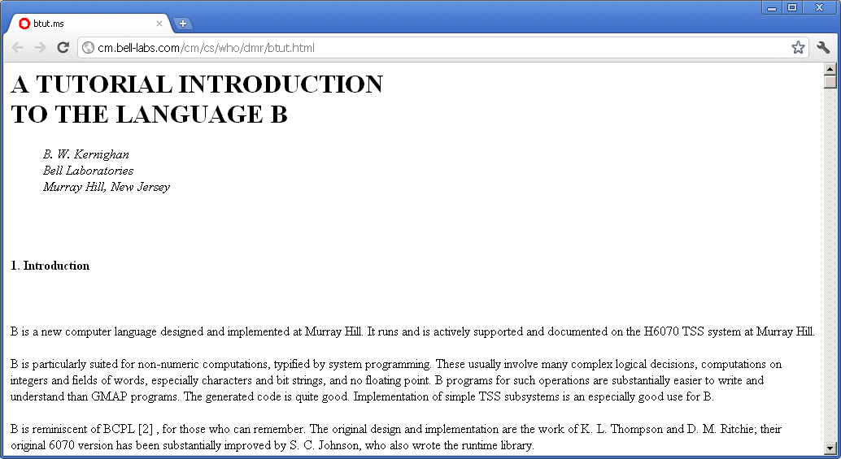
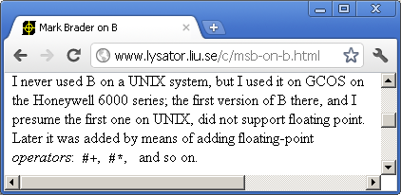
B hasn’t yet floating-point ?
xxxx

Slide 3
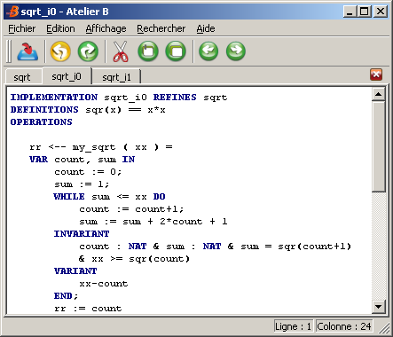
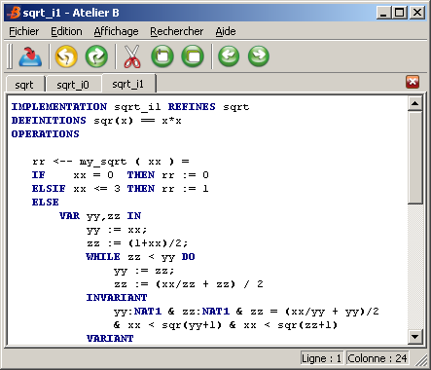
OOps … Sorry, here is the B design language (1/2)
2 languages in 1 : design = specification + coding
« B0 » : no recursion, pointer, unsigned, short, bitfield, cast, exception, …
  Simple data (boolean, integer, array) + simple control (:=, if, while, proc. calls)
  Targeted at (1) embedded and critical software, (2) cristal clear semantics
    « Turing complete » : Paris RER A and 14th line, New-York, …
Inspiré de proval.lri.fr /gallery

Slide 4
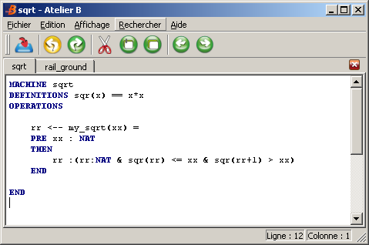
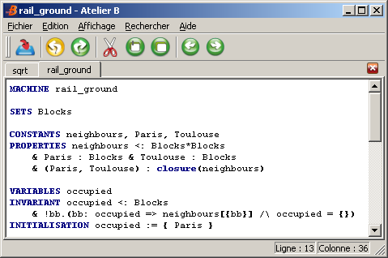
The B design language (2/2) : specification
B : logic + finite sets
Main characteristics : right (of the V) is folded over the left (of the V)
  each requirement has to be immediately proved
Classic V
« B » V

Slide 5
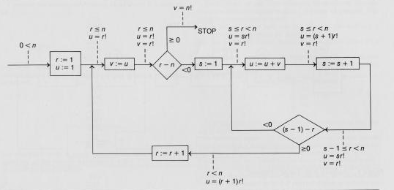
B hasn’t yet floating-point, because …
1949 Turing « Checking a large routine »
1966 Peter Naur, 1967 Robert Floyd
1968 NATO Garmish conf.: « SW crisis »
1969 Tony Hoare : Prog = (Pre, Post)
1975 E. Dijkstra : Pre → WP(Prog, Post)
1977 : RER A (East-West commuter line of Paris area, RATP/SNCF)
c. 1980 : SACEM → consortium Alsthom / CSEE / Matra Transport
  First French railway critical SW: around 2*5Kloc (safety-related part)
c. 1983 : Pierre Chapront (Alsthom) : Hoare logic instead of Unit Test !!!
  « coded processor » (Matra) instead of redundancy → no floating-point numbers
1987 : problems rising up to RATP → audit of 2 independent experts
  Jean-Raymond Abrial (ADA lang., Z notation), Stéphane Natkin

Slide 6
The problem: Hoare logic doesn’t scale up
Analysis of field problems :
  Remember : around 2*5Kloc, call tree of depth 6
Proof is effective on leaf-procedures,
but not on intermediate or global procedures :
  Creation of pre/post conditions from the specification documents is difficult/impossible,
    « fuzzy » traceability between SRS/HLR and SDD/LLR (* DO178 terminology *)
  → « bottom-up » creation of pre/post : loss of traceability
  → explosion of the size of the proof obligations
    Called procedures are not « abstracted » : they are « expanded » in the calling procedures,
  And this size is no more manageable
2) J.R. Abrial proposition:
Formal « re-expression » of the specification, in order to abstract the design
  traceability
  Proof obligations of manageable size

Slide 7
« Refinement » (1/2) : control flow
1978-1981 R.J. Back, 1987 Morris, Morgan, …
The program T refines the program S iff :
  T is less non-déterministic : S = (x := 0 [ ] x := x-1), T = (x := x-1)
    The set of possible output values reduces
  T is less pre-conditionned : S = (x > 5 | x := x-1), T = (x > 0 | x := x-1)
    The set of possible input values increases
To put it clearly : T est usable instead of S
Example:
  x >= 1 | r :( r:INT & sqr(r-1) < x & sqr(r+1) > x) /* +/-floor(sqrt(x)) or +/-ceil(…) */
  x >= 1 | r :( r:NAT & sqr(r-1) < x & sqr(r+1) > x) /* floor(sqrt(x)) or ceil(…) */
  x >= 1 | r :( r:NAT & sqr(r) <= x & sqr(r+1) > x) /* floor(sqrt(x)) */
  x >= 0 | r := libmath_floor(libmath_sqrt(x)) /* this is B0 : code generation */

Slide 8
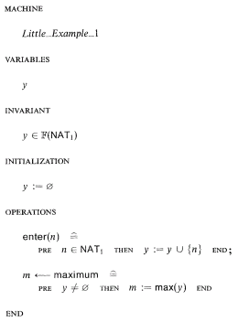
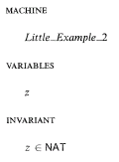
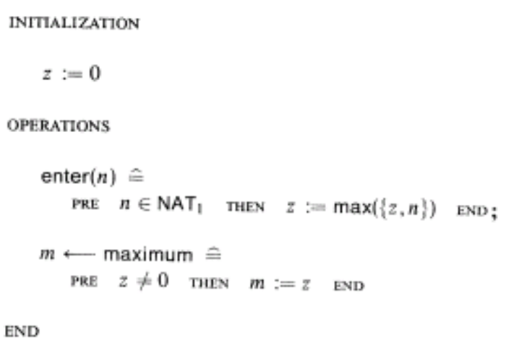
Refinement (2/2) : data
© B-Book
Use by a client :
  enter(5); enter(3); x1 ← maximum; enter(2); enter(6); x2 ← maximum;
  y not visible (in client’s code)
Wherever M1 does the job, M2 does also

Slide 9
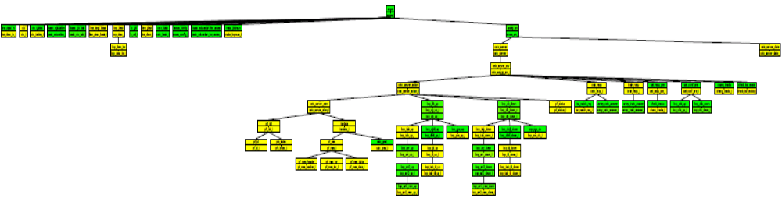
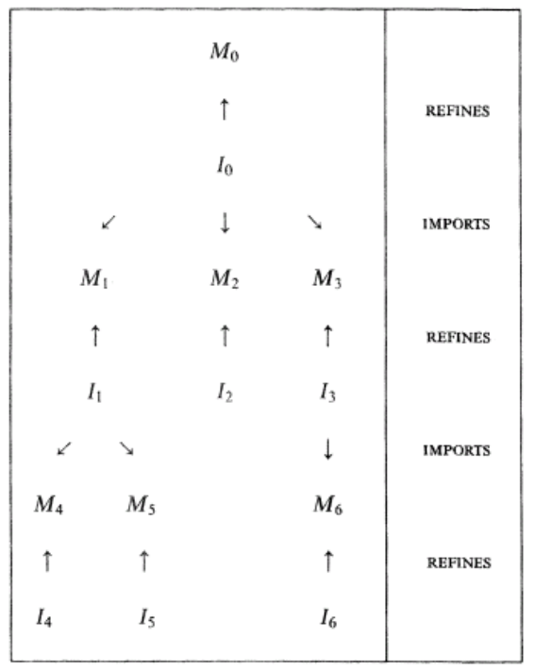
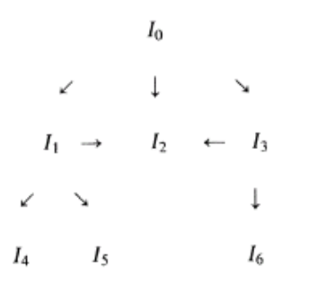

Post-SACEM (c. 1990) : structuration
with Fernando Mejia (Alsthom)
Critical for scale-up, but justification to be completed
  Papers of Marie-Laure Potet

Slide 10
Why is floating-point necessary ?
Railway : booleans, enums and integers (fixed-point)
Avionics : booleans, enums and … 90% of the rest is floating-point
ARINC in
Algorithm/Continuous/Physical thread:
FP variables/operations
ARINC out
Speed <= LOW_THRESHOLD
baro_altitude_status = VALID
Management/Discrete/Logical Thread:
integer variables/operations
Why B couldn’t call librairies, proved with Frama-C/Jessie ?
  This segregation is conceptual : Applications are not designed this way
  → Huge « traffic » of Pre/post cond. between B and Frama-C : not feasible

Slide 11
Which floating-point ?
2 « facts/opinions » :
  Floating-point proofs are (in general) more complex than integer proofs
    To be more precise (but more subjective) : Floating-point >> Real > Integer
  In railway, there is no evidence that formal proof is less expensive than test
    The only evidence is that it is better …
Exact formalisation of the IEEE 754 ?
NO !!! (more precisely: not only) simplified properties are necessary
  Compatible with industry needs (e.g. : Inertial Units: 10⁻¹³ on basic operators)
Simple models of the IEEE operators : a+b = a ⊕ b accurate to 10⁻¹³
  Relative precision, excepted for denormalised numbers → forbid them ?
REAL vs. FLOAT ?
  Example of use : prove that a rotation matrix has its determinant equal to 1 (exactly)
  Do they have a role to play in the certification process ? (SW ? System ?)
  Is FLOAT included in REAL ? (ACSL)

Slide 12
To prove what ?
Change of « safety concept » :
Railway : « fail-safe » : COM/MON with simple MON
  Ground eqt. : « an occupied block must be surrounded by free blocks »
  Onboard eqt. : « doors must be unlocked only at null speed »
  → significantly simpler than the COM part
  → B method : data model based on sets and the invariant concept fit completely
Avionics : « fail-operational » : triplication
  Inertial unit : « attitude must be the integral of the rotations seen by the gyros »
  Engine control : « the kerosene injection throughput must be this precise function of the thrust setpoint »
  All : « perform a low-pass filter »
  → no simple safety property (compared to the fonction)
    Stated another way : safety is synonymous to performing nominally
  → can we abstract data ? (ex : rotation operator vs. Matrix)

Slide 13
With which process ?
Today : automatic translation from B0 to C/Ada
  Accepted in the railway context,
  But considered as a development tool in the DO178 context
  → should be developped with the same effort than the applications it is used for
Tomorrow (DO178 context) :
  Prove manual code
    Justify B0 <-> C correspondance
    A new plugin in Frama-C to translate C into B0 ? (key point is qualification)
  Justify proofs
    Today : no proofs, just the tactic given to the prover
    → choose a « standard format » of proof (Coq ?) and write a « translator »
  Prove Simulink/Scade

Slide 14
Summary and follow-up
Generic question : proving large floating-point programs : a crazy dream ?
  Prove what ?
    Will it be possible to prove functional properties like in railway ?
    If not, will it be interesting (from industrial point of view) to limit to librairies ?
  Which formalisation of floating-point numbers ? (simple properties to find)
    Which floating-point numbers ? Must we forbid denormalised numbers ?
  REAL numbers vs. Certification (SW. and System)
B questions :
  Structuration of models : need for a complete justification
    The B-Book doesn’t cover the structure of all models (« extended sees »)
  Process of dev. : must be considered as a verification tool → needs a C->B0 translator
    Correspondance B0 ←→ C : need for a complete justification
  Proofs : they should probably exist (are tactics enough for certification ?)
PUB : the AtelierB is now free → try it !

