Slide 1

StateCHARTS FOR UNIFIED MBD as simple as possible, as rich as needed
Aircraft Equipment
Aerospace Propulsion
Defense

Slide 2
WARNING 1 : I have failed to respect the 20’ time-frame …
1) CONTEXT/MOTIVATION and IMPLICIT MESSAGES of the paper,
2) focus on HIERARCHY
Weak/strong transitions (Gerard Berry), restart and last constructs (Marc Pouzet & coll.) : see the paper
3) Conclusions
WARNING 2 : all this applies only to SIMPLE AUTOMATA …
… and maybe not to MMI (cockpit, …), to RAILWAY, …

Slide 3
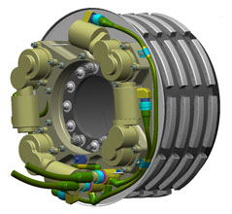
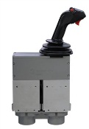


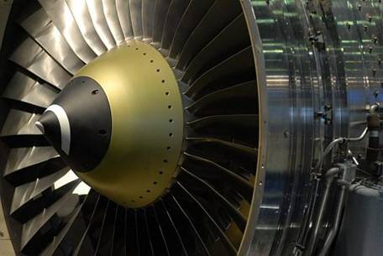

Problem: Safran MBD is diverse
Electronics

Slide 4
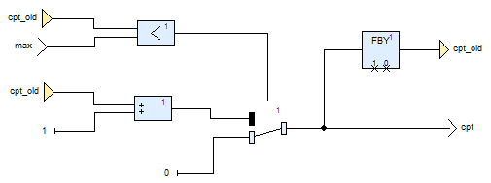
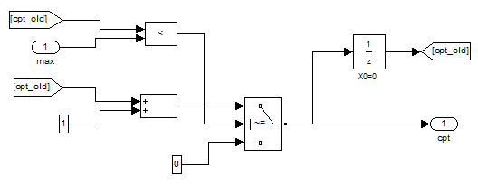
ERTS² 2016: engineering data-flow = ‘clockless’ Lustre
Unified MDB = Simulink(*) / Scade bijection
(*) discrete & strongly typed

Slide 5
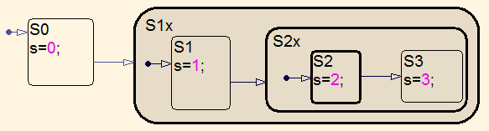
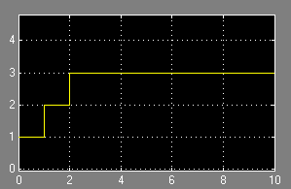
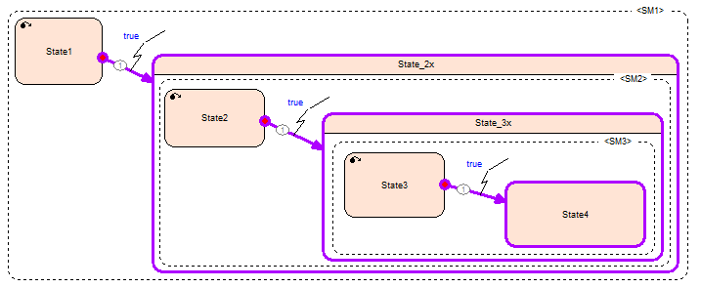
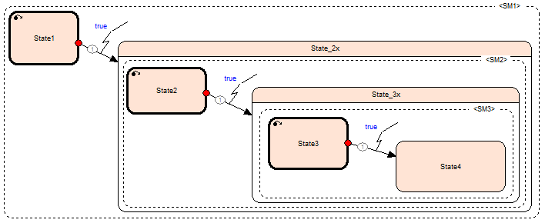
ERTS² 2016: hierarchical automatas differ FUNDAMENTALLY
Composite state = drawing
CLUSTERING
REFINEMENT
Composite state = sub-automaton

Slide 6
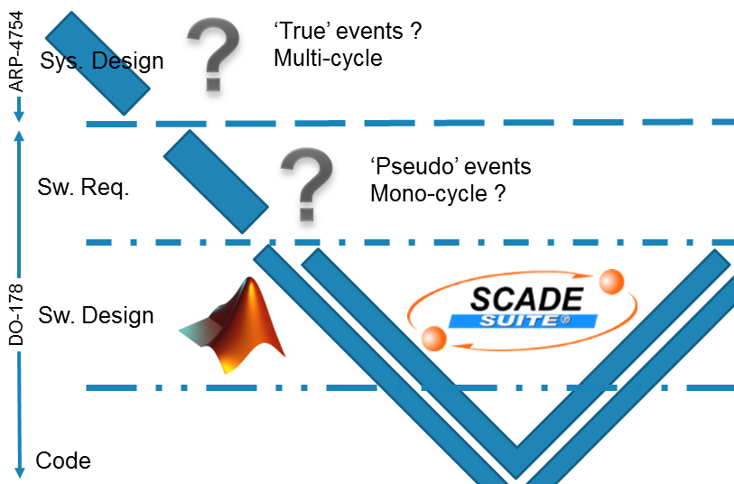
There are specific MOTIVATIONS for state-machines (1/3)
Requirement patterns
Refinement

Slide 7
There are specific MOTIVATIONS for state-machines (2/3)
Algorithms = Data-flows + Automata
S2
S1
S3
Simple arithmetic
S2
S1
S3
« not (Green & Green) » provable
at the specification level
Complex arithmetic

Slide 8
There are specific MOTIVATIONS for state-machines (3/3)
bla bla
boilerplate
Classic B
Event-B (LTL)
complexify
simplify
refine
abstract
new Galois connexion
‘Design’ for testability
‘Design’ for provability

Slide 9
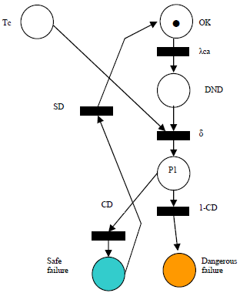
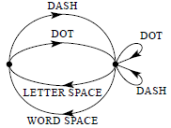
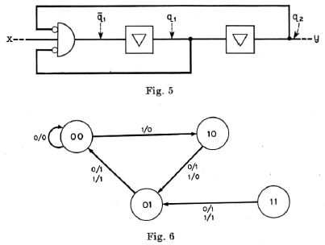
Automata: the pioneers
Petri (1962)
Markov chains (1906)
Moore
Mealy (1955)
SDL (1976)

Slide 10
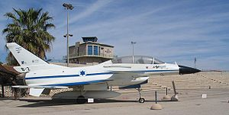
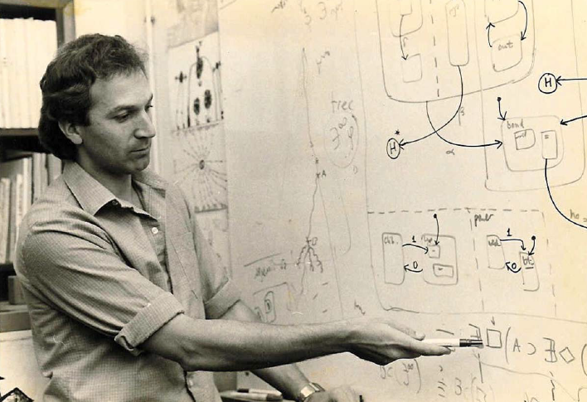
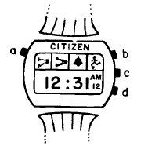
80’s: Harel’s Statecharts: University meets Industry (1/3)
Hierarchy
Concurrency
Communication

Slide 11
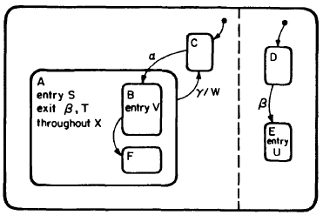
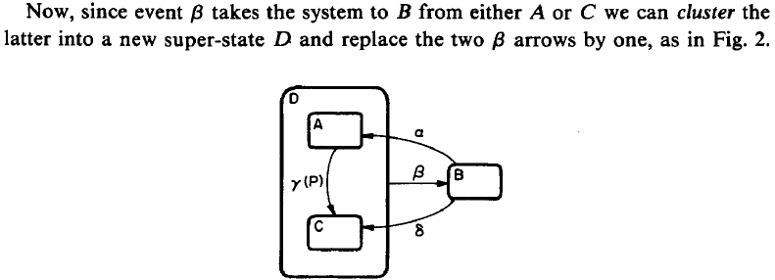
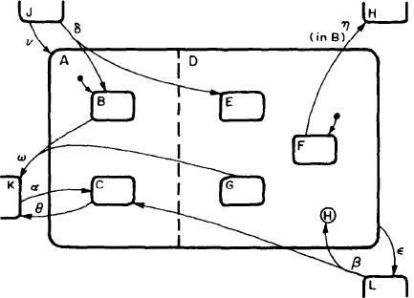

80’s: Harel’s Statecharts: University meets Industry (2/3)
Confusion clustering (drawing) / abstraction (sub-automaton)

Slide 12
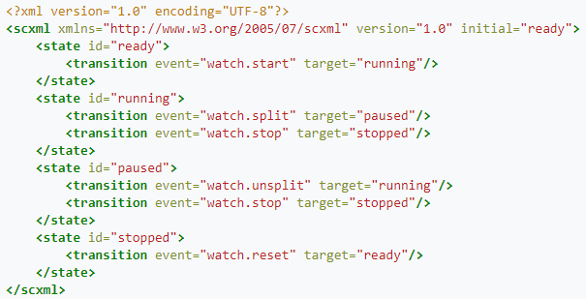
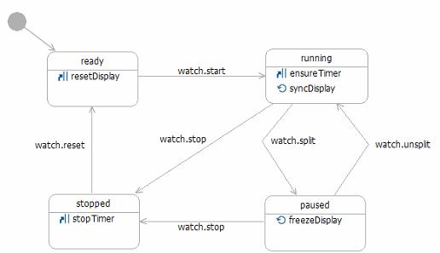
80’s: Harel’s Statecharts: University meets Industry (3/3)
https://www.w3.org/TR/scxml/
http://commons.apache.org/proper/commons-scxml/usecases/scxml-stopwatch.html

Slide 13
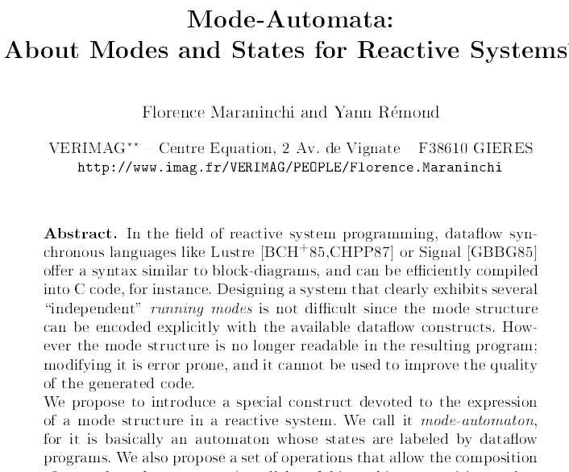
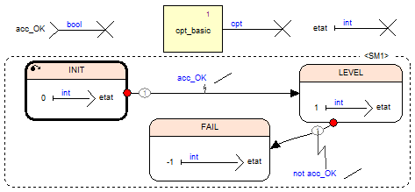

Slide 14
Mode-automata (2/2) : « Variant manager »
Scade VARIANTS
i
o
i
Moore / Mealy logic for outputs
i
Stateflowlogic for actions
o
o
i
Logic for next state
i
Logic for next state
Active state
i
Strong transition
i
Weak transition
Active state
1z
1z
1z
Prev. state
Next state
Prev. state
Next state
Prev. state
Next state

Slide 15
Clustering vs. abstraction (1/2) : neither is better, both are useful
CLUSTERING = partial refactoring
→ dashed borders ?
ABSTRACTION = full refactoring
= black box makes sense
= sub-drawing is sub-function
→ SK modelling rule

Slide 16
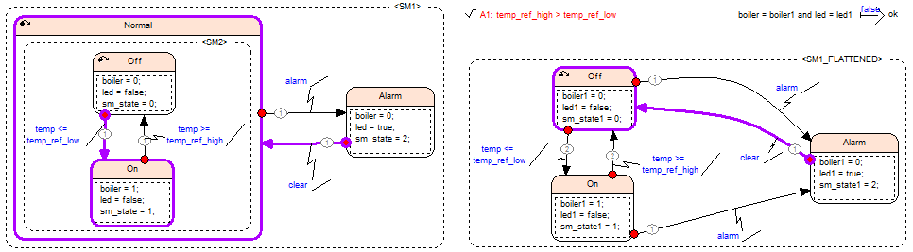
Clustering vs. abstraction (2/2) : Model-checking to the rescue

Slide 17
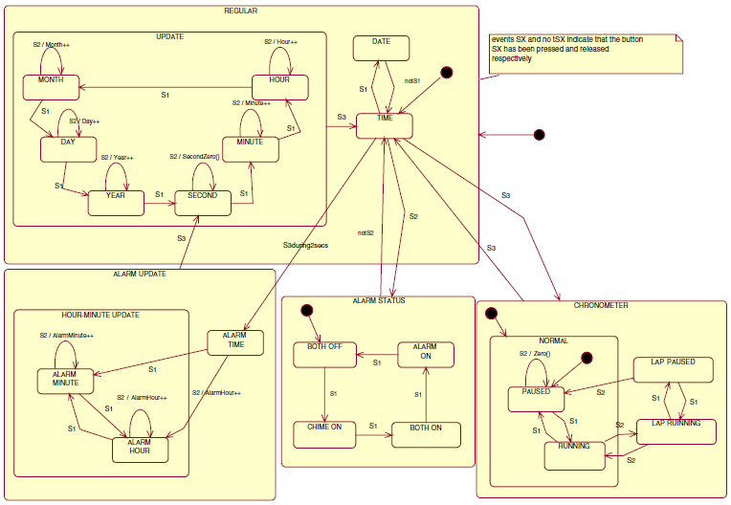
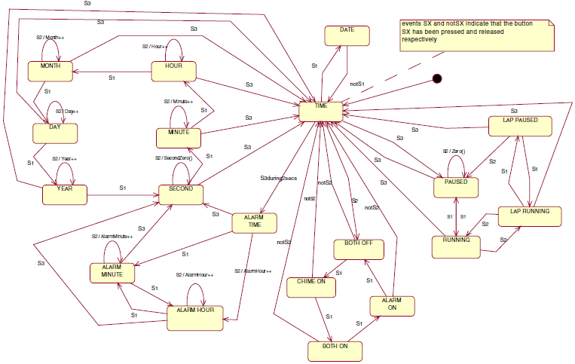
Assessing the understandability of UML statechart diagrams with composite states – A family of empirical studies (Cruz-Lemus & coll., 2009)
https://www.researchgate.net/publication/225212841, http://alarcos.esi.uclm.es/csexperiments/
« Surprisingly, our results do not seem to show that the use of composite states improves the understandability of UML statechart diagrams »
NO INFORMATION-HIDING

Slide 18
Conclusions
WARNING (bis): what follows holds only in our context
Max 10 flat automatas, max 10 states per automaton
WE DON’T HAVE YET THE SPECIFICATION FORMALISM
But the Simulink/Scade comparison give ideas …
… and warns against the CONFUSION CLUSTERING / ABSTRACTION
State-machines are THE candidates for introducing REFINEMENT in avionics
‘Design’ for testability → ‘Design’ for provability
Goal 1: Refinement technology (classic and event B) is HIDDEN
Goal 2: proof is AUTOMATIC
Be AWARE that Simulink’s Stateflows and Scade’s Mode-automata :
CAN BE (EASILY) ‘ALIGNED’ for flat automata
CANNOT BE (EASILY ?) ALIGNED for hierarchical automatas …
… but Model-checkers permit to identify the gap

Slide 19
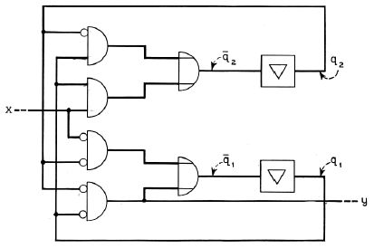
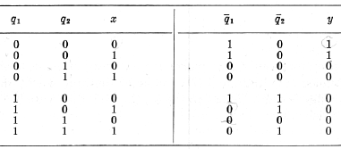
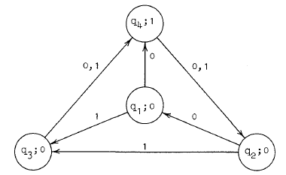
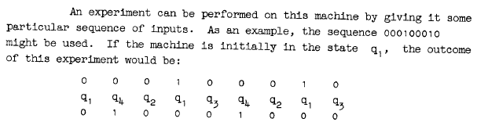
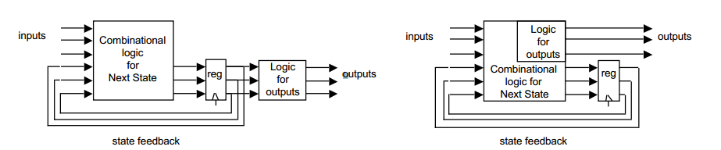
Appendix 1: Moore vs. Mealy

Slide 20
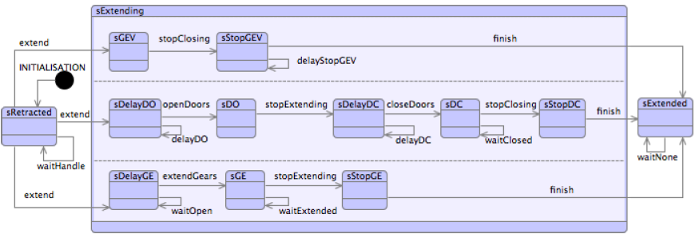
Appendix 2: state-machines for (event-)B
http://wiki.event-b.org/index.php/Event-B_Statemachines

