Slide 1
Phase 1
Jean-Marie Niyodusenga

Slide 2
Overview:
Exploratory Data Analysis
Tokenization
Display Results
Models
Error Analysis
Further work

Slide 3
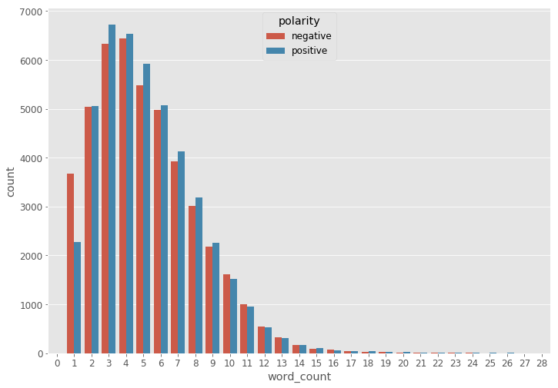
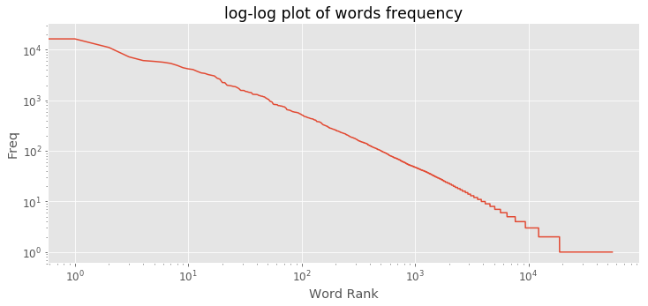
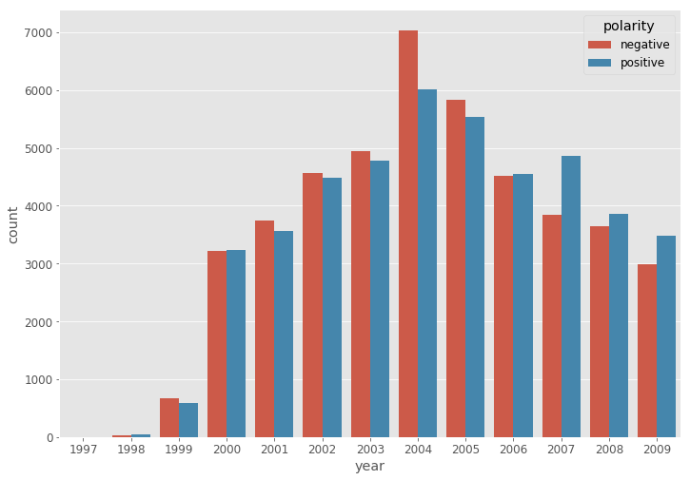
EDA:
Coding (social science) - 20 mins with
random samples then discussion
Punctuation was important (particularly ‘!’ and ‘?’)
Capitalization also seemed to matter but couldn’t find a way to get it into model
Trends:
Notes:
Hvordan får man de bullets som I har brugt på de andre slides?
Figurer?

Slide 4
Tokenization:
Tools: NLTK, Regular Expressions and Contractions.
Using GloVe Embedding:
5.6k tokens did not exist in the embedding (GloVe 42B)
Discarded tokens that only appeared once.
Finds:
Compare tokens from pre-trained embedding with our own to optimize tokenizer
Notes:
LIAM - du fjernede the good shit. 185k forskellige tokens efter tokenization. 86k efter vi fjerner dem som kun fandtes en gang i training data.

Slide 5
Model Accuracies:
 | Training 80% | Test 10% | Validation 10%
All positive | ~ 50% | ~ 50% | ~ 50%
Log reg (SAG L2) | ~ 0.97 | ~ 0.87 | ~ 0.87
GRU summary | ~ 0.86 | - | ~ 0.83
GRU reviews | ~ 0.94 | - | ~ 0.92
GRU combined | ~ 0.96 | ~ 0.94 | ~ 0.93

Slide 6
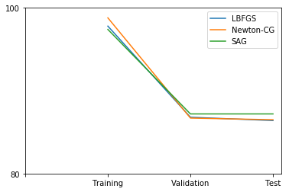
Logistic Regression
Review Text
SAG: minimize finite sums with stochastic average gradient
L2 regularization
Training accuracy: 97% Validation accuracy: 87% Test accuracy: 87%
Notes:
1 if token is there and 0 if not (binary BOW)

Slide 7
GRU model
summary
review
max len 500
Tried adding ‘word counts’ and ‘year’ to Concatenate layer but no improvement
batch size 128, early stopping ‘min’ patience=3, Nesterov Adam, drop-out 0.3 / 0.4, mask padding, unroll
lr=0.0006, fixed embeddings
lr=0.00006, trainable embeddings
lr=0.00006, epochs=2, on validation+test
Step 3 only before putting model into production
embedding, GloVe 42B 300d
GRU
100 units
GRU
150 units
concat
sentiment

Slide 8
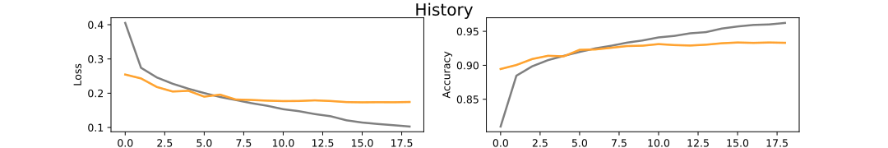
GRU training
Notes:
I think the embeddings were unfrozen after 13 epochs.

Slide 9
Future work

Slide 10
Neat things
Stuff I could have done
Print rows that were misclassified
Reversed the text
More units on GRU
qRNN
Tested on summary as well
CuDNN ! (Mo, Marius, Margrethe, Therese)
Did
Printed tokens not in pre-trained set
Worked on only 10% of training data or only summaries or reviews
Notes:
Social science coding on misclassified reviews could have given us a lot of clues (maybe the labels were just wrong?)
only ~3% difference between training and validation so could have increased units
We didn’t know about quasi-RNN until this Tuesday but it’s a much faster LSTM
Do we have other tips about what helps?

Slide 11
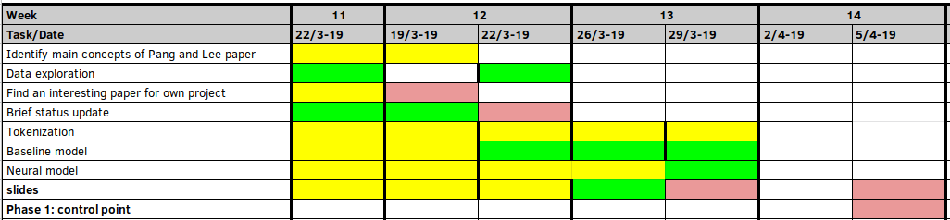
Further work:
Notes:
Further work is phase 2. If there’s stuff that might have been cool to do add it on the previous slide. Jeg ved ikke hvorfor jeg skriver på engelsk her.

