Slide 1

Decorator
Structural Design Pattern

Slide 2
What does it do?
The Decorator adds new functionalities to an existing object without sub-classing nor altering the behavior of the other elements of the same class

Slide 3
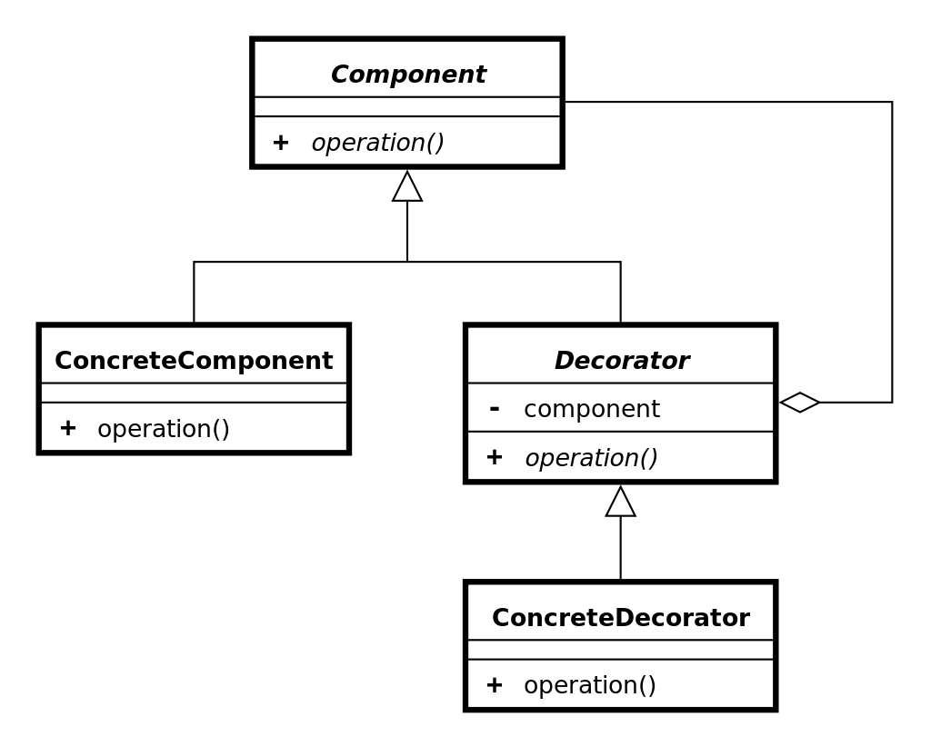
How it is implemented?

Slide 4
When to use it?
When you need to add non-essential behaviour without sub-classing
When you want to add and remove functionalities at run-time
When you need to add functionalities to a particular Object, without affecting the behaviour of other objects of the same class

Slide 5
Another kinds of Decorators
Interfaces
Abstract Decorators

Slide 6
Advantages & Disadvantages
Transparent
Flexible
Avoids excessive subclassing
It may create many small, similar objects; complicating our application architecture and polluting our namespace.

