Slide 1

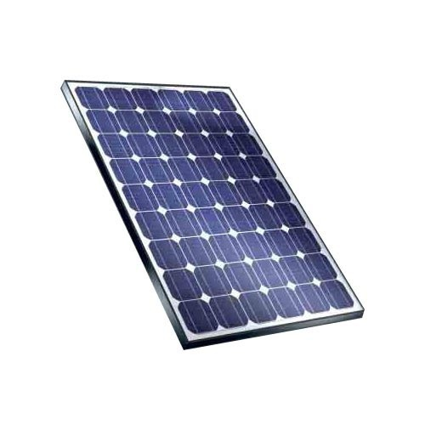



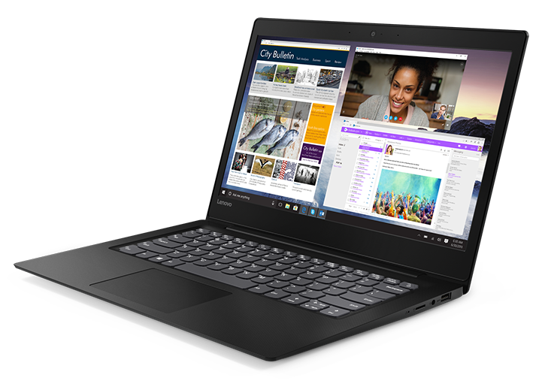
10Wp Solar panel
Remote WiFi LAN
Remote
unit
20m RFD antenna
Public Internet
Local WiFi LAN
PC with FLdigi, WSJT, ...
Local
unit

Slide 2
Remote unit (block diagram)
µBIT-X controller
WiFi ESP32
Codec WM8731
Solar
panel
Solar controller
ATtiny84
WiFi
antenna
+12V
sound
CAT
Battery Li-Ion
11.1V 13Ah
µBIT-X
TRx
Raduino &
Arduino Nano
HF antenna
VSWR
bridge

Slide 3
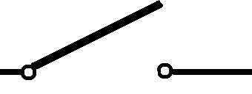
Local unit (block diagram)
WiFi
antenna
USB
to PC
Home Device
WiFi USB
ESP32
OLED
display
128*64
Audio codec
WM8731
Sound
to PC
Sound
to PC
Rotary encoder
Switch for connection

