Slide 1
Acoustoelectric Neural Recording and Neuromodulation
09.08.2023

Slide 2
Neural Recording: (exp 107 t1)
I seem to have pressure induced disjuncts in the file which mess everything up. I should try using a shorter pulse.
Next time switch from the settings that initially worked, then to the new ones.
I can’t see the k gamma in the raw signal that well – so what would it even demodulate? I need to see k gamma to be able to do anything. I can in file 3 and 4 (gain = 1000).
Use a lower sample rate and a HW 3k cut off filter.

Slide 3
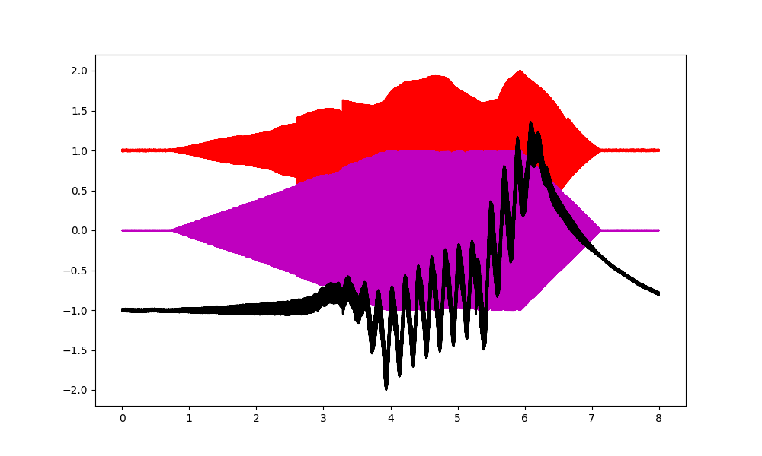
MEPS
I am a factor of 5 off, despite my input signals being correct. Something interesting is happening. The black signal shows the neural signal, which is off by a factor of 5 in frequency from the input signal difference.
Answer, turns out one side was NOT plugged in…

Slide 4
Neural Recording exp 107 t2
I have systematic noise in both current and pressure recordings. This may have to do with the Fs interacting with the applied US f or PRF. I should optimize this in the phantom. (It could be the Fs, or the new cable).
Try using the other side of the current source from d bono, as it is isolated and effectively what I need to do the artefact test? Oops no- wrong frequency range(doesn’t output linearly under 10khz).
I cannot definitely see f mixing in the current only artefact test – if I do I would need to use signal isolation on the end of the impedance adapter.

Slide 5
Phantom tests.
Recreate the noise issue then fix it by modifying the sample rate.
Try this also with MEPS. Was I getting the same thing? One of my probes was not connected.

Slide 6
TODOs
Check heat mat for noise, check connectivity of the new measurement cable.
Phantom: try mouse brain, mesh, PVDF+PVDF then transducer. I need to stop the US from mixing with itself.
Or mouse brain, mesh, PVDF + PVDF, transducer so as to block the E signal from the transducer.
The electric field alone, induces a DC artefact. Does this cause nerve block?

Slide 7
In future calibrate via the mixing prf.
Insert electrode in the brain to get good delta.
Analyse the data from this experiment. E107/t5. The data collected all seemed reasonable representation of where I am at.
Do more phantom experiments to understand how to minimize the DC offset.
MEPS experiment needs US alone, E field alone to help understand the spiking.
Look at the spiking activity when I apply dual ultrasound…

Slide 8
Neural Recording Date: 17/08/2023
The gamma is there whether I apply US or not, inclusive of spiking. I need to move to a timed metric like VEP, AND do demodulation at higher PRF frequencies.
The previous paper by Xizi and co, may simply be the VEP sub-harmonics? Since their PRF was only 80. There result MAY BE an ARTEFACT.
Plan a single non-recovery VEP demodulation experiment.
I have results showing mixing is NOT occurring in the preamp. GREAT!
However, I also need this applying US vs not result.

Slide 9
MEPS
Going back to dual acoustic, I had about 4000 microvolts p-p when I saw something(1Hz). It was very clear and without all this noise.
e100_neural_recording_pat_e_mouse\t6_mep_delta_wave_motorcortex, shows the good data.

Slide 10
New MEPS test
Wire only, try with larger surface area.
New meps waveform with two PRF waves mixing together to keep the pressure and current more linear.
Do a phantom test, is it more linear, do I get weird amplitude changes at all? Apply current alone and US alone, then both together.
Goal is to get a linear straight forward f mixing interaction without generating all these extra frequencies.
Also, I’d prefer NOT to be switching cables around so calibrate with the PRF. Test this here.
It is possible the silver wires add non-linearities.

Slide 11
Phantom e107 t 6
Calibration with PRF works fantastically, 3 second duration. Use from now on.
I apply my dual prf waveform, and I see a TON of non-linear components. I am using copper tape to increase the surface area of my wire which is applying the stimulation. The dual PRF waveform works fine.
PRF: Move the voltage up, and I do get a larger 18 microvolt ae. At 80hz.
I can even have the preamp set lower…
I get this non-linear leap in amplitude… round 3V… in phantom too.

Slide 12
MEP Mouse
Preamp: 1hz high pass, 100hz low pass.
V out = 3, use aemeps_prf.py
Ensure I am applying the voltage well… like if I get a small amplitude, know to fiddle with connection.
Calibrate with the ae_demod_PRF.py code.
Use the silver wire connector mouse, simply because that mouse is ready, and has reliable signals.
I had a lot of trouble calibrating, and appeared to be measuring noise… I couldn’t see a delta wave.

Slide 13
Blip analysis – and conclusion as to what to do for this 200hz or 20hz which appears after some time.
Noise springs in at the second half of files… this is where the 200Hz arises. This could be due to magnetostriction in the transformer. Pausing the current for a moment would fix it?
Solution: I implemented a 0.05s pause if the ISI is set.
The height differences throughout the file, are due to the bit depth of the daq… and only visible at low amplitudes… The way to fix for it is to ensure my daq ranges suit the voltage being injected. #
The noise is coming from the voltage source, and not from the acoustic source. It seems to only occur when the transformer is attached to a non-linear load?

