Slide 1
Acoustoelectric Neural Recording and Neuromodulation
11.08.2023

Slide 2
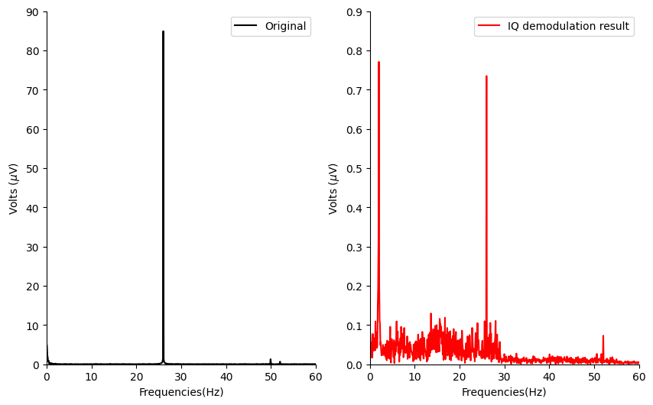
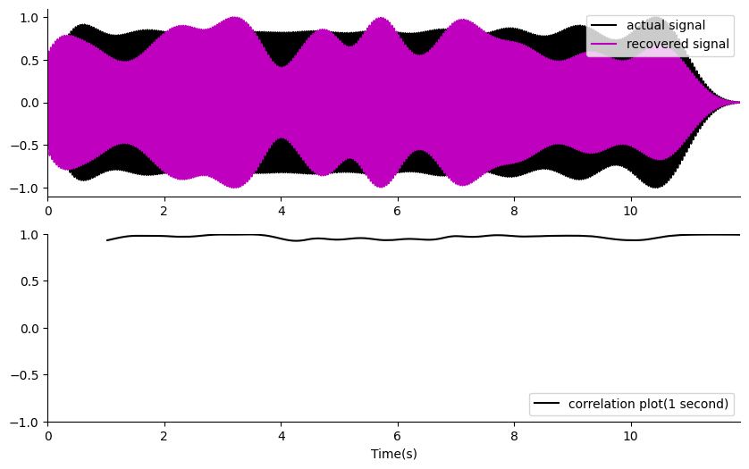
Demodulation in Phantom (e105 t2)
Tank phantom pipeline. I can recover a small 26Hz signal quite well using PRF 80 and a single file(no repeats), or even use of the second harmonic. The harmonics of the 26Hz, get in the way a bit(i.e. making this fake 2hz business, but otherwise it looks good).
Hilbert transform works, but has a phase aberration issue, whereas IQ demodulation, or multiplication by the carrier leads to a lagged but phase alignable solution. Note: the modulated data has a slight lag due to the acoustic conversion.
Code (xizi_postprocess.py, xizi_postprocess2.py)
Introduced by 26Hz second harmonic being too close to the PRF
Introduced by 26Hz second harmonic being too close to the PRF

Slide 3
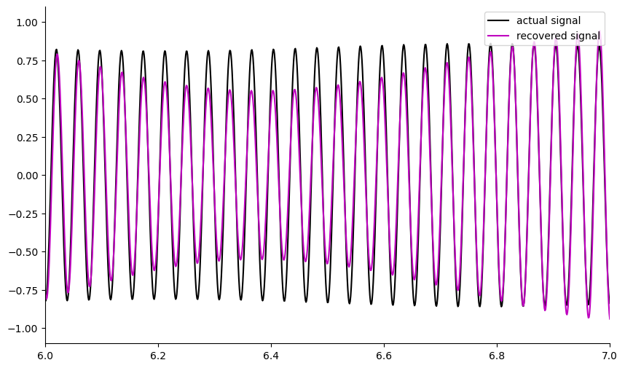
Close up of demodulation result taken at a random point in the file.
Normalized Signal (V)
Time(s)

Slide 4
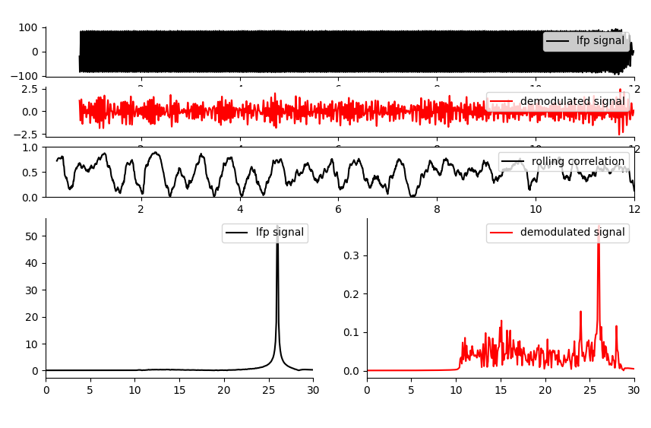
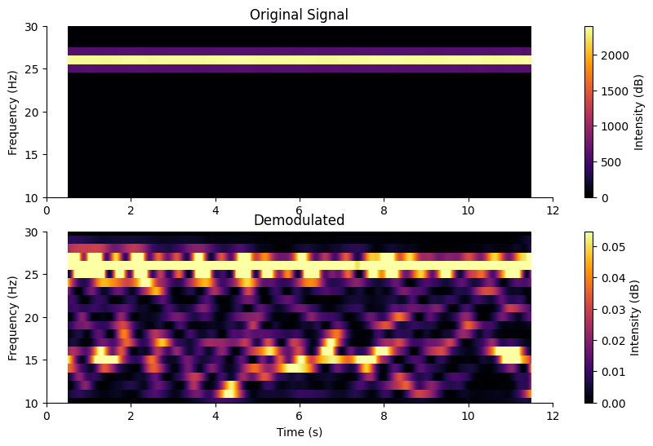
Phantom: 26Hz 50µV signal recovery.
E105/t2/f5
Further work can be done here to optimize the amplitude and SNR of the recovered signal. ONGOING.
Where I place the filter in the recording/algorithm path is important to the SNR.
Increasing the PRF improves the SNR but decreases the amplitude of the recovered signal, so there is a balance between sample rate, PRF, pulse length and recovered signal amplitudes.

Slide 5
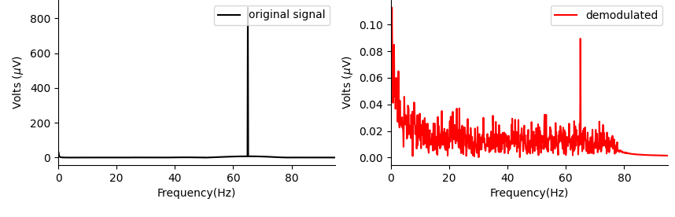
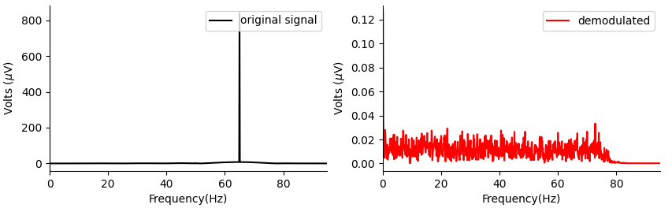
Could the result be an artefact of electrical noise? (e105/t6/f1-4 and 5-8). Check by performing acoustically connected versus not test.
Acoustically Connected
Not
Acoustically Connected, but all signals run through the system as in the acoustically connected case.
Note: I repeated this 4 times for each category and see the same result.
67Hz is only recovered when the system is acoustically connected.

Slide 6
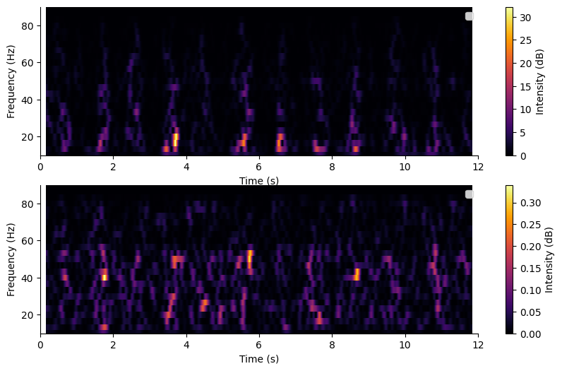
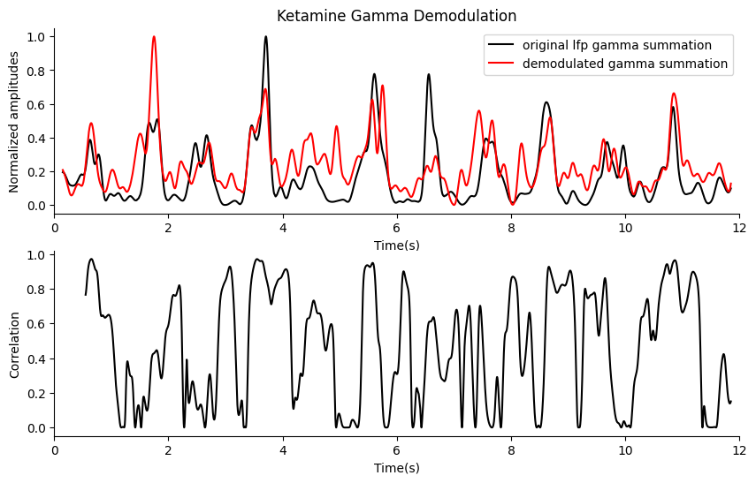
In vivo: ketamine gamma band demodulation
Date: 06/08/2023 E105,t4, file 11
Original Signal
Demodulated Signal
There is a clear power band trend with time, when there are ups there is gamma power for both the original and demodulated signal.
Artefact Test:
1. The recorded measurement signal is nowhere near the saturation limit or DAQ range limits, meaning no rectification is taking place.
2. Common mode coupling between the measurement cable and the cable that powers the ultrasound. To prove this is not what is causing the correlation, do acoustically connected versus not connected test where all the same signals are being run through all cables. If I can still demodulate when the transducer is not coupled to the mouse brain, then I’ll know I have a capacitive coupling(non-linear mixing) effect induced by this coupling. If I do not see any correlation of the demodulated signal when the acoustic signal is not connected, then the demodulation is real. (my phantom test suggests this is NOT the case).
3. It is possible that I am picking up the original signal in my demodulation(PRF 180), so shift the demodulation up in frequency 400-1000Hz). What does the raw signal PSD look like 90-180? (my test doesn’t show anything, so, so far it seems reasonably convincing).

Slide 7
Demodulation Experiment Plan.
Phantom: Try to optimize neural recording further for optimal amplitude and SNR.
Mouse: I have a recovering mouse that should give higher ketamine induced gamma as it has an electrode at the Medial Prefrontal Cortex: (AP 2.4, ML 0.4) - https://pubmed.ncbi.nlm.nih.gov/21880935/. Try demodulation with new improved settings. This time ensure I get an acoustically connected vs not artefact measurement to ensure I am not inducing artefact.
How can I ensure it is real and not an artefact?
There is a clear power band trend with time, when there are ups there is gamma power for both the original and demodulated signal.
Artefact Test:
1. The recorded measurement signal is nowhere near the saturation limit or DAQ range limits, meaning no rectification is taking place.
2. Common mode coupling between the measurement cable and the cable that powers the ultrasound. To prove this is not what is causing the correlation, do acoustically connected versus not connected test where all the same signals are being run through all cables. If I can still demodulate when the transducer is not coupled to the mouse brain, then I’ll know I have a capacitive coupling(non-linear mixing) effect induced by this coupling. If I do not see any correlation of the demodulated signal when the acoustic signal is not connected, then the demodulation is real. (my phantom test suggests this is NOT the case).
3. It is possible that I am picking up the original signal in my demodulation(PRF 180), so shift the demodulation up in frequency 400-1000Hz). What does the raw signal PSD look like 90-180? (my test doesn’t show anything, so, so far it seems reasonably convincing).

Slide 8
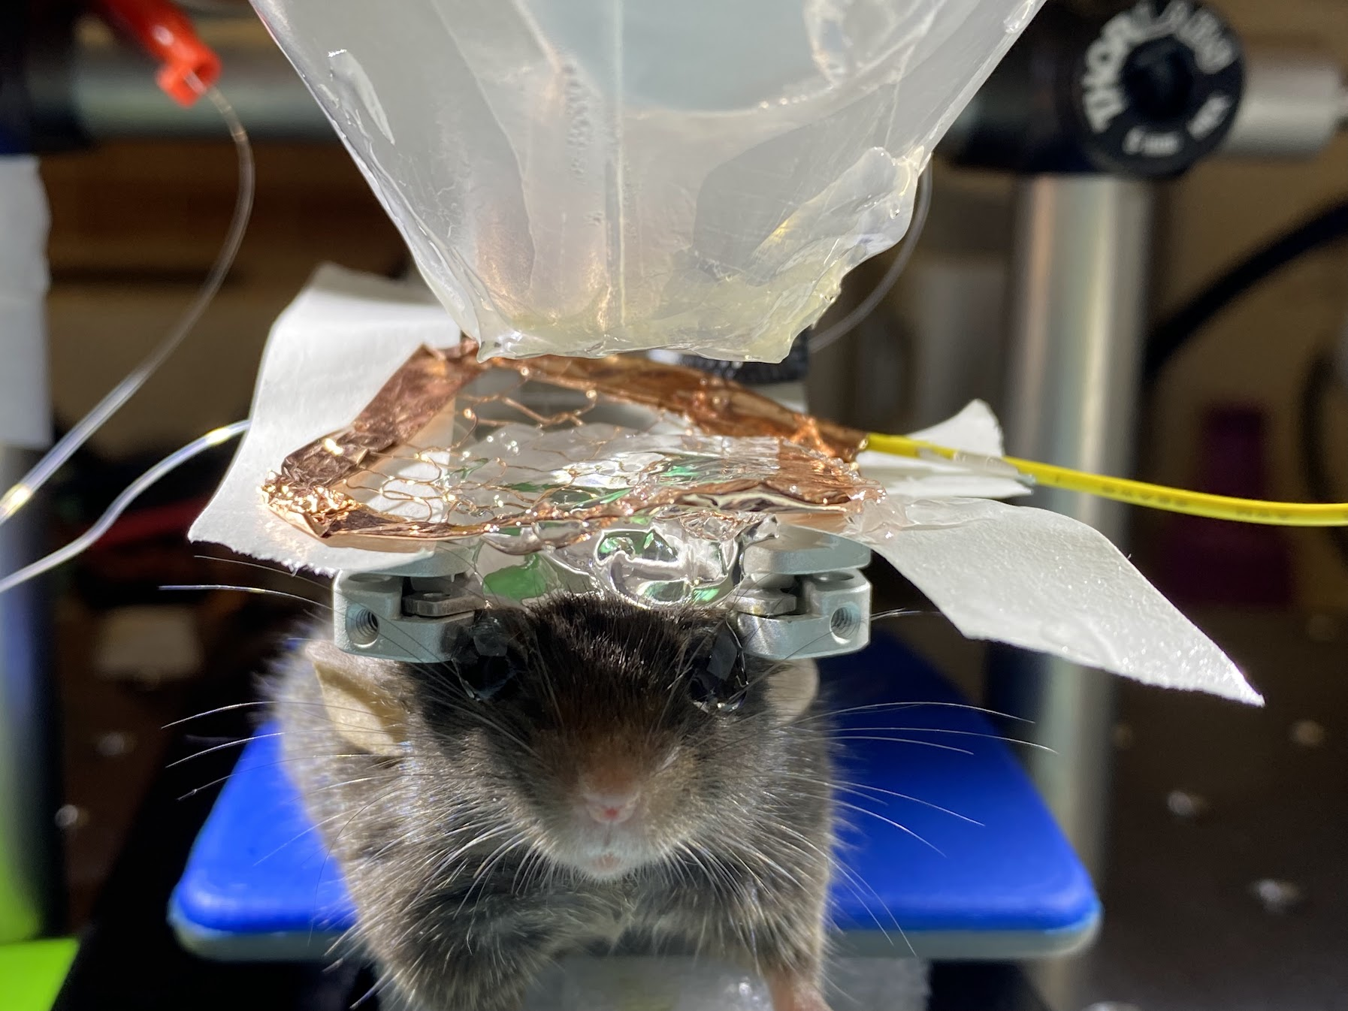
Acoustoelectric Neuromodulation

Slide 9
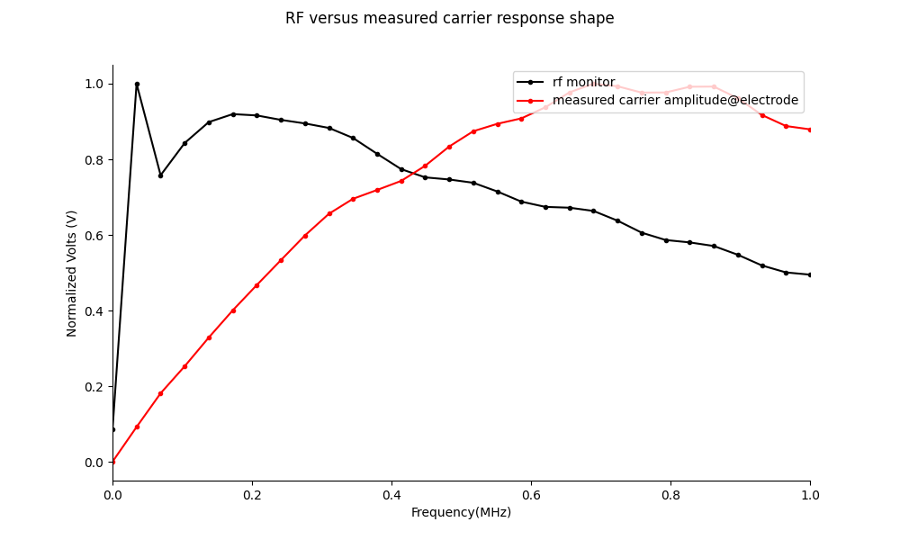
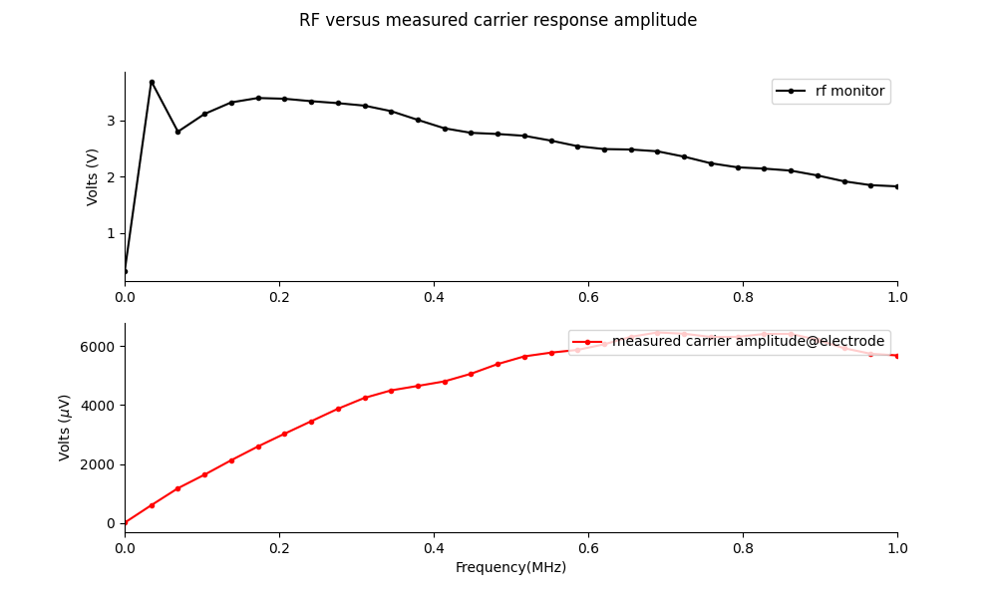
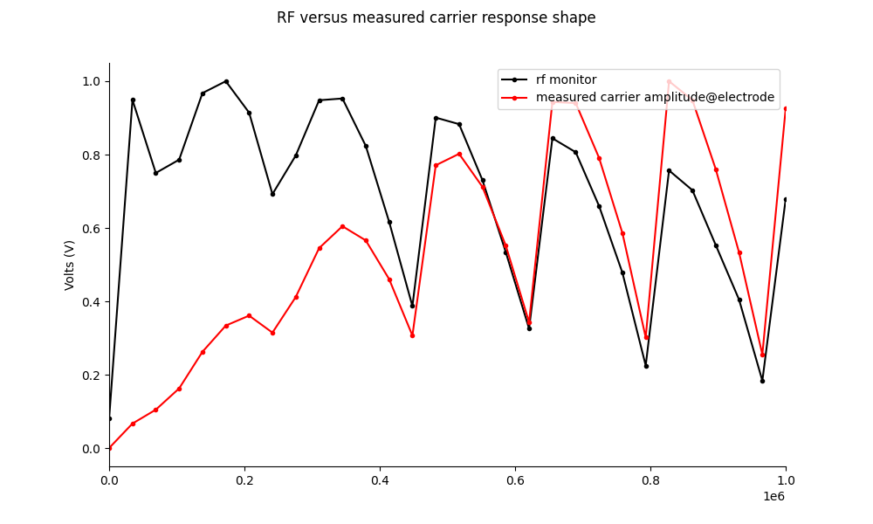
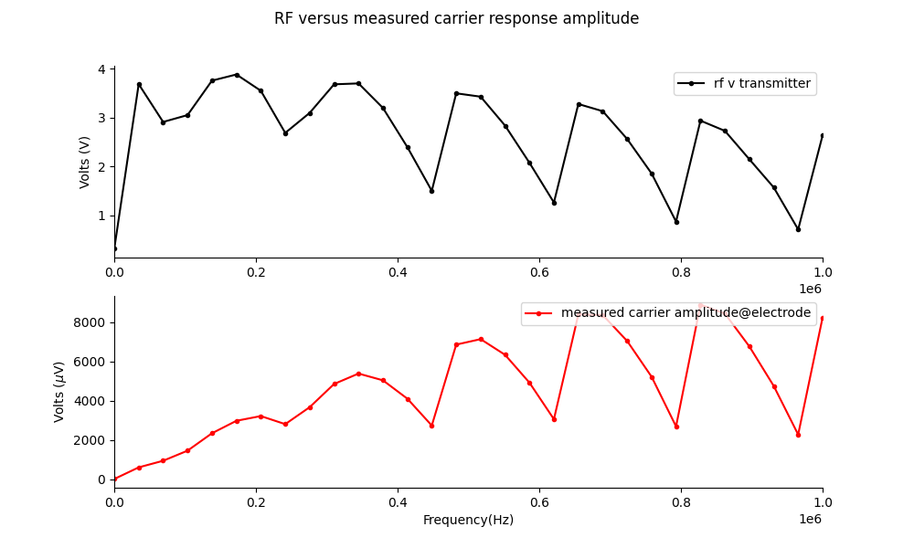
RF transmittance of e field with silicon sheet.
It is possible that the silicon sheet attenuates the acoustic field. It may also attenuate the electric field coming from the transducer.

Slide 10
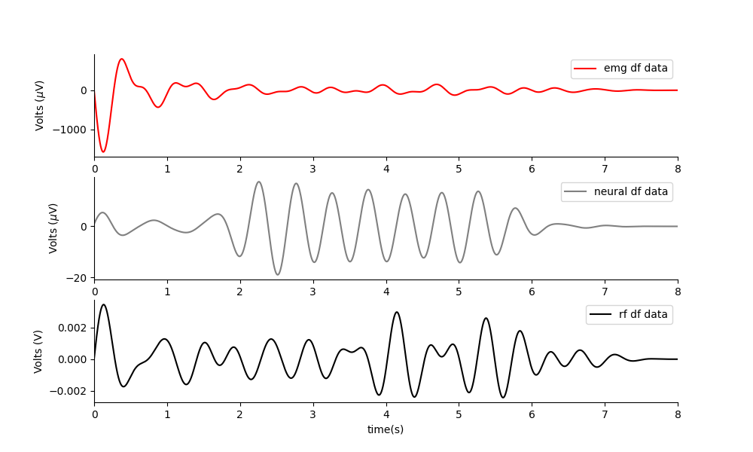
Phantom: Two acoustic fields.
Works perfectly. There is none of this signal in the rf output.

Slide 11
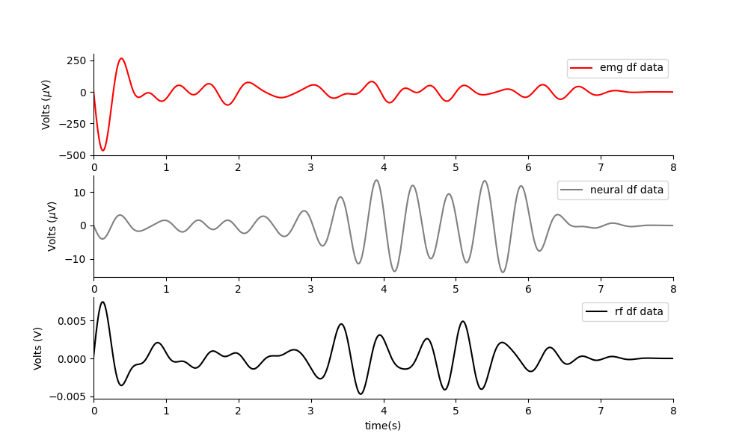
Phantom: Acoustoelectric neuromodulation
Works great. The mesh current emitter is near where the head would be.
Note: It will be better to have a long ramp on the acoustic field, so as not to induce a DC movement artefact from the DC offset induced by the US.

Slide 12
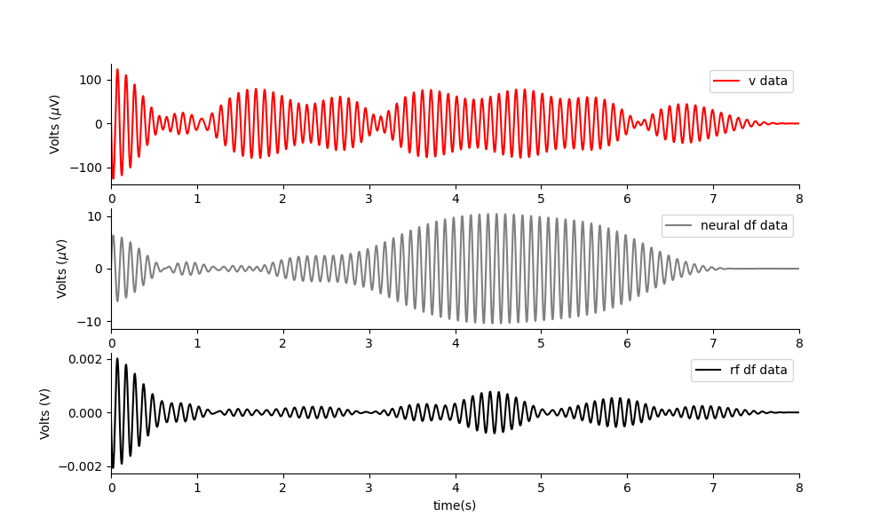
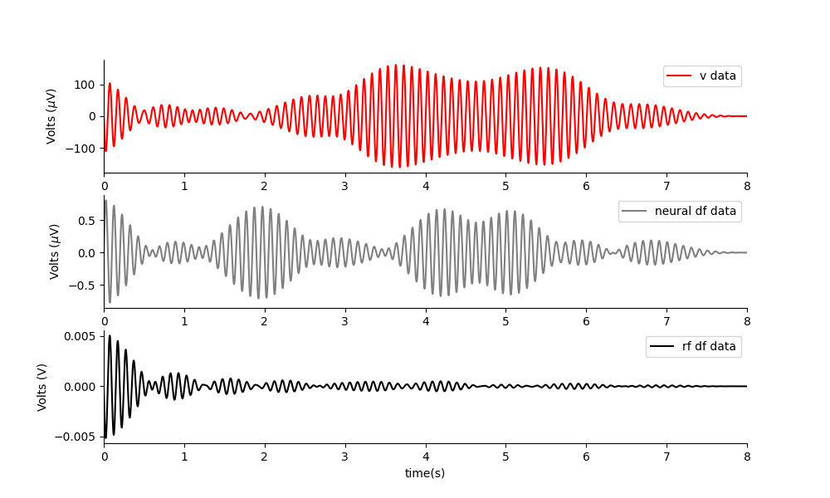
Phantom: RF E TI (two electric fields) applied at same amplitudes.
2khz + 2.01khz
500khz + 500.01khz
2khz + 2.01khz
Nothing really gets through, what is left may be due to my tight rf filter artefacts. Shape doesn’t follow the output.
The two high f signals get through, and then the mixing occurs in the saline phantom.

Slide 13
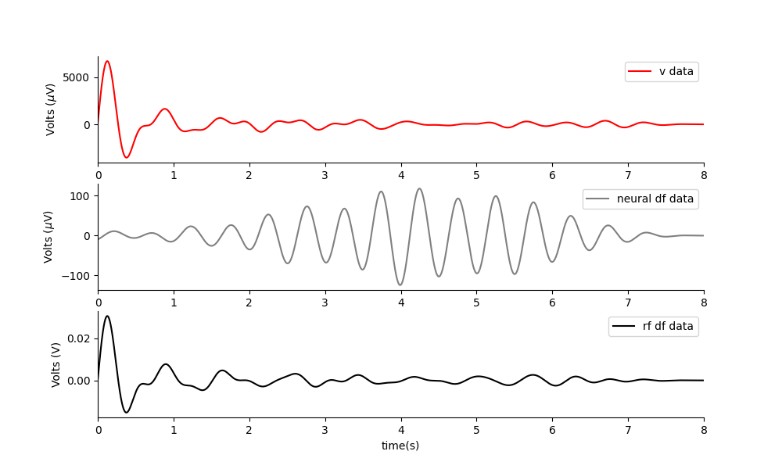
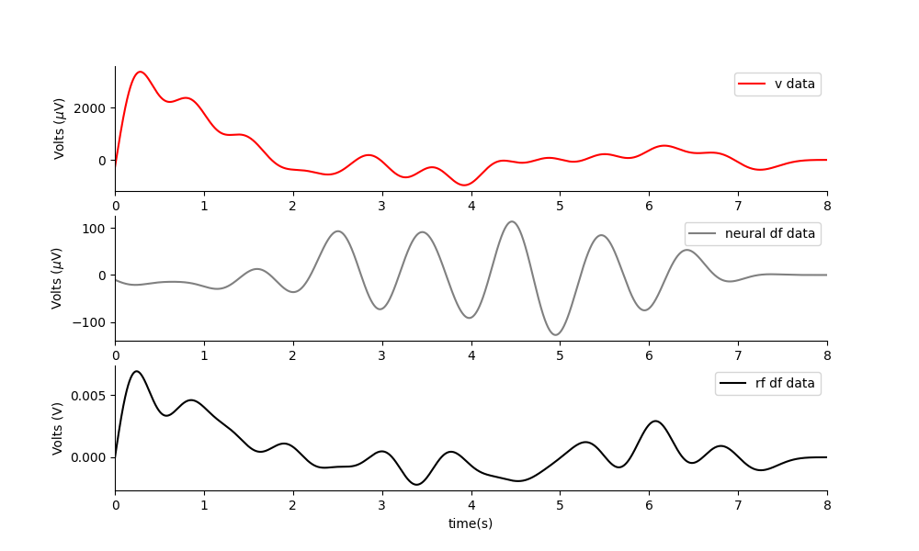
In vivo: two acoustic fields.
Experiment e105, t3 and t4. I could obtain excellent neural amplitudes at small difference frequencies such as 1Hz and 2Hz for both the dual acoustic field, and the RF AE paradigm. However, I didn’t get movements. I did not get a good amplitude for RF TI. I got much larger neural df amplitudes than I did in the phantom set up.
NOTE: all the signals are far bigger in the mouse than in the phantom.
Two acoustic waves, 1Hz apart. 1MPa. Both the electric mesh and the silicon sheet are in place. No movement elicited.
It is possible that:
I am not positioned accurately(Perhaps I need to position over the other electrode – try moving 2mm left or right).
The mesh is stopping the e field from the transducer from getting in.
The silicon is stopping the acoustic field.
The any of the two fields is being dispersed or attenuated by the mesh/silicon.
TODO: try without the silicon.
Initially very I can do it with just US gel, then insert the mesh. Do measurements of the total amplitude across the spectrum with and without the mesh in place.

Slide 14
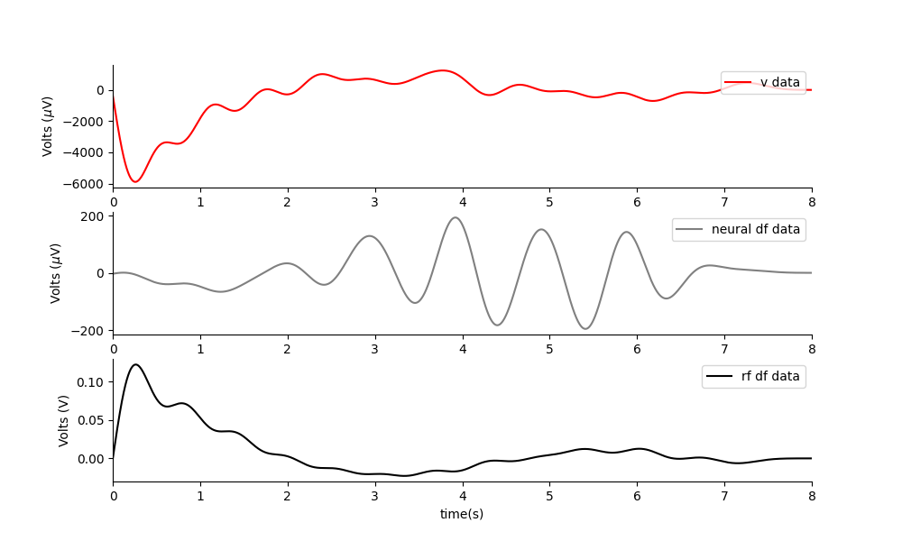
In vivo: RF AE
One acoustic and one electric field, 1Hz apart. 1MPa, 2V out. Both the electric mesh and the silicon sheet are in place. No movement elicited.

Slide 15
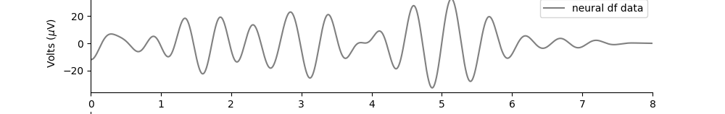
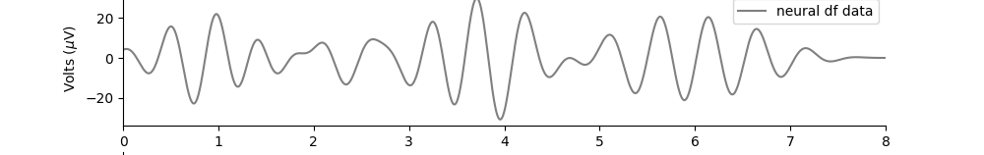
In Vivo: RF TI – so far looks inconsistent.
Two electric field, 2Hz apart. 4v out. Both the electric mesh and the silicon sheet are in place. No movement elicited. I think the signal at df is background noise as it is just a tight filter.
Two electric field, 2Hz apart. 6v out. Both the electric mesh and the silicon sheet are in place. No movement elicited- it is likely that this field is far less focused than the US – so it may not induce a movement.

Slide 16
Leave one out test for overhead RF MEPS system
Test 1: Electric field at 500khz decreases when there is PVDF and US only. When there is mesh, it is at original size. When there is mesh and PVDF it is also at original size.
This shows that the PVDF effects the amplitude of the monopole antenna field.
Test 2: When a voltage is applied and the acoustoelectric effectis measured(same pressure and same voltage applied each time), the amplitude is worst when there is PVDF, mesh and GEL. Second worst with PVDF and gel. The PVDF and mesh appear to effect the pressure amplitude particularly when together(potentially enabling air bubbles too). This suggests the PVDF inhibits the pressure field amplitude also.
Next experiment plan:
The PVDF layer inhibits both pressure and electric field, lets remove it for the next experiment.
Ultrasound Cone
Copper Mesh
PVDF
V+
Measurement electrodes
Conductive gel
V-
Test 1: No V+ or V- applied, just measuring electric field change at 500kHz.
Test 2: Acoustoelectric effect at the site, amplitude dependent on the incident pressure.

Slide 17
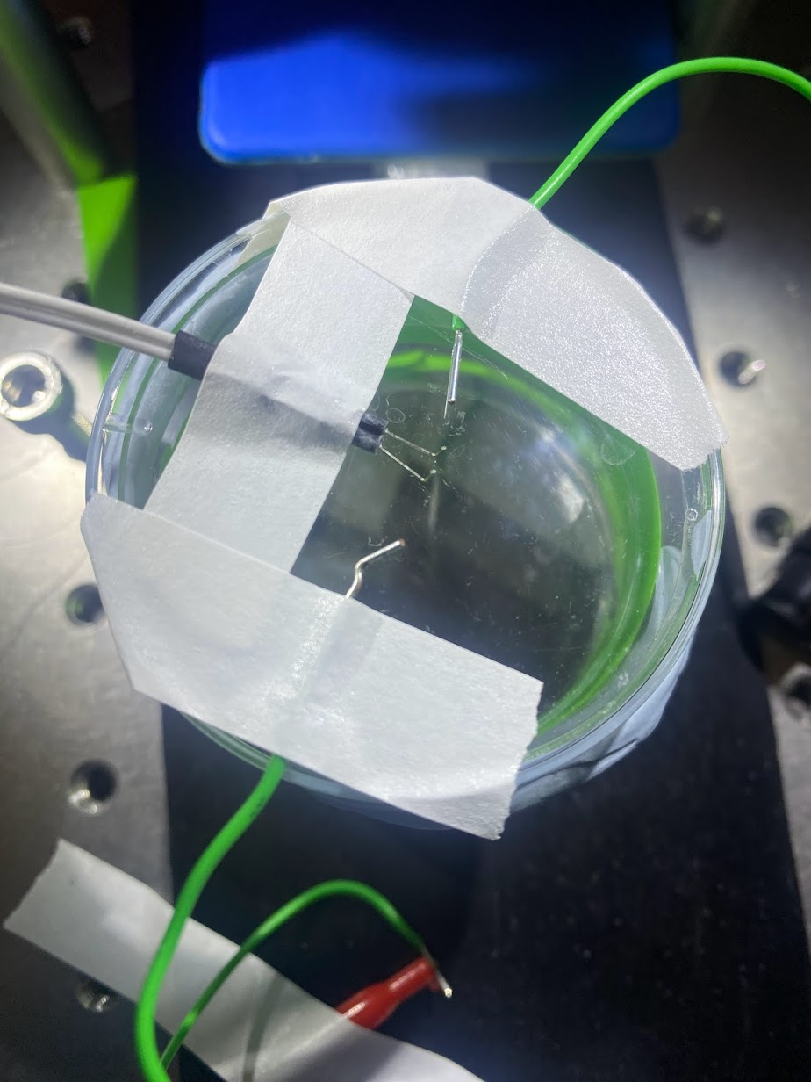
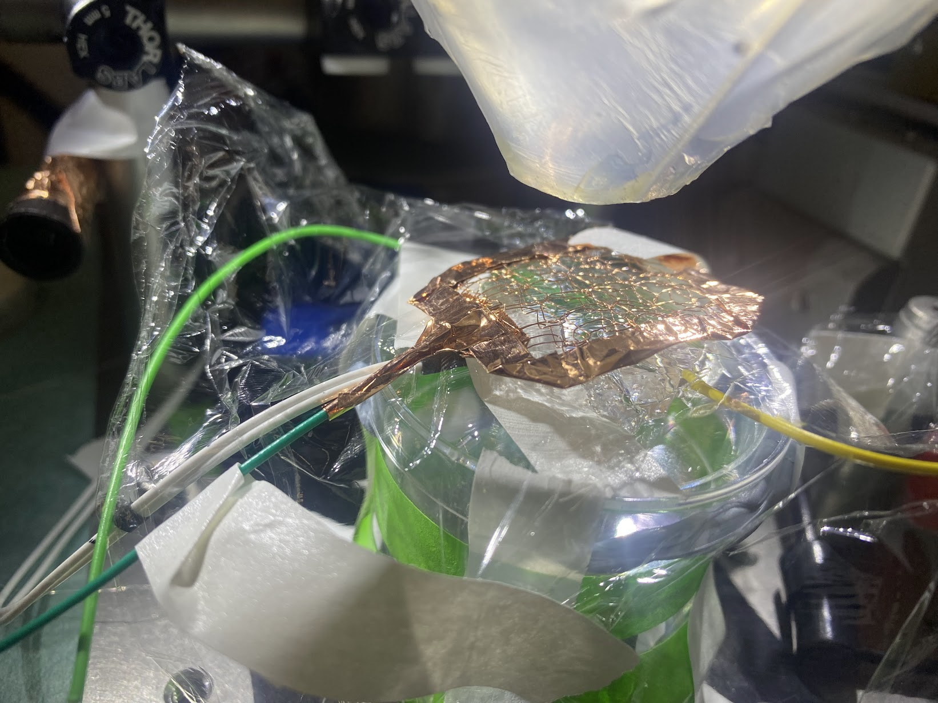
Physical set up.

Slide 18
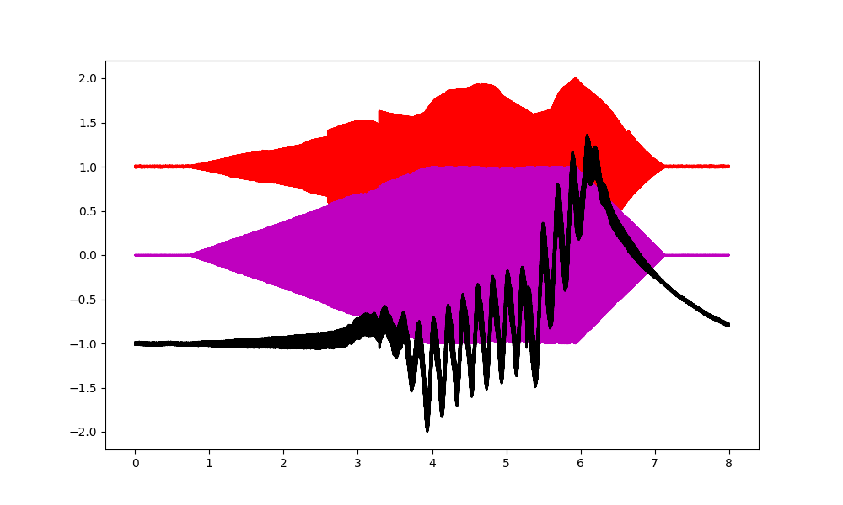
In Vivo MEPS test with mesh only.
I am a factor of 5 off, despite my input signals being correct. Something interesting is happening. The black signal shows the neural signal, which is off by a factor of 5 in frequency from the input signal difference.
Note: this mouse does not have a good connector. It is possible I have a poor connection.

