Slide 1
Investigation of the source of noise in AE neuromodulation
10.09.2023

Slide 2
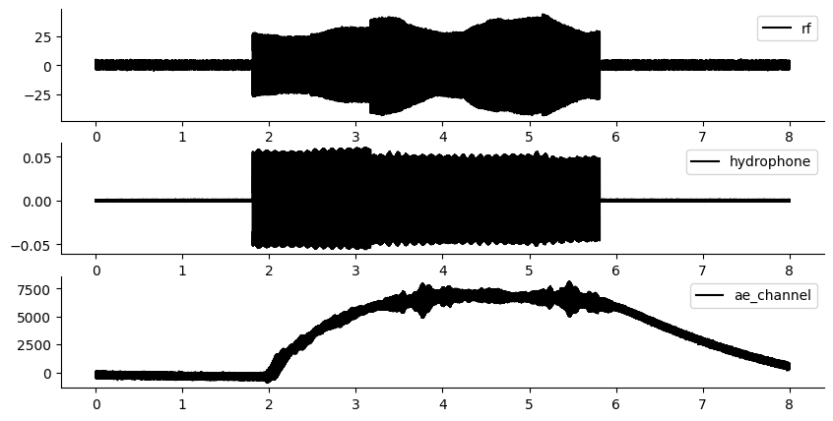
Raw data

Slide 3
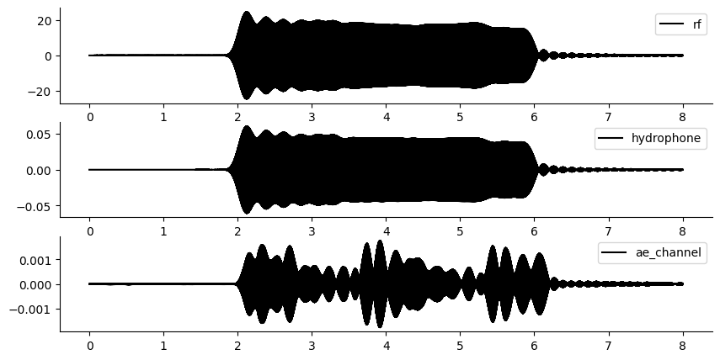
500kHz filter only
Filtered around 500kHz, the hydrophone and the rf channel look the same.
Some amplitude appears to be lost, but this appears to be due to the amplitude of the rf signal.

Slide 4
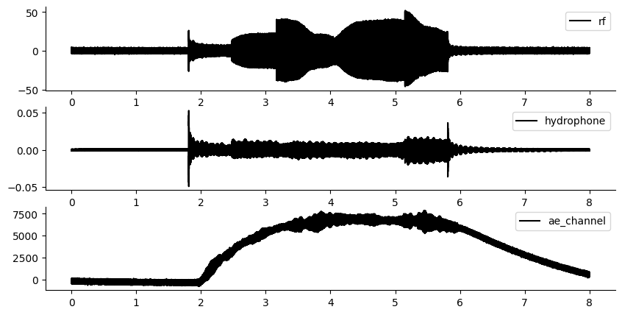
Band stop filter only , looking at everything except 500khz.
Large irregularities in the RF signal, small ones only in the hydrophone. This suggests that there is some electrical reflections issue.

Slide 5
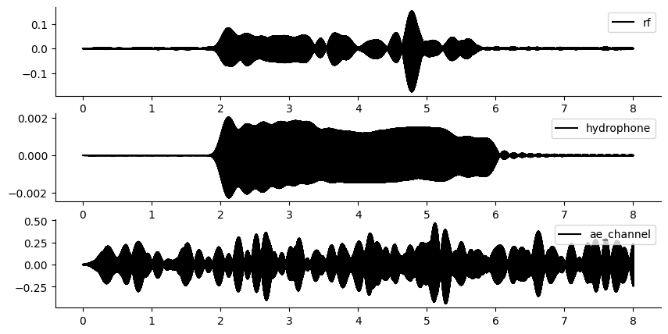
1MHz filter bandpass
The hydrophone 1MHz

Slide 6
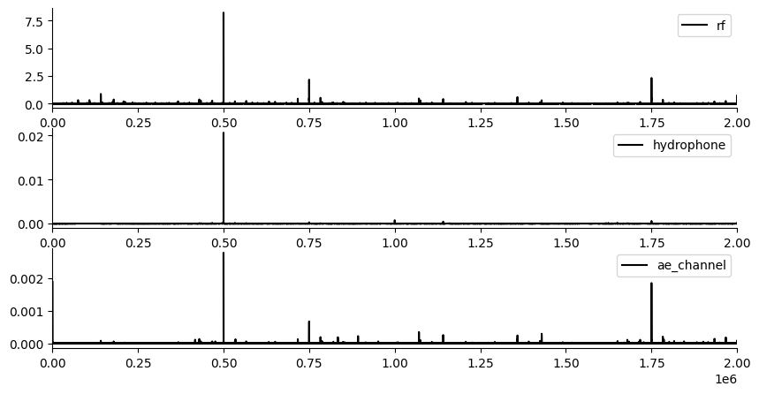
FFT of these 3 signals
Here we can see that the rf noise is considerable, the the pressure signal is relatively unaffected but the AE measurement channel has all these frequencies which are also present in the rf amplifier also present.

Slide 7
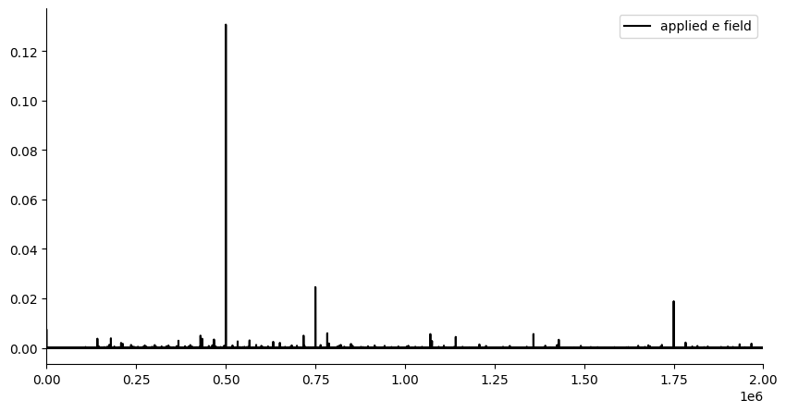
FFT applied e field
E field is at 500khz-10hz.

Slide 8
Results:
It appears there are not extra acoustic frequencies really(maybe a tiny bit?), but what there is, is extra electrical frequencies in the RF amplifier, which then take energy away from the main 500kHz.
TODO:
Questions: Is the ramp up real or a filtering effect?
By placing F21 in the way of the monopolar antenna, can we reduce the rf artefacts? Does reducing the rf artefacts at the measurement electrode enable a cleaner AE field?
What if I put a monitor on both the function generator and the RF amplifier? That way I could determine if the rf amplifier is sending a signal back which is changing the output on the function generator.
For dual acoustic signal, look at the LFP response and spiking data? I know I got the movement – can I see the spikes? If not – I may need to go back to the more invasive electrode style as that appears to get spikes.

Slide 9
E107 t5 aemeps
Why is there a multiple of 5, and a multiple of 10 of every df?
Could this be related to a transient offset?
Is it based on the equipment or the mouse? – the equipment as it is true also in the phantom.
The onset of extra harmonics occurs when the ultrasound rf monitor obtains extra signals.
Thus the F21 should remove this problem. TO TEST

Slide 10
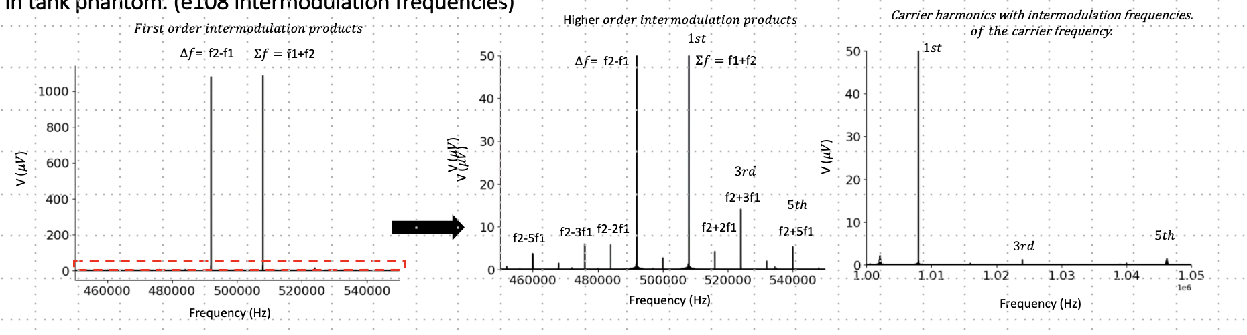
Intermodulation Frequencies are present in the ae effect, just 100 times smaller than the first order products. (e108)
Ratio of 1st order to other orders: 1000 microvolts: 10 microvolts. So about 100.

Slide 11
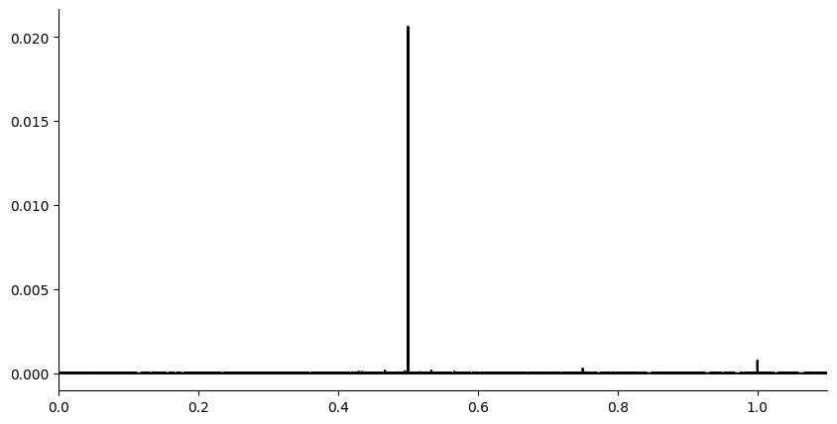
Do we see harmonics in hydrophone: yes?
Yes, but not at DC as hydrophone filters DC. As we know, harmonics occur in sound waves.

Slide 12
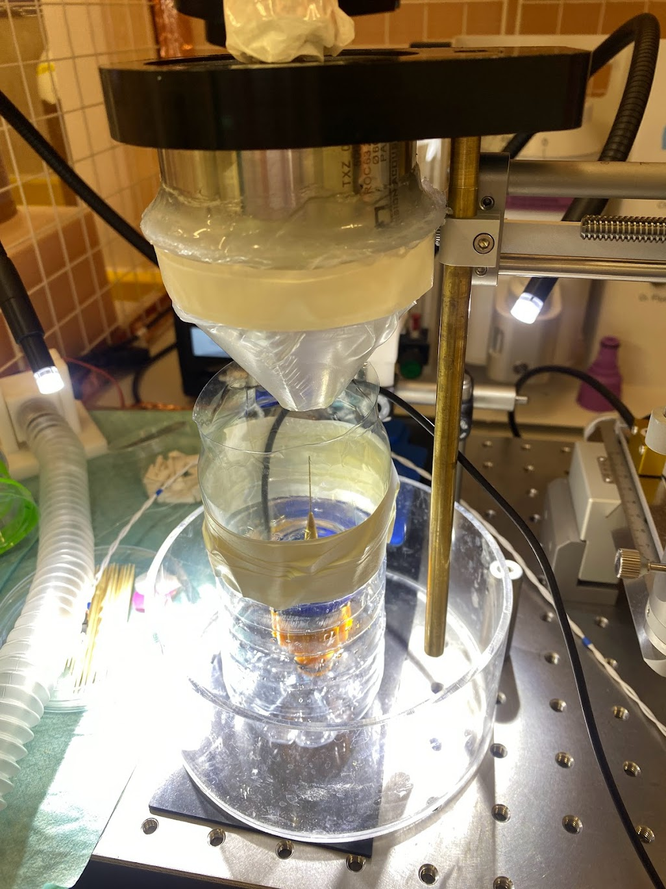
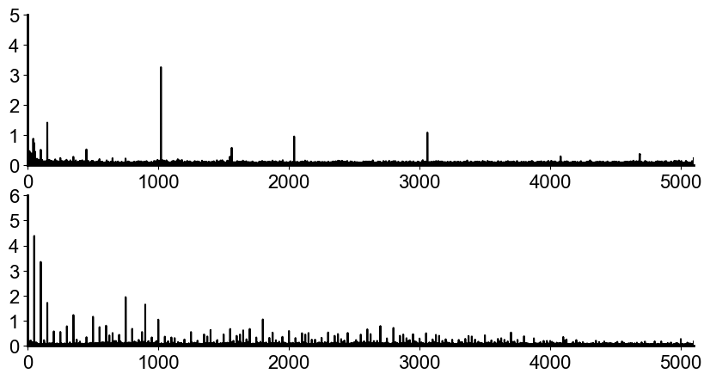






Can I set up the hydrophone at my mouse set up? Yes PRF waveform pressure versus electrical measurement. (e108)
When I repeat the same waveform PRF 1020 I can see the mixing frequencies clearly ONLY in the electrical signal. It is not present in the pressure signal, though some very small amplitude mains harmonics are.
$$measurement electrode$$
$$μV$$
$$mains harmonics$$
$$hydrophone$$
$$kPa$$
$$frequencies(Hz)$$

Slide 13
How do we explain why the demodulation works?
500kHz mixes with the LFP. However, it mixes every 1020Hz due to the pulse rate. Hence
Why do intermodulation frequencies occur between an acoustic field and an electric field? Whenever there is phase lead and lag caused by the inhomogeneities in the medium, intermodulation frequencies occur. If there is ever an offset between two volumes in the medium which oscillates out of phase we can expect intermodulation frequencies to occur. How many intermodulation frequencies, is based on the strength of the signal, and the spacing of the inhomogeneities.

Slide 14
Can we explain why we see the LFP at the PRF?
- The first order products of the LFP mixing would be around 500kHz and 100 times larger than any secondary products. However, I have electrical noise there from the monopolar antenna of the ultrasound transducer. There is no electrical noise around the PRF of 1020Hz.
- The ionic distortion also happens at the PRF of 1020 due to the acoustic pulse repetition rate. Hence this ionic distortion with the pressure change at 1020Hz PRF is what induces the mixing with the LFP.

Slide 15
Tests with F21.
F21 thickness requirement test.
Run the PRF signal through the acoustic transducer and measure the electrical signal. Obtain the electrical amplitude of the PRF with a few different .
Pressure only test.
run ae_calibrate_with_prf.py without F21 until I find the center point. Do an extremely rough crosshair with 1mm increments.
Place the F21 such that DV remains the same. Repeat the cross-hair test. Do I still see the PRF?
AE neuromodulation test:
Independently apply a voltage source, keeping the pressure the same and DV the same with and without the F21. Obtain the difference frequency using acoustoelectric effect. Is my signal now without the RF noise when I use F21?
AE neural recording test:
Apply a small signal with the PRF signal applied. Try with and without the F21. Does either the noise around 500khz, all the PRF amplitude change?

