Slide 1
Acoustoelectric Spatial Maps and artefact tests for neural decoding
04.09.2023

Slide 2
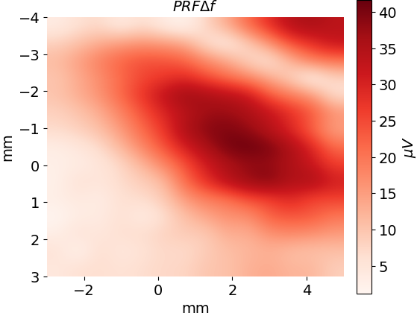
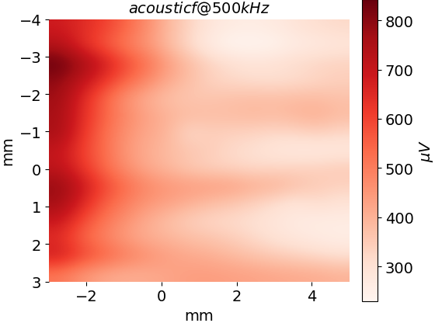
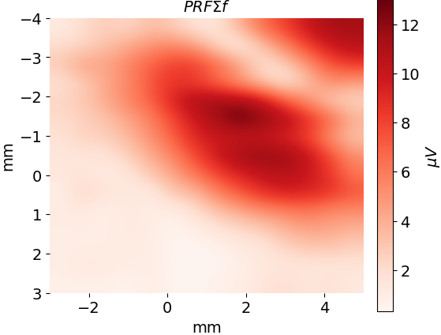
PRF 1020 spatial test, showing the PRF signal follows the pressure focus. (e109t1)
There is a focal spot around each electrode… my electrodes are about 6mm apart here and at the same angle as shown. I should have painted the electrodes with nail polish and made a distant reference.

Slide 3
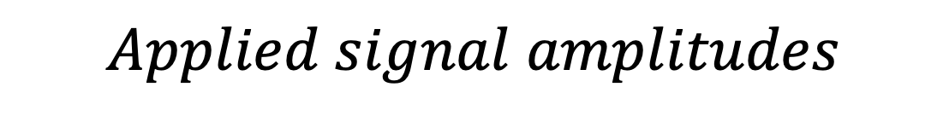
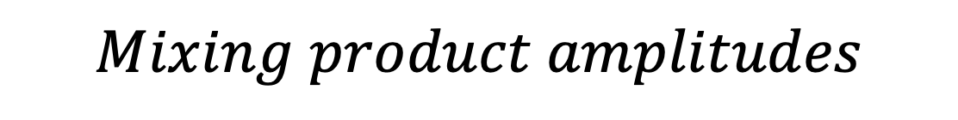
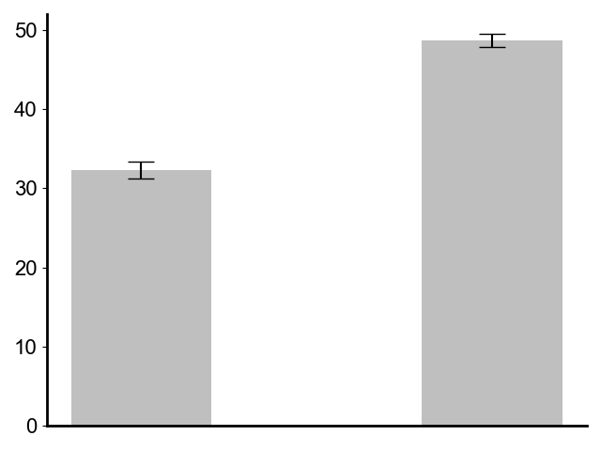
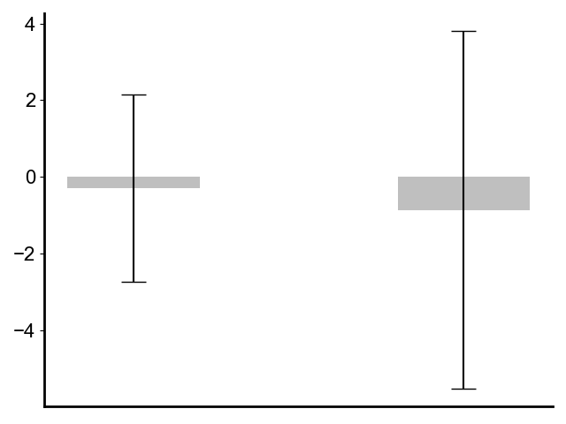
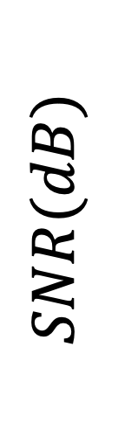
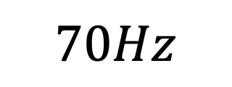
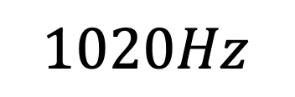


E107 (t3) preamplifier artefact test.
The mixing product frequencies are below the noise floor. The applied signal amplitudes are larger than what we see in vivo (with 1020Hz@200𝜇𝑉and 70Hz@31𝜇𝑉), hence the frequency mixing that we see in our neural decoding experiment does NOT occur in the preamplifier.

Slide 4
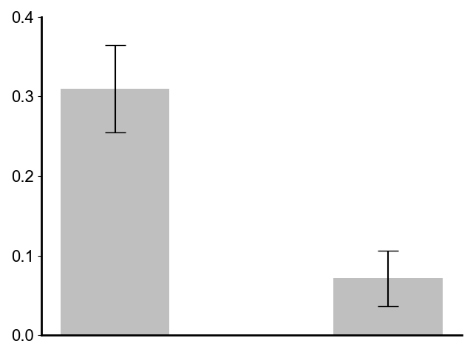
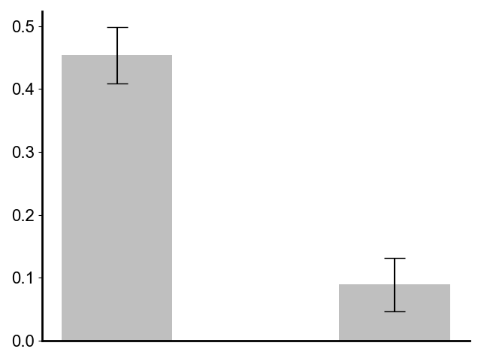
Neural Decoding Correlation Test: E105 t3/t4 US ON vs US OFF artefact test
Mouse 1 (e105 t3)
Mouse 2 (e105 t4)
P = 1.4e-5
P = 1.4e-7
***
***
N=7
N=7
Correlation
Correlation
US ON
US OFF
US ON
US OFF
I see a better signal recovery at low PRF’s. The best signal recovery is with no US. This suggests I have not yet decoded the signal. Instead, I am seeing the gamma spikes amplitudes that were already there. This suggests that I am not doing neural decoding for e107 t2/t5. If I go back to e105 t3/t4 It DOES look that I am doing neural decoding when comparing against straight recordings without US. Why are the experiments in e107 so bad, and the ones in e105 so good? Is it the mouse?

Slide 5



PRF 1020 spatial test. (e109t2) Day 2
I updated the electrode configuration so the differential reference is more distant, and the PtIR length is covered in nail polish so I have more of a point electrode measurement in space. Notably, the distant reference means the monopole antenna e field at the carrier frequency is huge-5591 microvolts. It doesn’t really change the measured amplitude of the acoustoelectric PRF generated field though.
The distant reference means there is a bigger difference for the carrier frequency, with very high values this time. These high values are reflected in the difference and sum frequency trends. You can see that the background AE difference changes.
40
0

Slide 6
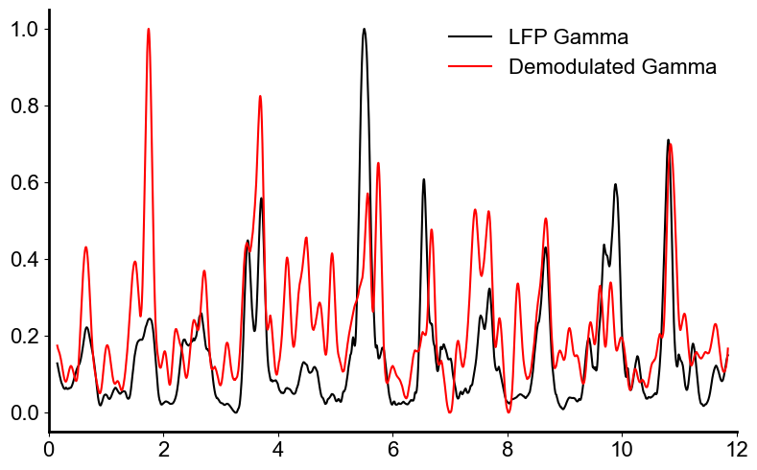
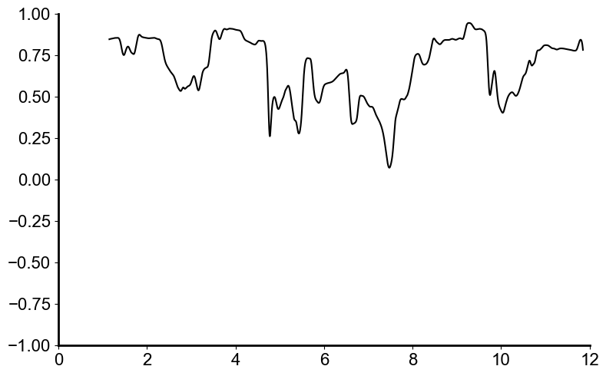
Beautified kgamma demodulation plots and algorithm diagram
PRF = 180
Correlation
Normalized Gamma Sum
Time(s)
Time(s)

Slide 7
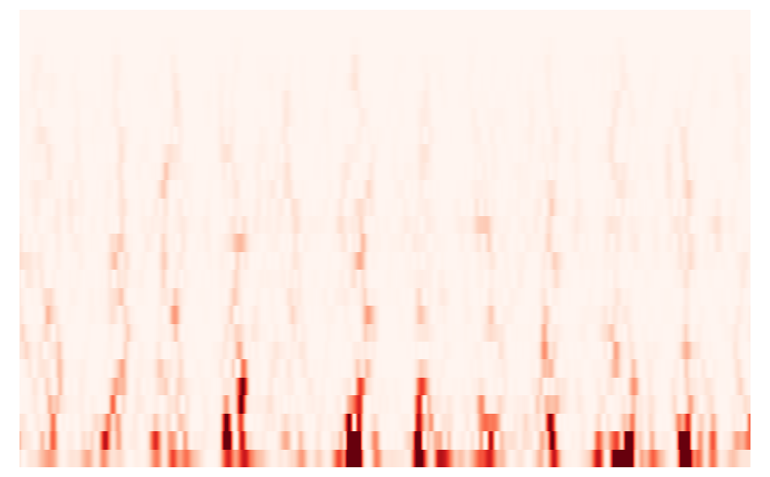
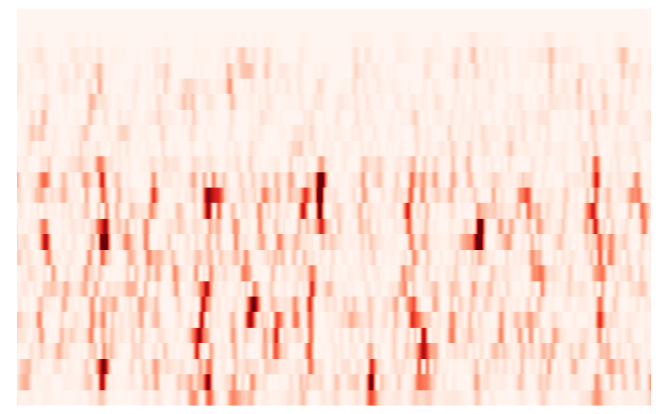
90
126
E105 t4 File 11
Frequency (Hz)
dB
LFP Spectrogram
5
0
PRF180
90
0.34
Frequency (Hz)
dB
Demodulated Spectrogram
5
0
0
Time(s)
12

Slide 8
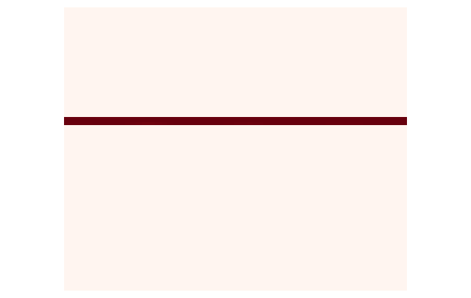
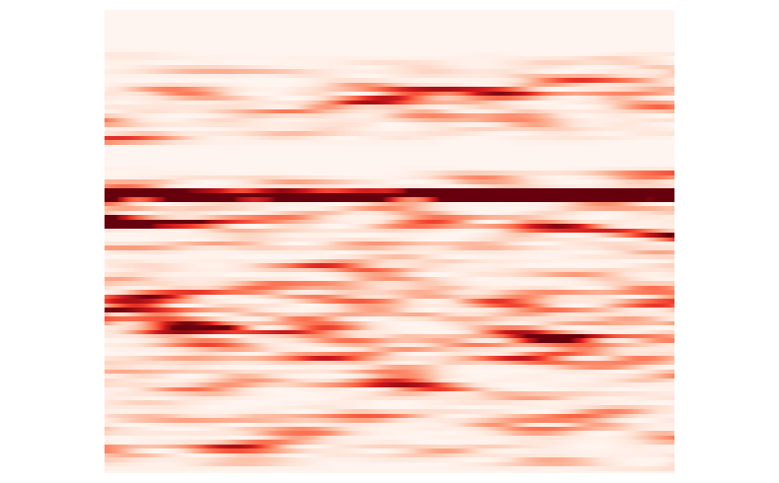
Demodulation of phantom data (e105 t2 f10).
PRF = 80
Phantom Data
Demodulated Data
40
7130
40
0.37
26
26
Frequency (Hz)
Frequency (Hz)
dB
dB
5
0
5
0
0
Time(s)
12
0
Time(s)
12

Slide 9
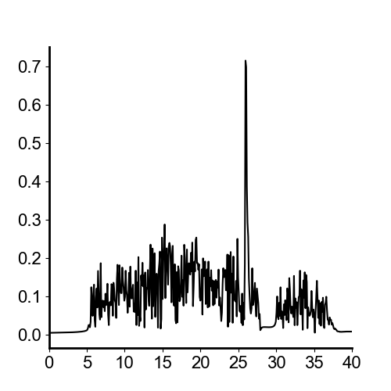
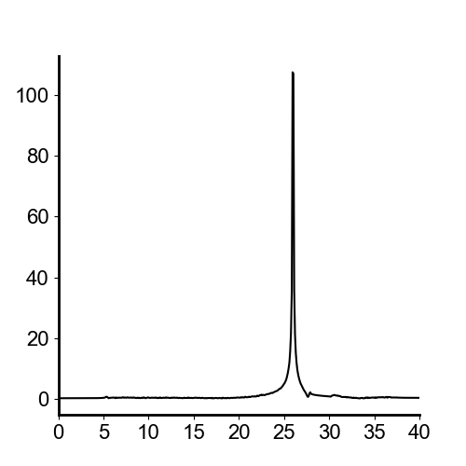


Demodulation of phantom data (e105 t2 f10).
PRF = 80
Phantom LFP
Demodulated Result
V ($μV$)
V ($μV$)
Frequency (Hz)
Frequency (Hz)

Slide 10
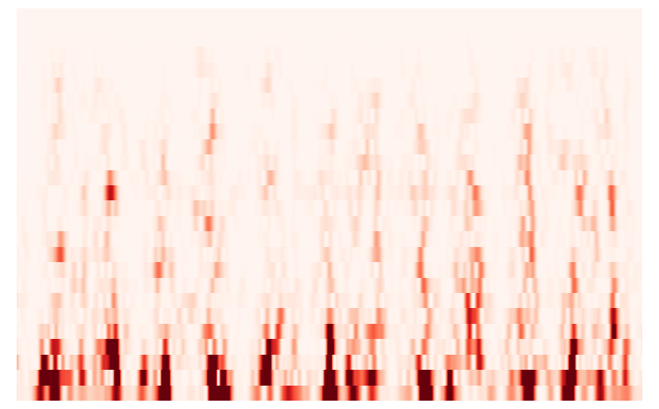
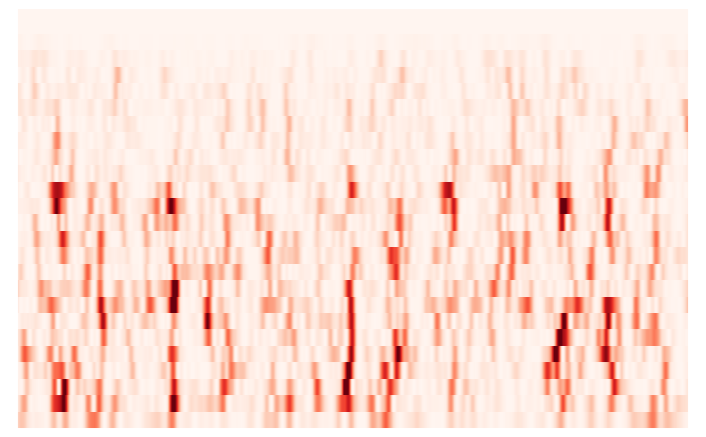
E105 t4 File 8
Frequency (Hz)
5

