Slide 1
F21 characterization
04.09.2023

Slide 2
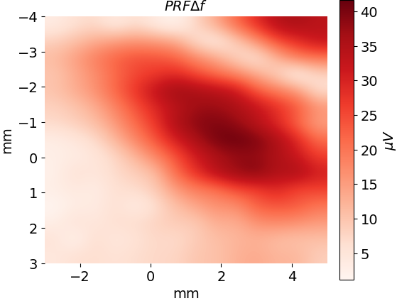
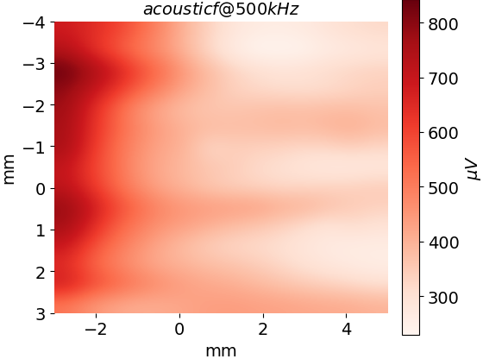
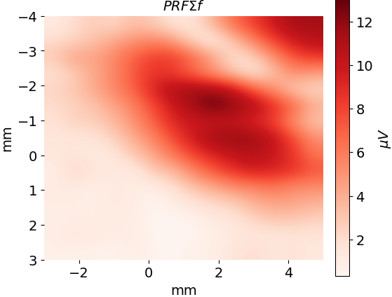
PRF 1020 spatial test, showing the PRF signal follows the pressure focus. (e109t1)
There is a focal spot around each electrode… my electrodes are about 6mm apart here and at the same angle as shown. I should have painted the electrodes with nail polish and made a distant reference.

Slide 3
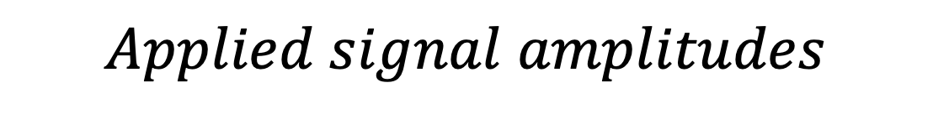
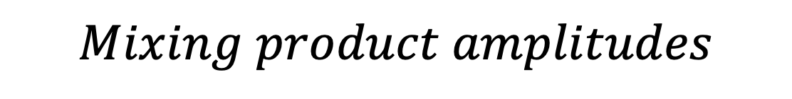
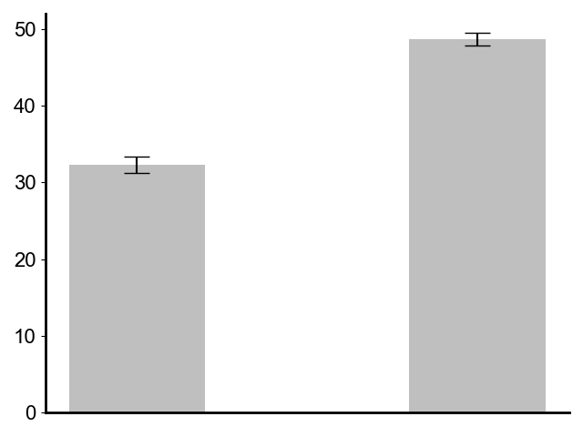
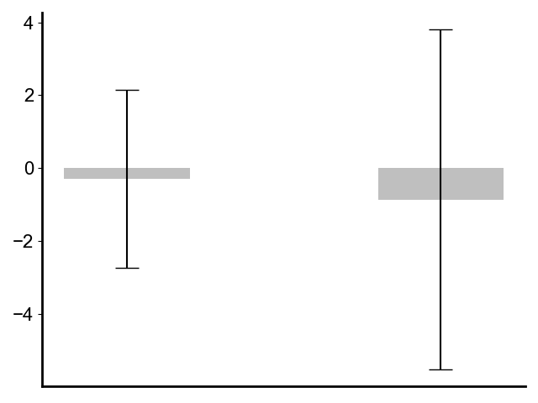
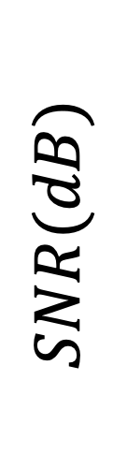
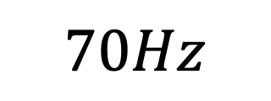
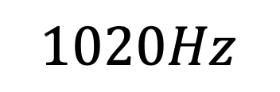


E107 (t3) preamplifier artefact test.
The mixing product frequencies are below the noise floor. The applied signal amplitudes are larger than what we see in vivo (with 1020Hz@200𝜇𝑉and 70Hz@31𝜇𝑉), hence the frequency mixing that we see in our neural decoding experiment does NOT occur in the preamplifier.

Slide 4
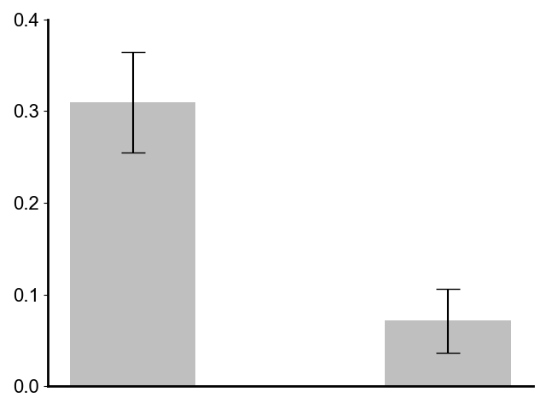
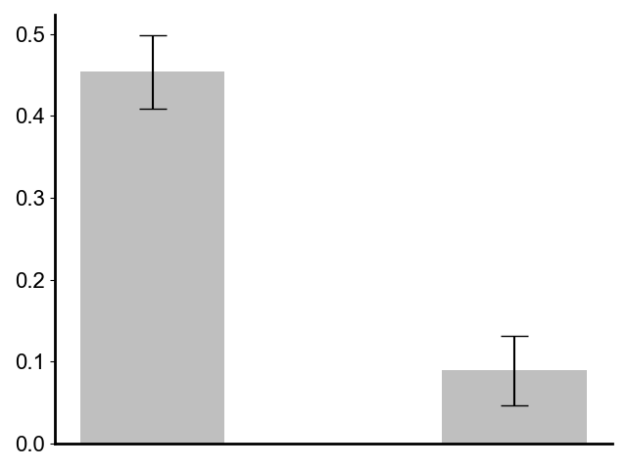
Neural Decoding Correlation Test: E105 t3/t4 US ON vs US OFF artefact test
Mouse 1 (e105 t3)
Mouse 2 (e105 t4)
P = 1.4e-5
P = 1.4e-7
***
***
N=7
N=7
Correlation
Correlation
US ON
US OFF
US ON
US OFF
I see a better signal recovery at low PRF’s. The best signal recovery is with no US. This suggests I have not yet decoded the signal. Instead, I am seeing the gamma spikes amplitudes that were already there. This suggests that I am not doing neural decoding for e107 t2/t5. If I go back to e105 t3/t4 It DOES look that I am doing neural decoding when comparing against straight recordings without US. Why are the experiments in e107 so bad, and the ones in e105 so good? Is it the mouse?

Slide 5



PRF 1020 spatial test. (e109t2) Day 2
I updated the electrode configuration so the differential reference is more distant, and the PtIR length is covered in nail polish so I have more of a point electrode measurement in space. Notably, the distant reference means the monopole antenna e field at the carrier frequency is huge-5591 microvolts. It doesn’t really change the measured amplitude of the acoustoelectric PRF generated field though.
The distant reference means there is a bigger difference for the carrier frequency, with very high values this time. These high values are reflected in the difference and sum frequency trends. You can see that the background AE difference changes.
0
0

Slide 6
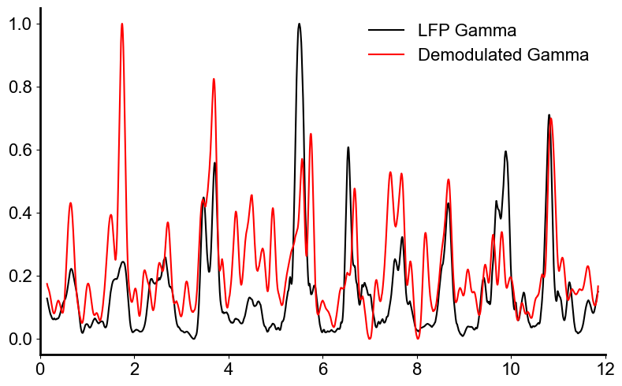
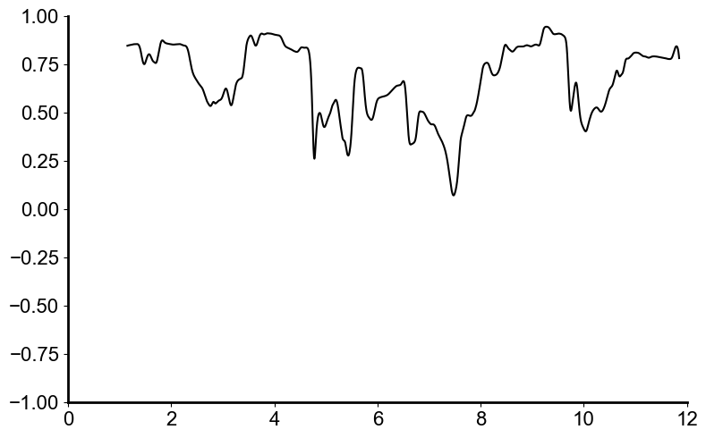
Beautified kgamma demodulation plots and algorithm diagram
PRF = 180
Correlation
Normalized Gamma Sum
Time(s)
Time(s)

Slide 7
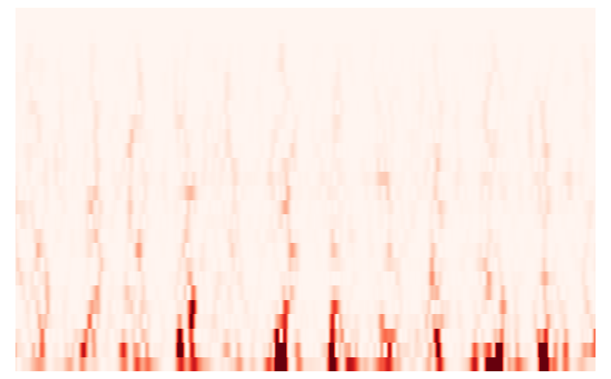
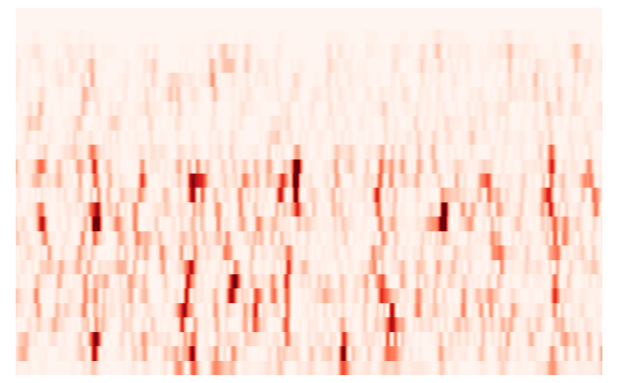
90
126
E105 t4 File 11
Frequency (Hz)
dB
LFP Spectrogram
5
0
PRF180
90
0.34
Frequency (Hz)
dB
Demodulated Spectrogram
5
0
0
Time(s)
12

Slide 8
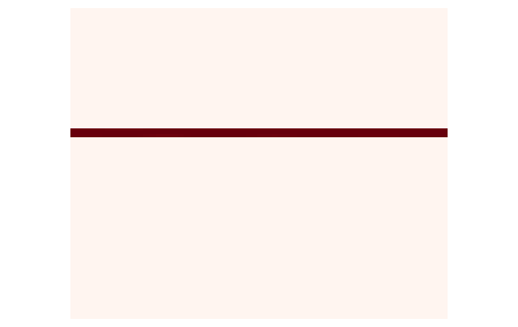
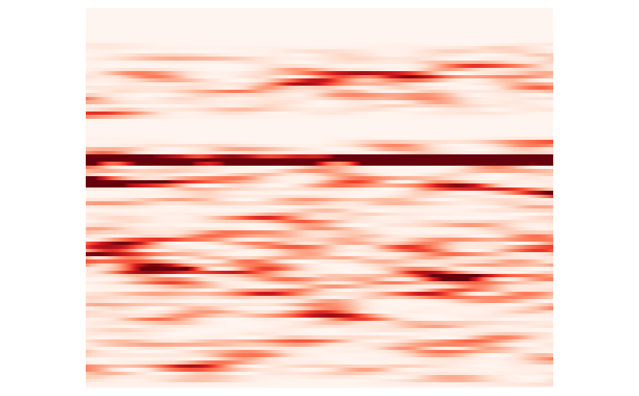
Demodulation of phantom data (e105 t2 f10).
PRF = 80
Phantom Data
Demodulated Data
40
7130
40
0.37
26
26
Frequency (Hz)
Frequency (Hz)
dB
dB
5
0
5
0
0
Time(s)
12
0
Time(s)
12

Slide 9
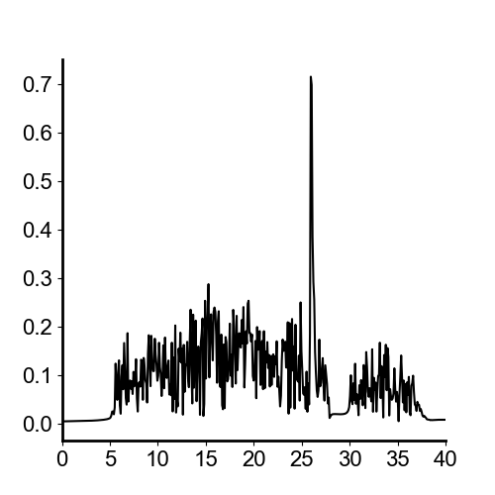
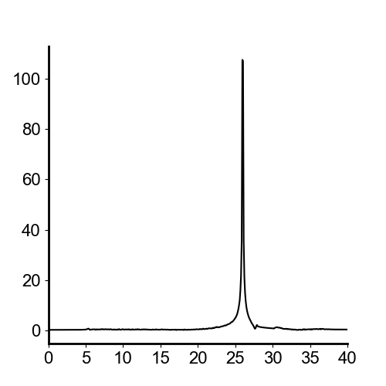


Demodulation of phantom data (e105 t2 f10).
PRF = 80
Phantom LFP
Demodulated Result
V ($μV$)
V ($μV$)
Frequency (Hz)
Frequency (Hz)

Slide 10
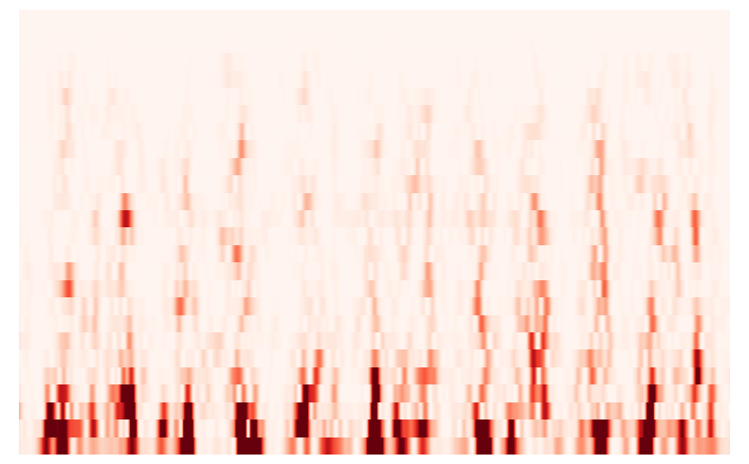
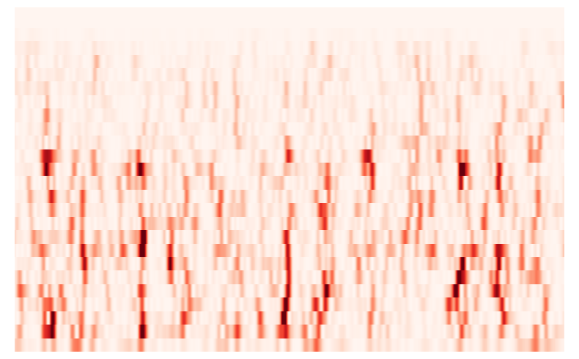
E105 t4 File 8
Frequency (Hz)
5

Slide 11
Tests with F21.
F21 thickness requirement test.
Run the PRF signal through the acoustic transducer and measure the electrical signal. Obtain the electrical amplitude of the PRF with a few different .
Pressure only test.
run ae_calibrate_with_prf.py without F21 until I find the center point. Do an extremely rough crosshair with 1mm increments.
Place the F21 such that DV remains the same. Repeat the cross-hair test. Do I still see the PRF?
AE neuromodulation test:
Independently apply a voltage source, keeping the pressure the same and DV the same with and without the F21. Obtain the difference frequency using acoustoelectric effect. Is my signal now without the RF noise when I use F21?
There appears to be no clear center point in either of these…
AE neural recording test:
Apply a small signal with the PRF signal applied. Try with and without the F21. Does either the noise around 500khz, all the PRF amplitude change?

Slide 12
Aemeps_prf.py test.
My goal, is to remove the unwanted low frequency artefacts.
I think they are an aliasing artefact. This is why I can see the df when I filter the data time series, but not in the FFT?
This means there is no limitation to me doing ae meps.
However, turning up the voltage is difficult due to the preamp. I still do want the high frequency 1k data for spike analysis… how to do this then?

Slide 13
I could do ae meps, or I could do the PRF analysis with the oil in place.
The oil has made a mess. Clean it up. Do the MEPS exp. Water is dripping out.

Slide 14
Noise situation.
I think it is an aliasing issue… and everything is actually… fine. Continue with goal 1: ae neuromodulation.

