Slide 1
Acoustoelectric neuromodulation. Is this a proof?
29.09.2023

Slide 2
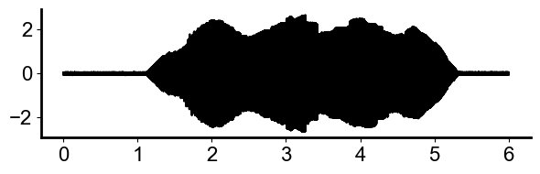
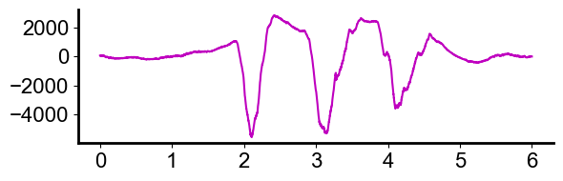
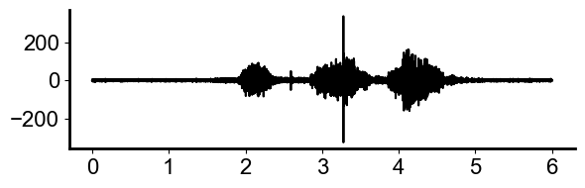
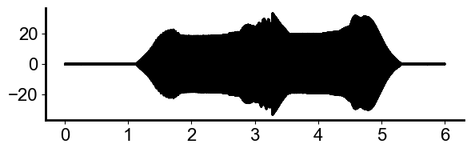



Mouse: Acoustoelectric neuromodulation df = 1Hz. (e113 t1 file 12)
Water filled US cone
Applied Voltage
Local Field Potential (0.5-300Hz)
Volts($μ$V)
Volts(V)
$$×$$
Spikes (300-1000Hz)
RF Ultrasound
Volts($μ$V)
Volts(V)
Time(s)
Time(s)

Slide 3
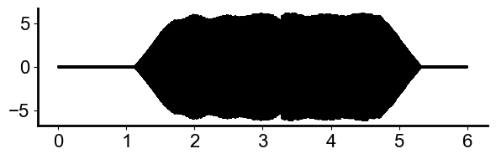
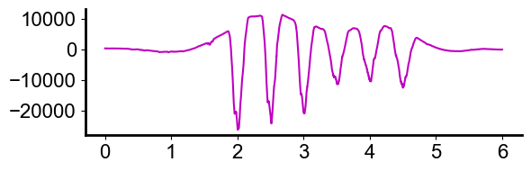
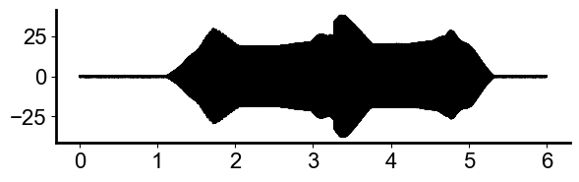
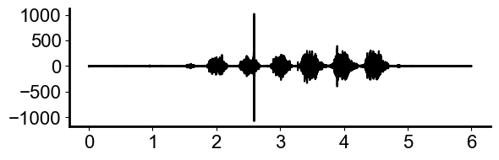


Mouse: Acoustoelectric neuromodulation df = 2Hz. (e113 t1 file21)
Applied Voltage Monitor
Local Field Potential (0.5-300Hz)
Volts($μ$V)
Volts(V)
$$×$$
Spikes (300-1000Hz)
RF Ultrasound
Volts(V)
Volts($μ$V)
Time(s)
Time(s)
Note: This had the slightly leaky mineral oil layer.

Slide 4
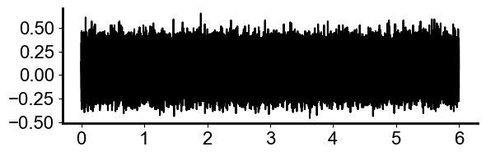
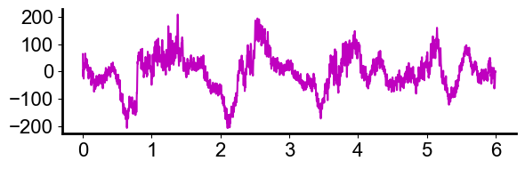
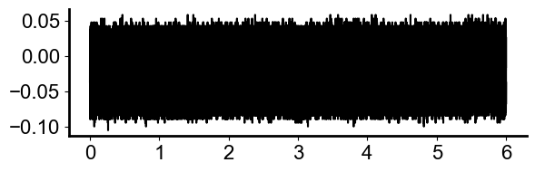
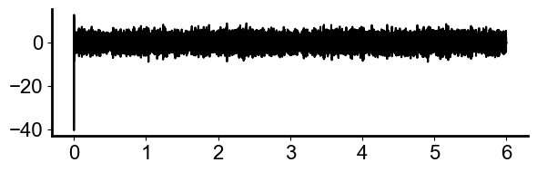


Could the 2hz difference frequency be endogenous in its origin?
When NO signals applied (e113 t1 file 9 ) I do NOT see the difference frequency.
Applied Voltage Monitor
Local Field Potential (0.5-300Hz)
Volts($μ$V)
RF Ultrasound
Spikes (300-1000Hz)
Volts($μ$V)
Time(s)
Time(s)
RESULT: the 2Hz is NOT endogenous and there are no signs of it in the LFP or spikes,
though you can see some ketamine induced delta waves in the local field potential.

Slide 5
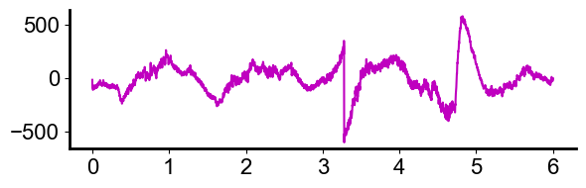
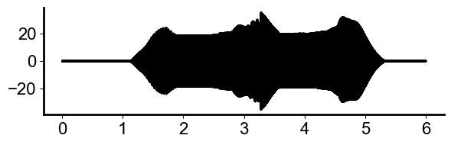
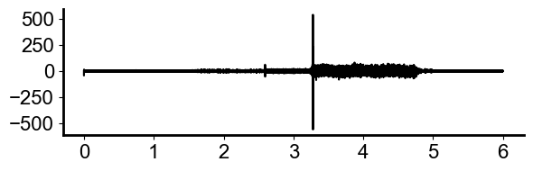
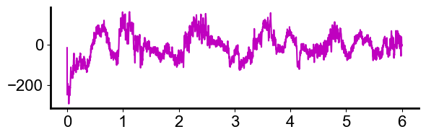
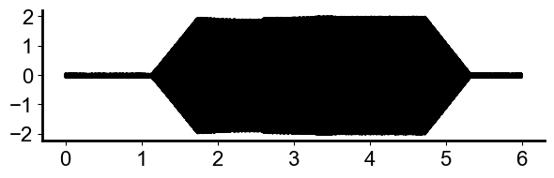
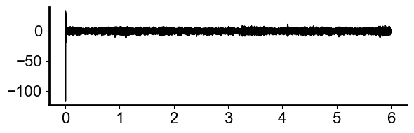




Does any one applied signal alone produce a difference frequency of 2Hz?
1MPa Pressure alone (e113 t1 file 10 )
Local Field Potential (0.5-300Hz)
Volts($μ$V)
Spikes (300-1000Hz)
Volts($μ$V)
I unfortunately have EM noise in my rf amplifier which induces spikes over time…
but no 2Hz.
These are endogenous delta rhythms induced from ketamine. (not at 2hz)
1V applied alone (e113 t1 file 11)
Volts($μ$V)
Local Field Potential (0.5-300Hz)
Volts($μ$V)
Spikes (300-1000Hz)
RESULT: No 2hz

Slide 6
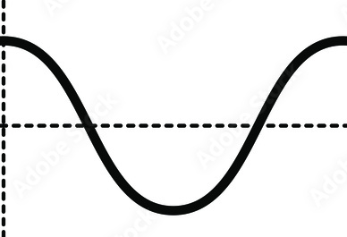
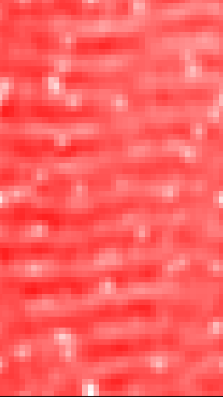
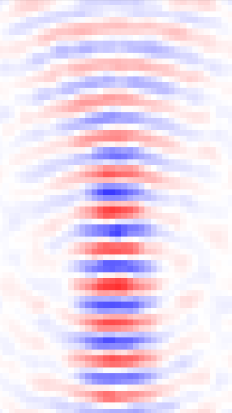
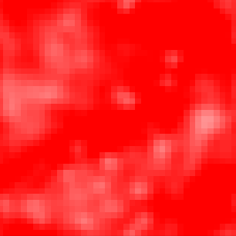
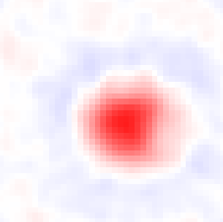




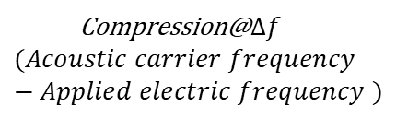




Is the mixed signal focal?
Compression@ Acoustic Carrier frequency (500kHz)
Compression@$∆f$
$$(Acoustic carrier frequency −Applied electric frequency )$$
$$t$$
$$t$$
Since only the mixing products are focal, and not the applied signals as shown in the phantom data from the Uren tank, we can rule out the applied electric signal mixing with the electrical artefact from the ultrasound. If it were electrical mixing only, it would not be focal with the shape of the acoustic field.
THE FOCALITY OF THE MIXED SUM AND DIFFERENCE FREQUENCIES PROVES MIXING IS NOT PURELY ELECTRICAL MIXING.
IF IT WERE ELECTRICAL COMPONENTS MIXING, IT WOULD NOT BE FOCAL.
0.03
0.15
$$Φ_{AE}(V)$$
$$Φ_{AE}(V)$$
$$5 mm$$
$$5 mm$$
-0.03
-0.15
0.15
0.03
$$Φ_{AE}(V)$$
$$Φ_{AE}(V)$$
$$5 mm$$
$$5 mm$$
-0.03
-0.15

Slide 7
We can prove it is the acoustoelectric effect dominating the stimulation if we can show focality in the mouse. However, this has an issue with reflections in the mouse.
We can completely electrically isolate the signals.
We can add a monitor on the function generator output of the voltage signal, as this is isolated from the load. This will prove that the signal mixing is not coming from this voltage generator.

Slide 8
Possible confounds to the mouse experiment?
In the mouse experiment, I cannot measure focality due to mouse head reflections[s4l reference here] unless I use a very small signal to minimize reflections. Hence, I need a different way to prove the resulting mixing effect is not due to the electrical signal from the ultrasound mixing with the electrical output from the isolation transformer. The best way to do this is to isolate these sources using an acoustically transparent, electrically insulating material such as mineral oil or F21 so that they are independent of each other. i.e. the only electrical signal is the applied one, and the only other signal applied to the brain/phantom is acoustic.
Could the preamp be creating the difference frequency? No, because we can measure neural spiking. Hence the difference frequency is IN THE MEDIUM.

Slide 9
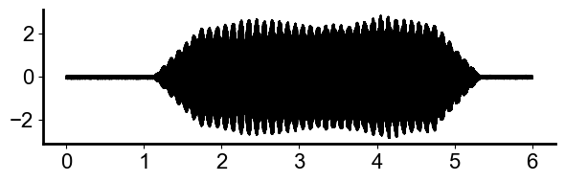
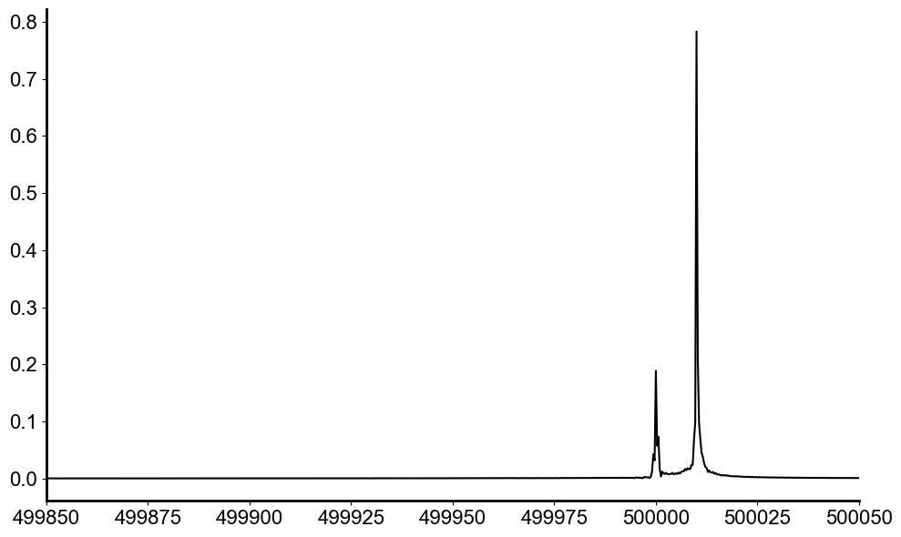
Possible mouse experiment confound: the e field applied from the voltage source adjusts based on the US electrical PRF. (e113 t1 f6 - mouse) i.e. total harmonic distortion
df = 10. The applied voltage here, seems to clearly have the difference frequency within it, though it isn’t in the fft perhaps because I had a 40V daq range?
I can decrease the DAQ range to 2V and do a new phantom measurement to confirm if there is frequency mixing here. However, based on how the voltage source works, I do EXPECT to see the df anyway. I can also see the US PRF electrical signal in the FFT of the applied voltage source signal. See left.
Perhaps some of my f mixing amplitude is coming from non-linear mixing in the medium between the two electric signals?
This is a possibility – however, it’d be better to remove this option for non-linear signal distortion. This is possible with mineral oil.
Volts(V)
Time(s)
Applied signal
Applied voltage source close up
Volts(V)
Freeloader signal from the US
Frequency (Hz)

Slide 10
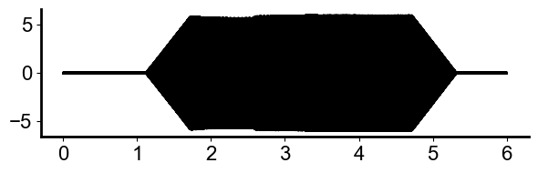
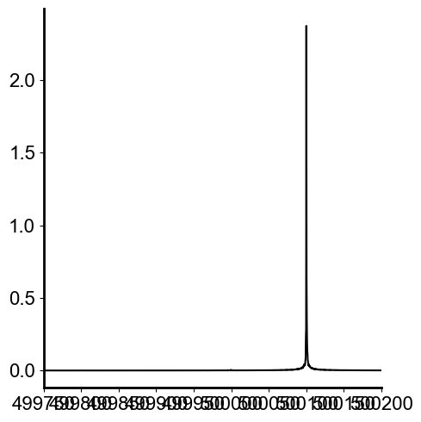
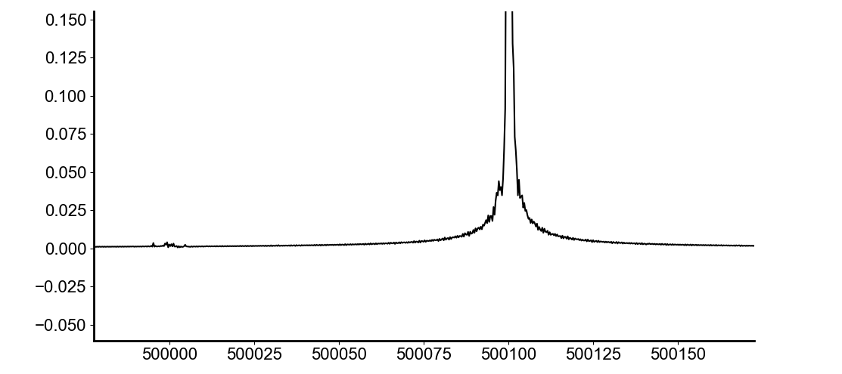
Mineral Oil Solution (e114 mineral oil t1 f3)
Note: leaking mineral oil situation at the end. Messy. Also leaked on my mouse yesterday. It turns out that mineral oil dissolves parafilm and stuck to the cone in a horrible way. I do not like using this, it keeps leaking everywhere.
Volts(V)
Time (s)
Electrically isolate the ultrasound cone from the mouse, such that only the acoustic wave gets through. I can try to do this with either F21 or mineral oil filled US cone. Currently, I do not know if either of these solutions blocks the pressure wave. Test both with the hydrophone.
Mineral Oil Cone(instead of water filled): I have massively reduced the signal getting into the voltage transformer.
Applied voltage source
Applied signal
Applied voltage source close up shows the applied signal at 500100 massively dominating the US 500khz.
Applied signal
Freeloader signal from the US is much smaller with mineral oil cone. This small amount may be coming from the cables etc. which means it would not be focal and is nothing to be concerned about.
Frequency (Hz)
Frequency (Hz)
Acoustoelectric difference frequency is still a good 2000 microvolts amplitude, making this a pure acoustoelectric interaction.

Slide 11
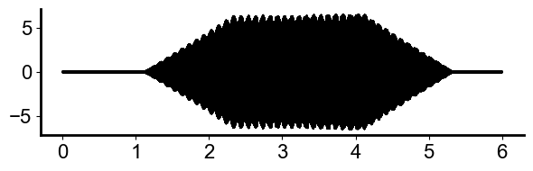
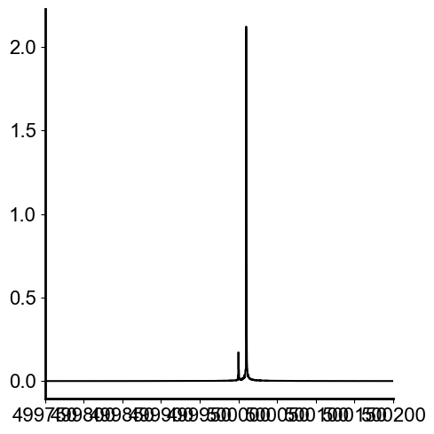
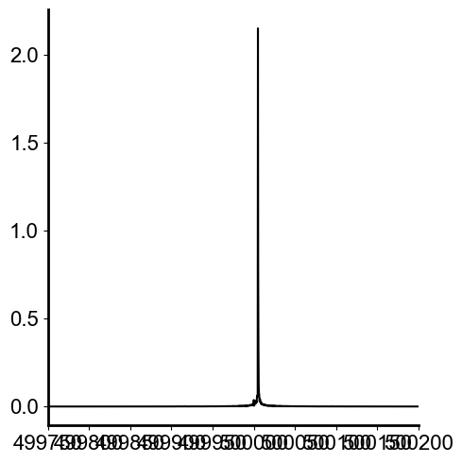
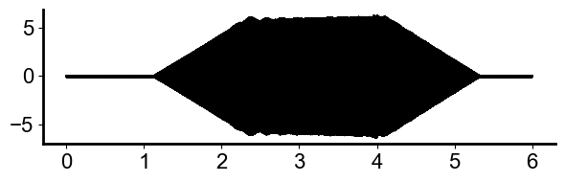
F21 looking at freeloader US signal. (e114 t2 f14)
Voltage monitor(load side of tx) - Without thin piece of F21
Applied voltage source with no F21
With F21
Volts(V)
Voltage monitor(load side of tx)-With thin piece of F21
Volts(V)
Volts(V)
REDO this plot very carefully.
Double check these have the same electrode positions?

Slide 12
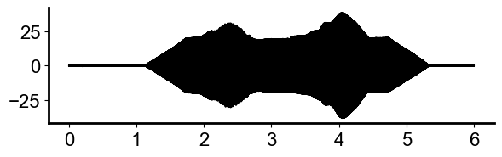
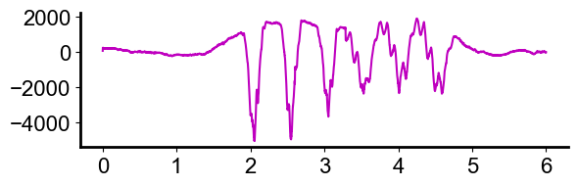

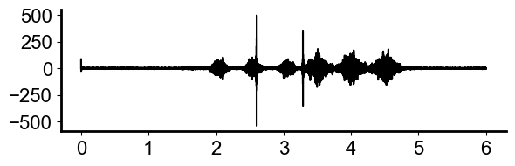
Mouse, mineral oil cap/parafilm df = 2Hz (e113 t1 f19)
RF data
LFP
Applied Voltage (measured load side of tx)
Spikes
Note: oil and water was leaking out and onto mouse. Discovery: Mineral oil dissolves the parafilm.
Exp stopped soon after this.

Slide 13
Addressing the applied e field confound with a two-tone test.
If the signals are sufficiently independent, i.e. one acoustic, one isolated electric then there is no way frequency mixing can occur unless there is an acoustoelectric interaction.
To prove this is not an electrical mixing phenomena in the medium, we send through an electric field as before, and an additional electric only field through a second source(no acoustic part) which has the amplitude equivalent to what we measure on the e field monitor chan with F21 in place. This should be a super tiny electric field.
The transformer doesn’t let low frequencies through anyway. So maybe we can send the combined signal through the function generator.
Then measure to see if frequency mixing occurs on the measurement channel.

Slide 14
Acoustoelectric neuromodulation proof points
Acoustoelectric sum and difference frequencies are focal with the acoustic signal, thus not caused by an electrical mixing phenomenon. (See separate proof for mouse experiment against electrical mixing)
Preamp Test. Since we see neural spiking, and also note focality with ultrasound the difference frequency is not an artefact of the preamplifier but occurring in the medium with spatial specificity.
It cannot be an acoustic signal mixing with itself, because then we would not see the difference frequency between the applied electric signal and the acoustic signal. Thus, we can narrow it down to the acoustic signal mixing with electric signal.
That means we have acoustoelectric neuromodulation.

Slide 15
F21 and water filled cone.
Do hydrophone test with F21. Does pressure still get through?
Do electrical two tone test with F21, what does the applied voltage look like with and without it(note the electrode configuration). (Kind of a repeat of the test I did before, but with more electrode position rigor.)
Mechanism of Ultrasound Neuromodulation Paper.
Do a PRF*PRF map, but firstly do a quick map without the F21 to find the center and verify I still see the focality.
Add the plot of the PRF * PRF with hydrophone and with electric signal. (I’ve already collected this data).

Slide 16
Repeat mouse test, with acoustic prf electric noise insulation(F21).
Try with and without F21.
Try using new PRF parameters. 1500 ms on time to adhere to the I_spta guidelines for safe use. (burstlength = 0.3)

Slide 17
Power/safety calculation.
PA: Pulse Average, TA: Time Average, SP: Spatial Peak
Safety limits: I_SPTA ≤ 720 mW/cm2 (specified by FDA in 1991), I_SPPA ≤ 190 W/cm3
How to calculate I_SPTA. This seems like the most important one?
Spatial Peak is 1MPa(at the focus). TA, intensity averaged over the time altogether.
Intensity is all positive(dB). I=10log10(), I =P/A . 1MPa/0.03(3cm area at 500khz?) http://www.sengpielaudio.com/calculator-soundvalues.htm

Slide 19
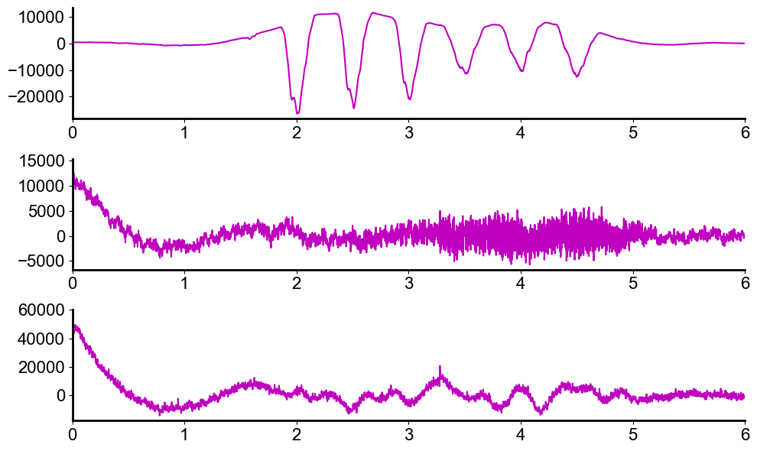



Is the difference frequency in the applied signals at all? (e113 t1 file21)
NOTE: THIS WHOLE SECTION IS INVALID because the signal isn’t captured in my daq resolution.
However, also – you would EXPECT the df voltage to be in the applied voltage because that’s how it works… so this is not a good test.
Due to the signal isolation, it’d be in the transformer output, but not the function generator.
Local Field Potential (0.5-300Hz)
Volts($μ$V)
Applied voltage data filtered(0.5-300Hz)
Volts($μ$V)
Applied RF data filtered(0.5-300Hz)
Volts($μ$V)
These are all on the same scale, and it’s clear that there is no 2hz in the applied signals.

Slide 20
Is the difference frequency in the applied signals at all? (e113 t1 file21)
I could measure from the function generator for the voltage instead? This should not have the difference frequency in it because the transformer isolates. If I can show that the difference frequency amplitude is smaller than that measured in solution… still nothing because the transformer does 2x…

Slide 21
- set up the hydrophone and do a pressure measurement with and without the F21 in place. Does the amplitude significantly change?
- it would be nice to have a difference frequency spatial map at 10Hz. This should be the same as the previous one I have with 8khz and 500khz.
- using ae_calibrate_with_prf.py it DOES look like the PRF*PRF amplitude is decreased with F21. Create a new map with this showing df/sf and carrier amplitudes as well, comparable with the previous map I made. Firstly, do a rough map without the F21, to show that I do get prf*prf focality… then do the nothing ness map.

Slide 23
10Hz focality plot, with mineral oil cone.
Theory, at a current of 500khz, the signal goes everywhere… do I get focality when I use a lower frequency e field?
The pressure signal e amplitude looks really high. Do a measure when connected, and not connected. It is surprisingly high both times. I think this is why I am not seeing focality.

Slide 24
Water filled cone, focality plot, 10hz df.
The core problem is that I do not know if my preamp, or ultrasound is broken. Maybe both are fine.
A lot of the variance has to do with how I am measuring the df, and what is the distance between my measurement and reference probes is. It seems likely, that the US is delivering a large voltage and the mineral oil blocks it to some degree.
The core issue is that I cannot measure focality. I have past focality maps, but not one from today or when I measured the mouse, so I cannot be sure it is the ae effect. Basically – having a focal spot makes it the ae effect.
I can rule out acoustic/acoustic mixing already from the 500khz data I have.

Slide 25
PRF focality in mineral oil filled cone.
With carrier, 1020 and sum frequency info too. Same preamp settings as previous.

Slide 26
Lastly: Preamp non-linearity test.

Slide 27
Why did my file interpretation seem different from the files in the folder yesterday? Something weird happened? From the data analysis, mineral oil seemed like a great option.
Can I see 10Hz acoustoelectric focality using a mineral oil filled cone? (Previously I did this with the same two stim/measure electrodes..(e97_meps t3)) – would need to work on the daq ranges here.
What does the PRF look like using a mineral oil filled cone? Does it have focality?
Phantom test with higher resolution voltage monitor – do I see the difference frequency appear when using a water filled cone? I will then need to apply this signal separately -

Slide 28
Could it be electrical mixing from the PRF of the applied ultrasound be mixing with the applied voltage? i.e. all EM mixing?
WE KNOW MIXING IS OCCURING as there is nothing at the difference frequency from the applied signals. (Wait: it is possible I am just below the noise floor of my voltage and rf monitors so I don’t know this for sure? )
However, we do not know if we are mixing the electric signal from the ultrasound with the applied electric signal, or the acoustic signal is mixing with the applied electric signal?
Fill cone with mineral oil as an electrical insulator.
RESULT: though it has no conductance as measured with multimeter, I can still see the electrical carrier signal around 4000 microvolts. When I add the shielding back to the cable it goes down to 1400 microvolts.
- do phantom test with it. PRF focality test. There is no focality. This is really interesting here… Need to do a big picture plot of this.
- ae_calibrate_with_ae 8khz… I am having trouble seeing the focality this way, I think because the current density is everywhere the pressure is. So what I need to do is have pressure, then the dual electrode has one being the current generator, the other the measurement electrode. The third is the reference.
I am currently not answering the question – is any pressure actually coming out with the mineral oil cone? To do this, I either need the hydrophone, or a different set up so I can capture the focus.
It turns out mineral oil dissolves parafilm film, so I had air bubbles…
- BIG NOTE: If I ramp the voltage to surpass the charge injection limit, I get a lot of non-linearities. This is certainly causing some of my problems. Also, the voltage from the transducer was entering into my applied signal – never good. The acoustoelectric neuromod paper should be done with the mineral oil in the cone.
- MEP dual signal.

Slide 29
Alternate methods for determining whether it is caused by:
Electric signal mixing with acoustic signal.
Electric signal mixing with electric signal.
If this is the case, the stimulation area would not be focal. Show that it is focal. i.e. the PRF *PRF data that I already have?
Acoustic signal mixing with acoustic signal.
Show that this doesn’t occur through the PRF test I have already done.
What if the electric signal from the ultrasound is in solution, thus entering into the output of my signal generation? (well, that is why it is isolated…).. This… is also why it’d be better to shield the US electrically. Firstly though – prove that I am having this issue.
TODO: can I use F21 and measure pressure with the hydrophone?
Can I fill cone with mineral oil, and measure pressure with the hydrophone?
Do a focality map of the difference frequency generated at 10Hz.

Slide 30
Next things to do:
Do a focality plot at the difference frequency of 10Hz, using just a water filled US cone 1MPa. This would just be of the difference frequency.
Test the F21 using the Hydrophone.
Prove that the electric signal from the US is altering the signal from the current generator. - signal analysis.
= = = = = = =
It would be better to do AE neuromodulation, when no(or at least very little) electrical signal from US reaches mouse.
Consider a new mouse, with a 3rd electrode for applying voltage, embedded in brain instead of outside.

Slide 31
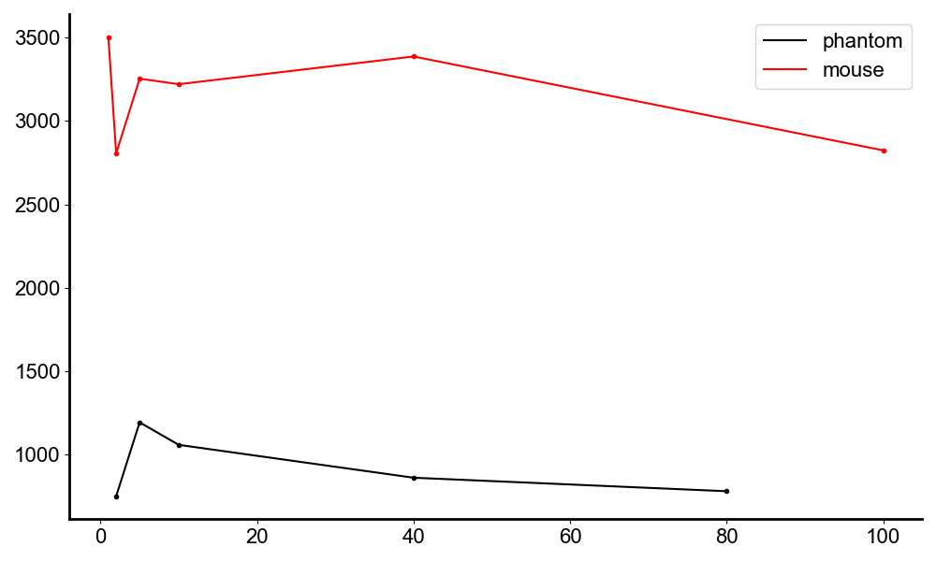
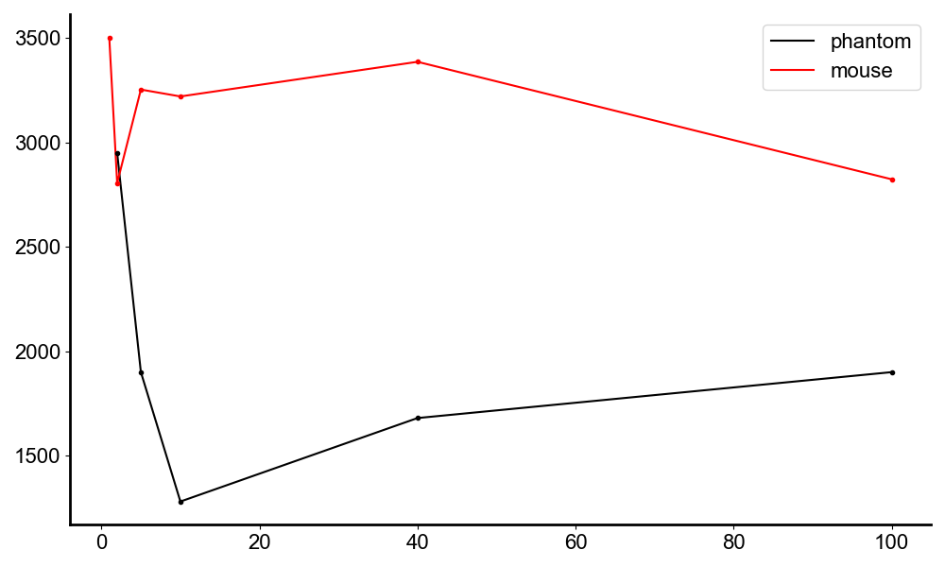

Amplitude trend with difference frequency
I need to repeat this and do it properly with comparison against a phantom. These are results from e113 t1(mouse with implanted electrodes), e107 t6(phantom). Though I apply voltage, where I apply it matters? Or does it?
Volts($μ$V)
Frequency (Hz)

Slide 32
Could the difference frequency be induced in the preamp?
Evidence 1: Since there are neural spikes, the difference frequency is induced before it enters the preamplifier.
Evidence 2: e105 t? (I will need to redo this once I have final amplitude data anyway, so I am holding off on the post processing plots as I know I can do it without mixing in the preamp) - will do it post oil test.

Slide 33
Phantom Focality Plot
With and without oil? PRF and dual signal results?

Slide 34
What current am I applying when I get a response? What is the E and J?
Look at e113 to find out.

