Slide 1
Neural recording
15/07/2023
Ketamine induced Delta waves

Slide 2
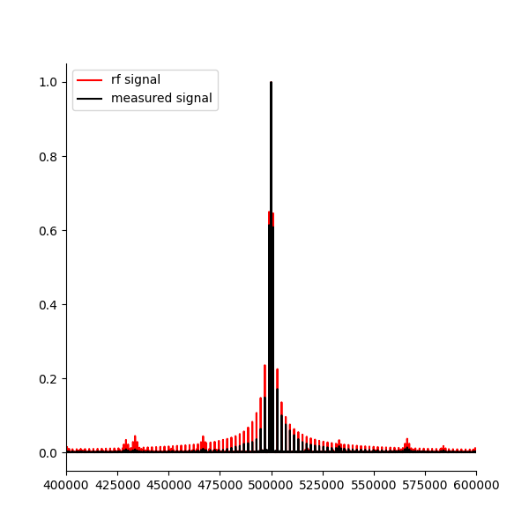
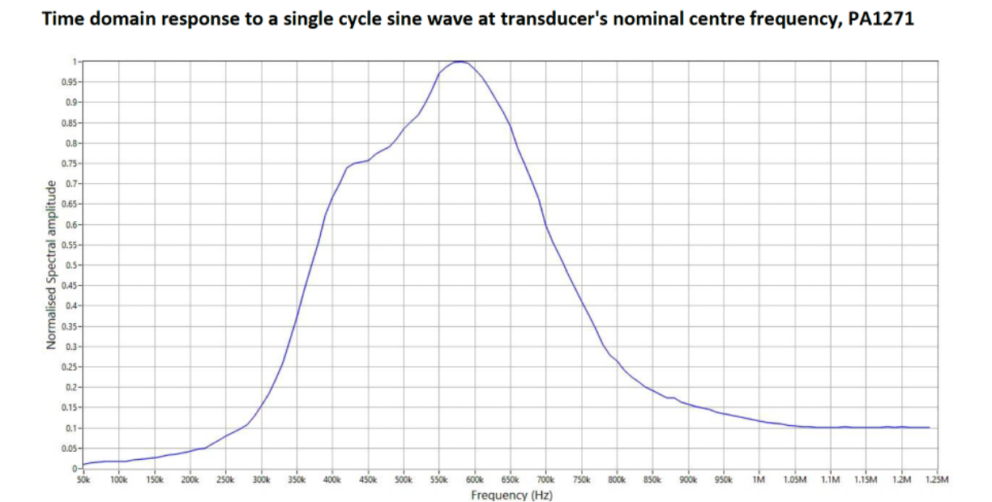
Further proof the measured voltage in the medium is proportional to acoustic signal rather than applied electric signal
When sending through the PRF signal, you can see the left side is attenuated more despite the input signal from the RF amplifier being symmetric. This shows that the voltage signal in the mouse brain, is resulting from the acoustic signal. e100t6
Idea: send through constant amplitude sine waves and map the acoustic amplitude using the voltage measurement in saline.

Slide 3
Voltage out vs voltage measure in saline.
P out = 0.05V in all cases, measured at pre-calibrated focal point sending through a different frequency each time.
- measure the carrier frequency amplitude, and the difference frequency with respect to that frequency if using the dual sine wave pressure output.

Slide 4
Is 4Hz coming out of the RF monitor at all?
Find the focus in phantom.
Use the super strong low pass filter on RF monitor so I can see low frequency signals of the RF monitors output. When I apply dual sine wave, do I see 4Hz? What amplitude is it at in microvolts? Is the amplitude I see in saline higher or lower?
(in vivo) Alternatively, place a high pass filter at the output of the RF amplifier and repeat the MEP experiment? (the E&I 240L spec sheet says it is 10kHz -12MHz range). What is the amplitude at the stim frequency(it may have diminished slight due to the filter)? Do I still see MEPS at the difference frequency?

Slide 5
Dual sine wave demodulation (500kHz + 501.02kHz) – exp 101/t1
With 5kHz low pass filter in place before preamp.
Ketamine/Xylazine.
Demodulation is done at 1020Hz. There should be no other sine waves interfering at the mixing frequency, and the preamp should mean I can use a high gain without worrying about OVERLOAD.
I have 3 mice. A motor cortex exclusive mouse, the external EEG electrode mouse, and the implanted electrode mouse which has been used many times.

