Slide 1
Stuff
21/07/2023
Ketamine induced Delta waves

Slide 2
E104,t1 mouse demod.
I had the electrodes really close together, and seem to have lots of mains noise, and I CANNOT see the mixing frequency at 1khz… This means I should not be able to demodulate anything. I think I need the electrodes further apart as common mode rejection is a problem.
I have a mouse that is in the recovery period, whereby I could test this.
ALSO: select the demodulation frequency to be 1020, so it IS NOT CONFUSED WITH THE MAINS NOISE.
Why can I see the 1khz in some files but not in the demod ones with the filter? There is something very wrong with the demod files.
Next time skip the filter, if needed filter on the preamp.

Slide 3
2Hz MEP amplitudes at different carriers
2hz amplitudes at
500khz : 25.7
250khz: 1.71 (maybe at noise floor).
750khz: 2.67
1Mhz: 4 microvolts.
The trend at 1kHz mixing frequency appears very different to 2Hz… Here the 500kHz is clearly stronger.

Slide 4
Concept, create a dual wave calibration…
I should be calibrating position with the intended demodulation amplitude. i.e. at 1020Hz using just the ultrasound transducer… oh wait… this means I do not need to plug into the other generator at all…

Slide 5
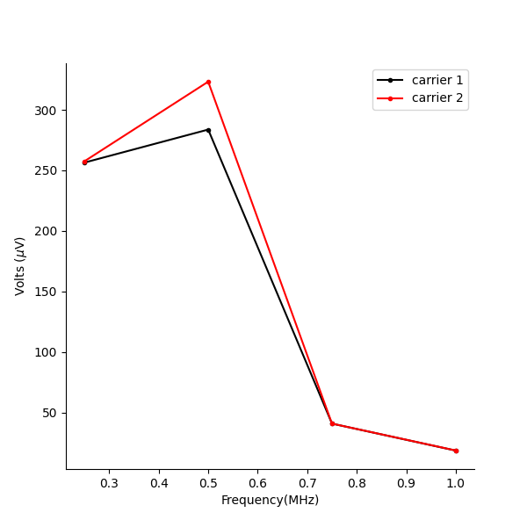
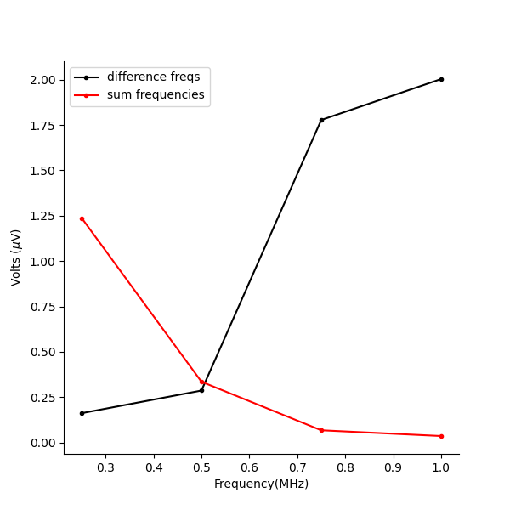
Trend with increasing carrier frequency.
Each dot is a mean of 3 measures.
Difference frequency(of 1khz) amplitude increases as applied frequency goes up.

Slide 6
TODO: implement PWM code and calculate the IPP power stats. This is in preparation for C-fos staining and safety metrics.
I should have it implemented and pre-tested as an effective mep test.

