Slide 1
RF Acoustoelectric
28/07/2023

Slide 2
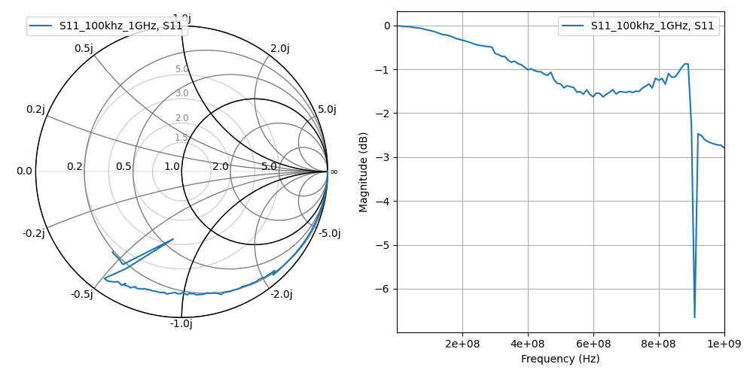
S11 of a mouse
It appears to have increasing losses with frequency increase which makes sense as the dielectric loses energy as ions vibrate and make heat. The vibration is what we would want for the acoustoelectric effect. There appears to be a resonance point at 900MHz. This could also be due to the cable connecting to the VNA.
Since the reactance is in the bottom half of the smith chart, it is a capacitive medium.

Slide 3
Goal:
I know applying two acoustic fields elicits neuromodulation at the difference frequency, but is it due to acoustic mixing, acoustoelectric mixing, or electric mixing?
To disentangle:
2 acoustic fields. Is it the acoustic field alone?
2 electric fields.
1 electric field, 1 acoustic field.
I cannot induce movement with the silicon sheet and mesh in place over the head – this may be attenuating both the electric field and the acoustic field.
If RF TI doesn’t work, we know that some acoustic signal is required.
Could if be acoustic mixing alone? (block the electric field coming from the transducer – does it still work?)
Does the mesh block the electric field coming from the US transducer?

Slide 4
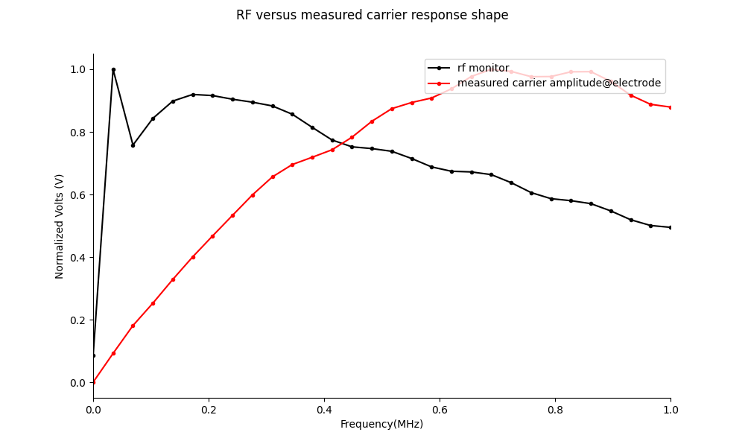
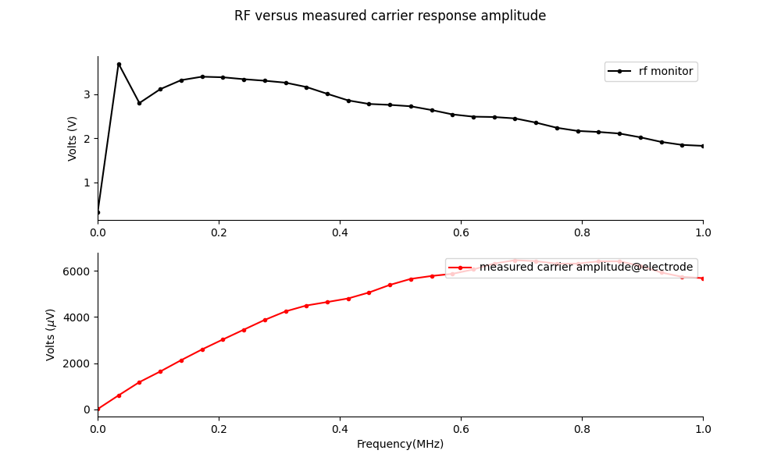
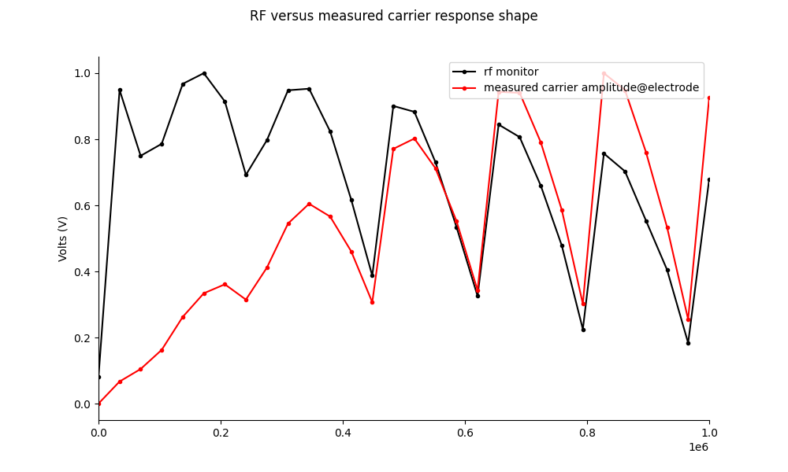
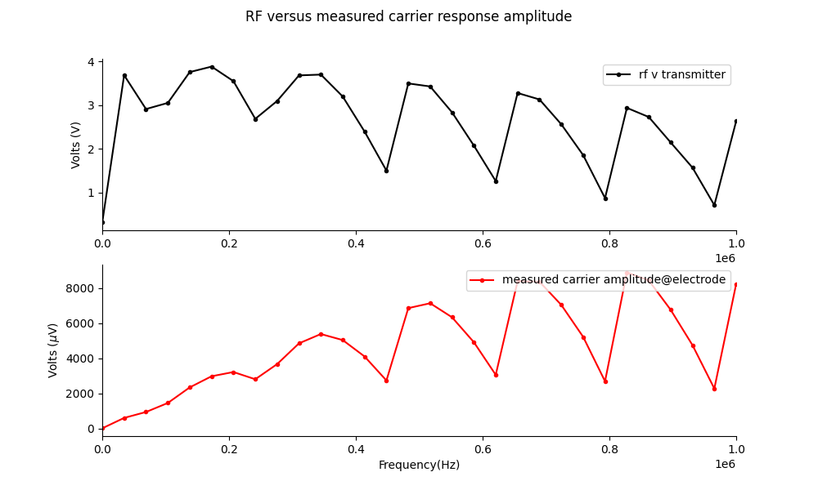
RF transmittance of e field with silicon sheet.
It is possible that the silicon sheet attenuates the acoustic field. It may also attenuate the electric field coming from the transducer.

Slide 5
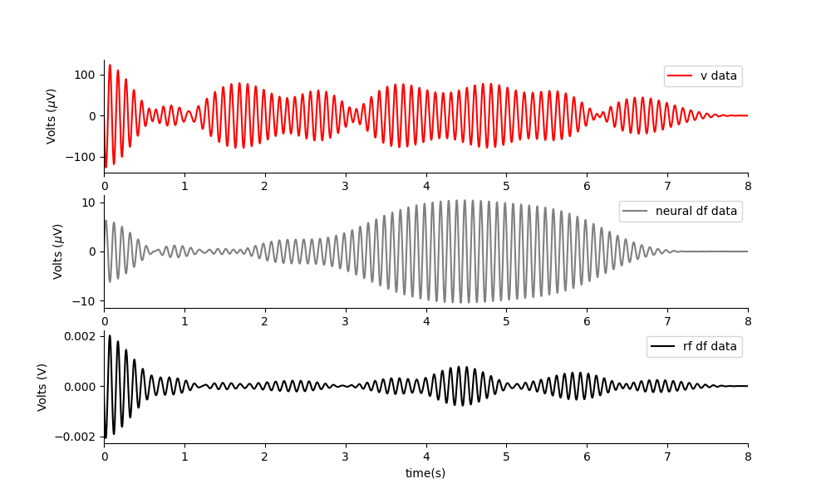
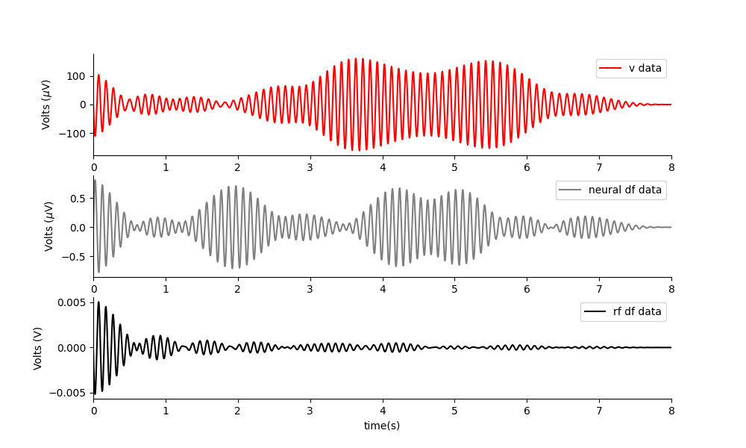
Phantom: RF E TI (two electric fields) applied at same amplitudes.
2khz + 2.01khz
500khz + 500.01khz
2khz + 2.01khz
Nothing really gets through, what is left may be due to my tight rf filter artefacts. Shape doesn’t follow the output.
The two high f signals get through, and then the mixing occurs in the saline phantom.

Slide 6
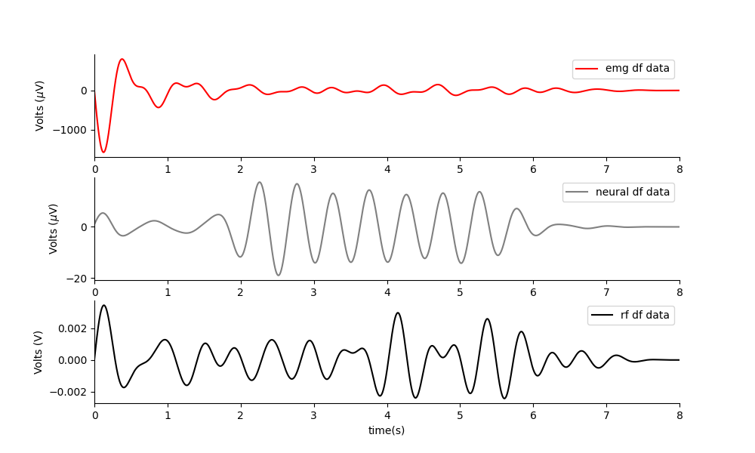
Two acoustic fields.
Works perfectly. There is none of this signal in the rf output.

Slide 7
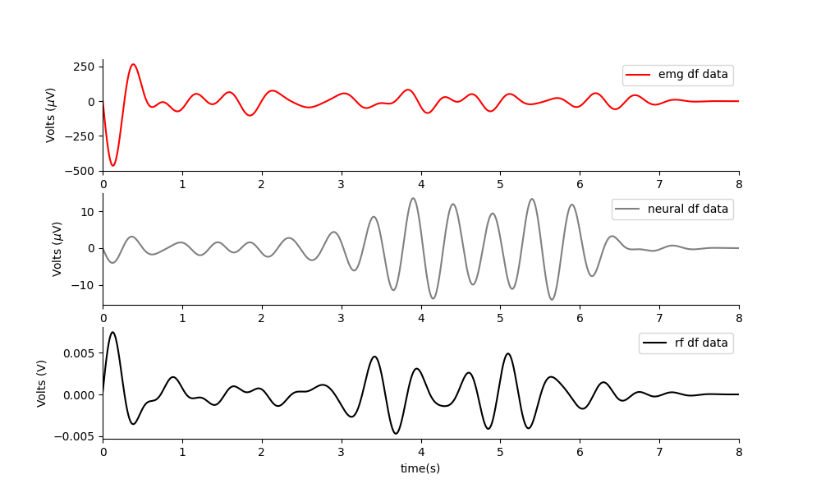
Acoustoelectric in Phantom
Works great. The mesh current emitter is near where the head would be.
Note: It will be better to have a long ramp on the acoustic field, so as not to induce a DC movement artefact from the DC offset induced by the US.

Slide 8
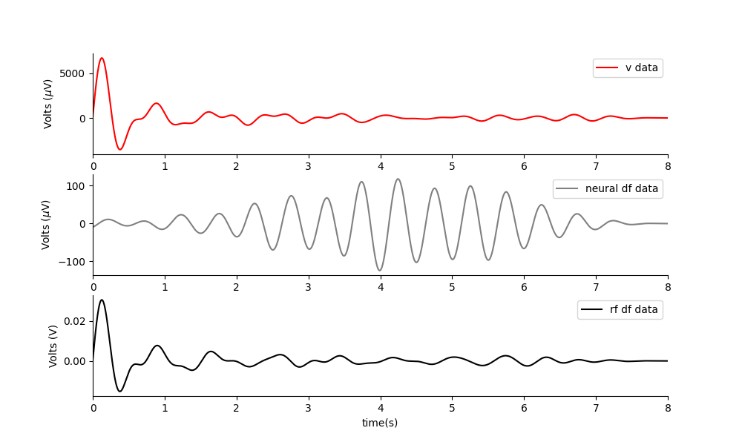
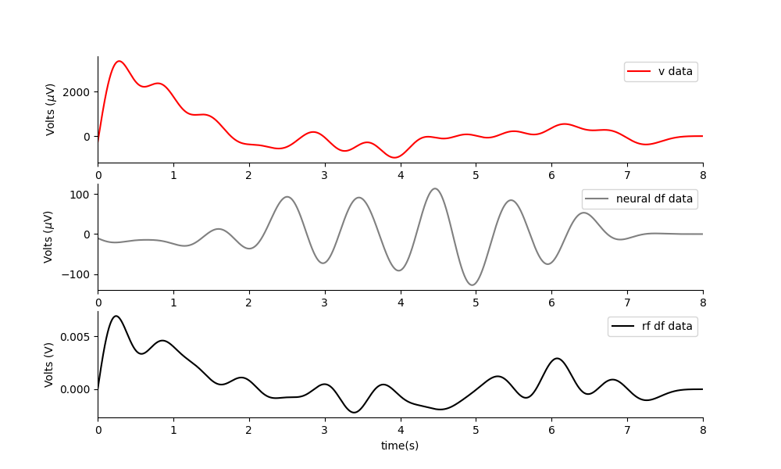
MEPS in mouse at neurally relevant amplitudes.
Experiment e105, t3 and t4. I could obtain excellent neural amplitudes at small difference frequencies such as 1Hz and 2Hz for both the dual acoustic field, and the RF AE paradigm. However, I didn’t get movements. I did not get a good amplitude for RF TI. I got much larger neural df amplitudes than I did in the phantom set up.
NOTE: all the signals are far bigger in the mouse than in the phantom.
Two acoustic waves, 1Hz apart. 1MPa. Both the electric mesh and the silicon sheet are in place. No movement elicited.
It is possible that:
I am not positioned accurately(Perhaps I need to position over the other electrode – try moving 2mm left or right).
The mesh is stopping the e field from the transducer from getting in.
The silicon is stopping the acoustic field.
The any of the two fields is being dispersed or attenuated by the mesh/silicon.
TODO: try without the silicon.
Initially very I can do it with just US gel, then insert the mesh. Do measurements of the total amplitude across the spectrum with and without the mesh in place.

Slide 9
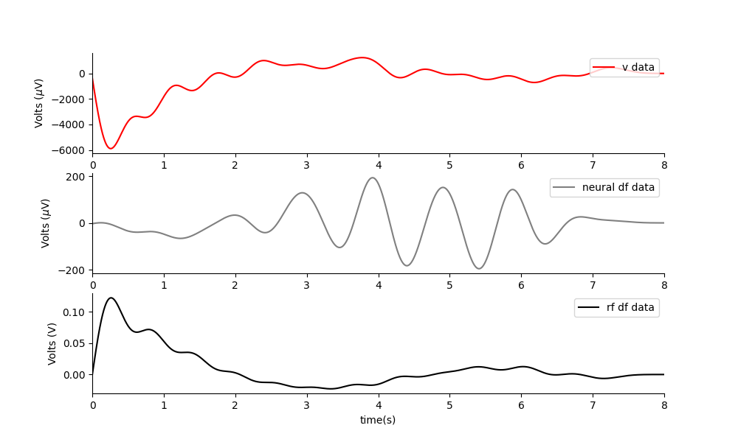
RF AE
One acoustic and one electric field, 1Hz apart. 1MPa, 2V out. Both the electric mesh and the silicon sheet are in place. No movement elicited.

Slide 10
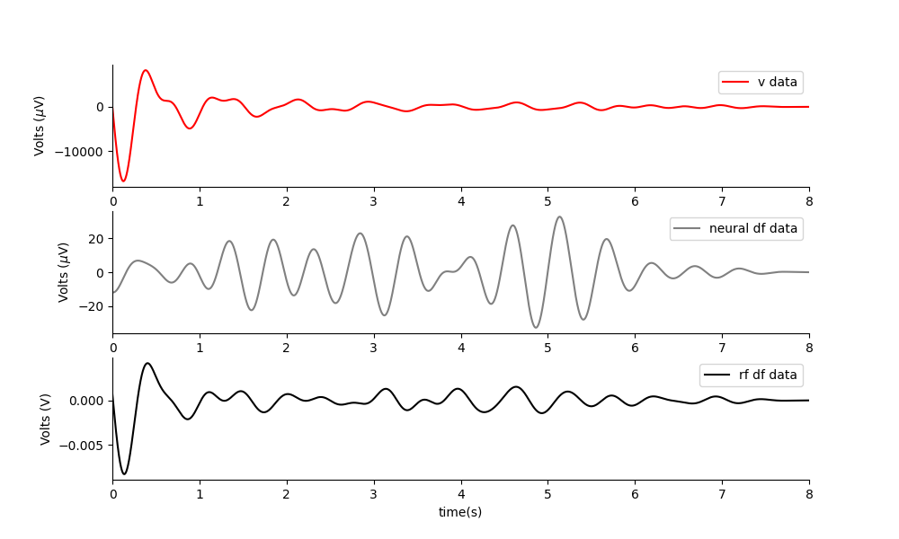
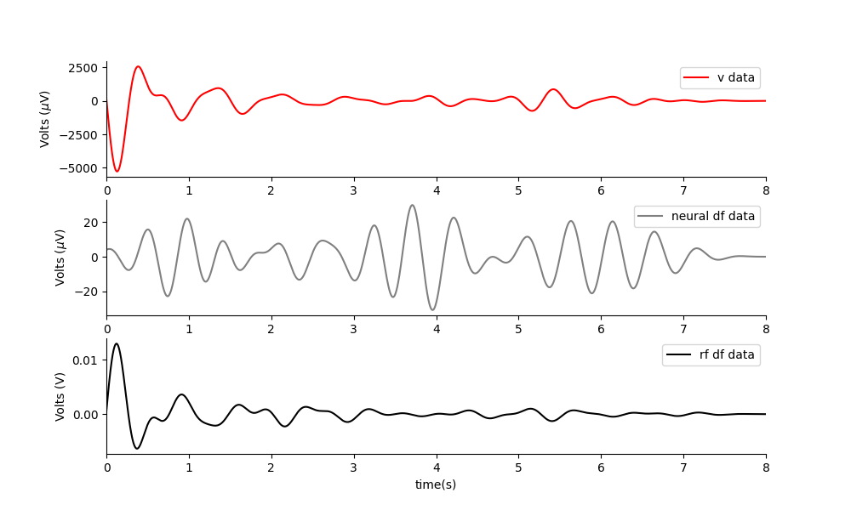
RF TI – so far looks inconsistent.
Two electric field, 2Hz apart. 4v out. Both the electric mesh and the silicon sheet are in place. No movement elicited. I think the signal at df is background noise as it is just a tight filter.
Two electric field, 2Hz apart. 6v out. Both the electric mesh and the silicon sheet are in place. No movement elicited.

Slide 11
Alternatives to mesh and silicon.
Copper wire ring around the end of the transducer? Too large, wouldn’t enable close enough coupling to location?
PEDOT sheet.
Initially try using mesh alone without the silicon in between. It is possible the silicon is not letting the acoustic wave through enough. It is also possible the mesh is blocking the electric signal from the US.
Try with and without mesh, without the preamp filter, and not the amplitude of the carrier frequency.

Slide 12
TODO: leave one out test in phantom.
When I apply the metal mesh and apply an acoustic field, I use a 3k low pass filter… so I cannot really estimate the true scale of the 500khz field. I do however got a good neural amplitude measurement.
In phantom, apply mesh, silicon and no filter… measure amplitudes with different combinations.
Does the mesh or silicon change the measurable amplitudes?

Slide 13
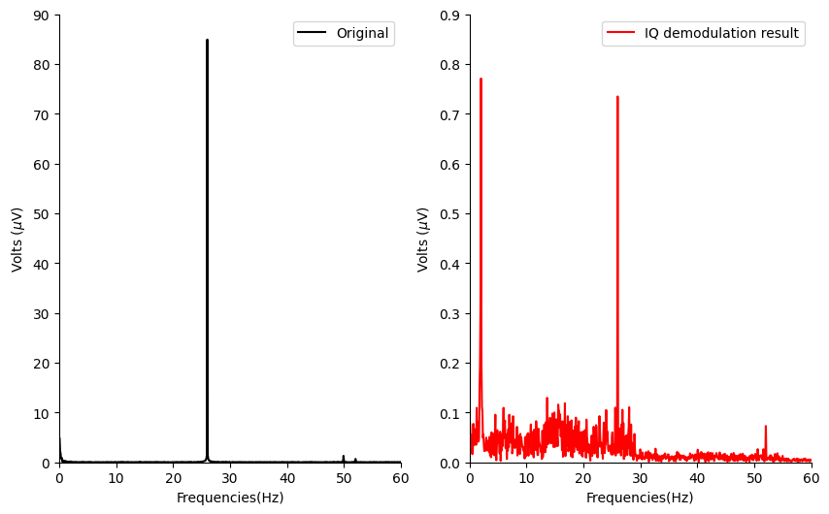
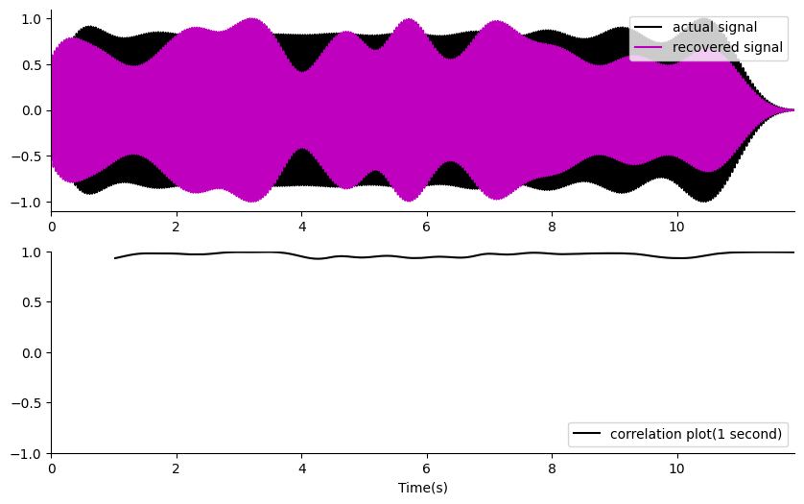
Demodulation in Phantom (e105 t2)
Tank phantom pipeline. I can recover a small 26Hz signal quite well using PRF 80 and a single file(no repeats), or even use of the second harmonic. The harmonics of the 26Hz, get in the way a bit(i.e. making this fake 2hz business, but otherwise it looks good).
Hilbert transform works, but has a phase aberration issue, whereas IQ demodulation, or multiplication by the carrier leads to a lagged but phase alignable solution. Note: the modulated data has a slight lag due to the acoustic conversion.
Code (xizi_postprocess.py, xizi_postprocess2.py)
Introduced by 26Hz second harmonic being too close to the PRF
Introduced by 26Hz second harmonic being too close to the PRF

Slide 14
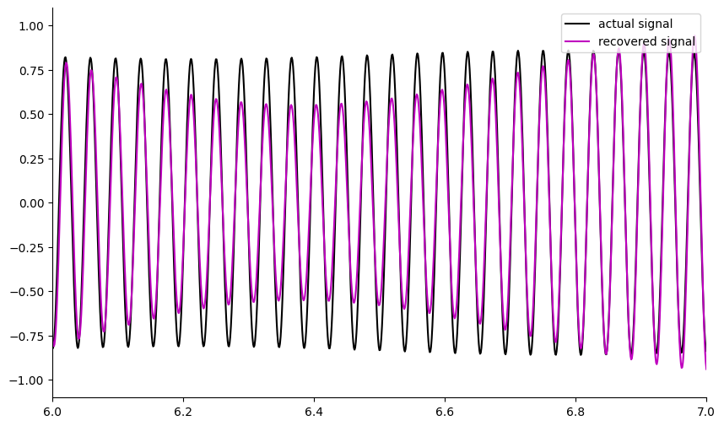
Close up of demodulation result taken at a random point in the file.
Normalized Signal (V)
Time(s)

Slide 15
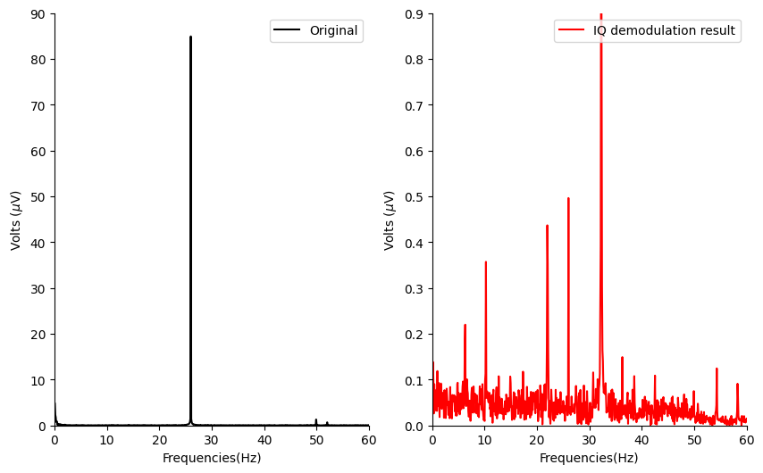
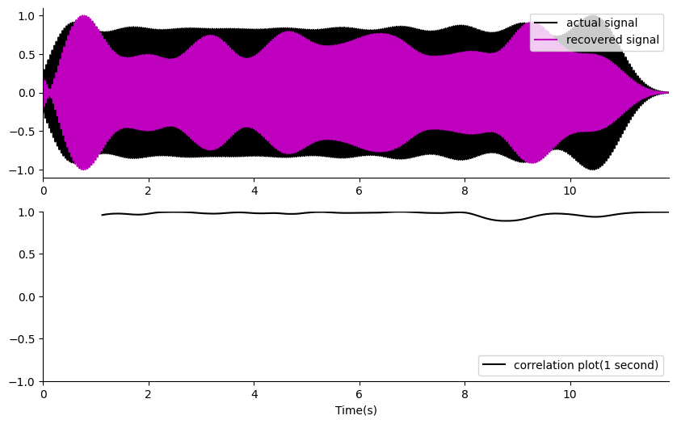
Demodulation in Phantom (e105 t2) by 160Hz(the second mixing frequency)
Works, but I am getting some harmonic distortion from the mains and 26hz secondary harmonics. I could use each of the mixing frequencies to isolate the signal as only the 26Hz is present in both the 80HZ and 160Hz demodulation recovery. The rest are harmonics. So use the second mixing frequency as a noise reduction strategy.

Slide 16
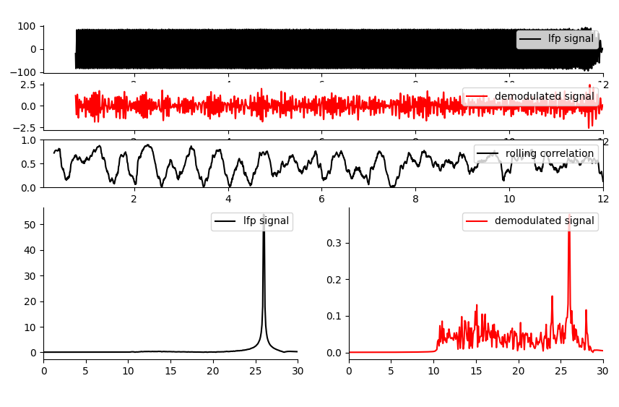
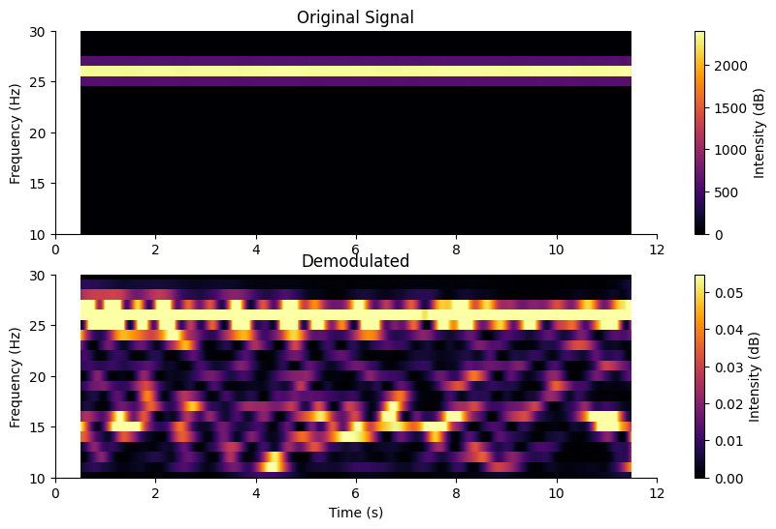
Phantom: 26Hz 50µV signal recovery.
E105/t2/f5
Further work can be done here to optimize the amplitude and SNR of the recovered signal. ONGOING.
Where I place the filter in the recording/algorithm path is important to the SNR.
Increasing the PRF improves the SNR but decreases the amplitude of the recovered signal, so there is a balance between sample rate, PRF, pulse length and recovered signal amplitudes.

Slide 17
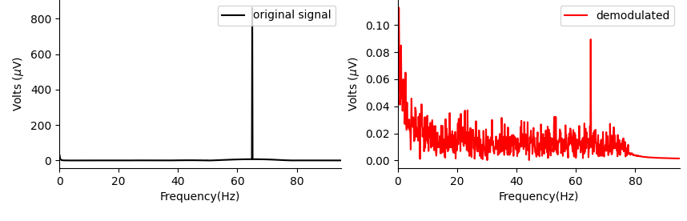
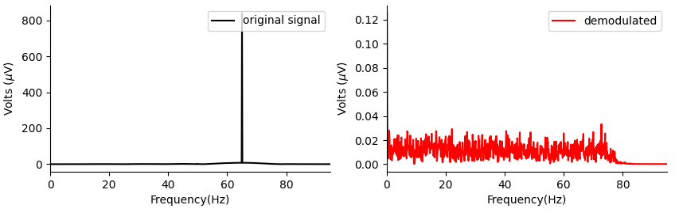
Could the result be an artefact of electrical noise? (e105/t6/f1-4 and 5-8). Check by performing acoustically connected versus not test.
Acoustically Connected
Not
Acoustically Connected, but all signals run through the system as in the acoustically connected case.
Note: I repeated this 4 times for each category and see the same result.
67Hz is only recovered when the system is acoustically connected.

Slide 18
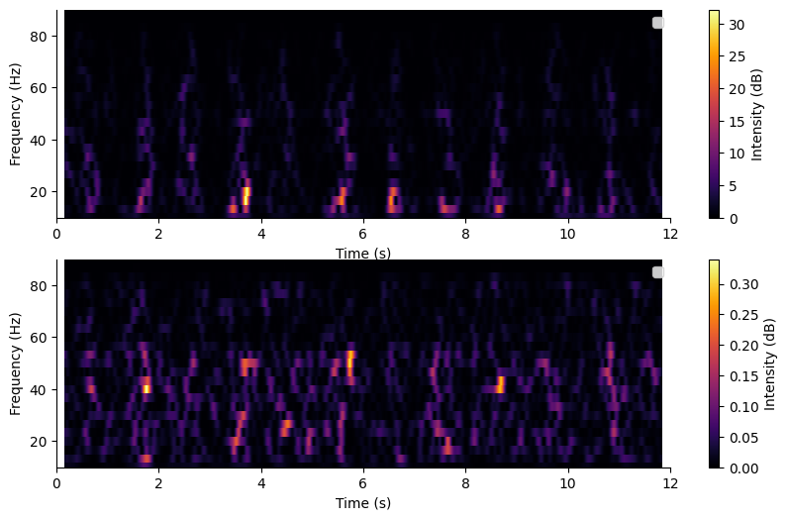
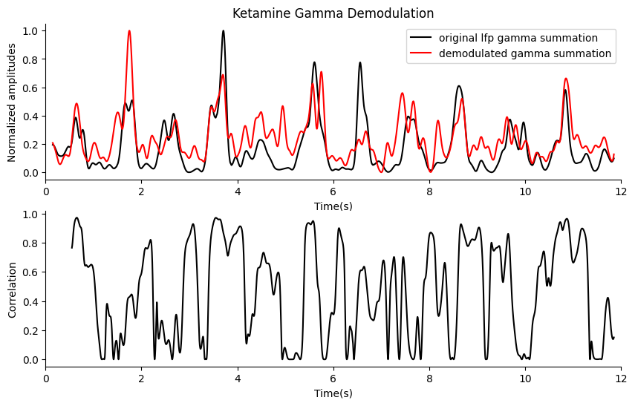
In vivo: ketamine gamma band demodulation
Date: 06/08/2023 E105,t4, file 11
Original Signal
Demodulated Signal
There is a clear power band trend with time, when there are ups there is gamma power for both the original and demodulated signal.
Artefact Test:
1. The recorded measurement signal is nowhere near the saturation limit or DAQ range limits, meaning no rectification is taking place.
2. Common mode coupling between the measurement cable and the cable that powers the ultrasound. To prove this is not what is causing the correlation, do acoustically connected versus not connected test where all the same signals are being run through all cables. If I can still demodulate when the transducer is not coupled to the mouse brain, then I’ll know I have a capacitive coupling(non-linear mixing) effect induced by this coupling. If I do not see any correlation of the demodulated signal when the acoustic signal is not connected, then the demodulation is real. (my phantom test suggests this is NOT the case).
3. It is possible that I am picking up the original signal in my demodulation(PRF 180), so shift the demodulation up in frequency 400-1000Hz). What does the raw signal PSD look like 90-180? (my test doesn’t show anything, so, so far it seems reasonably convincing).

Slide 19
Demodulation Experiment Plan.
Phantom: Try to optimize neural recording further for optimal amplitude and SNR.
Mouse: I have a recovering mouse that should give higher ketamine induced gamma as it has an electrode at the Medial Prefrontal Cortex: (AP 2.4, ML 0.4) - https://pubmed.ncbi.nlm.nih.gov/21880935/. Try demodulation with new improved settings. This time ensure I get an acoustically connected vs not artefact measurement to ensure I am not inducing artefact.
How can I ensure it is real and not an artefact?
There is a clear power band trend with time, when there are ups there is gamma power for both the original and demodulated signal.
Artefact Test:
1. The recorded measurement signal is nowhere near the saturation limit or DAQ range limits, meaning no rectification is taking place.
2. Common mode coupling between the measurement cable and the cable that powers the ultrasound. To prove this is not what is causing the correlation, do acoustically connected versus not connected test where all the same signals are being run through all cables. If I can still demodulate when the transducer is not coupled to the mouse brain, then I’ll know I have a capacitive coupling(non-linear mixing) effect induced by this coupling. If I do not see any correlation of the demodulated signal when the acoustic signal is not connected, then the demodulation is real. (my phantom test suggests this is NOT the case).
3. It is possible that I am picking up the original signal in my demodulation(PRF 180), so shift the demodulation up in frequency 400-1000Hz). What does the raw signal PSD look like 90-180? (my test doesn’t show anything, so, so far it seems reasonably convincing).

Slide 20
Phantom demodulation
I can see lower frequencies in the fft better, if I have more data…
The higher the PRF, the better the signal to noise ratio. (i.e. 80hz is not great)
The higher the pressure, the higher the recovery amplitude.
Below 5 Hz is full of Poisson noise, even in the phantom. Just don’t try to demodulate such low frequencies.
There is a trade-off between amplitude and PRF as SNR increases with higher PRF, but amplitude decreases. I may be able to optimize this some more.
Final settings:
PRF: 4020, burst length = 0.0004, P out = 0.13, Fs = 10khz.

Slide 21
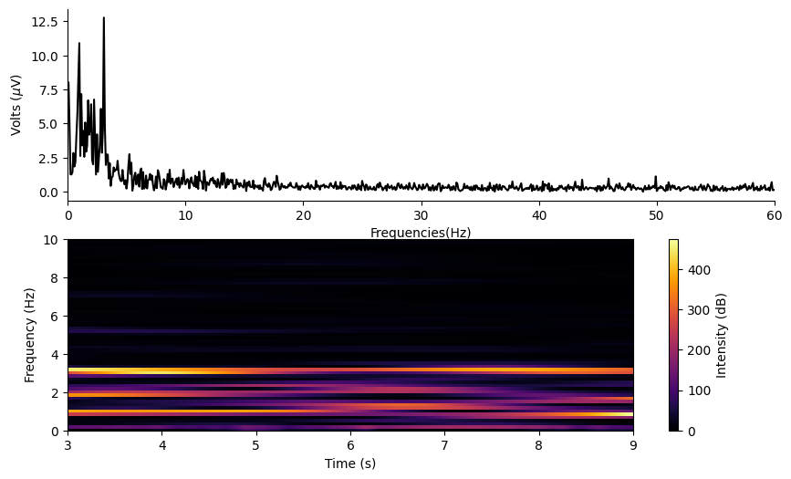
Ketamine PSD analysis
There is a large 3.01Hz peak in mouse 3(two electrodes in motor cortex 0.9Hz and 3.1Hz peak). While not as large as the artificially injected signal, it seems big enough. (t3, file 3 is pretty good)
There is a more variant peak, with max around d0.9Hz and 2.7Hz when I used the mouse with one electrode in motor one in v1.
I can’t see anything really at low gamma 35-45Hz.

Slide 22
Demodulation, copy Xizi Song’s SSVEP parameters as closely as possible.
Update my mouse_stream so that I can have a PRF that mimics the SSVEP paper. 1.57MPa. 10μs pulse length 1Mhz 90 Hz PRF. It looks like they use a single RF pulse. Such that it then decreases in amplitude due to its resonance. - Done. Ready to try. Need to turn on the RF amplifier to test it.
Nothing, US for 2 Seconds, then VEP stimulus.
I could decrease my sample rate too, so I could record this for a longer period of time.
Sample rate Fs = 5e3
They record 100 seconds of data, with a 9Hz LED. There is an equivalent amount of rest time for the mouse to not grow used to the LED.
Initially, keep the delta wave paradigm. They used urethane, I will use k/xylazine.
This seems like a good place to start:
20 second files at a lower sample rate? The I’d only need 5-6 of these recordings.
Pressure V out = 0.125, (1.6MPa), or 0.15 for 2MPa.

Slide 23
I cannot go for 20 seconds, because of shite. I cannot save to local memory such a large amount of data. I need to set it up so I have an option to rotate the fg buffer.

Slide 24
Demodulation post-processing (Xizi style)
Downsample(200hz using resample fcn matlab), average then decode.
For e phys signal, bandpass 6-40Hz. For HF AE signal 65-95 Hz(PRF = 80).
Then averaging across trials.
Then Hilbert transform.
With a 26Hz precise sine wave, I appear to regain the 26Hz using this method(if I bandstop out all the harmonics and mains noise), but it is spread spectrum… likely because it gets tacked out of phase at the end of each file. If I have them all in phase – then what?
Also I should get some uninhibited low sample rate and no stimulus applied, ketamine data so I can look at the PSD. I am seeing vague suggestions I should be monitoring occipital lobe instead?

Slide 25
New mouse experiment.
Do some long recordings to obtain just the ketamine PSD with no other stimulus. I need to understand what I am seeing. I should see some low gamma activity as well.
MEPS with acoustoelectric effect:
Head based rf transmitter using copper mesh.
Long ramp to avoid DC offset movements.

