Slide 1
RF Acoustoelectric
28/07/2023

Slide 2
Goal:
I know applying two acoustic fields elicits neuromodulation at the difference frequency, but is it due to acoustic mixing, acoustoelectric mixing, or electric mixing?
To disentangle:
2 acoustic fields. Is it the acoustic field alone?
2 electric fields.
1 electric field, 1 acoustic field.
I cannot induce movement with the silicon sheet and mesh in place over the head – this may be attenuating both the electric field and the acoustic field.
If RF TI doesn’t work, we know that some acoustic signal is required.
Could if be acoustic mixing alone? (block the electric field coming from the transducer – does it still work?)
Does the mesh block the electric field coming from the US transducer?

Slide 3
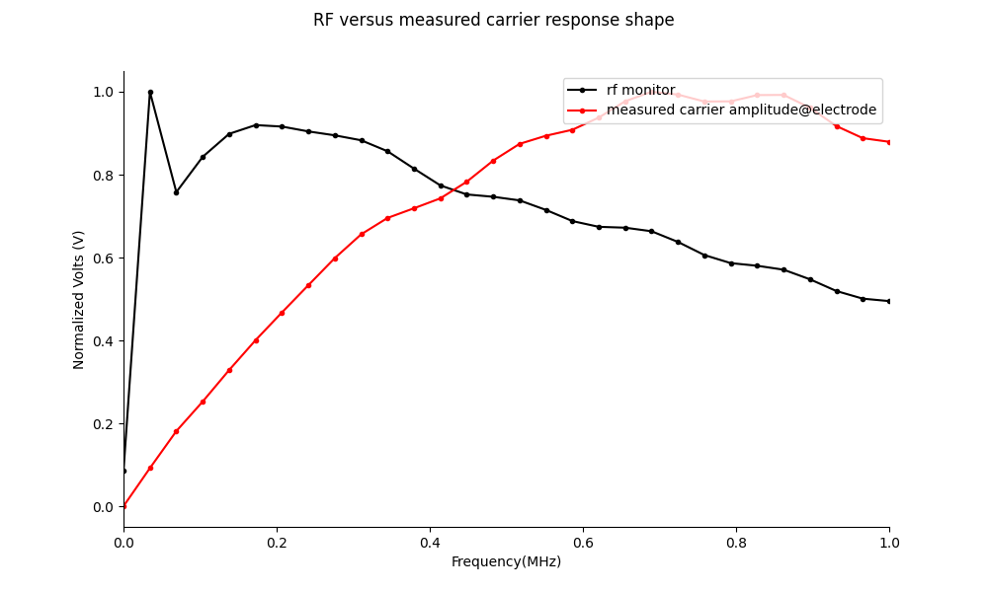
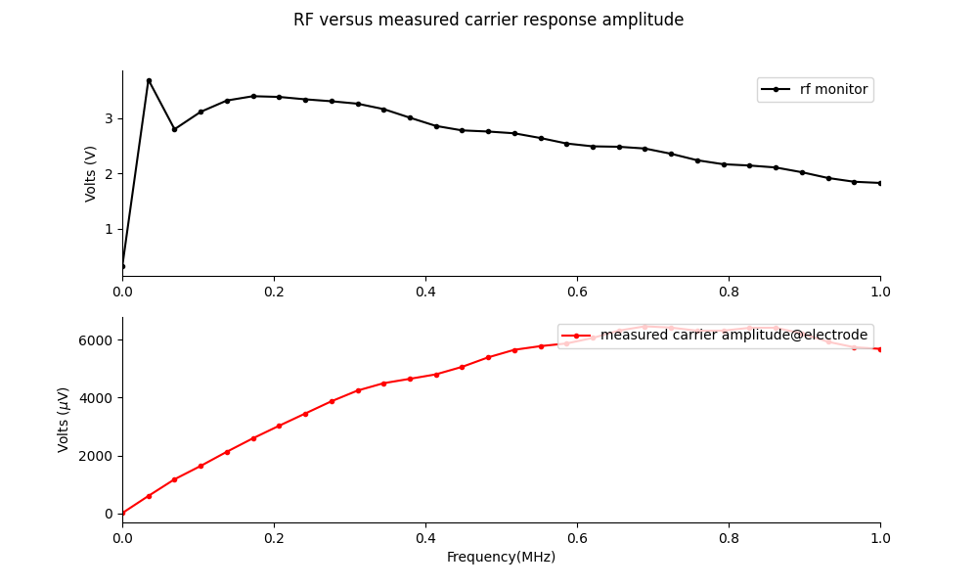
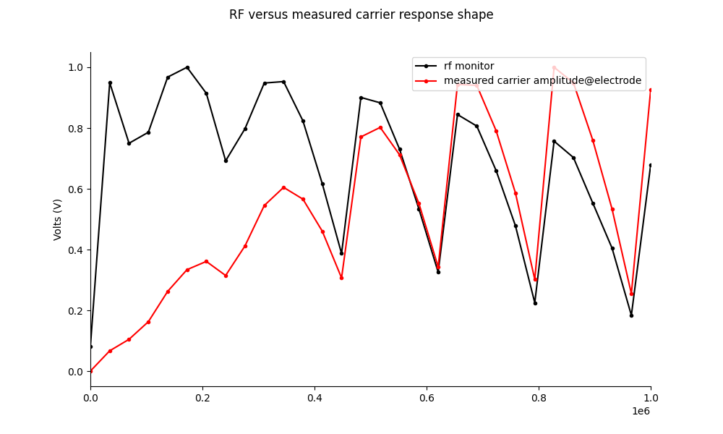
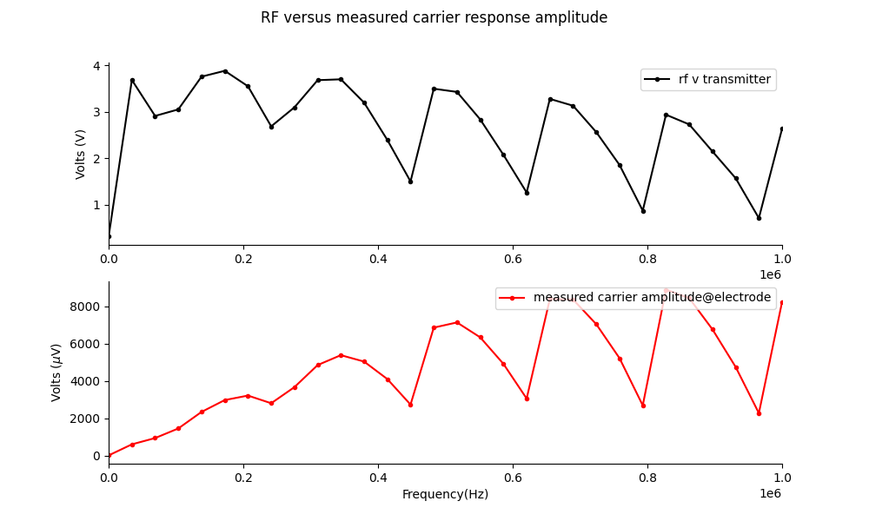
RF transmittance of e field with silicon sheet.
It is possible that the silicon sheet attenuates the acoustic field. It may also attenuate the electric field coming from the transducer.

Slide 4
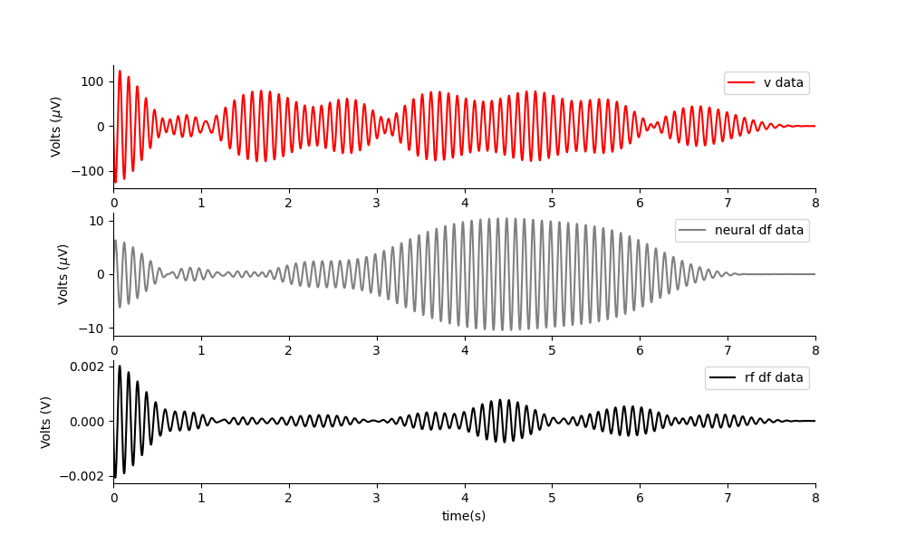
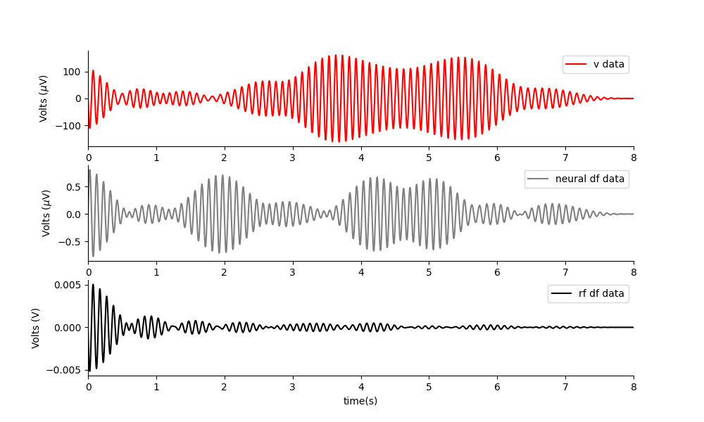
Phantom: RF E TI (two electric fields) applied at same amplitudes.
2khz + 2.01khz
500khz + 500.01khz
2khz + 2.01khz
Nothing really gets through, what is left may be due to my tight rf filter artefacts. Shape doesn’t follow the output.
The two high f signals get through, and then the mixing occurs in the saline phantom.

Slide 5
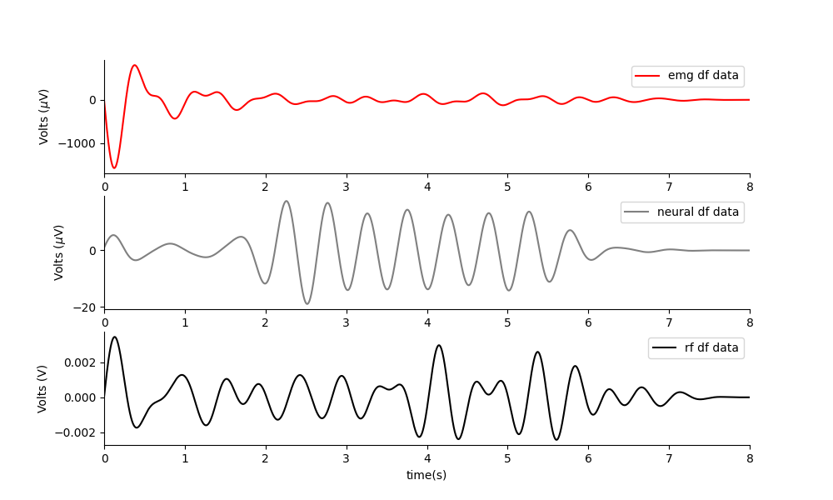
Two acoustic fields.
Works perfectly. There is none of this signal in the rf output.

Slide 6
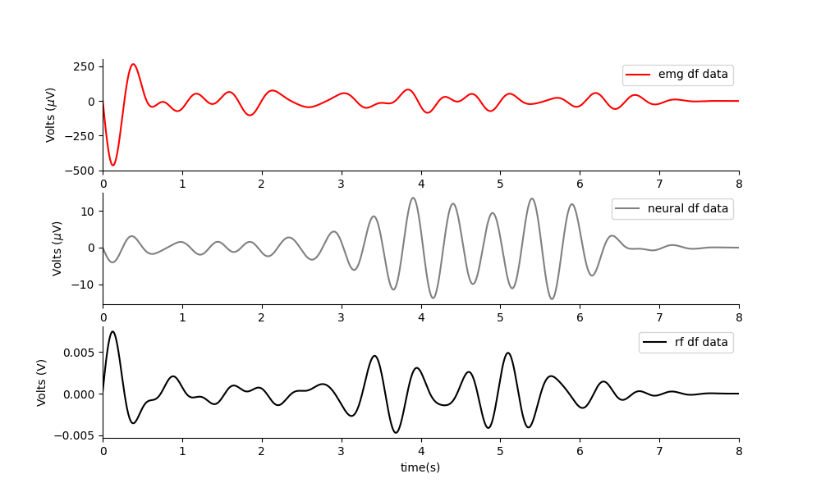
Acoustoelectric in Phantom
Works great. The mesh current emitter is near where the head would be.
Note: It will be better to have a long ramp on the acoustic field, so as not to induce a DC movement artefact from the DC offset induced by the US.

Slide 7
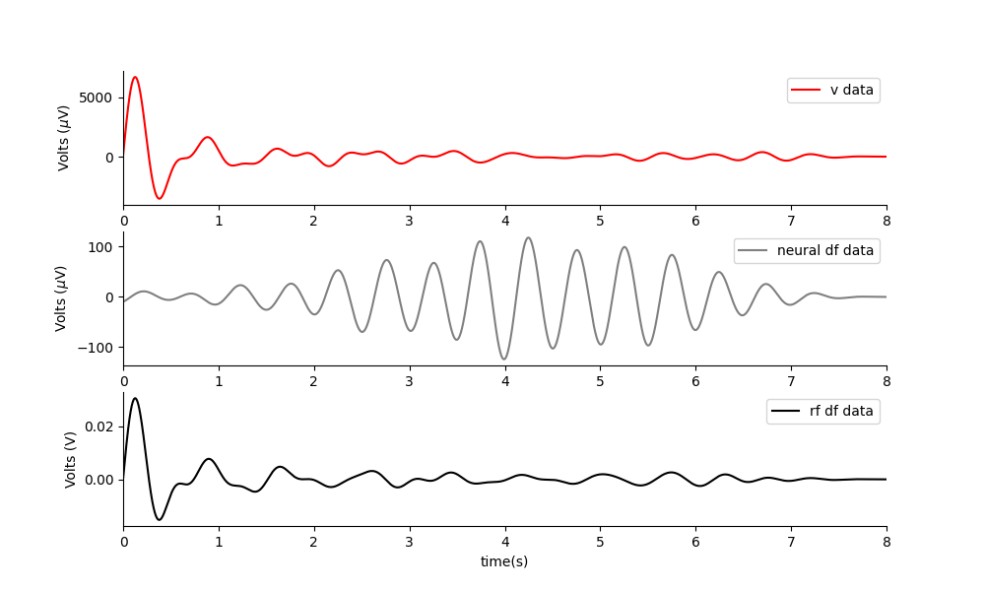
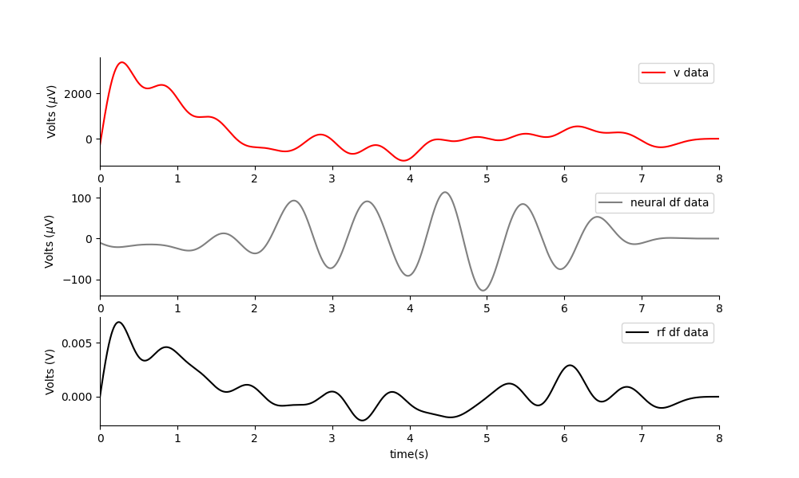
MEPS in mouse at neurally relevant amplitudes.
Experiment e105, t3 and t4. I could obtain excellent neural amplitudes at small difference frequencies such as 1Hz and 2Hz for both the dual acoustic field, and the RF AE paradigm. However, I didn’t get movements. I did not get a good amplitude for RF TI. I got much larger neural df amplitudes than I did in the phantom set up.
NOTE: all the signals are far bigger in the mouse than in the phantom.
Two acoustic waves, 1Hz apart. 1MPa. Both the electric mesh and the silicon sheet are in place. No movement elicited.
It is possible that:
I am not positioned accurately(Perhaps I need to position over the other electrode – try moving 2mm left or right).
The mesh is stopping the e field from the transducer from getting in.
The silicon is stopping the acoustic field.
The any of the two fields is being dispersed or attenuated by the mesh/silicon.
TODO: try without the silicon.
Initially very I can do it with just US gel, then insert the mesh. Do measurements of the total amplitude across the spectrum with and without the mesh in place.

Slide 8
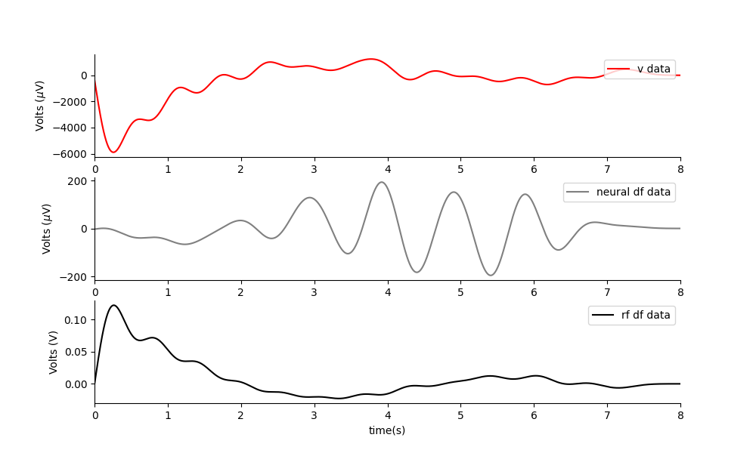
RF AE
One acoustic and one electric field, 1Hz apart. 1MPa, 2V out. Both the electric mesh and the silicon sheet are in place. No movement elicited.

Slide 9
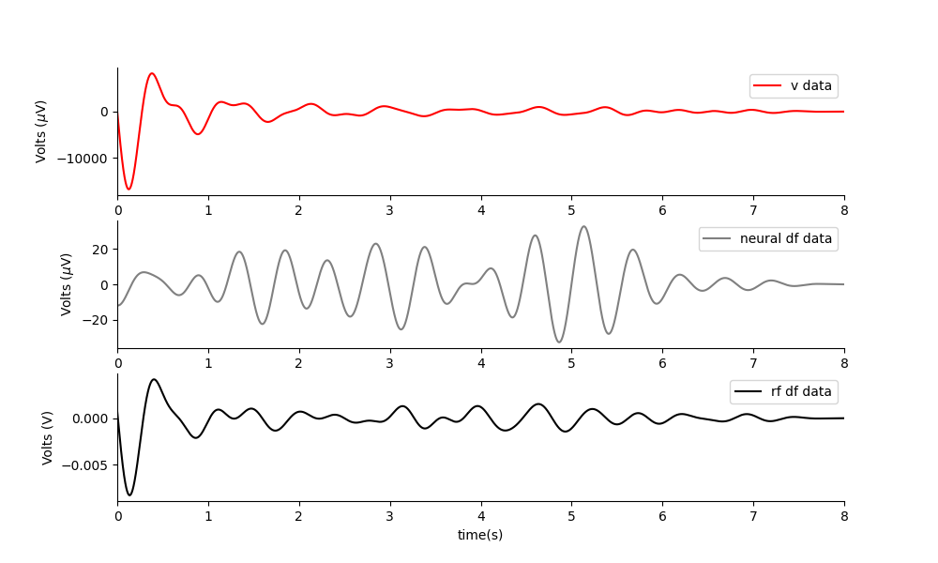
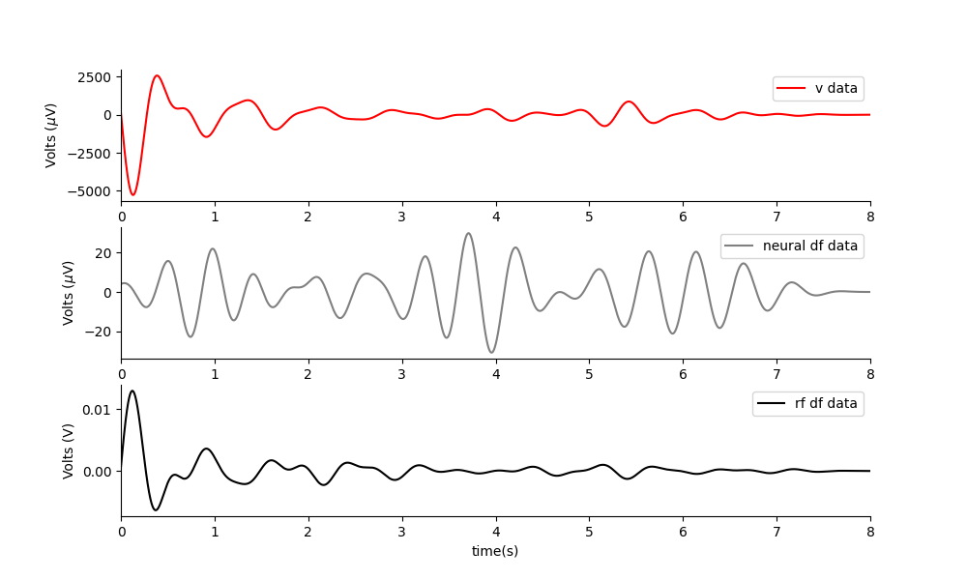
RF TI – so far looks inconsistent.
Two electric field, 2Hz apart. 4v out. Both the electric mesh and the silicon sheet are in place. No movement elicited. I think the signal at df is background noise as it is just a tight filter.
Two electric field, 2Hz apart. 6v out. Both the electric mesh and the silicon sheet are in place. No movement elicited.

Slide 10
Leave on out test for overhead RF MEPS system
Test 1: Electric field at 500khz decreases when there is PVDF and US only. When there is mesh, it is at original size. When there is mesh and PVDF it is also at original size.
This shows that the PVDF effects the amplitude of the monopole antenna field.
Test 2: When a voltage is applied and the acoustoelectric effectis measured(same pressure and same voltage applied each time), the amplitude is worst when there is PVDF, mesh and GEL. Second worst with PVDF and gel. The PVDF and mesh appear to effect the pressure amplitude particularly when together(potentially enabling air bubbles too). This suggests the PVDF inhibits the pressure field amplitude also.
Next experiment plan:
The PVDF layer inhibits both pressure and electric field, lets remove it for the next experiment.
Ultrasound Cone
Copper Mesh
PVDF
V+
Measurement electrodes
Conductive gel
V-
Test 1: No V+ or V- applied, just measuring electric field change at 500kHz.
Test 2: Acoustoelectric effect at the site, amplitude dependent on the incident pressure.

Slide 11
Evidence for Acoustoelectric effect being the mechanism.
Evidence 1: We can develop the electric field seen in a mouse, in saline via frequency mixing due to acoustoelectric effect.
PVDF layer attenuates the electric field coming from the US.

