Slide 1
Acoustoelectric Neural Recording and Neuromodulation
09.08.2023

Slide 2
Neural Recording: (exp 107 t1)
I seem to have pressure induced disjuncts in the file which mess everything up. I should try using a shorter pulse.
Next time switch from the settings that initially worked, then to the new ones.
I can’t see the k gamma in the raw signal that well – so what would it even demodulate? I need to see k gamma to be able to do anything. I can in file 3 and 4 (gain = 1000).
Use a lower sample rate and a HW 3k cut off filter.

Slide 4
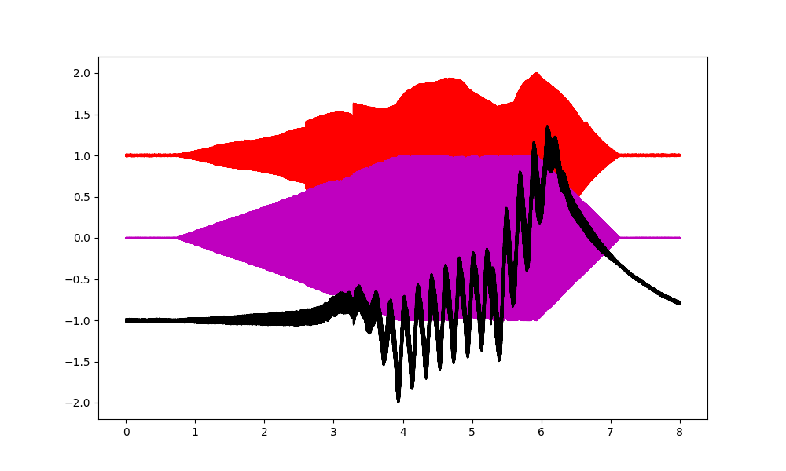
MEPS
I am a factor of 5 off, despite my input signals being correct. Something interesting is happening. The black signal shows the neural signal, which is off by a factor of 5 in frequency from the input signal difference.

