Slide 1
RF TI with an antenna and air gap. (completely non-invasive)
20.09.2023

Slide 2
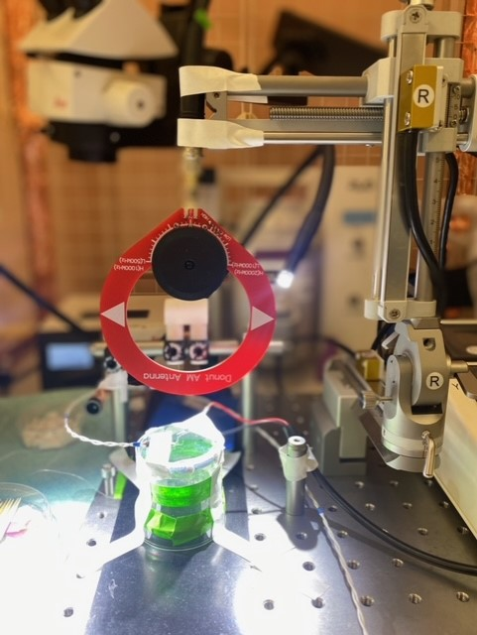
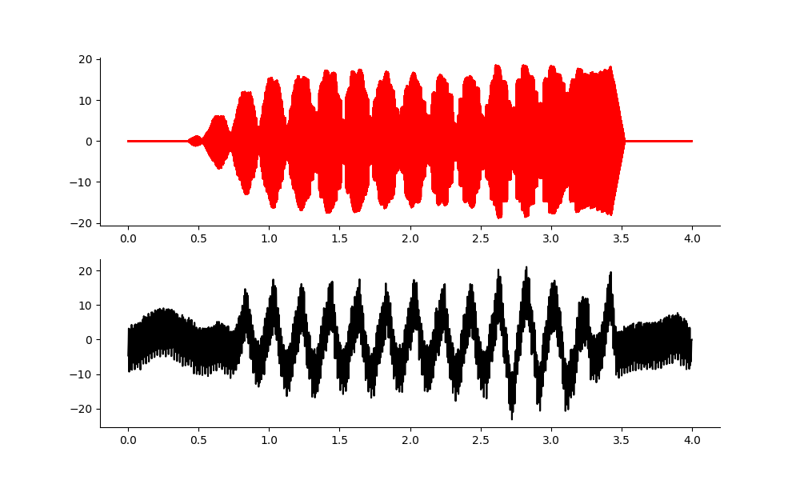
RF TI may work. Here is 5Hz df.
F1 = 1MHz
F2 = 1MHZ + 10Hz
Gain = 500
Vout = 10V
Preamp filter at 1k low pass. 6dB
Location, v close to gel.
Output signal
volts
Measurement signal
microvolts
Time(s)

Slide 3
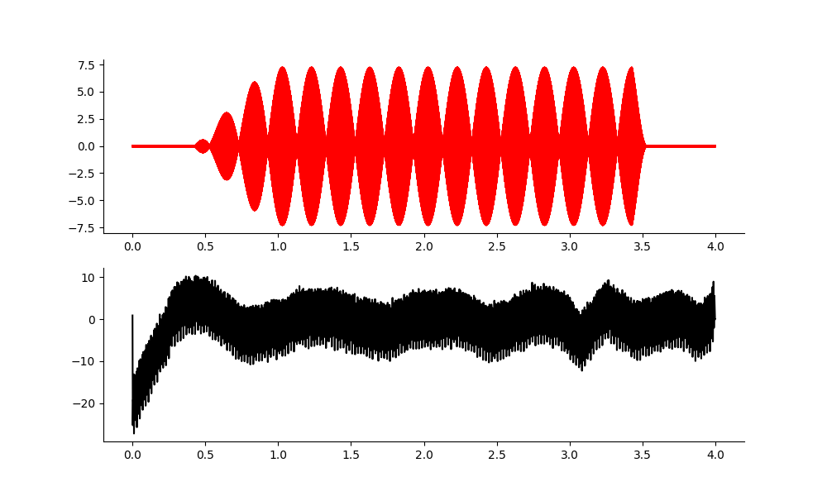
2khz and 2khz + 5Hz (same settings as previous page)
Nothing there

Slide 4
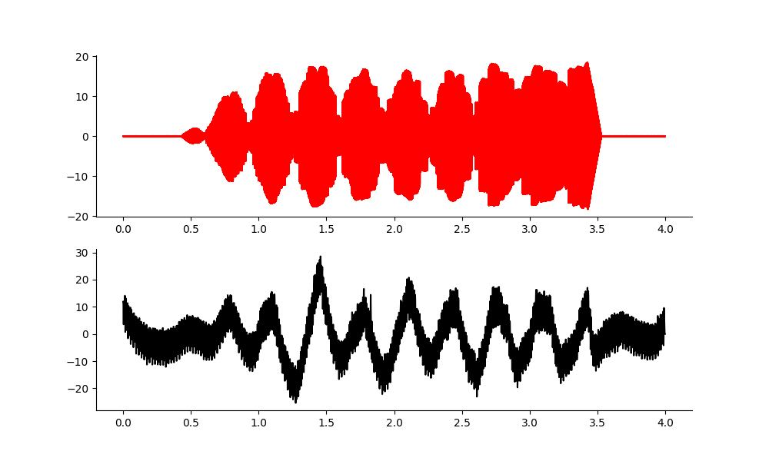
Back to 1MHz, df = 3Hz. (file 3)
About 30 microvolts.

Slide 5
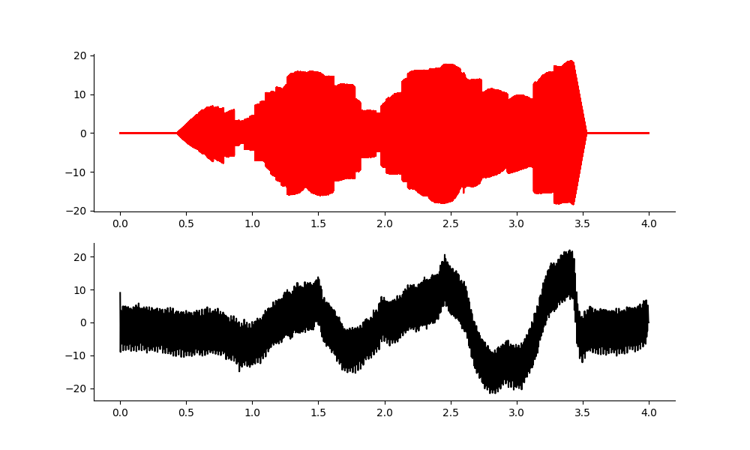
1MHz carrier, df = 1Hz. (file 4)
About 30 microvolts.

Slide 6
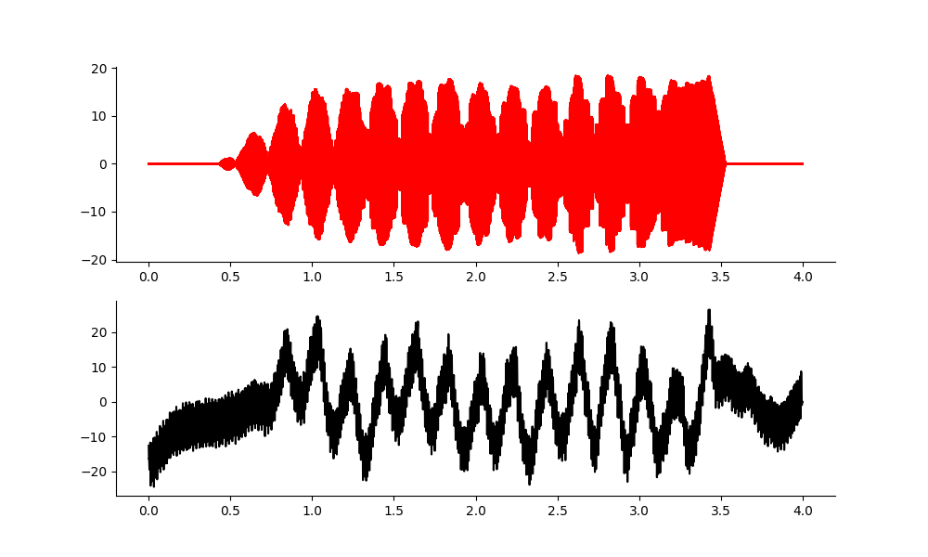
1MHz carrier, df = 5Hz. (file 5)

Slide 7
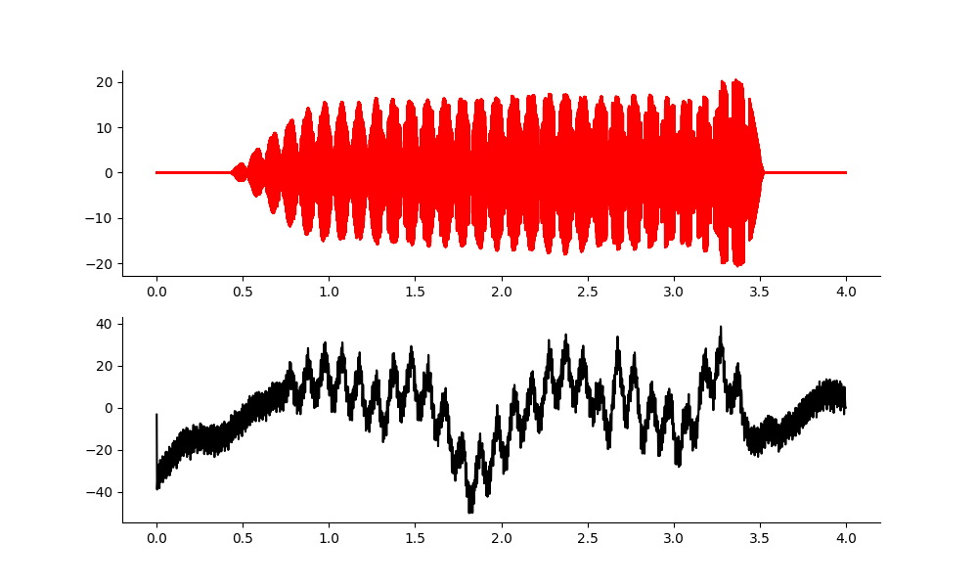
1MHz carrier, df = 10Hz. (file 6)

Slide 8
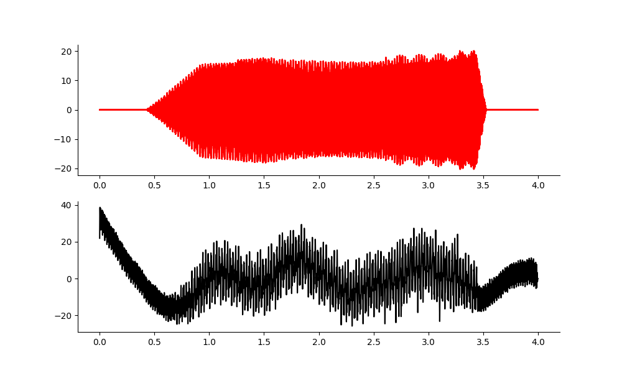
1MHz carrier, df = 40Hz (file 7 )
About 30 microvolts.

Slide 9
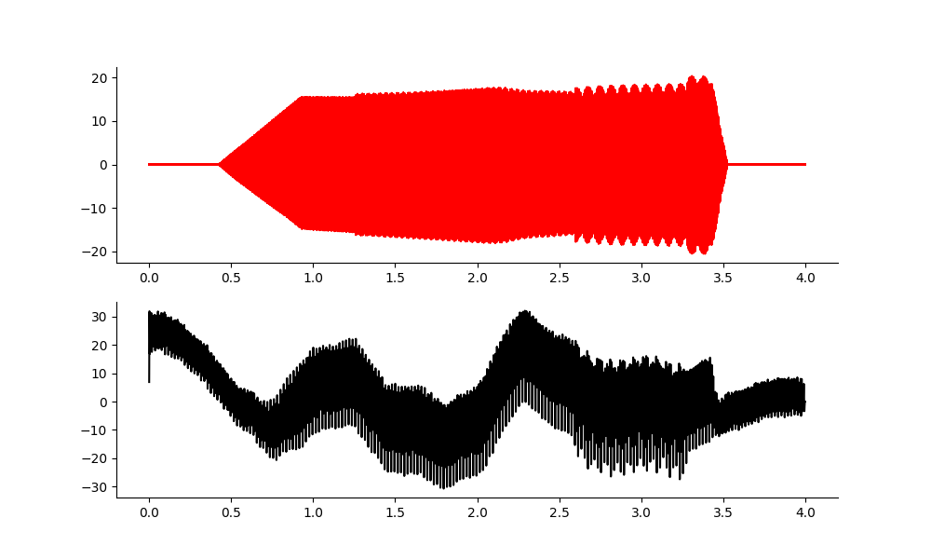
1MHz carrier, df = 100Hz (file 8 )

Slide 10
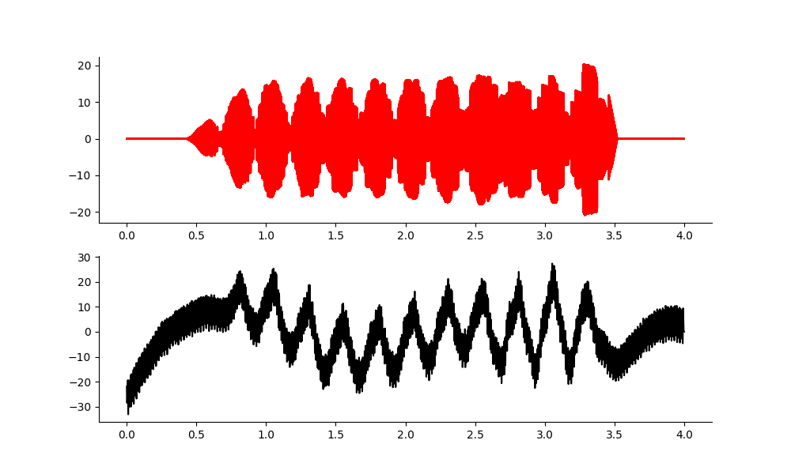
1MHz carrier, df = 4Hz (file 9 )

Slide 11
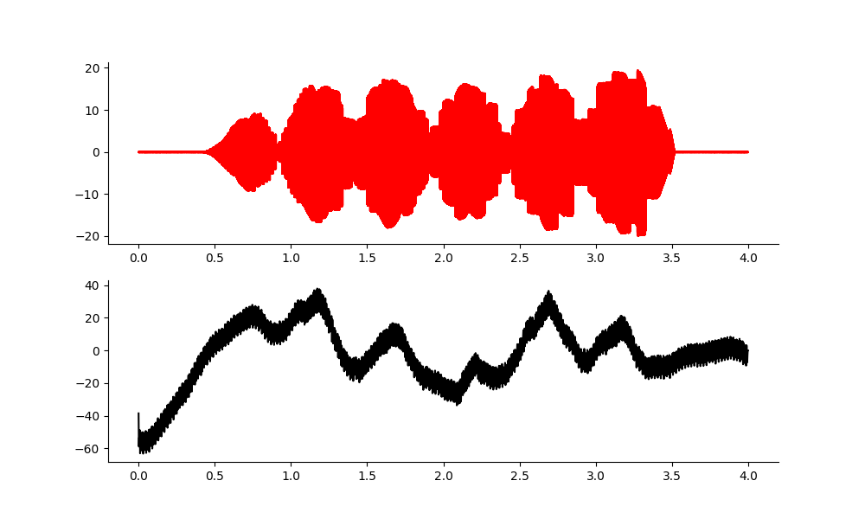
1MHz carrier, df = 2Hz (file 10 )

Slide 12
Mouse Run rf_ti.py and ae_rf_transmitter_transfer_function.py
- Run at df = 1,2,3,4,5,10,40,100, vout = 10V.
- What is the ratio between the mix f and the applied f in the mouse? – the ratio appear to change over time, increasing as the mouse came out of k.
- transmission spectrum in the mouse? – I didn’t attempt.
- I think my amplitudes were too low to evoke spikes.
TODO: make a spike timing diagram. - - Analyze frequency/amplitude trends.
For future, consider using a higher carrier frequency - I may need to decouple my transmit frequency from record frequency to do this. i.e. 5MHz carrier would be better than 1MHz in terms of energy transmitted.
My antenna only goes up to 2MHz. So try 2MHz.

Slide 13
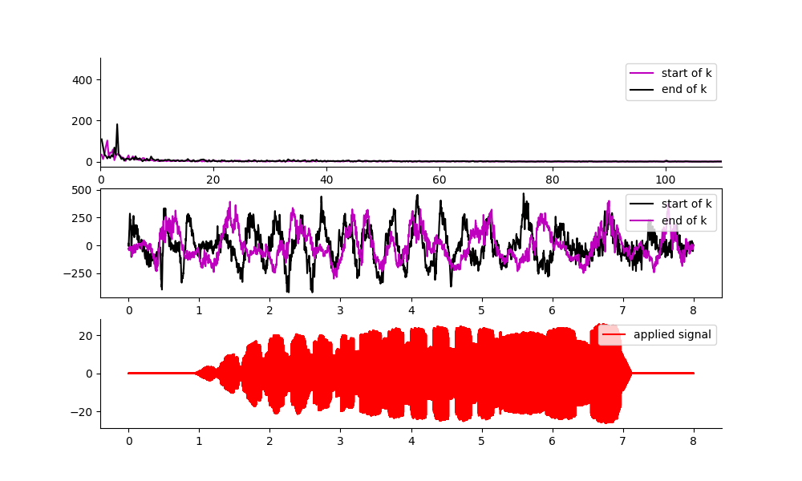
Mouse: Df = 3Hz (e112_RF_antenna t2 mouse)
There is a massive difference between the start and end of the ketamine. Entrainment happens far more easily when ketamine is low.
Did I change the position? I did a bit…
Maybe I should try Isoflurane again?

Slide 14
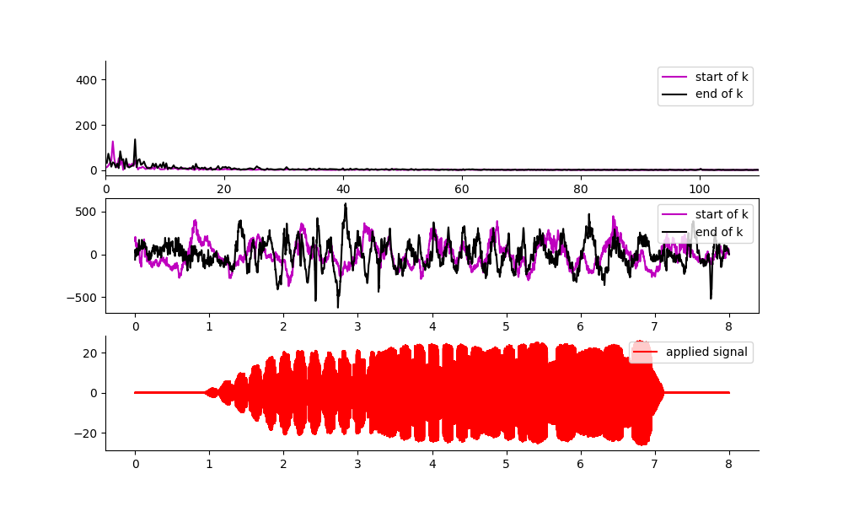
Mouse Df = 5Hz
Entrainment occurs more easily when k is wearing off. Amplitude is near non-existent when k is newly administered.

Slide 15
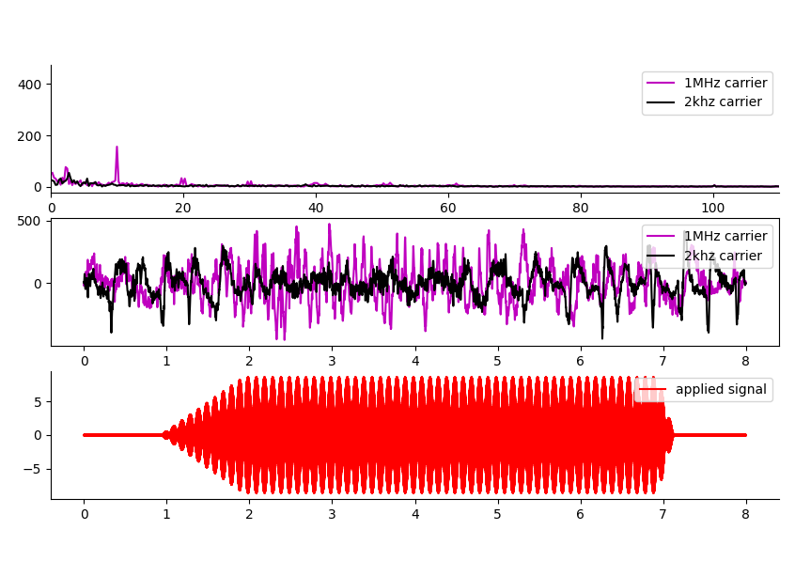
Carrier 2kHz compared with 1MHz (df = 10Hz)
The 10Hz is clear and present when the carrier is 1MHz, and non-existent(below noise floor) at 2kHz.
The ratio of the signal 4000 microvolts : 30-200 microvolts pending anaesthesia level.
10Hz

Slide 16
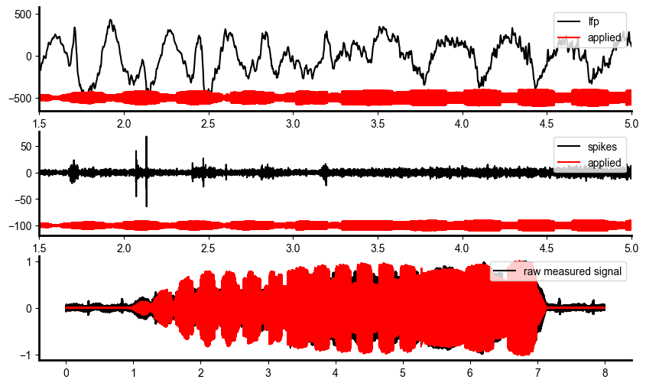
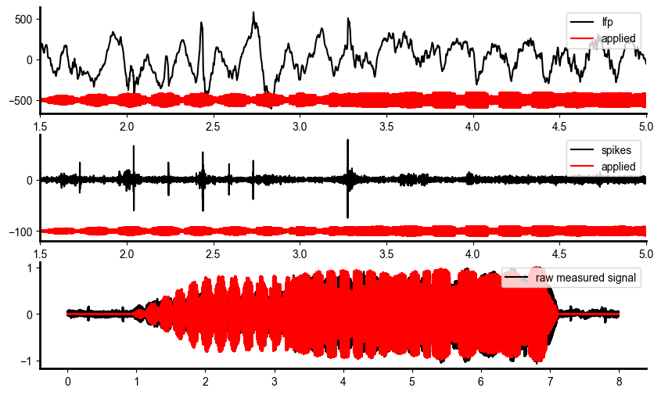
Phase offset changes as df changes.
3hz df f 28
5hz df f 27
I can’t really see a change in the phase offset. I only see entrainment when the ketamine is wearing off,
and it is a good amplitude. The trend of amplitude with frequency is there too. To make a better phase inference, I need more recordings… not just when k is wearing off etc…

Slide 17
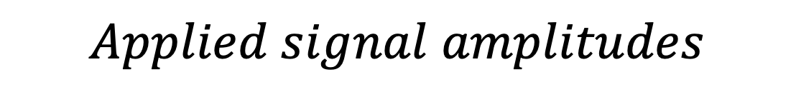
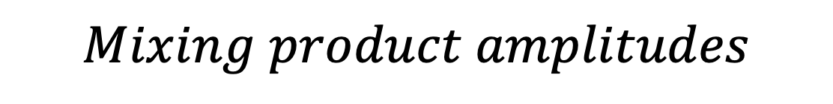
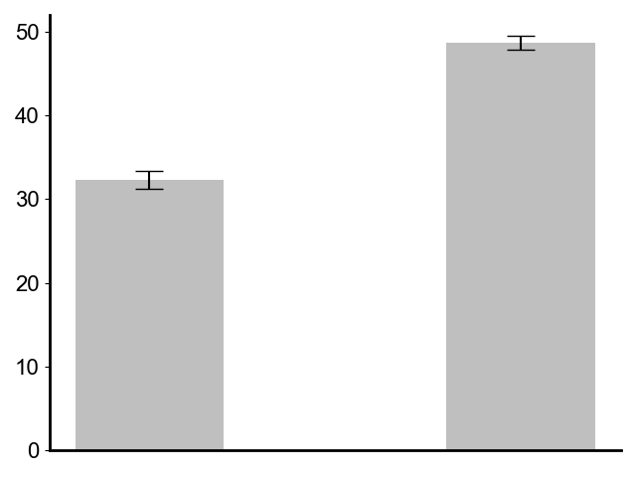
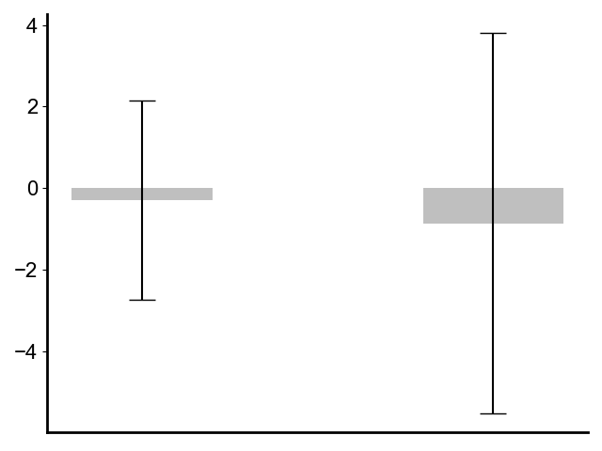
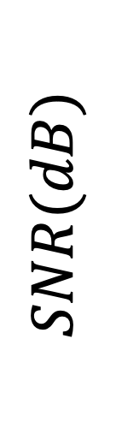
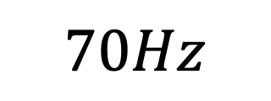
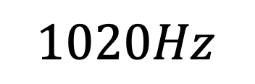

The mixing product frequencies are below the noise floor. The applied signal amplitudes are larger than what we see in vivo (with 1020Hz@200𝜇𝑉and 70Hz@31𝜇𝑉), hence the frequency mixing that we see in our neural decoding experiment does NOT occur in the preamplifier.
E107 (t3) preamplifier artefact test.

Slide 18
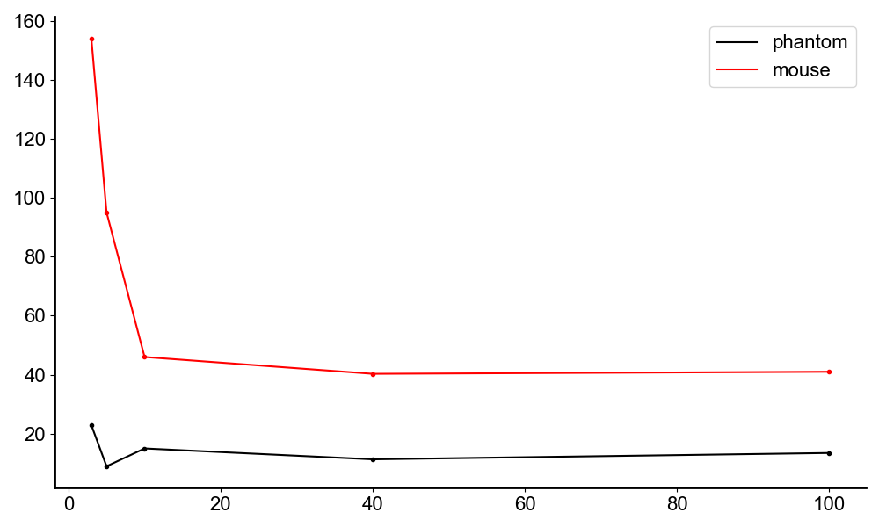
Mouse: Is it actually a neural response? Or am I just generating the df in vivo?
Frequency vs amplitude in phantom/mouse.
Note: My neural amplitudes were too low to evoke enough spikes to make a good spike diagram, nor did I obtain behavioural proof. I think I need to get a higher amplitude lfp to do that, which means I need to go to a higher carrier so more signal gets through into mouse brain. The anaesthesia was also a problem as I only saw entrainment, right at the end.
There is a clear trend that the mouse amplitudes are higher at lower frequencies, 5Hz, 3hz being very high amplitude.
Note: I measure the amplitude by taking the FFT amplitude at the difference frequency.
microvolts
Frequencies(Hz)

Slide 19
RF TI Phase analysis.
TODO:
I think the data was there, but I could only see spikes around the end due to ketamine.
I think I should repeat exactly this experiment, just at 2MHz, and using low level isoflurane. I need to put headbar on better, so mouse can withstand low level iso.

Slide 20
Moving to a higher frequency so I can elicit higher amplitude df.
It is ok to have the generator at a different f to the recording.
It is ok to have each generators at different fs.
1e7,i.e. 10MHz output Fs on gen current is ok.
I can go up to 2MHz carrier f, with a 10MHz sample rate. i.e. 5 samples per period.
Optionally, I can buy a different antenna that goes to 4MHz.

Slide 21
Electrical Tests to do.
Direct 5Hz instead of 2kHz.
Use a pulse stimulation, to show that evoked field follows at delay.
Look at time separation of the evoked signal and the applied signal.
do phantom amplitude experiment at 2MHz carrier, Fs = 10MHz. Is the amount that gets through larger than at 1MHz? By how much?
Can I obtain spiking information.
Does the antenna really make an amplitude difference compared to direct application of fields?

