Slide 1
RF TI using the RF amplifier.
12.10.2023

Slide 2
Direct electrical stimulation and RF TI experiment.
Direct e-stim using a pulse and sine wave.
If I stim and measure with the same electrode… (no gain, using a pulsed e stim, i.e. 30ms duration), can I see LFP or spikes. i.e. use ch5 diff input, or ch1 for single ended. Adjust daq ranges appropriately. Is there a particular amplitude I can see LFP response?
Low frequency direct sine wave, using a high-pass filter on the preamp. In this case, the stim electrode would be different to the measurement electrodes. The stim electrode can be placed in gel over the top of the mouse head, and the GND a cup electrode in the mouth. Can I see spikes?
Try a few different amplitudes. Where do I see a response?
Silicon sheet using Transformer? , 5Hz and much high frequency 2MHz RF TI.
Silicon sheet, then stim electrode in gel? Apply high frequency PRF set up at 2Mhz. Also apply direct 5Hz. What happens on the measurement electrodes for each case with the same difference frequency?
Code rf_ti_hf_test.py
Goal: See pulse induced LFPs, and sine wave induced spikes.
Then try rf ti again, but with a non-resonant and close to head solution.
I am not confident that I can output a signal this way with the RF amplifier.

Slide 3
E116 t1. mouse with e pulses.
I only saw one or two LFP – right at the end. Then the head bar came off..
I think I need to work on this more so I can understand when I do and don’t get LFPs – it is definitely mouse based. Switch back to isoflurane.
Improve my fixation of the headbar.

Slide 4
Try to test/fix the other side of the bono tx.
Esra said that high frequencies don’t penetrate… but then how do HF water filled antennas work? What I am seeing is HF everywhere as if the medium no longer mattered.

Slide 5
T2 – mouse with Pat’s surgery, isoflurane test.
Implanted electrodes, surgery earlier in the day. Given 2hr break.
Do e stim with the rf amplifier. Inc low frequency sinusoidal stim.
Add the impedance adapter in the path for the rf out.
Then do rf ti with the rf amplifier.

Slide 6
Direct electrical stimulation and RF TI experiment-t2
Direct e-stim using a pulse and sine wave.
Pulsed e stim, using preamp, and low pass filter set to 10k.
Low frequency direct sine wave, using a high-pass filter on the preamp. In this case, the stim electrode would be different to the measurement electrodes. The stim electrode can be placed in gel over the top of the mouse head, and the GND a cup electrode in the mouth. Can I see spikes?
Try a few different amplitudes. Where do I see a response? Is it isoflurane level dependent.
Remember to change the impedance adapter I and V chans to the bono transformer.
Silicon sheet using Transformer? , 5Hz and much high frequency 2MHz RF TI. Low pass filter in place.
Silicon sheet, then stim electrode in gel? Apply high frequency PRF set up at 2Mhz. Also apply direct 5Hz. What happens on the measurement electrodes for each case with the same difference frequency?
Code rf_ti_hf_test.py
Goal: See pulse induced LFPs, and sine wave induced spikes.
Then try rf ti again, but at 2Mhz, try to adjust iso level until I get spikes.

Slide 7
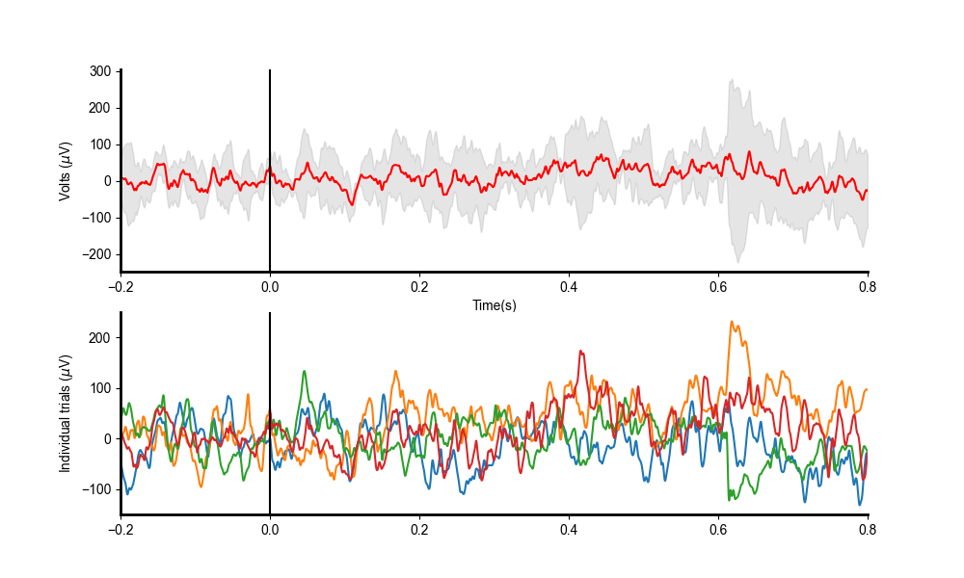
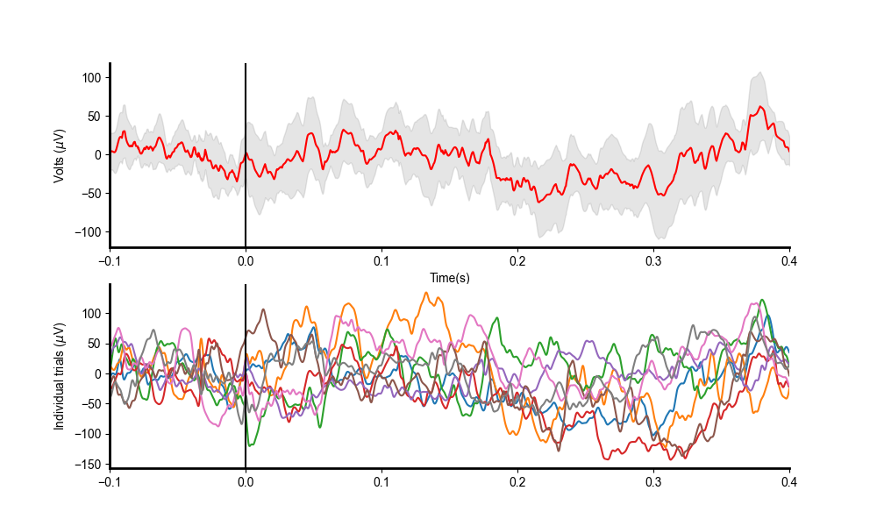
T2 results – I can see something I think.. But it is very small and unconvincing.
Error bar is the 95% confidence interval
Direct stim results PRF = 1
Direct stim results PRF = 2

Slide 8
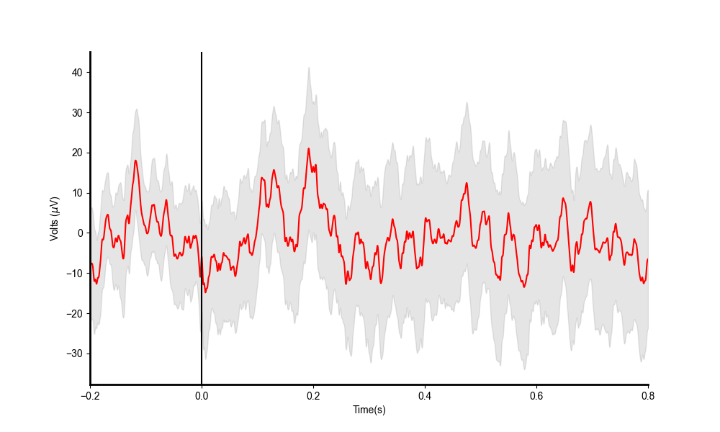
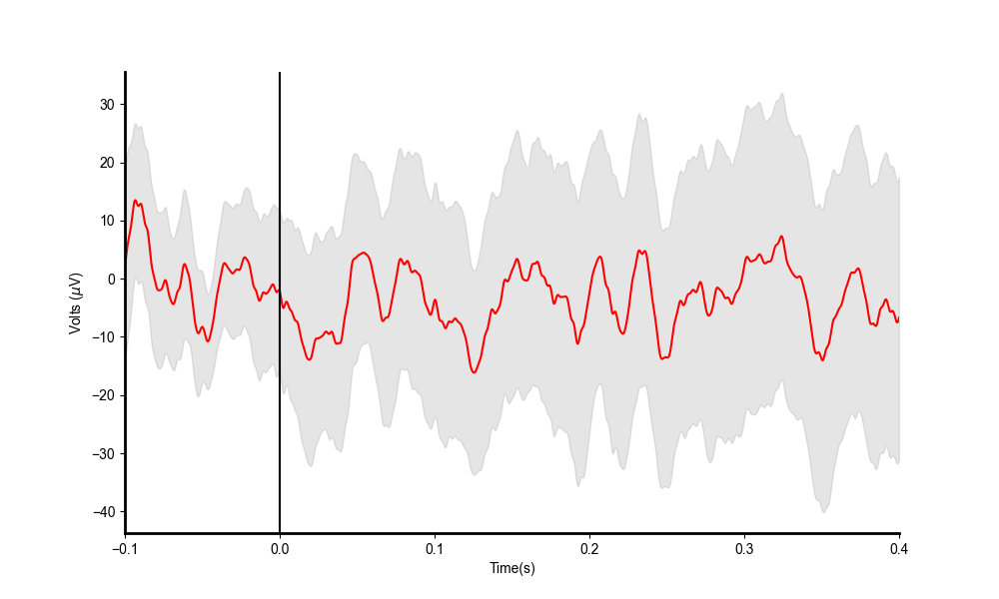
RF TI
E116 t2 200 microsecond pulse.
RF stim results PRF = 1
RF stim results PRF = 2

Slide 9
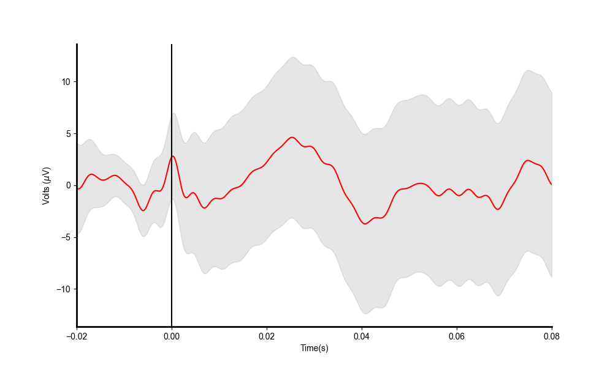
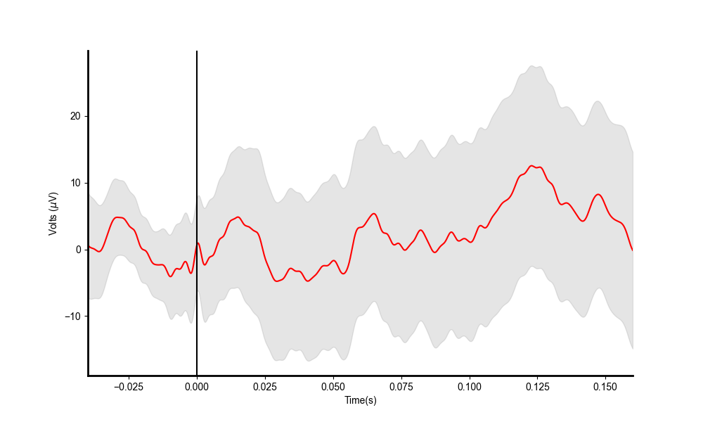
RF TI
E116 t2 200 microsecond pulse.
RF stim results PRF = 5
RF stim results PRF = 10

Slide 10
Summary of e116 t3
The amplitudes are a bit small, but their *MAY* be something there.
I used a very short 200 microsecond pulse time. Some studies show longer pulses(up to 0.05s) increase the amplitude of the effect.
Plan for t4
Use just one PRF setting i.e. PRF =1 . Use only direct stim. Iso = 0.5. Vary the length of the pulse. Use at least 10 repeats.
I can also vary the amplitude, up to the point where I OVLD the preamp, even with the filter…(band )10k low pass, 0.3Hz high pass.

