Slide 1
RF TI, physics investigation
17.10.2023

Slide 2
Do high frequencies really mix in ionic solutions? (e118 t1)
- Salinity Test
Deionized. (40 microvolts)
1.1 g (0.225%) (63 microvolts)
2.2g (0.45%) (75 microvolts)
4.5g (0.9%) (78 microvolts)
1.8% 9g (87 microvolts)
(5 recordings of each) – Collected. Plotted
- show 10hz direct vs modulated with same preamp settings. - Collected. Plotted.
- transmittance function. With 4 repeats so I can have a std. - Collected. Plotted.
- amplitude fall off with vertical distance. – Collected. Plotted.
- amplitude fall off with horizontal distance. – Collected. Slightly falls off with distance, maybe low reps in fft a problem. Plotted.
- temperature df change. – Collected. Plotted.
Simulation of amplitude fall off with distance using FDTD in Sim4Life?

Slide 3
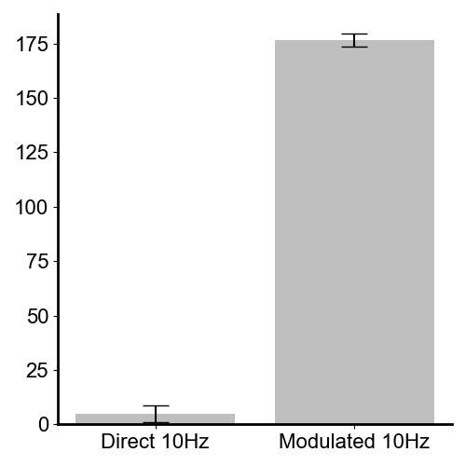
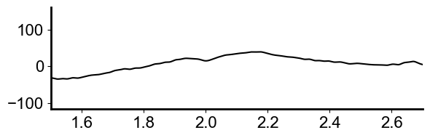
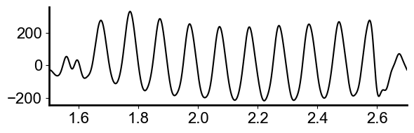
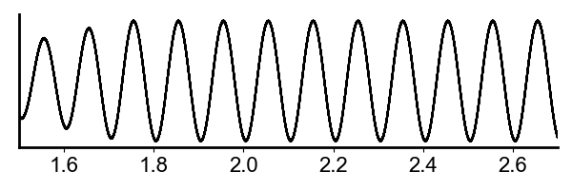
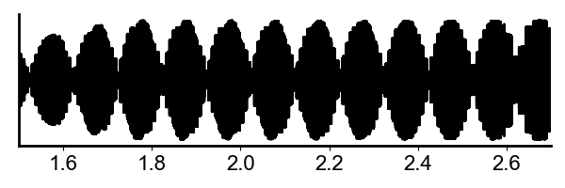
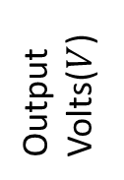


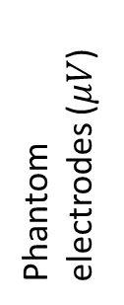
Direct 10Hz vs modulated 10Hz. (e118 t1,t2, t3)
$Both signals shown are filtered \left(0.5−40Hz\right), and the same amplitude output signal is applied from the function generator. All else$ in instrumentation is the same.
$$Direct 10Hz@ measurement electrode$$
$$2MHz+\left(2MHz+10Hz\right)@ measurement electrode$$
***
P = 1e-12
Phantom electrodes ($μV$)
$∆f$=10Hz ($μV$)
Time(s)
Time(s)
Output Volts($V$)
Direct signals at low frequencies are not transmitted, only the high frequency signal gets through to the solution whereby it mixes without there being an electrode interface at all. Also, no 10Hz from hardware non-linearity enters the saline(0.9% concentration). The mixing frequency is created entirely in the saline solution.
In previous work in TI[REF to Nir, Xiaoqi] a possible artefact cause is non-linear mixing in the signal generation chain(which is difficult to remove), particularly when sending through two sine waves (i.e. the classic two-tone test). Since low frequencies do not pass through air gaps (high capacitance) or the isolation transformer, RF TI doesn’t have this issue.

Slide 4
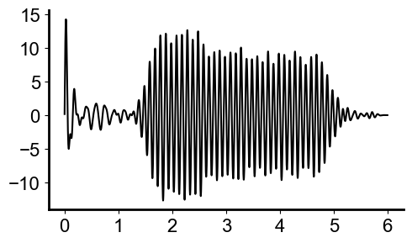
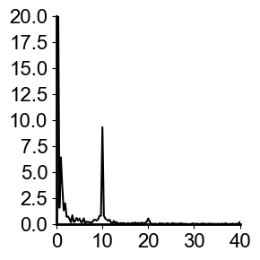
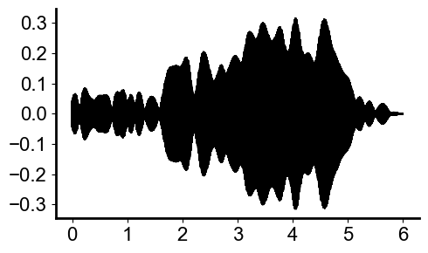
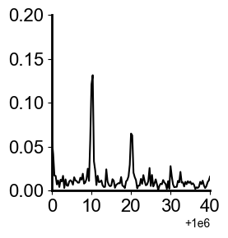
Proof of frequency mixing.
Difference df = 10Hz.
Sum

Slide 5
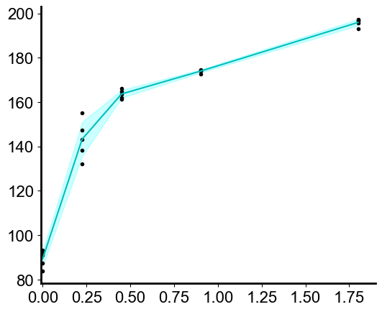

Salinity
Salinity directly effects the amplitude of the difference frequency, though appears to asymptote with NaCl saturation.
This shows the difference frequency measured is not an artefact of the preamplifier, as every setting is kept the same in these recordings, except the saline concentration.
The frequency mixing amplitude is dependent on the conductivity of the medium and high frequencies really do mix in ionic solutions.
5 measures at each saline concentration
$∆f$=10Hz ($μV$)
% saline

Slide 6
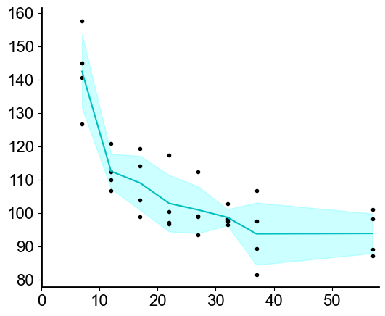
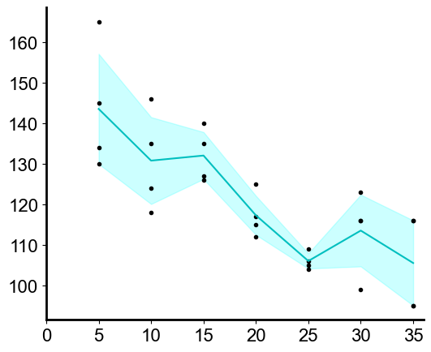


Fall off with distance.
I moved the stereotax with antenna attached to see how distance effected the mixing amplitude.
Vertical distance with mixing amplitude
Horizontal distance with mixing amplitude
$∆f$=10Hz ($μV$)
$∆f$=10Hz ($μV$)
Horizontal distance from electrodes (mm)
Vertical distance from saline (mm)
Note: Horizontal measures were taken 10mm above the surface of the liquid.

Slide 7
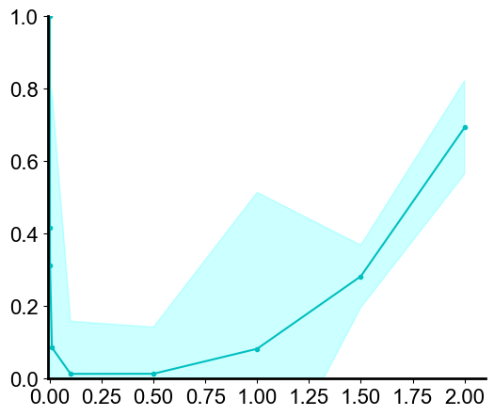
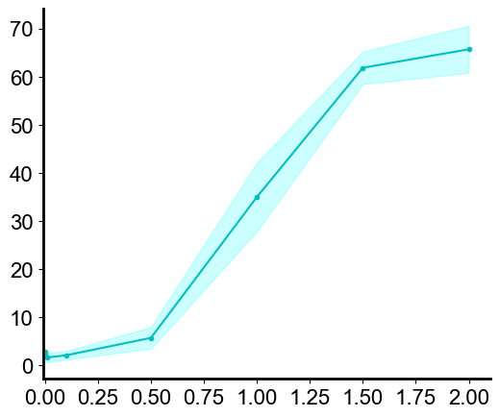

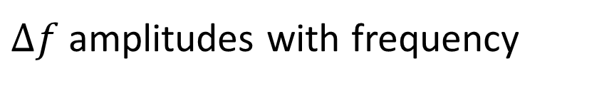
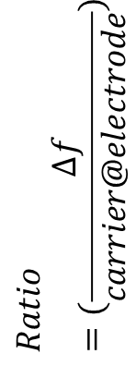
Transmittance Function. (no filters on preamp)
Ratio of applied signal amplitude to df.
Carrier doesn’t get through, df below noise floor.
df is small, but the measured carrier is high due to both isolation tx and antenna response.
$∆f$ amplitudes with frequency
Far more efficient (1.27)transference into df amplitude.
$∆f$=10Hz ($μV$)
$$Ratio=(\frac{∆f}{carrier@electrode})$$
Frequency(Mhz)
Frequency(Mhz)
Note: 4 repeat measures at each point

Slide 8
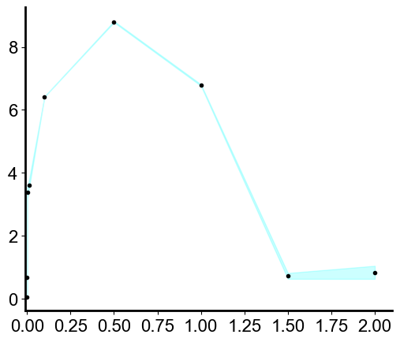
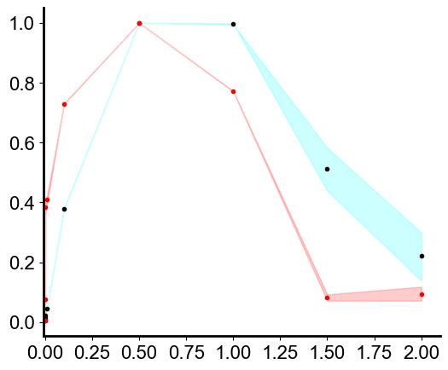
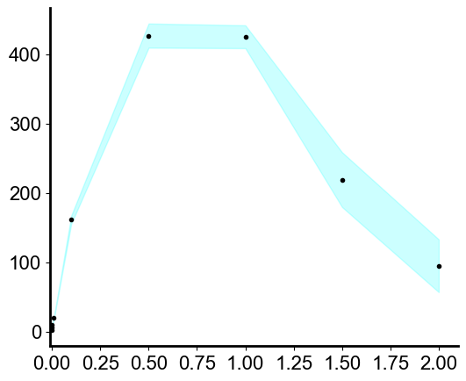
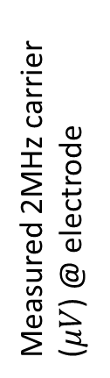
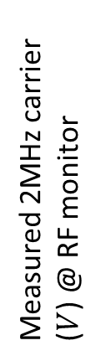
Transmittance: carrier amplitudes with frequency.
The RF output changes shape based on the tx box and antenna S11 response.
More gets through to the measurement electrodes, as frequency increases.
Normalized shape comparison
Measured 2MHz carrier ($V$) @ RF monitor
Measured 2MHz carrier ($μV$) @ electrode
Frequency(Mhz)
Frequency(Mhz)
Frequency(Mhz)

Slide 9
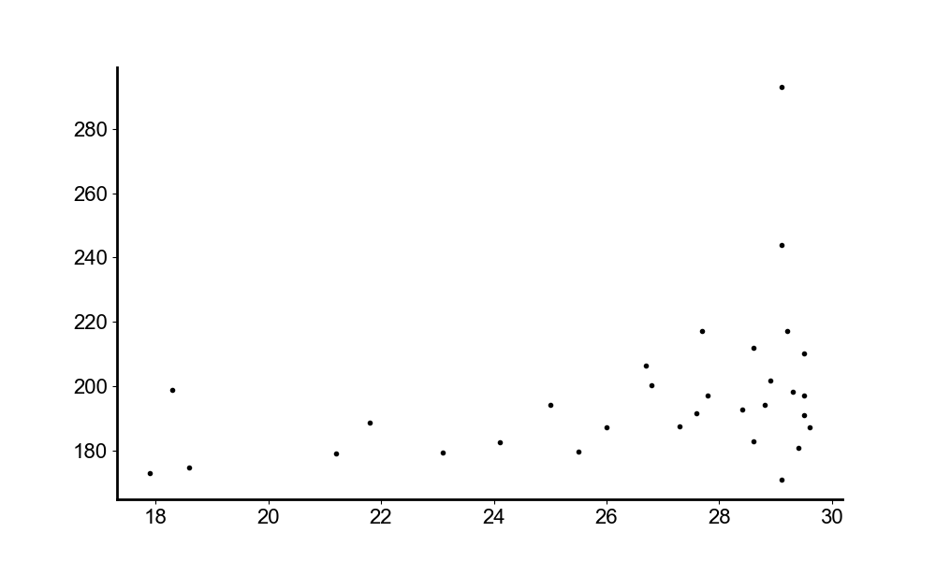

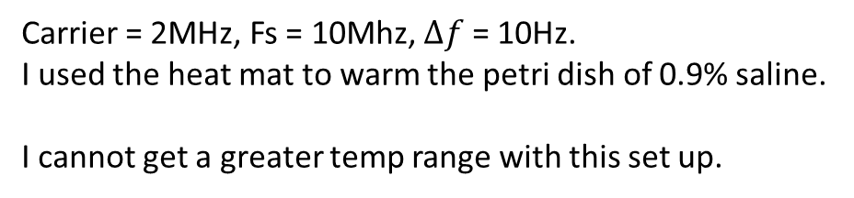

Difference frequency with temperature change.
Carrier = 2MHz, Fs = 10Mhz, $∆f$ = 10Hz.
I used the heat mat to warm the petri dish of 0.9% saline.
I cannot get a greater temp range with this set up.
$∆f$=10Hz ($μV$)
Temperature ($℃$)

Slide 10
How can I increase the amplitude of df?
Use the RF amplifier with the antenna so I can input a bigger signal. Create a v out vs df plot.
Does pulsing the RF amplifier i.e. PRF 1020 make for a larger df? No it doesn’t.
Increasing the frequency is tricky due to RAM on DAQs.
Result: Using higher frequencies leads to higher amplitude, but also more non-linear mixing artefacts(Arnold tongues and intermodulation products).
At 500khz, at a high v output I get a pretty good signal. The RF amplifier can go to higher voltages than the transformer(which is limited to 2x the function generator output), hence I can readily control my signal amplitude using the RF amplifier.

Slide 11
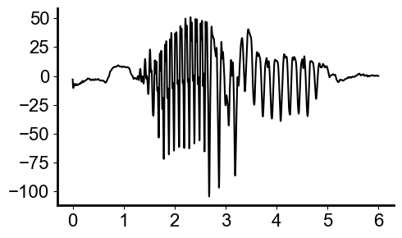
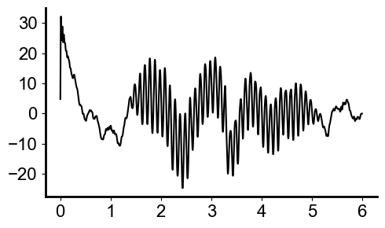
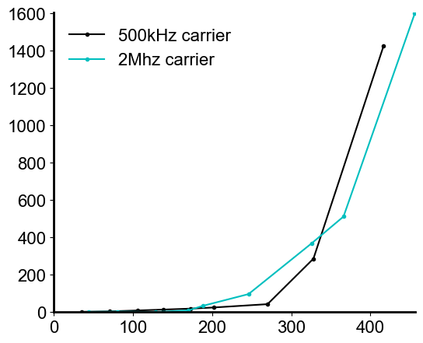
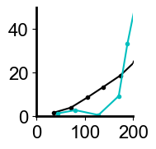
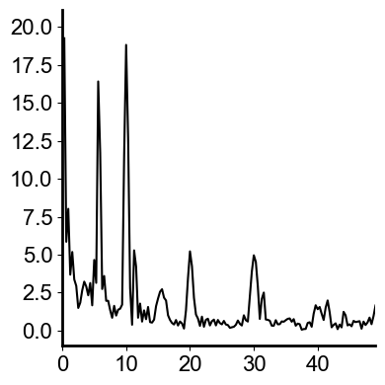
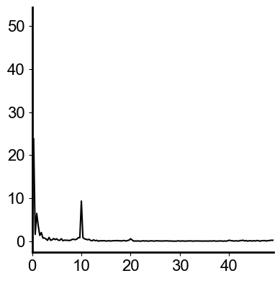

T2- RF TI with the RF amplifier
Vout = 0.25 in both, 180V p-p
2MHz carrier exhibits Arnold tongues with 5Hz dominating.
500kHz has less intermodulation distortion.
$∆f$=10Hz@electrodes ($μV p−p$)
Vout @ RF amplifier (V p-p)

