Slide 1
Frequency switching protocol.
25.10.2023

Slide 2
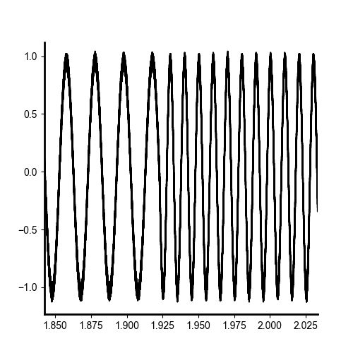
Implementation and Testing
‘fswitching’, implemented on both function generator outputs. The is no ‘gap’, ‘break’ or reason for this to
50Hz
100Hz
Shown here: switching between 50 and 100hz on current function generator.
Note: be careful to pick a whole number of wavelengths so it doesn’t stop with any blip for the prf duration.

Slide 3
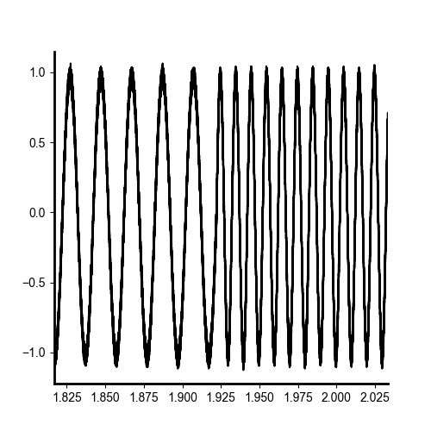
RF amplifier out.
Shown here: switching between 50 and 100hz on pressure function generator.
Note: be careful to pick a whole number of wavelengths so it doesn’t stop with any blip for the prf duration.
There is no stopping or starting of the function generator, once loaded – this is all continuous.

