Slide 1
Neural recording
05/07/2023
Ketamine induced Delta waves

Slide 2
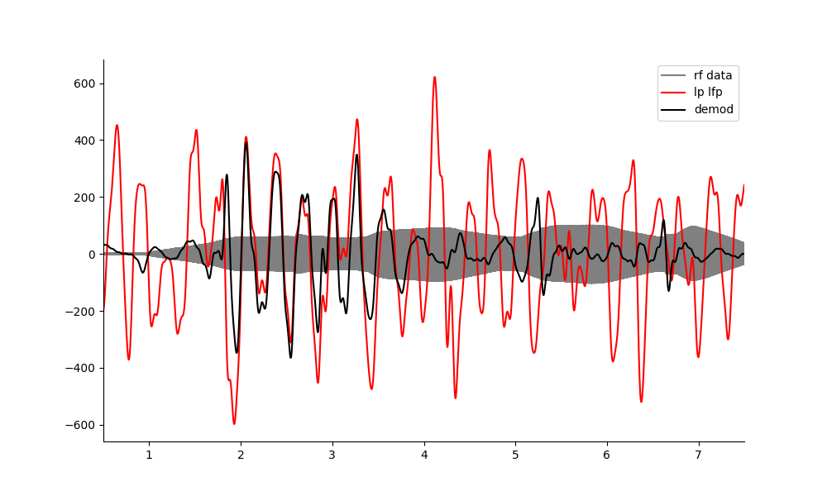
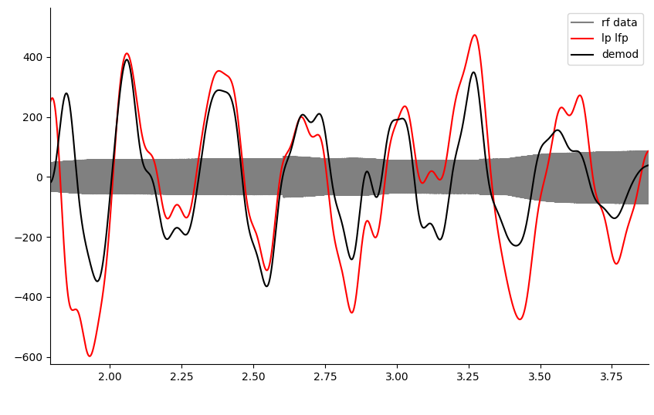
Neural recording at 500kHz continuous wave works at intervals… BUT
Is confounded by the many reflections which are also all mixing with each other and sudden pressure transients changing amplitudes and creating phase inversions.
Interestingly, the amplitude is good, possibly due to the amplification effect in vivo. This means I don’t need a lot of data to do it, nor do I have an SNR problem. Rather I need a better strategy to get around the confounds mentioned.

Slide 3
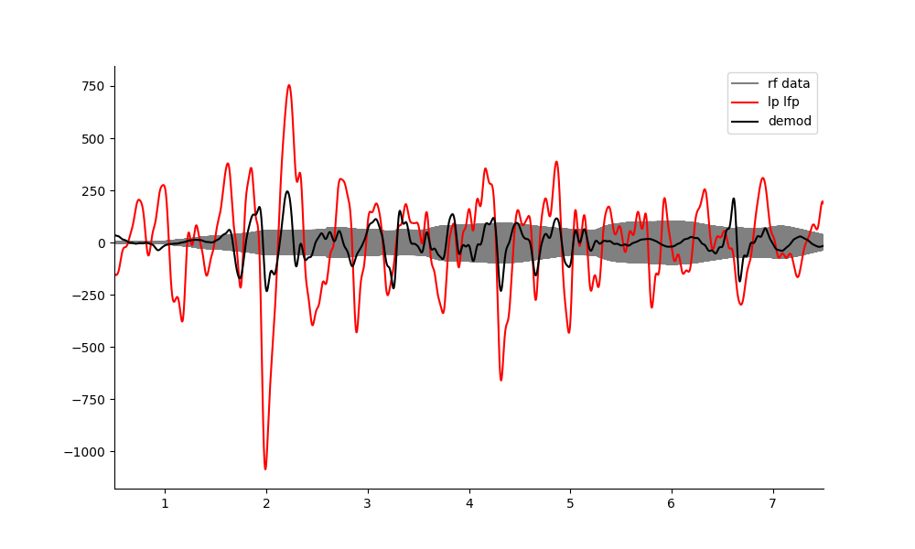
Another file example.
Transient amplitude shift

Slide 4
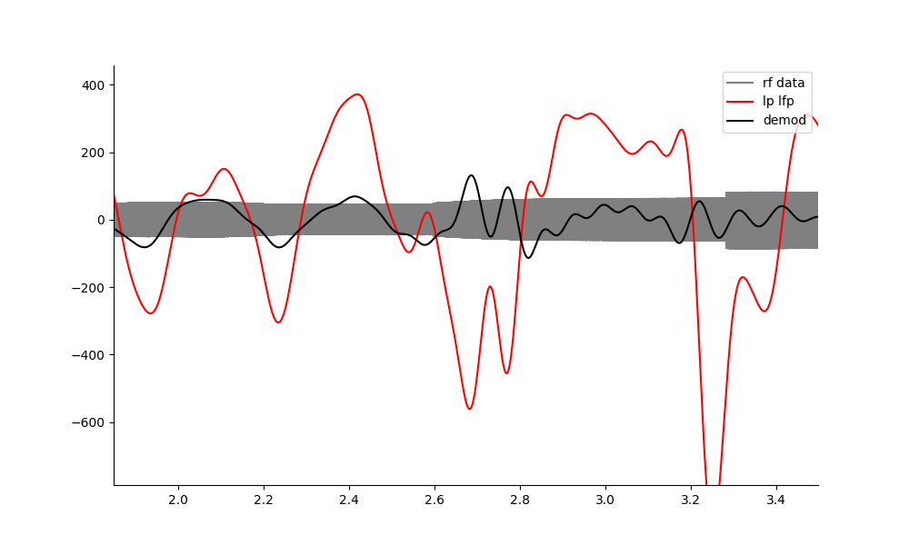
Confounds.
Whenever there is a jump in acoustic amplitude(reflection?), the demodulation goes wrong.
Phase inversion
Lost the plot, too many reflections?

Slide 5
Possible Solutions
Use a PRF 1020 so that the reflections have time to settle before each pulse. Instead of demodulating around 1.02khz, demodulate this at 500kHz?
Alternatively, use a much lower pressure.
Realisation: I don’t need large amount of data to do it or average over it. I need to solve for the phase inversions and reflections issues instead.
With a single frequency the amplitude conversion ratio is good, but reflections provide other confounds.
Note: the k induced oscillations are awesome.

Slide 6
PRF 1020

Slide 7
PRF 120

