Slide 1
Neural recording
05/07/2023
Ketamine induced Delta waves

Slide 2
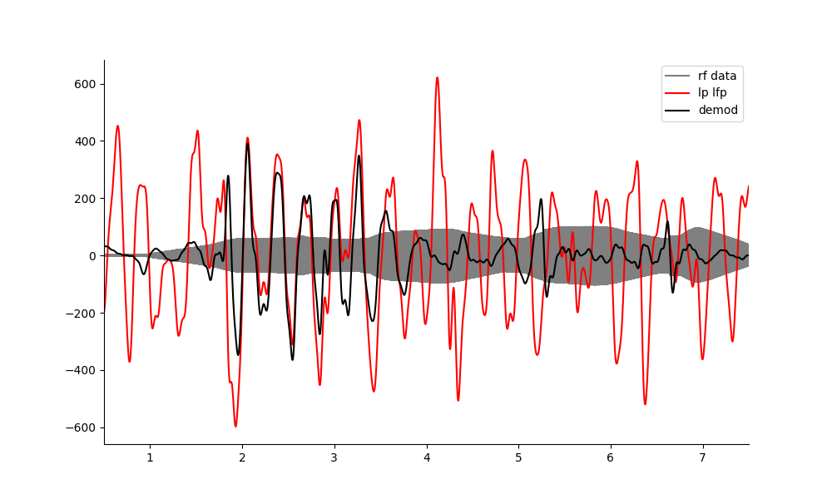
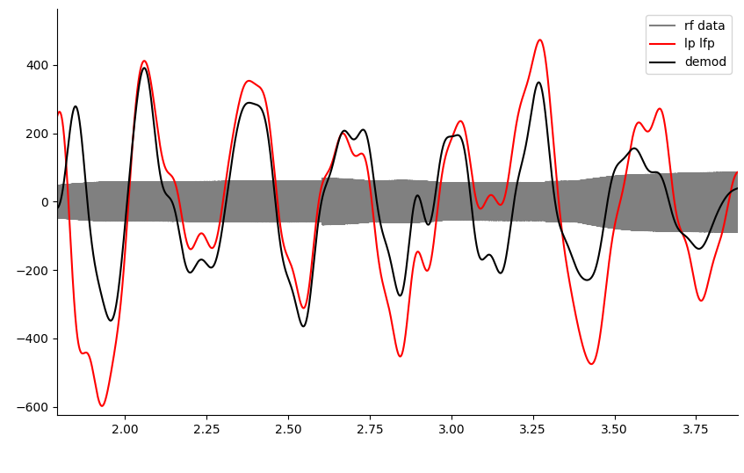
Neural recording at 500kHz continuous wave works at intervals… BUT
Is confounded by the many reflections which are also all mixing with each other and sudden pressure transients changing amplitudes and creating phase inversions.
Interestingly, the amplitude is good, possibly due to the amplification effect in vivo. This means I don’t need a lot of data to do it, nor do I have an SNR problem – a single file with no averaging is fine. Rather I need a better strategy to get around the confounds mentioned.

Slide 3
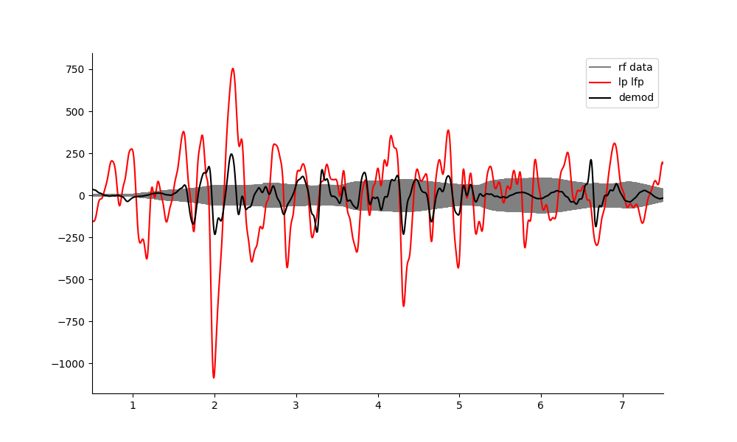
Another file example.
Transient amplitude shift

Slide 4
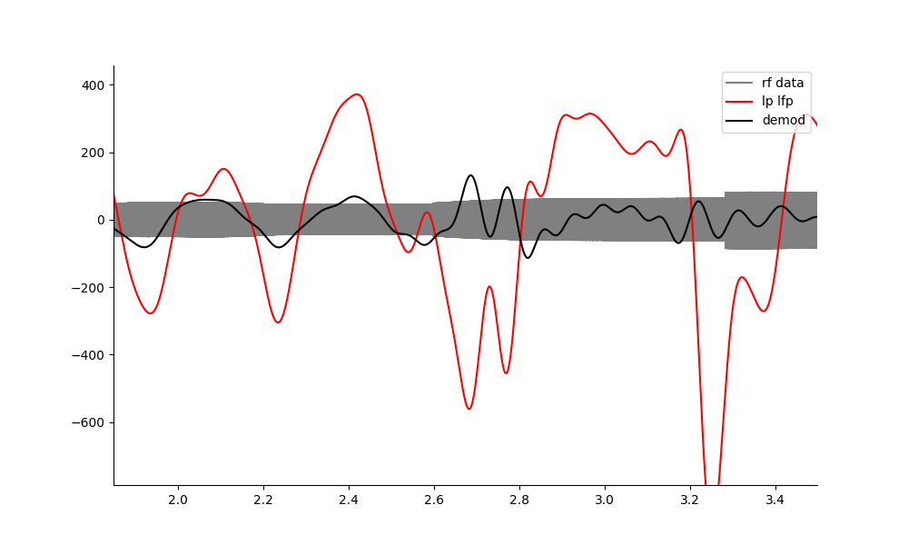
Confounds.
Whenever there is a jump in acoustic amplitude(reflection?), the demodulation goes wrong.
Phase inversion
Lost the plot, too many reflections?

Slide 5
Possible Solutions
Use a PRF 1020 so that the reflections have time to settle before each pulse. Instead of demodulating around 1.02khz, demodulate this at 500kHz?
Alternatively, use a much lower pressure.
Realisation: I don’t need large amount of data to do it or average over it. I need to solve for the phase inversions and reflections issues instead.
With a single frequency the amplitude conversion ratio is good, but reflections provide other confounds.
Note: the k induced oscillations are awesome.

Slide 6
PRF 1020 exp100, t4 mouse
I tried this, but I could see nothing in any of the data. Perhaps the transducer was positioned incorrectly? My 1020 amplitude is only 1.4 microvolts… too small. WRONG POSITION!
Suggestion. Move back to the easier to position 672.8kHz transducer?
OR, ensure I get a large amplitude response at the carrier frequency, before continuing with demodulation. 500khz worked in t3.

Slide 7
Neural recording: (i.e. frequency mixing) is not steady state. Do a proper analysis of e100 t3.
We can use the amplitude of the sum component as a proxy for how accurate the neural recording demodulation is.
When the carrier signal goes down in amplitude, the sum and differences go up.
Analysis with a sum amplitude threshold, as well as an acoustically connected vs not artefact test.
Using the neural data which is when US in steady state(no ramp)
Create a running cross-correlation metric: R*2. - Done

Slide 8
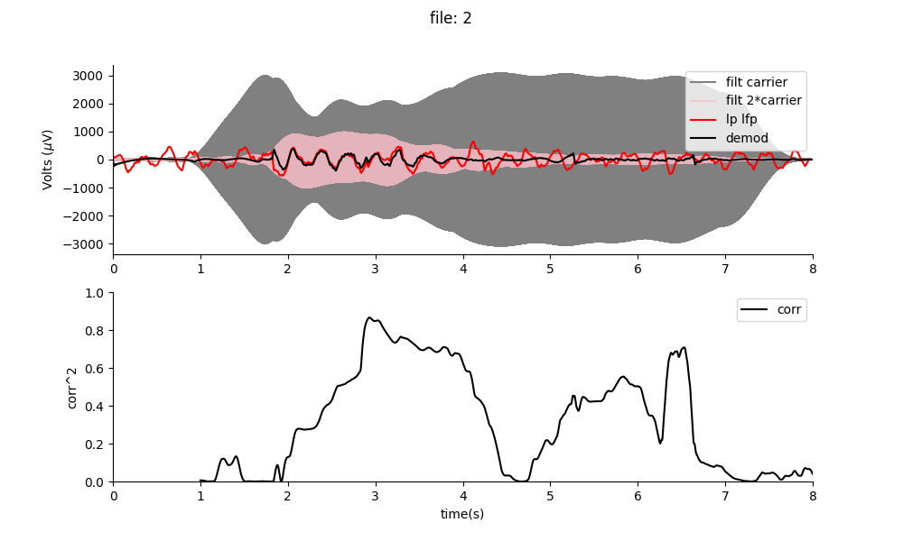
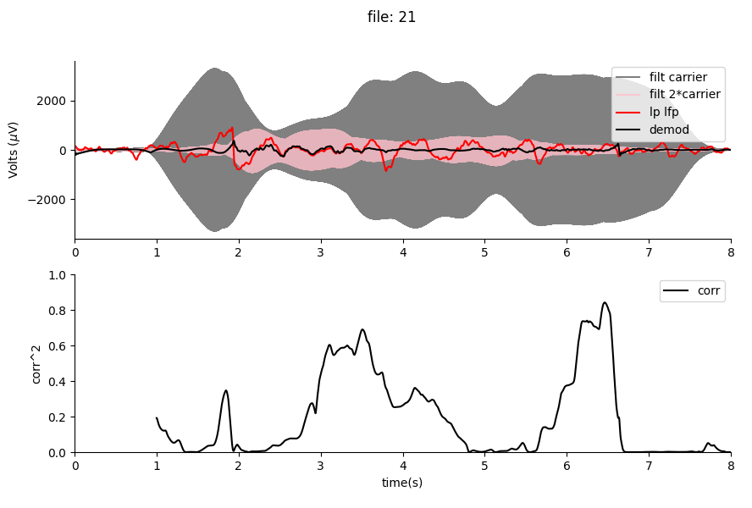
E100 t3
The frequency mixing changes in amplitude over time, and the sum frequency amplitude can be used as a proxy for when frequency mixing is more prevalent.
Acoustically connected to mouse
The accuracy of the demodulation, is proportional to the amplitude of the sum frequency.
40Hz low pass cut-off

Slide 9
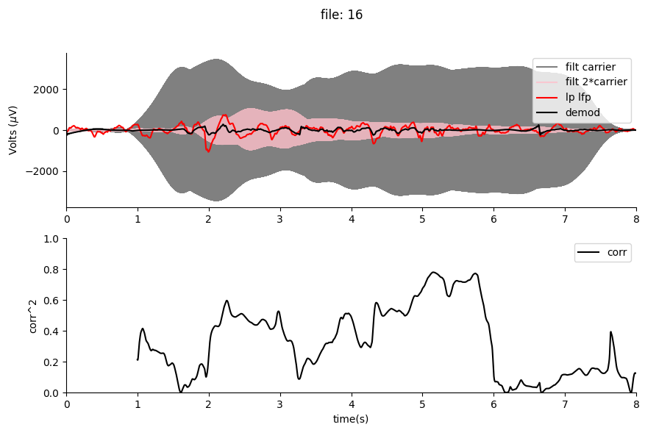
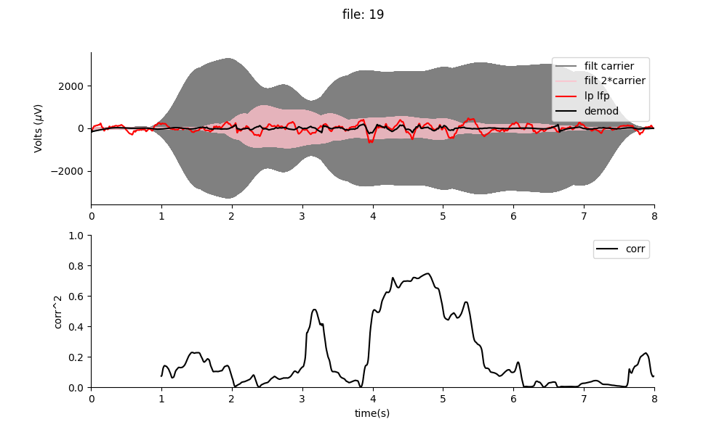
Acoustically connected
sometimes there are phase inversions

Slide 10
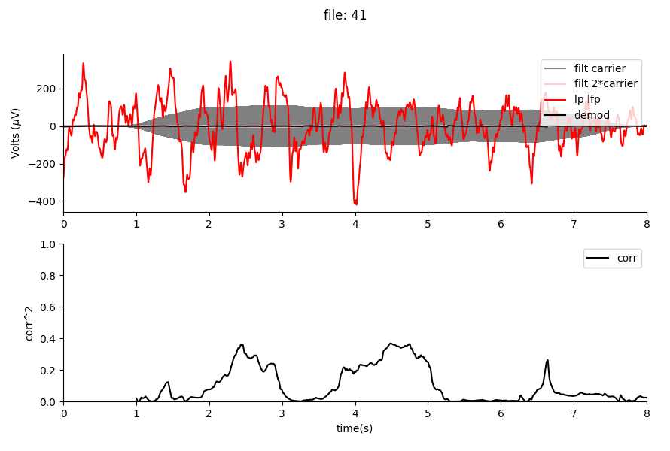
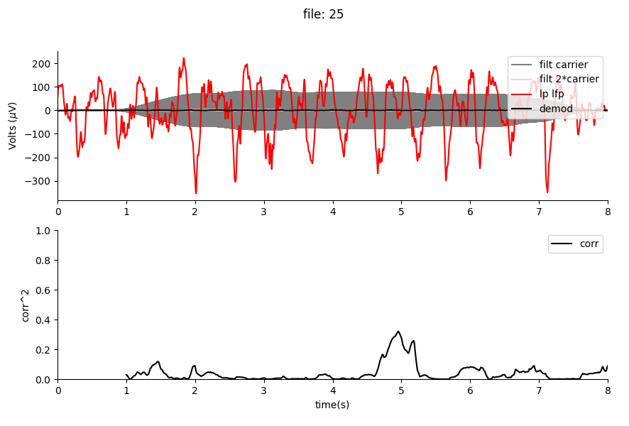
Not acoustically connected
The sum frequency is non-existent, and the correlation around chance. The amplitude of the demodulated signal is very low compared to the neural signal.

Slide 11
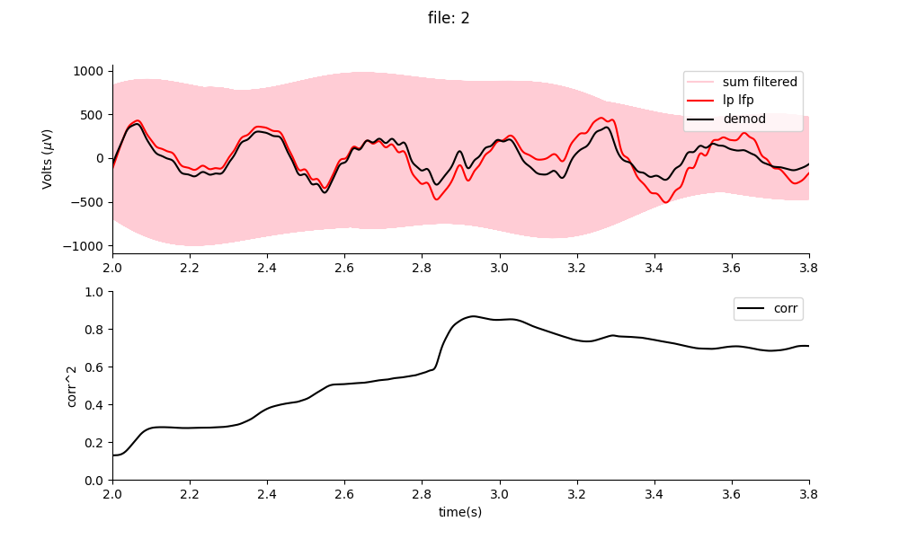
Demodulation of a single file (no averaging, non-invasive – electrode is not inside the brain).
40Hz low pass cut-off
Why is this novel or important?
Single time demodulation at a focal area enables for the first-time, real-time recovery of neural signals at depth.
Since modulated signals are at a much higher frequency, they can be separated from signals outside the focal area at low frequencies giving us the ability to decode neural signals at precise spatial locations.
The amplitude of the recovery signal is close to lossless, and 500kHz can travel longer distances with fewer losses than normal neural frequencies due to lower impedance of the medium.
Note: This techniques effectiveness is dependent on burst like amplification and mixing in the mouse brain.

Slide 12
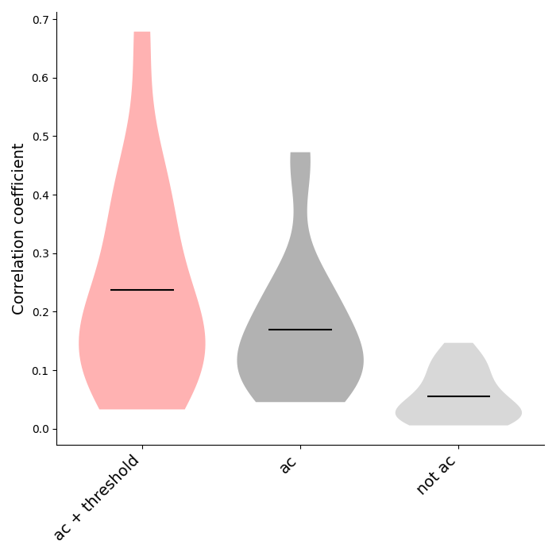
Is it an artefact? (e100 t3) : time series correlation analysis
Use the correlation median correlation metric and compare between non acoustically connected control and demodulation data. Note: the correlation doesn’t take the relative amplitude into account.
For a more intelligent algorithm we can use the sum frequency as a proxy to determine if the neurons are open to frequency mixing (i.e. if sum frequency amplitude >500 microvolts), with this yields a median correlation metric of n +- std.
***
P1
P1 = 0.00007
P2 = 0.00017
Groups n: (14,20,21) (number of whole 8 s files in each group)
On the left we compare the average correlation coefficient(between original and demodulated data) when we:
Use a sum frequency-based frequency to determine when the mixing is good and compare to not acoustically connected case.
Compare all files in the acoustically connected case versus the not acoustically connected case.
***
P2
It is not an artefact.

Slide 13
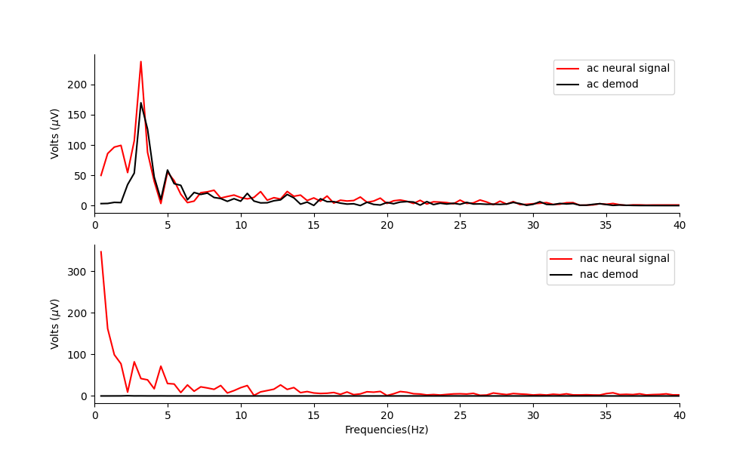
Spectrum analysis – it is not an artefact.
Compare the spectrum at an above threshold region(i.e. when there is burst like mixing) of acoustically connected file, with the same region of file not acoustically connected. i.e. file 2 vs file 41.
demod filter low cut to avoid carrier interference
It is clear that the demodulated signal when acoustically connected has spectral similarity to the original delta wave neural signal.

Slide 14
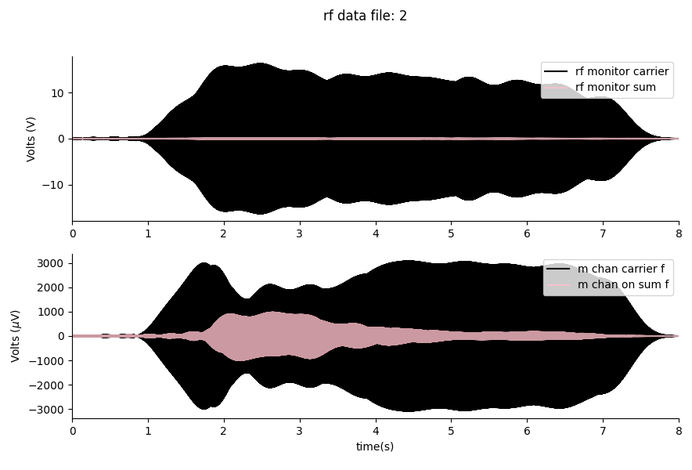
Comparing the RF monitor data (e100 t3)
Here we can see that the data on the RF monitor channel looks quite different from the data on the measurement channel. Notably, the mixing frequency is much larger in vivo.
Importantly, the shape of the mixing cannot be explained by the applied electric signal. The mixing amplitude and shape are evolving in vivo due to an acoustoelectric interaction.
It is not an artefact.

Slide 15
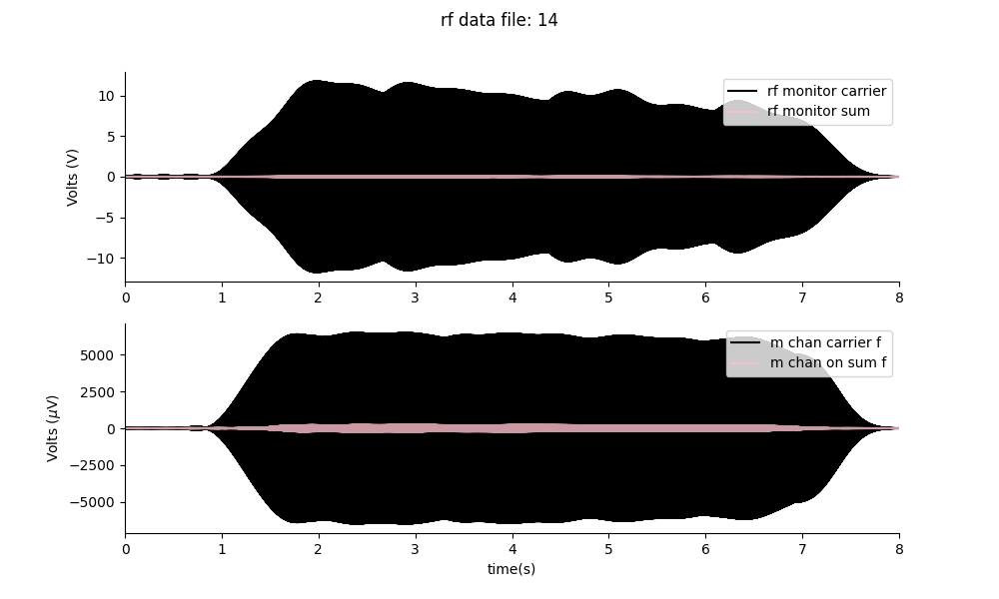
Can I do it again? e100 t5 11/07/2023
No I couldn’t. The carrier amplitude was really high, and I saw NO DC offsets… my ae calibration amplitudes were extremely low too.
ae_calibrate_with_ae, aedelta_demod.py
I couldn’t see the DC offset when US was applied… My AE effect was extremely small during calibration.
Comparing to t3, I had huge DC offsets. In this one, I have no DC offset. Something is very, very different. I have less mixing occurring on this occasion and I am not sure why.
T5 – no sum frequency or DC offset, also demod didn’t work… at least it is well correlated here to when f mixing takes place.
In T3 the mouse was not as warm as I had used the chemical heater, and it had a larger ket/xyl dosage… it was the same mouse. Other alternatives is that this only works once? Or my position calibration was terrible on this occasion, but I don’t think that is it as I did try a fair few positinos. Or that the skull dried and hardened and was no longer acoustically transparent?
Try a different mouse.

Slide 16
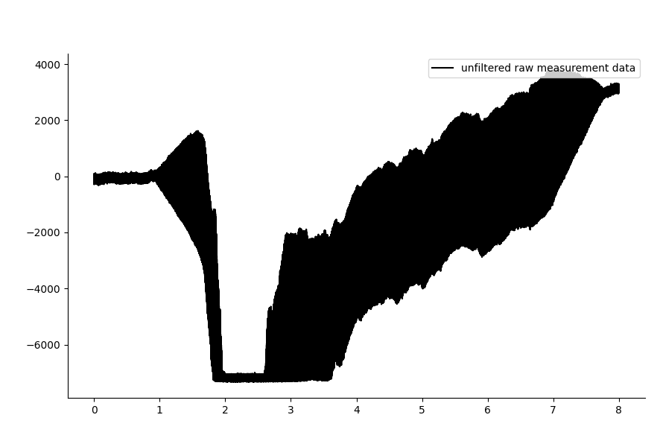
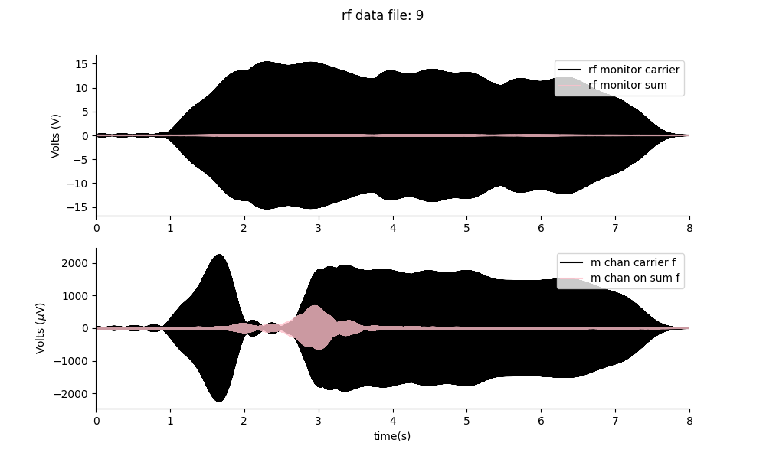
Exp 100 t6 – delta wave motor cortex mouse.
High sum frequency, suggests demodulation taking place.
DC offset was so large I reached saturation of my DAQ range

Slide 17
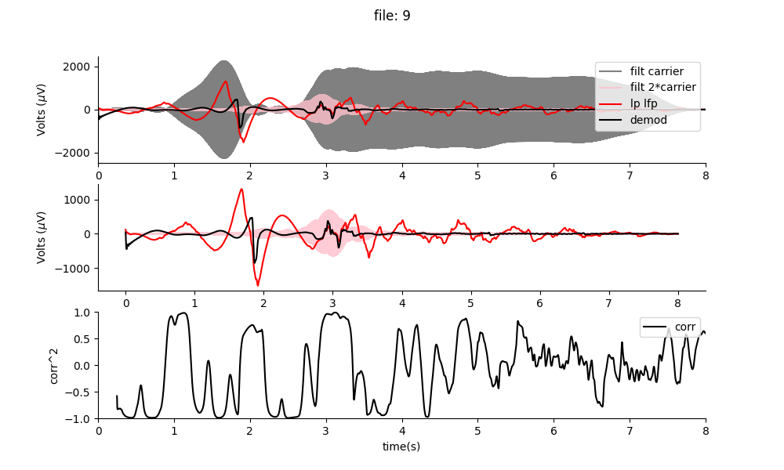
The whole file
I could have got the out range area if my preamp gain was smaller. TODO.

Slide 18
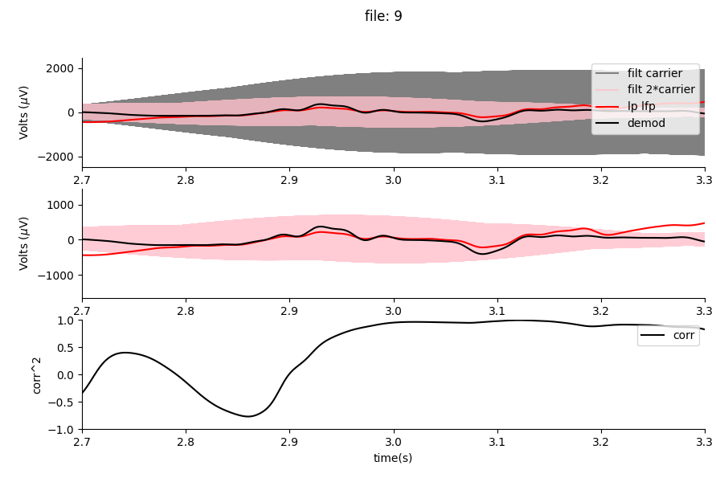
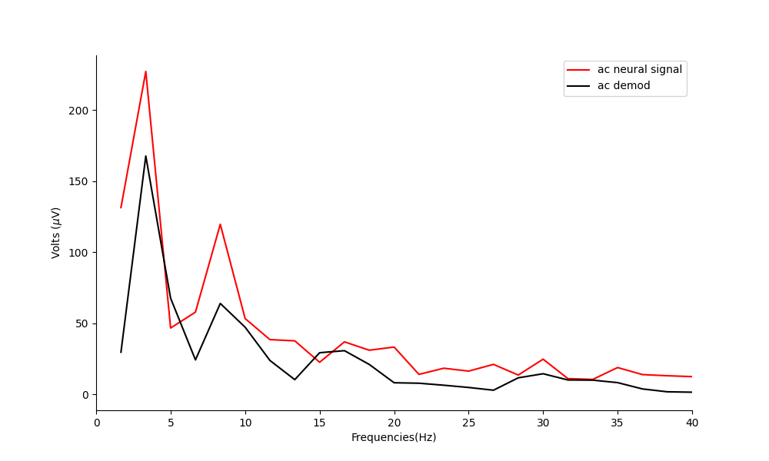
Demodulation accuracy is high when sum frequency is high.

Slide 19
Whenever I can demodulate the signal clearly, is when the daq range is saturating and rectifying. Hence I do not think I am actually demodulating in this case.

Slide 20
Questions:
Does the mixing effect decrease with time after surgery?
Does it decrease based on how many times I’ve used the mouse?
Is the burst like mixing effect based on the mouse temperature?
HOW DO I MAKE IT TURN ON MORE!

