Slide 1
Acoustoelectric Neuromodulation
10/07/2023
Dual frequency mixing

Slide 2
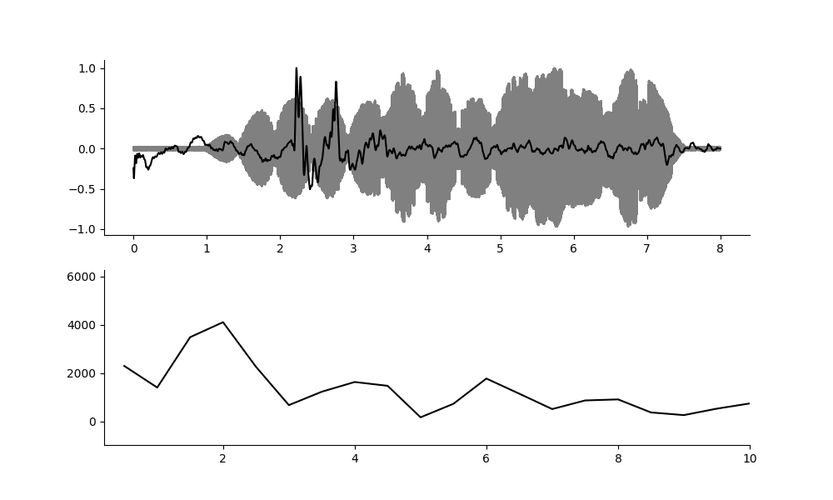
E100 t4 – first try at dual US neuromod.
The RF data doesn’t look clean here.
2Hz. (file 35)
3Hz. Not clear.

Slide 3
Superposition amplitude or envelope(frequency mixing)?
If it is the envelope we expect an onset effect, and a beat frequency MEP oscillation. (constrained to mixing refactory periods)
If the waveform amplitude is what triggers the MEP oscillation, there should be an amplitude threshold which triggers the change. We can test this by applying a continuous ramp and seeing if there is a movement threshold later in the file. (There would still be a DC offset here but it would be a slow one. )
We know the onset triggers something.
Ramps are the difference. If we ramp slowly, we expect an effect at a particular amplitude when a threshold is reached.

Slide 4
Next experiment.
Max time 4 seconds. Have signal on only for 2s in the middle.
No ramp, the mixing of signals is its own ramp.
Measure neural signal, AND EMG signal and with video. EMG signal can be measured with differential input only. Neural signal measured on preamp.
Work on ae_dual_acoustic_waveform.py , run this at a couple of different pressures. This code should show me the filtered df amplitude of the neural signal.
I need a larger number of recordings of each. I didn’t get a movement every time. Need to employ some averaging.
Is it due to f mixing, or superposition amplitude? Do a long slow ramp to find out. Can I do a US offset effect this way if I stop the ramp suddenly?

Slide 5
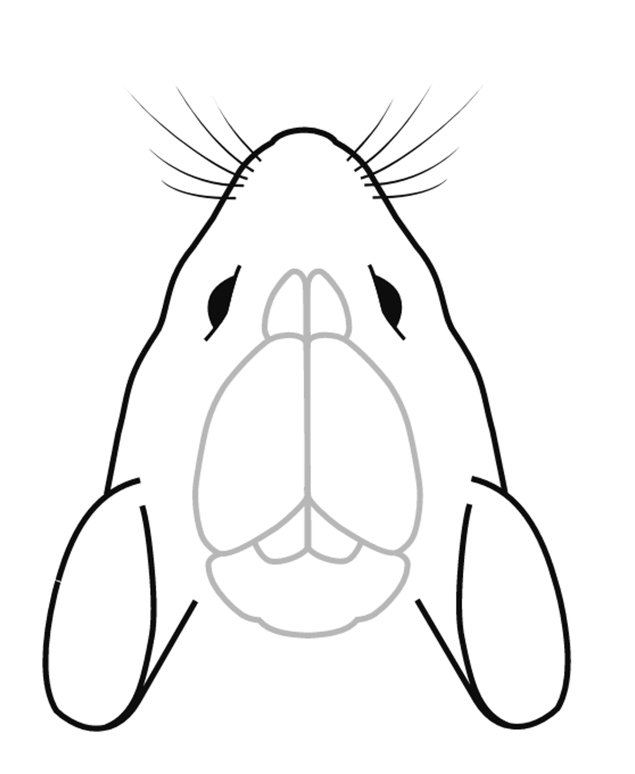
Experiment set up.
Pressures to test:
0.1 (1MPa)
0.05 (500kPa)
0.01
0.15
EMG electrode placement, I could place electrodes on, other forepaw, both of them?
For the MEP experiment run:
Ae_ramp_acoustic_Waveform.py
And aemeps_dual_acoustic_waveform

Slide 6
Next MEP experiment
Ae_ramp_acoustic_waveform.py
And aemeps_dual_acoustic_waveform
- The EMG goes into the differential input (adjust daq range to 0.2V for best resolution), and the preamp output is the neural signal at the motor cortex on CH0.
Make one more cup electrode?

Slide 7
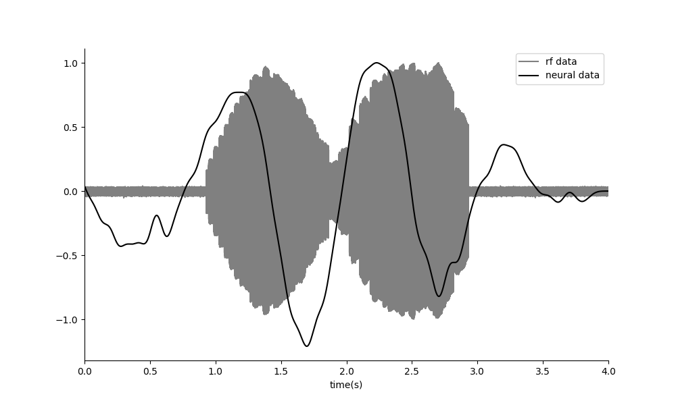
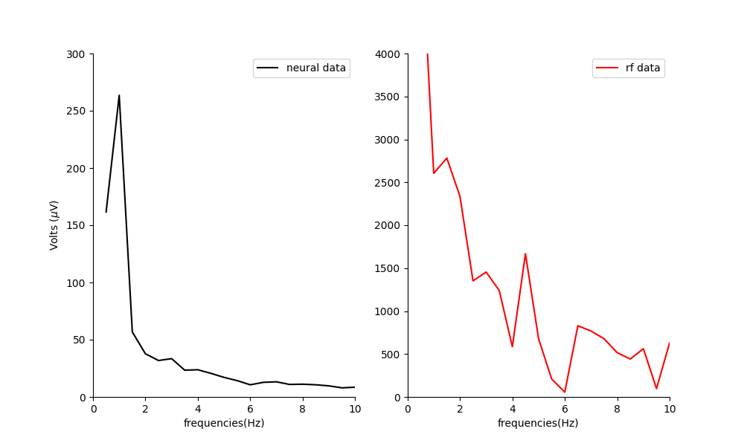
1Hz
Neural Data FFT
RF Monitor Data FFT

Slide 8
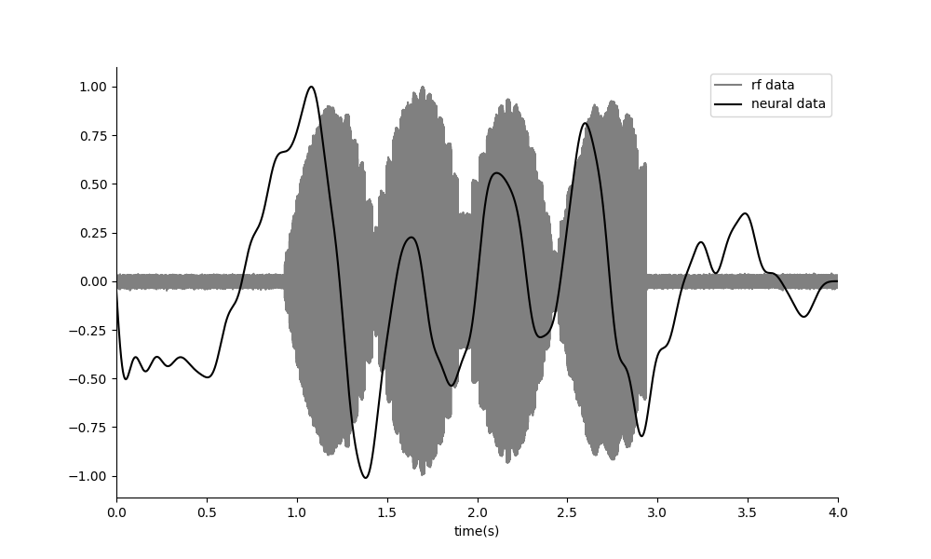
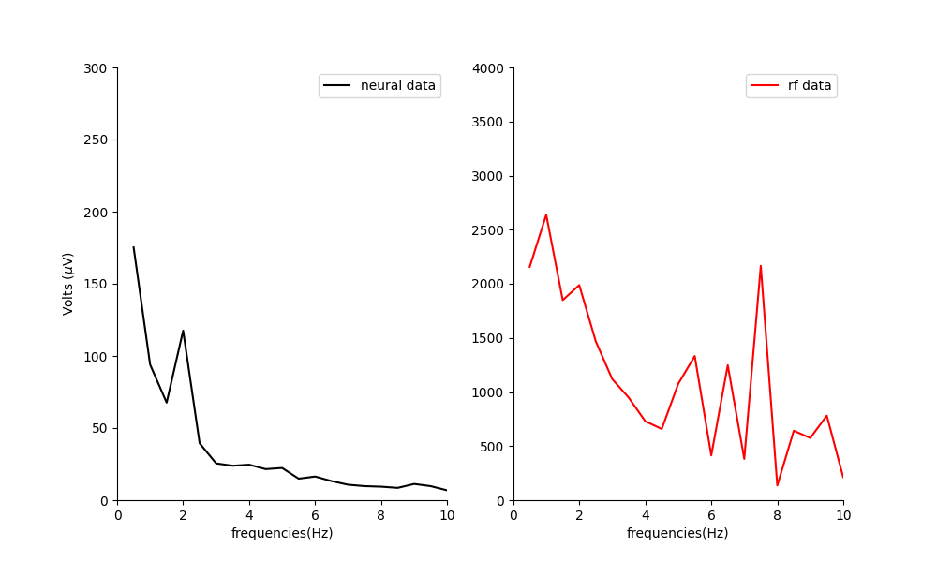
2Hz

Slide 9
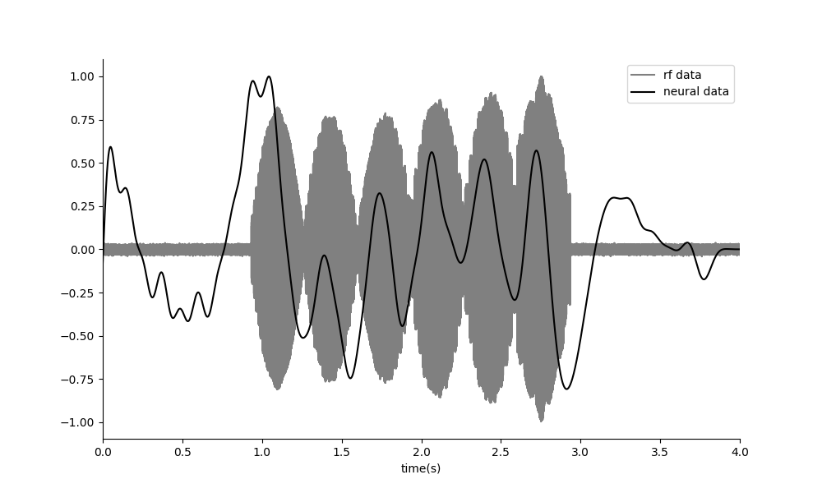
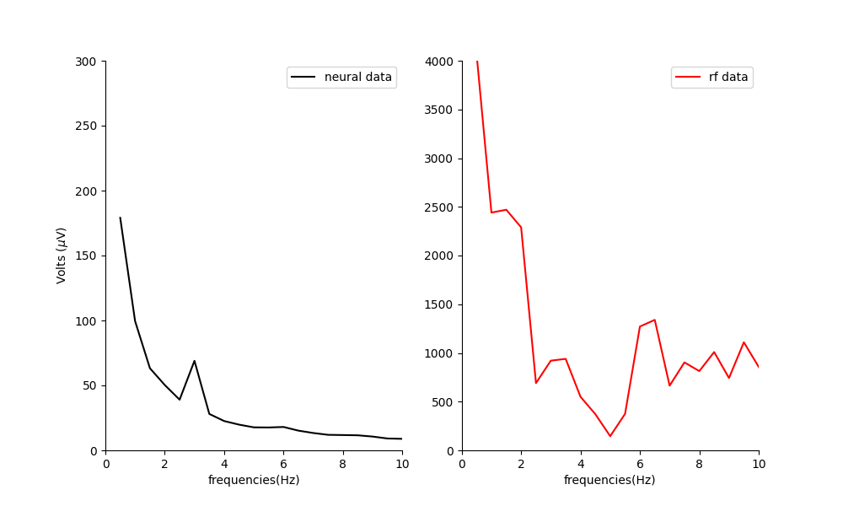
3Hz

Slide 10
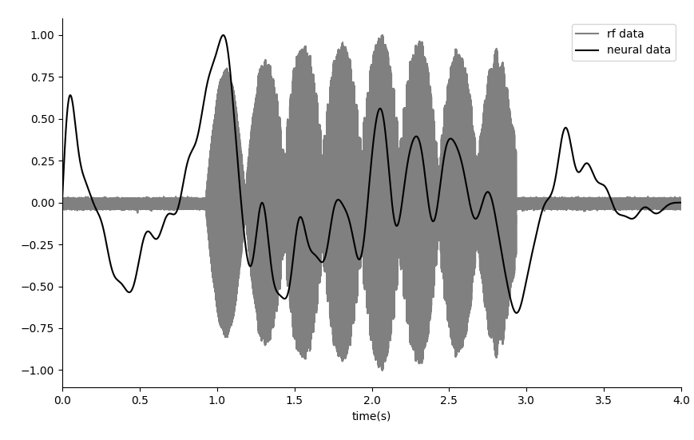
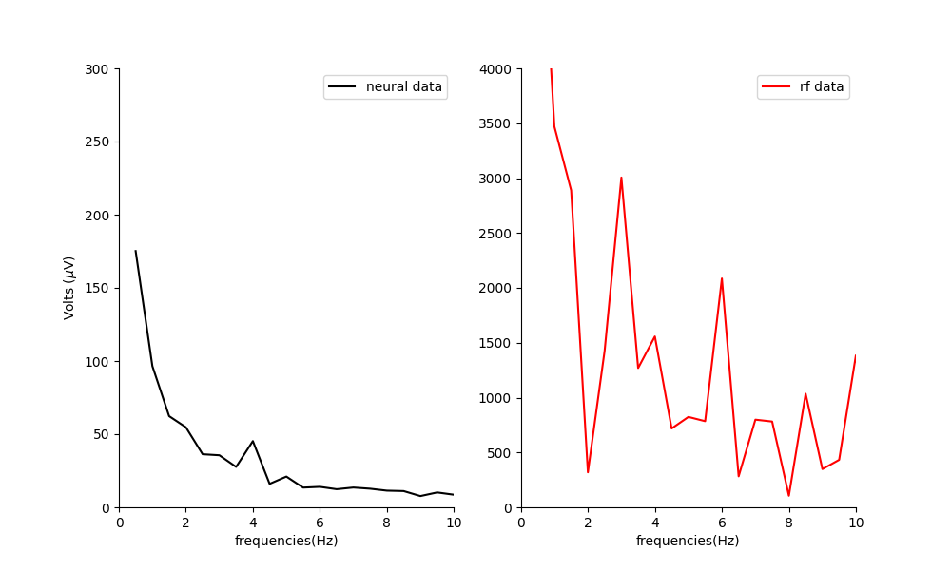
4Hz
The amplitude of the neural oscillation decreases as we go up in frequency. This mirrors the amplitude we see in the video.

Slide 11
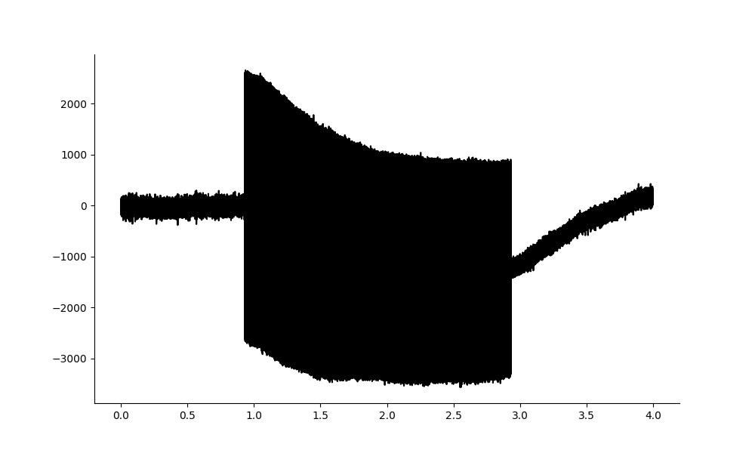
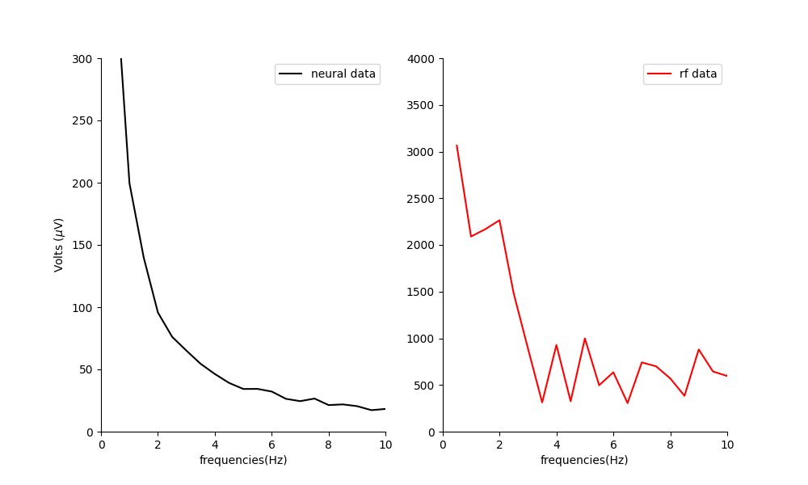
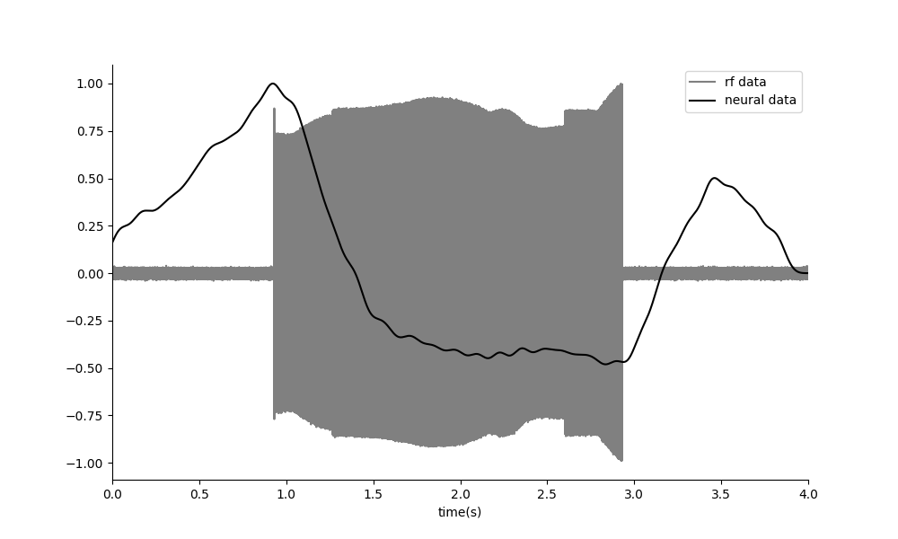
DC
Raw Neural data clearly shows DC offset, and carrier frequency
Neural data filtered 0.1-10Hz

Slide 12
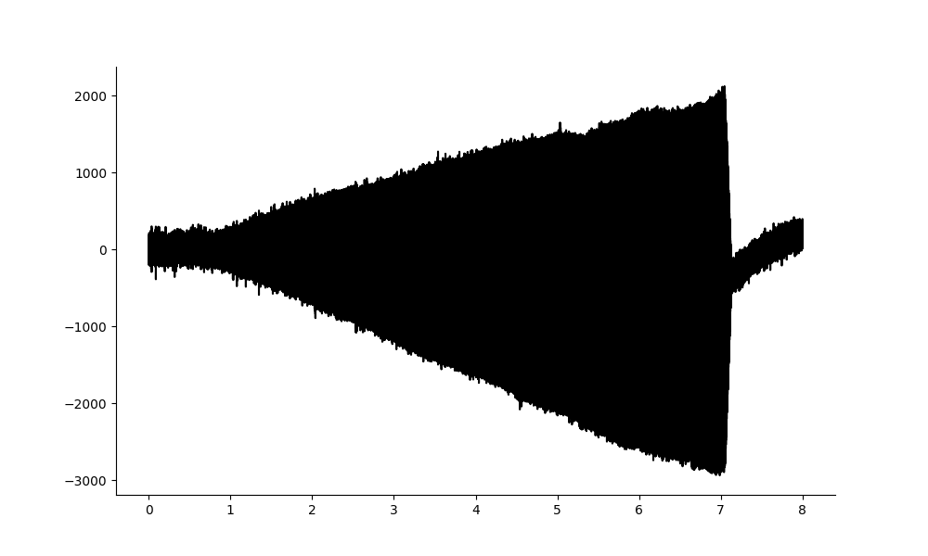
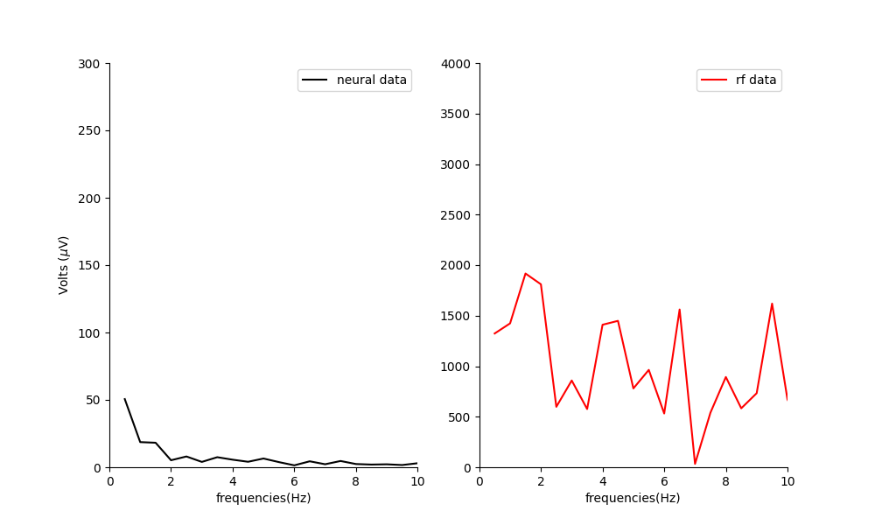
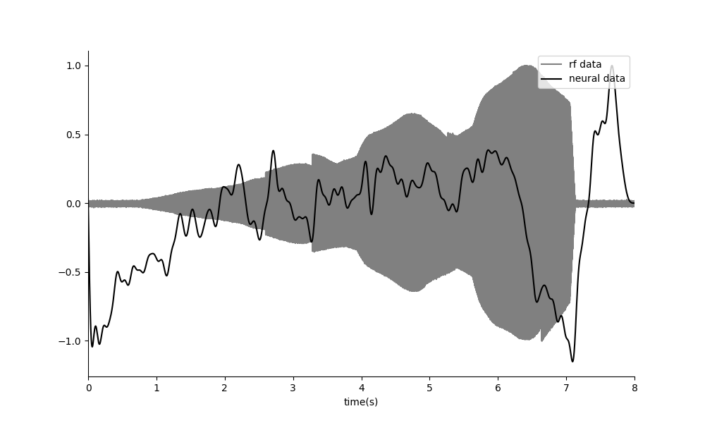
RAMP
If the US neuromodulation effect was due to an amplitude threshold, you would expect to see a movement when that threshold is reached. Instead you see no movement as the ramp is relatively slow, and a small movement when the US turns OFF. This suggests that US neuromodulation is an envelope effect and not due to the amplitude of the applied signal alone.

