Slide 1
Acoustoelectric characterization in mouse versus saline.
03/06/2023

Slide 2
Calibration Diagram
I,V Monitor
Voltage
output
DAQ
I
V
Goldcup reference electrode
0.9% Saline
Computer
NOTE: do not add a gnd to this, otherwise my impedance measure will be wrong.
Single electrode stim and measurement system with vertically aligned cup electrode reference.

Slide 3
Demodulation Diagram
SR560 Preamp
DAQ
LED in Faraday Cage
Goldcup reference electrode
0.9% Saline
Computer
Single electrode stim and measurement system with vertically aligned cup electrode reference.

Slide 4
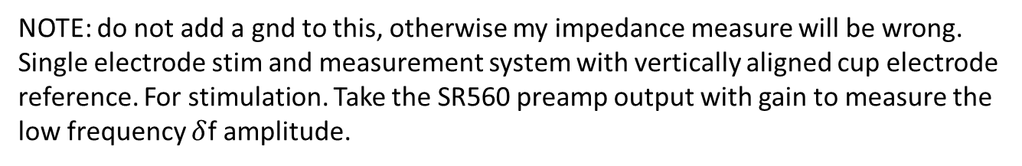
Stimulation diagram
SR560 Preamp
LPFILTER
I,V Monitor
Voltage
output
I
DAQ
V
Goldcup reference electrode
0.9% Saline
Computer
NOTE: do not add a gnd to this, otherwise my impedance measure will be wrong.
Single electrode stim and measurement system with vertically aligned cup electrode reference. For stimulation. Take the SR560 preamp output with gain to measure the low frequency $δ$f amplitude.

Slide 5
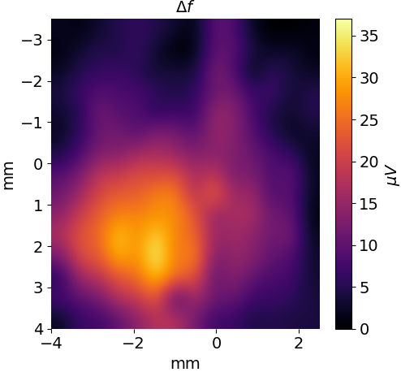
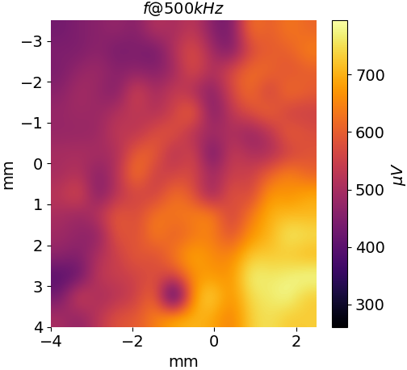
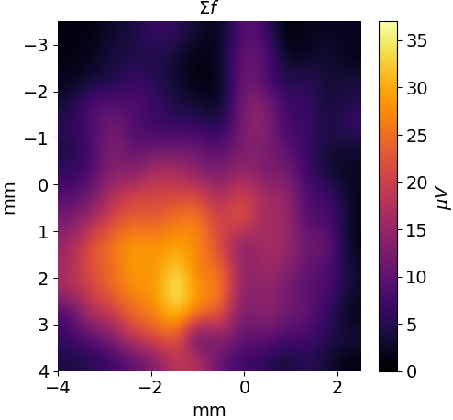
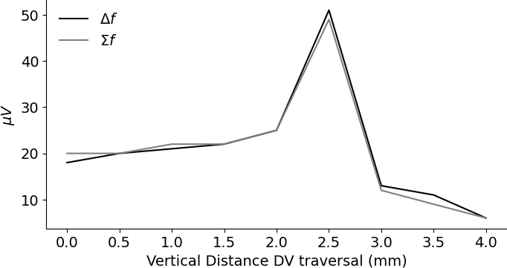
SALINE: 8kHz 1V amplitude, single electrode spatial calibration at 1MPa
AP
ML
Focal point
You can see the difference frequency and the electrical carrier frequency are totally uncorrelated. The 500kHz amplitude seems more guided by the distance from the US source. Gold cup reference electrode mounted vertically below the stim/measure electrode with 7mm spacing.
Note: This is about 0.1mA
DV
e97t6

Slide 6
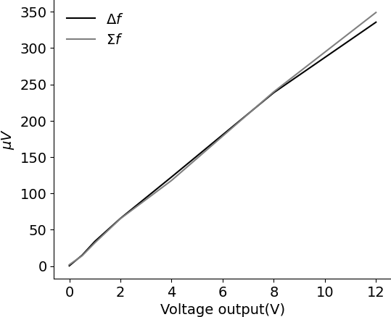
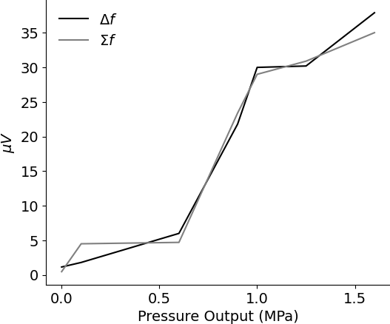
Saline at the calibrated focal point:
Varying voltage with
pressure constant @ 1MPa
Varying pressure with
voltage constant @ 1V
Gradient = 200/6 = 33.3
i.e. AE_amplitude(microvolts) = 33.3 (applied voltage)
Gradient = 35/1.5 = 23.3
e97t6

Slide 7
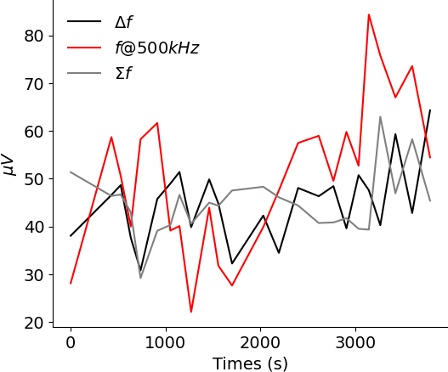
AE amplitude with time in saline
Over 1 hour there is no discernible trend, whereas in a mouse the ae amplitudes go down over time.
Note: V_out = 3V, Pressure = 1MPa in this plot. Position is calibrated to be at the focal point. 8khz.
TODO: show this relationship compared with the mouse more clearly on the same plot.
e97t5

Slide 8
AE amplitudes comparison statement.
e.g. The amplitude of the acoustoelectric effect is larger in the mouse than in saline. Scale of magnitude increase is 5?? The gradient change in saline while varying voltage or pressure compared with a mouse is…
In previous experiments I get more variant and higher amplitude data in a mouse. i.e. at the same frequency and output voltage I get up to 160 microvolts df with inexact position calibration. i.e. AE_t1. With exact calibration it’ll be even higher.
I also know that in mouse, ae amplitude decreases with time, but in saline it doesn’t.
TODO: NEED to collect really nice mouse data to show this more clearly.
The mechanism is unclear, though likely has to do with voltage gated ion channels(reference Shapiro’s Nat Comms 2022 here).

Slide 9
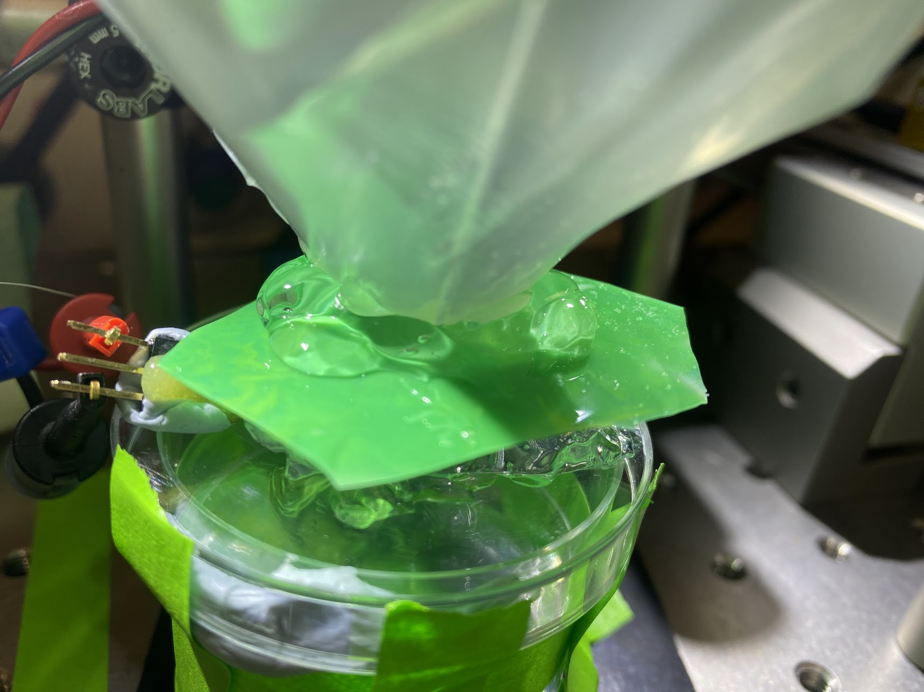
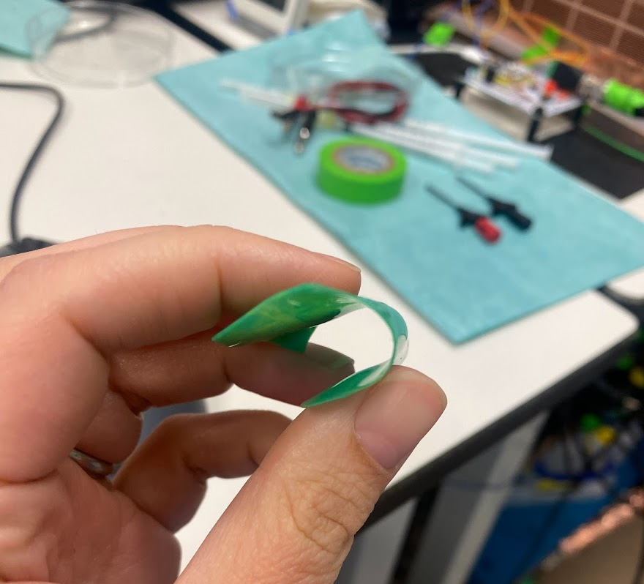
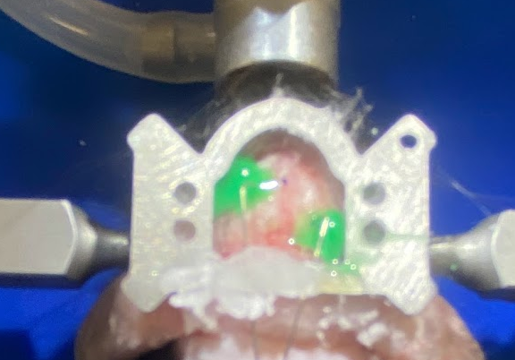
Big problem for mouse measurements requiring new surgery
Problem: The thin silver wires keep breaking meaning I need to reattach them to the screws, which can wiggle the screws, and connecting little hook grabbers directly to this wire can cause strain on the screw which is directly connected to the brain causing tissue damage and signal degradation over time. As such, I need a new surgery with strain relief incorporated- which still maintains a very small vertical form factor so I can position the US directly overhead. The wires in the mouse brain should be sealed such that no moisture can escape the brain cavity, whilst still maintaining acoustic transparency.
Thus I plan to use silicon to seal around the PtIr wires, directly bonding them to non-conductive dental cement at the back of the headbar to provide stability and strain relief for connection. The silicon is acoustically transparent based on my testing. The dental cement is not conductive, being both stabilizing and insulating.
New mouse surgery, without screws with PtIr wire with acoustically transparent silicon, and added strain relief at back of head bar.

Slide 10
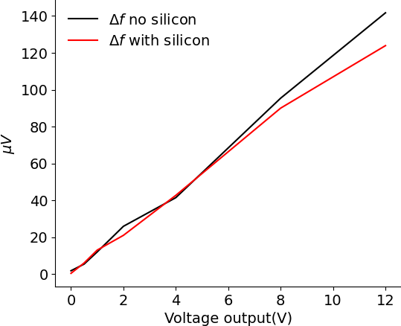
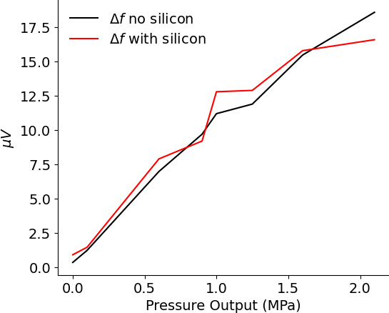
Is the silicon material acoustically transparent?
Yes, it appears to approximately be based on the position calibrated plots above! Note: there may be a sub-0.5mm position inaccuracy.
This means that it seals the moisture into the brain around the implanted electrodes, and I can still use the US over the top of it.

Slide 11
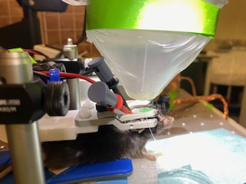
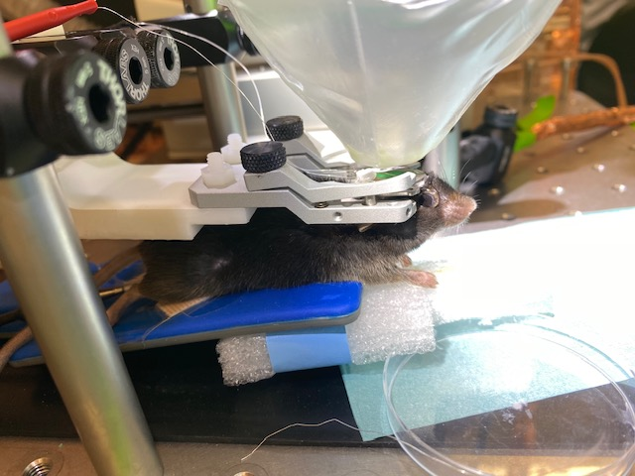
Testing whether this new surgery is viable.
Impedance between electrodes @ 8kHz = 3.78kohms (vout =1V, i = 0.244ma, z = 3.78kOhm ). This is good.
So that I can fit the US transducer, I cannot put grabbers or anything vertical at the back of the head bar where the wires are for connection. I use the silver wire here, which in turn connects to mini-grabbers which are located further back. This means my US can move freely back and forward which is what I need to be able to calibrate the position correctly.
Grabbers are in the way of the US movement
I now have full range of motion with the US.
Impedance between electrodes @ 8kHz = 3.78kohms (vout =1V, i = 0.244ma, z = 3.78kOhm ). This is good.
I got great VEPs since the measurement wires were not shorted together, and the mouse had not had a lot of time for VEP amplitude to decrease due to tissue damage.

Slide 12
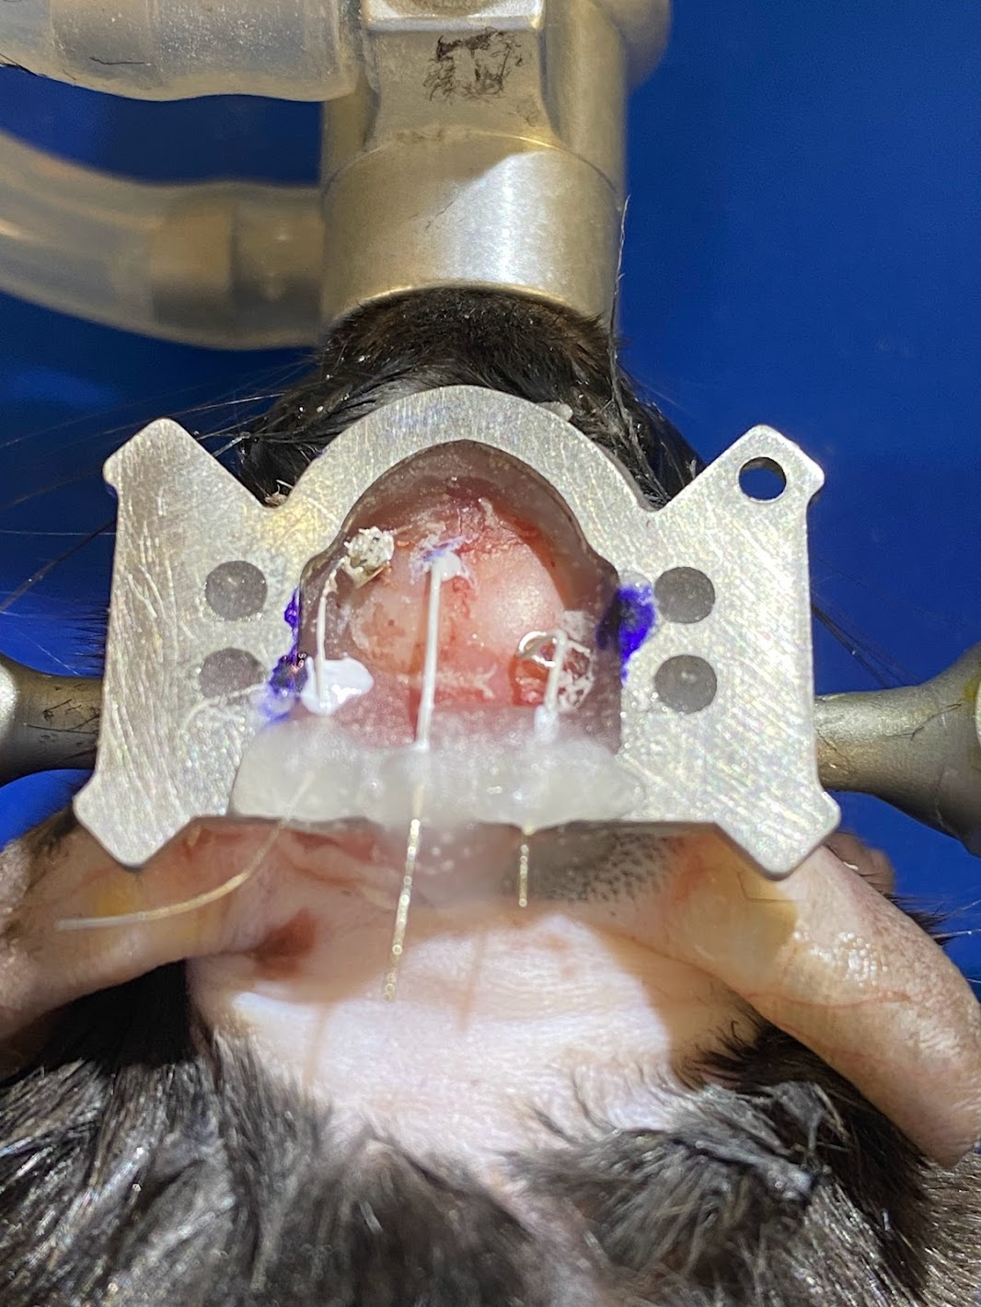
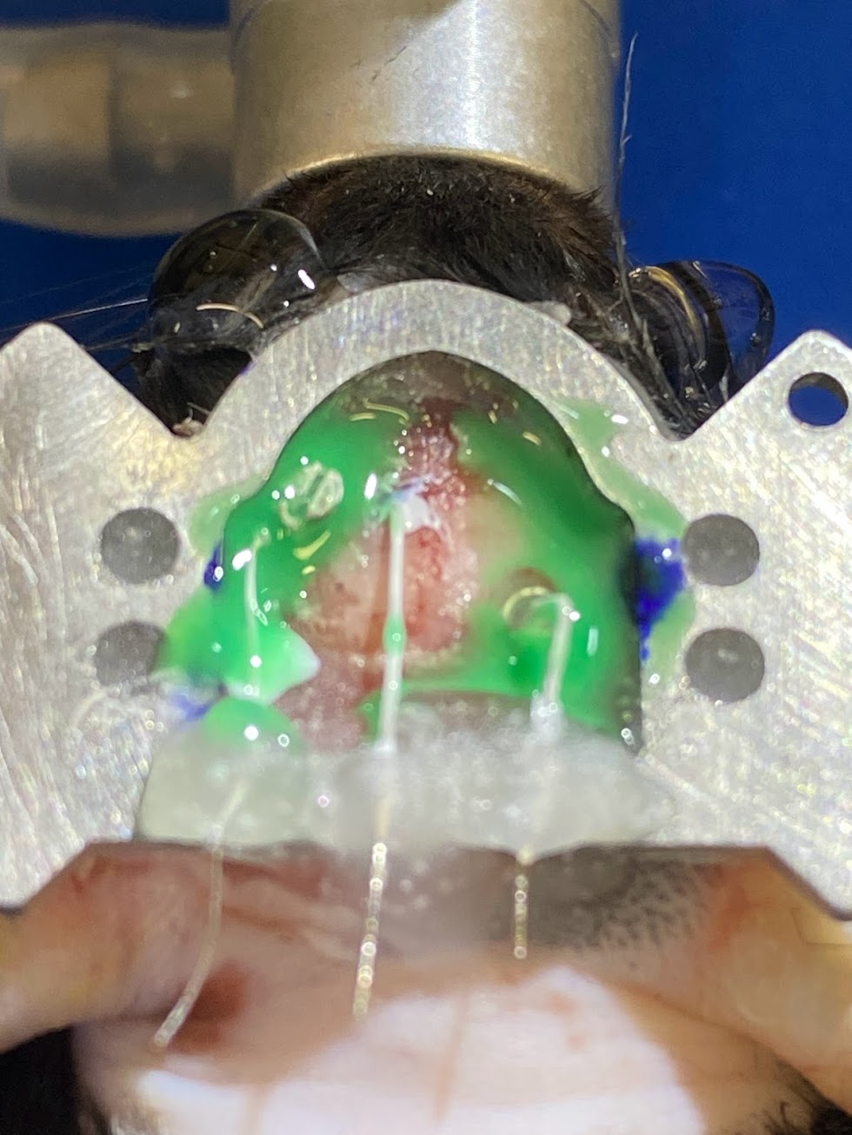
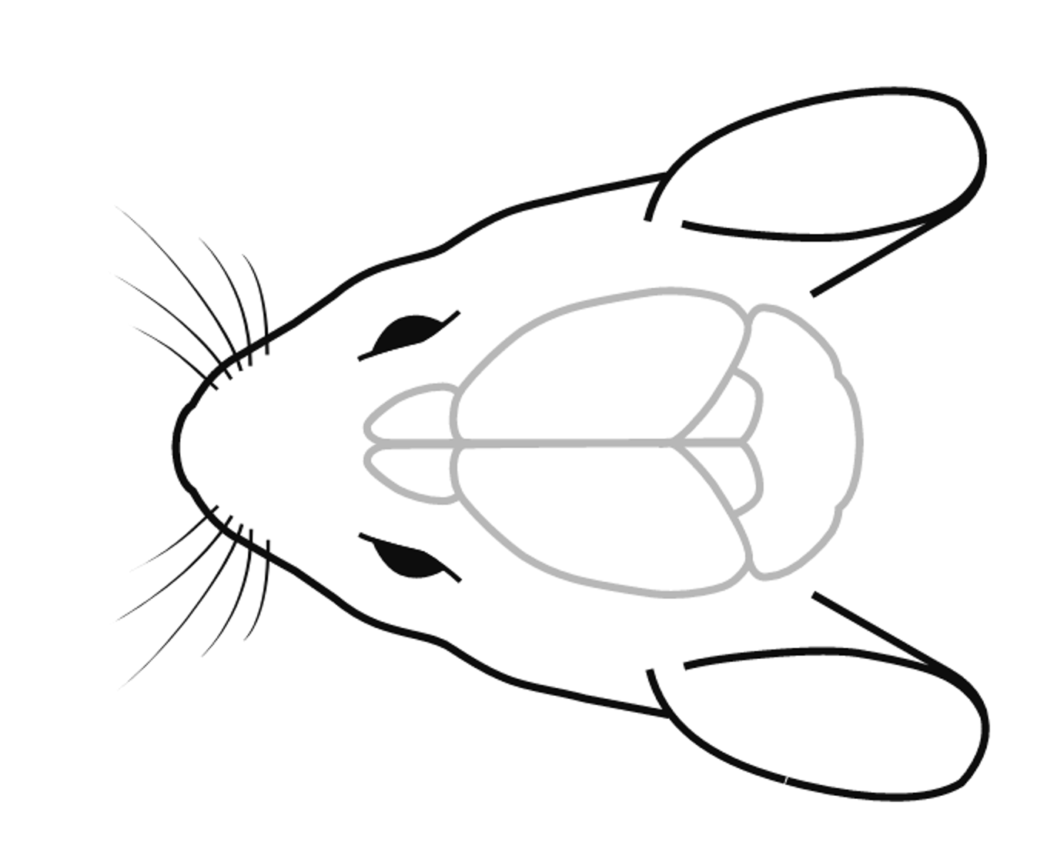
Mouse surgery on 13/06/2023, optimized for higher current density for forepaw MEPs, with non-invasive EEG test electrode for longer lasting signal quality and mouse usage.
MEP Screws: So that I can achieve higher current density when doing MEP stimulation, use a screw at ML 2.5mm, and a PtIr wire embedded 1.5mm deep at ML= 0.25mm. This should give greater surface area to the stim and reference electrode(higher current), and higher current density due to the improved geometry. There is space between the electrodes to apply acoustic wave, where the right forepaw area is located.
For EEG electrode use PtIr spiral electrode on surface of skull. If this works, it ideally provides better SNR than a point electrode, and doesn’t degrade over time due to tissue damage. Can be up to 3mm by 3mm in size.

Slide 13
Testing of new mouse with small surface area PtIr embedded electrodes and strain relief.
Impedance 3k, I can see VEPs clearly at time = 5 days after surgery.
I can calibrate position too similar to in saline, however my amplitudes all appear extremely small with this first mouse done in this style. The strain relief seems really effective and a good plan though.
The main change is the surface area of the electrodes from previous mice. This suggests that the amplitude changes I am seeing are due to surface area (i.e. the amount of current per unit voltage I can inject), and electrode geometry. Thus, it is possible I have no amplitude difference between mouse and saline.
To test this concept, I do saline tests with screw and electrode vs two points electrodes.
Takeaways:
The screw and wire have a much larger AE amplitude than two wires alone. This is due to the surface area.
The closer the reference is to the stim electrode, the larger the field. This is due to electric field geometry distribution.
Playing with the current density will be key to obtaining the highest AE strength. At the beginning I noticed some strange very high numbers values, and my values kept changing over time with the screw and wire test. This may be due to the screw location moving. My best chance of doing this is not too long after the surgery, so that neurons are as intact as possible.
I suggest I try this tomorrow(Thursday), then if it doesn’t work, try various set ups in saline until I get the optimal value, then do this surgery in the mouse.

Slide 14
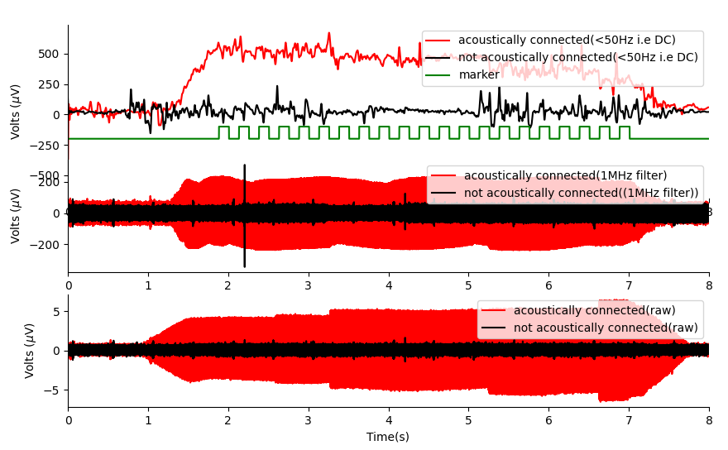
E97-t11 results analysis (mouse/isoflurane)
Positive Result: There is a consistent DC offset and sum when ultrasound is applied to the mouse brain.
The DC offset and 1MHz suggests that the 500khz commode mode noise is mixing with itself to form 0Hz and 1MHz signals.
The bottom plot shows the measurement channel, where you can see a large 500khz signal when there is an acoustic connection with the brain. I believe this acoustic signal is due to commode mode noise, with some small component being due to piezoelectric effect in ionic liquids.

Slide 15
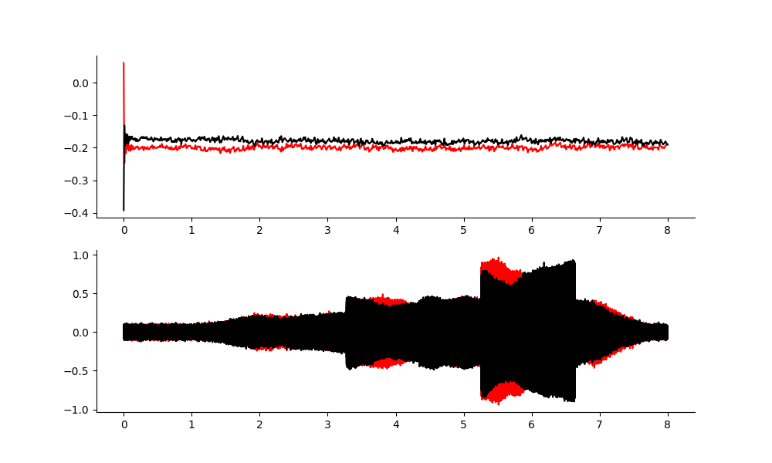
Back up on the rf amplifier output.
DC offset at the RF Amplifier output is non-existent
1MHz band filtering, shows reflections in cable, but is very different to what we see in the mouse.
RESULT: A separate source of is occurring in the tissue, potentially acoustoelectric mixing of 500khz.

Slide 16
Why not look at hydrophone data?
The problem with looking at hydrophone data, is the hydrophone picks up both electrical and acoustic signals. It doesn’t discern between the two.
The hydrophone may be non-linear… as it is an amplifier. If it picks up the carrier frequency as it should, it could add its own non-linearities.

Slide 17
TODO repeat the amplitude study BUT WITH MEP DATA Question: Does the measured DC offset induced in US neuromodulation correlate to neural firing? Yes it does appear to.
A DC offset changes the relative thresholds for either excitatory or inhibitory activity. Here we show that through a continuous wave ultrasound excitatory activity is modulated in the motor cortex.
Without ultrasound
With ultrasound
Can I also record EMG, with the LED on too?

Slide 18
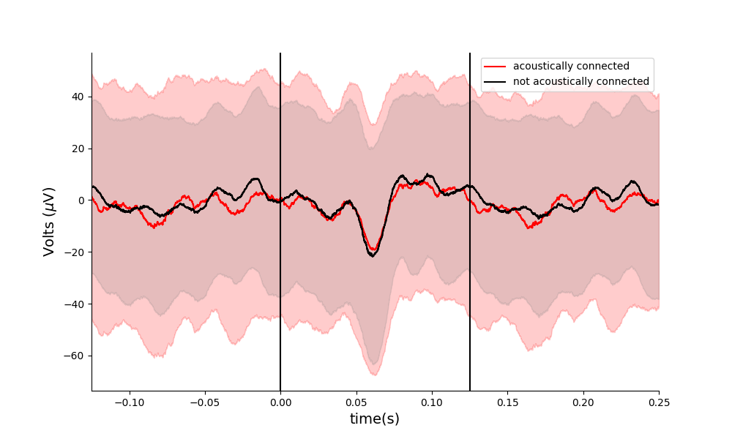
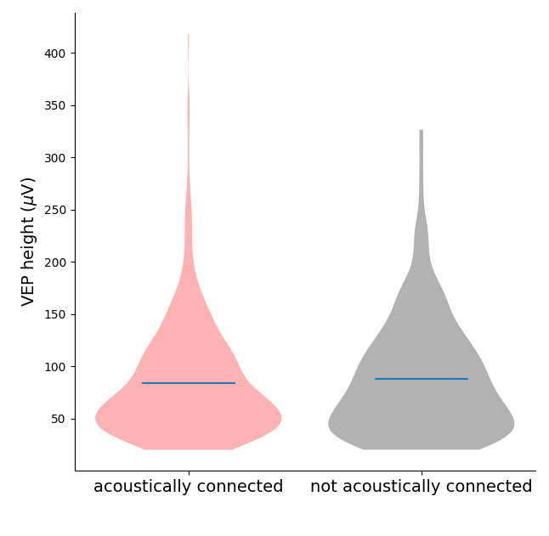
E97-t11 results analysis – vep software threshold 20 microvolts
Number of repeats (Acoustically connected: 480, not acoustically connected: 406). T-test p-value = 0.27 (not significantly different).

Slide 19
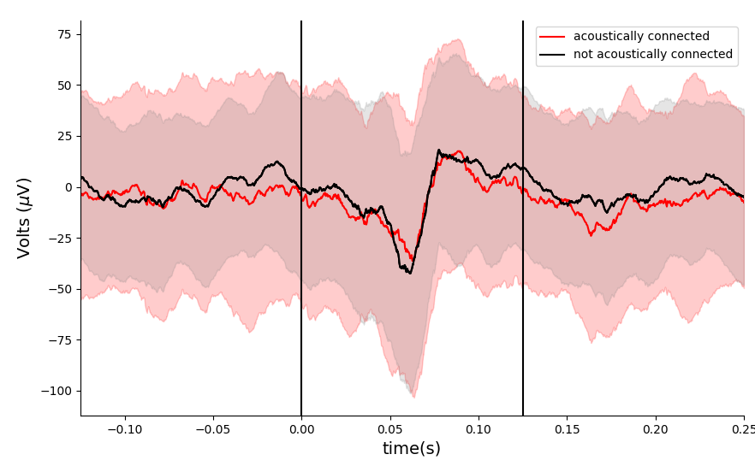
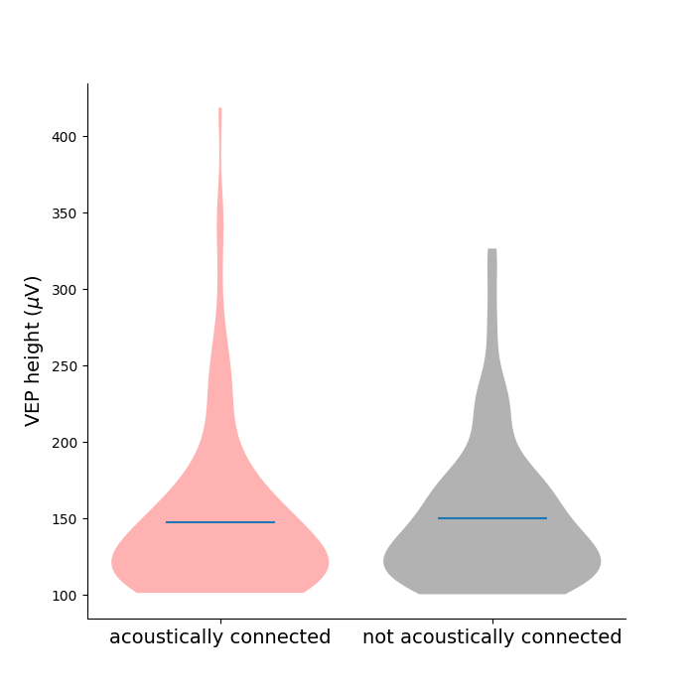
E97-t11 results analysis – taking all VEPs > 100 microvolts
There is no clear difference here when acoustically connected and not when comparing height. These plots do not contain the large DC offset that I see.

Slide 20
What has been shown
Ramped V1 transcranial ultrasonic stimulation modulates but does not evoke visual evoked potentials, ulika Nandi,Ainslie Johnstone, Eleanor Martin,Til Ole Bergmann,Bradley Treeby,Charlotte J. Stagg
This paper uses a ramped PRF before each VEP, and they show that it is offset by an amount, i.e. a DC offset. This is what I also see, except I am using a continuous wave.

Slide 21
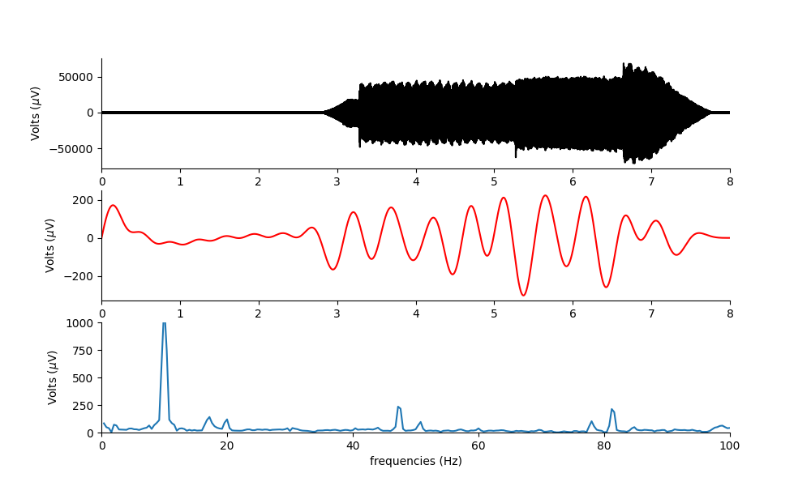
2hz difference frequency.
Tight filter
2Hz

Slide 22
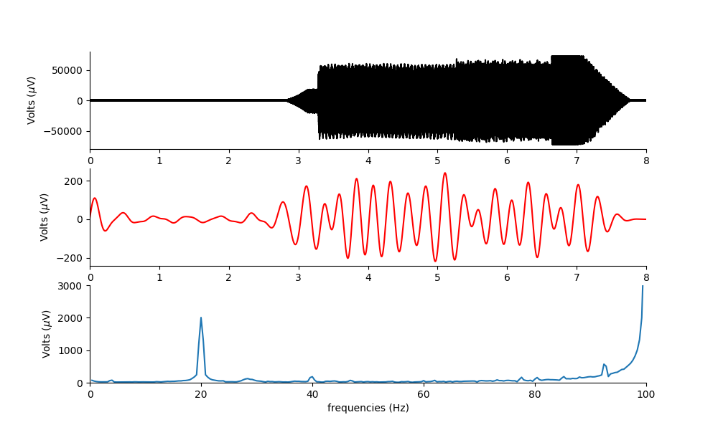
4Hz difference frequency
Tight filter to see the 4Hz
4Hz
We can see the 4Hz(not the amplitude is best read in time series as there are not enough repeats to obtain an accurate FFT amplitude. It is about 400 microvolts pp. The larger signals are coming from the harmonic distortion present due to applying a larger signal at 499.996khz. The harmonic distortion appears to be coming from the function generator.

Slide 23
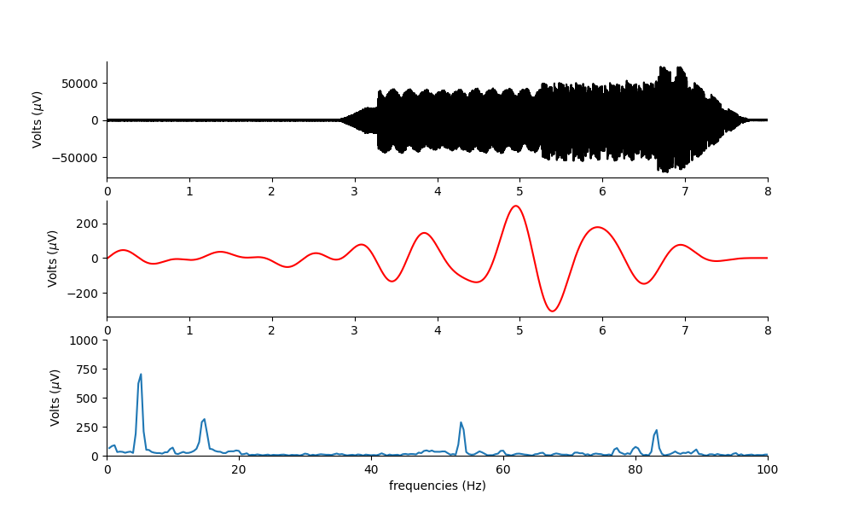
Mep experiment with screw/wire mouse and David Bono’s transformer.
Ket/xyl. I can generate a difference frequency and see it on the preamp. It is about350 microgvolts in ampolitude with an implanted wire electrode and a gold cup in mouth.
If I can make the exposed volume large in the head, or target the right forepaw more accurately – I may be able to MEP.
However, there is a large DC offset created when the US starts and changes amplitude.
I am using the preamp to amplify the small df signal, then filtering it in software.
1Hz
1hz difference frequency in mouse.
It is an uneven 1hz… making it hard to visually detect.

Slide 24
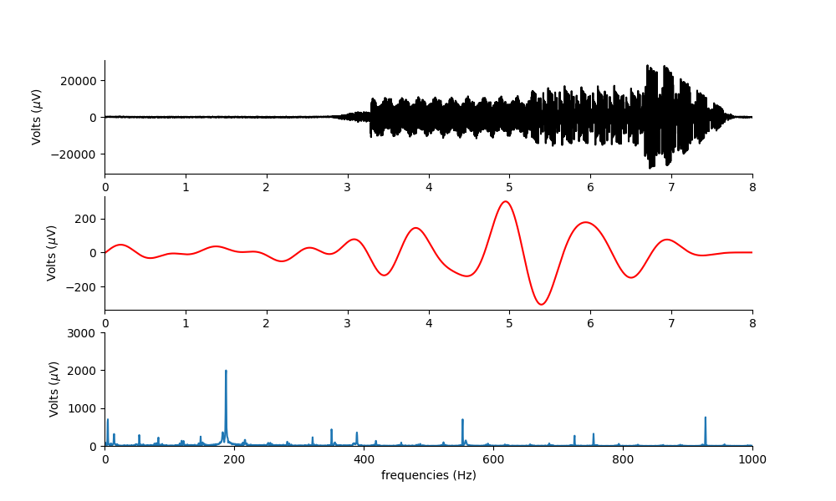
Filtering 0.5-1000hz
0.5-1000hz filter
0.5-2hz filter
1000Hz is in the neural range… so we may expect a more generalized response if we include the harmonic distortion.

Slide 26
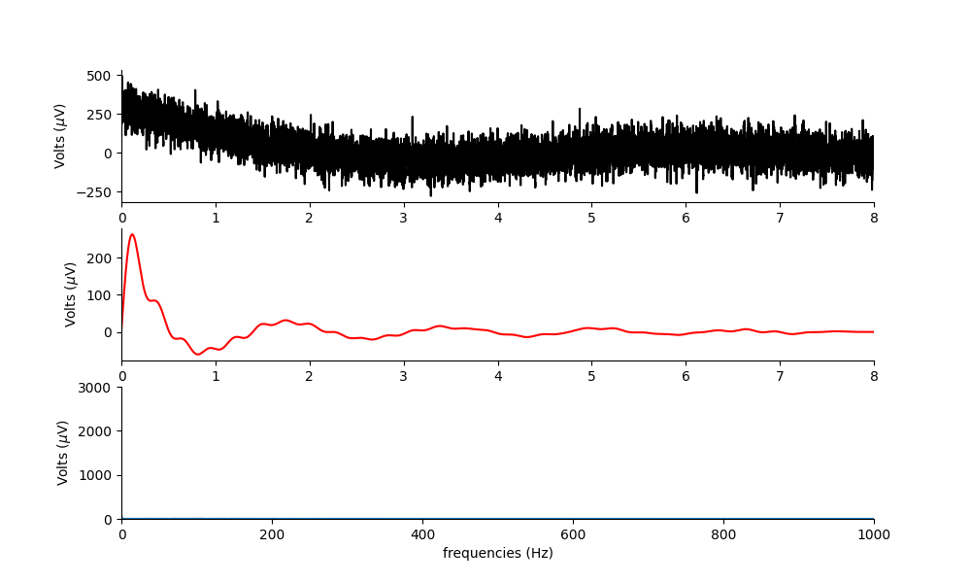
Pressure but no current.
Can’t see anything below 1000Hz.
If I filter around 500khz I can see the carrier signal.
When I did this, I still got mouse movement due to the ultrasound.
0.5-1000hz filter
Nothing at 2Hz dF

Slide 27
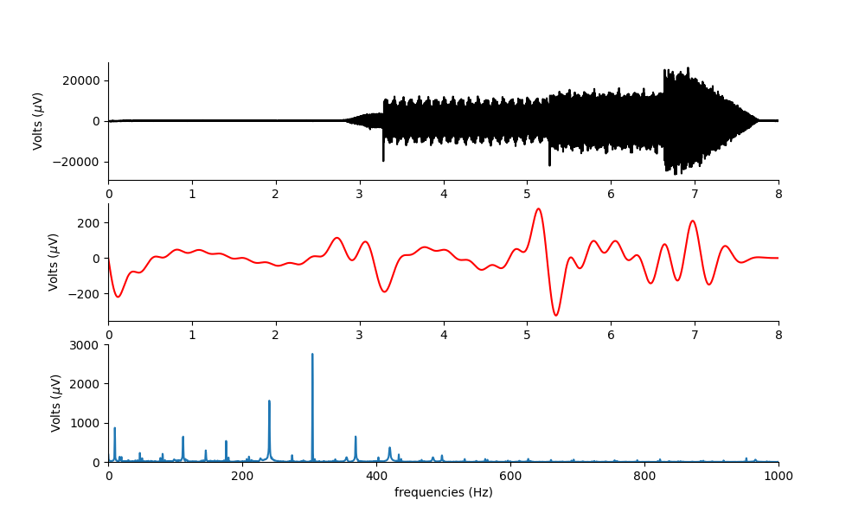
Current but no pressure 2hz df in theory.
There is no real 2Hz, but you can see the harmonic distortion alone has low frequency components. Perhaps the mouse flinched slightly when it started, but did not move apart from this. Update: the Mouse flinched due to the onset only, and I think these other frequencies are due to aliasing and therefore are not REAL electrical signals in the brain.

Slide 28
New Stimulation diagram
I
V
SR560 Preamp
LPFILTER
Bono transformer
Voltage
output
dF
DAQ
V
I
Goldcup reference electrode
0.9% Saline
Computer
This set up is only for high frequencies, as the Bono transformer only does these. The LP filter removes the high amplitude stimulation electric frequency, then amplifies the small difference frequency so we can see it.

Slide 29
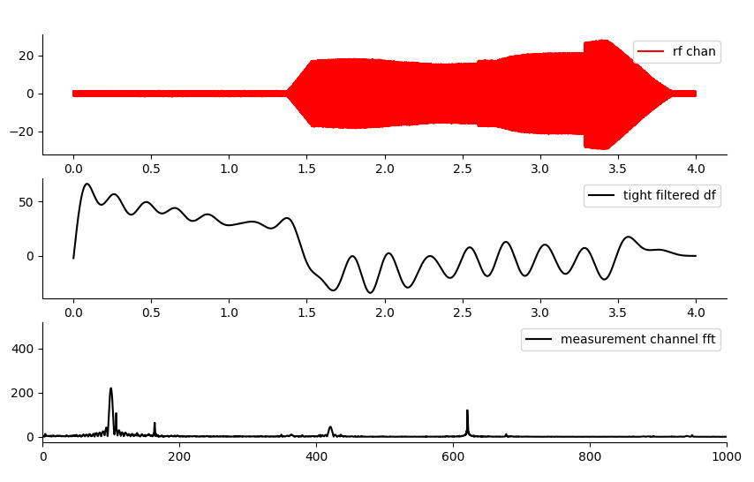
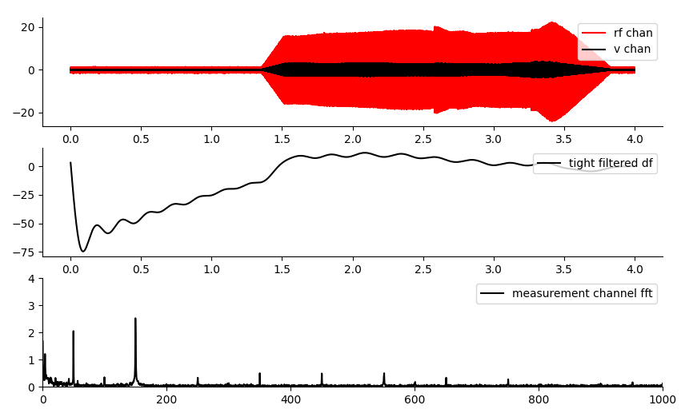
Saline test with and without hp filter at the fg output.
No HP filter at FG output (e97 t21, 1)
HP filter at FG output (e97 t21, 2)
The harmonic distortion dominates the low frequency amplitudes, though the AE effect is also there. This means that I cannot get an AE induced MEP, unless I can get rid of the harmonic distortion.
The filter is massively attenuating the output voltage, but now I can see the df without too much other interference. It would be better just to get rid of the problem…

Slide 30
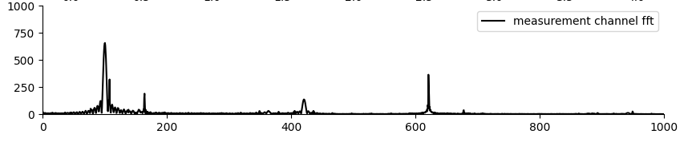
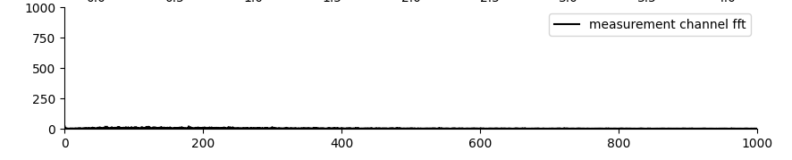
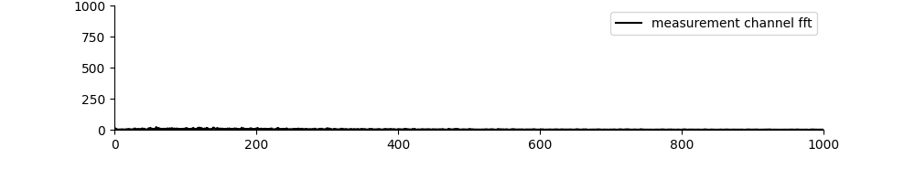
Harmonic Distortion/Fs issue.
500kHz and 5Mhz sampling rate do not cause aliasing.
499.996kHz and 5Mhz sampling rate cause aliasing.
Function generator set to 4.99996MHz for a dF of 4.
Result: Sample rate must be an integer multiple of the fg output.

Slide 31
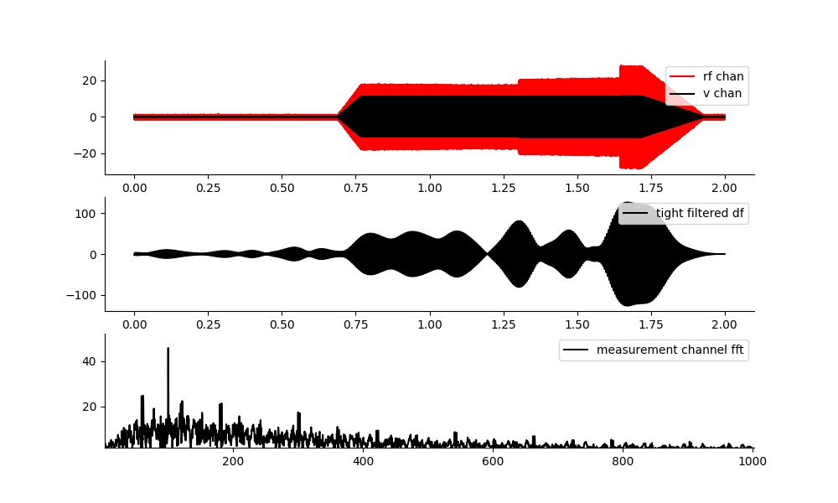
You can see the 100hz mixing frequency pretty clearly here.
So why has my difference frequency at low frequencies disappeared at very low frequencies? Was it a term in the aliasing? It wouldn’t follow the pressure distribution if it were only a term in aliasing.

Slide 32
Larger surface area, and voltage max to get large ae amplitude.
If the ptir wire is inside the mouse, I have small surface area which limits the current I can inject. If I can make a patch electrode – this could work.
Or if I could use pedot to increase the volume of the inserted electrodes, this could work too.
The screws are giving large amplitudes so far, because they were conducting across the US gel… which is not ideal. Also they came loose and are not stable.

Slide 33
TODO list
Do soldering of LED board wiggly bit, and get it set up and working for the MEP experiment.
Do a saline test for position at DC, 500kHz and 1MHz.
New surgery using pats electrodes in motor cortex. (Plan for Tuesday)
Get PtIr plate electrodes set up for a phantom AE amplitude test, and test it against the PtIr wires.
A MEP experiment, just looking at the effects of ultrasound, with EMG and video recordings as well. Get the synced LED/and potentially a paw surface electrode synced up to it.
Continue working on why I cannot see low frequency dFs. Is it spectral spreading due to phase shift?

Slide 34
Saline tests with two PtIr wire, and PtIr plates.
Understand how to obtain large amplitude AE field better. What is optimal?

Slide 35
What is the smallest current I can use to see a paw movement with direct stimulation?
Remember I cannot send 2hz through David bonos transformer…
Need to use a different set up to do this. i.e. the old impedance adapter.

Slide 36
t11
All my amplitudes are really small. My impedance is good.
I think that with less surface area, I have less current. This is true but doesn’t explain the entirety of the amplitude change.
My dF frequency is tiny in comparison to previously in the mouse.
Previously in the mouse it is possible current was going from screw to screw, and my AE amplitude is measured in the saline not the brain. This also explains why I couldn’t get a VEP for a period of time.
Why was my US carrier amplitude so high yesterday?

Slide 37
Next mouse
MEP Screws: So that I can achieve higher current density when doing MEP stimulation, use two screws one at 0.25mm, second at 2.5mm.
For EEG electrode use twisted PtIr on surface of skull. If this works, it ideally provides better SNR than a point electrode.
How big, and what coordinates? 3mm by 3mm would be good.
Two screws – attach the striped slightly thinner PtIr wire that has PTFE insulation around them? Which in turn goes out the back of the headbar. Does this seem strong enough?
Idea 1: use gold/copper foil as electrode for both MEP and EEG.
Idea 2: Coper cup electrode in mouth as the reference, to enable a vertical high surface area field which is also non-invasive.

Slide 39
Mouse spatial distribution.
VEP: AP -3.5mm, ML -1.5 left of bregma.
Motor Cortex Forepaw: AP 0.0mm, ML 2.0
Distance between two points =
D = sqrt ((x2-x1)^2+ (y2-y1)^2)
D = Sqrt(3.5^2 + 3.5^2) = sqrt(12.25+12.25) = 4.94 mm
Distance between two screws is approx. 5mm.
At 12V, we have an average of 1.6mV at the difference frequency. The electric field in V/m would be:
E = 0.0016/0.005 = 0.32 V/m assuming a constant electric field in the 5mm region. This is not true though, as the voltage point source dissipates 1/r^2. Thus the electric field at the point the screw is, will be stronger. So really, it depends on the impedance of the medium.

Slide 40
Questions to answer. Figure 1 AE characterization.
Is the AE amplitude bigger in a mouse than in saline? How can I prove this is just not a position calibration issue, or connection impedance issue? How to conclusively show this? ANSWER: Do a complete X,Y,Z calibration in both saline and mouse. With the same connections and cabling. Keep all files.
Does the AE amplitude decrease over time in saline, compared to a mouse? One hour tracking at 2 minute intervals?
Are the AE amplitude vs voltage and AE vs pressure gradients similar in saline and a mouse?

Slide 41
Amplitude calibration should be done such that electric field is aligned with acoustic field.
When I tried doing a calibration with a 5mm horizontal alignment, I got much lower values than when I had the vertical electrode alignment. It was hard to do any calibration.
This suggests I need to do a vertically aligned electrode spatial calibration in the mouse.
TODO: try using the gold cup electrode to do a spatial calibration. Immediately I got a higher value. Why?

Slide 42
Can I obtain a 4 Hz difference frequency in saline and see it in the data?
No, I am getting some serious aliasing issues. These may be alleviated by adding back a low pass filter. TEST THIS. Not so much. Here, I think measuring and stimming from same electrode is an issue. The filter isn’t helping and I am not sure how to get this well again.
In the phantom uren tank, I used the low pass filter, and it just worked when I did an 8 second measurement.
If I decrease the sample rate, I am seeing a clear mixing frequency. Something about this I do not understand correctly.
In Uren, I measured with a different electrode/amplifier etc. I can still do this here If I use the middle electrode, and a distance reference.

Slide 43
Can I modulate up a 4Hz signal, and see it in the data?
Yes. This works. 1v output (0.1mA). This is still much larger than a naturally occurring VEP – so need to surpass Johnson noise of EEG when measuring.
It’s a ratio of 1:400 when exactly calibrated… so doing this is entirely dependent on having low noise, and excellent position calibration.

Slide 44
TO DO list. What frequency to do this at? 8kHz
With a more distant reference – ideally with same spacing as mouse, calibrate the center and do a 15 by 15 calibration saline image at dF and carrier. Repeat this spatial map in a mouse.
At the center point, with distant reference – do a difference/sum vs pressure, and difference/sum vs voltage. Repeat in a mouse after position calibration.
Measure the amplitude of the AE amplitude at the center point for a fixed setting over time for 1 hour. Repeat in a mouse. Ideally I get a comparative plot showing AE amplitude stays the same in saline, and changes in a mouse.
Test out adding a low pass filter to my voltage input for stimulation set up.

